Slide 1
Application Delivery Fundamentals 2.0 B: Java
Spring Form Handling

Slide 2
Module Objectives
In this module you will be able to
Understand basics of form handling
Understand handling of form data in a Spring MVC application

Slide 3
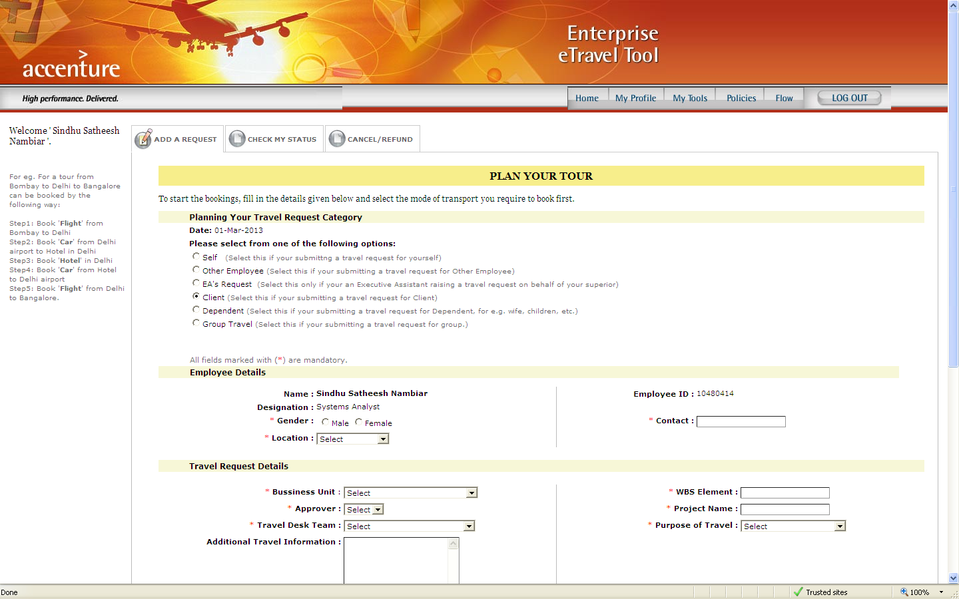
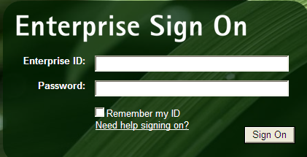
Forms
Web clients use Forms for submitting information to the server. Eg., login to a website, registering as a new customer, raising travel request, etc.,

Slide 4

Form Handling
Web portals characteristically have a need of handling client data provided in the forms
Data is transferred :
from client’s interface to the server for processing
from server to client and binded to his interface for publishing information.
Client
WebServer
Submit Form
Response
Fill Form

Slide 5
Types of Request : GET and POST
There are different types of Request that a client can make while transferring form data, the popular ones being GET and POST
GET | POST
Should be used for requesting information | Should be used for submitting data that needs to be processed
Has restrictions on data length | Does not have restrictions on the data length
Sent as querystring on the url | Sent the request body
Can be bookmarked | Cannot be bookmarked
Fast | Slower than GET
Should not be used for sending sensitive information | Should be used for sending sensitive information

Slide 6
Spring Form Handling
Spring provides a comprehensive set of data binding-aware tags for handling form elements when using JSP and Spring Web MVC.
Each tag provides support for the set of attributes of its corresponding HTML tag counterpart
Spring's form tag library is integrated with Spring Web MVC, giving the tags access to the command object and reference data your controller deals with.

Slide 7
Spring Form Handling
Request
Command / Form
Form Controller
Dispatcher Servlet
Response
ModelAndView
View
View

Slide 8
Configuration
The form tag library is bundled in spring-webmvc.jar
The library descriptor is called spring-form.tld
To use the tags from this library, add the following directive to the top of your JSP page:
<%@ taglib prefix="form" uri="http://www.springframework.org/tags/form" %>

Slide 9
The form tag
Renders an HTML 'form' tag and exposes a binding path to inner tags for binding
Any HTML attributes that are valid for an HTML form can be specified
It puts the command object in the PageContext so that the command object can be accessed by inner tags

Slide 10
The form tag
<form:form commandName=“visitor">
<table>
<tr>
<td>First Name:</td>
<td><form:input path="firstName" /></td> </tr>
<tr>
<td>Last Name:</td>
<td><form:input path="lastName" /></td> </tr>
<tr>
<td>Age:</td>
<td><form:input path=“age" /></td> </tr>
<tr>
<td colspan="2">
<input type="submit" value=“Register" />
</td>
</tr>
</table>
</form:form>

Slide 11
The input tag
Renders an HTML 'input' tag with type 'text' using the bound value
<form:form commandName=“visitor">
<table>
<tr>
<td>First Name:</td>
<td><form:input path="firstName" /></td> </tr>
……
……
…..
<tr>
<td colspan="2">
<input type="submit" value=“Register" />
</td>
</tr>
</table>
</form:form>

Slide 12
@ModelAttribute
Annotation used in a Spring MVC web application
It is used in two scenario’s
to inject data objects(model) before a view page(jsp) loads. This is to ensure that the jsp page has all the data required to display itself. The injection is achieved by binding a method return value to the model.
to read data from a model and passing on to the parameters of the handler method.

Slide 13
@ModelAttribute - Example
@ModelAttribute("countryList")
public List<Country> populateCountry() {
List<Country> countryList = new ArrayList<Country>();
Country c1 = new Country();
c1.setCountryId(1);
c1.setCountryName("India");
countryList.add(c1);
c1 = new Country();
c1.setCountryId(2);
c1.setCountryName("Others");
countryList.add(c1);
return countryList;
}
<form:form name="form1" modelAttribute="user" method="POST" >
<h2><center>User Login Page</center></h2>
<div align="center"><form:errors id="InvalidUser" /></div>
<table width="100%" height="150" align="center" border="0">
<tr>
<td width="50%" align="right">User Name</td>
<td width="50%" align="left"><form:input path="userName" size="19"/></td>
</tr>
<tr>
<td width="50%" align="right" >Password</td>
<td width="50%" align="left"><form:password path="password" size="20"/></td></tr>
<tr>
<td colspan="2" align="center">
<form:select path="country">
<form:options items="${countryList}" itemValue="countryId" itemLabel="countryName" />
</form:select>
</td></tr>
<tr>
<td colspan="2" align="center">
<input type="button" value="Login" onClick="javascript:loginPage();"></td>
</tr>
<tr>
<td colspan="2" align="center"><font color="red">${ERROR}</font></td>
</tr>
</table>
</form:form>

Slide 14
@ModelMap
Implementation of Map for use when building model data for use with UI tools.
The ModelAndView class uses a ModelMap class that is a custom Map implementation that automatically generates a key for an object when an object is added to it.
This class serves as generic model holder for both Servlet, but is not tied to it
Notes:
Faculty Notes:
Refer to the link given below for detailed information
http://static.springsource.org/spring/docs/2.5.x/api/index.html?org/springframework/web/bind/annotation/ModelAttribute.html

Slide 15
@ModelMap - Example
@RequestMapping("/login.htm")
public ModelAndView loadLoginPage(
HttpServletRequest request,
HttpServletResponse response,
ModelMap map) throws Exception
{
User user = new User();
map.addAttribute(user);
// redirecting to the login page (sample.jsp)
return new ModelAndView("sample");
}
Notes:
Faculty Notes:
Refer to the link given below for detailed information
http://static.springsource.org/spring/docs/2.5.x/api/index.html?org/springframework/web/bind/annotation/ModelAttribute.html

Slide 16
@SessionAttribute
Annotation that indicates the session attributes that a specific handler uses
Declared at the type level, applying to the model attributes that the annotated handler class operates on
The attributes are only stored for a conversational session. They will be removed once the handler indicates completion of its session.
i.e SessionAttributes declared with this annotation are for temporary usage only.
For permanent session attributes, use session.setAttribute() instead.
Notes:
Faculty Notes:
Refer to the link given below for detailed information
http://static.springsource.org/spring/docs/2.5.x/api/index.html?org/springframework/web/bind/annotation/ModelAttribute.html

Slide 17
@SessionAttributes - example
@Controller
@SessionAttributes({ "mySessionAttribute" })
public class MySessionAttributeController {
@RequestMapping(value = "/showmysessionattribute", method = RequestMethod.GET)
public ModelAndView view(
@ModelAttribute(value = "mySessionAttribute") MyAttribute myAttributeDataHolder,
HttpServletRequest request, HttpServletResponse response)
throws Exception {
myAttributeDataHolder.setSomeValue("Hello from Session Attribute!");
return new ModelAndView("mysessionattribute");
}
}
Session Attribute created here
Session Attribute value set here for a request
Notes:
Faculty Notes:
Refer to the link given below for detailed information
http://static.springsource.org/spring/docs/2.5.x/api/index.html?org/springframework/web/bind/annotation/ModelAttribute.html

Slide 18
@ExceptionResolver
Introduced in Spring 3.0
Deal with Exceptions that occur during controller execution
Used with @ResponseStatus to set a Http status code when a method is invoked.
Handler methods annotated with this annotation provide very flexible method signatures
Notes:
Faculty Notes:
Refer to the link given below for detailed information
http://static.springsource.org/spring/docs/2.5.x/api/index.html?org/springframework/web/bind/annotation/ModelAttribute.html

Slide 19
@ExceptionHandler - example
@ExceptionHandler(NullPointerException.class)
public ModelAndView handleNPException(NullPointerException e) {
ModelAndView modelAndView = new ModelAndView(“Null");
modelAndView.addObject("message", “NullPointerException - " + System.currentTimeMillis());
return modelAndView;
}
Notes:
Faculty Notes:
Refer to the link given below for detailed information
http://static.springsource.org/spring/docs/2.5.x/api/index.html?org/springframework/web/bind/annotation/ModelAttribute.html

Slide 20

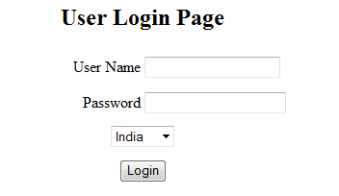
Spring MVC - Form: See It
Demonstration:
Faculty will demonstrate how to handle ModelAndView elements in Spring controller and Form tags
Time Allocated: 20 min
Environment or File: Sample Controller.java/sample.jsp
Steps:
Open the project ADFExtensionCodebaseM4MVC Form_participant in Eclipse
Run it on Tomcat server.
You should be able to see a click link for Sample. Click on it.
You should see a screen like the one below (see 2a. below).
Click the link to view sample code
Enter user name and password (see 2b. below).
Password should match the name. Try various combinations and see how it behaves.
2a
2b

Slide 21
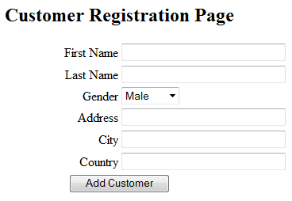
Try It
Now Try It:
Spring MVC Form Handling
Time Allocated: 30 min
Environment or File: : ActivityController.java (incomplete) / sample.jsp (complete)
Steps:
Open the project ADFExtensionCodebaseM4MVC Form_participant in Eclipse
Go to the src folder
Open com.accenture.adfx.module4.sample.ActivityController.java
Complete the Try It TODO 1 - TODO 11 mentioned in ActivityController.java to
Insert a customer record in the database.
Save and run the program.
Click the link to run Activity code
Enter Customer details and click Add Customer (see 2b.).
2b.
2a.

Slide 22
Questions

Slide 23
Module Summary
In this module we
Understood the spring tag library
Understood spring form handling
Discussed @ModelAttribute and @ModelMap annotations
How to create add form handling functionality to our Spring MVC applications

Slide 24
References
http://static.springsource.org/spring/docs/3.0.x/reference/view.html

