Slide 1
Application Delivery Fundamentals 2.0
Module 7 : JPA (Java Persistence API)
Notes:
Faculty Notes:
Introduce yourself, if necessary.
Introduce the module and time frame, which is approximately 3.5 hours
Verify the students have the proper handouts for the module.
Ensure the students have access to the required software for the practice exercises.
Participant Notes:
N/A

Slide 2
Course Goals / Objectives
At the end of this module, participants will be able to:
Demonstrate understanding of ORM
Demonstrate understanding of JPA
Identify the need for JPA
Explain the features of JPA
Demonstrate the understanding of the JPA Architecture and the components of the architecture.
Explain the significance of the EntityManagerFactory, EntityManager and Entity

Slide 3

Agenda
This module will cover the following topics:
Introduction to ORM
Understanding JPA (Java Persistence API)
Why JPA
Features of JPA
JPA Architecture

Slide 4
Introduction to ORM
Persistence
Every Java Application has to manage application data.
It’s a proven fact that data is best managed in a database.
In recent times we have very powerful RDBMS which manage data very efficiently.
Hence in a typical architecture we have processing logic residing in a Java application which interacts with an RDBMS to manage the data requirements.

Slide 5
Introduction to ORM
Problem with Persistence
Everything in Java is an object but this universal truth fails when it comes to database programming in Java.
Java developers have to bother about constructing SQL queries, passing data from a Java object to a SQL query and mapping the resultset back to Java objects.
As a result significant time and effort goes into coding the dao layer which could otherwise be abstracted from a developer allowing him to focus on business logic.

Slide 6
Introduction to ORM
Solution – OR mapping
What is OR mapping?
The term object/relational mapping (ORM) refers to the technique of mapping a data representation from an object model to a relational data model with a SQL-based schema.
A ORM basically intends to takes most of that burden off your shoulder. With a good ORM, you have to define the way you map your classes to tables once; which property maps to which column, which class to which table, and so forth.
(Contd…)
Notes:
Faculty Notes :
This slide introduces the concept of ORM.
This might be new to ASEs. Hence it is recommended to spend some time on making this concept clear on Persistence, Problem with Persistence and the ORM.

Slide 7
Introduction to ORM
Solution – OR mapping (Contd..)
With a good ORM, you can take the plain Java objects you use in the application and tell the ORM to persist them. This will automatically generate all the SQL needed to store the object. An ORM allows you to load your objects just as easily.

Slide 8
Java Persistence API
The Java Persistence API or JPA for short is one to the specification of JEE5 by SUN, which allows the programmer to develop the persistence layer for their desktop and web applications.
JPA is developed to ease the development of persistence layer and it has also standardized the Java ORM technologies
(Contd…)

Slide 9
Java Persistence API
JPA is not a product and can’t be used as it is for persistence. It needs an ORM implementation to work and persist Java objects.
JPA is a specification, so we will need a JPA implementation
The major implementations are
Toplink
OpenJPA
Hibernate
iBATIS
(We will use Hibernate in the examples).

Slide 10
Java Persistence API
The Java Persistence API provides an object/relational mapping facility to Java developers for managing relational data in Java applications
Java Persistence consists of three areas:
The Java Persistence API
The Query Language
Object relational mapping metadata

Slide 11
Why JPA
JPA is a standardized specification (version 1.0) and part of EJB3 specification
Many free ORM frameworks are available with can be used to develop applications of any size
Application developed in JPA is portable across many servers and persistence products (ORM frameworks).
Can be used with both JEE and JSE applications
JSE 5 features such as annotations can be used
Provides both annotations and xml based configuration support

Slide 12

Features of JPA
Standardized O/R mapping
Facilitates POJO based persistence.
Application Server is optional with JPA.
Support for Unidirectional and Bi-Directional relationships
User friendly retrieval methods

Slide 13
Entity
Entity is a lightweight persistence domain object.
Entity class represents a database table.
Entity instance represents a row in the database table.
Entity uses annotations to map java fields to the database.
Entity must follow the java bean naming conventions.
Must implement serializable if transferred through the network.

Slide 14
Entity (Continued…)
Consider the below table structure which will be mapped through Entity
CREATE TABLE Employee (EmpId bigint not null, FirstName varchar(50), LastName varchar(50), Email varchar(50), PhoneNumber varchar(50), Address varchar(50), Password varchar(50), primary key (EmpId));
Field | Type | Null | Key | Default | Extra
EmpId | bigint(20) | No | PK | 0
FirstName | varchar(50) | Yes |  | NULL
LastName | varchar(50) | Yes |  | NULL
Email | varchar(50) | Yes |  | NULL
PhoneNumber | varchar(50) | Yes |  | NULL
Address | varchar(50) | Yes |  | NULL
Password | varchar(50) | Yes |  | NULL
Notes:
Faculty Notes :
Faculty can explain about any database and the structure given in the slide and explain them the mappings through the Entity Class in the next slide

Slide 15
Entity Example
@Entity @Table(name=“Employee")
public class Employee {
@Id @Column(name="EmpId")
private int empId;
@Column(name="FirstName")
private String firstName;
@Column(name=“LastName")
private String lastName;
@Column(name="Email")
private String email;
public int getEmpId() {return empId; }
public void setEmpId(int empId) { this.empId = empId; }
public String getFirstName() {return firstName; }
public void setFirstName(String firstName) { this.firstName = firstName; }
public String getLastName() { return lastName; }
public void setLastName(String lastName) { this.lastName = lastName; }
public String getEmail() { return email; }
public void setEmail(String email) { this.email = email; }
}
Notes:
Faculty Notes :
@Entity – Making the class as an entity class which can be mapped to table
@Table – Maps the current class with Database Table – Table name is optional – in case any change of the table present in database this annotation could be used
@ID – Is used to map the attribute as Primary Key
@Column – Is used to map the attribute as normal columns

Slide 16
Managing Entities
Entities are managed by EntityManagerFactory and EntityManager objects.
EntityManagerFactory is a singleton object and represents the details of the data source. One factory for every data source.
EntityManager is instantiated for every connection/transaction.
EntityManager defines the methods to manage the entity life cycle.
Persist(), delete(), find() etc

Slide 17
Persistence Context
Every entity manager is associated with a persistence context.
Persistence context defines the scope under which entity instances are created, persisted and removed.
Persistence context is analogous to a container of entity instances where each entity has a live connection with the database.
(Contd…)

Slide 18
Persistence Context
Any changes done to the entity within the persistence context is reflected in the database.
There will be one and only one instance of an entity class within a persistence context.
Like a transaction persistence context can be propagated to several methods within a transaction.

Slide 19
Persistence Unit
Persistence Unit contains the list of all entity classes which can be managed by the entity manager.
Represented by persistence.xml
A Persistence Unit defines which classes are Persistent and which Persistence Provider should be used.

Slide 20
Entity Lifecycle
New/Transient
No persistent identity and not yet associated with the persistence context
Managed
Have a persistent identity and associated with the persistent context
Detached
Have a persistent identity but not associated with the persistent context
(Contd…)

Slide 21
Entity Lifecycle
Removed
Have a persistent identity and also associated with the persistent context but are scheduled for removal from the database.

Slide 22
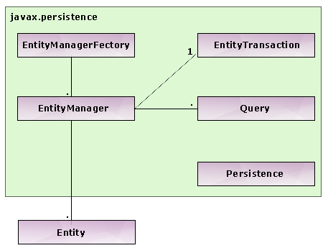
EntityManagerFactory, EntityManager, Entity & EntityTransaction
JPA Architecture includes the three components Entity, EntityManager and EntityManagerFactory.

Slide 23
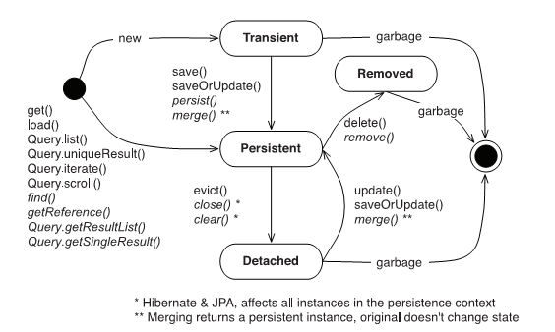
Entity Life Cycle (Continued…)
Notes:
Faculty Notes :
Sample for showing how the Entity works with all the methods of EntityManager like persist, delete is shown in the next coming modules.

Slide 24
See It
Demonstration:
Faculty will demonstrate how to use JPA with Table Mappings
Environment – Eclipse
Time – 60 Minutes
Instructions Contd…

Slide 25
See It- Instructions
File
Museum.java / CreateMuseumJPA .java / persistence.xml
Steps
Open the project ADFExtensionCodebaseM7JPA_participant
in Eclipse
Open CreateMuseumJPA.java and run as java application.
Refer the log for queries and result.
Refer persistence.xml for JPA configurations.
Try various combinations, refer the log and see how it behaves.

Slide 26
Try It
Activity
To Find a Customer Details based on the ID Column
Environment – Eclipse
Time – 60 Minutes
Instructions Contd…

Slide 27
Try It- Instructions
File
Customer.java / FindCustomerbyIDJPA.java / persistence.xml
Steps
Open the project ADFExtensionCodebaseM7JPA_participant in Eclipse
Open FindCustomerbyIDJPA.java and complete TO DOs
Refer the log for queries and result.
Refer persistence.xml for JPA configurations.
Try various combinations, refer the log and see how it behaves.

Slide 28
Additional Resources
Additional Links :
http://java.sun.com/javaee/5/docs/tutorial/doc/bnbqa.html
http://java.sun.com/javaee/5/docs/tutorial/doc/bnbpy.html
http://roseindia.net/jpa/jpa-features.shtml

Slide 29
Course / Module Summary
Fill in the blanks to complete Module Summary
Now that you have completed this module, you should be familiar with the following concepts:
The Java Persistence API provides an ______________________ facility to Java developers for managing relational data in Java applications
JPA is not a product and can’t be used as it is for persistence. It needs an ____ implementation to work and persist Java objects
JPA Architecture includes the three components Entity, ______________ and ___________________.

Slide 30
Course / Module Summary
Fill in the blanks to complete Module Summary
Now that you have completed this module, you should be familiar with the following concepts:
The Java Persistence API provides an object/relational mapping facility to Java developers for managing relational data in Java applications
JPA is not a product and can’t be used as it is for persistence. It needs an ORM implementation to work and persist Java objects
JPA Architecture includes the three components Entity, EntityManager and EntityManagerFactory

Slide 31
Questions

