Slide 1
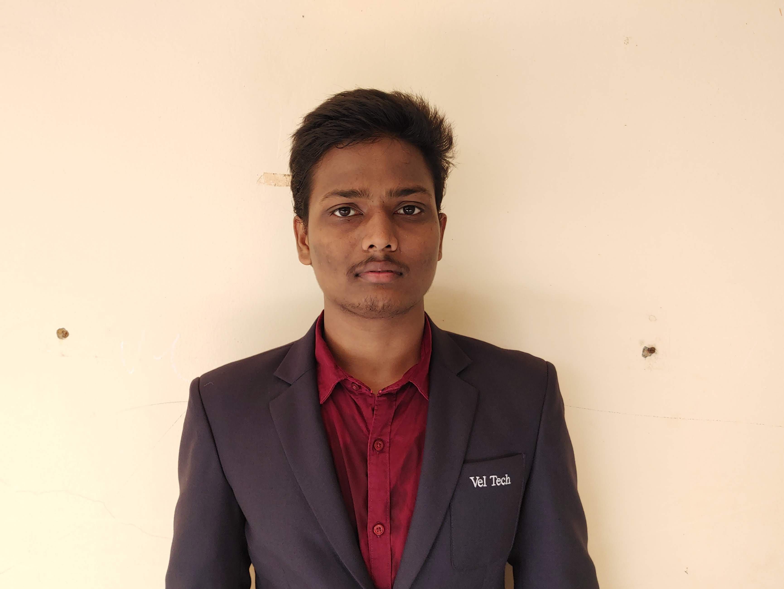

Uddandam Subramanyam
Analyst/Software Engineer
Bachelor of Technology,
Electronics & Communication Engineering : 2018-2022
ITransform L&D Left Shift Batch
Skills
C# | Basics, OOPS, Exception Handling ,Arrays ,Collection and Generics, Delegates and Events, File Io and Serialization.
.NET Framework | ADO.NET,ASP.NET WITH MVC5 AND WEB API, Entity Framework
Ado.net | Basics Architecture
Database | SQL
Tools | GIT
UI Technology | HTML5 ,CSS & Angular
Add On Skills | Communication Skills, Team Management
Udddandamsubramanyam07@gmail.com
+91 8498892133
A4
Full Stack Developer
Understanding of RDMS concepts using SQL Server.
Practical understanding of C# and SQL concepts using Visual Studio and SQL Server
Hands on experience in developing applications using .NET Framework, ADO.NET Core
Understanding of HTML5 , CSS and Angular Cli
Az-900 Certification
Completed case study on OnDemand Car Wash which is a Web based System where user can easily find out with nearby car wash servicing garage in Online. This project will be beneficial for those people who don’t want to go to the garage. It is an easy and time saving System. This online system provides home delivery of car wash service for that users have needs to register in this System. Then user needs to Login. By Login user can decide which service he/she has needs.
Technologies used:
ANGULAR
ASP.NET CORE
Microsoft SQL Server
Video Link : Click
Github_link
https://github.com/sdsameer07

