Slide 1
Car Price with Maintenance Prediction by using Machine Learning

Slide 2
Abstract
This project integrates machine learning into predictive analytics to address two key challenges: car resale price prediction and maintenance forecasting. By leveraging advanced algorithms, the model evaluates crucial factors such as car attributes, mileage, and operational data for accurate predictions.
The dual-module system ensures practical usability, offering insights for both individual users and industrial applications. The car price prediction helps buyers and sellers determine fair valuations, while the maintenance prediction enhances equipment reliability. This approach bridges innovation and functionality, providing a robust solution for informed decision-making.

Slide 3
Introduction
This project focuses on integrating machine learning into predictive analytics for solving real-world challenges. It features two key modules: car price prediction and predictive maintenance forecasting. By analyzing car attributes and operational data, the system provides accurate insights for decision-making. The solution is designed for practical usability, benefiting both individual and industrial users. It bridges innovation and functionality to deliver reliable, data-driven predictions.

Slide 4
Existing System
The existing systems for car price prediction and predictive maintenance often operate as separate solutions, limiting their scope and efficiency. Car price prediction relies heavily on manual estimation or basic calculators, which can lack accuracy. Similarly, traditional maintenance systems depend on periodic schedules, overlooking real-time sensor data insights. These approaches are prone to errors, resource wastage, and high operational costs. The lack of an integrated, machine learning-driven solution hinders advanced analytics and real-time decision-making.

Slide 5
Proposed System
The proposed system integrates car price prediction and predictive maintenance into a unified, machine learning-driven platform. It uses advanced algorithms to accurately estimate car resale values based on key features like age, fuel type, and kilometers driven. Simultaneously, it leverages real-time sensor data to predict maintenance needs, ensuring proactive and efficient upkeep.
This system eliminates manual errors, optimizes resources, and provides data-driven insights for enhanced decision-making. Its user-friendly interface further enables seamless interaction and accessibility for all users.

Slide 6
LITERATURE REVIEW
The literature review explores the advancements in machine learning applications for car price prediction and predictive maintenance. Studies highlight the effectiveness of regression models, such as Random Forest and Gradient Boosting, for accurately predicting car resale values based on attributes like mileage, fuel type, and ownership history. Similarly, research on predictive maintenance emphasizes the use of real-time sensor data and classification models like Random Forest and Support Vector Machines to identify potential failures.
Recent works demonstrate the growing importance of integrating IoT-based systems for monitoring key parameters like vibration, temperature, and pressure to enhance prediction accuracy. However, challenges such as data sparsity, feature selection, and real-time scalability persist. The review also identifies the potential for combining these domains into a unified platform for better decision-making and resource optimization. This integrated approach aligns with the industry’s growing focus on automation, data-driven insights, and sustainable practices.

Slide 7
Module
Data Preprocessing Module
Cleans and preprocesses the input data for both car price prediction and predictive maintenance.
Handles missing data, scales numeric features, and encodes categorical variables.
Ensures the data is in a suitable format for training machine learning models.
Car Price Prediction Module
Utilizes regression algorithms to predict the resale value of cars based on attributes like:
Current price, kilometers driven, fuel type, seller type, transmission type, and vehicle age.
Provides user-friendly input options for entering car details through the UI.
Predictive Maintenance Module
Monitors sensor data (vibration, temperature, and pressure) in real-time.
Predicts maintenance needs using classification algorithms.
Displays sensor metrics and alerts for potential failures.

Slide 8
Module
4.Visualization and Monitoring Module
Generates real-time graphs for sensor data trends using Plotly.
Provides dashboards for tracking predictions and system performance
5.Model Training and Deployment Module
Trains and fine-tunes machine learning models (e.g., Random Forest, XGBoost).
Deploys the models for real-time predictions and maintenance alerts.
6.User Interface Module
Developed using Streamlit for an interactive and intuitive UI.
Enables users to toggle between "Car Price Prediction" and "Predictive Maintenance" pipelines.

Slide 9
Algorithms
Linear Regression
Used in the Car Price Prediction module for its simplicity and ability to model relationships between continuous variables.
Predicts car prices by learning coefficients based on the input features.
Random Forest Regressor
Employed for robust car price prediction, handling non-linear relationships and feature interactions effectively.
Random Forest Classifier
Used in the Predictive Maintenance module for predicting maintenance needs.
Handles multi-feature inputs (vibration, temperature, pressure) to classify whether maintenance is required.

Slide 10
Algorithms
Gradient Boosting Algorithms (e.g., XGBoost, LightGBM)
Provides improved accuracy by minimizing errors iteratively during model training.
Suitable for both regression (price prediction) and classification (maintenance prediction) tasks.
Feature Scaling and Encoding
StandardScaler or MinMaxScaler for normalizing numeric features.
One-Hot Encoding or Label Encoding for categorical features like fuel type, seller type, and transmission type.
Real-Time Data Simulation
Simulates real-time sensor data using Python libraries (e.g., NumPy, Random) to feed into the Predictive Maintenance module.
Visualization Tools
Plotly for real-time graphing of sensor metrics (e.g., vibration, temperature, pressure) for easy monitoring.

Slide 11
Hardware Components
Processor:
Minimum: Intel i5 or equivalent
Recommended: Intel i7/AMD Ryzen 5 or higher for faster computations and smooth model execution.
RAM:
Minimum: 8 GB
Recommended: 16 GB or higher for handling large datasets and real-time processing.
Storage:
Minimum: 256 GB SSD or equivalent HDD.
Recommended: 512 GB SSD for faster data loading and model training.
GPU (Optional):
NVIDIA GTX 1050 or higher for accelerating machine learning model training (if large-scale models are involved).
Other Peripherals:
Keyboard, Mouse, Monitor, and Internet connection for development and data access.

Slide 12
Software Components
Operating System:
Windows 10/11, macOS, or Linux (Ubuntu 20.04 or higher preferred).
Programming Language:
Python 3.8 or higher.
Libraries and Frameworks:
Machine Learning:
Scikit-learn (for model training and prediction).
XGBoost and Random Forest algorithms.
Data Manipulation and Analysis:
Pandas and NumPy.
Visualization:
Matplotlib, Plotly, and Seaborn for charts and real-time graphs.
Web Framework:
Streamlit for building the user interface.

Slide 13
Development Tools:
IDE/Code Editor: Visual Studio Code, PyCharm, or Jupyter Notebook.
Version Control: Git for code versioning.
Package Manager: pip or conda for installing Python libraries.
Cloud Environment (Optional):
Google Cloud Platform (GCP), AWS, or Azure for model deployment and scalability.
Browser:
Google Chrome, Mozilla Firefox, or any modern web browser to interact with the Streamlit web application.

Slide 14
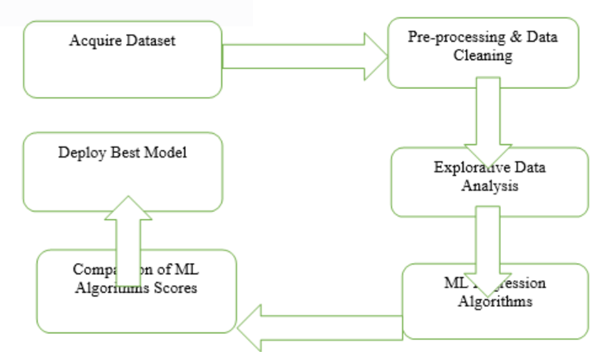
Block Diagram

Slide 15
UML Diagrams
Use Case Diagram
Data Flow Diagram
Sequence Diagram
State Diagram

Slide 16
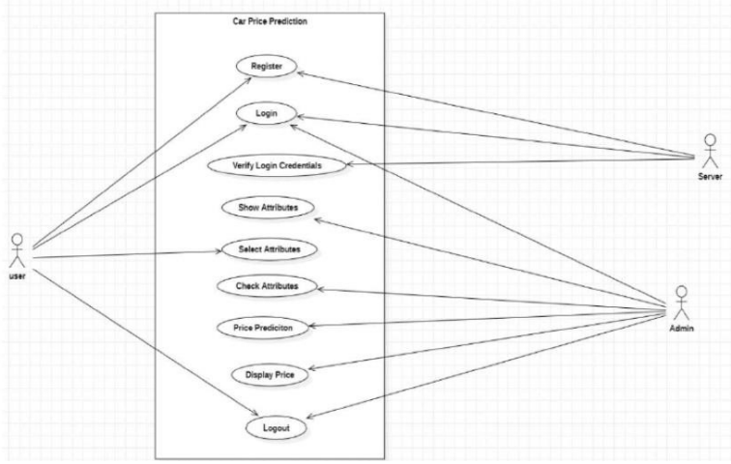
Usecase Diagrams

Slide 17
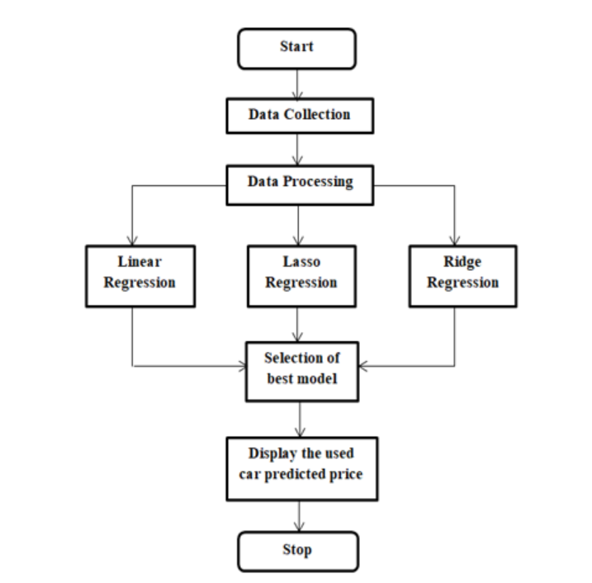
Data Flow Diagrams

Slide 18
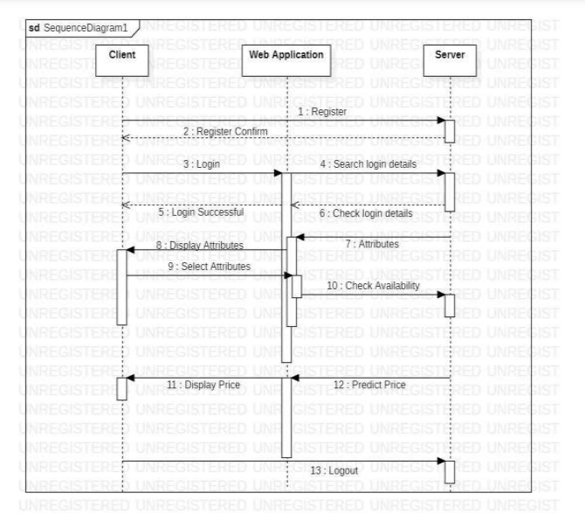
Sequance Diagrams

Slide 19
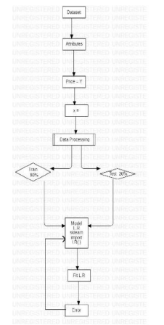
Active Diagrams

Slide 20
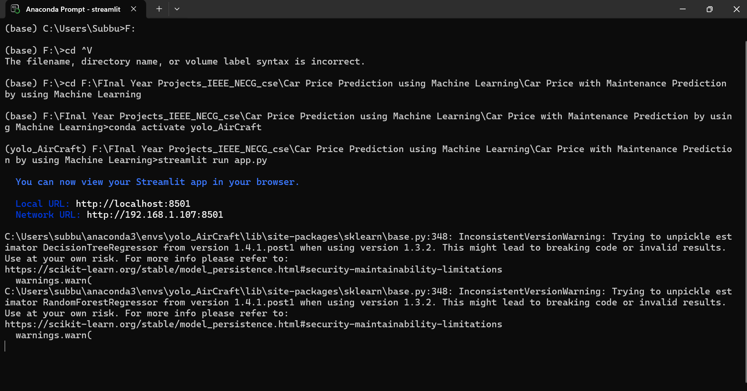
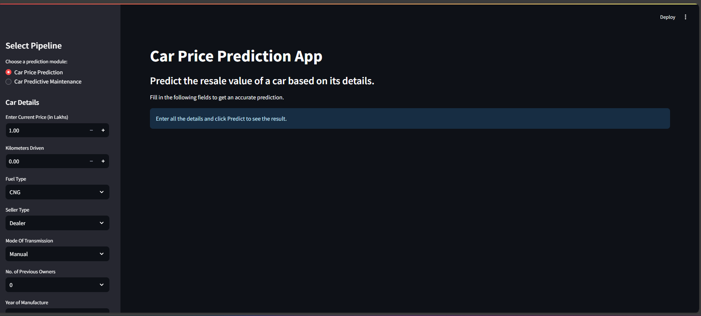
Final Output
The output of the project is divided into two modules: Car Price Prediction and Predictive Maintenance Prediction, each providing clear and actionable insights based on user inputs and real-time data processing. Below is a detailed description of the outputs:

Slide 21
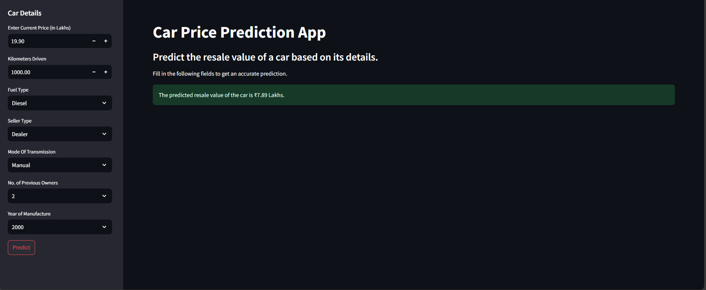
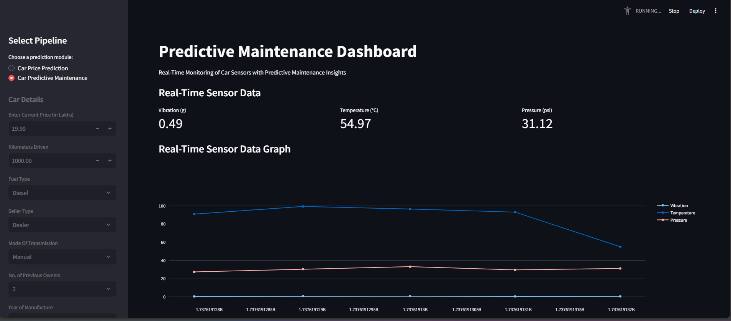
Final Output
Output Guide

Slide 22
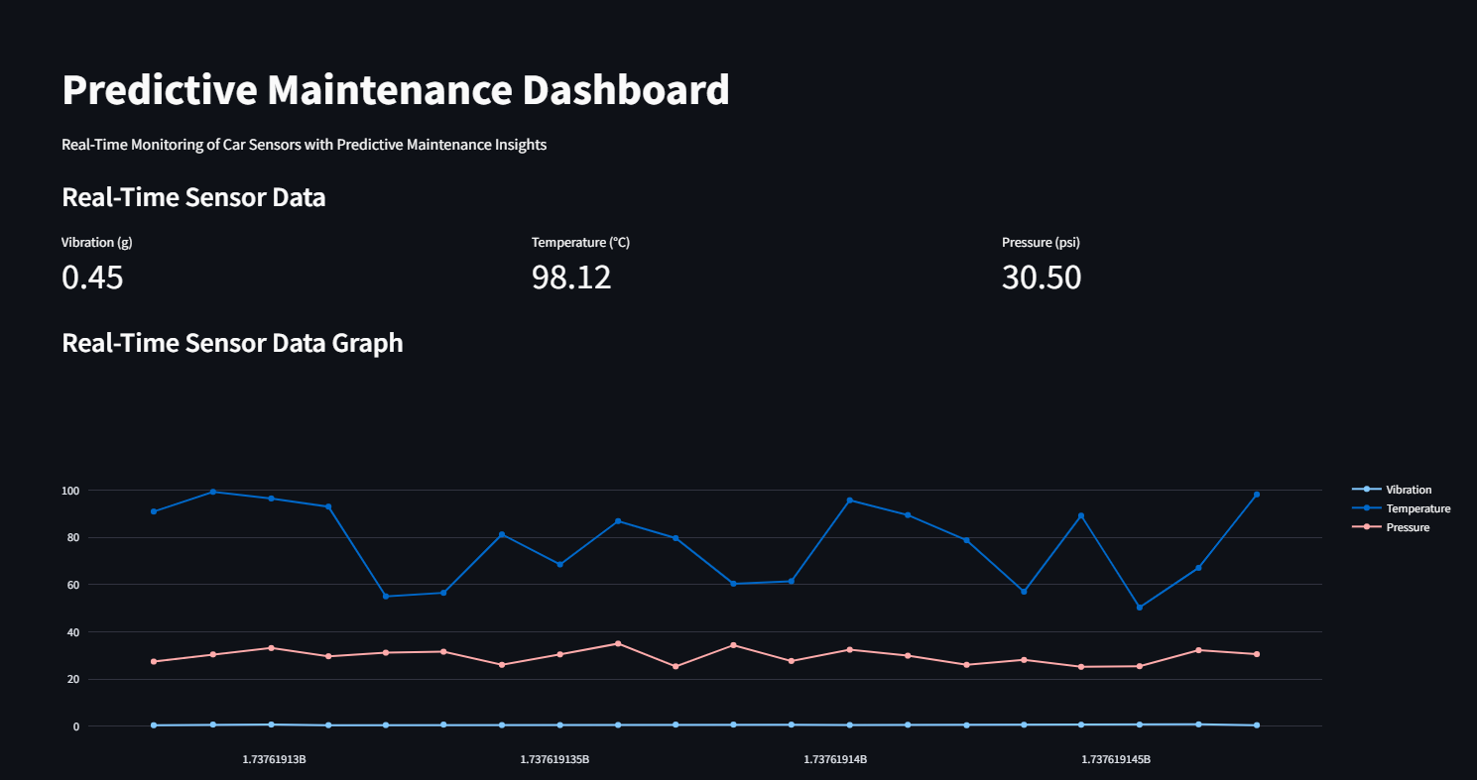
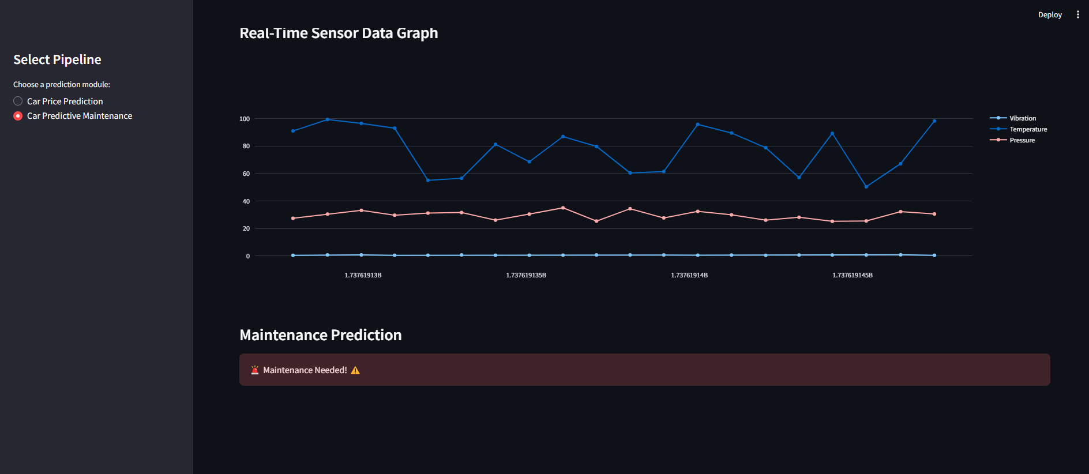
Final Output
Maintain Prediction

Slide 23
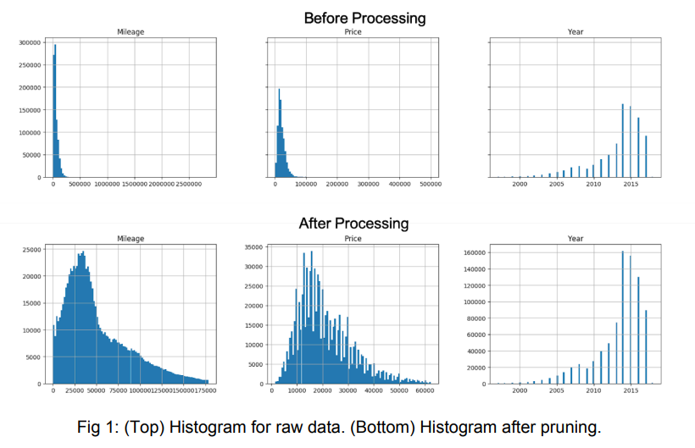
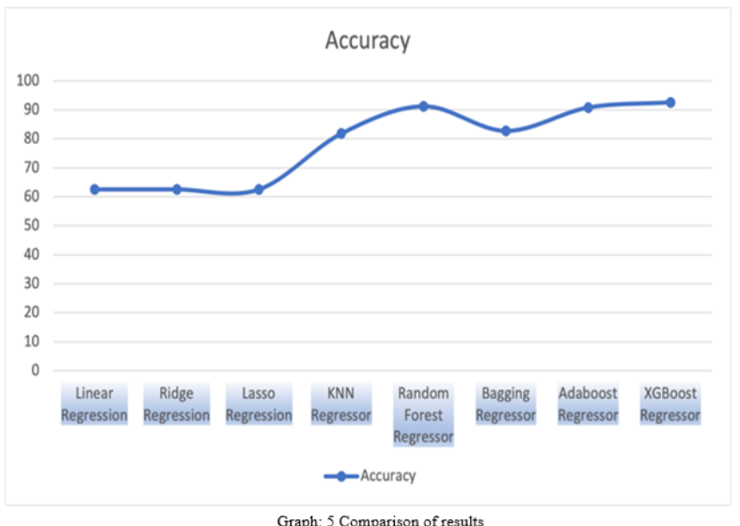
Final Output
Data Visualization

Slide 24
Conclusion
This project successfully integrates machine learning to address two critical domains: car price prediction and predictive maintenance. The Car Price Prediction module enables users to make informed resale value decisions based on key vehicle parameters. The Predictive Maintenance module leverages real-time sensor data to proactively identify potential system failures, reducing operational risks. Together, these modules demonstrate the power of AI in enhancing decision-making and operational efficiency. Future enhancements could incorporate more robust data and advanced algorithms for even greater accuracy and scalability.

