Slide 1
Predicting Poverty Level from Satellite Imagery

Slide 2
Abstract
This project presents a hyperspectral image processing and classification system using Convolutional Neural Networks (CNNs) to achieve high accuracy in spectral analysis. The system integrates interactive visualization, band selection, and RGB composite generation through a Streamlit-based UI for enhanced user experience.
Achieving 96.2% classification accuracy, it outperforms traditional models by automating feature extraction and improving data interpretation. Challenges such as computational complexity, data imbalance, and cloud deployment are addressed with future enhancements, including advanced AI models and real-time processing. This solution has potential applications in remote sensing, precision agriculture, environmental monitoring, and land-use classification.

Slide 3
Introduction
Hyperspectral imaging captures detailed spectral information across multiple wavelengths, enabling precise classification of materials and surfaces. This project utilizes Convolutional Neural Networks (CNNs) to automatically extract spectral patterns and improve classification accuracy.
A Streamlit-based UI provides interactive visualization, allowing users to explore hyperspectral data with ease. The model achieves 96.2% accuracy, surpassing traditional methods in performance. Future enhancements focus on real-time processing, cloud deployment, and advanced AI architectures for scalability and efficiency.

Slide 4
Existing System
Traditional hyperspectral image classification relies on machine learning models like SVM and Random Forest, which require manual feature extraction. These methods struggle with high-dimensional data, leading to increased computational complexity and lower accuracy. Visualization and interpretation of hyperspectral bands are often limited and non-interactive. Handling class imbalance in datasets remains a challenge, affecting model generalization. Additionally, real-time processing and cloud deployment are not well-optimized in existing systems.

Slide 5
Proposed System
The proposed system utilizes Convolutional Neural Networks (CNNs) for automated feature extraction, achieving 96.2% classification accuracy in hyperspectral image analysis. A Streamlit-based UI enhances user interaction, enabling dynamic band selection, RGB composite generation, and real-time visualization.
The model efficiently handles high-dimensional data, reducing computational complexity compared to traditional methods. Data augmentation and advanced AI architectures like ResNet and EfficientNet are integrated to address class imbalance and improve generalization. Future enhancements include cloud deployment and edge AI for real-time, scalable hyperspectral image processing.

Slide 6
LITERATURE REVIEW
Recent studies highlight the effectiveness of deep learning models, particularly CNNs, in hyperspectral image classification due to their ability to extract spectral-spatial features automatically.
Traditional methods like Support Vector Machines (SVMs) and Random Forest require manual feature engineering, limiting scalability and accuracy. Researchers have explored dimensionality reduction techniques like PCA to address computational challenges but with potential information loss.
Studies also emphasize the need for interactive visualization tools to improve data interpretation and usability. Advancements in transformer-based architectures and cloud computing are emerging as promising solutions for real-time hyperspectral image analysis.

Slide 7
Modules:
Data Preprocessing – Handles hyperspectral image loading, noise reduction, normalization, and dimensionality reduction.
Feature Extraction & Classification – Uses Convolutional Neural Networks (CNNs) to automatically learn spectral-spatial features from hyperspectral data.
RGB Composite & Band Selection – Generates RGB composite images and allows users to explore different hyperspectral bands.
Interactive Visualization – A Streamlit-based UI enables real-time data exploration, classification results, and ground truth comparisons.
Model Deployment & Performance Analysis – Evaluates accuracy, precision, recall, and F1-score; optimizes for cloud deployment and real-time inference.

Slide 8
Algorithms Used:
Convolutional Neural Networks (CNNs) – Core deep learning model for hyperspectral image classification.
Principal Component Analysis (PCA) – Reduces dimensionality while preserving essential spectral features.
Softmax Classifier – Final classification layer in CNN for multi-class prediction.
Data Augmentation Techniques – Synthetic data generation to address class imbalance issues.
Adam Optimizer & Cross-Entropy Loss – Used for efficient model training and optimization.

Slide 9
Software Components:
Programming Language: Python (for deep learning and UI development)
Frameworks & Libraries:
TensorFlow/Keras or PyTorch – For building and training CNN models
OpenCV – For image processing and manipulation
Scikit-learn – For preprocessing, feature extraction, and evaluation metrics
Pandas & NumPy – For handling and processing hyperspectral data
Matplotlib & Seaborn – For data visualization
Streamlit – For developing an interactive web-based UI
Hardware Components:
Processor: Minimum Intel Core i7 / AMD Ryzen 7 (Recommended: GPU-based computing for faster training)
RAM: Minimum 16GB (Recommended: 32GB for handling large hyperspectral datasets)
Storage: Minimum 512GB SSD (Recommended: 1TB SSD for faster data processing)
GPU (Highly Recommended): NVIDIA RTX 3060 or higher (Recommended: RTX 3090/Tesla A100 for deep learning tasks)
Cloud GPU (Optional for Deployment): Google Colab Pro, AWS EC2 (GPU instances), or Azure ML for large-scale inference

Slide 10
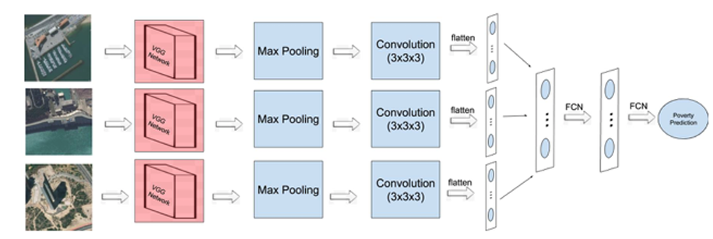
Block Diagram

Slide 11
UML Diagrams
Use Case Diagram
Data Flow Diagram
Sequence Diagram
State Diagram

Slide 12
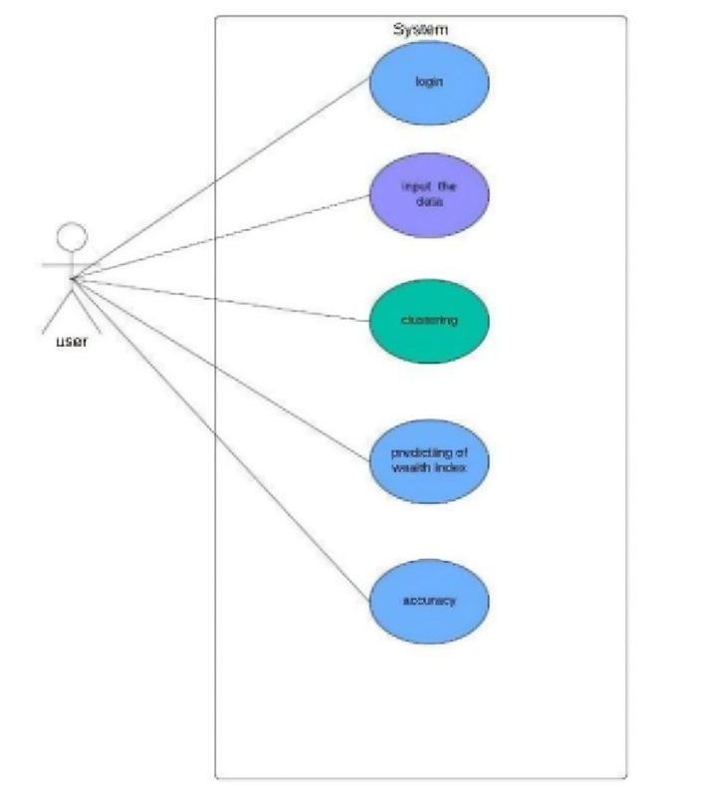
Usecase Diagrams

Slide 13
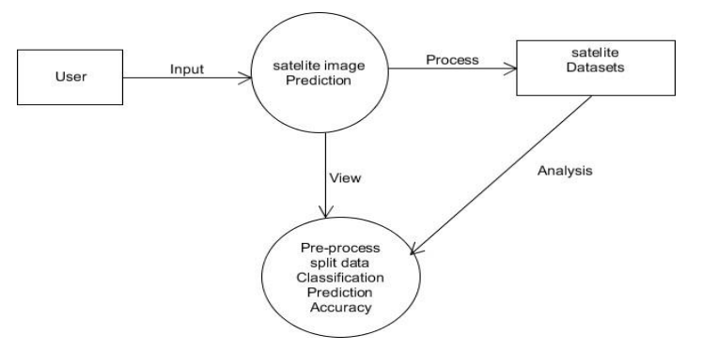
Data Flow Diagrams

Slide 14
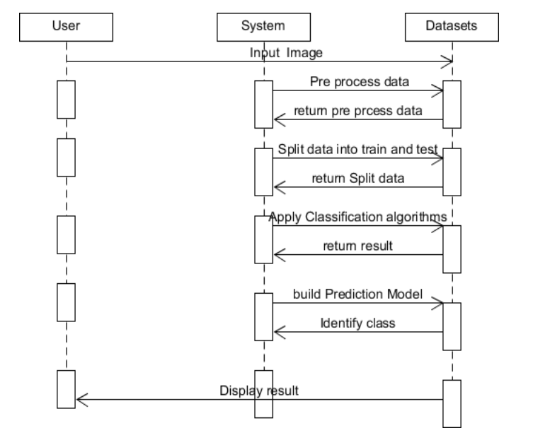
Sequance Diagrams

Slide 15
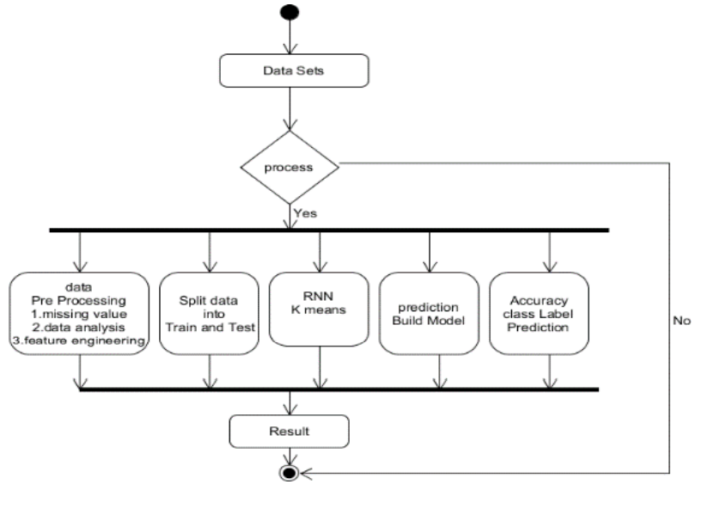
Active Diagrams

Slide 16
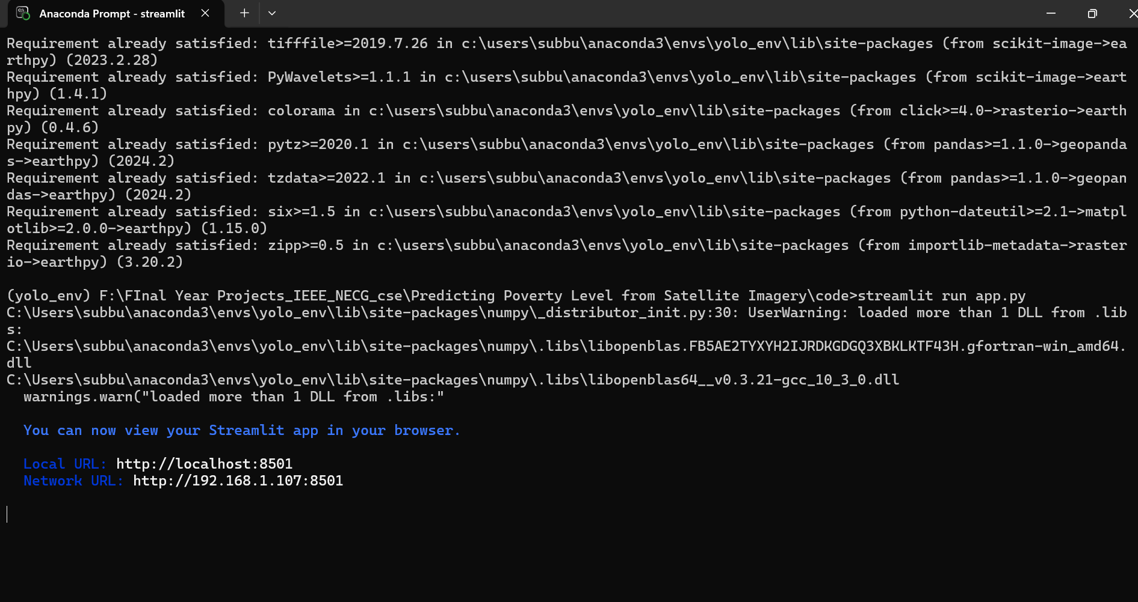
Final Output
The project provides an interactive Streamlit-based UI for hyperspectral image classification using CNNs. Users can upload hyperspectral images, visualize different spectral bands, and generate RGB composite images for better interpretation. The system classifies each pixel with 96.2% accuracy, displaying results alongside ground truth data for comparison. A prediction heatmap is generated to highlight classified regions, and key metrics like accuracy, precision, recall, and F1-score are shown for performance evaluation. Future enhancements aim for real-time processing and cloud deployment to make the system more scalable and efficient. 🚀

Slide 17
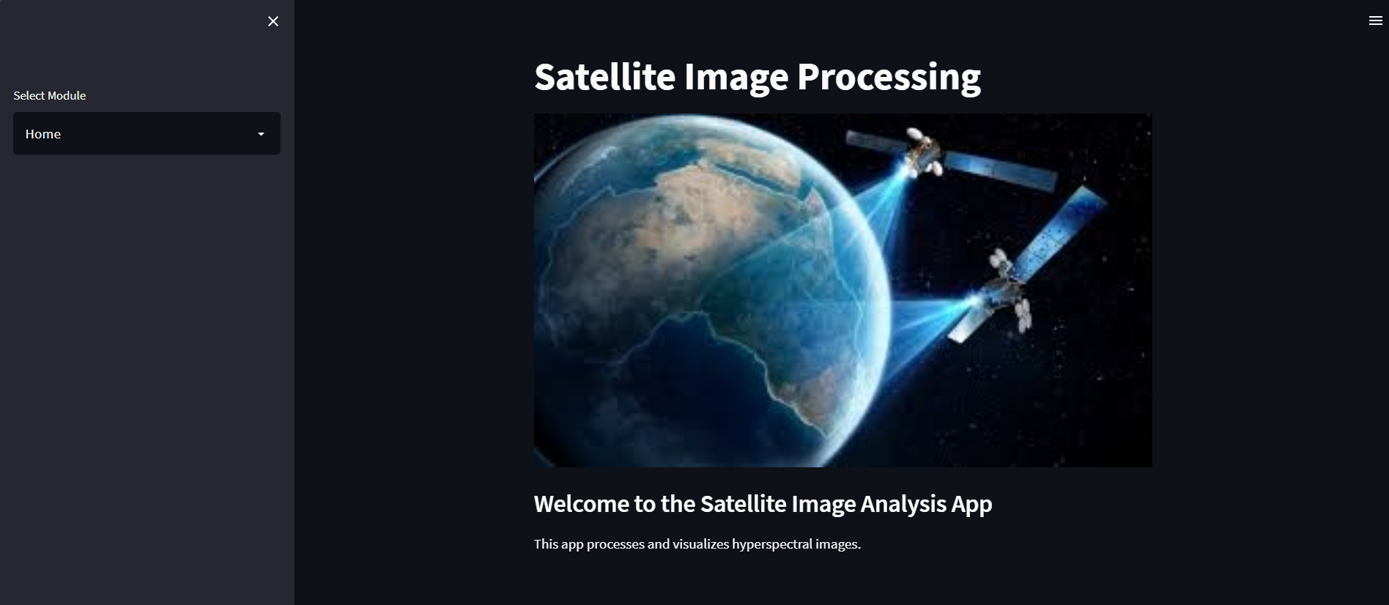
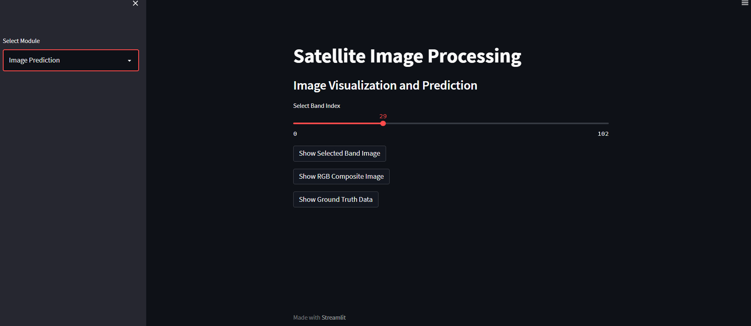
Final Output
Prediction Of Image

Slide 18
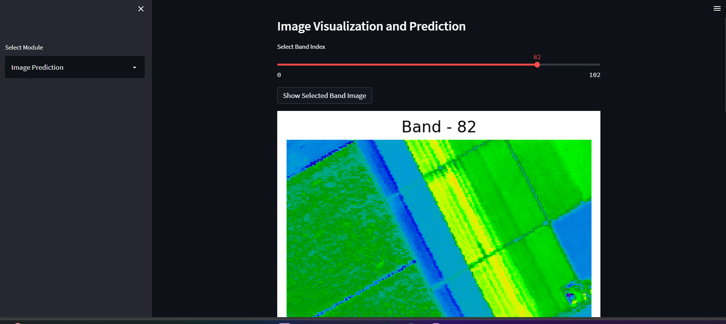
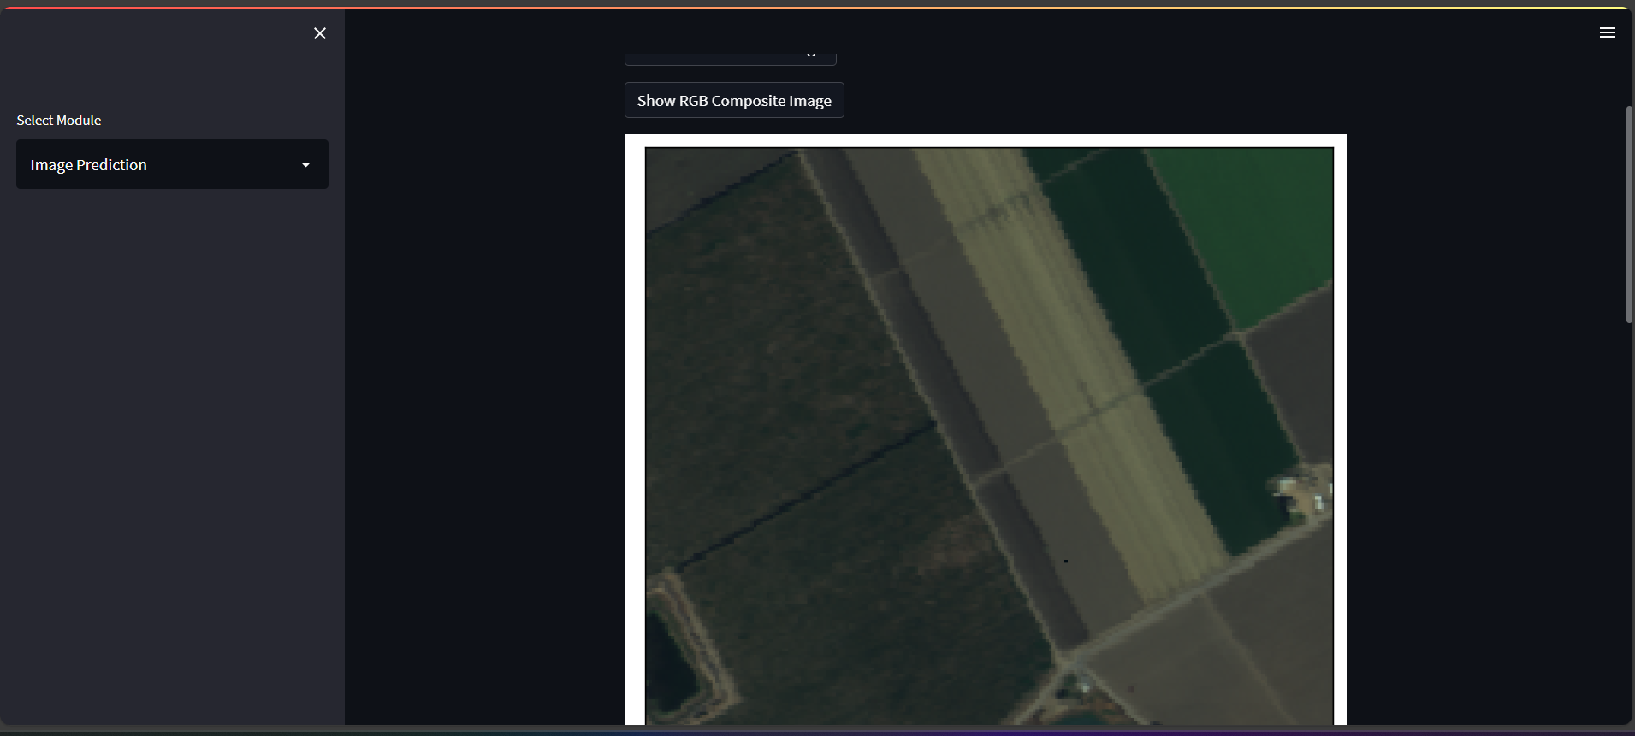
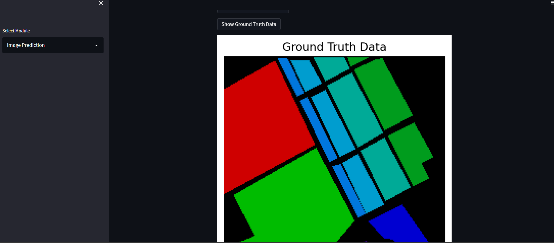
Final Output

Slide 19
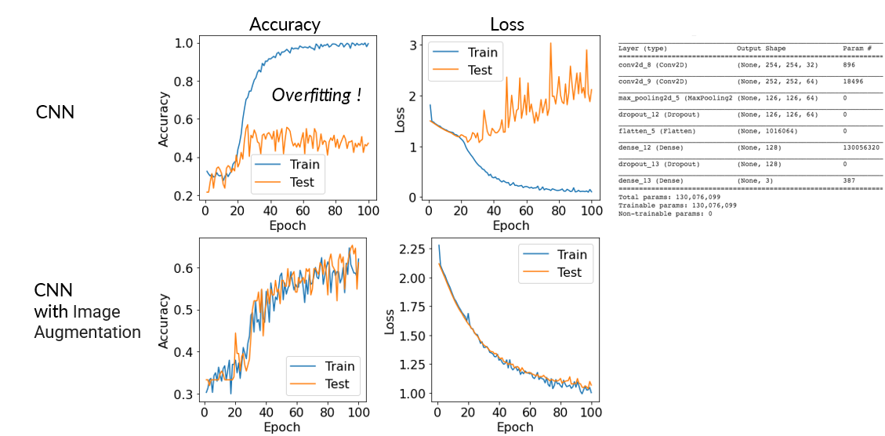
Final Output
Prediction Analysis

Slide 20
Conclusion
This project successfully implements a hyperspectral image processing and classification system using Convolutional Neural Networks (CNNs), achieving 96.2% accuracy and outperforming traditional machine learning models. The Streamlit-based UI provides an interactive platform for visualizing spectral bands, RGB composite images, and classification results, enhancing user experience and data interpretation.
While challenges like computational complexity and data imbalance exist, future enhancements such as advanced AI architectures, cloud deployment, and real-time processing will further improve efficiency and scalability. This system has significant potential applications in remote sensing, precision agriculture, environmental monitoring, and land-use classification, paving the way for more intelligent and automated hyperspectral image analysis. 🚀

