Slide 1
CS252
Graduate Computer Architecture
Lecture 12
Vector Processing
John Kubiatowicz
Electrical Engineering and Computer Sciences
University of California, Berkeley
http://www.eecs.berkeley.edu/~kubitron/cs252

Slide 2
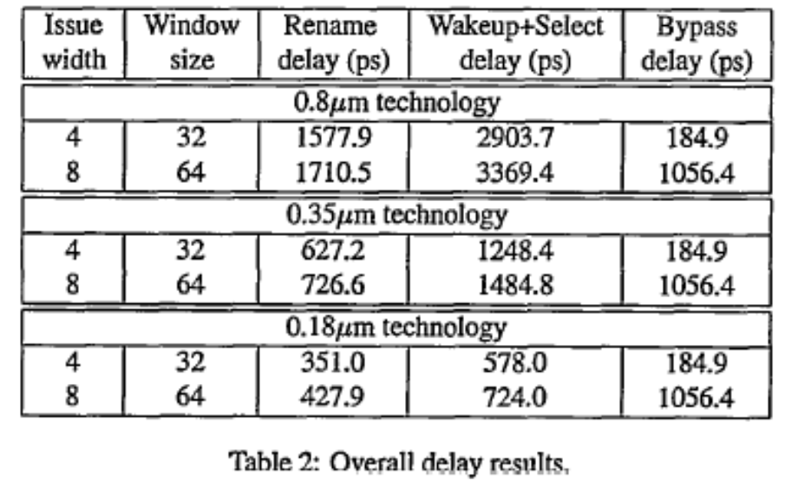
Discussion of papers (Con’t)
Complexity-effective superscalar processors
“Complexity-effective superscalar processors”, Subbarao Palacharla, Norman P. Jouppi and J. E. Smith.
  Several data structures analyzed for complexity WRT issue width
    Rename: Roughly Linear in IW, steeper slope for smaller feature size
    Wakeup: Roughly Linear in IW, but quadratic in window size
    Bypass: Strongly quadratic in IW
  Overall results:
    Bypass significant at high window size/issue width
    Wakeup+Select delay dominates otherwise
  Proposed Complexity-effective design:
    Replace issue window with FIFOs/steer dependent Insts to same FIFO

Slide 3
Discussion of Papers: SPARCLE paper
Example of close coupling between processor and memory controller (CMMU)
  All of features mentioned in this paper implemented by combination of processor and memory controller
  Some functions implemented as special “coprocessor” instructions
  Others implemented as “Tagged” loads/stores/swaps
Course Grained Multithreading
  Using SPARC register windows
  Automatic synchronous trap on cache miss
  Fast handling of all other traps/interrupts (great for message interface!)
  Multithreading half in hardware/half software (hence 14 cycles)
Fine Grained Synchronization
  Full-Empty bit/32 bit word (effectively 33 bits)
    Groups of 4 words/cache line ⇒ F/E bits put into memory TAG
  Fast TRAP on bad condition
  Multiple instructions. Examples:
    LDT (load/trap if empty)
    LDET (load/set full/trap if empty)
    STF (Store/set full)
    STFT (store/set full/trap if full)

Slide 4
Discussion of Papers: Sparcle (Con’t)
Message Interface
  Closely couple with processor
    Interface at speed of first-level cache
  Atomic message launch:
    Describe message (including DMA ops) with simple stio insts
    Atomic launch instruction (ipilaunch)
  Message Reception
    Possible interrupt on message receive: use fast context switch
    Examine message with simple ldio instructions
    Discard in pieces, possibly with DMA
    Free message (ipicst, i.e “coherent storeback”)
We will talk about message interface in greater detail

Slide 5
Supercomputers
Definition of a supercomputer:
Fastest machine in world at given task
A device to turn a compute-bound problem into an I/O bound problem
Any machine costing $30M+
Any machine designed by Seymour Cray
CDC6600 (Cray, 1964) regarded as first supercomputer

Slide 6
Supercomputer Applications
Typical application areas
  Military research (nuclear weapons, cryptography)
  Scientific research
  Weather forecasting
  Oil exploration
  Industrial design (car crash simulation)
All involve huge computations on large data sets
In 70s-80s, Supercomputer ≡ Vector Machine

Slide 7
Vector Supercomputers
Epitomized by Cray-1, 1976:
Scalar Unit + Vector Extensions
Load/Store Architecture
Vector Registers
Vector Instructions
Hardwired Control
Highly Pipelined Functional Units
Interleaved Memory System
No Data Caches
No Virtual Memory

Slide 8
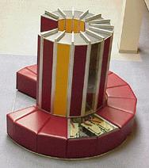
Cray-1 (1976)

Slide 9
Cray-1 (1976)
V0
V_{i}
V. Mask
V1
V_{j}
64 Element Vector Registers
V2
V. Length
V3
V_{k}
Single Port
Memory
16 banks of 64-bit words
+
8-bit SECDED
80MW/sec data load/store
320MW/sec instruction
buffer refill
V4
V5
V6
V7
FP Add
S0
S_{j}
FP Mul
( (A_{h}) + j k m )
S1
S2
S_{k}
FP Recip
64
T Regs
S_{i}
S3
(A₀)
S4
S_{i}
Int Add
T_{jk}
S5
S6
Int Logic
S7
Int Shift
( (A_{h}) + j k m )
A0
Pop Cnt
A1
A_{i}
A2
A_{j}
(A₀)
64
B Regs
A3
A_{k}
Addr Add
B_{jk}
A4
A5
A_{i}
Addr Mul
A6
A7
64-bitx16
NIP
CIP
4 Instruction Buffers
LIP
memory bank cycle 50 ns processor cycle 12.5 ns (80MHz)

Slide 10
Vector Programming Model
Scalar Registers
Vector Registers
r15
v15
r0
v0
[0]
[1]
[2]
[VLRMAX-1]
Vector Length Register
VLR
v1
Vector Arithmetic Instructions
ADDV v3, v1, v2
v2
+
+
+
+
+
+
v3
[0]
[1]
[VLR-1]
Vector Load and Store Instructions
LV v1, r1, r2
Vector Register
v1
Memory
Base, r1
Stride, r2

Slide 11
Vector Code Example
# C code
for (i=0; i<64; i++)
C[i] = A[i] + B[i];
# Scalar Code
LI R4, 64
loop:
L.D F0, 0(R1)
L.D F2, 0(R2)
ADD.D F4, F2, F0
S.D F4, 0(R3)
DADDIU R1, 8
DADDIU R2, 8
DADDIU R3, 8
DSUBIU R4, 1
BNEZ R4, loop
# Vector Code
LI VLR, 64
LV V1, R1
LV V2, R2
ADDV.D V3, V1, V2
SV V3, R3

Slide 12
Vector Instruction Set Advantages
Compact
  one short instruction encodes N operations
Expressive, tells hardware that these N operations:
  are independent
  use the same functional unit
  access disjoint registers
  access registers in the same pattern as previous instructions
  access a contiguous block of memory (unit-stride load/store)
  access memory in a known pattern (strided load/store)
Scalable
  can run same object code on more parallel pipelines or lanes

Slide 13
Vector Arithmetic Execution
Use deep pipeline (=> fast clock) to execute element operations
Simplifies control of deep pipeline because elements in vector are independent (=> no hazards!)
V1
V2
V3
Six stage multiply pipeline
V3 <- v1 * v2

Slide 14
Vector memory Subsystem
Cray-1, 16 banks, 4 cycle bank busy time, 12 cycle latency
  Bank busy time: Cycles between accesses to same bank
Good for: anything relatively prime to 16
  Notice that not as well had handling stride of 4 or 8
Better? Prime number of banks!
  Can do prime number of banks efficiently – even with power-of-2 address
Base
Stride
Vector Registers
Address Generator
+
0
1
2
3
4
5
6
7
8
9
A
B
C
D
E
F
Memory Banks

Slide 15
Vector Instruction Execution
ADDV C,A,B
Execution using one pipelined functional unit
Execution using four pipelined functional units
A[6]
B[6]
A[24]
B[24]
A[25]
B[25]
A[26]
B[26]
A[27]
B[27]
A[5]
B[5]
A[20]
B[20]
A[21]
B[21]
A[22]
B[22]
A[23]
B[23]
A[4]
B[4]
A[16]
B[16]
A[17]
B[17]
A[18]
B[18]
A[19]
B[19]
A[3]
B[3]
A[12]
B[12]
A[13]
B[13]
A[14]
B[14]
A[15]
B[15]
C[2]
C[8]
C[9]
C[10]
C[11]
C[1]
C[4]
C[5]
C[6]
C[7]
C[0]
C[0]
C[1]
C[2]
C[3]

Slide 16
Vector Unit Structure
Functional Unit
Vector
Registers
Elements 0, 4, 8, …
Elements 1, 5, 9, …
Elements 2, 6, 10, …
Elements 3, 7, 11, …
Lane
Memory Subsystem

Slide 17
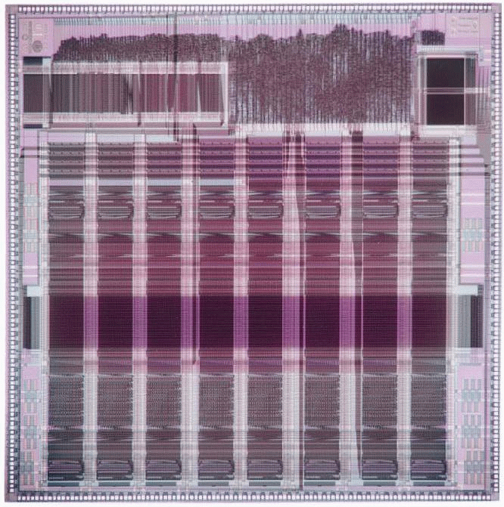
T0 Vector Microprocessor (1995)
Vector register elements striped over lanes
Lane
[24]
[25]
[26]
[27]
[28]
[29]
[30]
[31]
[16]
[17]
[18]
[19]
[20]
[21]
[22]
[23]
[8]
[9]
[10]
[11]
[12]
[13]
[14]
[15]
[0]
[1]
[2]
[3]
[4]
[5]
[6]
[7]

Slide 18
Vector Memory-Memory versus Vector Register Machines
Vector memory-memory instructions hold all vector operands in main memory
The first vector machines, CDC Star-100 (‘73) and TI ASC (‘71), were memory-memory machines
Cray-1 (’76) was first vector register machine
Vector Memory-Memory Code
Example Source Code
ADDV C, A, B
SUBV D, A, B
for (i=0; i<N; i++)
{
C[i] = A[i] + B[i];
D[i] = A[i] - B[i];
}
Vector Register Code
LV V1, A
LV V2, B
ADDV V3, V1, V2
SV V3, C
SUBV V4, V1, V2
SV V4, D

Slide 19
Vector Memory-Memory vs. Vector Register Machines
Vector memory-memory architectures (VMMA) require greater main memory bandwidth, why?
  All operands must be read in and out of memory
VMMAs make if difficult to overlap execution of multiple vector operations, why?
  Must check dependencies on memory addresses
VMMAs incur greater startup latency
  Scalar code was faster on CDC Star-100 for vectors < 100 elements
  For Cray-1, vector/scalar breakeven point was around 2 elements
Apart from CDC follow-ons (Cyber-205, ETA-10) all major vector machines since Cray-1 have had vector register architectures
(we ignore vector memory-memory from now on)

Slide 20
Administrivia
Exam: Wednesday 3/18
Location: 310 Soda
TIME: 6:00-9:00pm
Meet at LaVal’s afterwards for Pizza and Beverages
CS252 Project proposal due by Friday 3/13
  Need two people/project (although can justify three for right project)
  Some projects now up (projects link, click on sugestions link)
  More projects for ParLAB up later today (I hope)

Slide 21
Automatic Code Vectorization
for (i=0; i < N; i++)
C[i] = A[i] + B[i];
Scalar Sequential Code
Vectorized Code
load
load
load
Iter. 1
load
load
load
add
Time
add
add
store
store
store
load
Iter. 1
Iter. 2
Iter. 2
load
Vector Instruction
add
Vectorization is a massive compile-time reordering of operation sequencing
⇒ requires extensive loop dependence analysis
store

Slide 22
Vector Stripmining
Problem: Vector registers have finite length
Solution: Break loops into pieces that fit into vector registers, “Stripmining”
ANDI R1, N, 63 # N mod 64
MTC1 VLR, R1 # Do remainder
loop:
LV V1, RA
DSLL R2, R1, 3 # Multiply by 8
DADDU RA, RA, R2 # Bump pointer
LV V2, RB
DADDU RB, RB, R2
ADDV.D V3, V1, V2
SV V3, RC
DADDU RC, RC, R2
DSUBU N, N, R1 # Subtract elements
LI R1, 64
MTC1 VLR, R1 # Reset full length
BGTZ N, loop # Any more to do?
for (i=0; i<N; i++)
C[i] = A[i]+B[i];
A
B
C
+
Remainder
+
64 elements
+

Slide 23
Vector Instruction Parallelism
Can overlap execution of multiple vector instructions
  example machine has 32 elements per vector register and 8 lanes
Load Unit
Multiply Unit
Add Unit
load
mul
add
time
load
mul
add
Instruction issue
Complete 24 operations/cycle while issuing 1 short instruction/cycle

Slide 24
Vector Chaining
Vector version of register bypassing
  introduced with Cray-1
V1
V2
V3
V4
V5
LV v1
MULV v3,v1,v2
ADDV v5, v3, v4
Chain
Chain
Load Unit
Mult.
Add
Memory

Slide 25
Vector Chaining Advantage
Without chaining, must wait for last element of result to be written before starting dependent instruction
Load
Mul
Time
Add
With chaining, can start dependent instruction as soon as first result appears
Load
Mul
Add

Slide 26
Vector Startup
Two components of vector startup penalty
  functional unit latency (time through pipeline)
  dead time or recovery time (time before another vector instruction can start down pipeline)
Functional Unit Latency
R
X
X
X
W
R
X
X
X
W
First Vector Instruction
R
X
X
X
W
R
X
X
X
W
R
X
X
X
W
Dead Time
R
X
X
X
W
R
X
X
X
W
R
X
X
X
W
Dead Time
R
X
X
X
W
Second Vector Instruction
R
X
X
X
W

Slide 27
Dead Time and Short Vectors
No dead time
4 cycles dead time
T0, Eight lanes
No dead time
100% efficiency with 8 element vectors
64 cycles active
Cray C90, Two lanes
4 cycle dead time
Maximum efficiency 94% with 128 element vectors

Slide 28
Vector Scatter/Gather
Want to vectorize loops with indirect accesses:
  for (i=0; i<N; i++)
  A[i] = B[i] + C[D[i]]
Indexed load instruction (Gather)
  LV vD, rD # Load indices in D vector
  LVI vC, rC, vD # Load indirect from rC base
  LV vB, rB # Load B vector
  ADDV.D vA, vB, vC # Do add
  SV vA, rA # Store result

Slide 29
Vector Scatter/Gather
Scatter example:
  for (i=0; i<N; i++)
  A[B[i]]++;
Is following a correct translation?
  LV vB, rB # Load indices in B vector
  LVI vA, rA, vB # Gather initial A values
  ADDV vA, vA, 1 # Increment
  SVI vA, rA, vB # Scatter incremented values

Slide 30
Vector Conditional Execution
Problem: Want to vectorize loops with conditional code:
      for (i=0; i<N; i++)
      if (A[i]>0) then
      A[i] = B[i];
Solution: Add vector mask (or flag) registers
  vector version of predicate registers, 1 bit per element
…and maskable vector instructions
  vector operation becomes NOP at elements where mask bit is clear
Code example:
  CVM # Turn on all elements
  LV vA, rA # Load entire A vector
  SGTVS.D vA, F0 # Set bits in mask register where A>0
  LV vA, rB # Load B vector into A under mask
  SV vA, rA # Store A back to memory under mask

Slide 31
Masked Vector Instructions
Simple Implementation
  execute all N operations, turn off result writeback according to mask
Density-Time Implementation
  scan mask vector and only execute elements with non-zero masks
M[7]=1
A[7]
B[7]
M[7]=1
M[6]=0
A[6]
B[6]
M[6]=0
A[7]
B[7]
M[5]=1
A[5]
B[5]
M[5]=1
M[4]=1
A[4]
B[4]
M[4]=1
M[3]=0
A[3]
B[3]
M[3]=0
C[5]
M[2]=0
C[4]
M[1]=1
M[2]=0
C[2]
M[0]=0
M[1]=1
C[1]
C[1]
Write data port
M[0]=0
C[0]
Write Enable
Write data port

Slide 32
Compress/Expand Operations
Compress packs non-masked elements from one vector register contiguously at start of destination vector register
  population count of mask vector gives packed vector length
Expand performs inverse operation
M[7]=1
A[7]
A[7]
A[7]
M[7]=1
M[6]=0
A[6]
A[5]
B[6]
M[6]=0
M[5]=1
A[5]
A[4]
A[5]
M[5]=1
M[4]=1
A[4]
A[1]
A[4]
M[4]=1
M[3]=0
A[3]
A[7]
B[3]
M[3]=0
M[2]=0
A[2]
A[5]
B[2]
M[2]=0
M[1]=1
A[1]
A[4]
A[1]
M[1]=1
M[0]=0
A[0]
A[1]
B[0]
M[0]=0
Compress
Expand
Used for density-time conditionals and also for general selection operations

Slide 33
Vector Reductions
Problem: Loop-carried dependence on reduction variables
  sum = 0;
  for (i=0; i<N; i++)
  sum += A[i]; # Loop-carried dependence on sum
Solution: Re-associate operations if possible, use binary tree to perform reduction
  # Rearrange as:
  sum[0:VL-1] = 0 # Vector of VL partial sums
  for(i=0; i<N; i+=VL) # Stripmine VL-sized chunks
  sum[0:VL-1] += A[i:i+VL-1]; # Vector sum
  # Now have VL partial sums in one vector register
  do {
  VL = VL/2; # Halve vector length
  sum[0:VL-1] += sum[VL:2*VL-1] # Halve no. of partials
  } while (VL>1)

Slide 34
Novel Matrix Multiply Solution
Consider the following:
  /* Multiply a[m][k] * b[k][n] to get c[m][n] */
  for (i=1; i<m; i++) {
  for (j=1; j<n; j++) {
  sum = 0;
  for (t=1; t<k; t++)
  sum += a[i][t] * b[t][j];
  c[i][j] = sum;
  }
  }
Do you need to do a bunch of reductions? NO!
  Calculate multiple independent sums within one vector register
  You can vectorize the j loop to perform 32 dot-products at the same time (Assume Max Vector Length is 32)
Show it in C source code, but can imagine the assembly vector instructions from it

Slide 35
Optimized Vector Example
/* Multiply a[m][k] * b[k][n] to get c[m][n] */
for (i=1; i<m; i++) {
for (j=1; j<n; j+=32) {/* Step j 32 at a time. */
sum[0:31] = 0; /* Init vector reg to zeros. */
for (t=1; t<k; t++) {
a_scalar = a[i][t]; /* Get scalar */
b_vector[0:31] = b[t][j:j+31]; /* Get vector */
/* Do a vector-scalar multiply. */
prod[0:31] = b_vector[0:31]*a_scalar;
/* Vector-vector add into results. */
sum[0:31] += prod[0:31];
}
/* Unit-stride store of vector of results. */
c[i][j:j+31] = sum[0:31];
}
}

Slide 36
Multimedia Extensions
Very short vectors added to existing ISAs for micros
Usually 64-bit registers split into 2x32b or 4x16b or 8x8b
Newer designs have 128-bit registers (Altivec, SSE2)
Limited instruction set:
  no vector length control
  no strided load/store or scatter/gather
  unit-stride loads must be aligned to 64/128-bit boundary
Limited vector register length:
  requires superscalar dispatch to keep multiply/add/load units busy
  loop unrolling to hide latencies increases register pressure
Trend towards fuller vector support in microprocessors

Slide 37
“Vector” for Multimedia?
Intel MMX: 57 additional 80x86 instructions (1st since 386)
  similar to Intel 860, Mot. 88110, HP PA-71000LC, UltraSPARC
3 data types: 8 8-bit, 4 16-bit, 2 32-bit in 64bits
  reuse 8 FP registers (FP and MMX cannot mix)
­ short vector: load, add, store 8 8-bit operands
Claim: overall speedup 1.5 to 2X for 2D/3D graphics, audio, video, speech, comm., ...
  use in drivers or added to library routines; no compiler
+

Slide 38
MMX Instructions
Move 32b, 64b
Add, Subtract in parallel: 8 8b, 4 16b, 2 32b
  opt. signed/unsigned saturate (set to max) if overflow
Shifts (sll,srl, sra), And, And Not, Or, Xor
in parallel: 8 8b, 4 16b, 2 32b
Multiply, Multiply-Add in parallel: 4 16b
Compare = , > in parallel: 8 8b, 4 16b, 2 32b
  sets field to 0s (false) or 1s (true); removes branches
Pack/Unpack
  Convert 32b<–> 16b, 16b <–> 8b
  Pack saturates (set to max) if number is too large

Slide 39
Vector Summary
Vector is alternative model for exploiting ILP
If code is vectorizable, then simpler hardware, more energy efficient, and better real-time model than Out-of-order machines
Design issues include number of lanes, number of functional units, number of vector registers, length of vector registers, exception handling, conditional operations
Fundamental design issue is memory bandwidth
  With virtual address translation and caching
Will multimedia popularity revive vector architectures?

