Slide 1
INSTITUTE FOR ADVANCED COMPUTING AND SOFTWARE DEVELOPMENT AKURDI, PUNE
Documentation On
“BLUESKY-
(ONLINE SERVICES)”
PG-DAC SEPT 2022
Submitted By , Project Guide:
Group No. 101 Mr.Shivprasad
SUBRAT GUPTA(229216) Center Co-ordinator
SWAPNIL VAIDYA(229228) MR.Rohit Puranik

Slide 2
Points To Be Discussed
Introduction
Objectives
UML Diagrams
Screenshots
Specifications
Hardware and Software Requirements
Advantages
Disadvantages
Conclusion
Future Enhancements
References

Slide 3
Introduction:
In today's fast-paced world, people are always on the go and do not have the time to fix
their household problems themselves. This has led to a surge in demand for
online services like mechanic, plumber, and electrician. These services are now
readily available at the click of a button, making it easier for people to get
their problems fixed without leaving the comfort of their homes.
The purpose of this project report is to analyze the online services for mechanic,
plumber, and electrician, their impact on society, and their future potential.
The report will explore the benefits of online services, the challenges faced
by service providers, and the role of technology in enhancing the service
Experience.

Slide 4
Objectives:
To achieve the primary aim, the following objectives will be addressed in this project report:
1. To examine the current landscape of online services for mechanic, plumber, and electrician and to identify the major players in the market.
2. To analyze the benefits of online services, including their convenience, accessibility, and cost-effectiveness, and to provide examples of successful implementations of these services.
3. To explore the challenges faced by service providers, including maintaining quality standards, managing customer expectations, building trust, and remaining competitive in a rapidly evolving market.
4. To assess the impact of online services on society, including their potential to create job opportunities, improve the efficiency of service delivery, and reduce environmental impact.
5. To provide recommendations for service providers, policymakers, and researchers to address the challenges and opportunities in the online services industry.
6. To evaluate the future potential of online services for mechanic, plumber, and electrician, including the potential for expansion into new markets and the impact of emerging technologies on the industry.

Slide 5
Technology Used:
Front End :- React JS
Back End :- Java Spring Boot API
Database :- MySQL

Slide 6
UML Diagrams
ER Diagram
Use case Diagram
Data Flow Diagram
Activity Diagram
Class Diagram

Slide 7
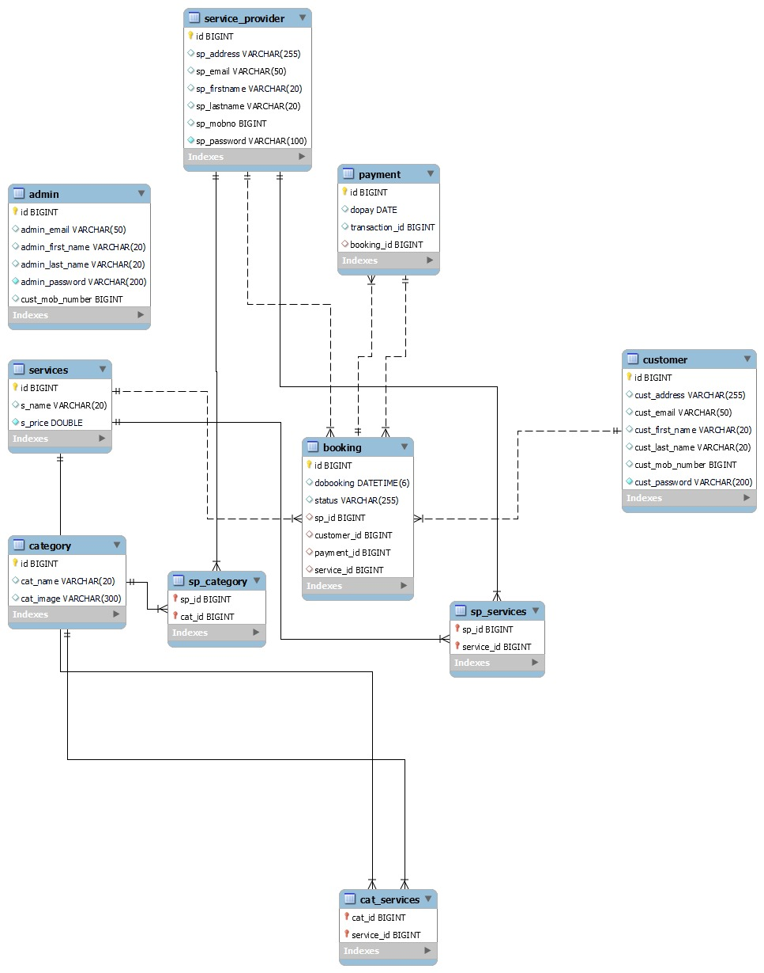
E-r diagram (db generated):

Slide 8
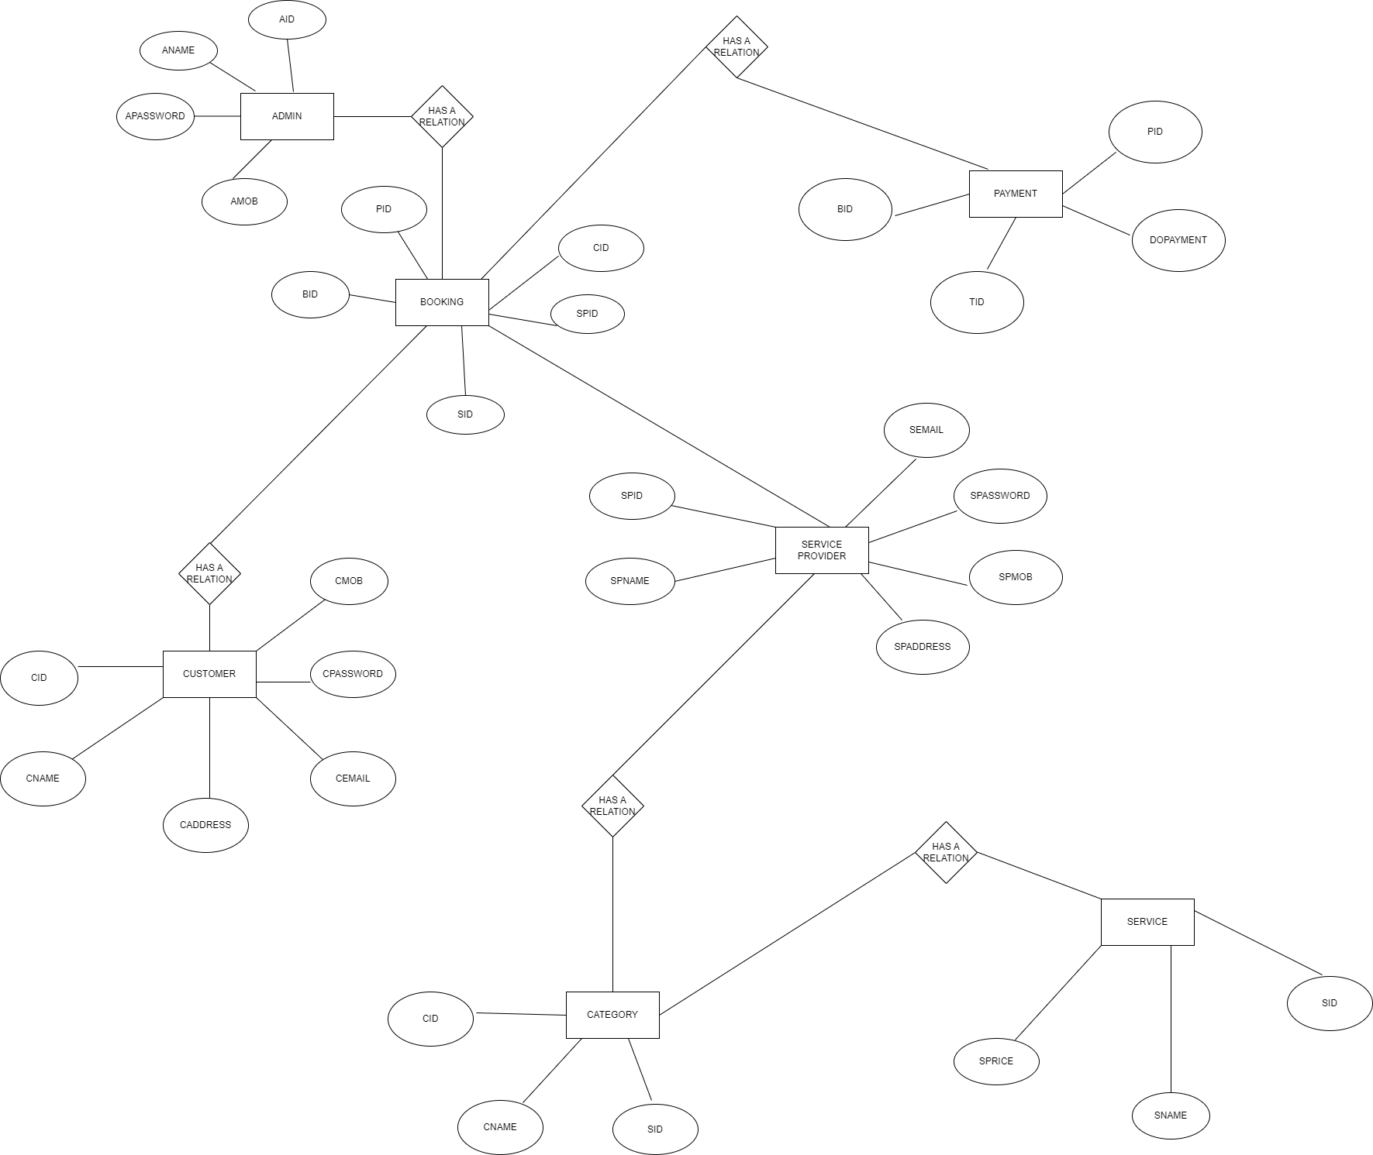

Slide 9
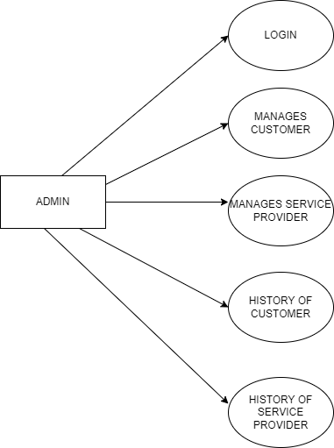
Use case diagram:

Slide 10
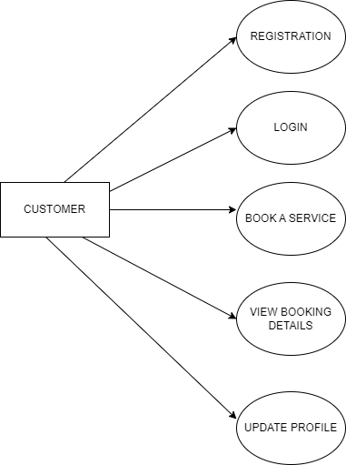

Slide 11
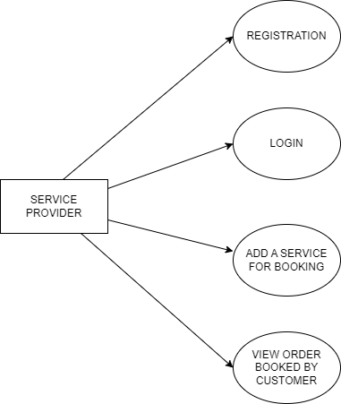

Slide 12
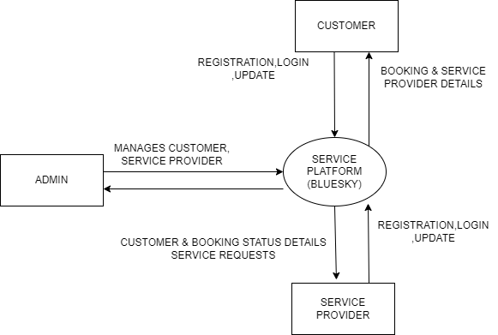
Data flow diagram:

Slide 13
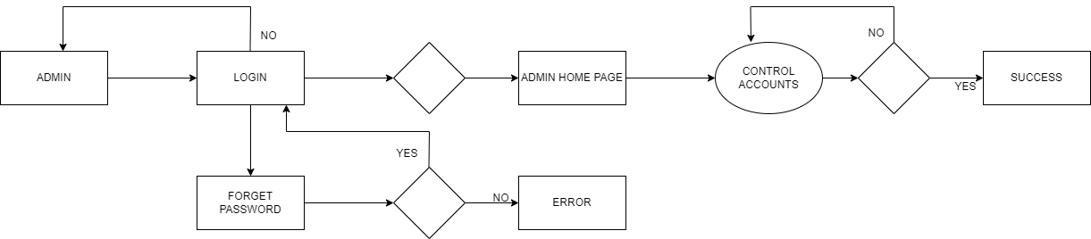
Activity diagram:

Slide 14
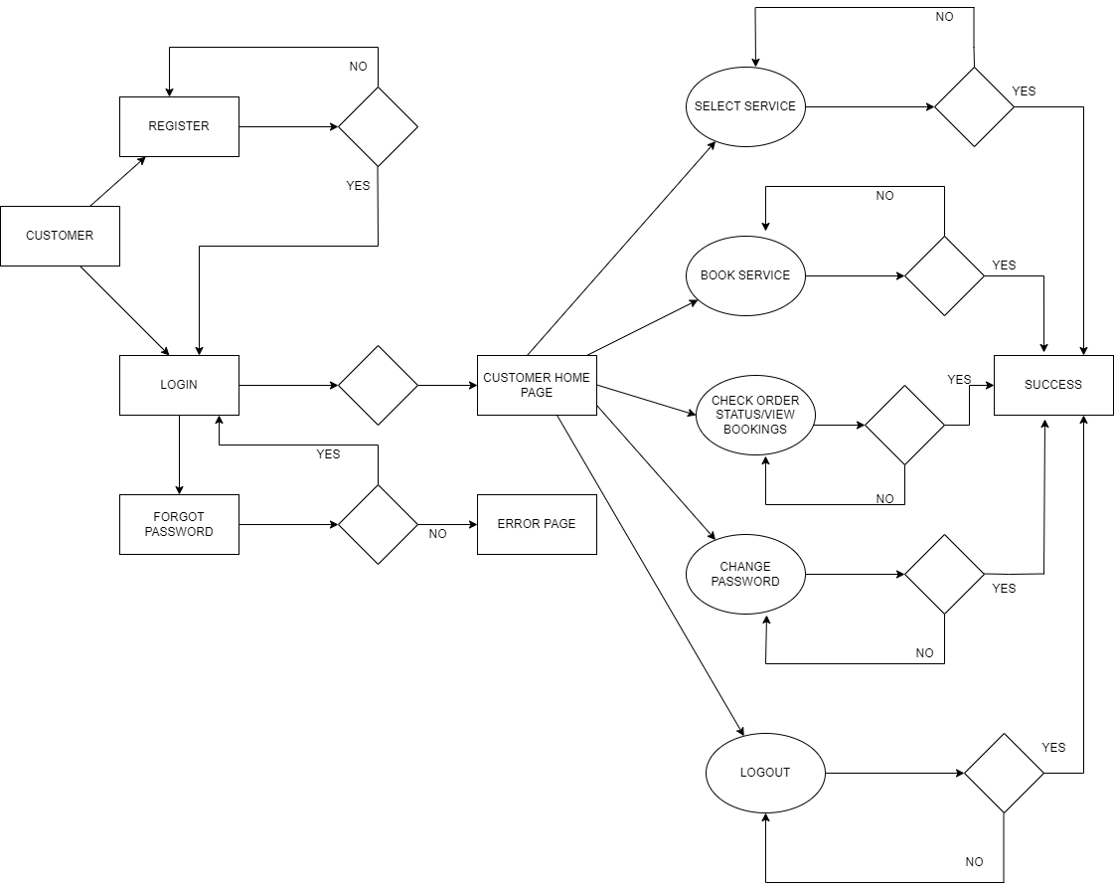

Slide 15
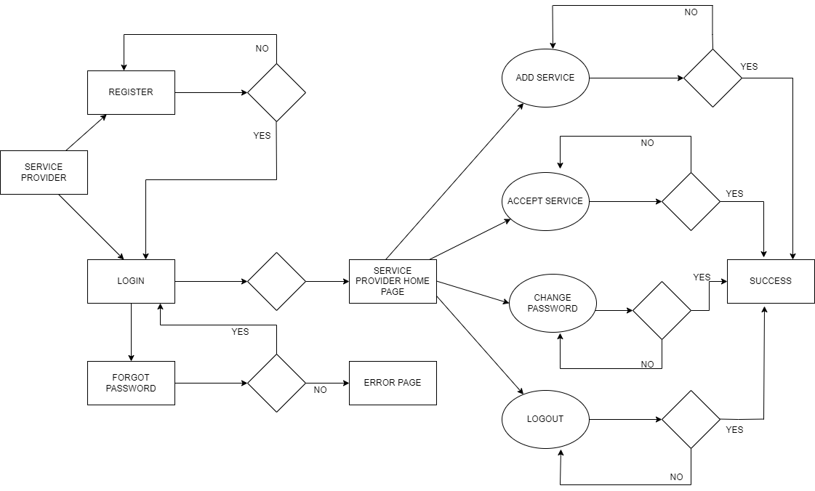

Slide 16
Screenshots:

Slide 17
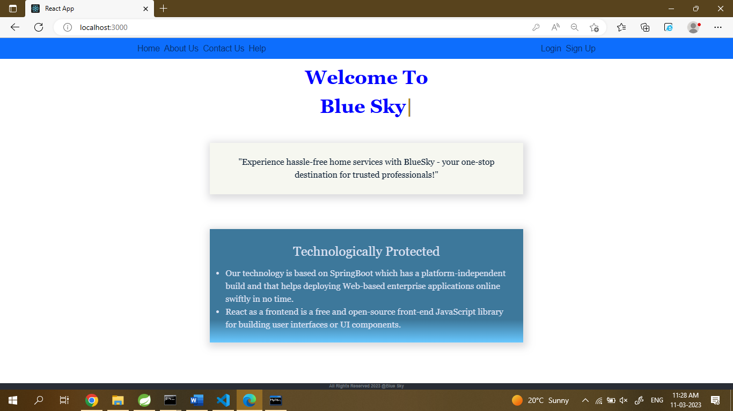

Slide 18
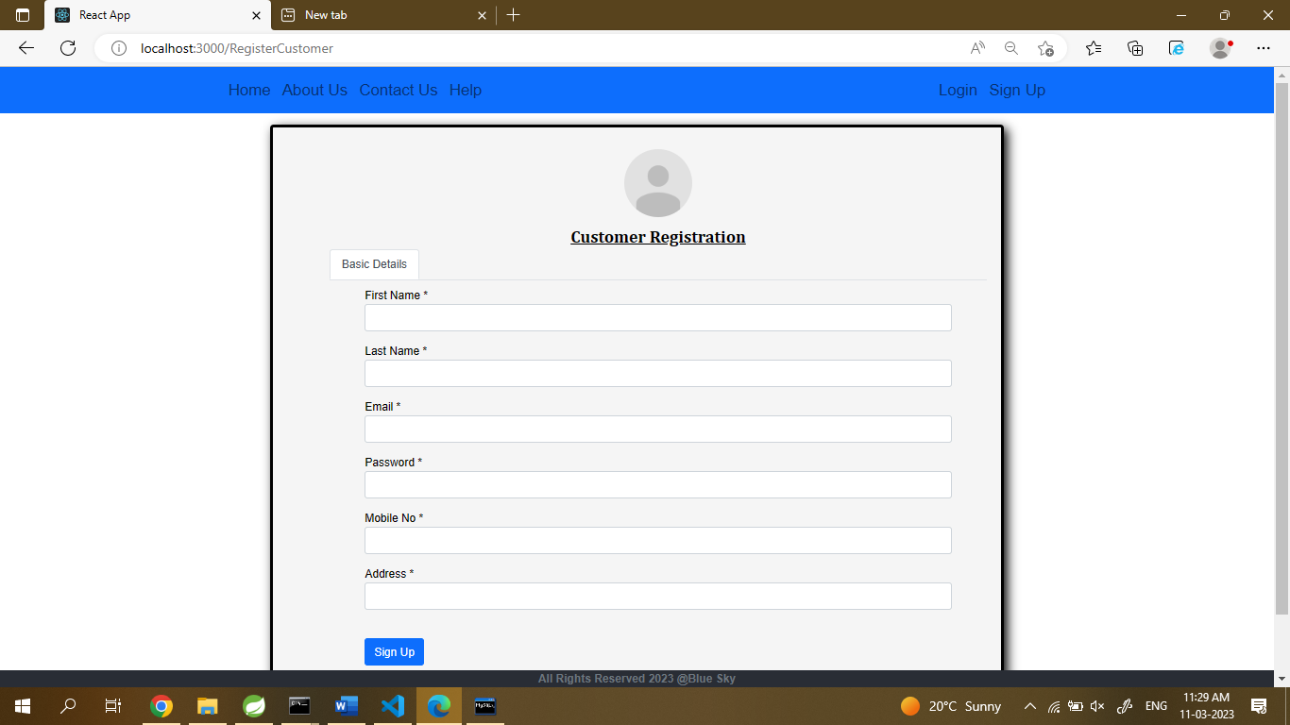

Slide 19
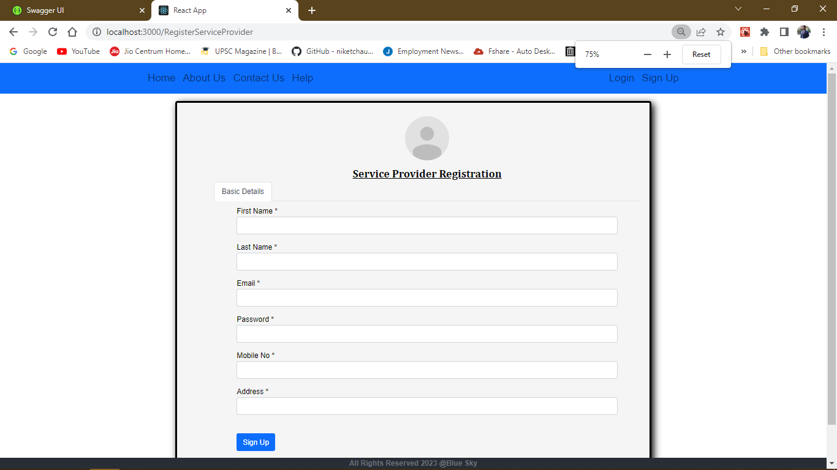

Slide 20
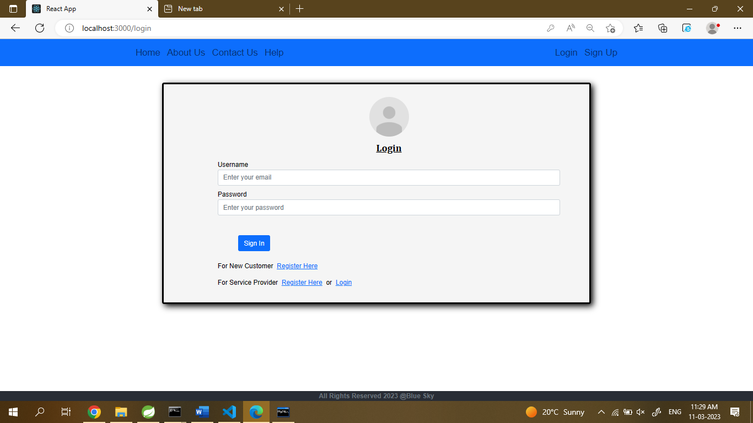

Slide 21
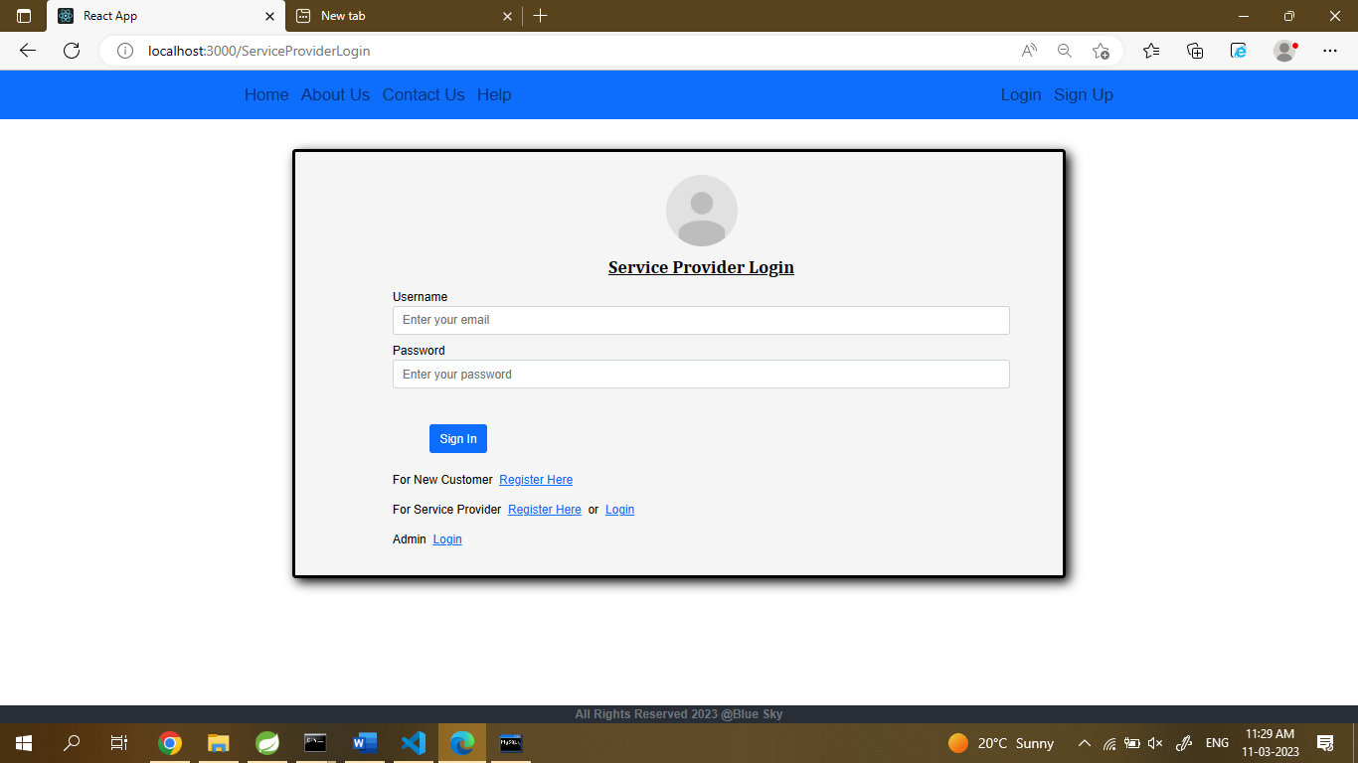

Slide 22


Slide 23
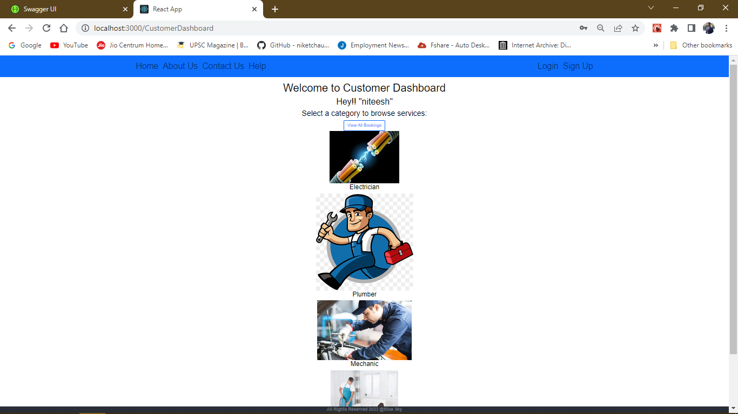

Slide 24
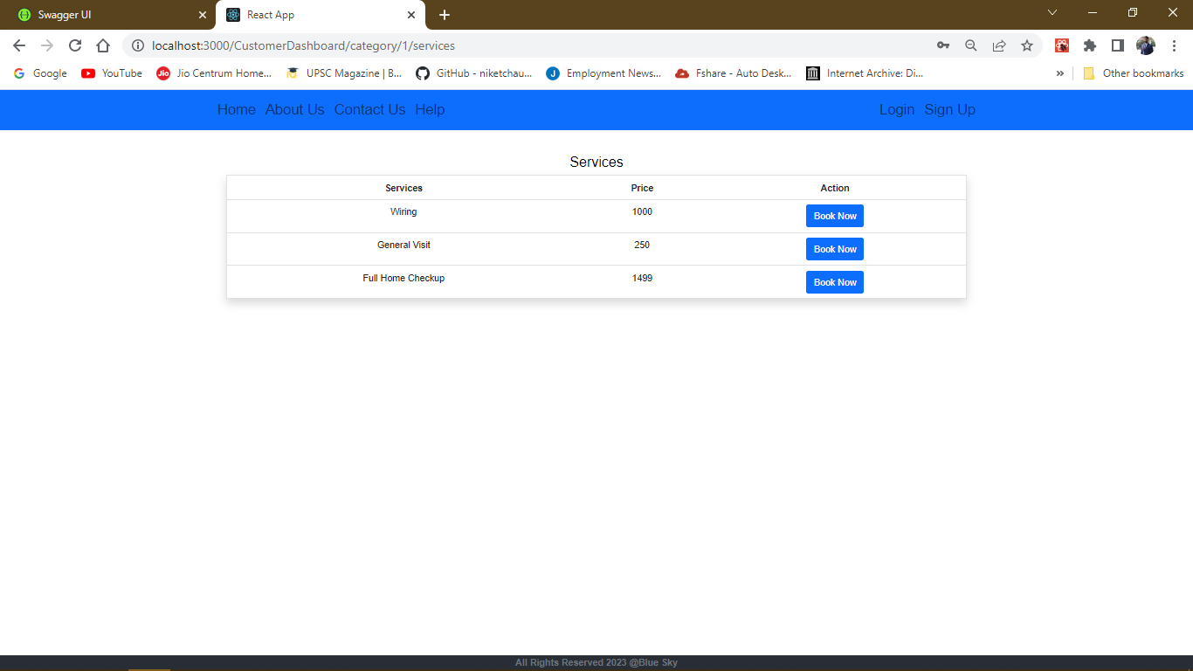

Slide 25
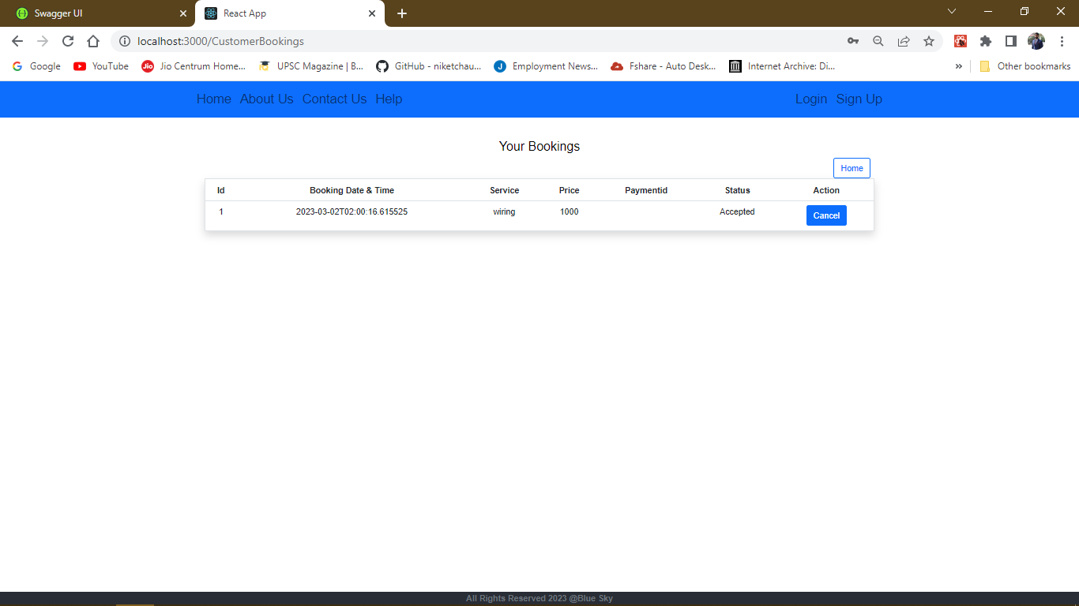

Slide 26
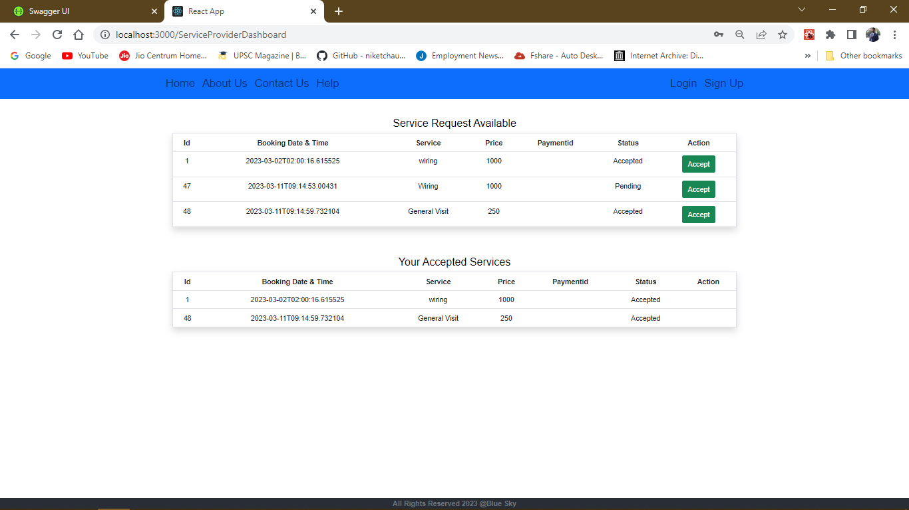

Slide 27
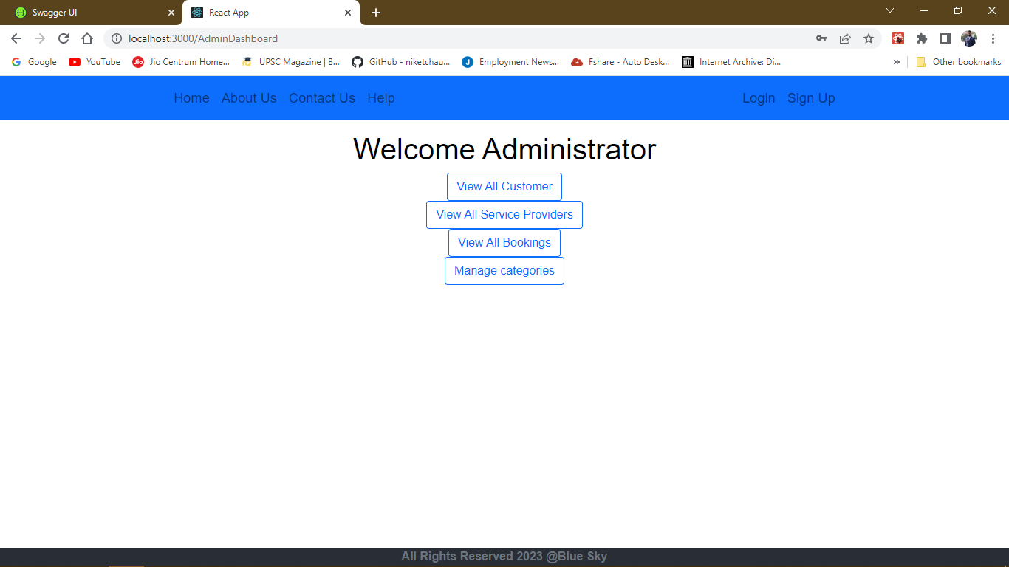

Slide 28
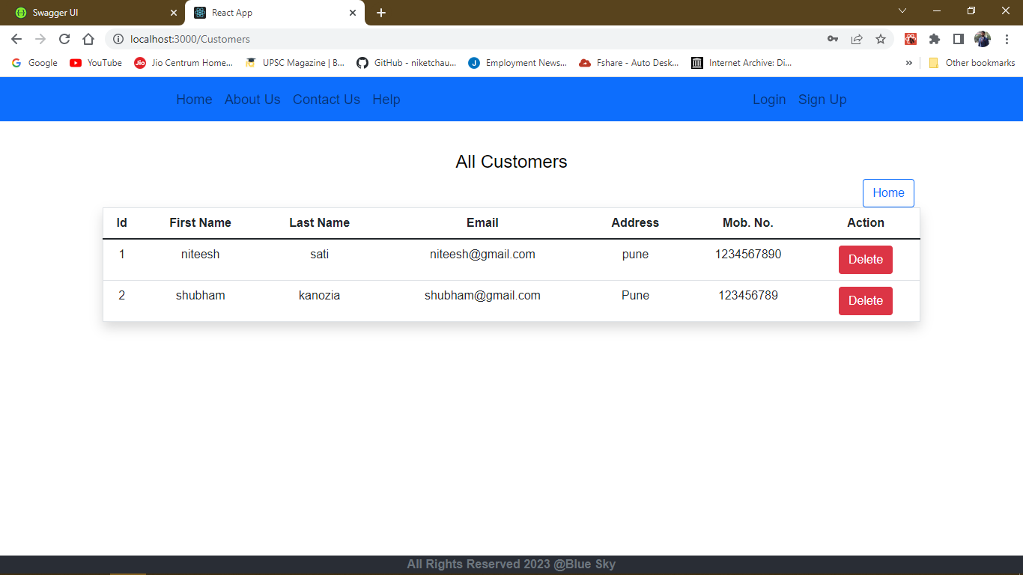

Slide 29


Slide 30
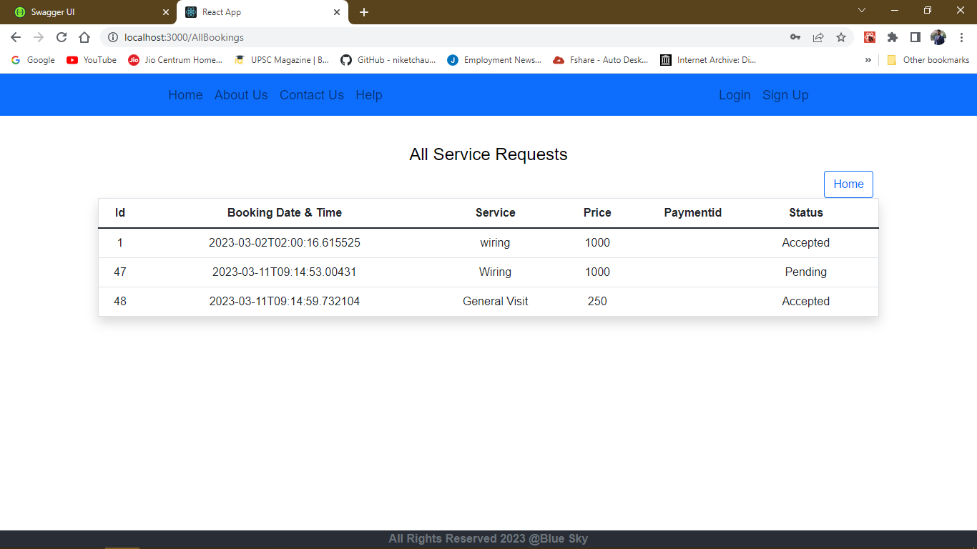

Slide 31
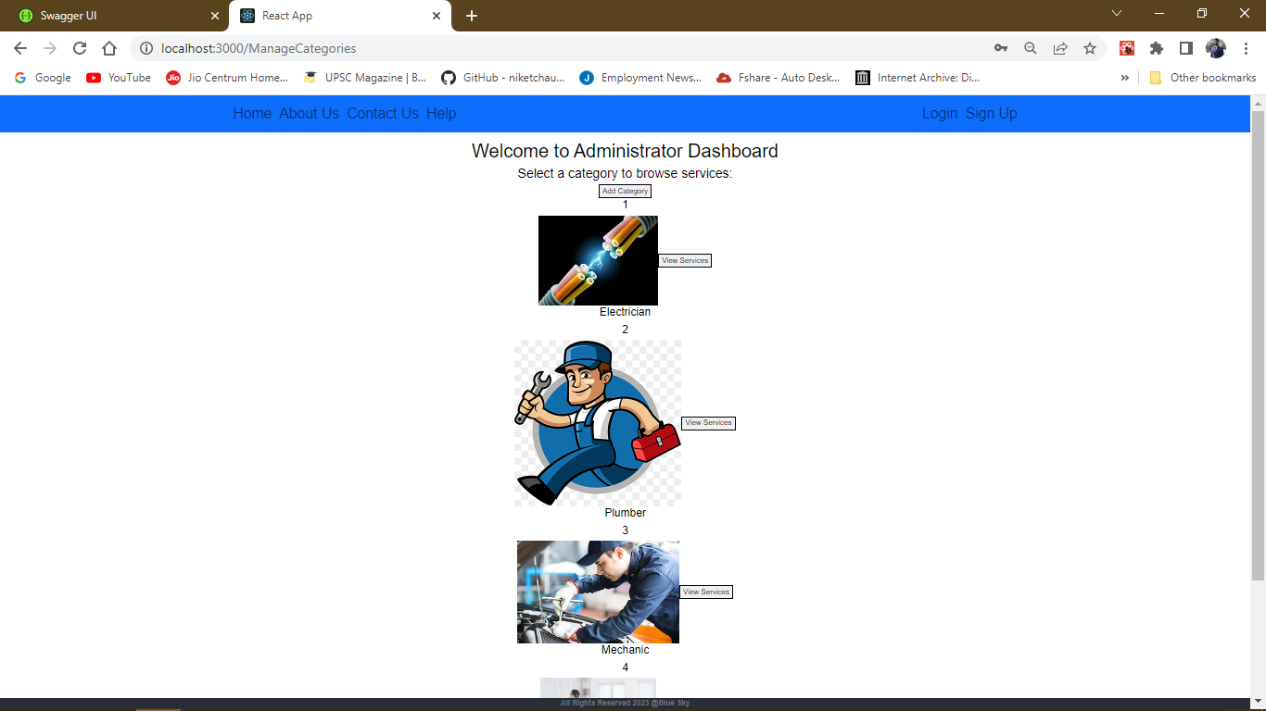

Slide 32
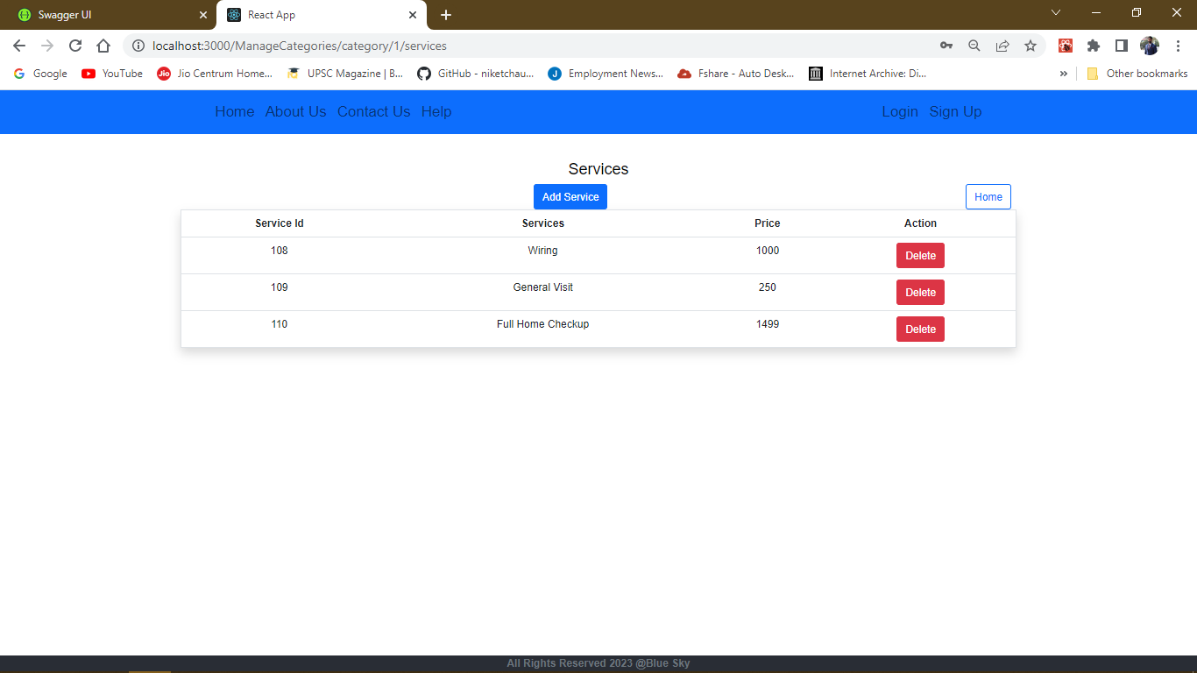

Slide 33
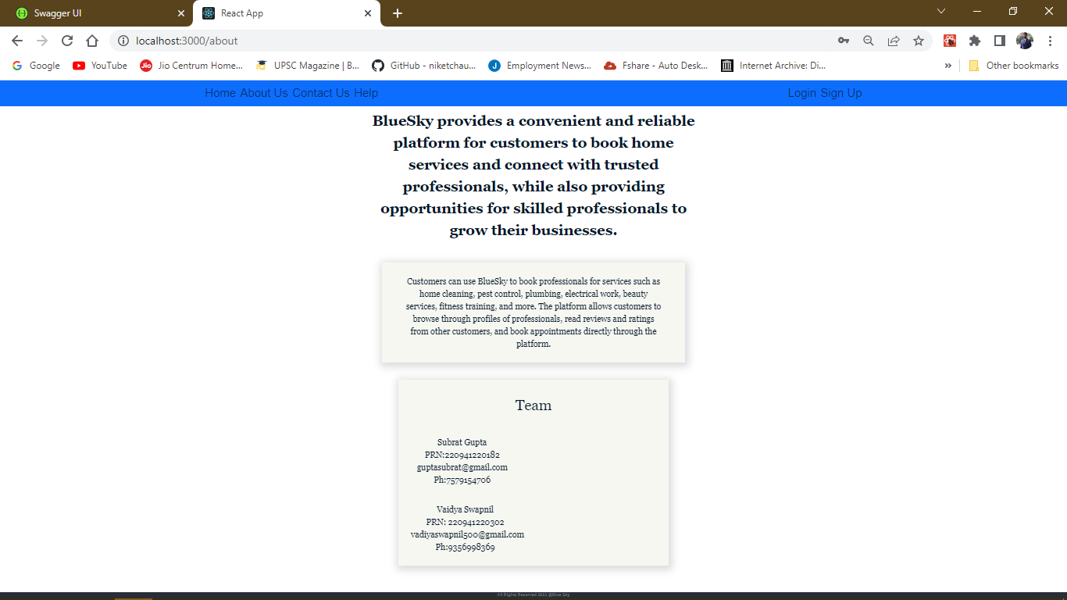

Slide 34
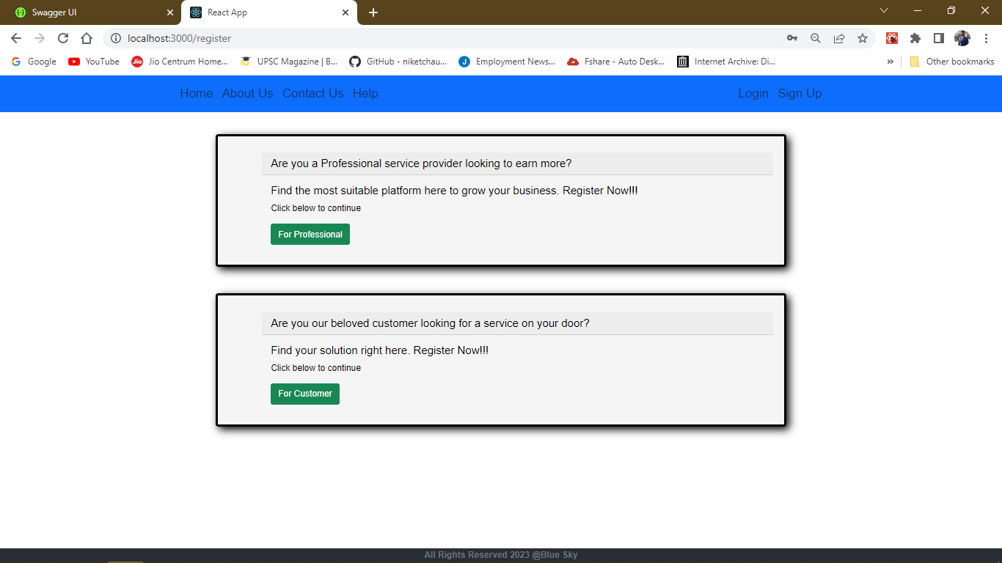

Slide 35
Specifications:
The application will use HTML ,CSS ,BootStrap
JavaScript , React as main web technologies.
These are the main and popular front end
technologies for making our project attractive
for look and feel
HTTP and FTP protocols are used as
communication medium. The client can access it
via HTTP protocol which is stateless
Several types of validations make this web
application a secured one and SQL Injections can
also be prevented.

Slide 36
Software and Hardware Requirements
Server Side:
Processor: Intel® Xeon® processor 3500 series
HDD: Minimum 500GB Disk Space
RAM: Minimum 4GB OS: Windows 10, Linux 6
Database: MySQL
Client Side (minimum requirement):
Processor: Intel Dual Core
HDD: Minimum 80GB Disk Space
RAM: Minimum 2GB OS: Windows 7, Linux

Slide 37
Advantages:
Managing online services
Managing all bookings.
Managing all the customers
Managing all the service providers.
Paper work is reduced due to record stored in online manner

Slide 38
Conclusion:
In conclusion, the online services for mechanics, plumbing, and electricians have revolutionized the traditional way of availing services. With the increasing use of smartphones and the internet, customers are finding it easier to book services online rather than physically visiting the service provider. The online services have not only made it more convenient for customers but have also opened up new opportunities for service providers to expand their business.
The advantages of online services include easy booking, quick response, and availability of a variety of service providers to choose from. Moreover, the online service providers offer competitive pricing, transparency in pricing, and quality assurance, which ensures customer satisfaction. The service providers also benefit from increased visibility, enhanced reputation, and efficient management of resources.
However, there are some challenges associated with online services such as managing customer expectations, ensuring timely service, and dealing with customer complaints. The service providers need to have a robust system in place to address these challenges and provide an excellent customer experience.
Overall, the online services for mechanics, plumbing, and electricians have disrupted the traditional service industry and have provided a new and convenient way for customers to avail themselves of services. As technology continues to evolve, we can expect more innovative solutions to emerge in the future.

Slide 39
Future enhancements:
The future scope for online services like mechanic, plumbing, and electrician is vast, and there are several opportunities to explore. Here are some of the potential areas for growth:
Expansion to new geographical areas: Online service providers can expand their services to new geographical areas and tap into new markets. This can be achieved by partnering with local service providers or hiring new professionals.
Integration with smart home devices: With the increasing adoption of smart home devices, online service providers can integrate their services with these devices. This will enable customers to book services automatically when a device detects a problem.
Offering new services: Online service providers can expand their offerings and include new services that complement their existing services. For example, a plumbing service provider can offer water quality testing services.
Building partnerships with other online service providers: Online service providers can build partnerships with other service providers such as car wash or house cleaning services, which will create cross-selling opportunities.
Overall, the online service industry for mechanics, plumbing, and electricians is still in its infancy, and there are ample opportunities to innovate and grow. Service providers who can adapt to the changing market dynamics and provide excellent customer experiences will stand to benefit in the long run.

Slide 40
References
https://www.w3schools.com/html/
https://stackoverflow.com/questions/tagged/reactjs
https://stackoverflow.com/questions/tagged/mysql
https://stackoverflow.com/questions/tagged/spring-boot

