Slide 1
HIVE HEALTH CARE ANALYTICS

Slide 2
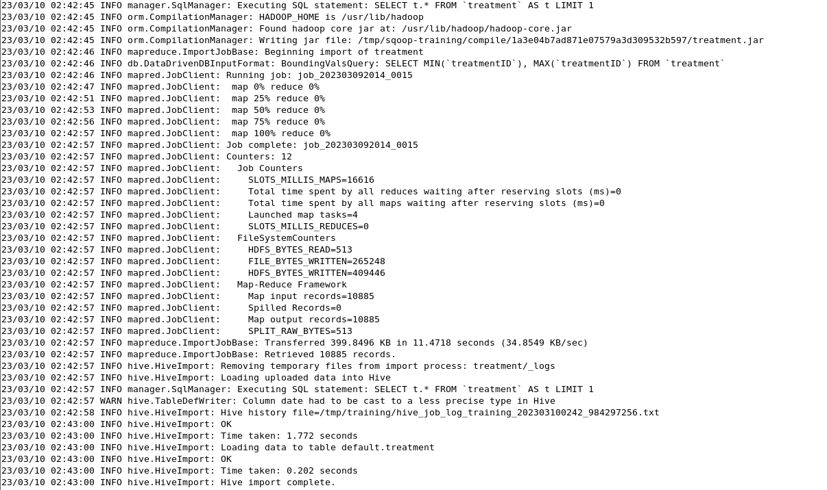
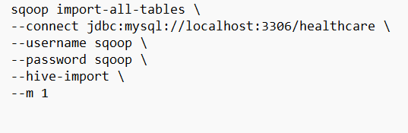
Data Ingestion Workflow
Creating Dump of Local SQL Server DB
Imported the data into Cloudera MySQL Sever using the dumped DB
Ingested the SQL DB’s tables into Hive Server using Sqoop

Slide 3
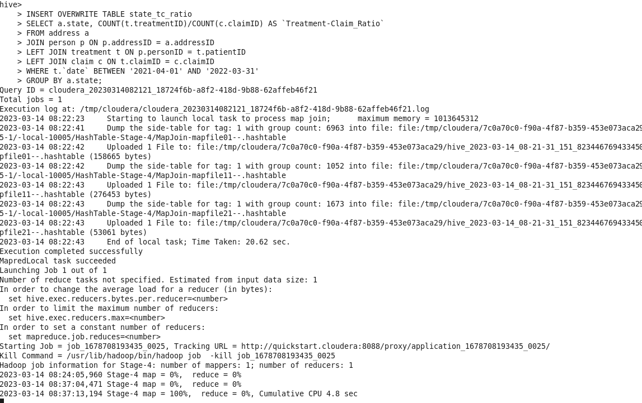
Problem Statement 1: An Insurance company wants a state wise report of the treatments to claim ratio between 1st April 2021 and 31st March 2022 (days both included).
Creating External Table
Insert Data Into External Table In Hive
CREATE EXTERNAL TABLE state_tc_ratio(
state STRING ,
ratio FLOAT
)
ROW FORMAT DELIMITED
FIELDS TERMINATED BY ','
LOCATION '/user/training/hive/Q1';

Slide 4
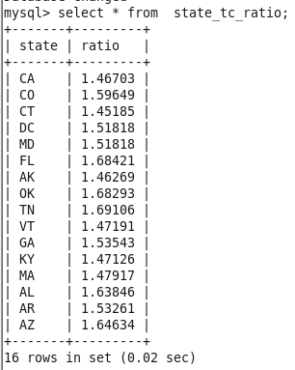
Move Data to Client DB using Sqoop Export
sqoop export \
--connect jdbc:mysql://localhost:3306/analysis \
--username sqoop \
--password sqoop \
--table state_tc_ratio \
--export-dir /user/training/hive/Q1/000000_0 \
--input-fields-terminated-by ',';
Output
Create Output Table in Client DB
CREATE TABLE state_tc_ratio(
state varchar(20) ,
ratio FLOAT
)

Slide 5
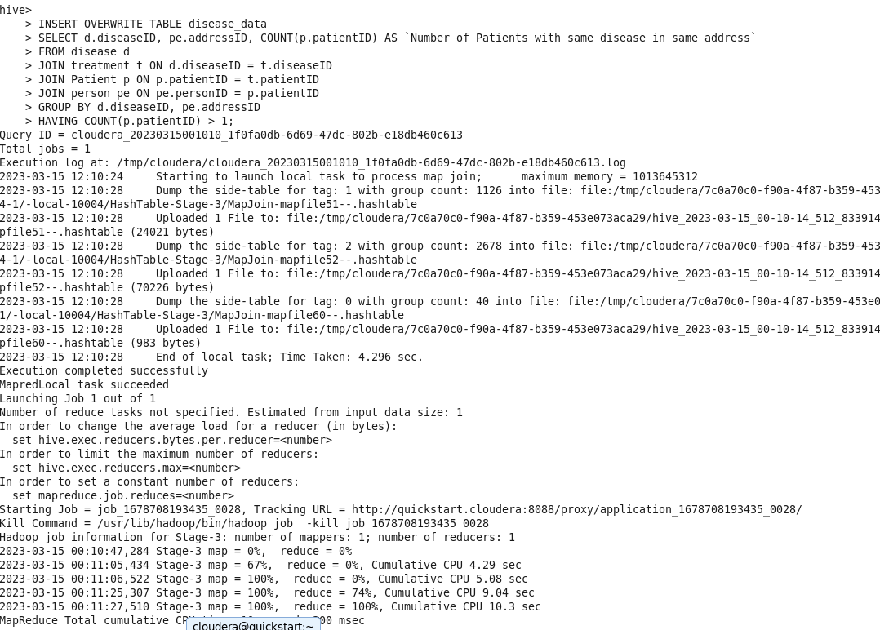
Problem Statement 2: The Healthcare department wants to know which disease is most likely to infect multiple people in the same household. For each disease find the number of households that has more than one patient with the same disease. Note: 2 people are considered to be in the same household if they have the same address.
Creating External Table
Insert Data Into External Table In Hive
CREATE EXTERNAL TABLE disease_data (
diseaseID int,
addressID int,
patientcount int
)
ROW FORMAT DELIMITED
FIELDS TERMINATED BY ','
LOCATION '/user/training/hive/Q2';

Slide 6
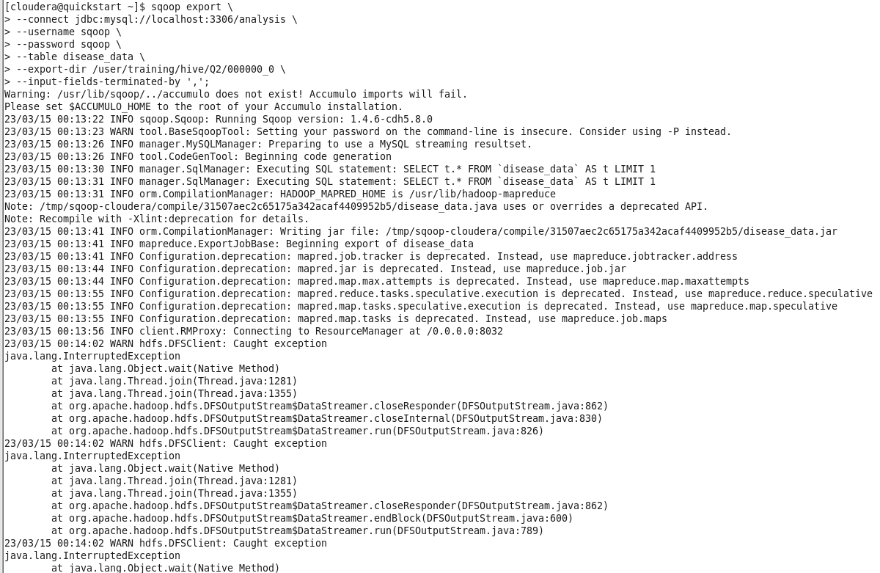
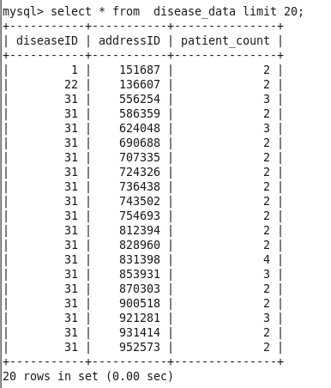
Move Data to Client DB using Sqoop Export
Output
Create Output Table in Client DB
CREATE TABLE disease_data (
diseaseID int,
addressID int,
patient_count int
)

Slide 7
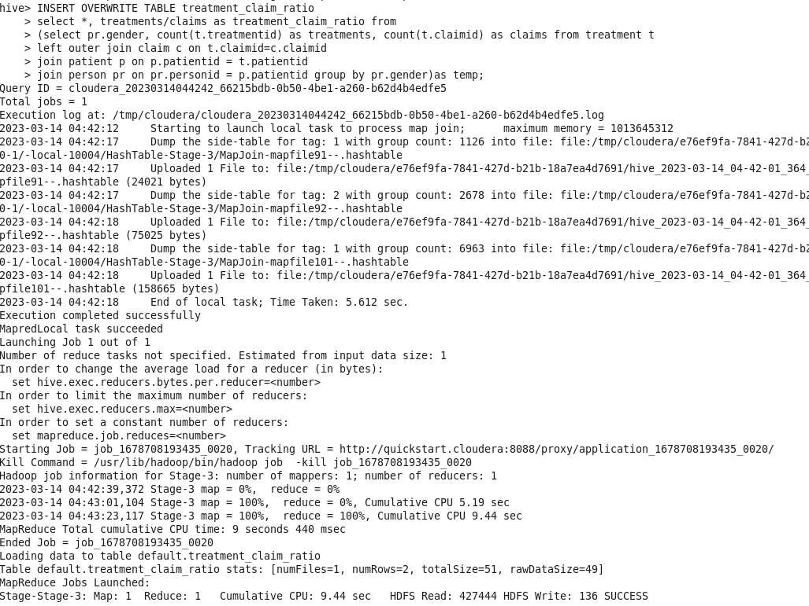
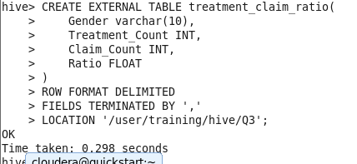
Problem Statement 3: Jacob, from insurance management, has noticed that insurance claims are not made for all the treatments. He also wants to figure out if the gender of the patient has any impact on the insurance claim. Assist Jacob in this situation by generating a report that finds for each gender the number of treatments, number of claims, and treatment-to-claim ratio. And notice if there is a significant difference between the treatment-to-claim ratio of male and female patients.
Insert Data Into External Table In Hive
Creating External Table

Slide 8
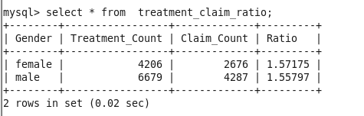
Move Data to Client DB using Sqoop Export
sqoop export \
--connect jdbc:mysql://localhost:3306/analysis \
--username sqoop \
--password sqoop \
--table treatment_claim_ratio \
--export-dir /user/training/hive/Q3/000000_0 \
--input-fields-terminated-by ','
Output
Create Output Table in Client DB
CREATE TABLE treatment_claim_ratio(
Gender varchar(10),
Treatment_Count INT,
Claim_Count INT,
Ratio FLOAT
);

Slide 9
Problem Statement 4: The Healthcare department wants a report about the inventory of pharmacies. Generate a report on their behalf that shows how many units of medicine each pharmacy has in their inventory, the total maximum retail price of those medicines, and the total price of all the medicines after discount. Note: discount field in keep signifies the percentage of discount on the maximum price.
Insert Data Into External Table In Hive
Creating External Table
INSERT OVERWRITE TABLE pharmacy_summary
SELECT
p.pharmacyid,
p.pharmacyname,
SUM(k.quantity) AS `Total_stock`,
SUM(m.maxprice) AS `Total_maxprice`,
ROUND(SUM(m.maxprice*(k.discount/100)),2) AS `Discounted_Price`
FROM
pharmacy p
JOIN keep k ON p.pharmacyid = k.pharmacyid
JOIN medicine m ON m.medicineid = k.medicineid
GROUP BY
p.pharmacyid,
p.pharmacyname;
CREATE EXTERNAL TABLE pharmacy_summary (
pharmacy_id INT,
pharmacy_name STRING,
total_stock INT,
total_maxprice FLOAT,
discounted_price FLOAT
)
ROW FORMAT DELIMITED
FIELDS TERMINATED BY ','
LOCATION '/user/training/hive/Q4';

Slide 10
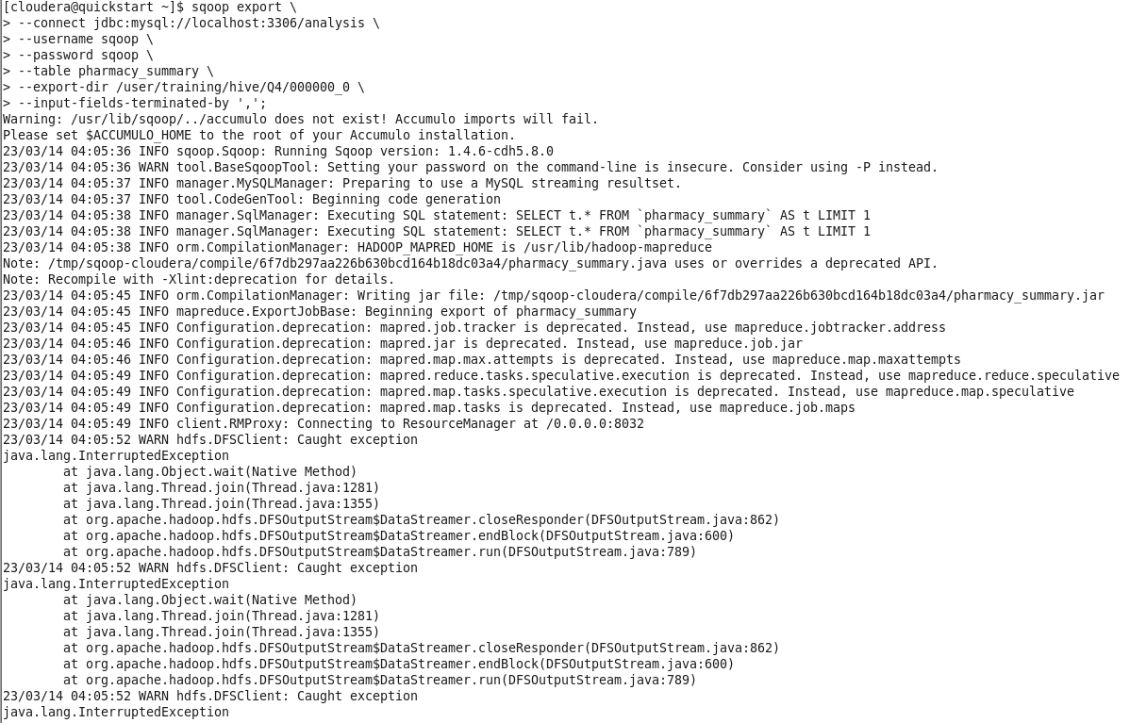
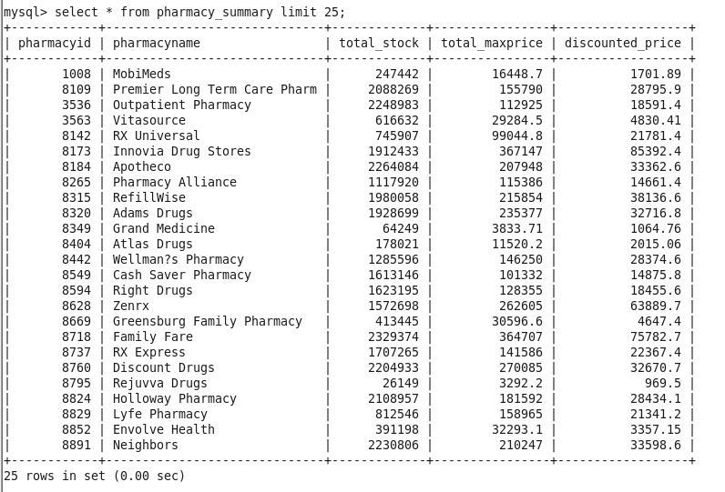
Move Data to Client DB using Sqoop Export
Output
Create Output Table in Client DB
CREATE TABLE pharmacy_summary (
pharmacy_id INT,
pharmacy_name VARCHAR(40),
total_stock INT,
total_maxprice FLOAT,
discounted_price FLOAT
)

Slide 11
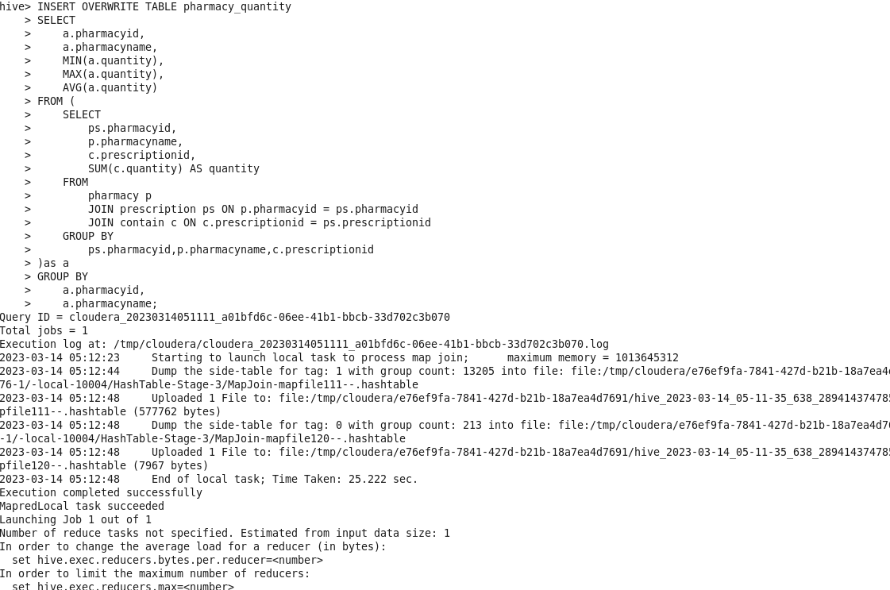
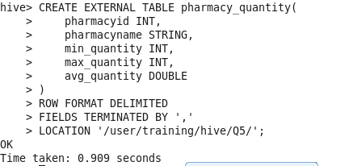
Problem Statement 5: The healthcare department suspects that some pharmacies prescribe more medicines than others in a single prescription, for them, generate a report that finds for each pharmacy the maximum, minimum and average number of medicines prescribed in their prescriptions.
Insert Data Into External Table In Hive
Creating External Table

Slide 12
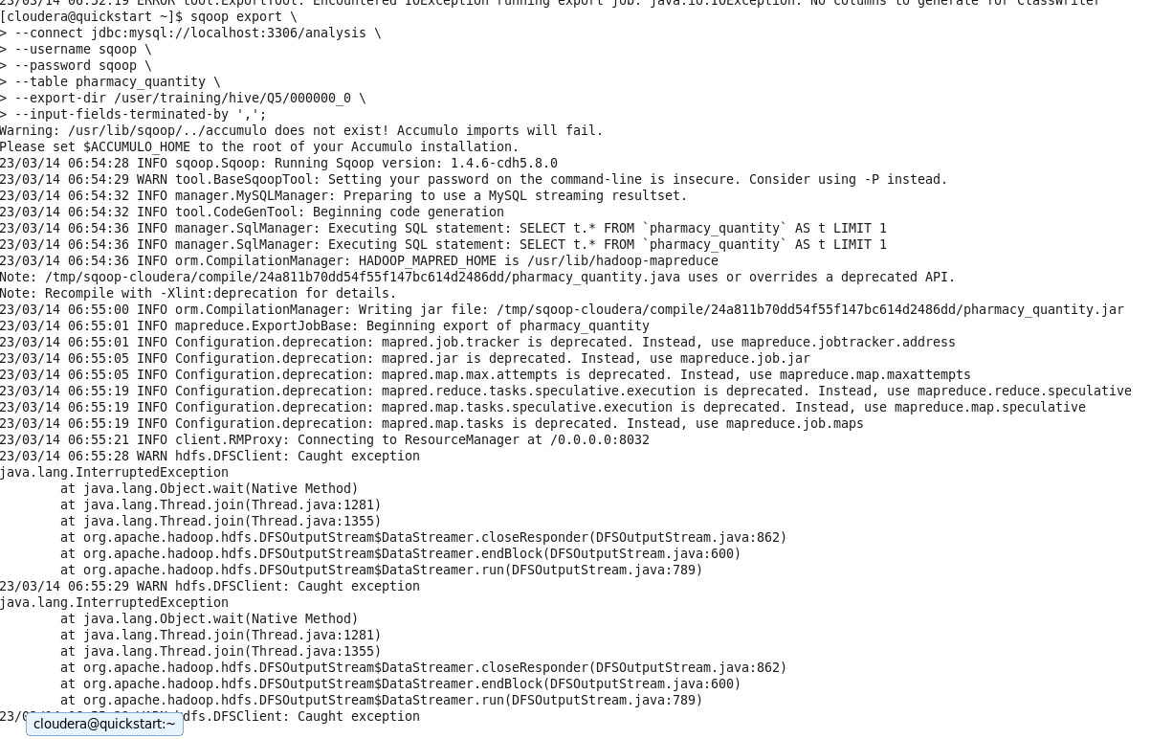
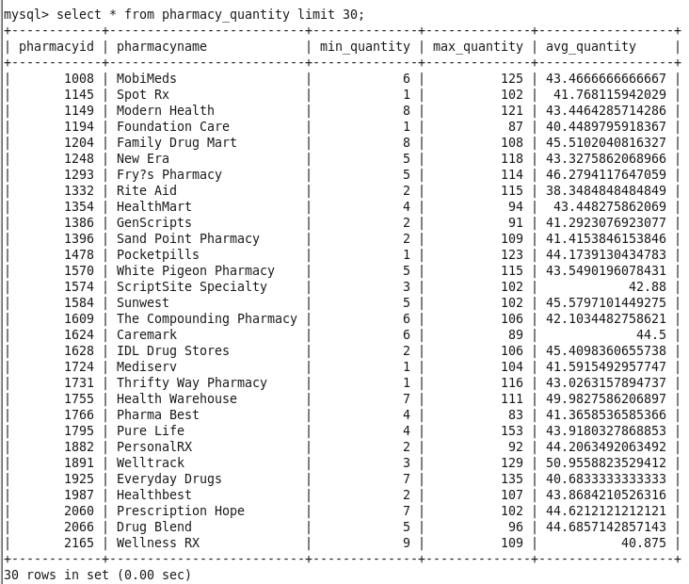
Move Data to Client DB using Sqoop Export
Output
Create Output Table in Client DB
CREATE TABLE pharmacy_quantity (
pharmacyid INT,
pharmacyname varchar(50),
min_quantity INT,
max_quantity INT,
avg_quantity DOUBLE
);

Slide 13
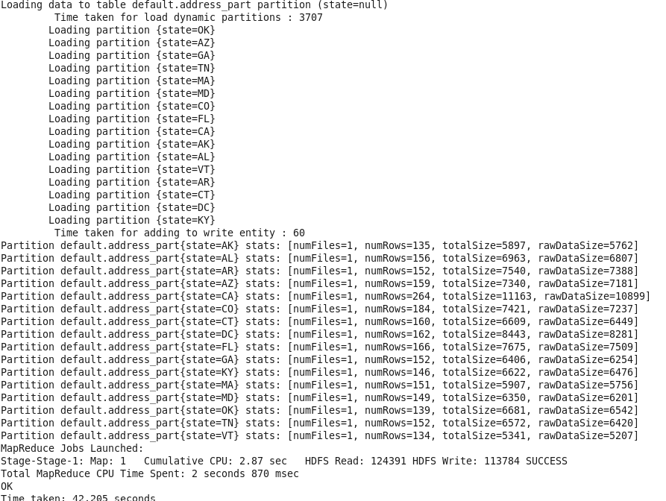
Problem Statement 6 The Healthcare department wants to know which disease is most likely to infect multiple people in the same household. For each disease find the number of households that has more than one patient with the same disease. Note: 2 people are considered to be in the same household if they have the same address.
Creating Partitioned and Clustered Table
CREATE TABLE address_part (
addressid INT,
address1 STRING,
city STRING,
zip INT)
PARTITIONED BY (state STRING) CLUSTERED BY (city) INTO 10 BUCKETS;
INSERT INTO TABLE address_part PARTITION (state) SELECT addressid,address1,city,zip,state FROM address;

Slide 14
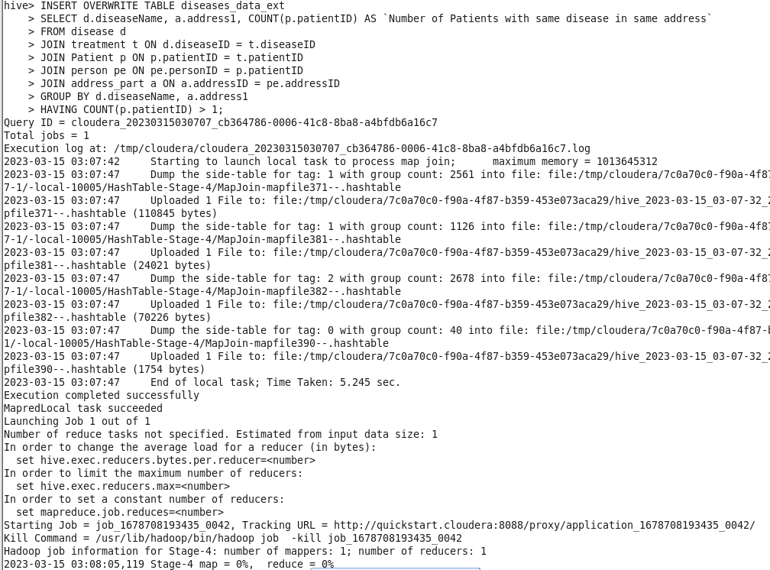
Creating External Table
Insert Data Into External Table In Hive
CREATE EXTERNAL TABLE diseases_data_ext (
disease string,
address string,
patientcount int
)
ROW FORMAT DELIMITED
FIELDS TERMINATED BY ','
LOCATION '/user/training/hive/Q6EXT';

Slide 15
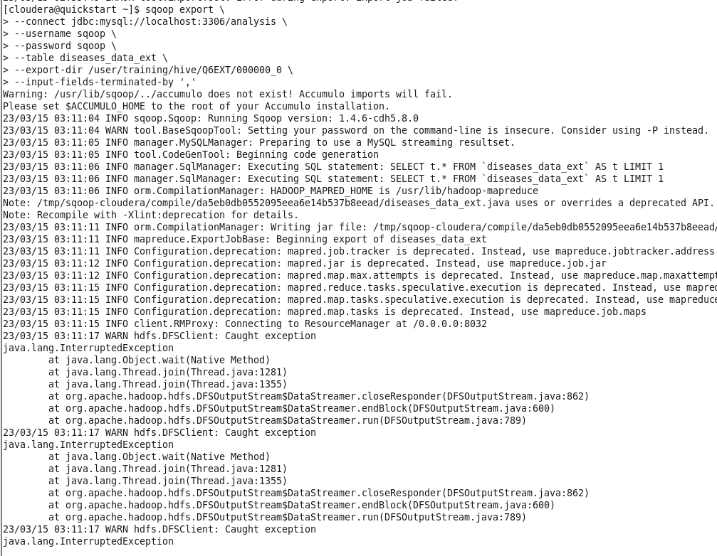
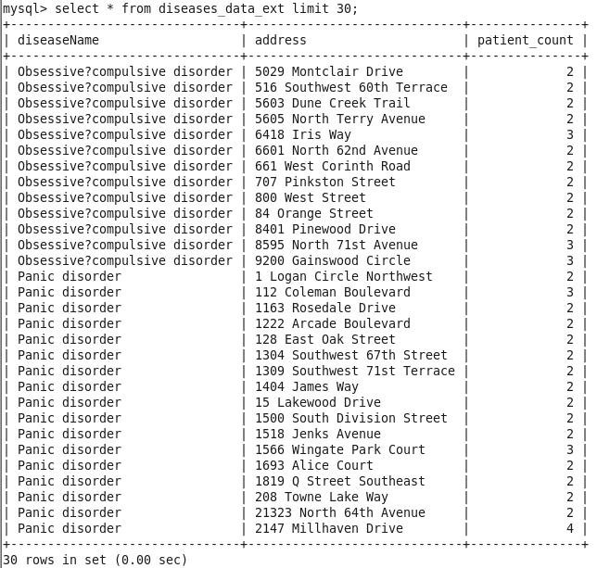
Move Data to Client DB using Sqoop Export
Output
Create Output Table in Client DB
CREATE TABLE diseases_data_ext (
diseaseName varchar(40),
address varchar(40),
patient_count int
)

Slide 16
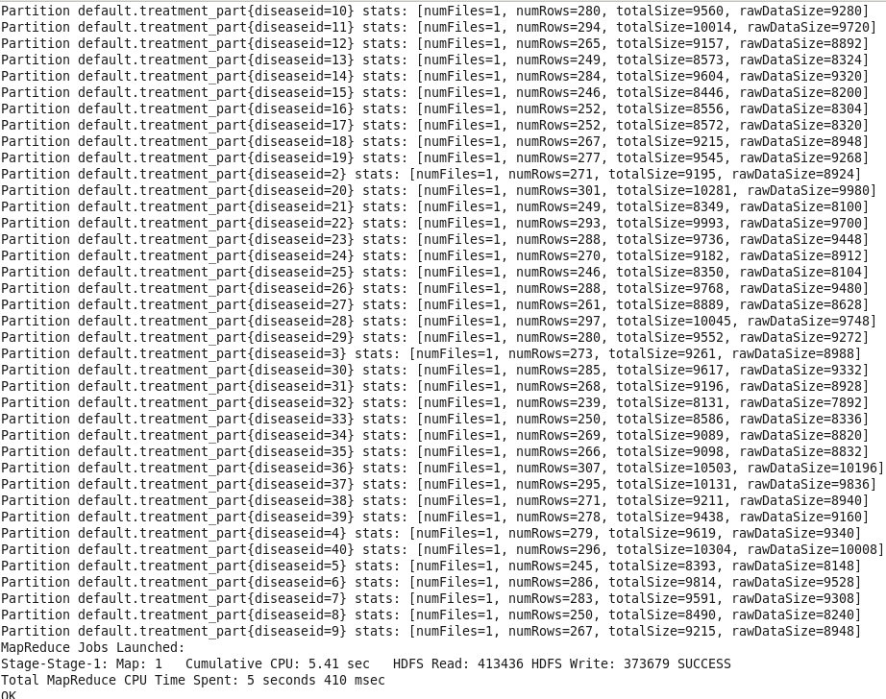
Problem Statement 7: An Insurance company wants a state wise report of the treatments to claim ratio between 1st April 2021 and 31st March 2022 (days both included).
Creating Partitioned Table
CREATE TABLE treatment_part(
treatmentID BIGINT,
patientID BIGINT,
date STRING,
claimID BIGINT
)
PARTITIONED BY (diseaseID STRING)
ROW FORMAT DELIMITED
FIELDS TERMINATED BY ',';
insert overwrite table treatment_part partition(diseaseID)
select treatmentID, patientID, date, claimID, diseaseID from treatment;

Slide 17
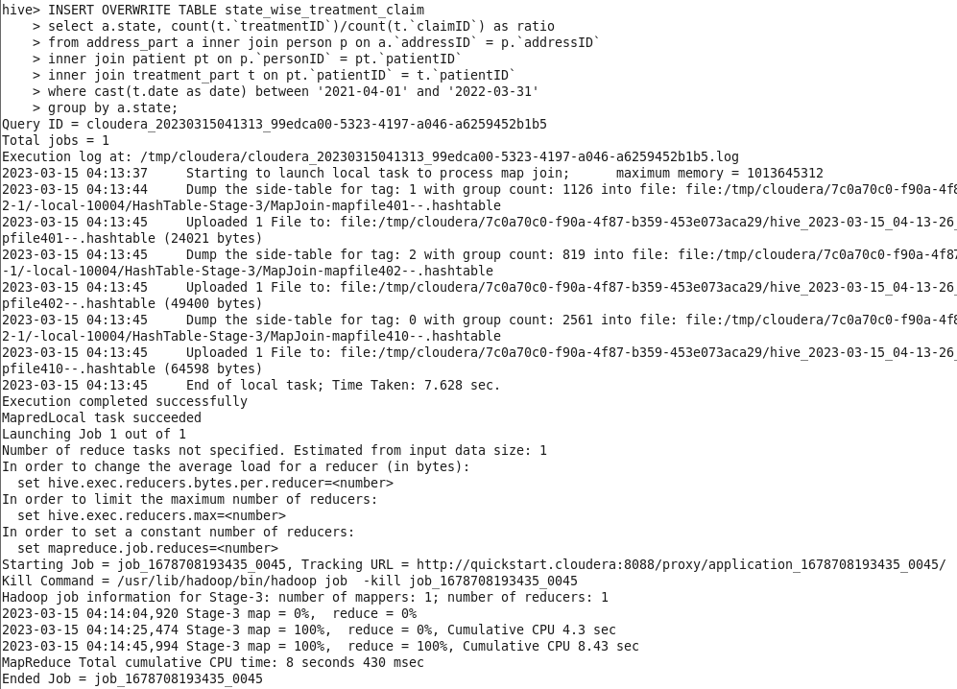
Creating External Table
Insert Data Into External Table In Hive
CREATE EXTERNAL TABLE state_wise_treatment_claim(
state STRING,
treatment_claim_ratio FLOAT
)
ROW FORMAT DELIMITED
FIELDS TERMINATED BY ','
LOCATION '/user/training/hive/Q7';

Slide 18
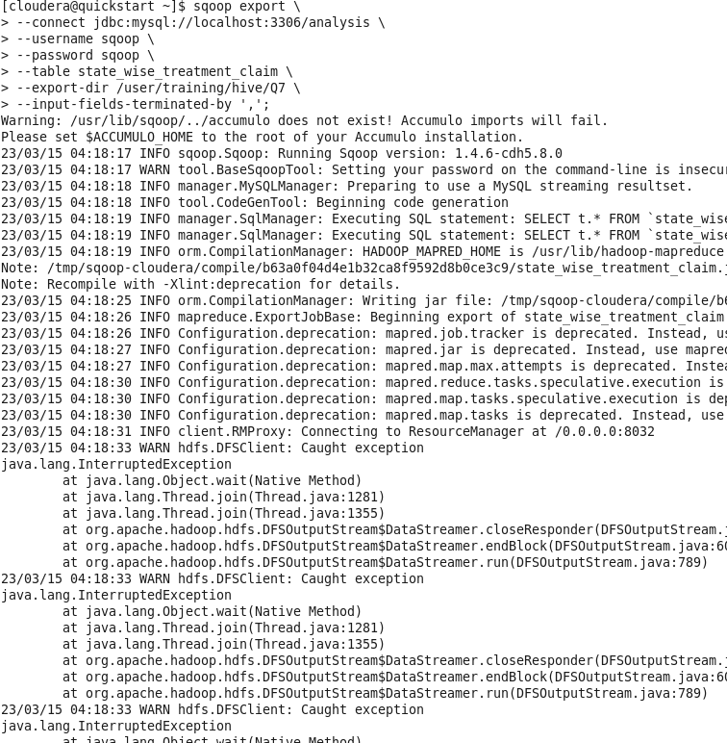
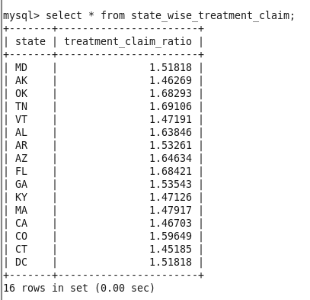
Move Data to Client DB using Sqoop Export
Output
Create Output Table in Client DB
CREATE TABLE state_wise_treatment_claim(
state varchar(20),
treatment_claim_ratio FLOAT
);

