Slide 1
xConnect Module (Contacts , Search, & Chat System)
Submitted by
Alok Sarkar
Roll no. : 10201019009
&
Subrata Halder
Roll no. : 10201019005
Guided by
Dr. Partha Garai

Slide 2
CONTENTS
Introduction
Objectives
Features
Resource Requirements
Data Flow Diagram
Screenshots
Conclusion
Future Scope
References

Slide 3
INTRODUCTION
Traditionally, if any student, teacher or other faculty wanted to contact to others, he/she had to contact through email, mobile or other social media and the process was very much decentralized.
The information related to various skills we learn is not available in Current IMS.
Job description related data is scarce in Current IMS.
Cross departmental connection are only limited by social clubs activities on campus.
To address these any more social connection issues we have tried to develop a system that connects the entire KGEC family, xConnect.

Slide 4
OBJECTIVES
Our design facilitates a common platform, where the faculty and the students can access their individual profiles.
It helps to provide information of job related or other non-academic events.
A student can easily search student that are related to any project, language, company or job position.
Anyone logged on IMS, can communicate and chat with others connected through IMS.
There is one global chat that is visible to all in real time and another personal chat based on connection.

Slide 5
FEATURES
Login through IMS portal.
Cross departmental, Cross Academic ,Skill specific, designation specific etc. various granular search.
Collapsible menu.
Contacts module.
Global Chat room.
My Profile Module.
Personal Chat module.
Favourites module
Noticeboard module

Slide 6
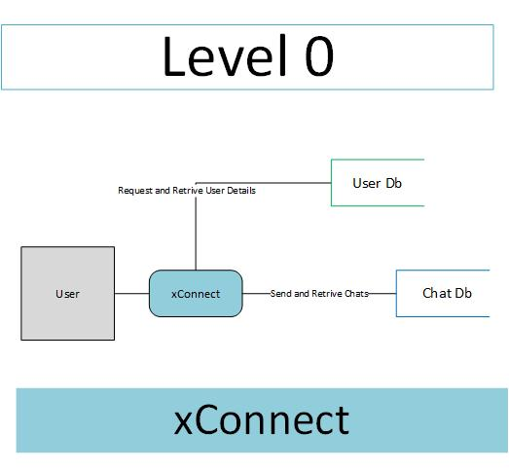
DIAGRAMS
Context Level DFD

Slide 7
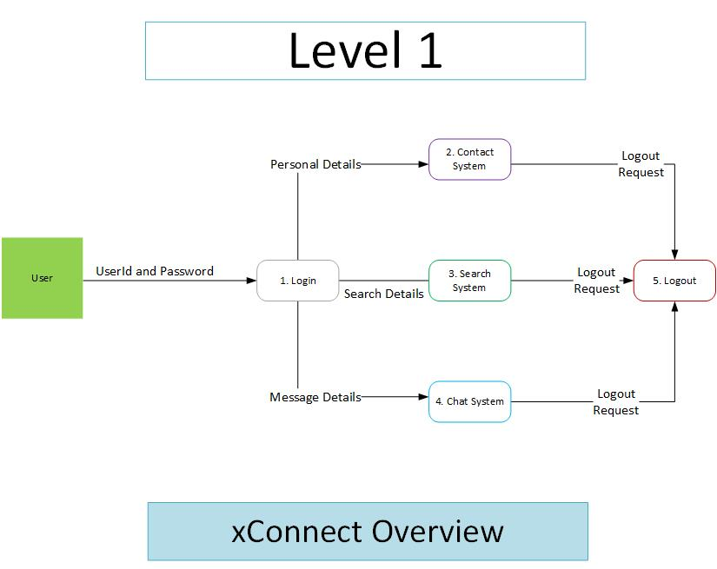
Level 1 DFD

Slide 8
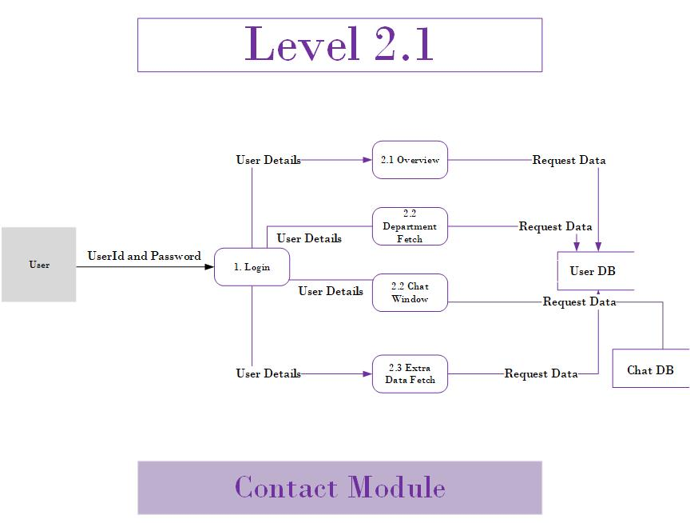
Level 2 DFD

Slide 9
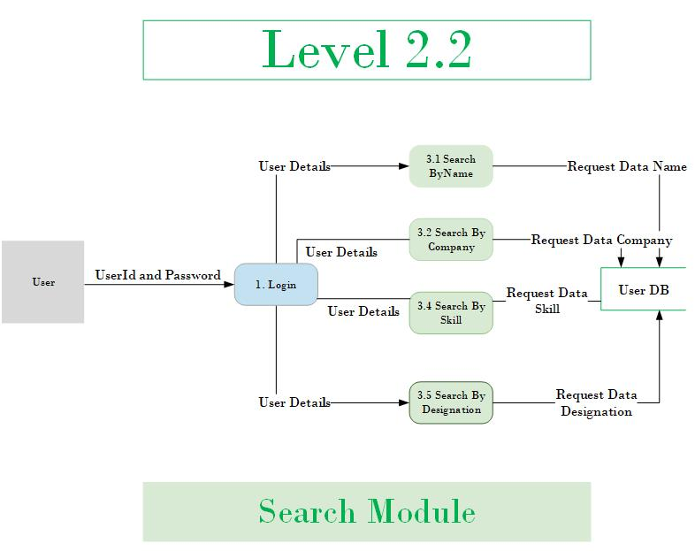
Level 2 DFD

Slide 10
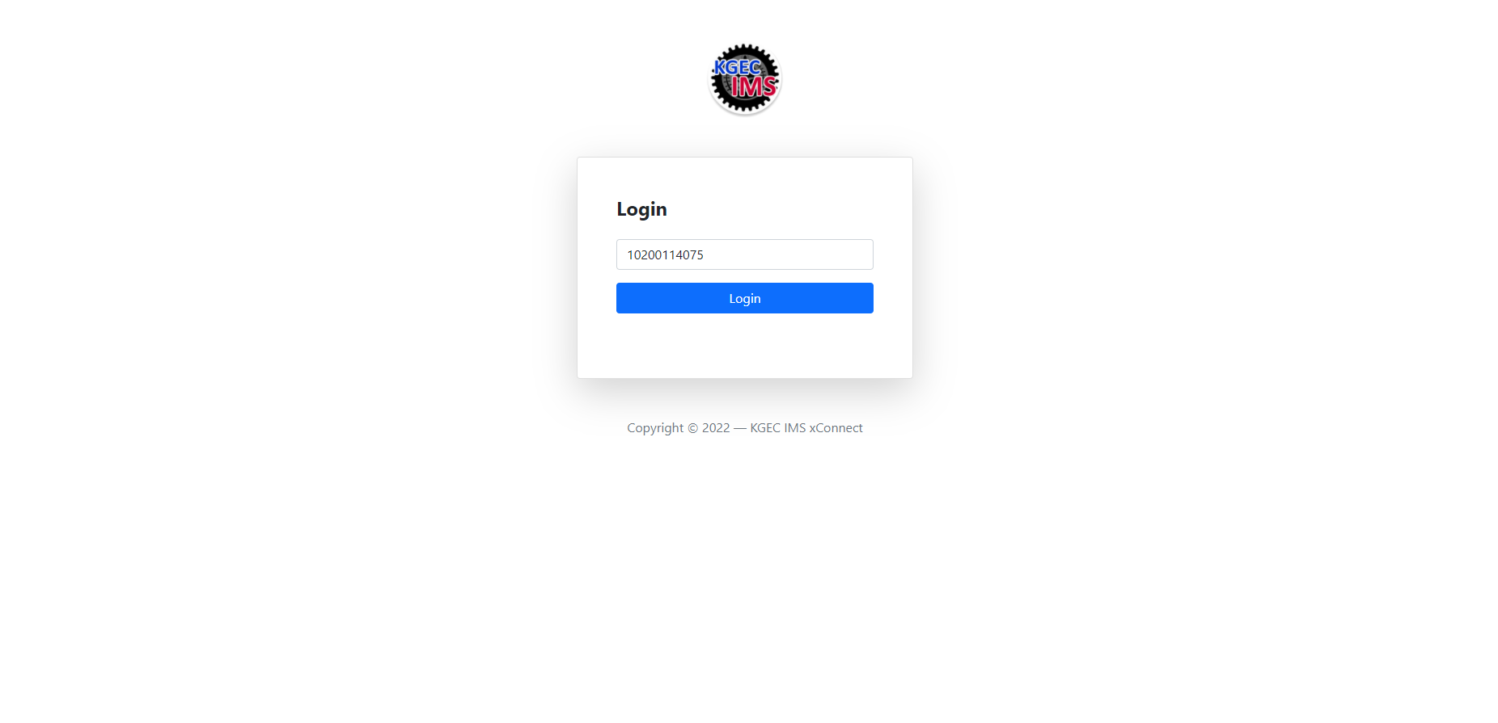
SCREENSHOTS

Slide 11
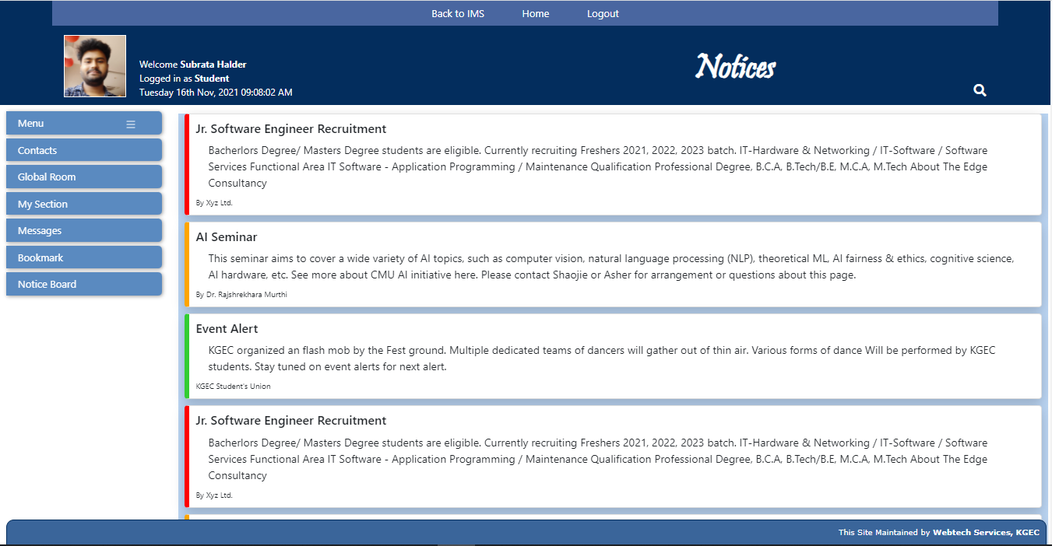
Notice Section

Slide 12
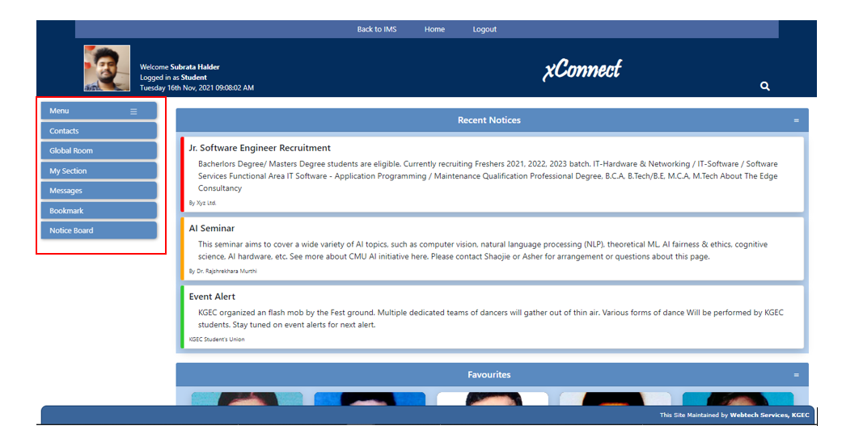
Sidebar (Full Size)

Slide 13
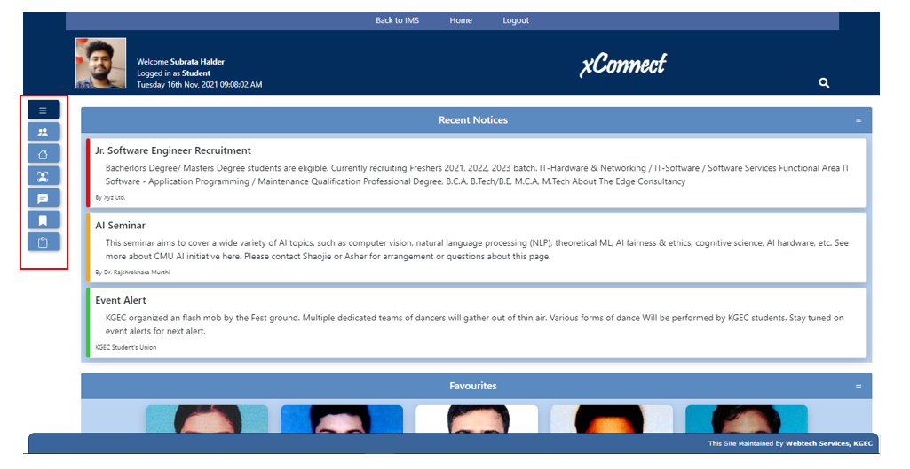
Sidebar (After Collapsed)

Slide 14
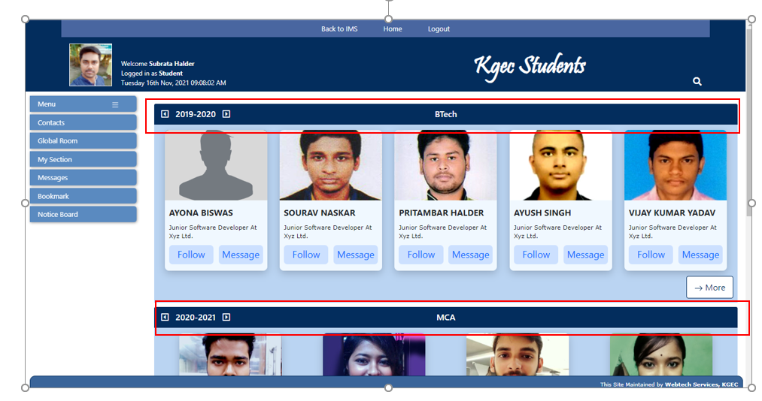
Contact Section

Slide 15
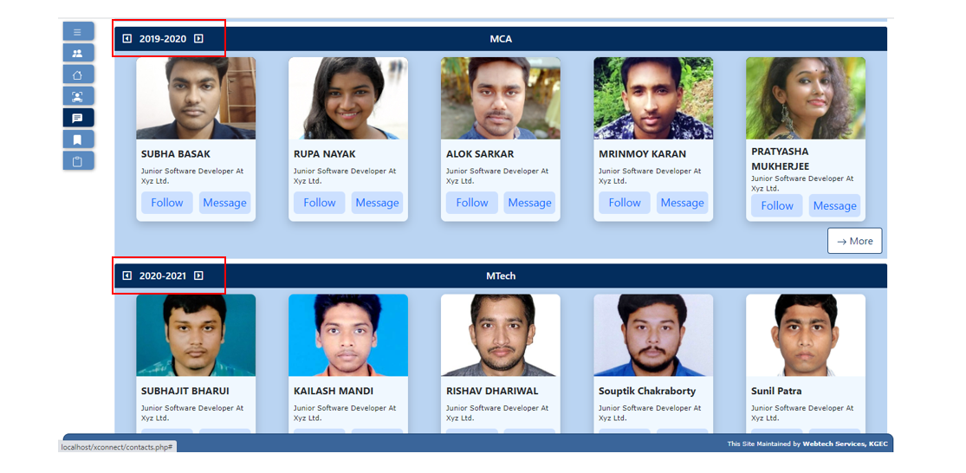
Aacademic Session Changer

Slide 16
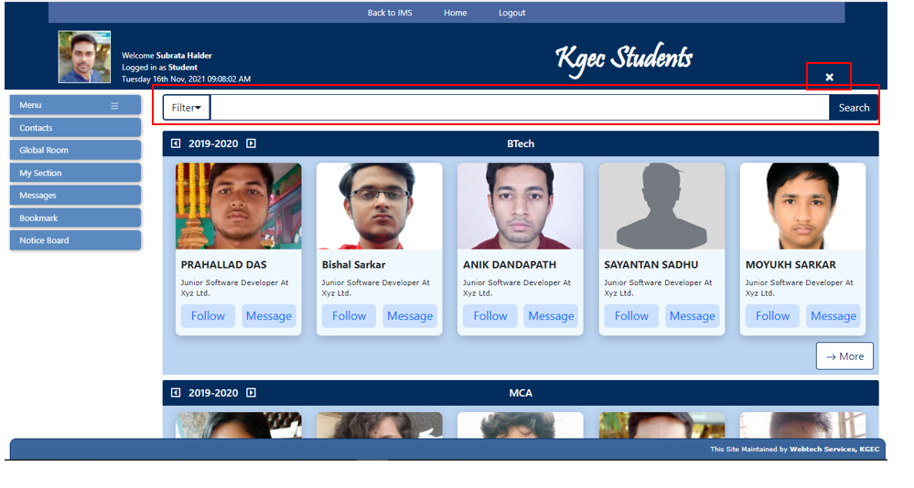
Search Section With Filter

Slide 17
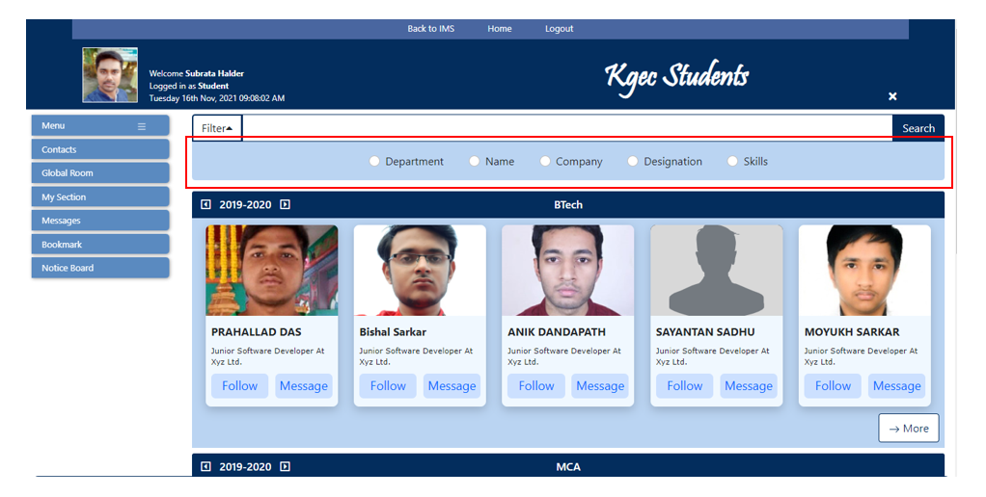
Available Filters

Slide 18
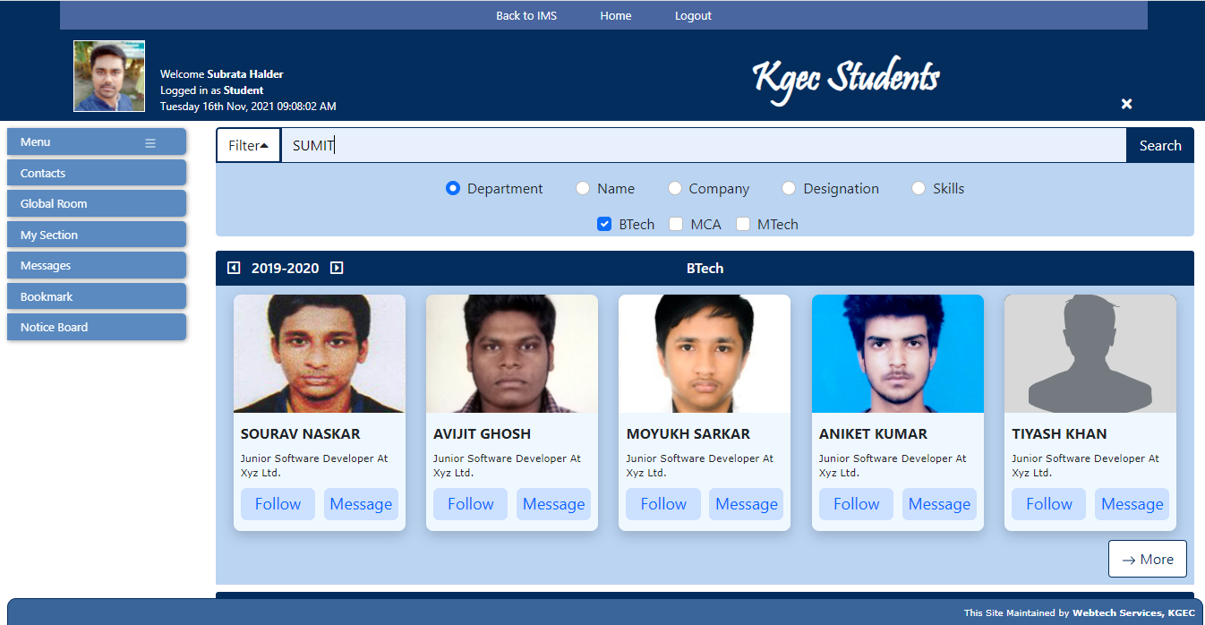
Cross-Department Search

Slide 19
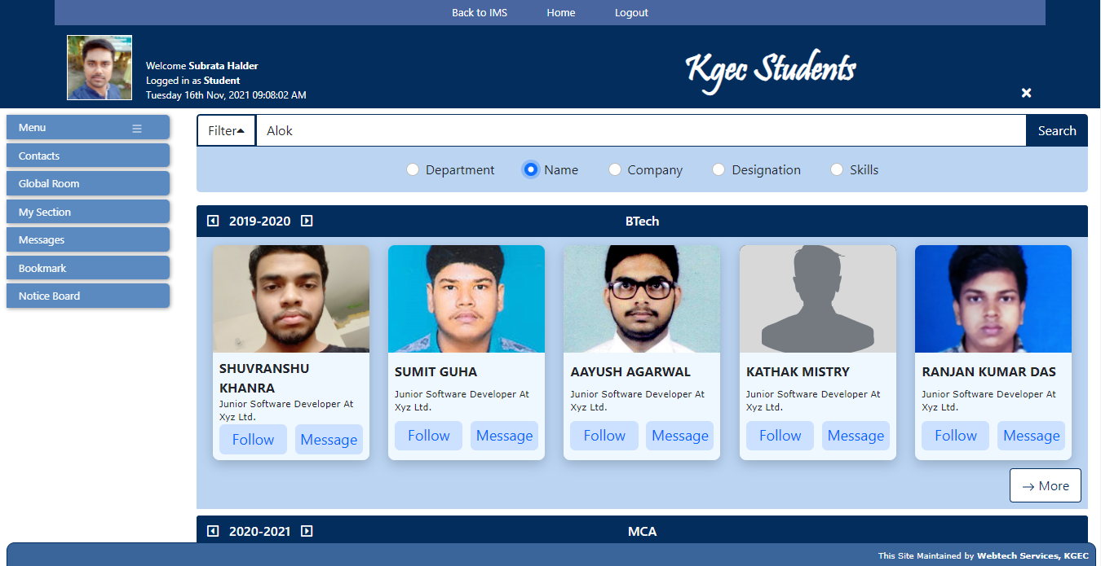
Search By Name

Slide 20
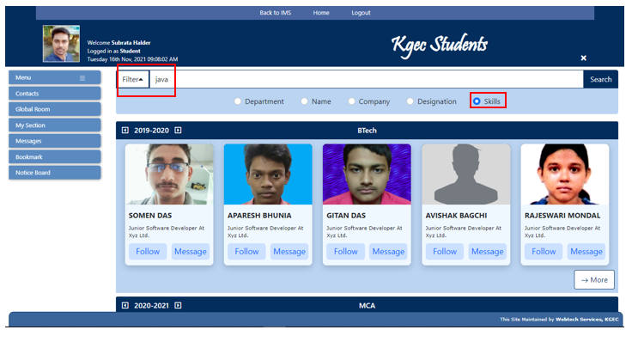
Skill Search

Slide 21
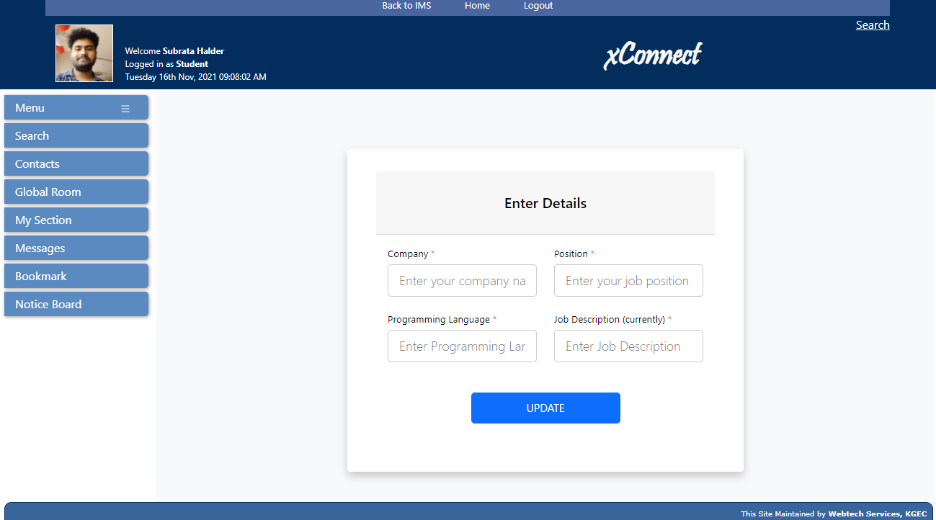
Extra Details

Slide 22
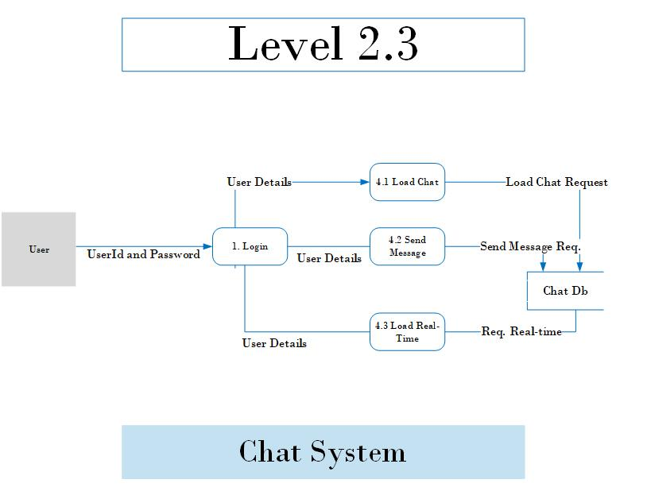

Slide 23
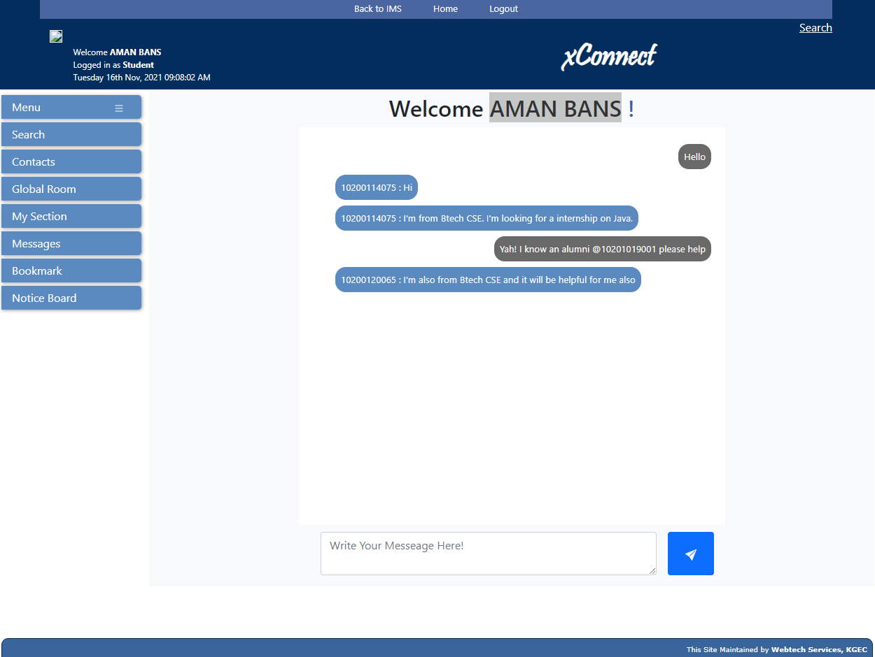
Chat Section (Aman’s Side)

Slide 24
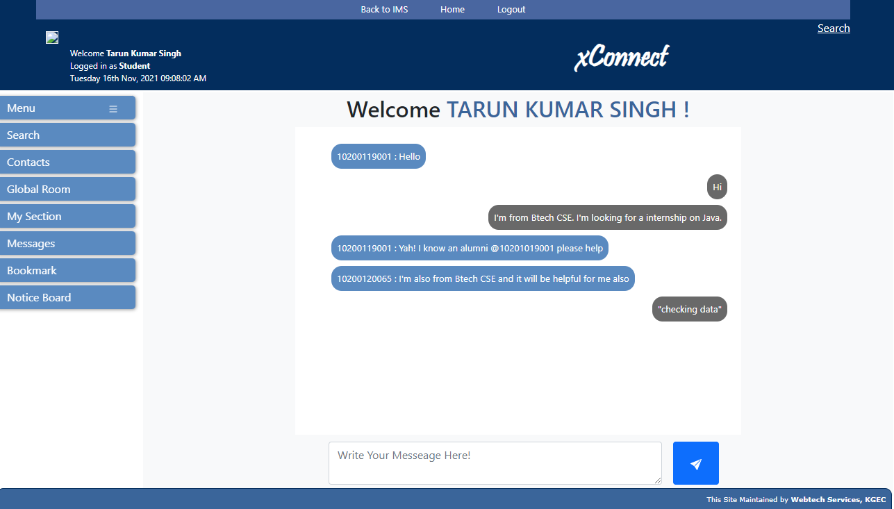
Chat Section (Tarun’s Side)

Slide 25
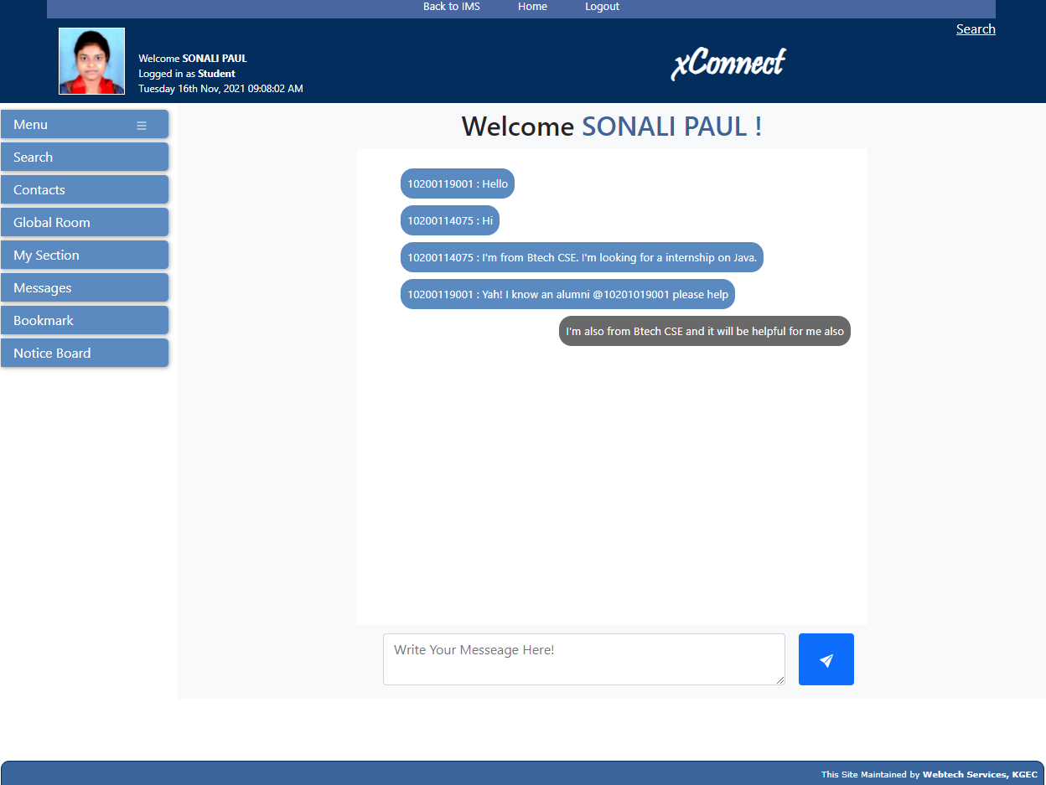
Chat Section (Sonali’s Side)

Slide 26
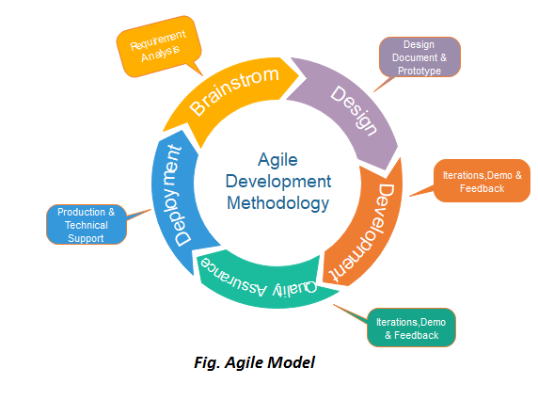
Agile Methodology

Slide 27
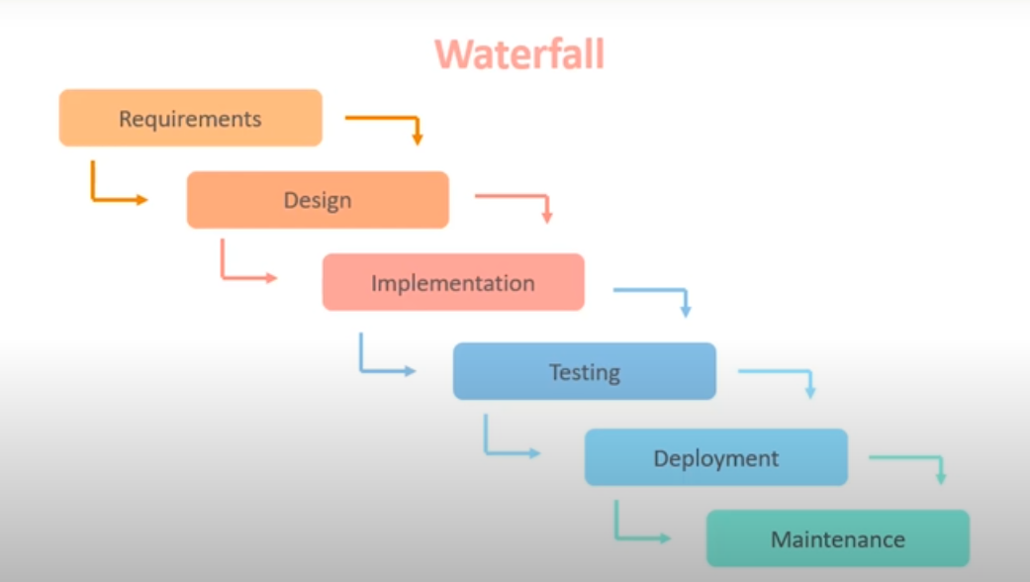
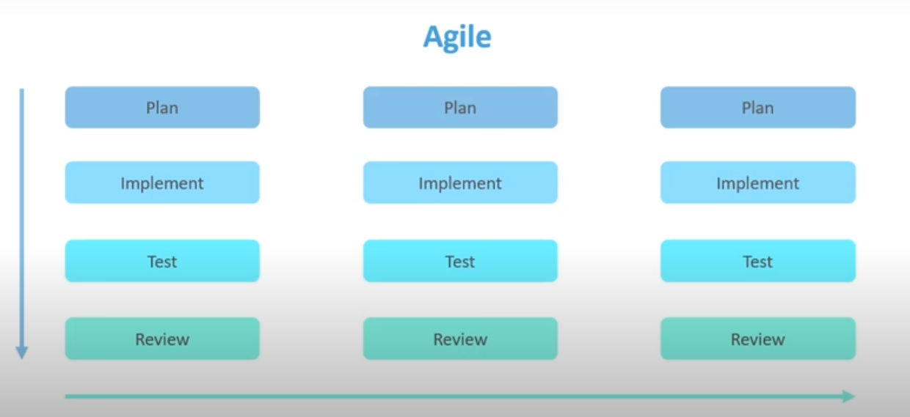
Waterfall VS Agile

Slide 28
Key Agile Concepts
User Stories: Functional increments called “user stories”, is expected to yield a contribution to the value of the overall product.
Incremental Development: Nearly all Agile teams favor an incremental development strategy; in an Agile context, this means that each successive version of the product is usable, and each builds upon the previous version by adding user-visible functionality.
Iterative Development: Agile projects are iterative insofar as they intentionally allow for “repeating” software development activities, and for potentially “revisiting” the same work products.
Daily Meeting: Keeping Consistency in time each team members briefly describes any “completed” contributions and any obstacles that stand in their way.
Milestone Retrospective: Once a project has been underway for some time, or at the end of the project, all of the team’s permanent members (not just the developers) invests from one to three days in a detailed analysis of the project’s significant events.

Slide 29
WHY WE HAVE CHOSEN AGILE METHODOLOGY
1. Superior quality product
2. User satisfaction
3. Better control
4. Improved project predictability
5. Reduced risks
6. Increased flexibility
7. Continuous improvement
8. Improved team morale
9. More relevant metrics

Slide 30
RESOURSE REQUIREMENTS
Hardware requirements:
Server Site:
A 2.40 GHz x64-capable processor.
2 GB of available (free) hard disk space.
2 GB or more RAM.
Developer Site:
A 2 GHz x64-capable processor.
2 GB of available (free) hard disk space.
2 GB or more RAM.
Client Site:
Pentium III 1.5 GHz processor.
512 MB of RAM.
500 MB of free hard disk space.
Software requirements:
Server Site:
Php 5.6.25 or higher.
MySQL Server 5.7.14 or higher.
Operating systems like Ubuntu 18.04, Windows Server 2016.
Developer Site:
Php 5.6.25 or higher.
MySQL Server 5.7.14 or higher.
Text editor like Notepad++.
Operating systems like Windows 10 Pro.
Client Site:
Browsers like Safari, Google, Chrome, Firefox etc.

Slide 31
CONCLUSION
This xConnect project could bring various departments closer than ever before.
Gather data, we can understand student’s interests, trending skills, trending job positions.
We can have our senior’s guidance more easily, on a one-to-one basis or as a whole.
. This could become the first of its kind of centralized chat for academic institutions
This module could also make freshers up to speed with KGEC trends.
Overall has huge potential for the future

Slide 32
FUTURE SCOPE
We could add encryption to the private chats to make them more secure from prying eyes.
large file support in the chat window.
The admin panel can be added for administration of various services.
For keeping the environment more academia friendly we could add students with “moderator” privileges.
We could add data analytics module for understanding the students’ behavior, their field of interests, trending skills, trending job positions, trending topics.

Slide 33
ACKNOWLEDGEMENT
I take this opportunity to express my profound gratitude and deep regards to my faculty Dr. Partha Garai for his exemplary guidance, monitoring and constant encouragement throughout the course of this project. The blessing, help and guidance given by him by time to time shall carry me a long way in the journey of life on which I am about to embark.
I am obliged to my project team members for the valuable information provided by them in their respective fields. I am grateful for their cooperation during the period of my assignment.

Slide 34
REFERENCES
Rajib Mall, Fundamental of Software Engineering, Fourth Edition, PHI Learning, 2015
Roger S. Pressman, Software Engineering: A Practitioner’s approach, Seventh Edition, McGraw Hill Education, 2009
Avi Silberschatz, Henry F. Korth, S. Sudarshan, Database System Concepts, Sixth Edition, McGraw-Hill, 2010
Luke Welling and Laura Thomson, PHP and MySQL Web Development, 5th Edition, Addison-Wesley Professional, 2016
Rasmus Lerdorf, Programming PHP, 1st Edition, O′Reilly, 2002
R. Mullen, HTML 3.2 Programmer’s Reference, 2nd ed. Ventana: California, 1997.
K. Brockschmidt, Programming Windows 8 Apps with HTML, CSS, and JavaScript, Final ed. Microsoft Press: United States, 2012.

Slide 35
THANK
YOU

