Slide 1
Aspect Term Extraction in Product Reviews
Subrata Ghosh

Slide 2
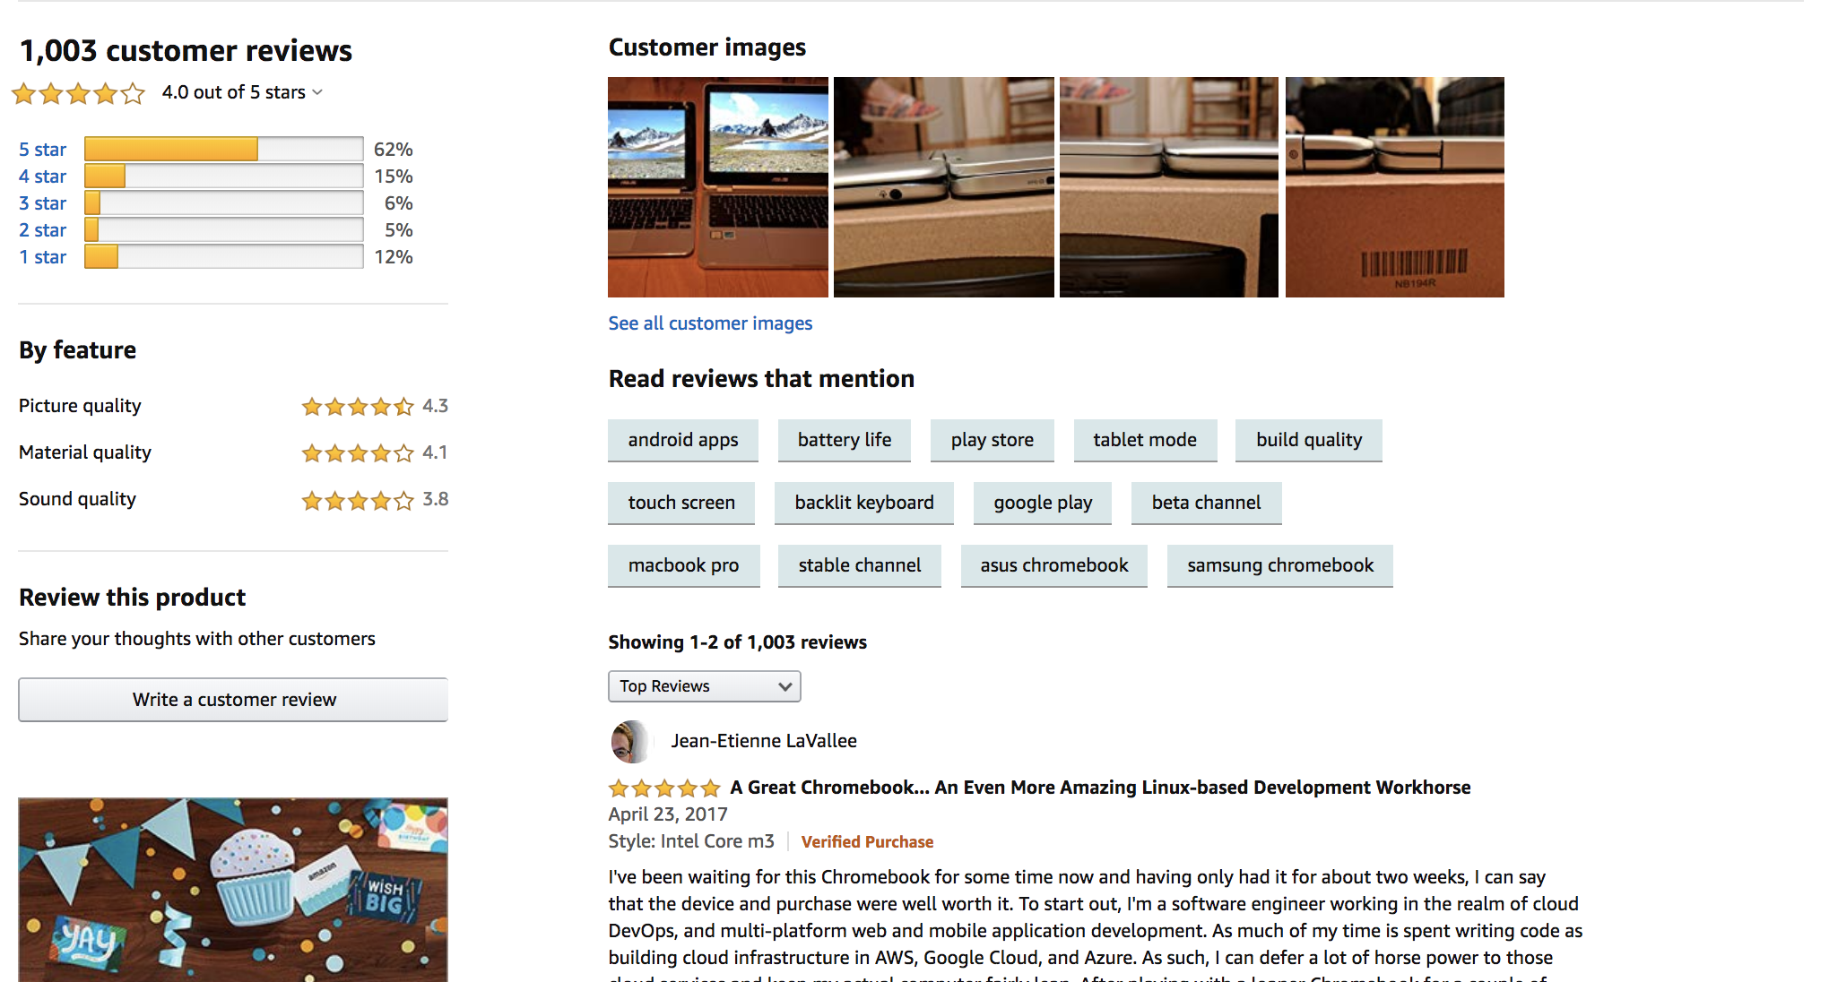
Use case
General use case
Case 1: Finding most important aspects. Aspect based review filtering.
Case 2: Aspect based rating.
Case 3: Combine customer review based on aspect terms.
O use case
Case 1: Based on most important positive impact aspects, new marketing strategy.
Case 2: Product improvement.
2
1
3

Slide 3
Problem Definition
Aspect Term:
Opinionated expressions.
Definition
It is the task of automatically extract aspect term from product review text.
For each word of a review, model should predict if the word is an aspect term or not of the reviewed product.
It is a multiclass classification problem. Multiclass = {O : not an aspect, B : first word of an aspect (Beginning), I : second, third, ... word of an aspect (Inside)}
It is a subtask of aspect-based sentiment analysis.
What need to do?
Given: Product reviews and aspect terms
Need to do: Build an ATE model which should predict the word is a class {O, B, I} of the reviewed product.

Slide 4
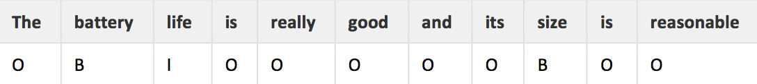
Problem: Example
Consider the product review and aspect terms:
Review text: ​ The battery life is really good and its size is reasonable
Aspect terms: Battery life, size.
BIO format:
ATE is to assign to each word one of the three possible classes:
O = not an aspect (Outside)
B = first word of an aspect
I = second, third, ... word of an aspect (Inside)

Slide 5
Applications
Find popular, positive, negative aspects of a particular product.
Improve customer experiences.
Contribute marketing strategy and product improvement.
Can complement information retrieval, text summarization etc.

Slide 6
Challenges
Challenge 1: AT is opinionated expression. See example 1.
Challenge 2: Domain product aspect terms. See example 2.
Challenge 3: Aspect term can be composed of more than one token. See example 3
Consider the Laptop reviews:
Examples:
I expected so as it's an Apple product.
I like Firefox.
The battery life is really good and its size is reasonable.

Slide 7
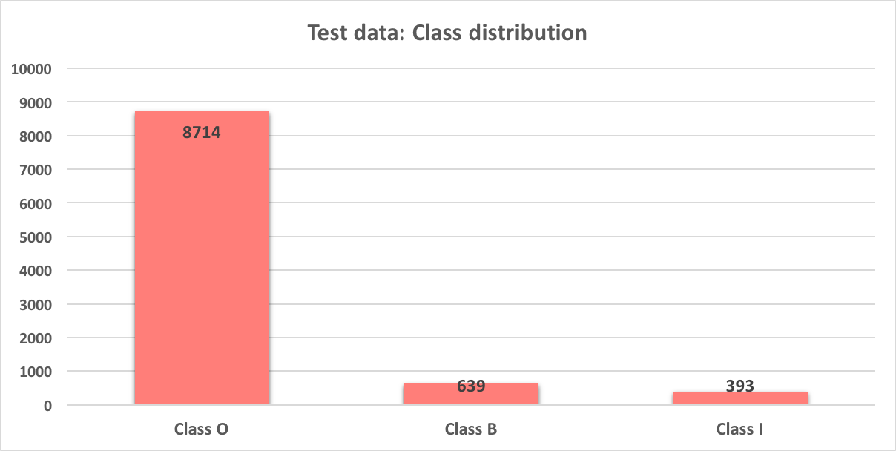
Data: Statistics
Data type | Number of review | #aspect (single word) | #aspect (multi word)
Training | 3045 | 365 | 590
Test | 800 | 167 | 226

Slide 8
Logic 1: Unsupervised approach
First, I try to solve this problem completely unsupervised way. So I did not use training data for this model.
Extract aspect terms using syntactic dependencies of words in a sentence.

Slide 9
Workflow with example
Review text: ​ The battery life is really good and its size is reasonable
Aspect - opinion pair: ​ [(battery, good), (size , reasonable), (battery, life )]
Aspect terms : ​ [battery life, size]
Convert to BIO format: ​[(The, O), (battery, B), (life, I), (is, O), (really, O), (good, O), (and, O), (its, O), (size, B), (is, O), (reasonable, O)]

Slide 10
Logical workflow
Product review text
(Test data)
Syntactic dependencies analyzer
Aspect term extractor
Convert BIO format

Slide 11
Algorithm: Syntactic rules
Stanford Parser: In build syntactic rules tool.
Stanford Parser notation:
(('good', 'JJ'), 'nsubj', ('life', 'NN'))
(('reasonable', 'JJ'), 'nsubj', ('size', 'NN'))
(('life', 'NN'), 'compound', ('battery', 'NN'))
Using the above notations we an create aspect-opinion pair.
This type of several syntactic rules we use to create aspect-opinion pair.
Nominal subject: The aspect is the subject of the opinion.
Noun compound modifier: Noun that serves to modify the head noun.
Adjectival modifier: The opinion is an adjectival modifier of the aspect.
Direct object: The target is the direct object of the opinion.

Slide 12
Algorithm: Aspect terms extractor
Consider the product review and aspect terms:
Review text: ​ The battery life is really good and its size is reasonable
Final aspect terms: {battery life, size}
In the above text “good” and “reasonable” is opinion word and “battery life” and “size” is aspects.
Stanford Parser notation | Extracted aspect
(('good', 'JJ'), 'nsubj', ('life', 'NN')) | life
(('reasonable', 'JJ'), 'nsubj', ('size', 'NN')) | size
(('life', 'NN'), 'compound', ('battery', 'NN')) | battery life

Slide 13
Evaluation
This is a class imbalance problem, as you can see in the data set almost 90% of word belongs to class O.
Class I: recall is very low, that mean this model only 19% correctly find out. Also, precision not good.
Class B: recall is not bad but precision is too low, that means wrong classification is high
Class O: Just because of class imbalance results looks good but actually it is not.
Logic | Class | Precision | Recall | F1-score
Logic-1 | O | 0.94 | 0.89 | 0.91
Logic-1 | B | 0.23 | 0.43 | 0.30
Logic-1 | I | 0.34 | 0.19 | 0.25

Slide 14
Logic 1: Pro and Cons
Pro:
Totally unsupervised, no need any training data.
Cons:
Not consider domain product aspect(challenge 2).
Class I: recall is too low.

Slide 15
Logic 2: Supervised approach
Second, I try to solve this problem completely supervised way. So I try use training data for this model.
It is string search based approach.

Slide 16
Logical workflow
Product review aspect terms (Training data)
Product review text
(Test data)
Domain product aspect database
Search and aspect extract
Convert BIO format

Slide 17
Algorithms
Domain product aspect database(DPAD) creation: In training data already given aspect terms. I use all those aspects to find aspect in test data.
Consider below review and DPAD:
DPAD: [“battery life” ,“size”,……………..]
Review text: ​ The battery life is really good and its size is reasonable
After search aspect terms = [battery life, size]
Aspect search in test data:
Just take each aspect term from DPAD and search it in the test review, if that aspect present in the review take it as a aspect term of that review.

Slide 18
Evaluation
Class I: recall is very low, that mean this model only 14% correctly find out. But, precision is too good.
Class B: recall is good and precision aslo better then logic-2
Logic | Class | Precision | Recall | F1-score
Logic-1 | O | 0.94 | 0.89 | 0.91
Logic-1 | B | 0.23 | 0.43 | 0.30
Logic-1 | I | 0.34 | 0.19 | 0.25
Logic-2 | O | 0.96 | 0.95 | 0.96
Logic-2 | B | 0.45 | 0.74 | 0.56
Logic-2 | I | 0.95 | 0.14 | 0.24

Slide 19
Logic 2: Pro and Cons
Pro:
Results is good compere to other logic.
Based on domain product aspect.
Cons:
Completely wrong approach, because it not fulfill aspect term definition itself.
Failed to solve challenge-1.
Class I: recall is very very low.

Slide 20
Logic 3: Combination of Logic-1 and Logic-2
Observation:
Logic-1: It is not use domain product aspect and results is not good.
Logic-2: Not fulfill AT definition so it is wrong approach although it gives good results. But Class –I, recall is very low.
Goal:
Remove all the cons of those two logics and get good results.
Idea:
Combine both the logic.

Slide 21
Logical workflow
Product review text
(Test data)
Syntactic dependencies analyzer
Product review aspect terms (Training data)
Aspect extract
Domain product aspect database
Link with domain product aspects
Aspect combiner
Aspect pruning
Convert BIO format

Slide 22
Algorithm: Syntactic rules
Stanford Parser: In build syntactic rules tool.
Stanford Parser notation:
(('good', 'JJ'), 'nsubj', ('life', 'NN'))
(('reasonable', 'JJ'), 'nsubj', ('size', 'NN'))
(('life', 'NN'), 'compound', ('battery', 'NN'))
Using the above notations we an create aspect-opinion pair.
This type of several syntactic rules we use to create aspect-opinion pair.
Nominal subject: The aspect is the subject of the opinion.
Noun compound modifier: Noun that serves to modify the head noun.
Adjectival modifier: The opinion is an adjectival modifier of the aspect.
Direct object: The target is the direct object of the opinion.

Slide 23
Algorithm: Aspect terms extractor
Consider the product review and aspect terms:
Review text: ​ The battery life is really good and its size is reasonable
Final aspect terms: {battery life, size}
In the above text “good” and “reasonable” is opinion word and “battery life” and “size” is aspects.
Stanford Parser notation | Extracted aspect
(('good', 'JJ'), 'nsubj', ('life', 'NN')) | life
(('reasonable', 'JJ'), 'nsubj', ('size', 'NN')) | size
(('life', 'NN'), 'compound', ('battery', 'NN')) | battery life

Slide 24
Algorithm: Link with domain aspect
All aspects got from aspect extractor just filter it.
Take only those aspects, also present in domain product aspects database.

Slide 25
Algorithm: Aspect combiner
Aspect term can be composed of more than one token so how I deal with?
Syntactic dependency rule :
(('life', 'NN'), 'compound', ('battery', 'NN')) battery life
Sentence POS tag sequence:
Noun followed by Noun:
[('The', 'DT'), ('battery', 'NN'), ('life', 'NN'), ('is', 'VBZ'),('really', 'RB'),('good', 'JJ')]. Battery life
Noun followed by Cardinal number:
[('I', 'PRP'), ('like', 'VBP'), ('windows', 'NNS'), ('8', 'CD') ]. Windows 8
Noun before Noun

Slide 26
Algorithm: Aspect pruning
Some cases, redundant aspect could be extract, lets consider below aspect term list:
Extracted aspect terms: [battery life, life, size]
Now, you can see “life” aspect already included in “battery life”.
After removing redundant aspect: [battery life, life, size]
Last: convert to BIO format and evaluate

Slide 27
Evaluation
Logic | Class | Precision | Recall | F1-score
Logic-1 | O | 0.94 | 0.89 | 0.91
Logic-1 | B | 0.23 | 0.43 | 0.30
Logic-1 | I | 0.34 | 0.19 | 0.25
Logic-2 | O | 0.96 | 0.95 | 0.96
Logic-2 | B | 0.45 | 0.74 | 0.56
Logic-2 | I | 0.95 | 0.14 | 0.24
Logic-3 | O | 0.96 | 0.99 | 0.97
Logic-3 | B | 0.72 | 0.64 | 0.68
Logic-3 | I | 0.79 | 0.43 | 0.56
Class I: Now recall is reasonable and precision is good.
Class B: recall is good and precision also better then logic-2

Slide 28
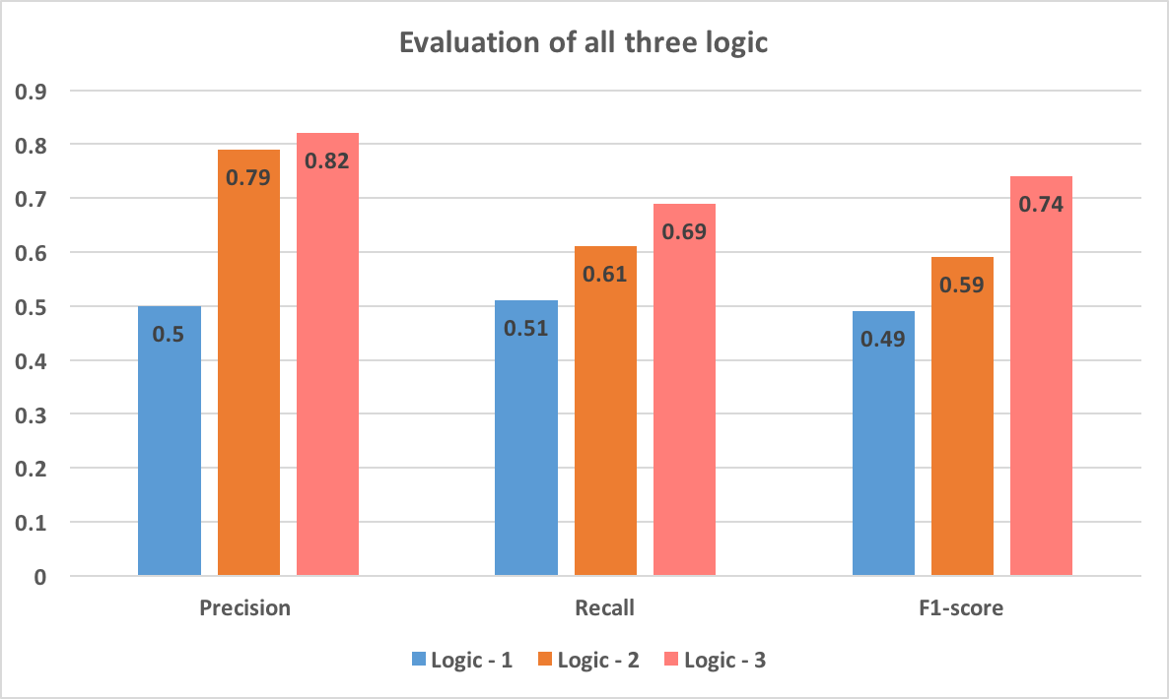
Evaluation: All three logic
In this multi-class setting, I take Micro-average Method.
Logic – 3 performs best in terms of every evaluation matrics.

Slide 29

Features work
Syntactical relations:
Can be improved further on by looking up more combined patterns and I have a gut feeling there are more combined patterns out there.
Aspect term with multiple token:
Yes, this part also we can improve by adding more POS tag pattern.

Slide 30
Thank You

