Slide 1
Camunda 7 Developer’s Guide

Slide 2
Topic – 1 (Introduction to BPM2.0 & Camunda)
Process Use-Case
BPMN 2.0 Introduction
Importance of Camunda BPM Engine
Camunda BPM Environments and Process
Standards of Camunda BPM
Camunda BPMN tool Overview
https://teams.microsoft.com/l/meetup-join/19%3ameeting_MmJmZGZlMWUtMjJhOC00ZWJlLTkyNmEtMmFhYjRjMTlmZTFl%40thread.v2/0?context=%7b%22Tid%22%3a%22906aefe9-76a7-4f65-b82d-5ec20775d5aa%22%2c%22Oid%22%3a%221e74db50-f25d-4a02-9b8b-6c0143ef7ada%22%7d
Notes:
https://github.com/subratagreen/camundaTraining

Slide 3
Use Case (Buy a Book)
Start
Went to a bookstore
Searched for a book
Got the book billed
Payment
Delivery
End

Slide 4
Use Case (Online Food Order)
Start
Opened Zomato/Swiggy
Ordered a veg combo
Provided address
Payment done
Food preparation start
Delivery notification sent
Delivered
End

Slide 5
What is Workflow
A sequence of operations to complete a task end to end.
It might consists of an orchestrated and repeatable pattern of activity.
Workflow may be considered a view or representation of real work.

Slide 6
OMG trio
The Object Management Group (OMG) is a computer industry standards consortium.
The three leading business modelling standards produced by the Object Management Group (OMG) in recent years:
Business Process Model and Notation (BPMN)
Case Management Model and Notation (CMMN) and
Decision Model Notation (DMN).

Slide 7
BPMN - introduction
BPMN – Business Process Modeling Notation – 2.0
BPMN is a flow chart method that models the steps of a planned business process from end to end.
BPMN is targeted at participants and other stakeholders in a business process to gain understanding through an easy-to-understand visual representation of the steps.

Slide 8
BPMN - Advantage
It provides a standard, common language for all stakeholders, whether technical or non-technical: business analysts, process participants, managers and technical developers, as well as external teams and consultants.
It also helps with communication leading to XML (Extensible Markup Language) documents needed to execute various processes.

Slide 9
Camunda BPMN
Camunda core is a Native BPMN 2.0 process engine that runs inside JVM.
Light-weight, open source
It is Java based framework but support other scripts and languages.
Camunda can be used as standalone process engine server or embedded inside Java App
Camunda supports Spring framework, microservices
It also provide and supports REST Api.

Slide 10
Questionnaire
What is a workflow ?
What are OMG Trio ?
What is BPMN and what is Camunda ?
Advantages of Camunda ?

Slide 11
Topic – 2 (Camunda Modeler & Architecture)
Introduction to Camunda Modeler
Download and Configure Camunda Modeler
Clustering Model Module
Camunda Architecture
Camunda Cockpit Walkthrough
Camunda Tasklist Walkthrough
Camunda Modeler Details
Process Engine Architecture Module

Slide 12
Camunda Ecosystem
Camunda Modeler
Server
Camunda Web Apps
Cockpit
Tasklist
Admin

Slide 13
Cockpit
Web application provided by Camunda Server.
It shows deployed processes – version wise.
It will show running processes.
It will show Human task.

Slide 14
Tasklist
Web application provided by Camunda Server.
It helps to start the deployed process.
It shows the process to particular user.
If there is any user task, it will wait for user to complete.
Authorized user can claim a process.
It shows personalized view based on permission.

Slide 15
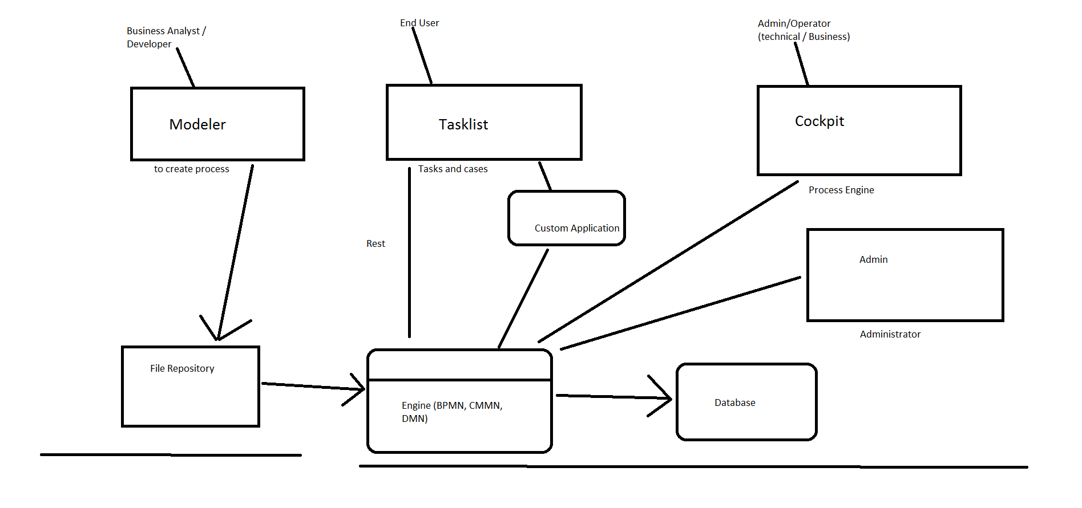
Camunda Architecture

Slide 16
Camunda Modeler Installtion
https://downloads.camunda.cloud/release/camunda-modeler/4.11.1/
Download and unzip
Start Camunda Modeler
Run Workflow

Slide 17
Wildfly Server Installation
https://downloads.camunda.cloud/release/camunda-bpm/wildfly/7.21/
Download and unzip
Open ..\camunda-bpm-wildfly<version>\
Run start-camunda.bat

Slide 18
Wildfly Server
When we start wildfly – it will start camunda Admin console and apps in browser.
It will also start built-in and installed applications. – tasklist, cockpit and admin and user defined others.
Rest API to deploy BPM: http://localhost:8080/engine-rest/deployment/create
If we need to deploy any application, need to keep the war file here: ..\camunda-bpm-wildfly\server\wildfly-\standalone\deployments

Slide 19
Deployment from Camunda modeler
Create a BPM diagram
Save it, check process id and name
Use deploy button – check process name, rest url
Check the deployment message in modeler
Open cockpit – check the recently deployed process
Open tasklist – start the process

Slide 20
Questionnaire
What are part of Camunda Ecosystem ?
What is Cockpit, Tasklist and Admin ?
How Camunda modeler understands where to deploy ?
How to change server port ?

Slide 21
Deployment from eclipse
Create a maven project in eclipse
Build the project – > mvn clean install
Start the application – Spring Boot

Slide 22
Questions
How to validate the BPMN before deployment:
Junit Test for BPMN
Implement BPMN Deployer and Parser
Use some Tools shared in Camunda Community
https://forum.bpmn.io/t/how-to-get-a-list-of-validation-errors-from-bpmn-js-properties-panel/7867
https://github.com/bpmn-io/ids
https://github.com/camunda/linting
https://jit.at/how-to-programmatically-validate-bpmn-models/

Slide 23
Topic – 3 (BPM Notations)
BPM Notations
Task - Service task, User Task, Script Task
Events – Message, Timer, Link, Signal, Start, End
Gateway – Parallel, Inclusive, Exclusive
Connector -
BPM Concepts
Expression
Data Type
Lane, Pool
Variables, JSON, XML
https://camunda.com/bpmn/reference/

Slide 24
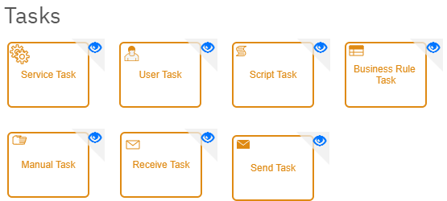
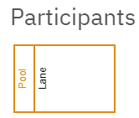
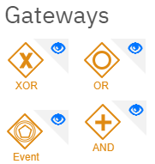
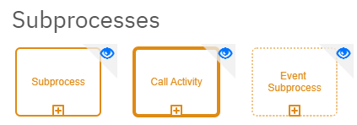
Basic BPM Notations

Slide 25
User Task
A User Task needs to be done by a human.
When the process execution arrives at such a User Task, a new task is created in the task list of the user(s) or group(s) assigned to that task.
We can use expression to assign a user at runtime - ${variable}
We can use Delegate Expression to evaluate in java Application - ${myService.findApprover()}

Slide 26
UT – Task Listener
A task listener supports the following attributes:
event (required): the type of task event on which the task listener will be invoked. Possible events are: create, assignment, update, complete, delete and timeout;
The delegation class that must be called which must implement the org.camunda.bpm.engine.impl.pvm.delegate.TaskListener interface.
public class MyTaskCreateListener implements TaskListener {
public void notify(DelegateTask delegateTask) {
// Custom logic goes here
}
}

Slide 27
UT –Execution Listener
Execution Listeners can be attached to any event (Start/End)
We can define:
Event Type: Start/End
Listener Type: Expression / Delegate Expression
Expression / Delegate Expression: ${myJavaClass.execute()} / ${myExecutionService}
Field Injection: variable
@Service
public class MyExecutionListener implements ExecutionListener {
@Override
public void notify(DelegateExecution execution) throws Exception {
System.out.println("User Task - ended..");
}
}

Slide 28
UT – Task / Execution Listener
When the user task is executed
The execution listener is called
The task listener is called
In general, the task listener event cycle is contained between execution listener events start and end. So the cycle when a user task is executed is:
ExecutionListener#start
TaskListener#create
TaskListener#{assignment}*
TaskListener#{complete, delete}
ExecutionListener#end

Slide 29
Multi-instance User Task
We can create multiple instances of a task.
For Ex: user task needs to approved by multiple user.
def assignee = ["demo","john","demo"]
execution.setVariable("assignee",assignee)
User task:
Loop cardinality – 3
Assignee: ${assignee[loopCounter]}

Slide 30
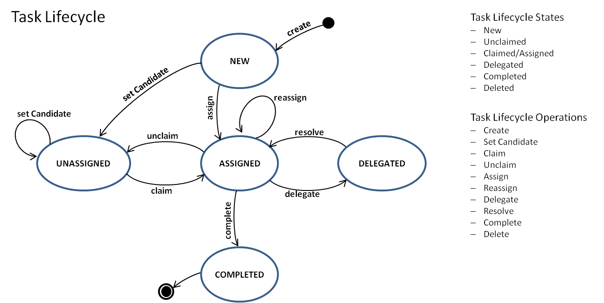
User Task

Slide 31
Service Task
A Service Task is used to invoke services.
Can Call Java code or provide a work item for an external worker to complete asynchronously or invoking a logic which is implemented in form of webservices.
Calling Java Code
There are four ways of declaring how to invoke Java logic:
Specifying a class that implements a JavaDelegate or ActivityBehavior
Evaluating an expression that resolves to a delegation object
Invoking a method expression
Evaluating a value expression

Slide 32
Service Task
java-delegate-vs-expressions-in-service-task
If our business logic is written in Java then we’re likely to want to use the implementation type of Java Class or Delegate Expression in both cases they would be calling a Java class which implements a JavaDelegate .
The difference is mainly based on how they are called.
Java Class would be called through the package name: com.example.workflow.TestingFun.TestingBear
Delegate Expression If we’re using beans you can call the class by it’s name, in the above example the bean has a @Named property so you can just call it by the name e.g. #{TestingBear}
Usually Delegate Expression is preferred because it becomes much easier to manage things like refactoring and replacing business logic. So i would tend go with that.

Slide 33
Service Task
Start a Process from another Process by delegating:
Create two bpmn workflow – CallerProcess, process_to_call
Create a service task in CallerProcess, with below implementation in execute method:
RuntimeService runtimeService = execution.getProcessEngineServices().getRuntimeService();
runtimeService.startProcessInstanceByKey ("process_to_call");

Slide 34
Service Task - connector
Connector: http-connector
Input-paramaters
url
Method
Headers
Output-parameter
Response

Slide 35
Script Task
A Script Task is an automated activity.
When a process execution arrives at the Script Task, the corresponding script is executed.
We can Add Script Task or We can use Script where ever available.
Groovy Script Ex:
println "activityId -- " + execution.activityId

Slide 36
Script Task
Java Script Ex:
var jsonData = JSON.parse(response);
for (var i = 0; i < jsonData.data.length; i++) {
var counter = jsonData.data[i];
console.log(counter.id + " " +counter.email);
if(counter.id == 2){
var userEmail = counter.email;
}
}
var execution = connector.getParentVariableScope();
var activityId = execution.getCurrentActivityId();
console.log("userEmail = "+userEmail+ “ | activityId = "+activityId);
execution.setVariable("userEmail",userEmail);

Slide 37
Gateway
Data-based Exclusive Gateway (XOR)
Model decisions based on data.
Parallel Gateway
Model fork / join concurrency.
Inclusive Gateway
Model conditional fork / join concurrency.
Event-based Gateway
Model decisions based on events.

Slide 38

Gateway - Exclusive
An exclusive gateway (also called the XOR gateway or, in more technical terms, the exclusive data-based gateway), is used to model a decision in the process.
When the execution arrives at this gateway, all outgoing sequence flows are evaluated in the order in which they have been defined.
Note that only one sequence flow is selected when using the exclusive gateway. In case multiple sequence flow have a condition that evaluates to ‘true’, the first one defined in the XML is exclusively selected for continuing the process.
If no sequence flow can be selected (no condition evaluates to ‘true’) this will result in a runtime exception, unless you have a default flow defined.

Slide 39

Gateway - Parallel
Gateways can also be used to model concurrency in a process.
The most straightforward gateway to introduce concurrency in a process model is the Parallel Gateway, which allows forking into multiple paths of execution or joining multiple incoming paths of execution.
Parallel gateway does not evaluate conditions.
A parallel gateway will simply wait for all incoming sequence flows and create a concurrent path of execution for each outgoing sequence flow

Slide 40

Gateway - Inclusive
The Inclusive Gateway can be seen as a combination of an exclusive and a parallel gateway.
Like an exclusive gateway, we can define conditions on outgoing sequence flows and the inclusive gateway will evaluate them.
However, the main difference is that the inclusive gateway can receive more than one sequence flow, like a parallel gateway.

Slide 41
Gateway - Inclusive
Exclusive ----> Exclusive : works as diagram
Parallel -----> Parallel : works as diagram
Exclusive -----> Parallel : Not work
Parallel ----> Exclusive : each outgoing branch from parallel will execute separately for each connected exclusive gw
Inclusive -----> Inclusive : work as diagram
Inclusive --> Parallel : Not work (parallel will for all the flows to complete)
Parallel ---> Inclusive : works as diagram
Inclusive ---> Exclusive : each matched outgoing branch from inclusive will execute separately for each connected exclusive gw
Exclusive --> Inclusive : works as diagram

Slide 42
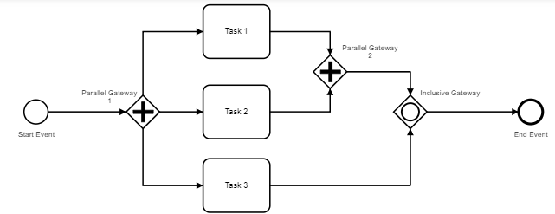
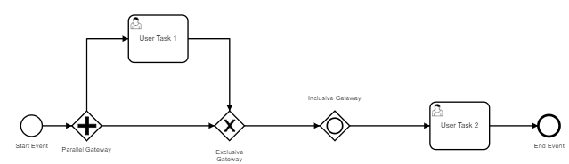
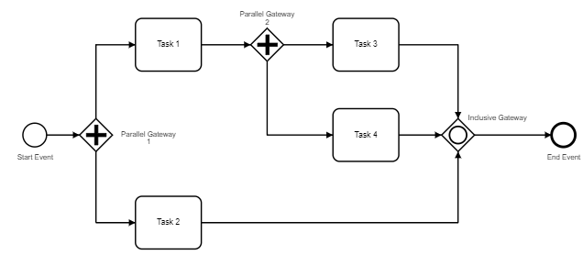
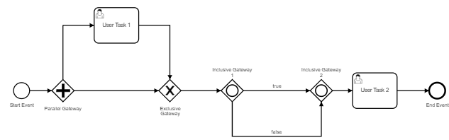
Gateway - Inclusive

Slide 43

Gateway – Event Based
The event-based Gateway allows you to make a decision based on events.
Each outgoing sequence flow of the gateway needs to be connected to an intermediate catching event.
When process execution reaches an event-based Gateway, the gateway acts like a wait state: execution is suspended. In addition, an event subscription is created for each outgoing sequence flow.
An event-based Gateway must have two or more outgoing sequence flows.
An event-based Gateway may only be followed by elements of the type intermediateCatchEvent. (Receive Tasks after an event-based Gateway are not supported by the engine yet.)
An intermediateCatchEvent connected to an event-based Gateway must have a single incoming sequence flow.

Slide 44
Gateway – Event Based
Event base gateway can be added to a flow where next node/branch it will go based on event fired.
Events like – Timer, Message, Signal
It is an exclusive gateway type, so at any given time – only one flow will continue.
We can join event based gateway to exclusive gateway

Slide 45
Topic – 4 (Process Engine and Server)
Embedded Process Engine
Container, Managed, Shared Process Engine
Standalone Process Engine
Getting started with Camunda Wildfly server
Access the server log and work with Server config Module

Slide 46
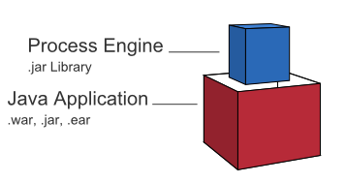
Embedded Process Engine
Camunda is a flexible framework which can be deployed in different scenarios.
In this case, the process engine is added as an application library to a custom application.
This way, the process engine can easily be started and stopped with the application lifecycle.
It is possible to run multiple embedded process engines on top of a shared database.

Slide 47
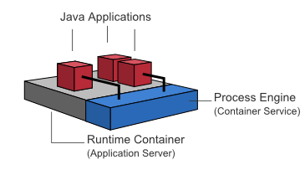
Shared, Container-Managed Process Engine
In this case, the process engine is started inside the runtime container (Servlet Container, Application Server, …).
The process engine is provided as a container service and can be shared by all applications deployed inside the container.
The concept can be compared to a JMS Message Queue which is provided by the runtime and can be used by all applications.
There is a one-to-one mapping between process deployments and applications: the process engine keeps track of the process definitions deployed by an application and delegates execution to the application in question.

Slide 48
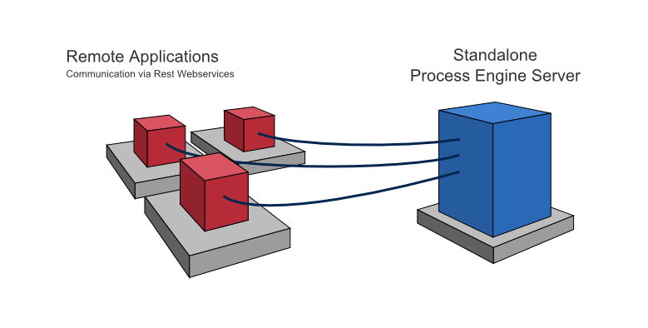
Standalone Process Engine
In this case, the process engine is provided as a network service.
Different applications running on the network can interact with the process engine through a remote communication channel.
The easiest way to make the process engine accessible remotely is to use the built-in REST API.
Different communication channels such as SOAP Webservices or JMS are possible but need to be implemented by users.

Slide 49
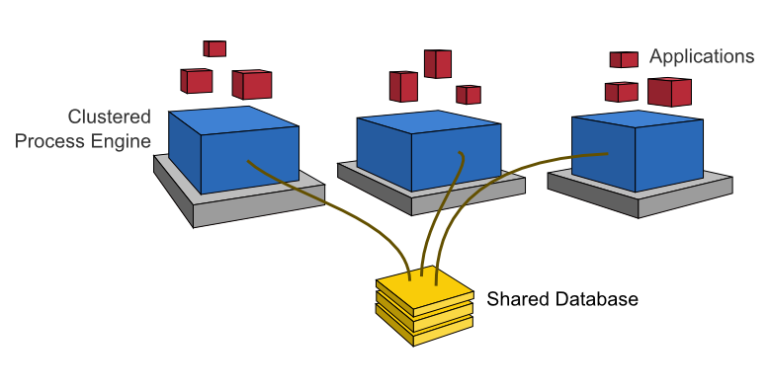
Clustering Model

Slide 50
Server log and work with Server config
https://docs.camunda.org/manual/7.21/user-guide/logging/#logging-categories
<!-- added logging start-->
<logger category="org.camunda.bpm.application">
<level name="DEBUG"/>
</logger>
<logger category="org.camunda.bpm.engine.dmn">
<level name="DEBUG"/>
</logger>
<!-- added logging end-->

Slide 51
Topic – 5 (Camunda Events and Error Handling)
Start Event, Intermediate Event, and End Event
Boundary Events(Timer, Message)
Error Handling with Retry
Event and Embedded-based subprocess
Error Handling through Event-based subprocess
Call Activity Module

Slide 52
Events
Start Event:
Can be started with a message(REST-API) or Timer start Event or Signal Start Event etc
End Event:
Event occurs when flow reaches to End task.
Intermediate Event (Boundary Event):
Intermediate – When we add an intermediate Event between two task.
Boundary – when we add an intermediate event on boundary of any other task.

Slide 53
Intermediate/Boundary Event
Intermediate
Throw
Catch
Boundary
Interrupting – it will interrupt current flow and only one flow will be executed.
Non-Interrupting – both flow will execute, just does the task.

Slide 54
Intermediate Events
Link
Message
Signal
Timer
Error
Conditional
Escalation
Compensation

Slide 55
Start Events
Start events define where a Process or Sub Process starts.
Blank
Timer
Message
Signal
Conditional
The engine requires at least one start event to instantiate a process.

Slide 56
Start Events
Blank(None Event):
None start events are unspecified events, also called ‘blank’ events.
A ‘none’ end event means that the result thrown when the event is reached is unspecified.
Timer:
Events waiting on a timer condition.
Message:
Events catching / throwing messages.
Signal:
Events catching / throwing signals.
Conditional
Events catching conditional events.

Slide 57
Timer Event
Timer events are events which are triggered by a defined timer.
They can be used as start event, intermediate event or boundary event.
Boundary events can be interrupting or not.
Defining a Timer
Time Date: <timeDate>2011-03-11T12:13:14Z</timeDate> (ISO 8601)
Time Duration: P10D or PT10M or PT4H (PnYnMnDTnHnMnS or PnW)
Time Cycle: R3/PT10H (Rn/<interval>) or 0 0/5 * * * ? (every 5 minutes, starting at full hour)
Handling of Timezones
If Timezone is not specified in timezon format.
Example of UTC format – (e.g., 2022-03-11T12:13:14Z)

Slide 58
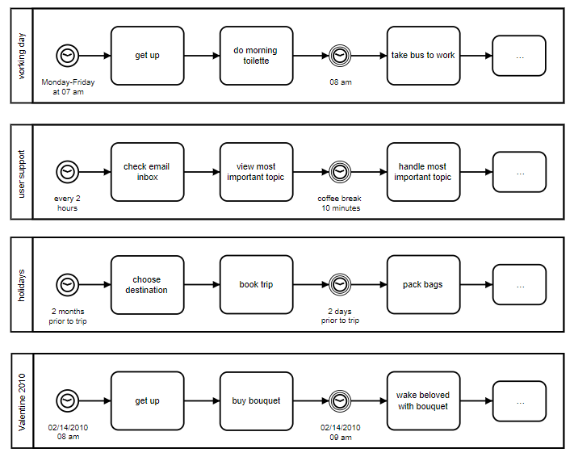
Timer Event Ex

Slide 59
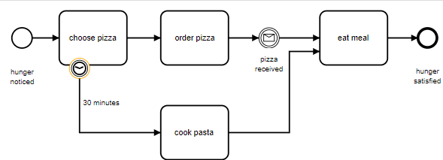
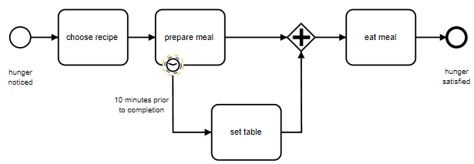
Timer Event Ex
Timer Boundary Interrupting
Timer Boundary Non-Interrupting

Slide 60
Signal Event
Signal events are events which reference a named signal. A signal is an event of global scope (broadcast semantics) and is delivered to all active handlers.
Define a Signal:
<bpmn:signal id="Signal_1mbsynv" name="Signal_Modify_flow" />
Rest Api to call Signal Event:
http://localhost:8080/engine-rest/signal
{
"name": "Signal_Modify_flow",
"variable": {
"alertType": {
"designChange": "add a pool in the workflow design"
}
}
}

Slide 61
Signal Event (as Boundary Event)
We can call specific process, if we make signal key unique
Ex: Define a Signal:
<bpmn:signal id="Signal_1mbsynv" name="Signal_Modify_flow -${execution.processBusinessKey}" />
Rest Api to call Signal Event:
http://localhost:8080/engine-rest/signal
{
"name": "Signal_Modify_flow-123123",
"variable": {
"alertType": {
"designChange": "add a pool in the workflow design"
}
}
}

Slide 62
Signal Event (as Intermediate Throw-Catch Event)
Create a workflow with Signal Intermediate Throw Event. (Signal_One)
Create a workflow with Signal Intermediate Catch Event. (Signal_One)
Start multiple process instance of Catch Event.
Start process – throw event.

Slide 63
Message event
Message events are events which reference a named message. A message has a name and a payload.
Unlike a signal, a message event is always directed at a single recipient.
A message start event can be used to start a process instance using a named message.
This effectively allows us to select the right start event from a set of alternative start events using the message name.
When we hit rest api – the process will start or message will be caught by Intemediate Catch or Message Boundary event…
Rest API: http://localhost:8080/engine-rest/message
{
"messageName" : "MsgEvent",
"businessKey" : "1",
"processVariables" : {
"question" : {"value" : "what is camunda", "type":"String"}
}
}

Slide 64
Message Boundary Event
Boundary events are catching events that are attached to an activity.
This means that while the activity is running, the message boundary event is listening for named message.
When this is caught, either of the flow will continue:
Interrupting boundary event: The activity is interrupted and the sequence flow going out of the event is followed.
Non-interrupting boundary event: One token stays in the activity and an additional token is created which follows the sequence flow going out of the event.

Slide 65
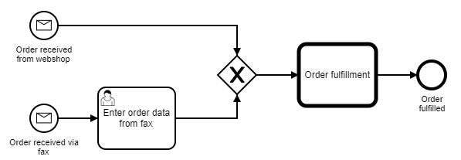
Message Start event
We Can have multiple message start event and one will be called depending on the message type

Slide 66
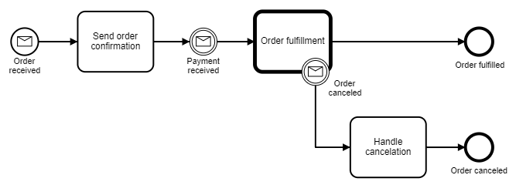
Message Intermediate Catching Event
When a token arrives at the message intermediate catching event it will wait there until a message with the proper name arrives.

Slide 67
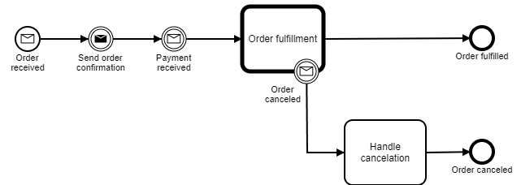
Message Intermediate Throwing Event
A Message Intermediate Throwing event sends a message to an external service.

Slide 68
Message event
Programmatically handle message
// correlate the message
MessageCorrelationResult result = runtimeService.createMessageCorrelation("messageName") .processInstanceBusinessKey("AB-123") .setVariable("payment_type", "creditCard") .correlateWithResult();

Slide 69
Pool, Lane
Pool can contain throw objects vertically or horizontally.
Lane helps to organize and categorize activities within a pool.
Link Event helps us to connect from one lane to another lane.
End task of a lane should be intermediate boundary → then should be configured as link throw event.
In next lane – start option should be intermediate start → and should be connected as link catch.
Both lane needs to be connected with same linkName.

Slide 70
Link Intermediate Event
Link can be added at end event and can be connected to start event in two different flow of a process.
Linkname is common identifier to join them.
Link can be used to connect multiple sub flows.

Slide 71
Conditional Events
It defines an event is triggered if a given condition is true.
It can be a Start event, intermediate or boundary.
Boundary event can be interrupting or non-interrupting.

Slide 72
Conditional Start Event
A conditional start event can be used to start a process by evaluating some condition. One process can have one or more conditional start events.
If more than one conditions are fulfilled the respective number of processes will be triggered.

Slide 73
Conditional Boundary Event
A conditional boundary event acts like an observer which is triggered if a specific condition is satisfied.
The interrupting event is the default.
The non-interrupting event leads to the original activity not being interrupted, the instance remains active.

Slide 74
Intermediate Conditional Catch Event
An intermediate conditional event is like a wait until the condition is true.
When the execution arrives at the catching event activity, the condition is evaluated for the first time.
If the condition is satisfied, the execution process continues to the next activity.
If the condition is not satisfied, the execution stays in this activity until the condition is satisfied.

Slide 75
Error Event
Error events are events which are triggered by a defined error.
Business Errors vs. Technical Errors
A BPMN error is meant for business errors - which are different than technical exceptions. So, this is different than Java exceptions - which are, by default, handled in their own way.
We can trigger error event either with a throwing error event within your process definition or from Delegation Code.
Another possibility to define an error is setting of the type (class name) of any Java Exception as error code.
When the error thrown by the error end event is catched a process variable with the name err will be created that holds the evaluated message.

Slide 76
Error Start Event
An error start event can only be used to trigger an Event Sub-Process - it cannot be used to start a process instance. The error start event is always interrupting.
Error End Event
When process execution arrives at an error end event, the current path of execution is ended and an error is thrown.
This error can be caught by a matching intermediate error boundary event.

Slide 77
Error Boundary Event
An intermediate catching error event on the boundary of an activity, or error boundary event for short, catches errors that are thrown within the scope of the activity on which it is defined.
Defining a error boundary event makes most sense on an embedded subprocess, or a call activity, as a subprocess creates a scope for all activities inside the subprocess.

Slide 78
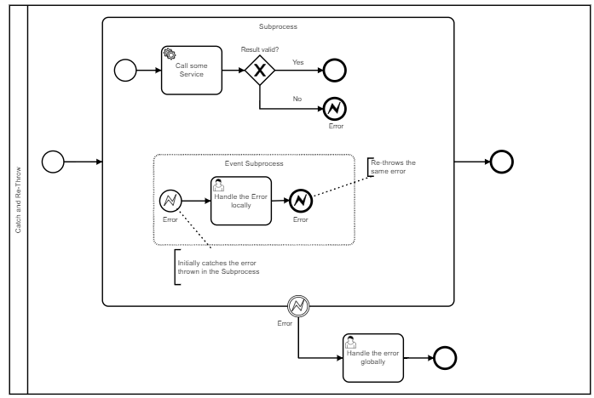
Catch and Re-Throw Pattern
An error can be handled by the error start event in the event sub process and the same error can be thrown from the event sub process to handle the error on the higher level scope

Slide 79
Error Event
Show re-throw Error
Show Error attributes in variable

Slide 80
Escalation Event
This event can be added as boundary or intermediate event but mostly used from a subprocess to main process.
Unlike an error, escalation event is not very critical and process can execute to next node/event/task.
Escalation event like other events, it needs to thrown and needs to caught/called, through an escalation ID object.
Escalation Id needs to have escalation name and code.

Slide 81
Escalation Event
Escalation events are events which reference a named escalation.
They are mostly used to communicate from a subprocess to an upper process.
Unlike an error, an escalation event is non critical and execution continues at the location of throwing.

Slide 82
Escalation Catch Event
Escalation Start Event
An escalation start event can only be used to trigger an event sub-process.
Escalation Boundary Event
escalation boundary event, catches escalations that are thrown within the scope of the activity on which it is defined.

Slide 83
Escalation Throw Event
Escalation Intermediate Throw Event
When process execution arrives escalation event, an escalation is thrown.. This escalation can be caught by an escalation boundary event or an event sub-process with an escalation start event which has the same or none escalation code.
Escalation End Event
When process execution arrives at an escalation end event, the current path of execution is ended and a named escalation is thrown.. can be caught by an escalation catch event

Slide 84
Cancel and Compensation Event
Cancel end event can be only used with transaction subprocess.
Intermediate compensation throw:
It will throw compensation event.
Compensation start event() can catch it
When cancel end event occurs,
a cancel event will be thrown,
will be caught cancel boundary event.
Cancel boundary event:
cancels the transaction and
triggers compensation.

Slide 85
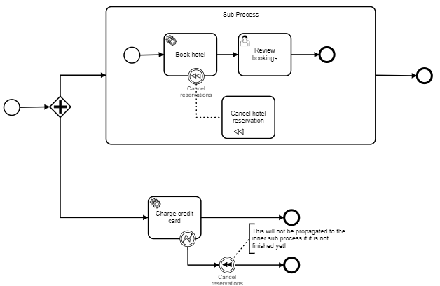
Compensation throw Event

Slide 86
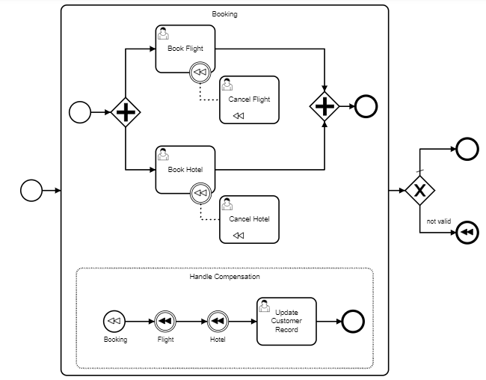
Compensation start Event

Slide 87
Cancel and Compensation Event
Cancel End Event
The cancel end event can only be used in combination with a transaction subprocess.
Cancel Boundary Event
An attached intermediate catching cancel boundary event, is triggered when a transaction is canceled.
Compensation Boundary Event
An attached intermediate catching compensation boundary event, can be used to attach a compensation handler to an activity or an embedded subprocess.
Transaction Sub Process

Slide 88
More Tasks
Send Task
Receive Task
Manual Task

Slide 89
Send Tasks
It’s a visual indication of what the execution is doing.
When we’re creating a message or making a call to an external system use a message task.
When we’re just calculating something then use a service task.
It helps operators understand what the system might be doing

Slide 90
Receive Task
A Receive Task is a simple task that waits for the arrival of a certain message.
When the process execution arrives at a Receive Task, the process state is committed to the persistence storage.
This means that the process will stay in this wait state until a specific message is received by the engine, which triggers continuation of the process beyond the Receive Task.

Slide 91
Manual Task
A Manual Task defines a task that is external to the BPM engine.
It is used to model work that is done by somebody who the engine does not need to know of and that has no known system or UI interface.
For the engine, a manual task is handled as a pass-through activity, automatically continuing the process when the process execution arrives at it.

Slide 92
Topic – 6 (Camunda Tasks)
Spin
Call Activity
Embedded and Event-based Subprocess
Business Rule Task
DMN Business Rule Task & DMN Hit Policy Module

Slide 93
Subprocess
Divide a process into multiple small processes.
Subprocess gives re-usability.
Subprocess is a part of main process.
Subprocess can be defined as:
Call activity
Event subprocess
Embeded Sub process
Transaction subprocess

Slide 94
Call Activity
Call activity references a process that is external to the process definition, whereas the subprocess is embedded within the original process definition.
The main use case for the call activity is to have a reusable process definition that can be called from multiple other process definitions.
When process execution arrives at the call activity, a new process instance is created, which is used to execute the subprocess, potentially creating parallel child executions as within a regular process. The main process instance waits until the subprocess is completely ended, and continues the original process afterwards.

Slide 95
Call Activity
To create a subprocess and invoke it from other processes.
Collaborate multiple processes.
Make sure – called element: sub process id
We can create a separate file(subprocess), which can be called from other parent process as well.
<camunda:in source="someVariableInMainProcess" target="nameOfVariableInSubProcess" />
<camunda:out source="someVariableInSubProcss" target="nameOfVariableInMainProcess" />

Slide 96
Embeded Subprocess
A subprocess is an activity that contains other activities, gateways, events, etc., which itself forms a process that is part of a bigger process. A subprocess is completely defined inside a parent process (that’s why it’s often called an embedded Subprocess).
We can have a sub process defined in parent process(bpmn).
Is it to show – part of the parent process is actually a set of specific tasks.
We can select a task → configure it to make it an embedded subprocess.

Slide 97
Event based subprocess
We can define event based subprocess which will be called based on event triggered. Ex: error event.
To do this – we can use pool and lane, then we can configure a task into subprocess, then change it to event based subprocess.
In event based subprocess → we can have start event as error start event which will be called in case of any error occurs.

Slide 98
Event based subprocess
Business Error
Technical Error
Handling the error – error throw and error catch.
Error throw: We can define end event as – error end event.
Error Catch: define Subprocess(expanded), change it to Event Subprocess → change start event → error start event.
We can throw multiple errors, which can be caught using specific or generic error start event.
Specific error catch: we can use error object(defined while throwing the error).
Generic error catch: if we do not provide and error object ref in error start event then it is generic error catch.

Slide 99
DMN
Make | Model year | Price Discount
Samsung | 2015 - 2020 | 10%
Nokia | 2015 - 2020 | 8%
Specification of popular group – OMG.
Helps to reduce multiple if-else in BPMN.
Provides tabular format to write business rules.
Easy for business analyst or non-technical guy.
Supports FEEL (friendly enough expression lang)

Slide 100
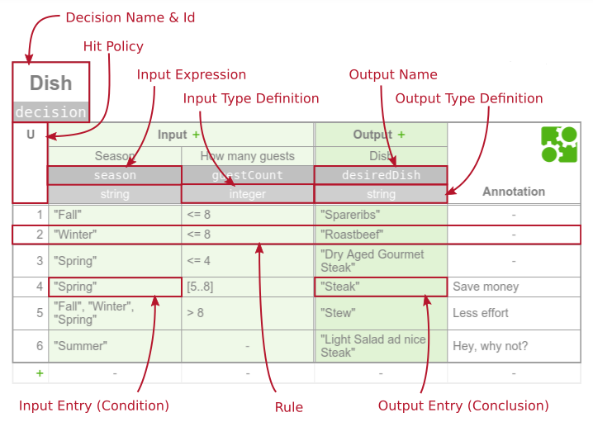
DMN

Slide 101
DMN Rest API
http://<<localhost:8080>>/engine-rest/decision-definition/key/<<dmn_mobile_demo>>/evaluate
{ "variables" : {
"make" : {"value" : “nokia", "type":"String"},
"year" : {"value" : ”2015”, "type":“Integer"}
} }
http://localhost:8080/engine-rest/decision-definition/key/Decision_courier-charges/evaluate
{
"variables": { "weigh": {"value": "50", "type": "Integer"},
"distance": { "value": "40", "type": "Integer“ } }
}

Slide 102
FEEL Language Elements
The Camunda DMN engine supports FEEL for input entries.
The FEEL term for expression in input entries are simple unary tests.
Comparison
“ “, <, <=, >, >=
Range
[1..10], ]1..10] or (1..10], [1..10[ or [1..10) , ]1..10[ or (1..10)
Disjunction
3,5,7 | <2,>10 | 10,[20..30]
Negation
not(>10) | not(3,5,7)

Slide 103
DMN Hit Policy
A decision table has a hit policy that specifies what the results of the evaluation of a decision table consist of.
A hit policy specifies how many rules of a decision table can be satisfied and which of the satisfied rules are included in the decision table result.
Unique Hit Policy
Any Hit Policy
First Hit Policy
Rule Order Hit Policy
Collect Hit Policy
Aggregators for Collect Hit Policy
SUM aggregator

Slide 104
Wildfly server – info and conf
Configure server – port, jdbc, LDAP (standalone.xml)
logging.properties – log level, printFormatter, log file appender etc
Deployment – deploy war file
Log – check the server log
Lib – add external libraries

Slide 105
Topic – 7 (Custom Form)
Types of Custom Form- Generated, Embedded, Generic, and External Module

Slide 106
Task Form
Embedded Task Form
Generated Task Form
External Task Form
Generic Task Form

Slide 107
Generic Task Form
Default provided form by Camunda Tasklist
The generic form will be used whenever you have not added a dedicated form for a UserTask or a StartEvent.
Like: Add a variable button to add a variable
Generic task forms can be very helpful during the development stage, so you do not need to implement all task forms before you can run a workflow.

Slide 108
Embedded Task Form
HTML based task form to display the form as we define in HTML.
These form needs to associated with Start or User Task, like below:
embedded:app:forms/task-form.html
embedded:app:forms/start-form.html
4 steps to create an Embedded Task Form
Add dependency - camunda-bpm-spring-boot-starter-webapp
Create a folder in resources as - /src/main/resources/static/forms/ form.html (add html form in this file)
Create a META-INF folder under resources and create a file as – /src/main/resources/META-INF/ processes.xml (keep it blank)
Add annotation to Application class - @EnableProcessApplication

Slide 109
Process Variable Binding
To define a default value for a form field, a process variable with the same name as the form field key needs to be defined.
Local variables (e.g. created by defining an Input Parameter for the User Task) take precedence over process variables.
When the User Task has an Input Parameter defined with the same name as the form field key, then this local variable will be used.
In this case, an Output Parameter needs to be defined to map the local variable to a process variable for usage in other process elements.

Slide 110
Generated Task Form
In Modeler, we can select start event or user task and go to form tab in properties pallet.
We can define form fields and other properties to get those shown as Task form.
In start event – we also can add a field as business key.

Slide 111
External Task Form
User will be directed to another application to complete the task.
Configure the task as, formKey =“app:<<task_form.html>>
Create an application and redirect current task form into that application, using below url:
"../.." + contextPath (of process application) + "/" + "app" + formKey (from BPMN 2.0 XML) + "processDefinitionKey=" + processDefinitionKey + "&callbackUrl=" + callbackUrl;

Slide 112
Topic – 8 (BPMN in Java Application)
Download and Install STS, JDK
Create and Develop Camunda project in STS
HelloWorld Application Development Module
Unit testing Junit
Application Deployment
Camunda JUnit Connector
Camunda with DAO
SpringBoot Application with Camunda Archtype Module

Slide 113
Topic – 8 (Junit Testing)
@SpringBootTest
@RunWith(SpringRunner.class)
public class WorkflowTest extends AbstractProcessEngineRuleTest
@Autowired
public RuntimeService runtimeService;
@Autowired
ProcessEngine engine;
Mocks.register("serviceImpl", new ServiceImpl());
assertThat(processInstance).isStarted()
.task()
.hasDefinitionKey("say-hello-1")
.hasCandidateUser("demo")
.isNotAssigned();

Slide 114
Topic – 9 (Gateway)
Types of Gateways: Exclusive, Inclusive Event-based, and Parallel Module

Slide 115
Topic – 10 (APIs)
Custom REST API, Camunda REST API

Slide 116
Camunda Rest apis
Different application can call bpmn process using RestAPI.
By RestAPI – we can do everything we are doing in cockpit/tasklist.
http://localhost:8080/engine-rest/engine
http://<<host:port>>/engine-rest/<restapi>
Rest API to deploy BPM:
http://localhost:8080/engine-rest/deployment/create

Slide 117
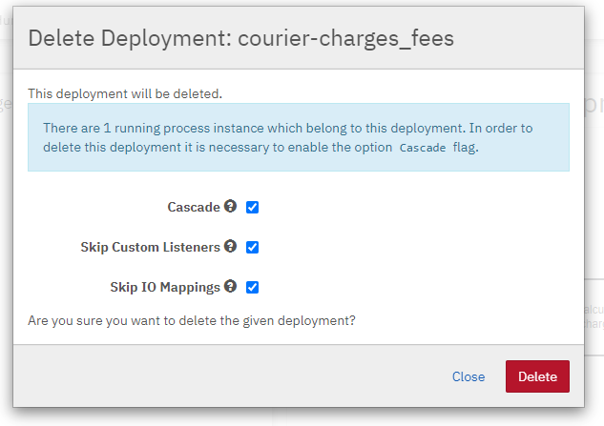
Delete a process
Enterprise Feature
Please note that this feature is only included in the enterprise edition of Camunda 7, it is not available in the community edition.
Community Edition
We need to delete process definition one-by-one.

Slide 118
Topic – 11 (Working with Camunda BPM)
Camunda Database
Spring Boot Application
Docker instance of Camunda
Best Practices

Slide 119
LDAP configuration
Open standalone-full.xml
Uncomment below section - <!-- LDAP CONFIGURATION -->
<plugin>
<class>org.camunda.bpm.identity.impl.ldap.plugin.LdapIdentityProviderPlugin</class>
<properties>
<property name="serverUrl">ldaps://localhost:4334/</property>
<property name="acceptUntrustedCertificates">false</property>
……………
</properties>
</plugin>
Also, need to setup LDAP authorization

Slide 120
Camunda 7 Architect Guide

Slide 121
Camunda Database
Database
Configuration
Useful Tables
History
Process

Slide 122
Camunda Database configuration
By default – H2 database comes with Camunda flavored servers.
Camunda also supports other databases, MySQL, Postgres etc
We will need to configure the database other than H2.
We can use this url to access H2 DB – http://localhost:8080/h2/h2/
<datasources>
<datasource jndi-name="java:jboss/datasources/ExampleDS" pool-name="ExampleDS" enabled="true" use-java-context="true">
<connection-url>jdbc:h2:mem:test;DB_CLOSE_DELAY=-1;DB_CLOSE_ON_EXIT=FALSE</connection-url>
<driver>h2</driver>
<security>
<user-name>sa</user-name>
<password>sa</password>
</security>
</datasource>

Slide 123
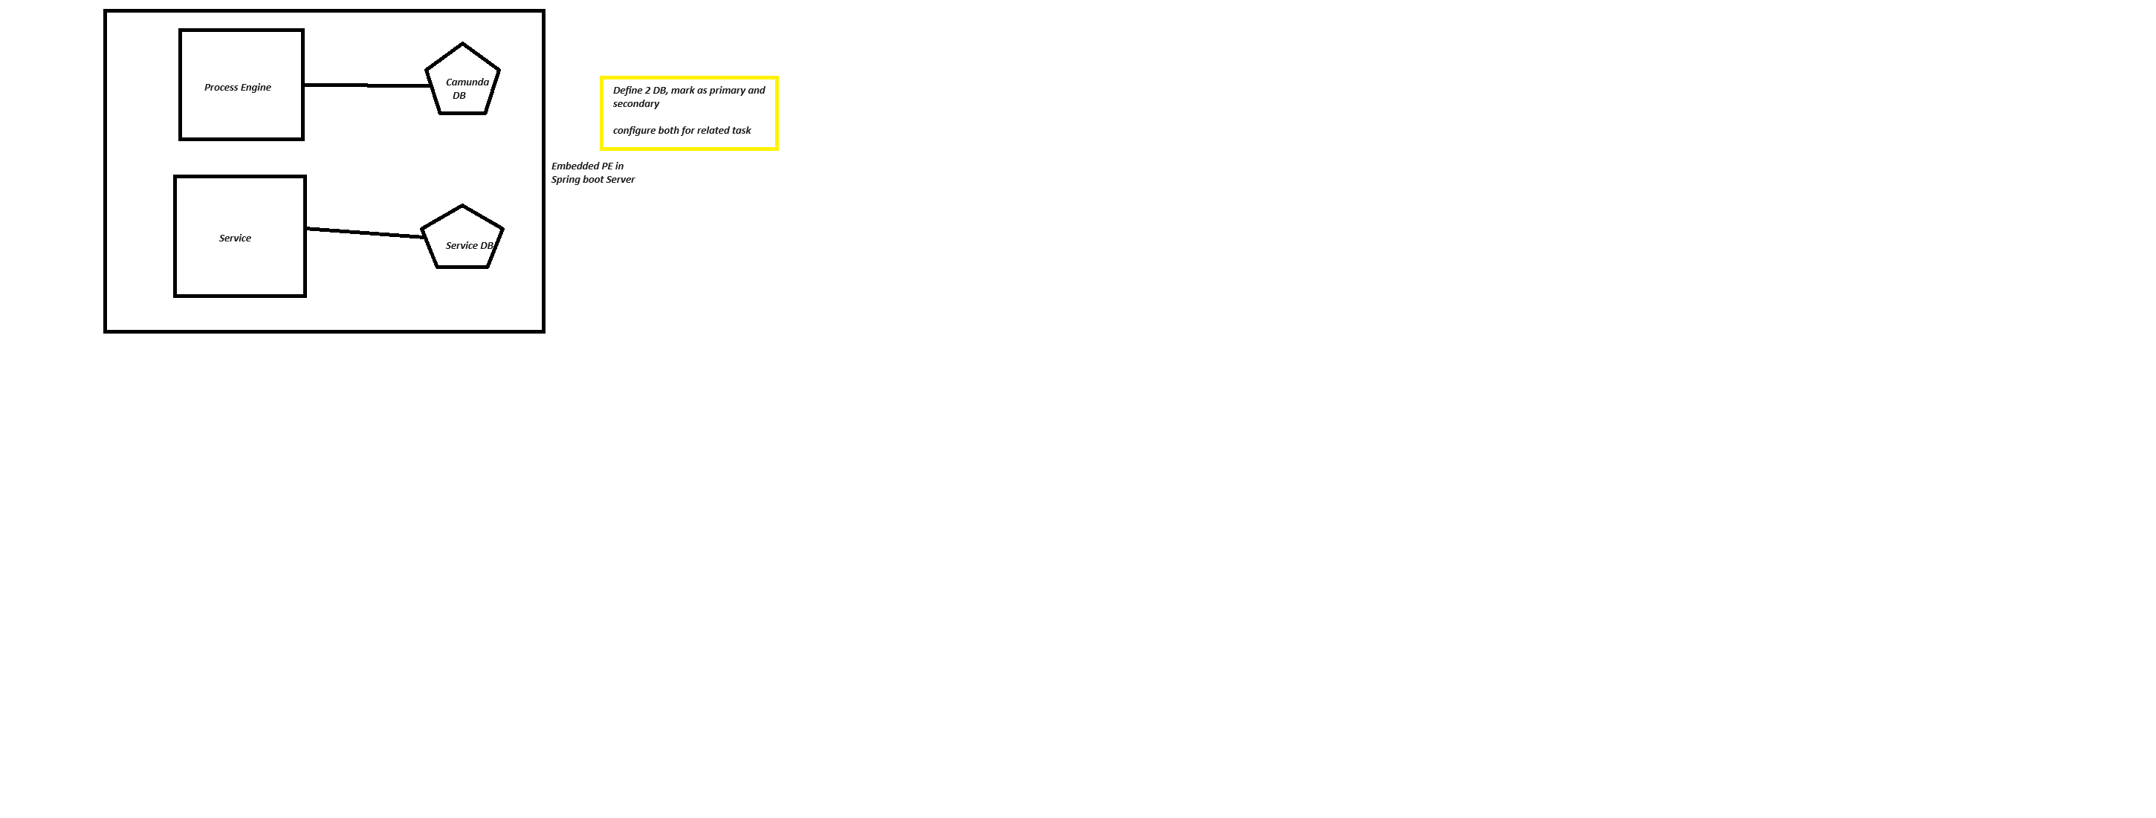
Camunda and APP Database configuration St. 1

Slide 124
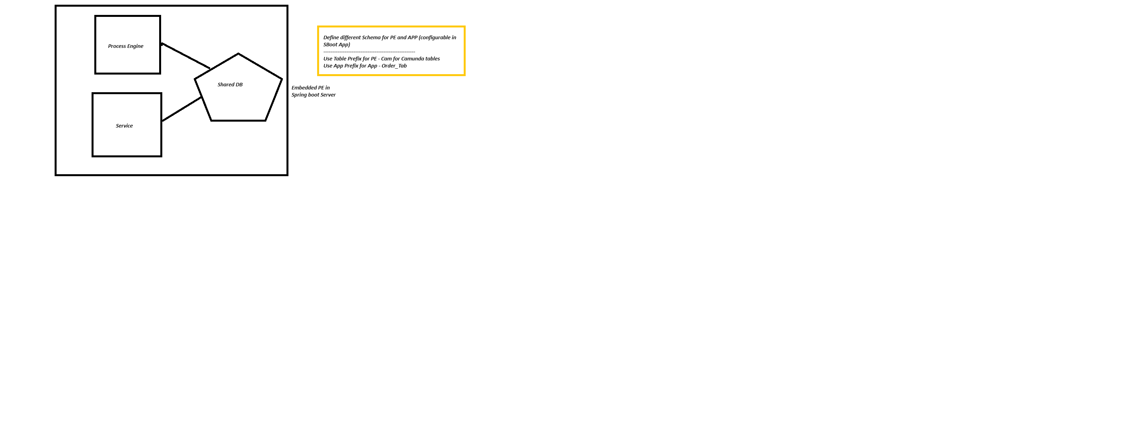
Camunda and APP Database configuration St. 2

Slide 125
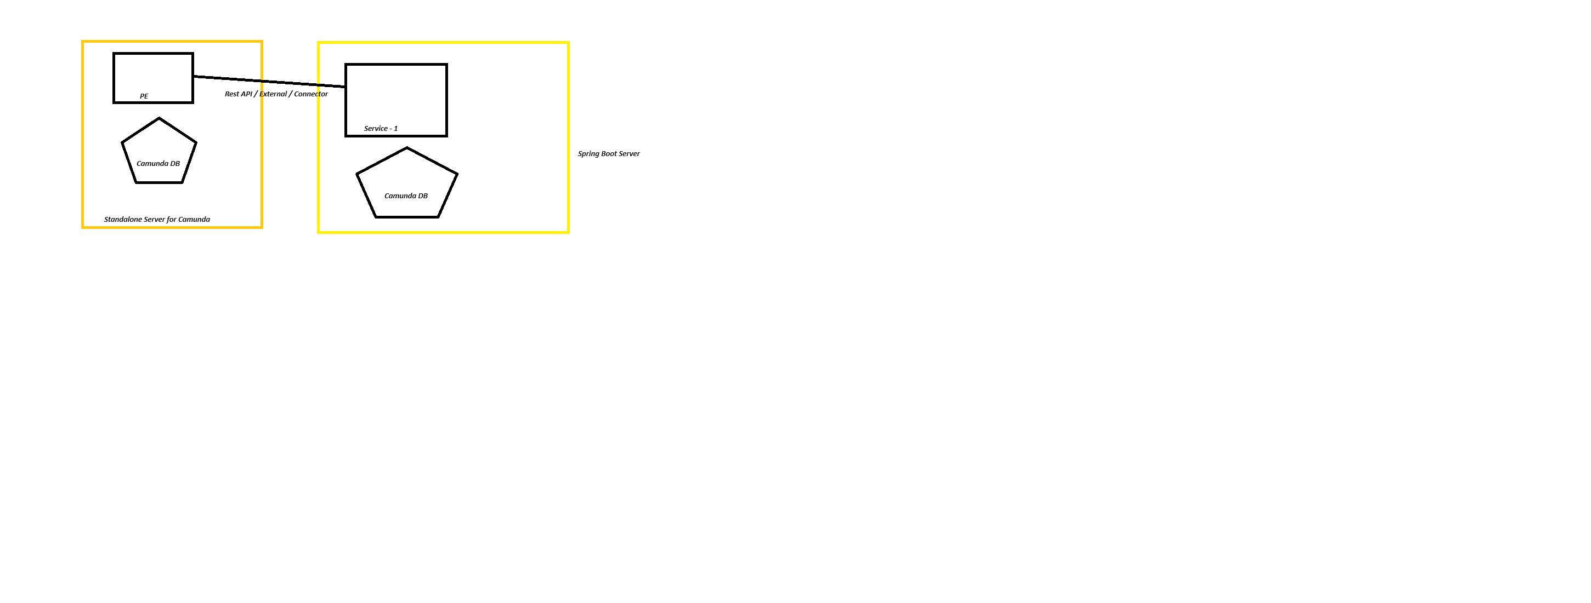
Camunda in Standalone Server and APP in other Server

Slide 126
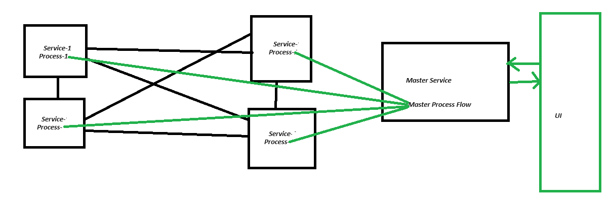
Process Orchestration

Slide 127
Useful tables
The database schema of the process engine consists of multiple tables.
The table names all start with ACT.
The second part is a two-character identification of the use case of the table.
This use case will also roughly match the service API.
ACT_RE_*:
RE stands for repository. Tables with this prefix contain ‘static’ information such as process definitions and process resources (images, rules, etc.).
ACT_RU_*:
RU stands for runtime. These are the runtime tables that contain the runtime data of process instances, user tasks, variables, jobs, etc. The engine only stores the runtime data during process instance execution and removes the records when a process instance ends. This keeps the runtime tables small and fast.
ACT_ID_*:
ID stands for identity. These tables contain identity information such as users, groups, etc.
ACT_HI_*:
HI stands for history. These are the tables that contain historical data such as past process instances, variables, tasks, etc.
ACT_GE_*:
General data, which is used in various use cases.

Slide 128
Useful tables
ACT_HI_PROCINST
Information of history Processes
ACT_HI_TASKINST
Information of history Tasks
ACT_ID_GROUP
Groups available in process engine
ACT_ID_USER
User Information
ACT_RU_AUTHORIZATION
User authorization logs
ACT_RU_TASK
Task Details

Slide 129
Useful tables
ACT_HI_PROCINST
ID_ | PROC_INST_ID_ | BUSINESS_KEY_ | PROC_DEF_KEY_ | PROC_DEF_ID_ | START_TIME_ | END_TIME_ | REMOVAL_TIME_ | DURATION_ | START_USER_ID_ | START_ACT_ID_ | END_ACT_ID_ | SUPER_PROCESS_INSTANCE_ID_ | ROOT_PROC_INST_ID_ | SUPER_CASE_INSTANCE_ID_ | CASE_INST_ID_ | DELETE_REASON_ | TENANT_ID_ | STATE_
07a2c56f-2bd9-11ef-989e-16d4246ce74d | 07a2c56f-2bd9-11ef-989e-16d4246ce74d | asd | generic-project-process | generic-project-process:1:84dee801-2a47-11ef-af3c-16d4246ce74d | 2024-06-16 17:37:40.779 | null | null | null | demo | StartEvent_1 | null | null | 07a2c56f-2bd9-11ef-989e-16d4246ce74d | null | null | null | null | ACTIVE

Slide 130
Useful tables
ACT_HI_TASKINST
ID_ | TASK_DEF_KEY_ | PROC_DEF_KEY_ | PROC_DEF_ID_ | ROOT_PROC_INST_ID_ | PROC_INST_ID_ | EXECUTION_ID_ | CASE_DEF_KEY_ | CASE_DEF_ID_ | CASE_INST_ID_ | CASE_EXECUTION_ID_ | ACT_INST_ID_ | NAME_ | PARENT_TASK_ID_ | DESCRIPTION_ | OWNER_ | ASSIGNEE_ | START_TIME_ | END_TIME_ | DURATION_ | DELETE_REASON_ | PRIORITY_ | DUE_DATE_ | FOLLOW_UP_DATE_ | TENANT_ID_ | REMOVAL_TIME_
07a78062-2bd9-11ef-989e-16d4246ce74d | say-hello | generic-project-process | generic-project-process:1:84dee801-2a47-11ef-af3c-16d4246ce74d | 07a2c56f-2bd9-11ef-989e-16d4246ce74d | 07a2c56f-2bd9-11ef-989e-16d4246ce74d | 07a2c56f-2bd9-11ef-989e-16d4246ce74d | null | null | null | null | say-hello:07a73241-2bd9-11ef-989e-16d4246ce74d | Say hello to demo | null | null | null | null | 2024-06-16 17:37:40.821 | null | null | null | 50 | null | null | null | null

Slide 131
Useful tables
ACT_ID_GROUP
ID_ | REV_ | NAME_ | TYPE_
camunda-admin | 1 | camunda BPM Administrators | SYSTEM

Slide 132
Use Case
Practice:
Create a report of running process
Create a UI page to list the running process
Create a UI page for all the BPMNs deployed
Try implementing something similar to Cockpit Dashboard

Slide 133
Topic – 1 (Spin)
Camunda Spin is a library for simple XML and JSON processing on the JVM.
For Java and JVM-based scripting languages such as Groovy, JRuby, Jython, JavaScript and Java Expression Language.
It provides a comprehensible fluent API for working with different data formats through lightweight wrapper objects.
Add Dependency as:
<dependency>
<groupId>org.camunda.spin</groupId>
<artifactId>camunda-spin-bom</artifactId>
<version>${version.spin}</version>
</dependency>
<dependency> <groupId>org.camunda.spin</groupId> <artifactId>camunda-spin-core</artifactId> </dependency> <dependency> <groupId>org.camunda.spin</groupId> <artifactId>camunda-spin-dataformat-all</artifactId> </dependency>

Slide 134
Working with XML
Reading XML from a String:
import static org.camunda.spin.Spin.*;
import static org.camunda.spin.DataFormats.*;
SpinXmlElement xml = S("<order />", xml());
OR
import static org.camunda.spin.Spin.*;
SpinXmlElement xml = XML("<order />");
Reading XML from a Reader:
import static org.camunda.spin.Spin.*;
FileInputStream fis = new FileInputStream("/tmp/incomingOrder.xml");
InputStreamReader reader = new InputStreamReader(fis, "utf-8");
SpinXmlElement xml = XML(reader);
Replace Elements
import static org.camunda.spin.Spin.XML;
SpinXmlTreeElement root = XML("<root><date/><order/></root>");
SpinXmlTreeElement child1 = XML("<child/>");
root.replaceChild(root.childElement("date"), child1);
SpinXmlTreeElement child2 = XML("<child/>");
root.childElement("order").replace(child2);

Slide 135
Mapping XML to Java :
We can map the following XML object
<?xml version="1.0" encoding="UTF-8"?>
<customer xmlns="http://camunda.org/example">
<name>Kermit</name>
</customer>
to an instance of Customer in the following way:
import static org.camunda.spin.Spin.XML;
String xmlInput = "<?xml version=\"1.0\" encoding=\"UTF-8\"?>
<customer xmlns=\"http://camunda.org/example\">
<name>Kermit</name></customer>";
Customer customer = XML(xmlInput).mapTo(Customer.class);
Mapping Java to XML:
We can map the customer back to XML as follows:
import static org.camunda.spin.Spin.XML;
String xml = XML(customer).toString();

Slide 136
Working with JSON
Reading JSON from a Reader:
Spin also supports reading JSON from an instance of java.io.Reader:
import static org.camunda.spin.Spin.*;
import static org.camunda.spin.DataFormats.*;
SpinJsonNode json = S(reader, json());
Reading JSON Properties
import static org.camunda.spin.Spin.*;
SpinJsonNode json = JSON("{\"customer\": \"Kermit\"}");
SpinJsonNode customerProperty = json.prop("customer");
String customerName = customerProperty.stringValue();
Writing to a Writer
import static org.camunda.spin.Spin.JSON;
SpinJsonNode jsonNode = JSON("{\"customer\": \"Kermit\"}");
StringWriter writer = jsonNode.writeToWriter(new StringWriter());

Slide 137
Mapping JSON to Java
We can map a JSON object {"name" : "Kermit"} to an instance of Customer as follows:
import static org.camunda.spin.Spin.JSON;
Customer customer = JSON("{\"customer\": \"Kermit\"}").mapTo(Customer.class);
Mapping Java to JSON:
We can map the customer back to JSON as follows:
import static org.camunda.spin.Spin.JSON;
String json = JSON(customer).toString();
Mapping to Generic Types
import static org.camunda.spin.Spin.JSON;
String json = "[{\"customer\": \"Kermit\"}, {\"customer\": \"Kermit\"}]"
List<Customer> customers = JSON(json).mapTo("java.util.ArrayList<somepackage.Customer>");

Slide 138
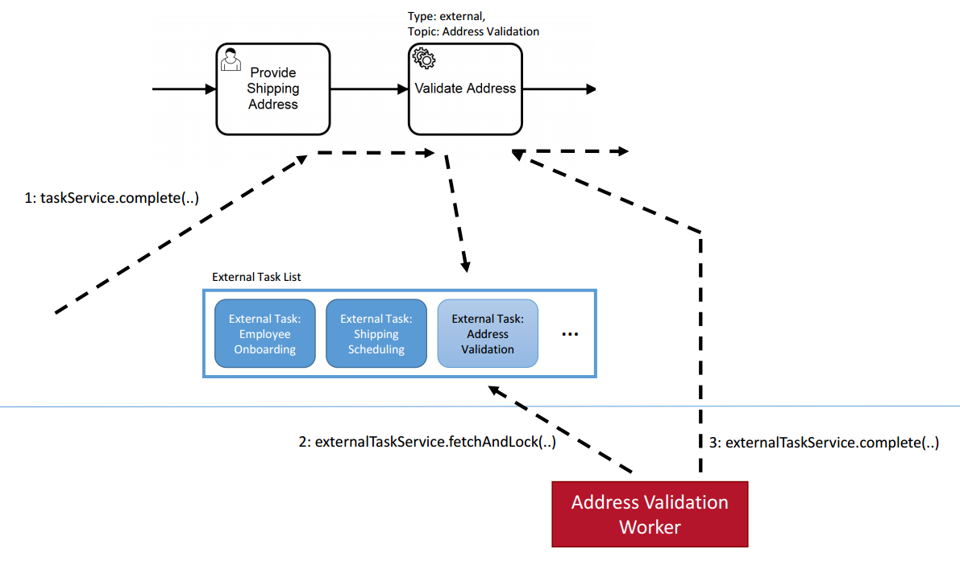
Topic – 2 (External Task)
External tasks: Providing a unit of work in a list that can be polled by workers

Slide 139
External Task
Process Engine:
Creation of an external task instance
External Worker:
Fetch and lock external tasks
External Worker & Process Engine:
Complete external task instance

Slide 140
External Task
External Task Process (Task Publisher/Provide)
Create a Service Task with external task topic name,
ex:
External Task Client (Task Subscriber)
Step 1 – Dependency
<dependency>
<groupId>org.camunda.bpm.springboot</groupId>
<artifactId>camunda-bpm-spring-boot-starter-external-task-client</artifactId>
</dependency>
Step 2 – External Task Provider Process engine and subscriber details
camunda.bpm.client:
base-url: http://localhost:8080/engine-rest #URL of Process Engine
lock-duration: 20000 # time in ms & external task will be locked
subscriptions:
ratingProvider:
variable-names: []
process-definition-key: externalTaskClientProcess
candidateRating:
variable-names: candidateScore
process-definition-key: externalTaskClientProcess
Step 3 – Write Handlers
@ExternalTaskSubscription("ratingProvider")
public class GenerateRatingHandler implements ExternalTaskHandler {

Slide 141
Topic – 3 (Camunda Transaction Agenda)
Transaction Management
Describe the transactional behavior of Camunda
Identify transaction boundaries in a process model
Identify and resolve incidents in a process instance
Model processes to make effective use of transactions
Transaction Concept and Wait State Elements
Asynchronous Before After and Custom Transaction Boundary

Slide 142
Transaction Boundaries
Transactions in Processes
The process engine is a piece of passive Java code which works in the Thread of the client.
A wait state
is a task which is performed later, which means that the engine persists the current execution to the database and waits to be triggered again.
wait states are transaction boundaries where the process state is stored to the database, the thread returns to the client and the transaction is committed.
Default Wait State Elements:
Receive Task
User Task
Message Event
Timer Event
Signal Event
The Event Based Gateway:

Slide 143
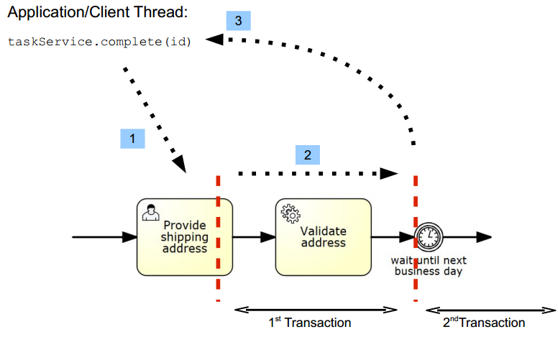
Async After and Before
Keep in mind that Asynchronous Continuations can add transaction boundaries to other tasks as well.
The transition from one such stable state to another stable state is always part of a single transaction, meaning that it succeeds as a whole or is rolled back on any kind of exception occurring during its execution.

Slide 144
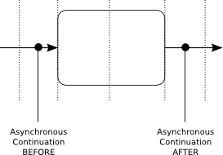
Configure Asynchronous Continuations
Asynchronous Continuations can be configured before and after an activity. Additionally, a process instance itself may be configured to be started asynchronously.
<serviceTask id="service1" name="Generate Invoice" camunda:asyncBefore="true" camunda:class="my.custom.Delegate" />
<serviceTask id="service1" name="Generate Invoice" camunda:asyncAfter="true" camunda:class="my.custom.Delegate" />

Slide 145
Configure Asynchronous Continuations
Also, we can configure
Retry Time Cycle
By Default Camunda retries
3 times
It also raises Incidents
Can be retried from cockpit
Incidents can be handled using –
ProcessEnginePlugin
DefaultIncidentHandler

Slide 146
Incidents
Incidents are notable events that happen in the process engine.
Such incidents usually indicate some kind of problem related to process execution.
Examples of such incidents may be a failed job with depleted retries (retries = 0), indicating that an execution is stuck and manual administrative action is necessary to repair the process instance.
If such incidents arise, the process engine fires an internal event which can be handled by a configurable incident handler.
Incident Types
failedJob: is raised when automatic retries for a job (timer or asynchronous continuation) have been depleted.
failedExternalTask: is raised when a worker of an External Task reports a failure and the given retries are set to a value <= 0.

Slide 147
Creating and Resolving Custom Incidents
An incident of any type can be created by calling RuntimeService#createIncident..
… or directly DelegateExecution#createIncident.
Implement Custom Incident Handlers
Incident Handlers are responsible for handling incidents of a certain type
public interface IncidentHandler {
String getIncidentHandlerType();
Incident handleIncident(IncidentContext context, String message);
void resolveIncident(IncidentContext context);
void deleteIncident(IncidentContext context);
}

Slide 148
Topic – 4 (Platform-microservices)
Managing Process Data
Describe how process data is persisted and managed by the Process Engine
Building Robust Process Applications
Handle expected events in business processes
Handle errors and unexpected events in business processes

Slide 149
Process Engine Concepts
Process Definitions
A process definition defines the structure of a process. You could say that the process definition is the process.
Query for Process Definitions
can query for all deployed process definitions using the Java API and the ProcessDefinitionQuery made available through the RepositoryService. Example:
List<ProcessDefinition> processDefinitions = repositoryService.createProcessDefinitionQuery() .processDefinitionKey("invoice") .orderByProcessDefinitionVersion() .asc() .list();
Keys and Versions
The key of a process definition (invoice in the example above) is the logical identifier of the process. It is used throughout the API, most prominently for starting process instance.
Suspend Process Definitions
Suspending a process definition disables it temporarily, i.e., it cannot be instantiated while it is suspended. The RuntimeService Java API can be used to suspend a process definition. Similarly, you can activate a process definition to undo this effect.

Slide 150
Process Engine Concepts
Process Instances
A process instance is an individual execution of a process definition.
Start a Process Instance
The simplest way to start a process instance is by using the startProcessInstanceByKey(...) method offered by the RuntimeService:
Interact With a Process Instance
Once we have performed a query for a particular process instance (or a list of process instances), you may want to interact with it. There are multiple possibilities to interact with a process instance, most prominently:
Triggering it (make it continue execution):
Through a Message Event
Through a Signal Event
Canceling it:
Using the RuntimeService.deleteProcessInstance(...) method.
Starting/Canceling any activity:
Using the process instance modification feature
If your process uses at least one User Task, you can also interact with the process instance using the TaskService API.

Slide 151
Jobs and Job Definitions
The Camunda process engine includes a component named the Job Executor. The Job Executor is a scheduling component, responsible for performing asynchronous background work.
Consider the example of a Timer Event:
whenever the process engine reaches the timer event, it will stop execution, persist the current state to the database and create a job to resume execution in the future. A job has a due date which is calculated using the timer expression provided in the BPMN XML.
When a process is deployed, the process engine creates a Job Definition for each activity in the process which will create jobs at runtime.
This allows you to query information about timers and asynchronous continuations in your processes.

Slide 152
Process Variables
Variables can be used to add data to process runtime state or, more particular, variable scopes.
Variable Scopes and Variable Visibility
All entities that can have variables are called variable scopes
If there is a process instance with two child executions,
each of which has created a task.
All these five entities are variable scopes and the arrows mark a parent-child relationship.
A variable that is defined on a parent scope is accessible in every child scope unless a child scope defines a variable of the same name.
The other way around, child variables are not accessible from a parent scope. Variables that are directly attached to the scope in question are called local variables.
In general, variables are accessible in the following cases:
Instantiating processes
Delivering messages
Task lifecycle transitions, such as completion or resolution
Setting/getting variables from outside
Setting/getting variables in a Delegate
Expressions in the process model
Scripts in the process model
(Historic) Variable queries

Slide 153
Process Variables
Set and Retrieve Variables - Overview
To set and retrieve variables, the process engine offers a Java API that allows setting of variables from Java objects and retrieving them in the same form.
two APIs:
Java Object Value API: Variables are represented as Java objects. These objects can be directly set as values and retrieved in the same form. This is the more simple API and is the recommended way when implementing code as part of a process application.
Typed Value API: Variable values are wrapped in so-called typed values that are used to set and retrieve variables. A typed value offers access to metadata such as the way the engine has serialized the variable and, depending on the type, the serialized representation of the variable. Metadata also contains an information whether a variable is transient or not.
Supported Variable Values
boolean: Instances of java.lang.Boolean
bytes: Instances of byte[]
short: Instances of java.lang.Short
integer: Instances of java.lang.Integer
long: Instances of java.lang.Long
double: Instances of java.lang.Double
date: Instances of java.util.Date
string: Instances of java.lang.String
null: null references

Slide 154
Process Variables
Object Value Serialization
When an object value is passed to the process engine, a serialization format can be specified to tell the process engine to store the value in a specific format.
Based on this format, the engine looks up a serializer.
The serializer is able to serialize a Java object to the specified format and deserialize it from a representation in that format.
Ex:
CustomerData customerData = new CustomerData();
ObjectValue customerDataValue = Variables.objectValue(customerData) .serializationDataFormat(Variables.SerializationDataFormats.JAVA) .create();
execution.setVariable("someVariable", customerDataValue);
Java Object API
The most convenient way of working with process variables from Java is to use their Java object representation.
com.example.Order order = new com.example.Order();
runtimeService.setVariable(execution.getId(), "order", order);
com.example.Order retrievedOrder = (com.example.Order) runtimeService.getVariable(execution.getId(), "order");

Slide 155
Process Variables
File Values
Files can be persisted as BLOBs in the database. The file value type allows to store additional metadata such as a file name and a mime type along with it.
FileValue typedFileValue = Variables .fileValue("addresses.txt") .file(new File("path/to/the/file.txt")) .mimeType("text/plain") .encoding("UTF-8") .create(); runtimeService.setVariable(execution.getId(), "fileVariable", typedFileValue);
JSON and XML Values
The Camunda Spin plugin provides an abstraction for JSON and XML documents that facilitate their processing and manipulation.
Input/Output Variable Mapping
To improve the reusability of source code and business logic, Camunda 7 offers input/output mapping of process variables. This can be used for tasks, events and subprocesses.
<camunda:inputOutput> <camunda:inputParameter name="x"> <camunda:list> <camunda:value>a</camunda:value> <camunda:value>${1 + 1}</camunda:value> <camunda:list> <camunda:value>1</camunda:value> <camunda:value>2</camunda:value> <camunda:value>3</camunda:value> </camunda:list> </camunda:list> </camunda:inputParameter> <camunda:outputParameter name="y"> <camunda:map> <camunda:entry key="foo">bar</camunda:entry> <camunda:entry key="map"> <camunda:map> <camunda:entry key="hello">world</camunda:entry> <camunda:entry key="camunda">bpm</camunda:entry> </camunda:map> </camunda:entry> </camunda:map> </camunda:outputParameter> </camunda:inputOutput>

Slide 156
Error Handling Strategies
There are a couple of basic strategies to handle errors and exceptions within processes. The decision which strategy to use depends on:
Technical vs. Business Errors:
Does the error have some business meaning and causes an alternative process flow (like “item not on stock”) or is it a technical malfunction (like “network currently down”)?
Explicit error handling or generic approach:
For some situations you want to explicitly model what should happen in case of an error (typically for business errors).
Transaction Rollbacks
The standard handling strategy is that exceptions are thrown to the client, meaning that the current transaction is rolled back. This means that the process state is rolled back to the last wait state.
Async and Failed Jobs
If you don’t want the exception being shown to the user, one option is to make service calls, which might cause an error, async (as described in Transactions in Processes). In that case the exception is stored in the process engine database and the Job in the background is marked as failed (to be more precise, the exception is stored and some retry counter is decremented).

Slide 157
Error Handling Strategies
Catch Exception and use Data Based XOR-Gateway
If you call Java Code which can throw an exception, you can catch the exception within the Java Delegate, CDI Bean or whatsoever.
BPMN 2.0 Error Event
The BPMN 2.0 error event gives you the possibility to explicitly model errors, tackling the use case of business errors.
The most prominent example is the “intermediate catching error event”, which can be attached to the boundary of an activity.
BPMN 2.0 Compensation and Business Transactions
BPMN 2.0 transactions and compensations allow you to model business transaction boundaries (however, not in a technical ACID manner) and make sure already executed actions are compensated during a rollback.

Slide 158
Error Handling Strategies
Monitoring and Recovery Strategies
In case the error occurred, different recovery strategies can be applied.
Let the User Retry
As mentioned above, the simplest error handling strategy is to throw the exception to the client, meaning that the user has to retry the action himself. How he does that is up to the user, normally reloading the page or clicking again.
Retry Failed Jobs
If you use Jobs (async), you can leverage Cockpit as monitoring tool to handle failed jobs, in this case no end user sees the exception.
Explicit Modeling
Of course you can always explicitly model a retry mechanism as pointed out in Where is the retry in BPMN 2.0:
User Tasks for Operations
Actually this is a valid approach in which you assign errors to an operator as User Tasks and model what options he has to solve the problem.

Slide 159
Error Handling Strategies
Exception codes
Sometimes an API call doesn’t succeed because a problem occurs. The Java programming model uses exceptions to handle these situations.
Built-in codes
We identified common situations in which the engine throws an exception and assigned a built-in error code to the exception.
Custom codes
Sometimes you may want to assign codes to specific errors Camunda hasn’t covered so far.
Configuration
You can configure the exception error codes feature in your process engine configuration:
To disable the exception codes feature entirely,
set the flag disableExceptionCode in your process engine configuration to true.
To disable the built-in exception code provider

Slide 160
Topic – 5 (Platform Config)
Platform Configuration
Configure logging
Configure clustering
Configure multi-tenancy
Secure a Camunda environment
Authentication – User, Group
Authorization – provide role access

Slide 161
Configure logging
SLF4J
Most Camunda modules, including the Camunda engine, use slf4j as logging “facade”.
This allows users to direct logging output to the logging “backend” of their choice, such as logback or log4j.
Preconfigured Logging with a Shared Process Engine
When installing Camunda as a shared process engine in an application server, Camunda logging is pre-configured.
On all application servers except Wildfly, logging is pre-configured using the slf4j-jdk14 bridge.
Adding a Logging Backend for Embedded Use
When using the Camunda Maven modules in a custom application, only the slf4j API is pulled in transitively.

Slide 162
Configure logging
Logging Categories
Process Engine
The process engine logs on the following categories.. Etc..
Logger | Description
org.camunda.bpm.application | logs details for the deployed process application on the engine
org.camunda.bpm.container | logs container operations in the engine
org.camunda.bpm.engine.bpmn.behavior | logs operations performed on bpmn activities
org.camunda.bpm.engine.bpmn.parser | logs events that occur during the parsing of the bpmn models

Slide 163
Configure clustering
Camunda Optimize Cluster which is mainly useful in a failover scenario but also provides means of load-balancing in terms of distributing import and user load.
Configuration
1. Import - Define Importing Instance
Import - Event Based Process Import
2. Distributed User Sessions - Configure shared secret token
Import - Define Importing Instance
Configure the cluster in a way that only one instance at a time is actively importing from a particular Camunda Platform engine.
The configuration property engines.${engineAlias}.importEnabled allows to disable the import from a particular configured engine.

Slide 164
Configure clustering
Import - Define Importing Instance
failover cluster consisting of two instances connected to one engine, the engine configurations in the environment-config.yaml would look like the following:
Instance 1 (import from engine default enabled):
...
engines:
'camunda-bpm':
name: default
rest: 'http://localhost:8080/engine-rest'
importEnabled: true
...
Instance 2 (import from engine camunda-bpm disabled):
...
engines:
'camunda-bpm':
name: default
rest: 'http://localhost:8080/engine-rest'
importEnabled: false
historyCleanup:
enabled: false
Note that the second non-importing instance has the history cleanup disabled. It is strongly recommmended to do that for all non-importing Optimize instances in the cluster to prevent any conflicts when the history cleanup is performed.

Slide 165
Configure clustering
Import - Event Based Process Import
event based process import and clustering there are two additional configuration properties to consider carefully
engines.${engineAlias}.eventImportEnabled and controls whether data from this engine is imported as event source data as well for Event Based Processes.
You need to enable this on the same cluster node for which the engines.${engineAlias}.importEnabled configuration flag is set to true.
eventBasedProcess.eventImport.enabled controls whether the particular cluster node processes events to create event based process instances.
This allows you to run a dedicated node that performs this operation, while other nodes might just feed in Camunda activity events.

Slide 166
Configure clustering
Distributed User Sessions - Configure shared secret token
If more than one Camunda Optimize instance are accessible by users for e.g. a failover scenario a shared secret token needs to be configured for all of the instances.
This enables distributed sessions among all instances and users do not loose their session when being routed to another instance.
The relevant configuration property is auth.token.secret which needs to be configured in the environment-configuration.yaml of each Camunda Optimize instance that is part of the cluster.
It is recommended to use a secret token with at least a length of 64 characters generated using a sufficiently good random number generator, for example the one provided by /dev/urandom on Linux systems.
The following example command would generate a 64 character random string:
< /dev/urandom tr -dc A-Za-z0-9 | head -c64; echo

Slide 167
Configure clustering
The corresponding environment-config.yaml entry would look the same for all instances of the cluster:
auth:
token:
secret: '<your secret 64 character string>'

Slide 168
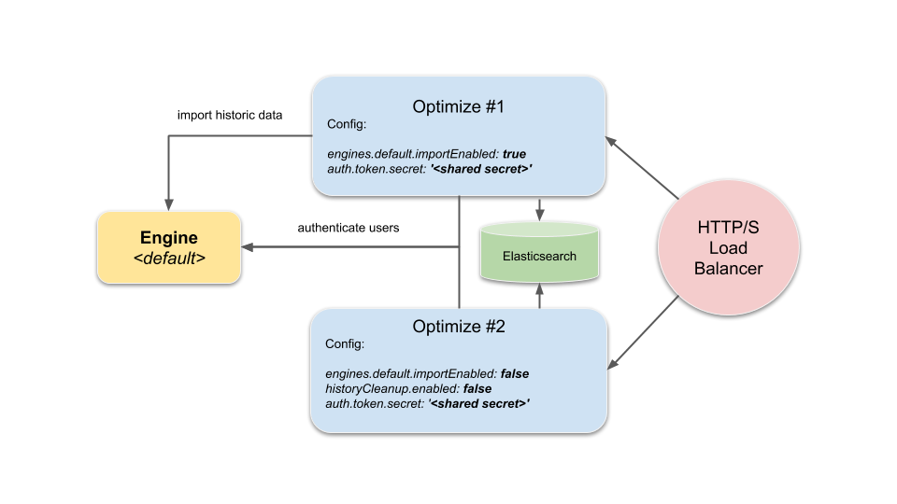
Configure clustering
Camunda Optimize Cluster which is mainly useful in a failover scenario but also provides means of load-balancing in terms of distributing import and user load.
Configuration
1. Import - Define Importing Instance
Import - Event Based Process Import
2. Distributed User Sessions - Configure shared secret token

Slide 169
Multi-tenancy
Multi-Tenancy –
single Camunda installation should serve more than one tenant.
For each tenant, certain guarantees of isolation should be made. For example, one tenant’s process instances should not interfere with those of another tenant.
Multi-Tenancy can be achieved in two different ways-
1. Use one process engine per tenant.
2. Use just one process engine and associate the data with tenant identifiers.
The two ways differ from each other in the level of data isolation, the effort of maintenance and the scalability. A combination of both ways is also possible.

Slide 170
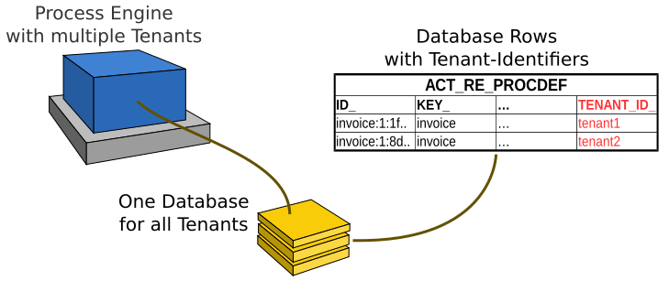
Multi-tenancy
Single Process Engine With Tenant-Identifiers
Multi-Tenancy can be achieved with one process engine which uses tenant identifiers (i.e., tenant-ids).
The data of all tenants is stored in one table (same database and schema).
Isolation is provided by the means of a tenant identifier that is stored in a column.
The tenant identifier is specified on the deployment and is propagated to all data that is created from the deployment (e.g., process definitions, process instances, tasks, etc.).

Slide 171
Multi-tenancy (working with Single Tenant)
Deploy Definitions for a Tenant
To deploy definitions for a single tenant, the tenant identifier has to be set on the deployment.
Specify the Tenant Identifier via Java API
repositoryService .createDeployment()
.tenantId("tenant1")
.addZipInputStream(inputStream)
.deploy()
Specify the Tenant Identifier via Spring Configuration
Create a Process Instance
runtimeService .createProcessInstanceByKey("key")
.processDefinitionTenantId("tenant1")
.execute();
Correlate a Message
runtimeService .createMessageCorrelation("messageName") .tenantId("tenant1") .correlate();

Slide 172
Multi-tenancy (Working with all Tenants)
Deploy a Shared Definition
Deploying a shared definition is just a “regular” deployment not assigning a Tenant Id to the deployment:
repositoryService
.createDeployment()
.addClasspathResource("processes/default/mainProcess.bpmn")
.addClasspathResource("processes/default/subProcess.bpmn")
.deploy();
Include Shared Definitions in a Query
tenant id is null => process is a shared resource.

Slide 173
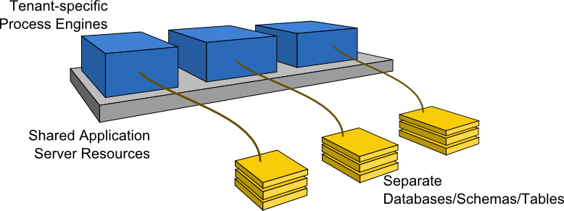
Multi-tenancy (One Process Engine Per Tenant)
Multi-Tenancy can be achieved by providing one process engine per tenant.
Each process engine is configured to use a different data source which connects the data of the tenant.
The data of the tenants can be stored in different databases, in one database with different schemas or in one schema with different tables.
The process engines can run on the same server so that all share the same computational resources such as a data source (when isolating via schemas or tables) or a thread pool for asynchronous job execution.

Slide 174
Multi-tenancy (One Process Engine Per Tenant)
Configure the Process Engines
The process engines can be configured in a configuration file or via Java API.
Each engine should have a name that is related to a tenant such that it can be identified based on the tenant. For example, each engine can be named after the tenant it serves.
Database Isolation
If different tenants should work on entirely different databases, they have to use different JDBC settings or different data sources.
Schema or Table Isolation
For schema- or table-based isolation, a single data source can be used which means that resources like a connection pool can be shared among multiple engines. To achieve this,
the configuration option databaseTablePrefix can be used to configure database access.
consider switching on the setting useSharedSqlSessionFactory.

Slide 175
Multi-tenancy (One Process Engine Per Tenant)
Example Configuration for Schema Isolation
Multi-Tenancy settings can be applied in the various ways of configuring a process engine.
<?xml version="1.0" encoding="UTF-8"?>
<bpm-platform xmlns=http://www.camunda.org/schema/1.0/BpmPlatform>
<job-executor>
<job-acquisition name="default" />
</job-executor>
<process-engine name="tenant1">
<job-acquisition>default</job-acquisition> <configuration>org.camunda.bpm.engine.impl.cfg.StandaloneProcessEngineConfiguration</configuration>
<datasource>java:jdbc/ProcessEngine</datasource>
<properties>
<property name="databaseTablePrefix">TENANT_1.</property>
<property name="history">full</property>
<property name="databaseSchemaUpdate">true</property>
<property name="authorizationEnabled">true</property>
<property name="useSharedSqlSessionFactory">true</property>
</properties>
</process-engine>
<process-engine name="tenant2">
<job-acquisition>default</job-acquisition>
<configuration>org.camunda.bpm.engine.impl.cfg.StandaloneProcessEngineConfiguration</configuration>
<datasource>java:jdbc/ProcessEngine</datasource>
<properties>
<property name="databaseTablePrefix">TENANT_2.</property>
<property name="history">full</property>
<property name="databaseSchemaUpdate">true</property>
<property name="authorizationEnabled">true</property>
<property name="useSharedSqlSessionFactory">true</property>
</properties>
</process-engine>
</bpm-platform>

Slide 176
Multi-tenancy (One Process Engine Per Tenant)
Access the Process Engine of a Tenant
To access a specific tenant’s process engine at runtime, it has to be identified by its name. The Camunda engine offers access to named engines in various programming models:
Plain Java API: Via the ProcessEngineService any named engine can be accessed.
CDI Integration: Named engine beans can be injected out of the box. The built-in CDI bean producer can be specialized to access the engine of the current tenant dynamically.
Via JNDI on Wildfly: On Wildfly, every container-managed process engine can be looked up via JNDI.
The Camunda web applications Cockpit, Tasklist and Admin offer tenant-specific views out of the box by switching between different process engines.

Slide 177
Secure a Camunda environment
Disallow unauthorized access by securing the Camunda 7.x before going live with your process applications.
Understand Camunda user management essentials,
enforce authorization for the REST API,
define access rights for Camunda specific resources such as process definitions, and
consider integrating with your Single-Sign-On (SSO).

Slide 178
Secure a Camunda environment
Understanding user management essentials
Understanding users, groups and tenants
Understanding memberships
Understanding authentication
Understanding authorizations

Slide 179
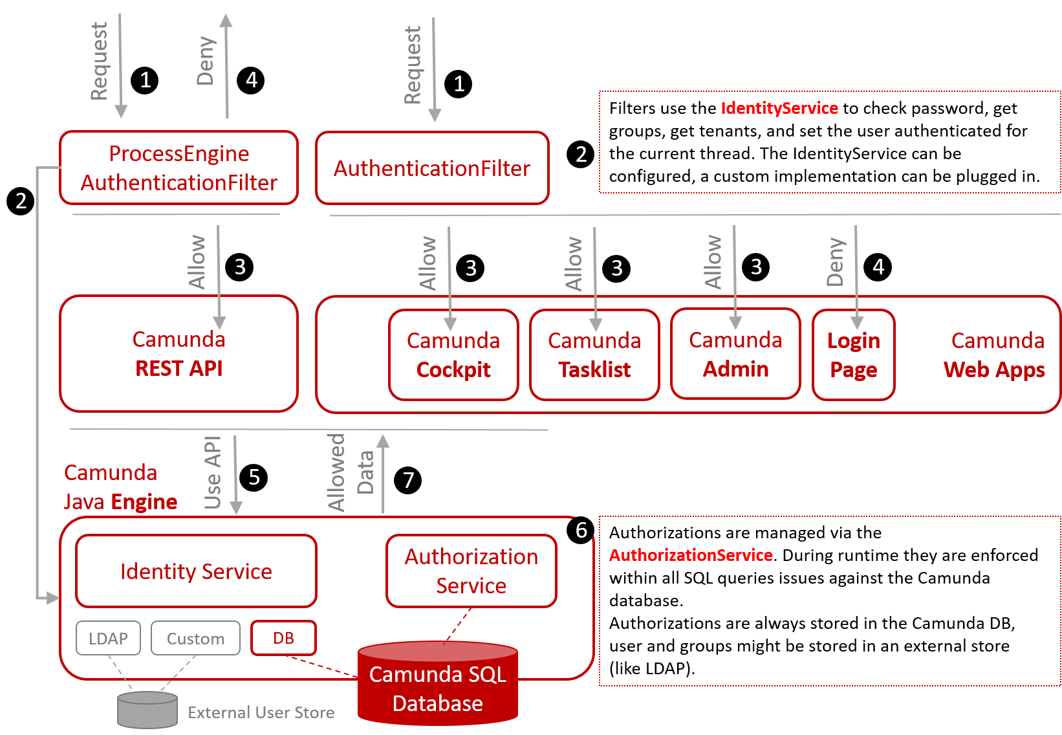
Secure a Camunda environment
Securing Camunda with authentication and authorizations – Admin Web App

Slide 180
Secure a Camunda environment
Securing Camunda's REST API – Spring Security
Enable at least Basic Authentication for the REST API by adjusting the spring-security url patterns.
Default ProcessEngineAuthenticationFilter authenticates the user with HTTP Basic Auth.
It makes use of the IdentityService to check the user's password and to load group and tenant memberships for that user.
If that was successful, it sets the user as authenticated for the current thread via the Java API.

Slide 181
Secure a Camunda environment
Securing Camunda's web applications
The Camunda web applications (Tasklist, Cockpit, Admin) have by default a form based authentication turned on.
There is no further need for changing any configuration when going into production
Supporting single sign-on (SSO) – Spring Security
To implement SSO by making use of the ContainerBasedAuthenticationFilter.
This means that you do not need to replace the existing AuthenticationFilter by a custom one anymore, but you only need to add the ContainerBasedAuthenticationFilter that ships with the product and implement a custom AuthenticationProvider if required.

Slide 182
Topic – 6 (Sizing & Performance)
Sizing & Performance
Describe the factors that affect the performance of Camunda
https://docs.camunda.io/docs/components/best-practices/architecture/sizing-your-environment-c7/
Size a Camunda environment
Tune a Camunda environment for performance
https://docs.camunda.io/docs/components/best-practices/operations/performance-tuning-camunda-c7/

Slide 183
Topic – 7 (Manage Environments)
Managing Environments
Configure monitoring for a Camunda environment
Describe the versioning behaviour of Camunda
Backup & restore a Camunda environment

Slide 184
Best Practices
https://docs.camunda.io/docs/components/best-practices/best-practices-overview/

Slide 185
Assessment
request for new connection (customer)
- online form fillup (name, address, mobile, plan)
- submitted to BB Provider
- timeout - 2 days, after 2 days, it will be escalated to higher mgmt
registration of customer (account/operation)
- create account (name, address, mobile, plan)
- select a plan (list of plans)
- payment
- cash
- online
- payment recvd
- registration completed
- timeout - 1 day, after 1 day, it will be escalated to higher mgmt
installation (implementation/operation)
- get notification
- get account info
- manually install (LAN, BB, FIBER, Wireless Fiber)
- setup with laptop/desktop/mobile/tv/
- installation done
- call us directly (solve immidiately) - 7 days
- after 7 days, call customer care and raise a ticket
- timeout - 2 day, after 2 day, it will be escalated to higher mgmt
monthly/periodically payment
- notification is automated via online, email, message, calls
- payment
- cash
- online
plan change
- get list of plans
- select a plan
- if reqd, do the payment
raise a ticket
- automated device/network testing running in app/online website
- test modem/fiber device/sim
- test network in the area
- do speed test
- reboot device
- connects to customer care
- listen to the problem
- reboot device
- create a ticket
solve the ticket (implementation/operation)
- get notification
- get account info
- check the network device
- also check laptop/desktop/mobile/tv/
- resolve the problem
- timeout - 2 days, after 2 days, it will be escalated to higher mgmt

Slide 186
Troubleshooting
A nice read:
https://camunda.com/blog/2019/10/job-executor-what-is-going-on-in-my-process-engine/

Slide 187
Thank you - Subrat Das - subratagreen@gmail.com

