Slide 1
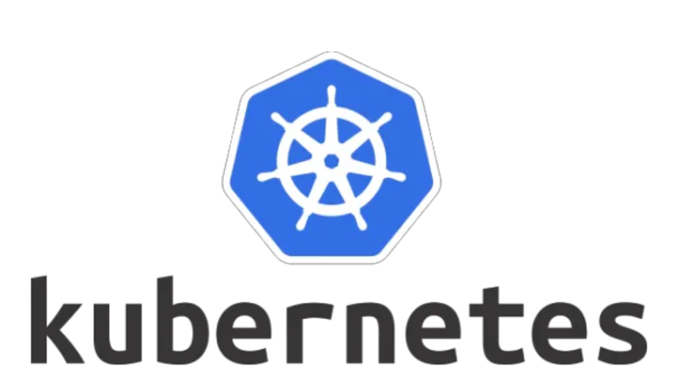

Slide 2
Overview
Kubernetes is a container orchestration technology
Kubernetes comes with a capability of automating deployment, scaling of application, and operations of application containers across clusters
Written on GoLang, it was first developed by Google and later donated to CNCF(Cloud Native Computing Foundation)

Slide 3
Features
Auto Scaling
Automate Deployment
Fault Tolerance
Load Balancing
Rollout and Rollback
Health Monitoring
Platform Independent

Slide 4
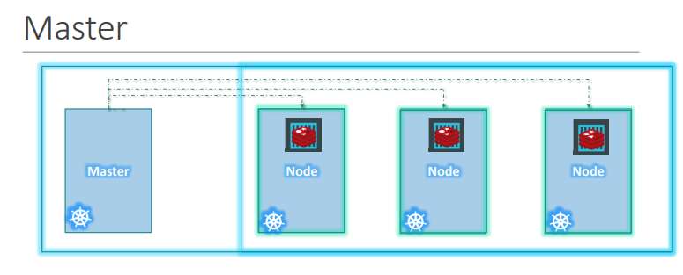
Kubernetes Architecture
Node(Minios) - A node is a machine – physical or virtual – on which kubernetes is installed. A node is a worker machine and this is were containers will be launched by Kubernetes.
Cluster - A cluster is a set of nodes grouped together.
Master - The master watches over the nodes in the cluster and is responsible for the actual orchestration of containers on the worker nodes.

Slide 5
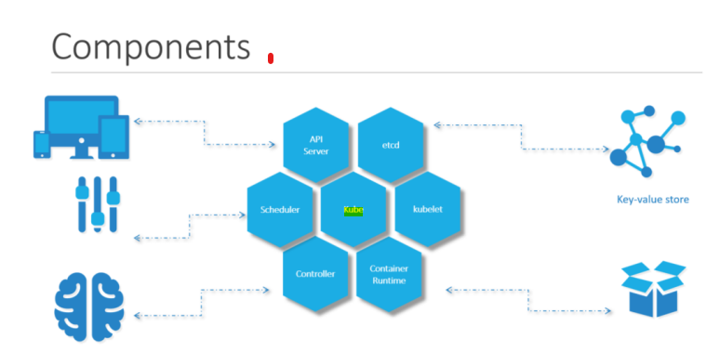
Components
An API Server
ETCD service
Kubelet service
Container Runtime
Controllers
Schedulers

Slide 6
