Slide 1

An Efficient Object Detection and Localization Framework using Modified YOLOv5
Under the guidance of Prof. Anup Nandy.
Presented by
Author: Subrat Kumar Pradhan
Department of Computer Science & Engineering
National Institute of Technology, Rourkela, Odisha - 769010
Contact: 119CS0550@nitrkl.ac.in
1

Slide 2
Research Contribution
Proposed a modified architecture of YOLOv5 model which enhances better performances in terms of precision and speed when detecting objects in diverse environmental conditions like low light, occluded, partial, distance/ tiny objects etc.
Proposed an efficient feature extraction method which enables a satisfying increase in accuracy of object detection.

Slide 3
Introduction
Object detection and localization are integral components of computer vision that enable the identification and precise positioning of objects within images or video streams.
By combining advanced techniques such as deep learning and convolutional neural networks, object detection and localization algorithms have achieved remarkable progress in accurately and efficiently locating objects in diverse environments.
These technologies find applications in fields such as autonomous vehicles, surveillance systems, image analysis, and robotics, facilitating tasks like real-time tracking, scene understanding, and interactive object manipulation.
Researches are going on to improve accuracy , speed and robustness of object detection in various environmental conditions.

Slide 4
Introduction
Image Processing: A group of interconnected computer vision tasks, such as recognizing things in digital photos, are together referred to as object recognition.
Image Classification :
Determine the class or category of an object in an image.
Object Localization :
When there are a group of objects in a single frame, find any object in a picture and use a bounding box to show where they are present accurately.
Object Detection :
Locate the presence of objects with a bounding box and types or classes of the located objects in an image.
Object Detection is categorized into 2 types:
Single Stage Detector
Double Stage Detector

Slide 5
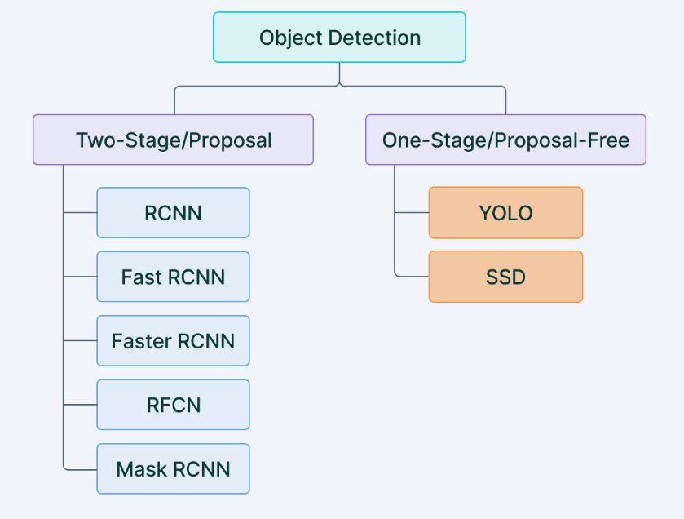
Introduction
Figure 1: Classification of Object Detection

Slide 6
Objective
To design an efficient and improved model for object detection with high precision and fast execution.
To investigate and analyze the impact of different images processing and feature extraction techniques on the proposed model's performance.

Slide 7
Literature survey
Huang et al.[1] proposed a tiny object detection algorithm based on enhanced YOLOv5 in light of the low accuracy of common object detection algorithms in identifying minuscule objects .
The performance of tiny object recognition is enhanced by modifying the YOLOv5 Neck portion, combining it with FPN and PANet, and performing feature fusing on four feature maps with various semantic information.
To better maintain target characteristics, the original ReLU activation function was replaced with the Swish activation function.
Teng et al.[2] proposed a real-time AUV (Automated Under Water Vehicle) underwater detection technique based on the enhanced YOLOv5s in order to enhance the independently recognise ability of AUV to trash underwater.

Slide 8
Literature survey
The anchor box is re-clustered in the improved network design using the KMeans++ clustering method to enhance the ground truth feature information.
Overall, the identification accuracy, recall, and mAP are 87.2%, 97%, and 90.6%, correspondingly.Each picture is detected on average in 0.29 seconds.
Kim et al.[3] proposed a method to fix the SMD (Singapore Maritime Dataset) dataset's annotations for the DNN algorithm benchmark and present an enhanced version called as SMD-Plus. Additionally,it suggests augmentation methods created especially for the SMD-Plus.
To address the class-imbalance issue in the training dataset, a more precise online transformation of training images using Copy & Paste is used. Additionally, the mix-up technique is used for YOLO-V5 in addition to the fundamental augmentation methods.
Ting et al.[4] proposes an enhanced YOLO V5 network to address the issue of insufficient feature extraction in existing ship recognition techniques caused by uneven feature distribution.

Slide 9
Literature survey
In particular, the feature extraction portion of the YOLO V5 network was replaced and fused using the Ghostbottle module, and superior experimental results were achieved when compared to the original YOLO V5 network.
In this research Yan et al.[5] proposes a lightweight fruit target real-time detection technique for the apple picking robot based on improved YOLOv5 was suggested in order to achieve the automatic recognition of graspable and ungraspable fruits for the picking robot in an apple tree picture.
BottleneckCSP -2 module was substituted with BottleneckCSP in the backbone architecture of the original YOLOv5s network, which has a improved designed network architecture to achieve the light-weight improvement of the network.
The average recognition time per picture was 0.015 seconds.

Slide 10
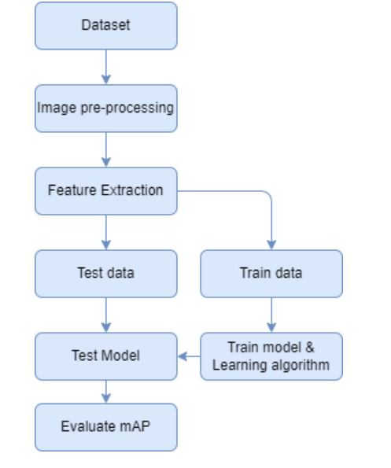
Methodology
Figure 1: Proposed Work Flow of the Model

Slide 11
Methodology
In this project, we implemented modified YOLOv5 model having certain architectural changes and fine tuning of hyperparameters.
Dataset:
The major objective of the proposed research project is to recognise items in a semi-structured environment with inadequate lighting, crowded objects, objects that are obscured by other objects, low light, reflecting surfaces, amorphous bodies, and partial views of an object.
For this project, a custom dataset has been produced. The dataset consists of eight different object classes: spoon, orange, apple, cup, banana, cricket bat, wrist watch and bottle.
By taking pictures of the objects and obtaining the photographs from Google, we were able to get 720 positive samples. The Dataset is divided into train and test set of 80 : 20 ratio. The entire dataset’s image is then scaled to 640*640 pixels.

Slide 12
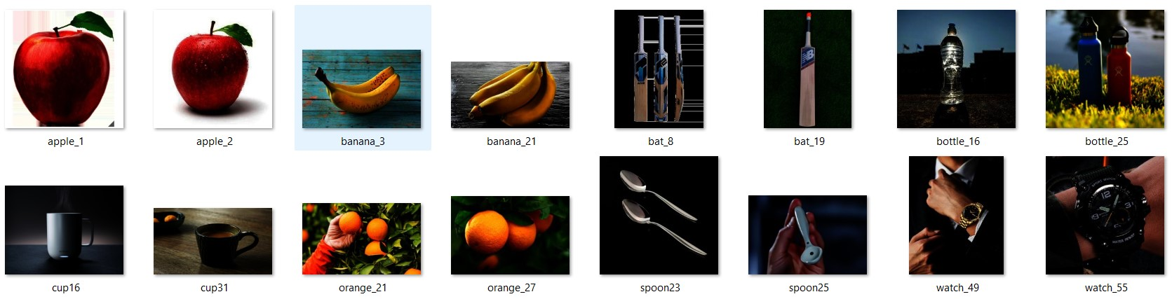
Figure 2: Sample Images of Proposed Dataset
Dataset

Slide 13
Methodology
Data Annotations :
For YOLOV5 model , annotations are done in YOLO format and for SSD MobileNetv2, PASCAL VOC format is used for labeling images.
Data Augmentations:
• Cropping the image
• Scaling the image
• Image flipping in both direction (horizontally and vertically)
• Translating the image in x and y direction
• Piece wise transformation of image
• gray scale conversion of the image and rotating the image with 60,120,180,240 and 360 degree

Slide 14
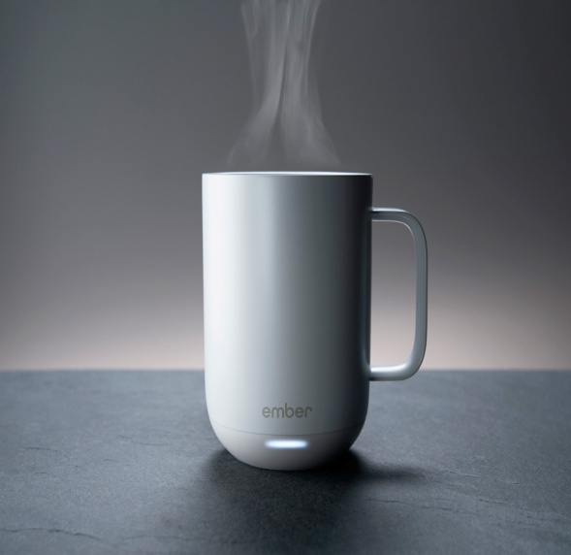
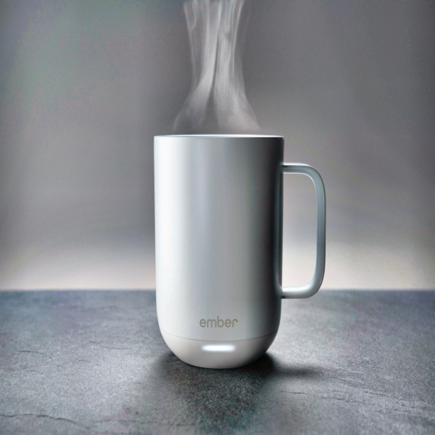
Image Processing
Histogram Equalization:
It works by remapping the grey levels of the picture in accordance with their probability distribution.
The main assumptions of histogram equalization is to re-map the provided intensity values of pixels to a target value in order to enhance the contrast of the image or the quality of its information.
Figure 3: Before and After Histogram Equalization

Slide 15

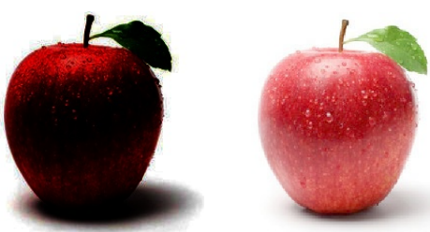
Gamma Correction
Gamma correction is a non-linear modification to each pixel’s value.
gamma correction performs a non-linear operation on the pixels of the original image and may result in saturation of the transformed image.
Figure 4: Before and After Gamma Correction

Slide 16
Feature Extraction
A method for shrinking the size of a picture in which a significant number of its pixels are represented while yet effectively retaining essential information is called feature extraction. The primary goal of feature extraction techniques is to retain pertinent data while removing unimportant data from the picture
If we supply the model with the data after feature extraction, which only includes key information, as opposed to the data in its raw form, the model’s accuracy improves.
Canny Edge Extraction
The multi-stage Canny edge detector is capable of detecting a variety of edges. A clever operator chooses the edge by applying a threshold, which significantly improves edge detection performance.

Slide 17
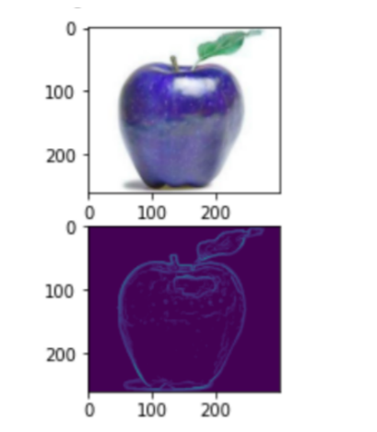
Canny Edge Extraction
The Canny edge detector offers a higher noise to signal ratio and accuracy when compared to other edge extraction methods. The canny edge detection process mainly involves steps like Noise Reduction, Gradient Calculation, Non-Max Suppression, Double Threshold , Edge Tracking by Hysteresis etc
Figure 5: Edge Extraction by Canny Edge Detection

Slide 18
Proposed Feature Extraction Technique
We have proposed a new technique for feature extraction of images for improving accuracy. It is a hybrid of AutoEncoder, Canny edge extraction and SIFT (Scale-invariant feature transform) method.
Autoencoder:
An autoencoder is a type of artificial neural network architecture that is used for unsupervised learning tasks, particularly in the field of deep learning.
It consists of two main components: an encoder and a decoder. The encoder maps the input data to a lower-dimensional representation, often referred to as a latent space or code.
The decoder reconstructs the input data from this lower-dimensional representation.
Autoencoders are commonly used for tasks such as dimensionality reduction, data compression, denoising, and anomaly detection.

Slide 19
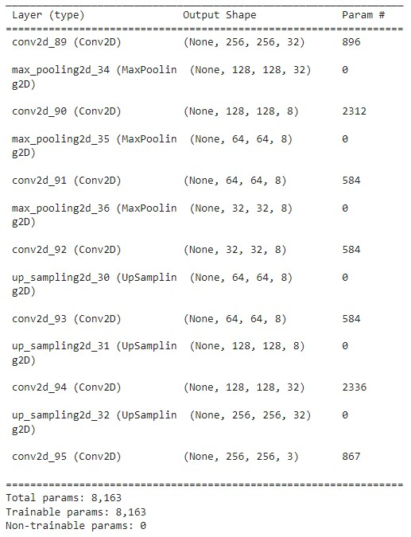
Proposed Feature Extraction Technique
Figure 6: Model Layers of Autoencoder used in Proposed Feature Extraction Method

Slide 20
Proposed Feature Extraction Technique
Canny Edge Extraction
This extraction method enables detection of edge. Edge detection is a technique that takes grey discontinuous points into account while identifying and segmenting pictures.
In order to extract features for this suggested technique, we applied clever edge detection.
SIFT (Scale Invariant Feature Transform) Method:
Scale-space extrema detection
Keypoint localization
Orientation assignment
Descriptor generation

Slide 21
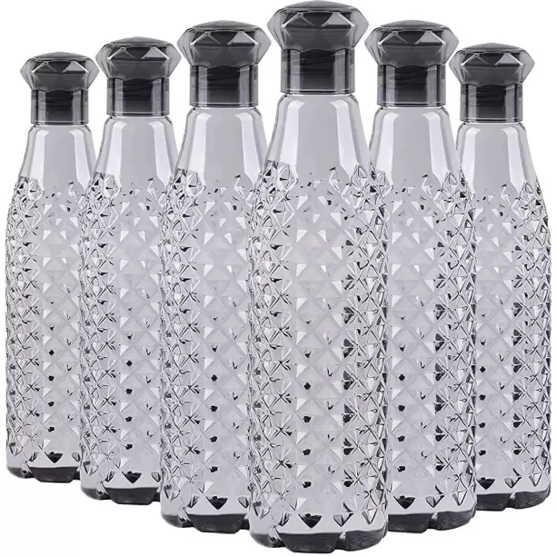
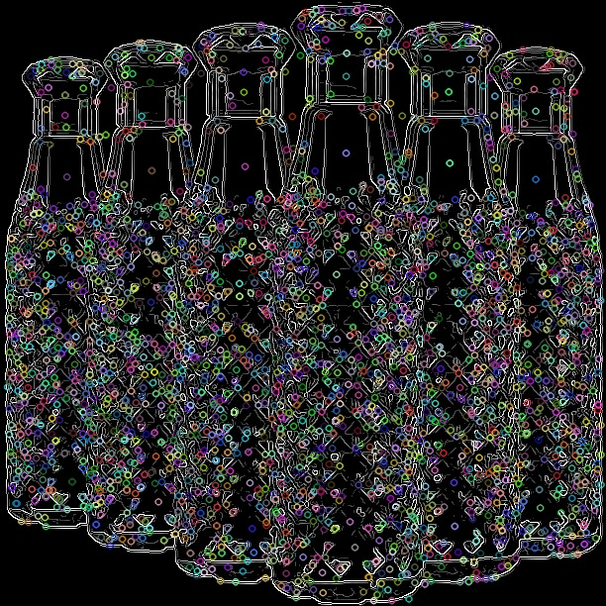
Proposed Feature Extraction Technique
Figure 7: Before and After Proposed Feature Extraction Technique

Slide 22
Model
In this study we have proposed a modified YOLOV5 model having changes in architectural design as well as fine tuning of hyperparameters to increase the performance and accuracy while detecting small and low light images.
Also we proposed SSD MobileNet v2 model for object detection task with fine tuning of hyperparameters. We compared the performances of both models in terms of accuracy and inference speed.
The models in YOLOv5 also show to be substantially smaller, quicker to train, and more adaptable for usage in a practical application. Speed and accuracy have both improved over the quick R-CNN.

Slide 23
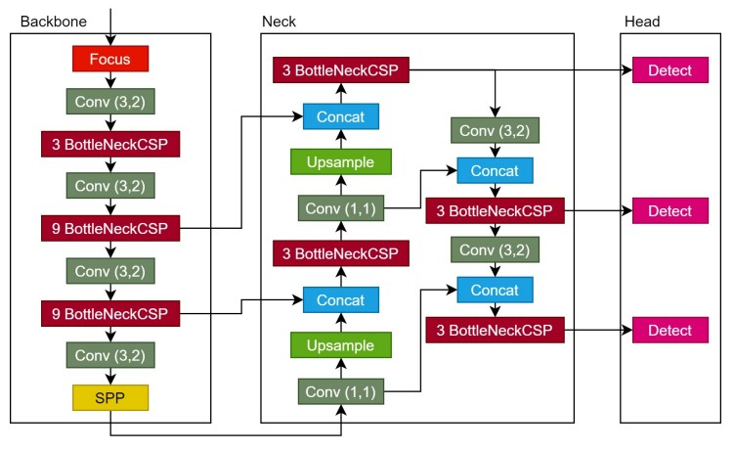
Model
Figure 8: Architecture of Conventional YOLOv5 Model

Slide 24
Proposed Modified YOLOv5 Model
Backbone:
This phase is essential for any object detector since it contains the primary framework for both abstracting and extracting contextual data from the input picture.
Additionally, to concentrate on recognizing certain feature maps, the neck and head's layer connections may be manually changed.
We have added an extra C3 module in the backbone which includes CBS (Conv2D, BN, SILU (Sigmoid + ReLU), 1 BottleNeck with Concat.
Here Leaky ReLU is replaced with SILU(Sigmoid + ReLU) which learns faster and better than ReLU due to its non linearity in nature.

Slide 25
Proposed Modified YOLOv5 Model
Adding an extra layer with suitable dimensions and connecting to Neck layer in exclusive manner by replacing with lower resolution featue maps help to improve accuracy without compromising the inference speed.
SPP (Spatial Pyramidal Pooling ) is replaced with SPPF (Spatial Pyramidal Pooling Fast ) which reduces the number of FLOPS ( Floating Point Operations per Seconds) and improves speed of the model significantly.
Neck:
It serves to collect as much of the data gathered by the backbone as possible before it is given to the head.
Prevent small-object information from being lost to higher levels of abstraction

Slide 26
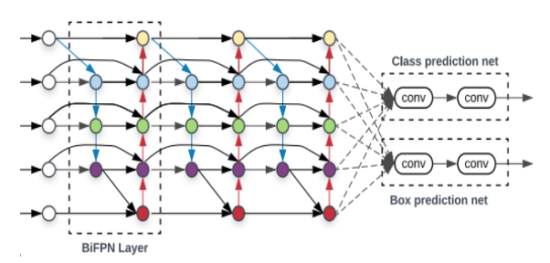
Proposed Modified YOLOv5 Model
In this research, we propose to replace the existing Pan-Net with a biFPN .
BiFPN optimizes these cross-scale connections by removing nodes with a single input edge
It adds an extra edge from the original input to output node if they are on the same level treating each bidirectional path as one feature network layer (repeating it several times for more high-level future fusion).
Figure 9 : Network Architecture of BIFPN

Slide 27
Proposed Modified YOLOv5 Model
Other Modifications:
The amount of parameters will need to be changed to accommodate the new structure since it may impair the network's capacity for learning.
The dimensions of the anchor boxes used in the head, which must be adjusted to the quality of the feature maps being utilized.
Freezing some layers of the model will allow us to train in less GPU memory and may improve mAP score of the model as well.

Slide 28
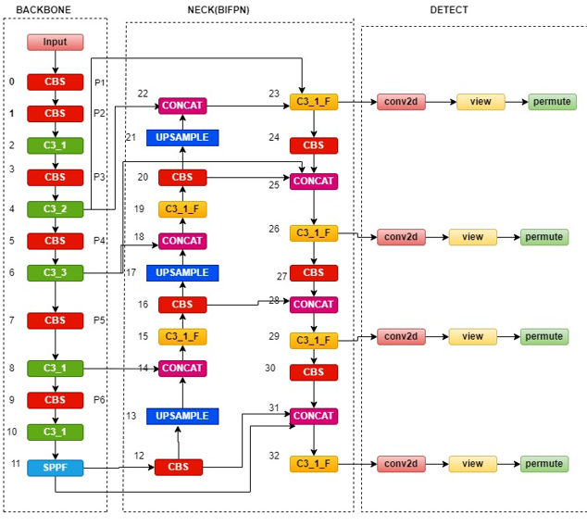
Proposed Modified YOLOv5 Model
Figure 10 : Network Architecture of Modified YOLOv5

Slide 29
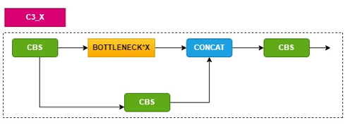
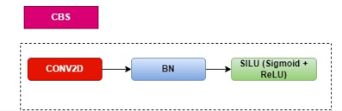
Proposed Modified YOLOv5 Model
Figure 8: Architecture of C3_x
Figure 9: Architecture of CBS

Slide 30
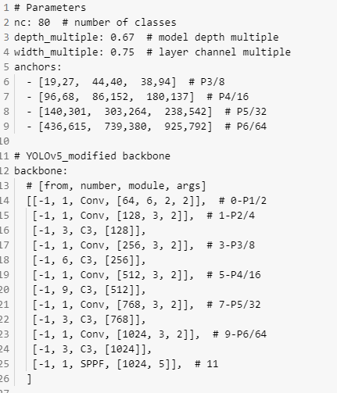
Proposed Modified YOLOv5 Model
Figure 11: YAML file configuration of Proposed Modified YOLOv5 Model (Anchors and Backbone)

Slide 31
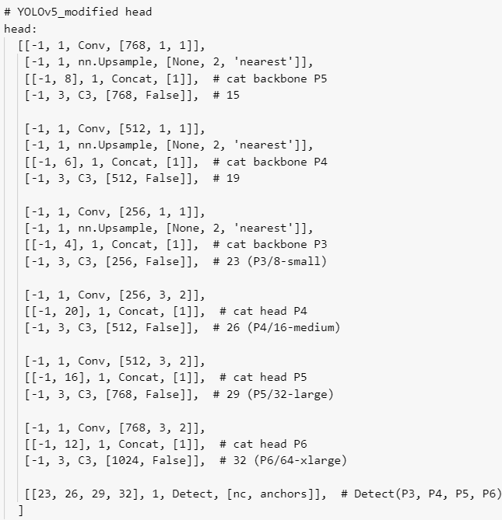
Proposed Modified YOLOv5 Model
Figure 12: YAML file configuration of Proposed Modified YOLOv5 Model (Head)

Slide 32
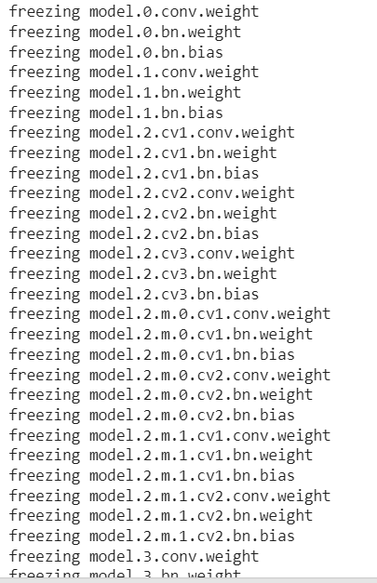
Proposed Modified YOLOv5 Model
Figure 13 : Sample image of Freezing weight and bias of some layers in the model.

Slide 33
Proposed Modified YOLOv5 Model
We've done a bit of experimentation with adding an additional large object output layer P6, following the EfficientDet example of increasing output layers for larger models, except in our case applying it to all models.
The current models have P3 (stride 8, small) to P5 (stride 32, large) outputs. The P6 output layer is stride 64 and intended for extra-large objects.
We have freezed weights and bias of some layers of the model to increase the accuracy as well as training in a model having large parameters in less amount of GPU memory.

Slide 34
Anchor Box Selection using Genetic Algorithm
Anchor boxes are a set of predefined bounding boxes of a certain height and width.
These boxes are defined to capture the scale and aspect ratio of specific object classes you want to detect and are typically chosen based on object sizes in your training datasets.
Steps to determine best fit anchor boxes:
Get bounding box sizes from the train data
Choose a metric to define anchor fitness
Do clustering to get an initial guess for anchors
Evolve anchors to improve anchor fitness

Slide 35
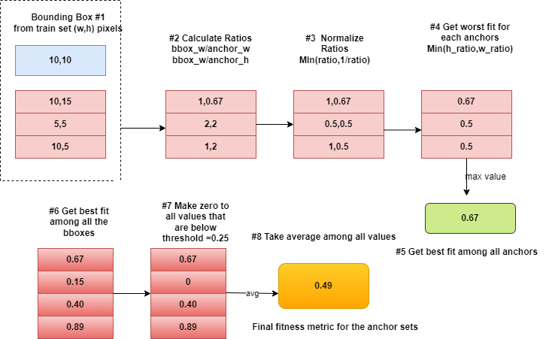
Metric to define anchor fitness
Figure 14: Fitness metric calculation for set of anchor boxes

Slide 36
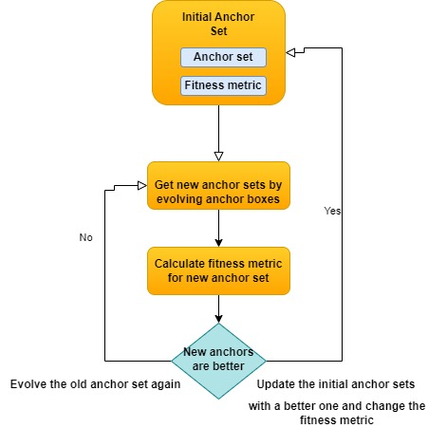
Evolve anchors to improve anchor fitness
Figure 15: Algorithm for evolving anchors

Slide 37
Results and Discussions
We performed several experiments to our proposed algorithm of modified YOLOV5 model.
With a batch size of 16, the model has successfully trained across 25 epochs (20 steps each epoch).Stochastic gradient descent (SGD) optimiser with learning rate of 0.05 and 4 number of anchors are used to train this proposed model.
We have recorded the performance metrics in the form of mean average precision(mAP), precision,recall and F1-score.
Our modified YOLOv5 model gives a mAP score of 95.8% at the IOU threshold of 0.5 and total loss of 0.01% which is quite satisfying.

Slide 38
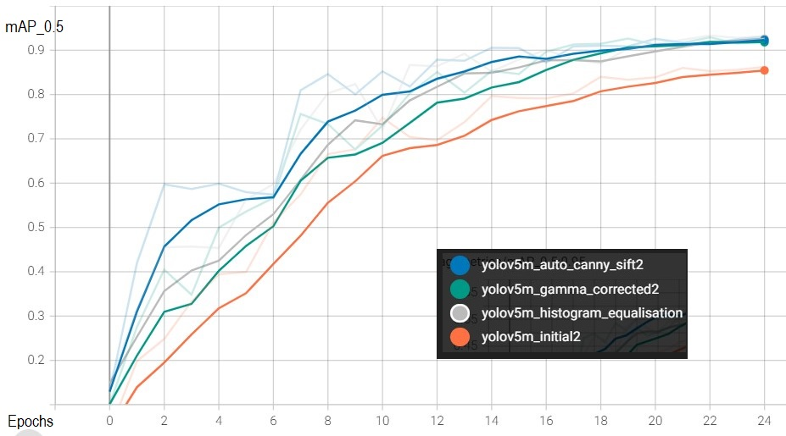
Results and Discussions
Figure 16: Comparison of mAP scores of proposed feature extraction and preprocessing techniques

Slide 39
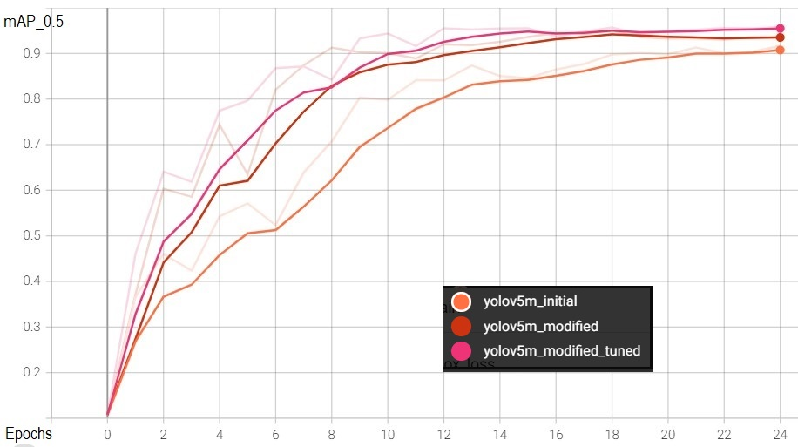
Results and Discussions
Figure 17 : Comparison of mAP scores of modified with initial architecture

Slide 40
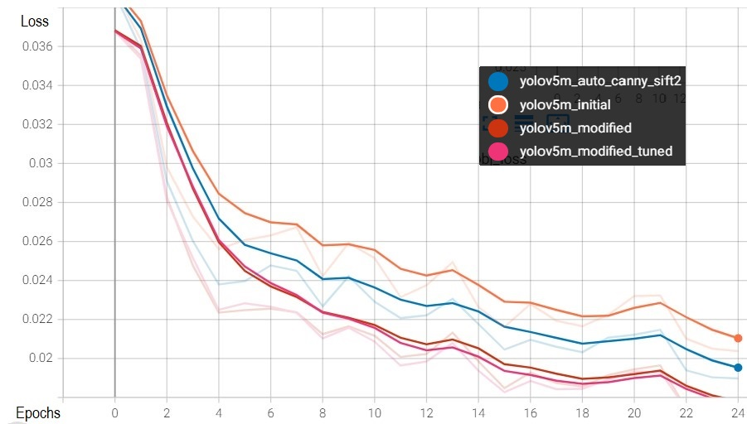
Results and Discussions
Figure 18: Total loss incurred in all the methods implemented

Slide 41
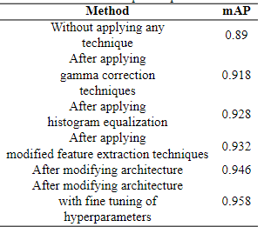
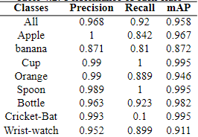
Results and Discussions
Table 1: mAP scores of all the techniques implemented
Table 2: Performances of each class in modified YOLOv5

Slide 42
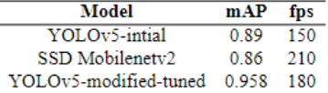
Results and Discussions
Table 3 shows comparison of mAP and fps among various object detection models. The result clearly shows that our proposed modified YOLOv5 model gives best performance in terms of mAP as well as fps.
Table 3: Performances of different models

Slide 43
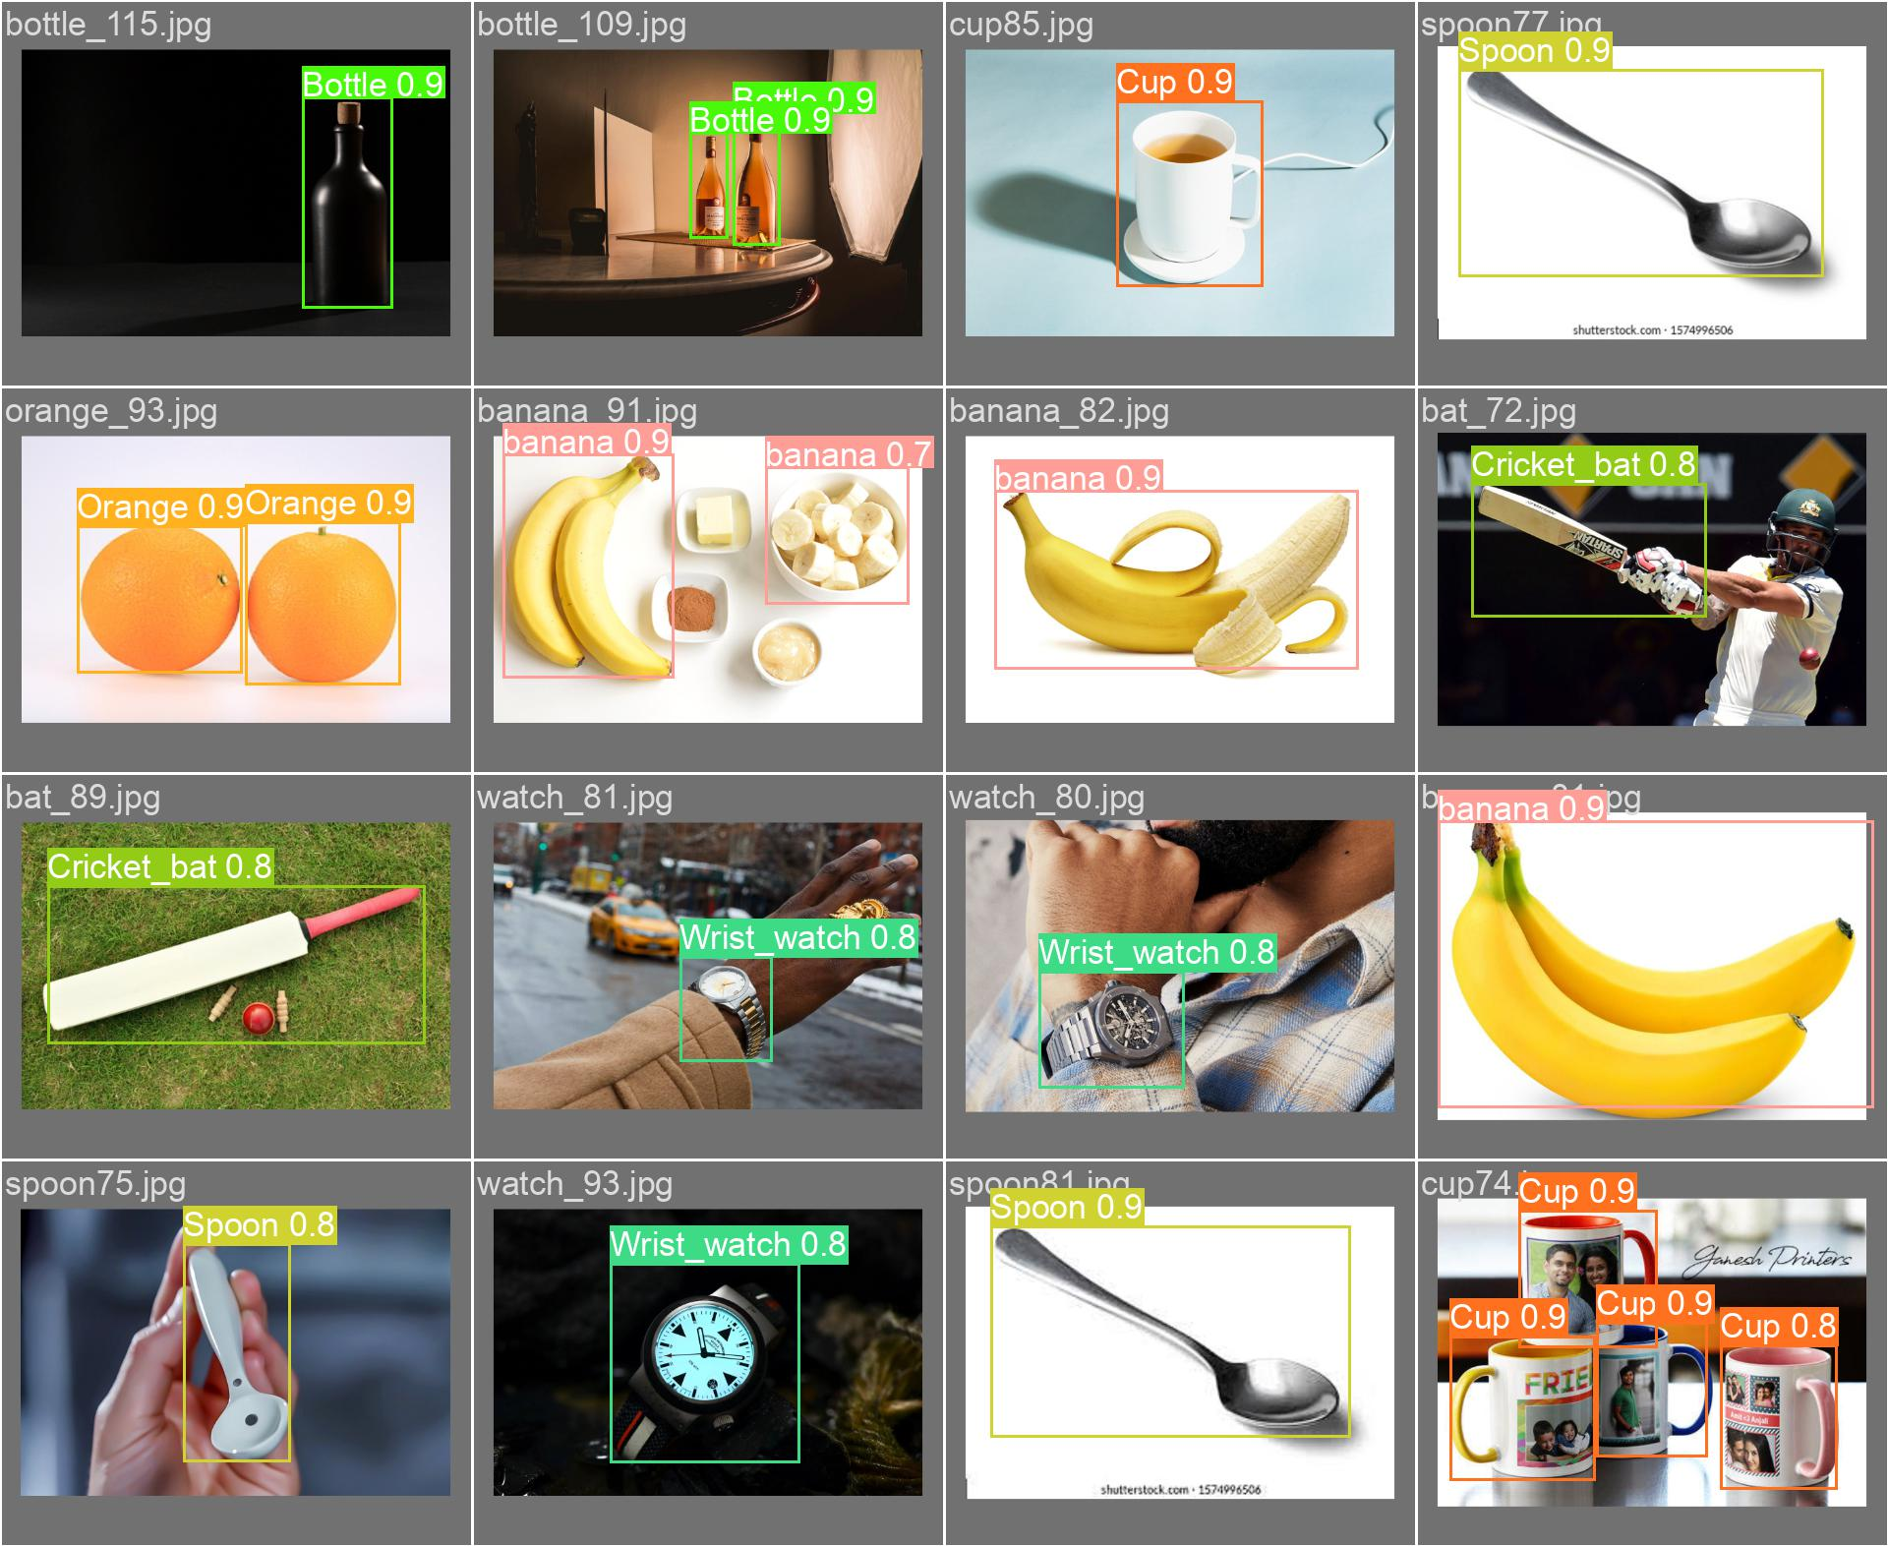
Results and Discussions
Figure 19: Some experimental results of object detection

Slide 44
Conclusion and Future works
Our modified YOLOv5 model gives good result after preprocessing and feature extraction techniques. We achieved mAP of 95.8% with 0.01 total loss which is very satisfying.
It achieves 180 fps which is almost same as SSD MobileNetv2 with better precision.
In comparison with SSD MobileNetv2 our model gives almost same frames per second with higher precision than it.
Our model gives good result for images of low light, tiny, occluded and partially visible objects.
In future this model can be integrated in a nao bot which can enhance real time object detection and grasping of objects using inverse kinematics algorithm.

Slide 45
References
[1] Huang, G., Liu, Z., Van Der Maaten, L., and Weinberger, K. Q., 2017. “Densely connected convolutional networks”. In Proceedings of the IEEE conference on computer vision and pattern recognition, pp. 4700–4708
[2] Teng, X., Fei, Y., He, K., and Lu, L., 2022. “The object detection of underwater garbage with an improved yolov5 algorithm”. In Proceedings of the 2022 International Conference on Pattern Recognition and Intelligent Systems, pp. 55–60.
[3] Kim, J.-H., Kim, N., Park, Y. W., and Won, C. S., 2022. “Object detection and classification based on yolo-v5 with improved maritime dataset”. Journal of Marine Science and Engineering, 10(3), p. 377.
[4] Ting, L., Baijun, Z., Yongsheng, Z., and Shun, Y., 2021. “Ship detection algorithm based on improved yolo v5”. In 2021 6th International Conference on Automation, Control and Robotics Engineering (CACRE), IEEE, pp. 483–487.
[5] Yan, B., Fan, P., Lei, X., Liu, Z., and Yang, F., 2021. “A real-time apple targets detection method for picking robot based on improved yolov5”. Remote Sensing, 13(9), p. 1619.

Slide 46
References
[6] Benjumea, A., Teeti, I., Cuzzolin, F., and Bradley, A., 2021. “Yolo-z: Improving small object detection in yolov5 for autonomous vehicles”. arXiv preprint arXiv:2112.11798. [7] Jung, H.-K., and Choi, G.-S., 2022. “Improved yolov5: Efficient object detection using drone images under various conditions”. Applied Sciences, 12(14), p. 7255. [8] Kim, J.-H., Kim, N., Park, Y. W., and Won, C. S., 2022. “Object detection and classification based on yolo-v5 with improved maritime dataset”. Journal of Marine Science and Engineering, 10(3), p. 377. [9] CENGİL, E., and ÇINAR, A., 2021. “Poisonous mushroom detection using yolov5”. Turkish Journal of Science and Technology, 16(1), pp. 119–127. [10] Wu, T.-H., Wang, T.-W., and Liu, Y.-Q., 2021. “Real-time vehicle and distance detection based on improved yolo v5 network”. In 2021 3rd World Symposium on Artificial Intelligence (WSAI), IEEE, pp. 24–28.
[11] Yan, B., Fan, P., Lei, X., Liu, Z., and Yang, F., 2021. “A real-time apple targets detection method for picking robot based on improved yolov5”. Remote Sensing, 13(9), p. 1619.

Slide 47
THANKYOU

