Slide 1
Techincal differences - P2V2C

Slide 2
Origin Story
LXC
cgroups
h/w isolation
SeLinux
Filesystem
Secomp
systemcall
Namespaces
nw/User/Mount

Slide 3
OnPrem
MiniKube
Minispray
Own VMs
Managed VM (EC2)
Prod setup
Master x 3 – Control Plane – H/A
Worker x 7 – Application Plane
Training setup (EC2)
Master x 1
Worker x 2

Slide 4
Instance deployments
Master
Name – master
OS – Ubuntu
Instance type – t2.medium
KeyPair – RSA / .pem
As soon as you click Create button, the private key downloaded.
Network Setting - Edit
Create Sec group
Name it
Enable “AutoAssign Public IP”
Set the rule to “All traffic”

Slide 5
Instance deployments
Worker
Name – <blank>
Instances - 2
OS – Ubuntu
Instance type – t2.micro
KeyPair – Reuse the key created in earlier step
Network Setting
Select Sec group
Choose the one created earlier
Enable “AutoAssign Public IP” (Edit if required)

Slide 6
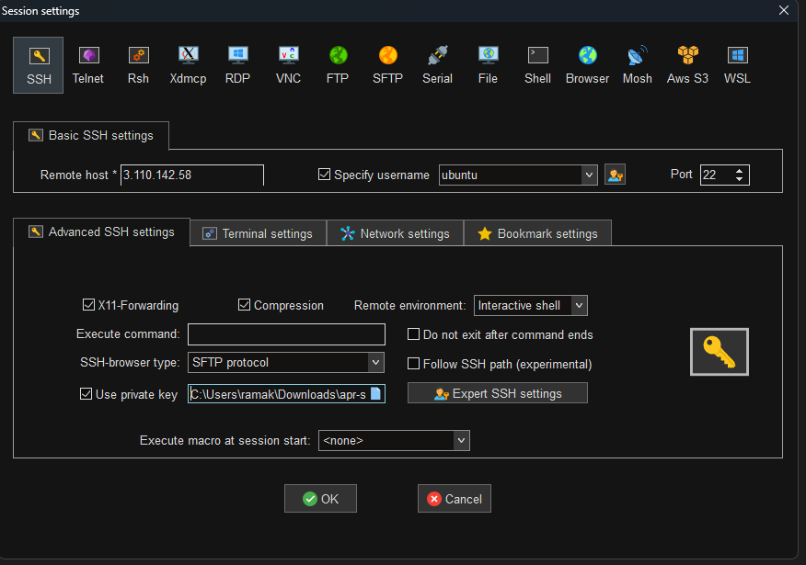
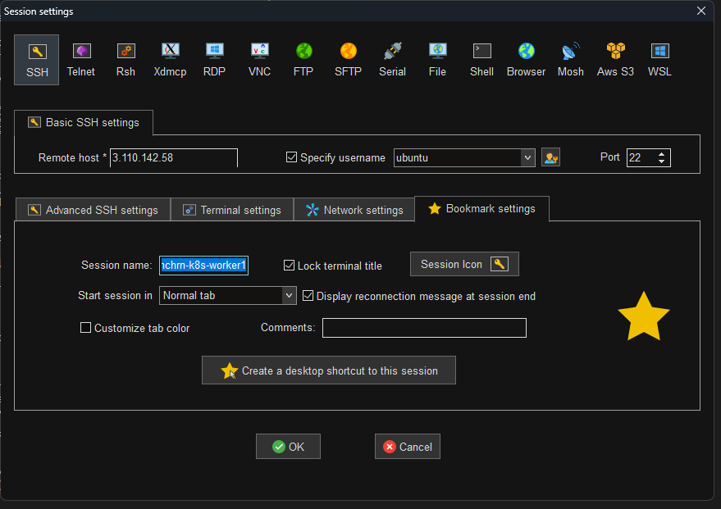
Configure MobaXterm
https://mobaxterm.mobatek.net/download.html

Slide 7
Pods
Worker Node
Pod
Pod
Pod
PBX
PBX
PBX
Pod
Pod
Pod
VoiceAssist
PBX

Slide 8
Pods
Worker Node
Pod
Pod
PBX
VoiceAssist
CallDb
Pod
Pod
PBX
VoiceAssist

Slide 9
YAML/YML
Pod Manifest
Camel case ➔ m_pConnStringToDb
Indentation
level1
level2
level2
level2
level1
Structural elements
Dictionary
key1: val1
key1:
key2: val2
key3: val3
Arrays
key1
key2
key3
Combinations
key
- key1: value1
- key2:
key3: value3
4 Major elements
apiVersion (module version)
kind (type of resource)
metadata (attributes)
spec (resources)
Container vs. Pod
Entrypoint → CMD
CMD → ARGS

Slide 10
Visual tools for Kubernetes
Kubernetes Dashboard
Rancher
Octant
Weave scope
Konstellate
etc…

