Slide 1
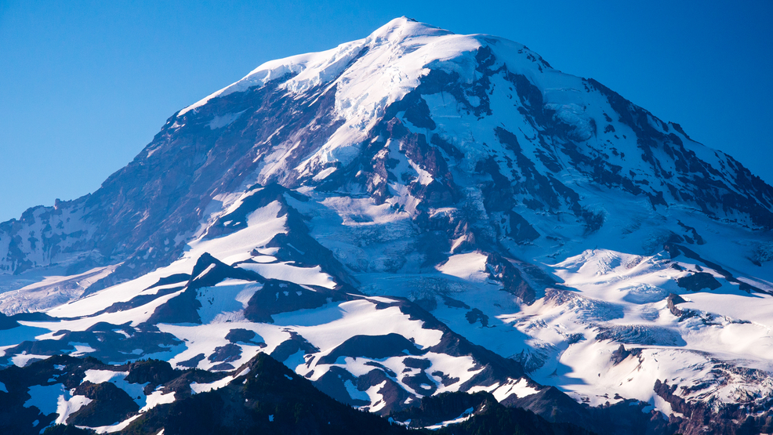
Mount Rainier:
The Climbers’ Challenge

Slide 2
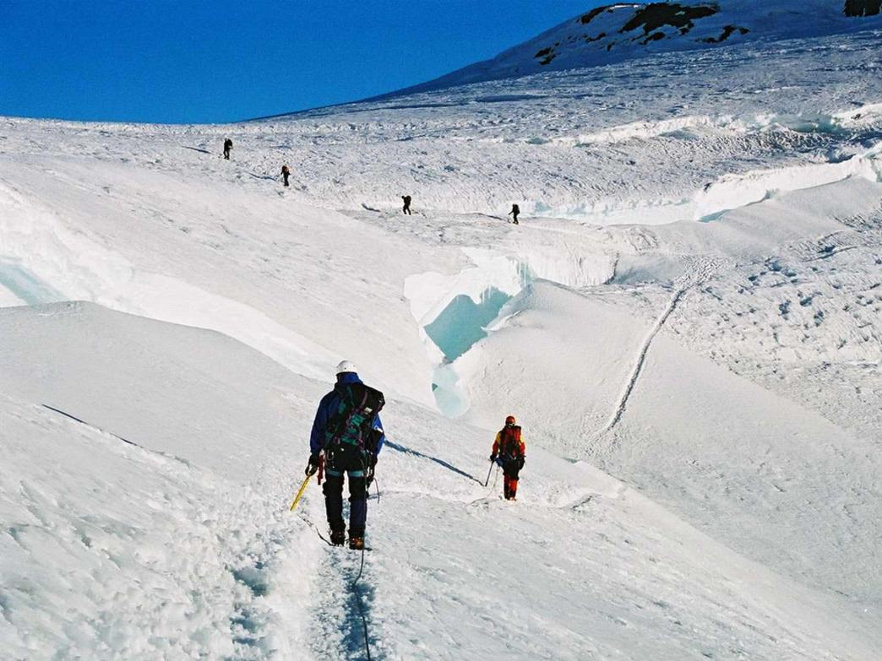
Authors
Subhrajyoty Roy (MB1911)
Abhinandan Dalal (MB1920)
Arindam Roy Chowdhury (MB1919)
Abhishek Bakshi (MB1938 )

Slide 3
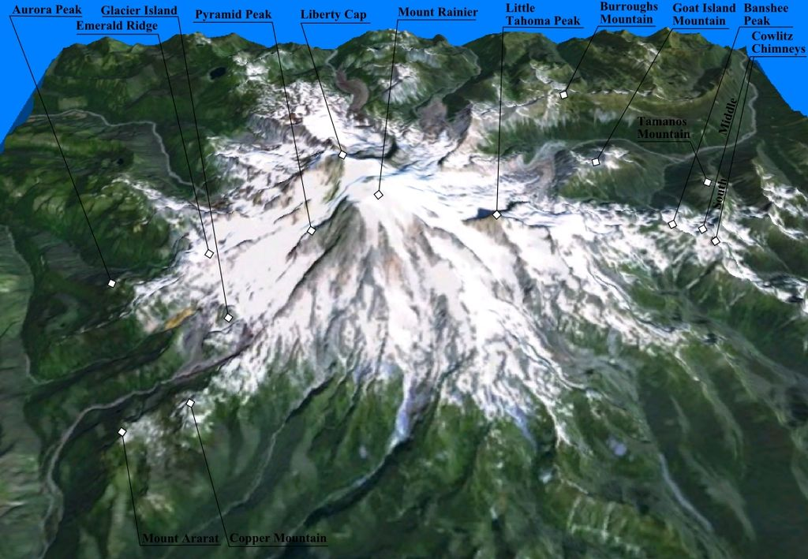
What? And Why?
Mount Rainier: Large active Stratovolcano located 59 miles south south-east of Seattle, Washington.
Highest Mountain peak of state Washington, the Cascade range; and most topographically prominent peak of the contiguous United States (ie, leaving out Alaska, Hawaii and islands.)
Elevation: 4392metres

Slide 4
Mountaineer’s Challenge
Difficult Climbing: Involving traversing largest glacier in the US south of Alaska.
Requires 2 to 3 days of summit, with high failure rates.
Weather and physical conditions posit largest challenges, with the former being very erratic.
Climbing teams require experience in glacier travel, self-rescue, and wilderness travel.
High rising climbers require permits by law.

Slide 5
Our Aims:
Use the Mount Rainier dataset from Kaggle
To model the climbers traffic on various routes based on weather conditions
To model the route wise success proportions based on weather conditions and time of year.

Slide 6
Data description
We use the dataset of the Climbier statistics, from 25th of September, 2014; to 27th of November, 2015.
The main routes of climbing are Disappointment Cleaver (the default route), Emmons Winthrop and Kautz Glacier. The remaining routes have too few data points to be considered.
Weather covariates are battery voltage, average temperature, relative humidity average, average wind speed, average wind direction, solare radiation, measured each day.
Climbing statistics include team size, day of beginning expedition, and number of successes in each team.

Slide 7
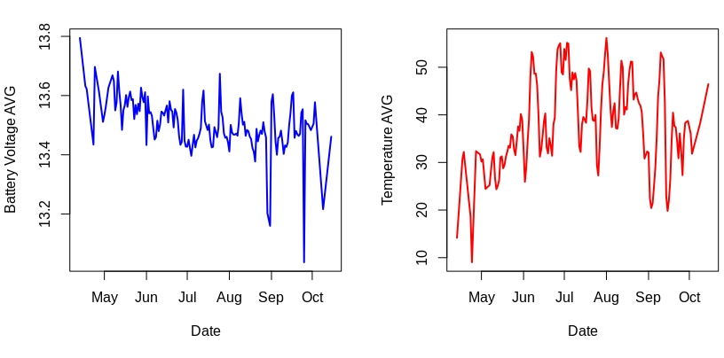
Viewing Weather Conditions

Slide 8
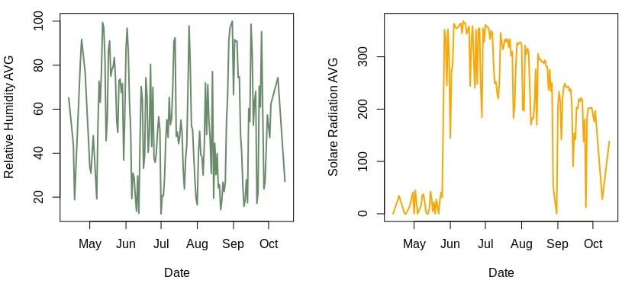
Viewing Weather Conditions

Slide 9
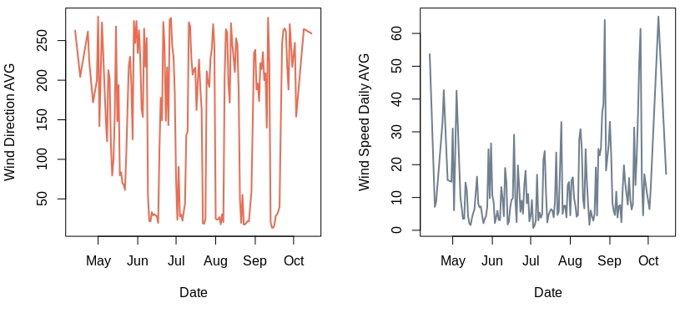
Viewing Weather Conditions

Slide 10
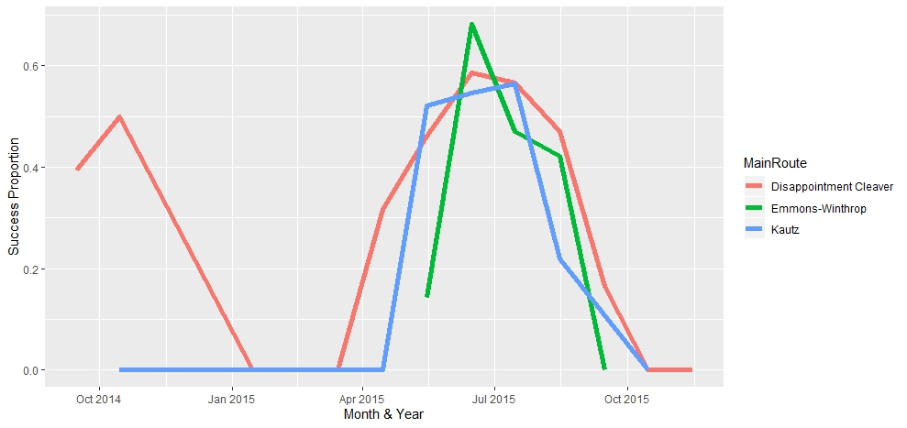
Time Modelling

Slide 11
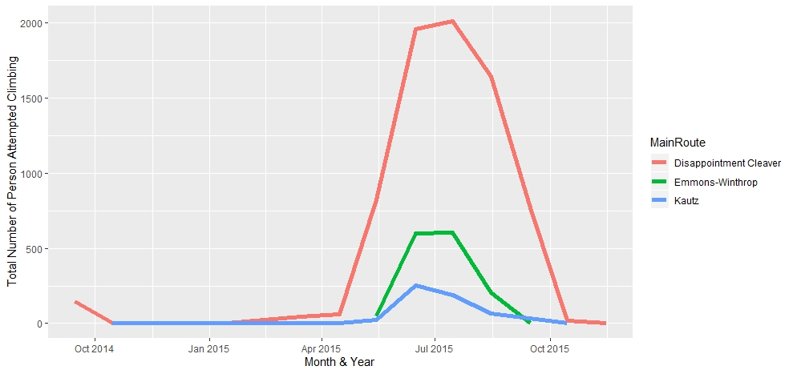
Time Modelling

Slide 12
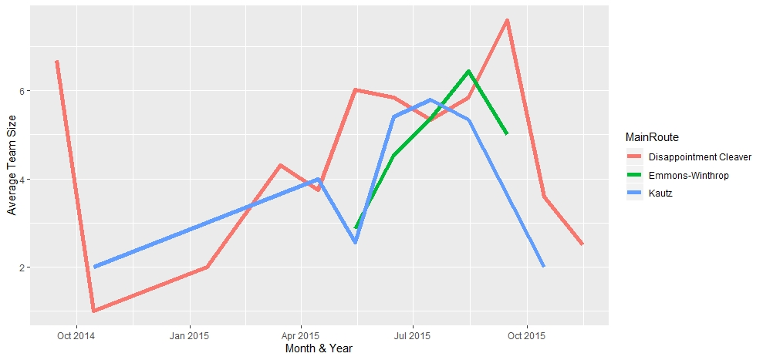
Time Modelling

Slide 13
Time Modelling
Note that the graphs show that the number of attempts upsurge during the middle of the year. This trend is seen in both years of the dataset.
Hence we use a sinusoidal time model, consisting of sine and cosine components with the crest at the middle of the year.
Month | Teams | Team Size
09/14 | 22 | 6.68
10/14 | 3 | 1.33
01/15 | 1 | 2
03/15 | 10 | 4.3
04/15 | 17 | 3.76
05/15 | 163 | 5.50
06/15 | 514 | 5.47
07/15 | 522 | 5.38
08/15 | 325 | 5.89
09/15 | 102 | 7.58
10/15 | 6 | 3.33
11/15 | 2 | 2.5

Slide 14
Model 1: Logistic Regression
We begin with the standard tool: Using a logistic model to predict the successes and failures.
j=1, 2 or 3 according as the jth route is traversed, x are the weather covariates as observed, and t is the traverse date of the year.

Slide 15
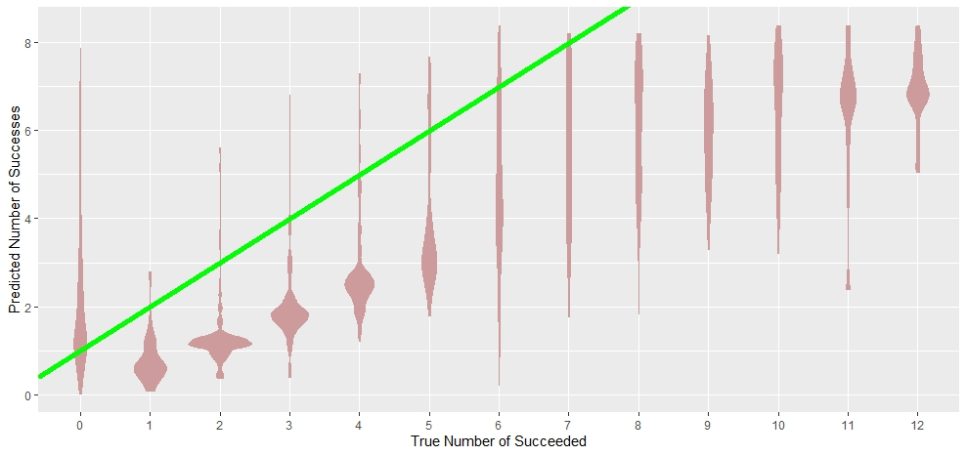
Fit from Logistic Regression: Training

Slide 16
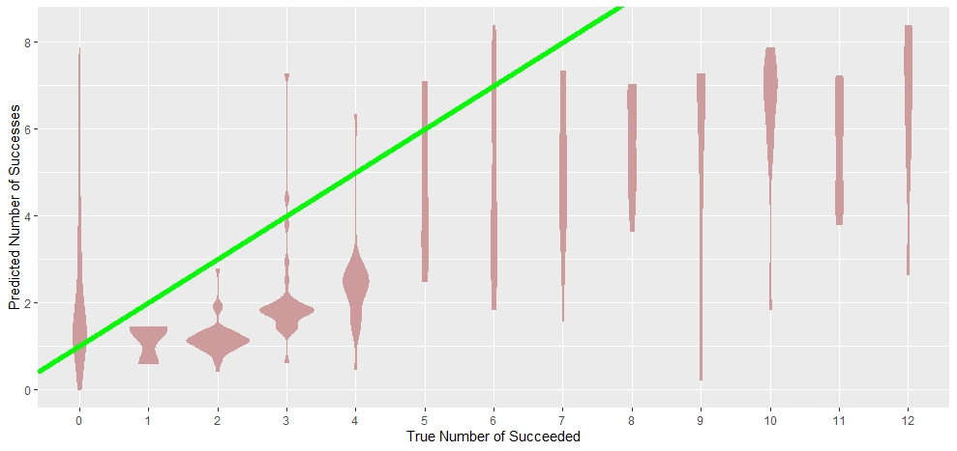
Fit from Logistic Regression: Test

Slide 17
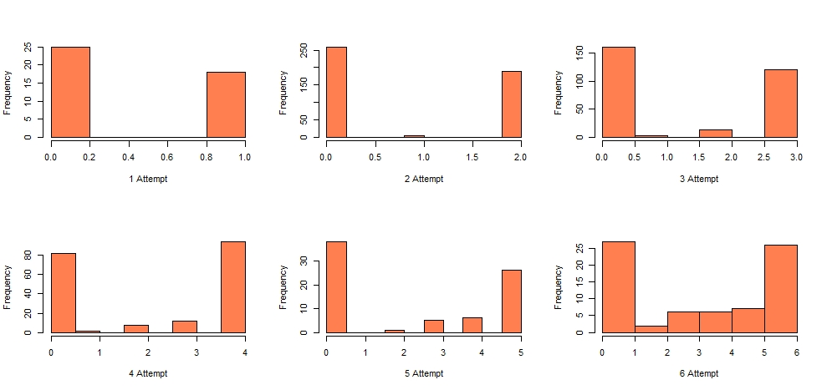
Histograms of success frequencies

Slide 18
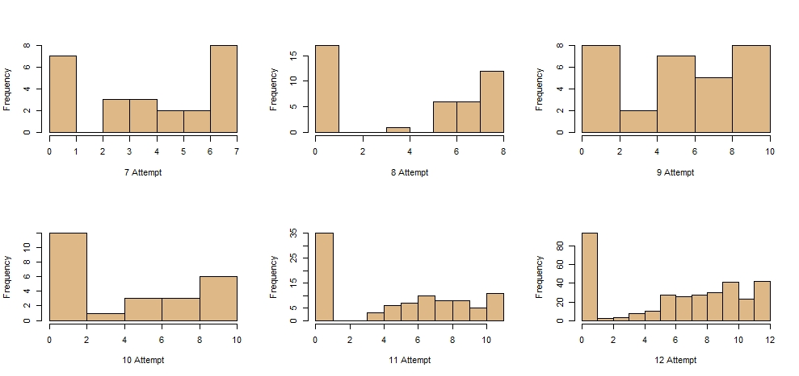
Histograms of success frequencies

Slide 19
Why did Logit regression fail?
Notice the peaks in the success proportions, mostly at 0 and n, n being the team size .
Why does this happen?
In a team mountaineering expedition, your success is not independent of your teammates
If your teammates fail, it is very unlikely that you succeed alone
If all your teammates succeed, it is highly likely that you succeed too.

Slide 20
Model 2: Independent ZIPs
Rising from the ashes of the previous model, we propose an alternative one.
If our team size had follows a Poisson distribution, and the successes arrivals and failure arrivals occur independently, we would have had the Binomial distribution.
Due to the high number of peaks at the end, it looks like both the successes and failures are 0 inflated.
We try with independent 0 inflated successes and 0 inflated failure Poisson model (assuming arrivals are Poisson).

Slide 21
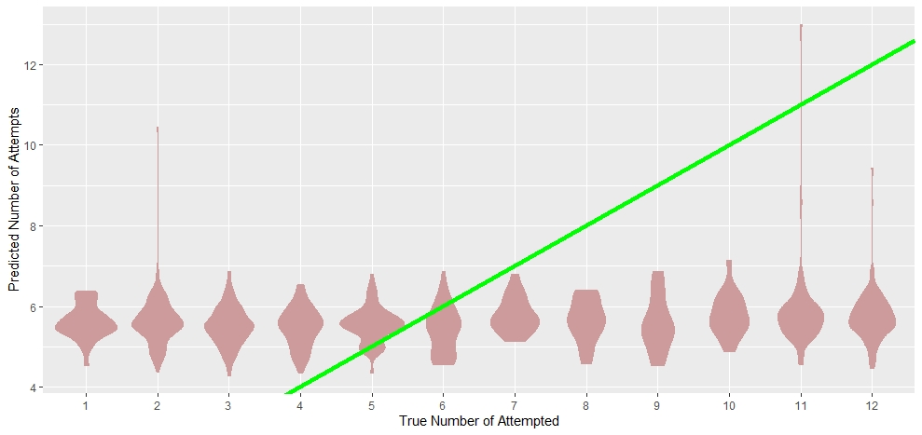
Fits of Independent ZIPs: Training Set

Slide 22
Assessing failure of Model 2
We used the number of attempts to be the sum of the number of successes and number of failures.
The failure of the ZIP model lies in the failure of the log-linear model fits for the two Poissons.

Slide 23
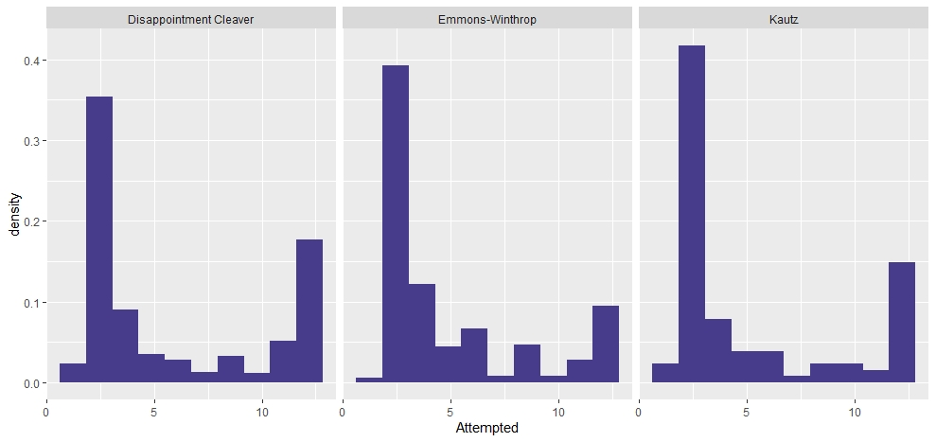
Histograms of Attempts

Slide 24
Model 3: Separating N and p
Till now, we had tried to model the number of successes directly.
However, the number of successes depend on N, and hence we try to model team size N, and the number of successes conditioned on N.
Modelling N: From the histogram of attempts, the mutimodality in the distribution of team size is prominent.
Hence, we use a three component mixture of Poisson distributions to model the team size N.

Slide 25
Modelling N: Mixture of Poisson
where N is the team size, N_{i} s are independent Poi(λ_{i}), i=1(1)3; (X1,X2,X3)~Multinomial(1,p₁,p₂,p₃)
The Poisson means are modelled by log-linear models of the covariates, and the multinomial proportions by a multinomial logistic model.

Slide 26
Results from Poisson mixture: Components
 | Component 1 | Component 2 | Component 3
Intercept | Estimate: 1.045 p value< 2e-16 | Estimate: 2.3798 p value< 2.2e-16 | Estimate: 1.104 p value< 2e-16
Route Emmons-Winthrop | Estimate: 0.1519 p value: 0.125 | Estimate: -1.1465 p value: 0.174 | Estimate: 1.187 p value< 2.2e-16
Route Kautz | Estimate: 0.0225 p value: 0.892 | Estimate: -1.272 p value: 1.051e-08 | Estimate: 1.278 p value< 2.2e-16
The weather covariates turn out to be not significant in the log-linear means of any component. We use the Disappointment Cleaver route as the base.

Slide 27
Results from Poisson mixture: Mixture probs.
 | Mix Prob 2 |  | Mix Prob 3
 | Esti | pval | Esti | pval
Intercept | -30.01 | 0.65 | -110 | 0.122
Route Emons | -8.315 | 0.005 | -5.429 | 0.040
Route Kautz | -4.309 | 0.636 | -4.739 | 0.249
sin(pi*t/365) | 23.77 | 0.027 | 3.422 | 0.000
cos(pi*t/365) | -3.72 | 0.01 | -4.964 | 0.000
Battery Voltage | 0.82 | 0.86 | 6.169 | 0.226
Temperature | -0.02 | 0.74 | -1.238 | 0.822
Rel.Humidity | -0.005 | 0.76 | -2e-02 | 0.249
Wind speed | 0.038 | 0.158 | 1.618 | 0.519
Wind direction | -0.001 | 0.58 | -4.337 | 0.837
Solar radiation | 0.001 | 0.813 | -1.399 | 0.807
The weather covariates turn out to be not significant in any mixture component as well. We use the Disappointment Cleaver route as the base, and component 1 to be the reference.

Slide 28
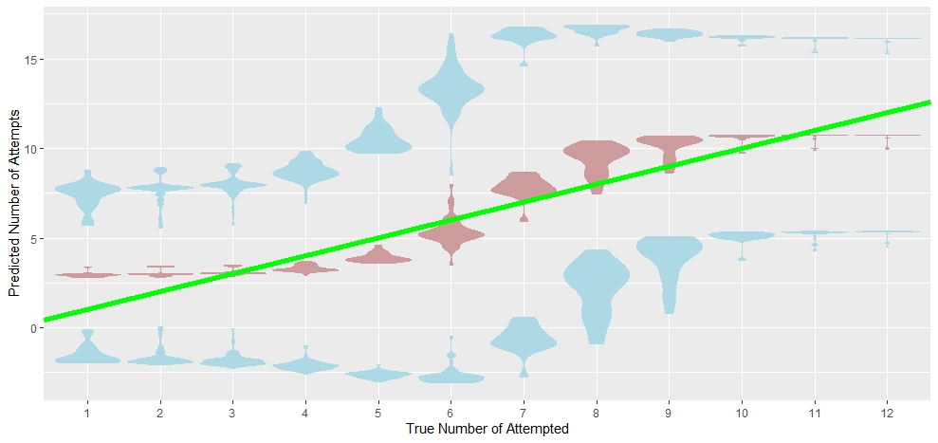
Fit of Number of Attempts: Training

Slide 29
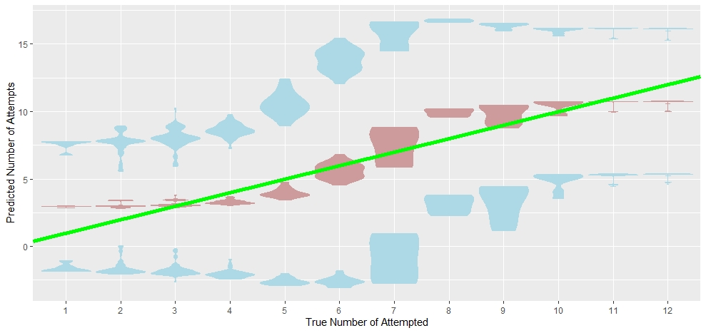
Fit of Number of Attempts: Test

Slide 30
Modelling Successes given Team Size
To accommodate the peaks in the 0 and N, we use a 0 and N inflated binomial model (ZNIB)
The 0 and N inflated binomial distribution arises when two zero-inflated Poisson count processes are constrained by their sum total.
Thus we keep the idea of Model 2, but now, we model these mixtures probabilities using multinomial logistic regression.
No. of successes X|N~ 0 wp p₁, Y wp p₂, N wp p₃, where 0 and N are degenerate, and Y is Bin(N,p).
Results show weather covariates to be finally significant

Slide 31
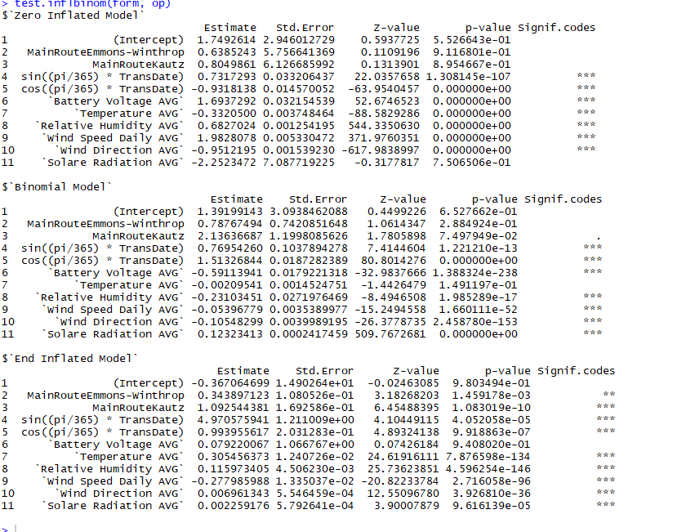

Slide 32
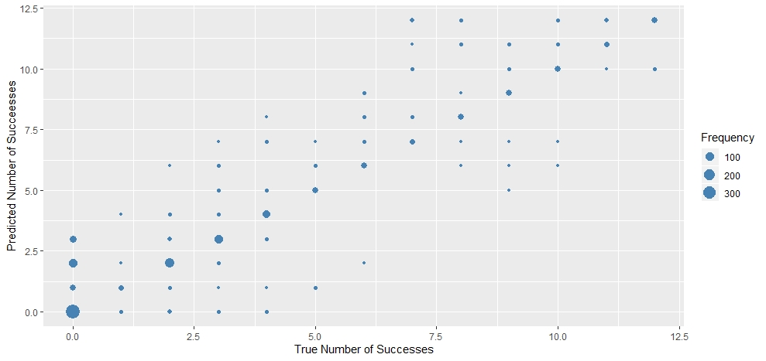
Fits of Number of Successes: Training

Slide 33
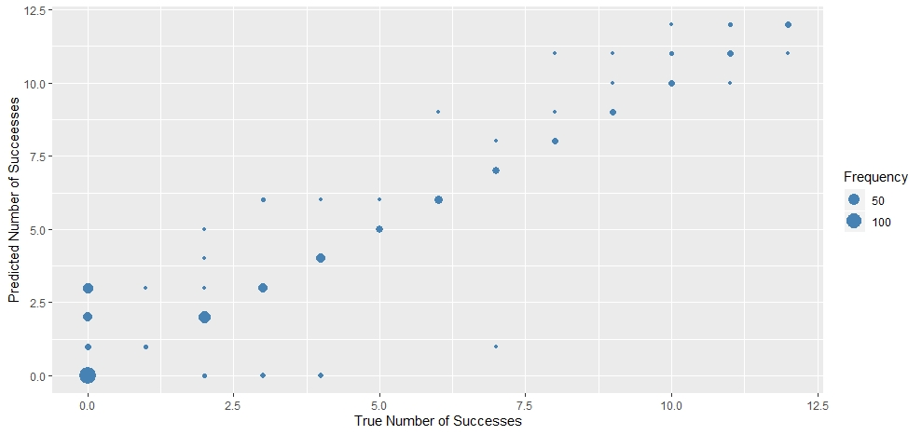
Fits of Number of Successes: Test

Slide 34
Comparing All models
AIC is less in Model 3, hence Model 3 has an advantage.
However, with respect to the prediction accuracy, it is fairly evident that Model 3 is a clear winner. Hence we declare our final model to be the team size to be a mixture of Poisson distribution, and number of successes given team size to have ZNIB.
Model 1: Logit | Model 2: Independent ZIP | Model 3: Mix Poisson and ZNIB
AIC: 6857.4 | AIC: 6374.770 | AIC: 6170

Slide 35
Remarks
Note that, in our final proposed model, the team size does not depend on the weather covariates.
Giving it a thought, note that the team is decided apriori, and hence the individual that day weather is not factored in deciding teams.
However, the time of the year is significant in team size. Thus an overall idea of seasons factors in deciding team size traffic.
The team size distribution would help the climbing industry to provide better service to climbers.

Slide 36
Remarks
However, the success proportions do depend on the weather covariates.
This dependence is significant not only in the 0 and end components, but also in the Binomial component of the success proportions.
The success of our endeavour lies in the overall satisfactory prediction of success of the climbing exercise, which had been a challenge due to the unpredictability of Mount Rainier route and weather conditions.

Slide 37
Return to Base Camp
Thank You

