Slide 1
OctoAssist
User Guide
How to use the OctoAssist ITSM platform
Production environment
https://octoassist.thirdoctopus.com
Third Octopus · May 2026 · Version 1.0

Slide 2
INSIDE THIS GUIDE
Five things you will learn how to do
1
Sign in
How to access OctoAssist with Microsoft Entra ID single sign-on or a local password.
2
Raise a ticket
Two paths — the agent ticket form for technicians, the requester portal for everyone else.
3
Work a ticket end-to-end
Triage, assign, comment, resolve, close — with the right keyboard shortcuts.
4
Use the everyday IT pages
Changes · Problems · Patches · Assets · Software · Knowledge Base · Reports.
5
Configure your settings
Where admins set SLAs, holidays, the CAB, the software catalog and email.
Notes:
Set expectations: this is a how-to deck. We walk through five user journeys end-to-end, each with screenshots.

Slide 3
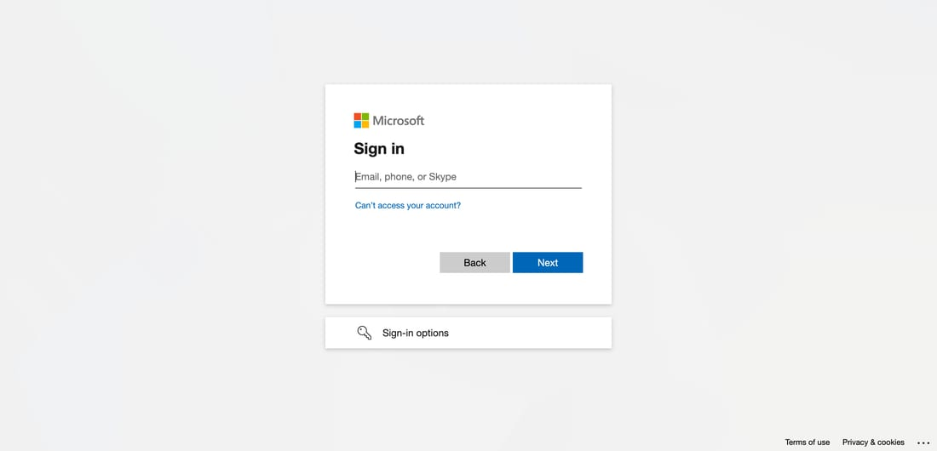
STEP 1 · SIGN IN
Open the sign-in page and choose how to authenticate
Two ways to sign in
🔐
Microsoft Entra ID (SSO)
Click 'Sign in with Microsoft Entra ID'. Use your work email. Recommended for everyone.
🔑
Local password
Enter the email + password supplied by your administrator. Falls back when SSO is unavailable.
Notes:
Two sign-in paths. Most users go via SSO. The local password is the fallback for the bootstrap administrator and for accounts not yet provisioned in Entra.

Slide 4
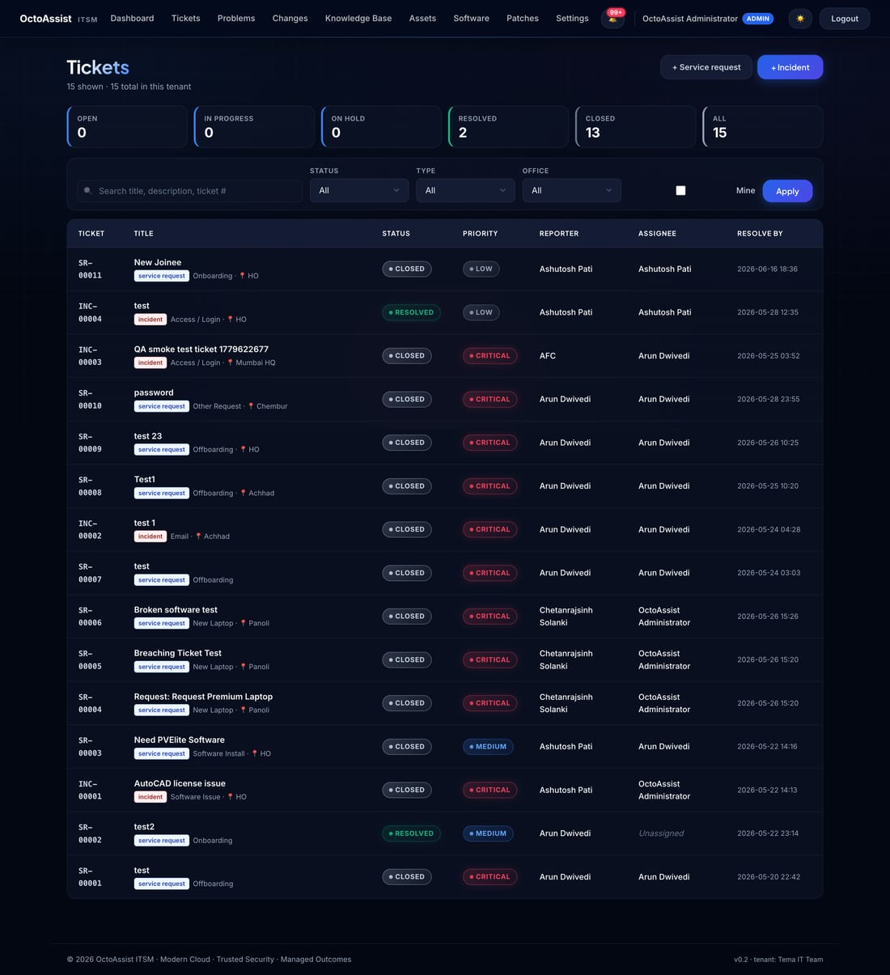
STEP 2 · YOUR HOME SCREEN
The Tickets page — everything you need on one screen
What each column shows
Ticket
Auto-generated number — INC-xxx or SR-xxx
Title
What the requester typed plus a category pill
Status
Open · In Progress · On Hold · Resolved · Closed
Priority
Low · Medium · High · Critical (colour-coded)
Reporter
Who raised it
Assignee
Who is working on it (or Unassigned)
Resolve by
Auto-calculated from the SLA matrix
Notes:
Walk the columns left-to-right. Emphasise the saved filters at top (Open / Mine / Unassigned) and the search box that hits title + ticket number + reporter name.

Slide 5
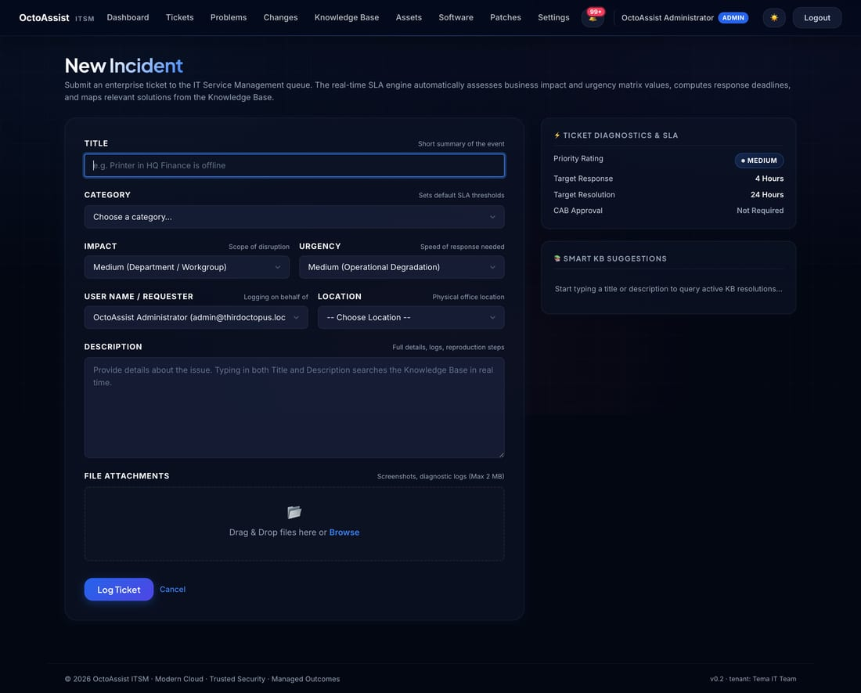
STEP 3 · RAISE A TICKET
Submit a new ticket — agent form
What to fill in
1
Title
One-line summary of the issue (under 80 characters).
2
Category
Pick the closest match — this drives the SLA.
3
Priority
Low / Medium / High / Critical based on impact.
4
Reporter
Pick from the directory if you are filing on behalf of a user.
5
Location
Mumbai HQ / Chembur / Vadodara / etc. — drives location routing.
6
Description
What's happening, what was expected, what error message appeared.
7
Submit
Reporter, assignee and CAB members are emailed instantly.
Notes:
Seven fields. Title and category are the most important — they determine routing and SLA. Encourage agents to fill the location field too if they know it.

Slide 6
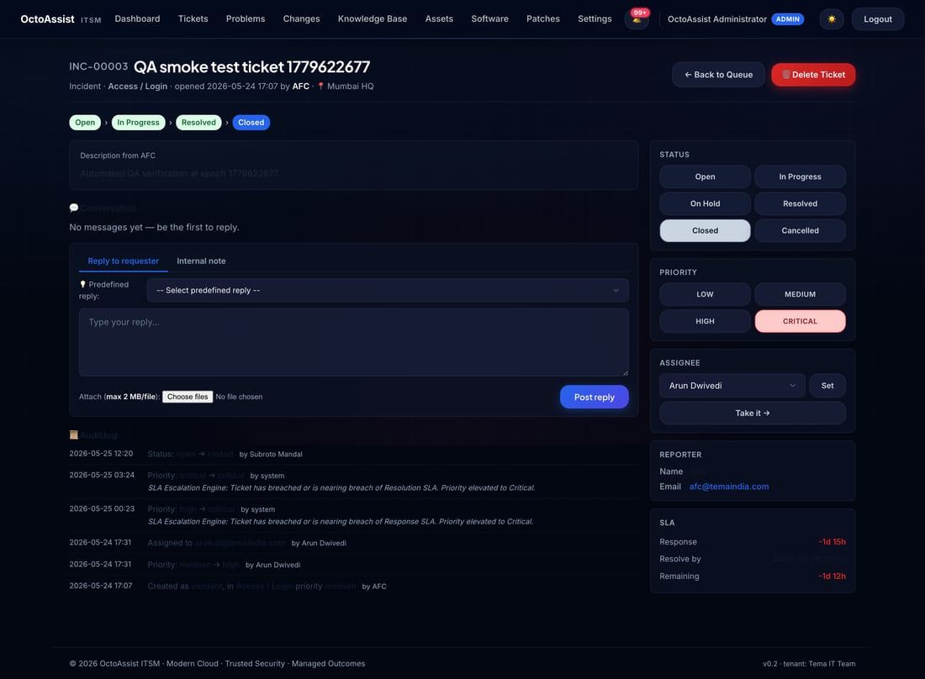
STEP 3 · WORK A TICKET
Triage → comment → resolve, all on one page
Five things you can do here
1
Change status
Open → In Progress → On Hold → Resolved → Closed.
2
Change priority
Raise or lower if impact changes.
3
Reassign
Pick another technician; both parties get email.
4
Add a comment
Public (emailed to requester) or Internal note.
5
Insert a reply
Pick from predefined templates dropdown.
Notes:
Walk one realistic ticket end-to-end. The activity log on the right is the audit trail — every state change is recorded.

Slide 7
STEP 3 · NOTIFICATIONS
Who gets emailed and when
Every state change fires an email via Microsoft Graph. You don't need to do anything — it's automatic.
Event
Recipients
Email subject
Ticket created
Reporter + assignee (if set) + every CAB member
[OctoAssist] T-xxxx — created
Ticket assigned
Reporter + new assignee
[OctoAssist] T-xxxx — Assigned to Technician
Status changed
Reporter
[OctoAssist] T-xxxx — Status Updated to …
Priority changed
Reporter
[OctoAssist] T-xxxx — Priority Updated to …
Public comment
Reporter and assignee (not the author)
[OctoAssist] T-xxxx — New comment posted
Notes:
Five trigger events, five email types. Internal notes don't fire mail to the requester — only public comments do.

Slide 8
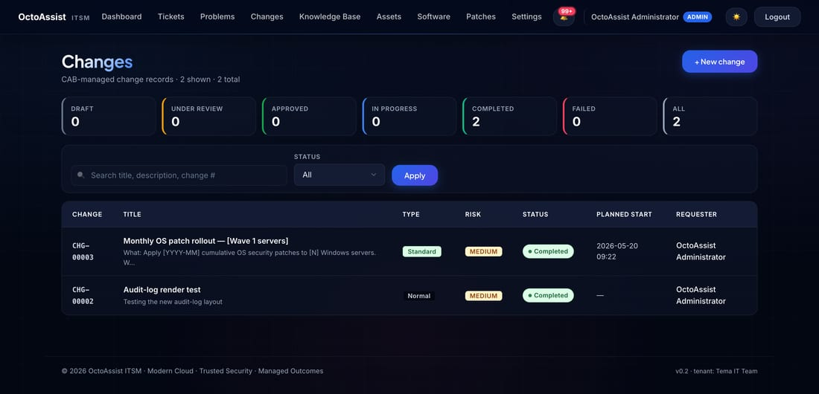
STEP 4 · CHANGES
Submit a change for CAB review
Draft
→
Pre-CAB
→
Under Review
→
Approved
→
Scheduled
→
In Progress
→
Completed
The seven-state change lifecycle
✅ Submit
📝 CAB review
📅 Schedule + execute
Fill title, type (Standard / Normal / Emergency), risk, target date, plan + rollback. Click Submit.
Every CAB member receives an email with one-click Approve / Reject. Quorum enforced before Approved.
Pick a window, mark In Progress at the start, mark Completed at the end. Activity log preserves every step.
Notes:
Three steps: Submit → CAB review → Schedule + execute. The rollback-plan field is required — without it the system rejects the submission.

Slide 9
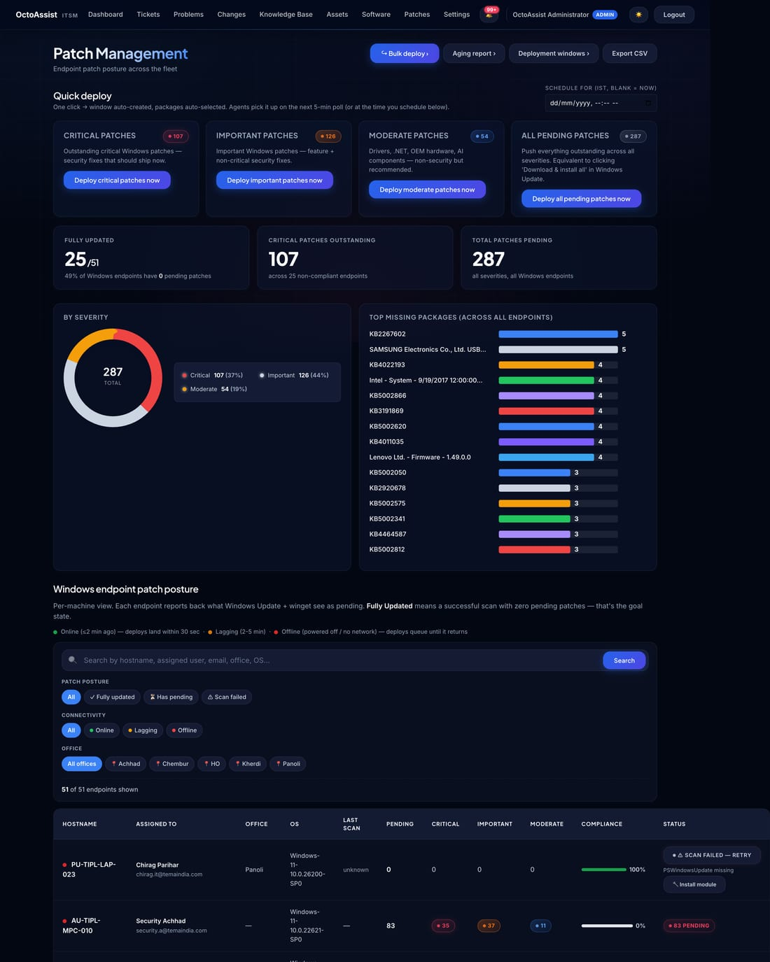
STEP 4 · PATCHES
See patch posture, schedule patch windows
What this page shows
●
Hostname + assigned-to user + office
●
Online status (last 5 min check-in)
●
Critical-pending patch count
●
Important-pending patch count
●
Last successful install date
To schedule a patch window
Patches → Patch windows → New
Pick start time + targets (endpoints or Asset Group) + auto-execute mode. Save.
Notes:
Filter chips at the top let you focus on Online only, Critical-pending only, or by office. The CSV export of this page is the auditor evidence for ISO 27001 A.8.8.

Slide 10
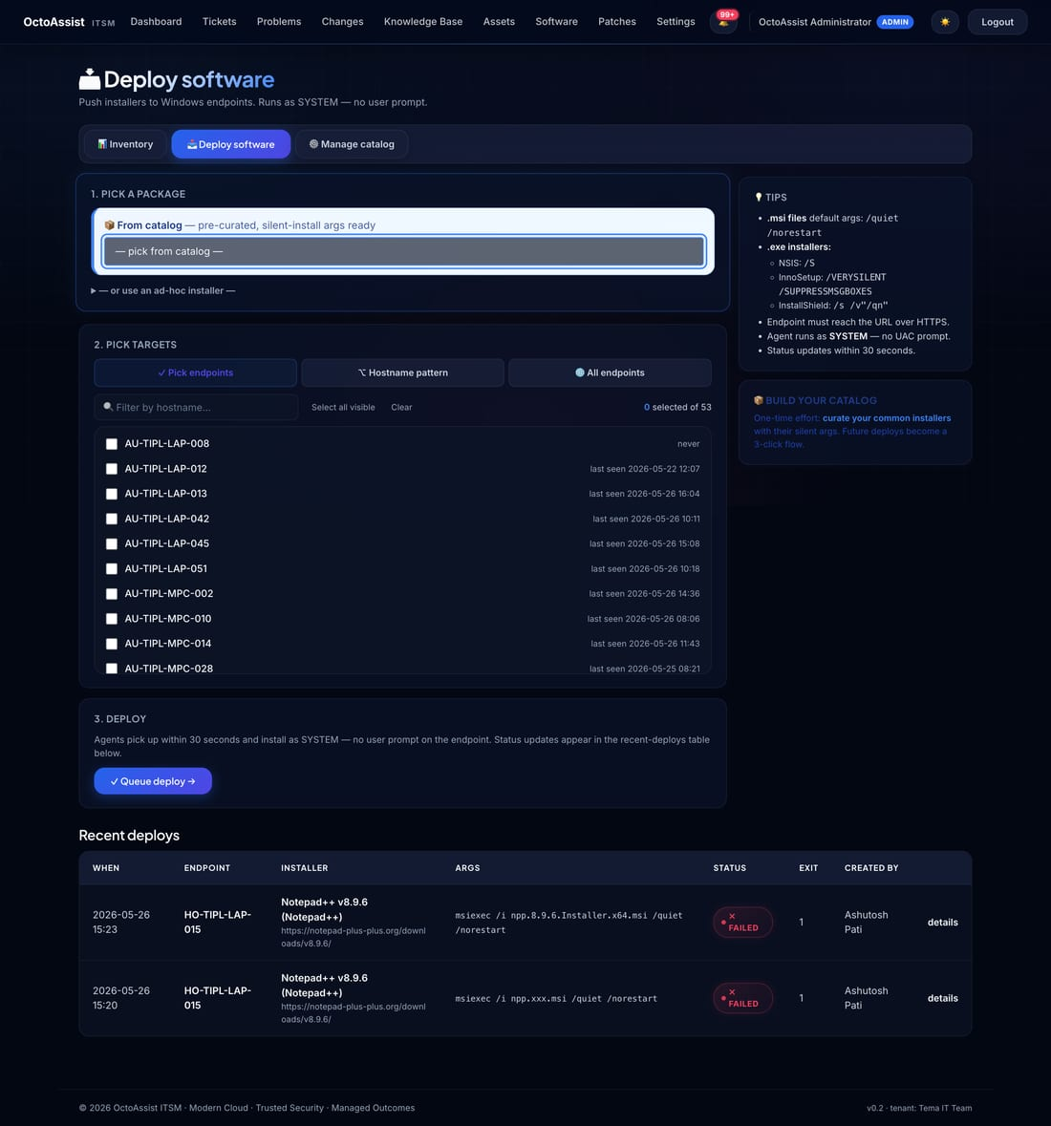
STEP 4 · DEPLOY SOFTWARE
Catalog-driven, multi-select, one-click queue
How to deploy software
1
Pick a package
From the catalog dropdown — Chrome, Acrobat, your LOB app, etc.
2
Pick targets
Multi-select endpoints, OR pick an Asset Group.
3
Queue deploy
Job runs at each endpoint's next 30-second check-in.
4
Track status
Live status flips: pending → in_progress → succeeded / failed.
Notes:
Reusable catalog means you never paste silent-install switches again. Add an installer once in Settings → Software catalog; pick it from the dropdown forever after.

Slide 11
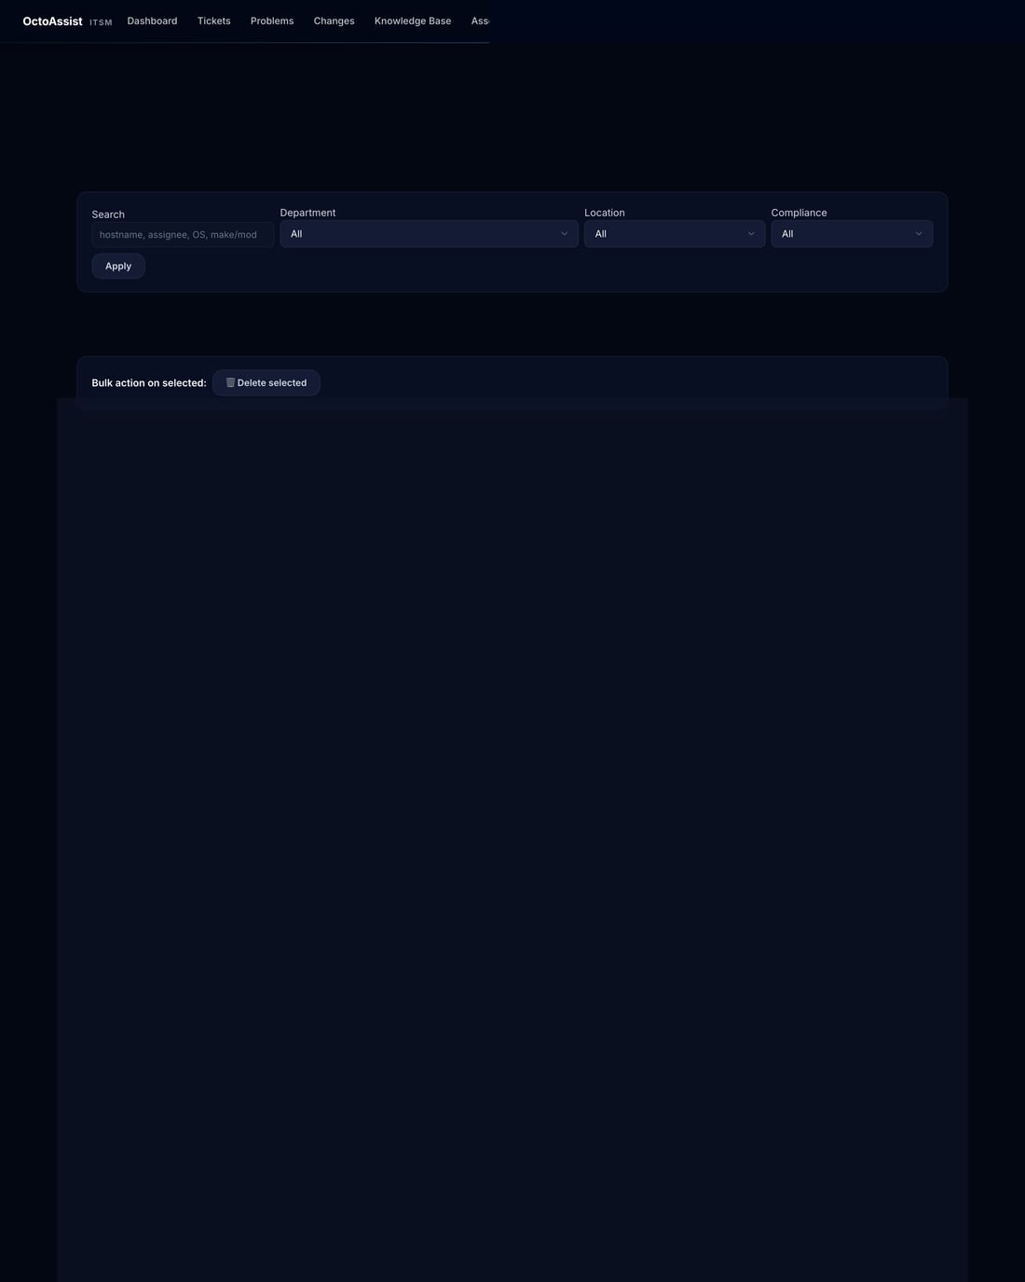
STEP 4 · ASSETS
Every Windows endpoint, reported by the agent
Click any hostname to drill in
●
Hardware spec (CPU, RAM, disk)
●
OS + build + last reboot
●
Installed software inventory
●
Windows Services panel
●
Patch posture + history
●
Remote actions queue + log
●
All tickets this user raised
Notes:
The Assets list is sortable by every column. To install the agent on a new endpoint, copy the one-liner from Settings → Tenant.

Slide 12
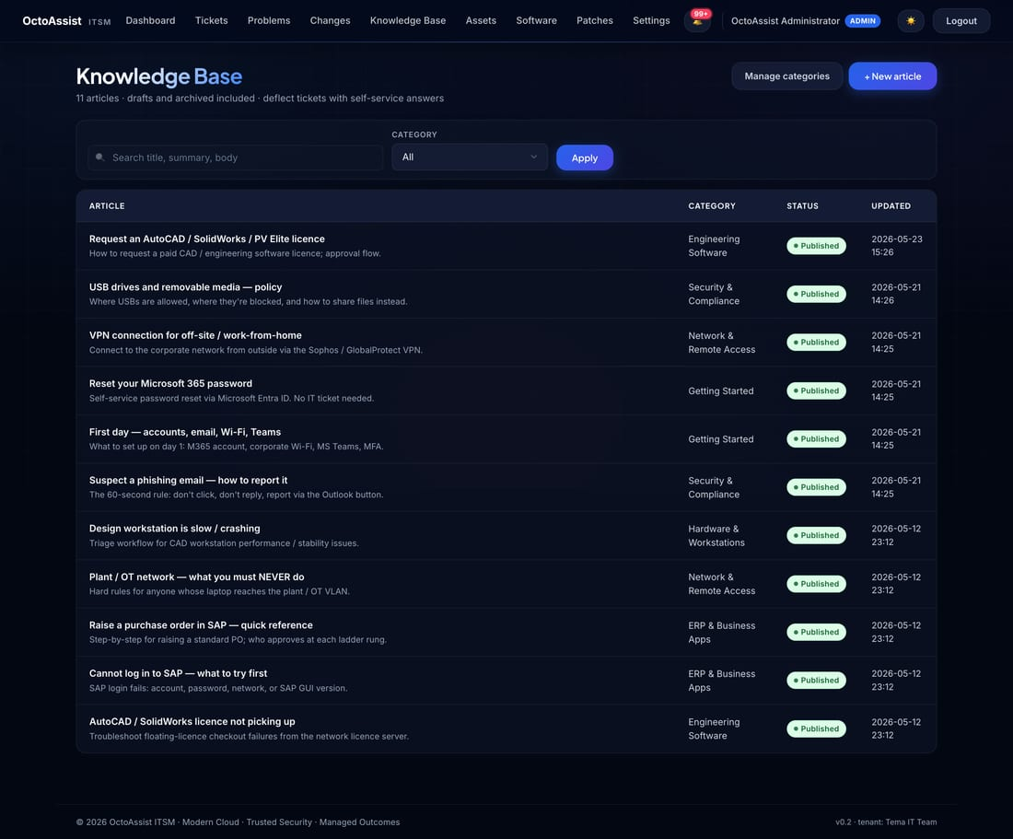
STEP 4 · KNOWLEDGE BASE
Self-service answers for common questions
Notes:
Search-first interface. Articles are category-tagged. Most KB items are step-by-step with screenshots — written to deflect tickets.

Slide 13
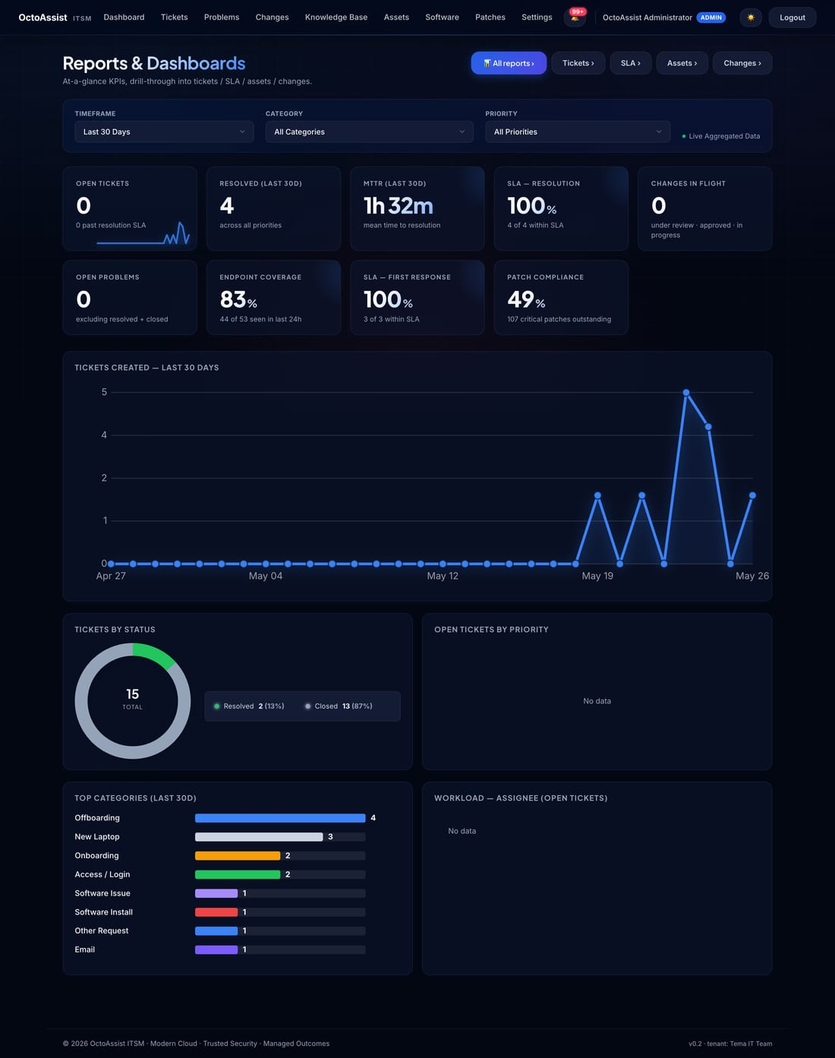
STEP 4 · REPORTS
Live KPIs with three filters: timeframe, priority, category
Filter bar
Timeframe
7 / 15 / 30 / 90 / 180 days
Priority
Low / Medium / High / Critical
Category
Network / Endpoints / Email / Access …
On the page you also get
KPI cards · trend sparklines · status & priority breakdowns · SLA compliance · workload by assignee
Notes:
Filters auto-submit when you change them. Sparklines redraw in under a second.

Slide 14
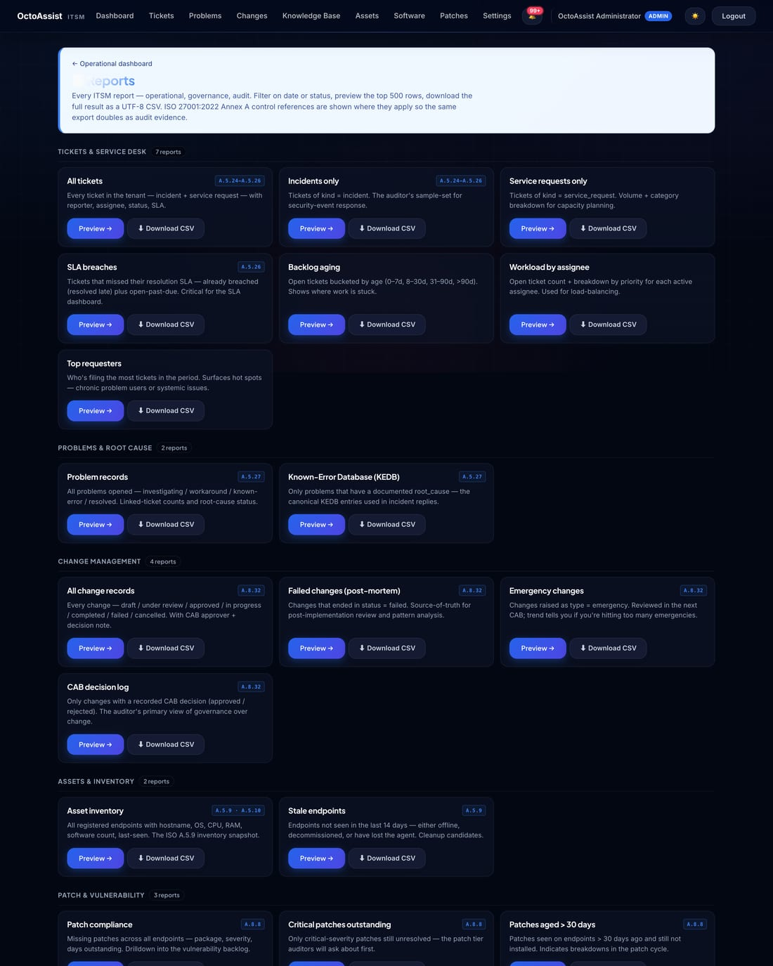
STEP 4 · REPORTS LIBRARY
25+ downloadable reports, all CSV
Notes:
Pick a report, click Download. Each CSV opens directly in Excel or Power BI. Use the date filters at the top of each report to narrow the export.

Slide 15
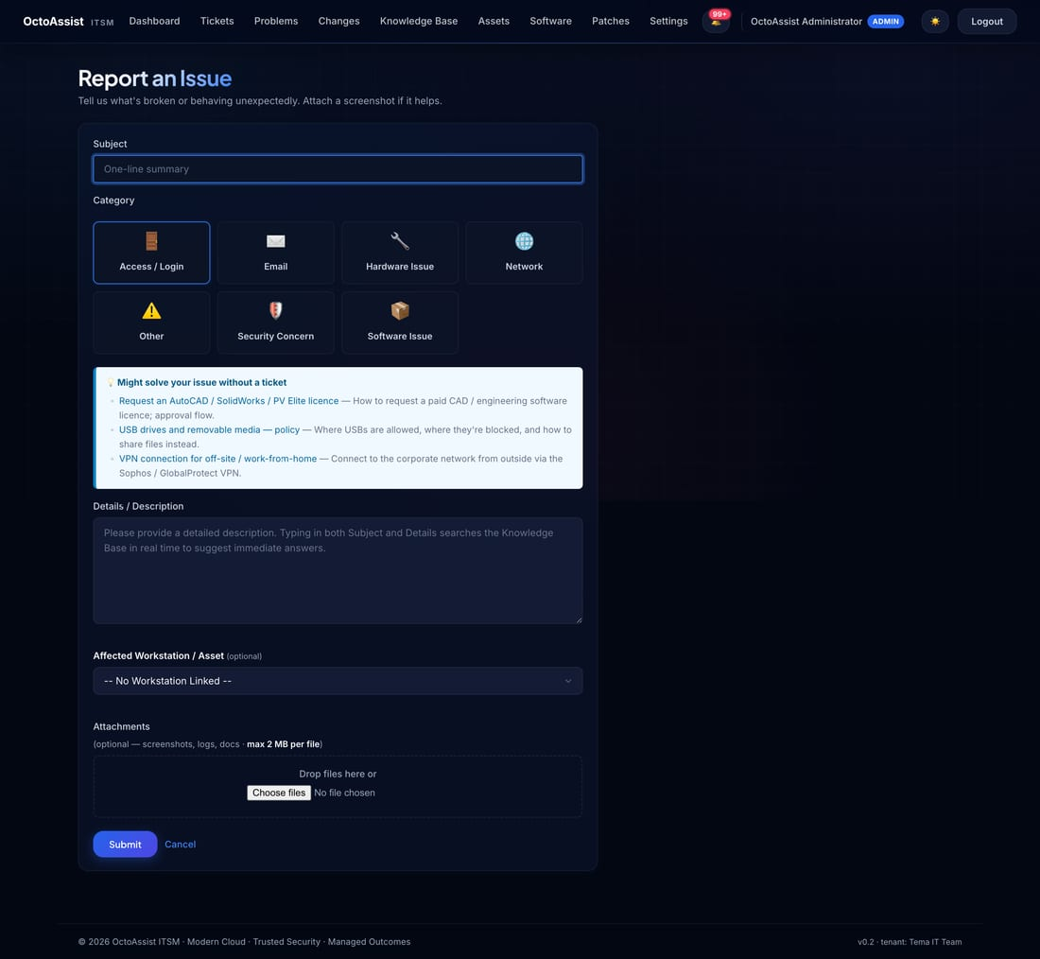
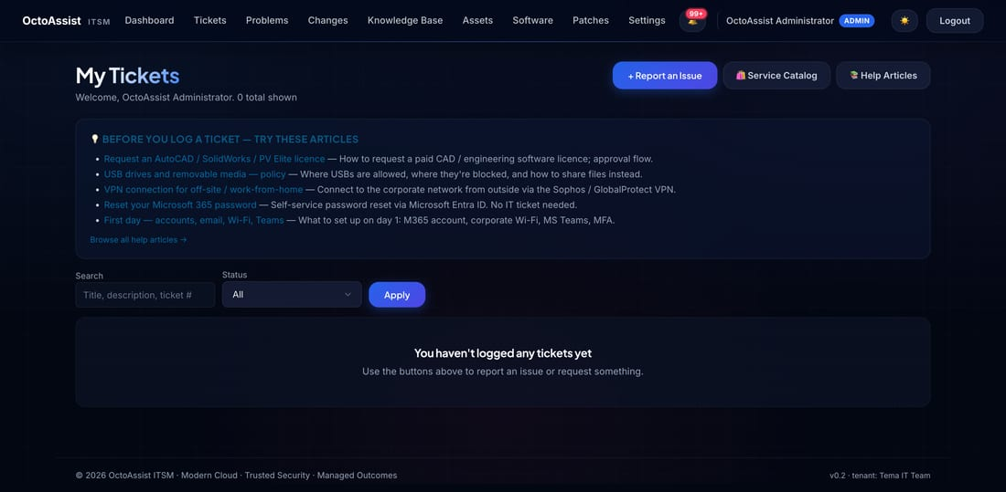
FOR REQUESTERS · PORTAL
Self-service portal — three things, no training
Dashboard — your tickets
New ticket — submit a request
🎟️
Raise a ticket
📬
Track your tickets
📚
Search the KB
Pick a category, type a description, attach files. Email confirmation in seconds.
Inbox-style view. Email update on every status change.
Self-service answers — password reset, VPN, printers, Outlook.
Notes:
The portal is intentionally narrow. Three actions, no surprises. Most of your 399 users will only ever see this view.

Slide 16
Step 5
Configure Your Settings
Admin-only — where you set SLAs, holidays, CAB, mail and software catalog

Slide 17
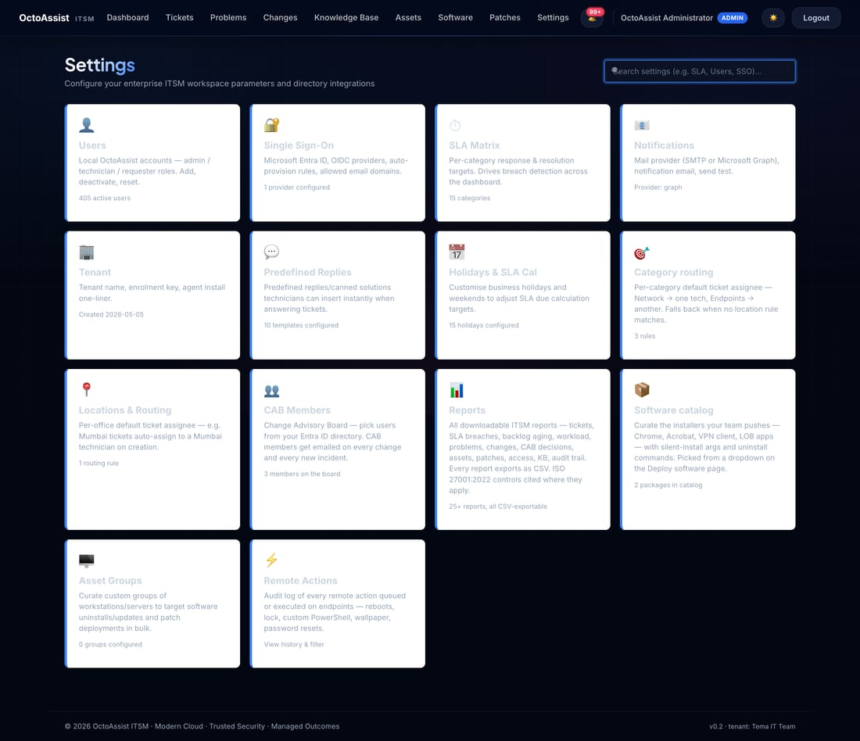
STEP 5 · SETTINGS
One landing page, every configurable area
Tiles you'll use most often
⏱ SLA Matrix
Response + resolution per category × priority
📅 Holidays
Skip dates in SLA business-day math
📧 Notifications
Mail provider + send test email
👥 CAB Members
Pick reviewers from Entra; sub-tab for committees
📦 Software catalog
Curate installer entries
Notes:
Each tile shows a live count so you can spot misconfiguration at a glance — e.g. 0 categories means no tickets will escalate.

Slide 18
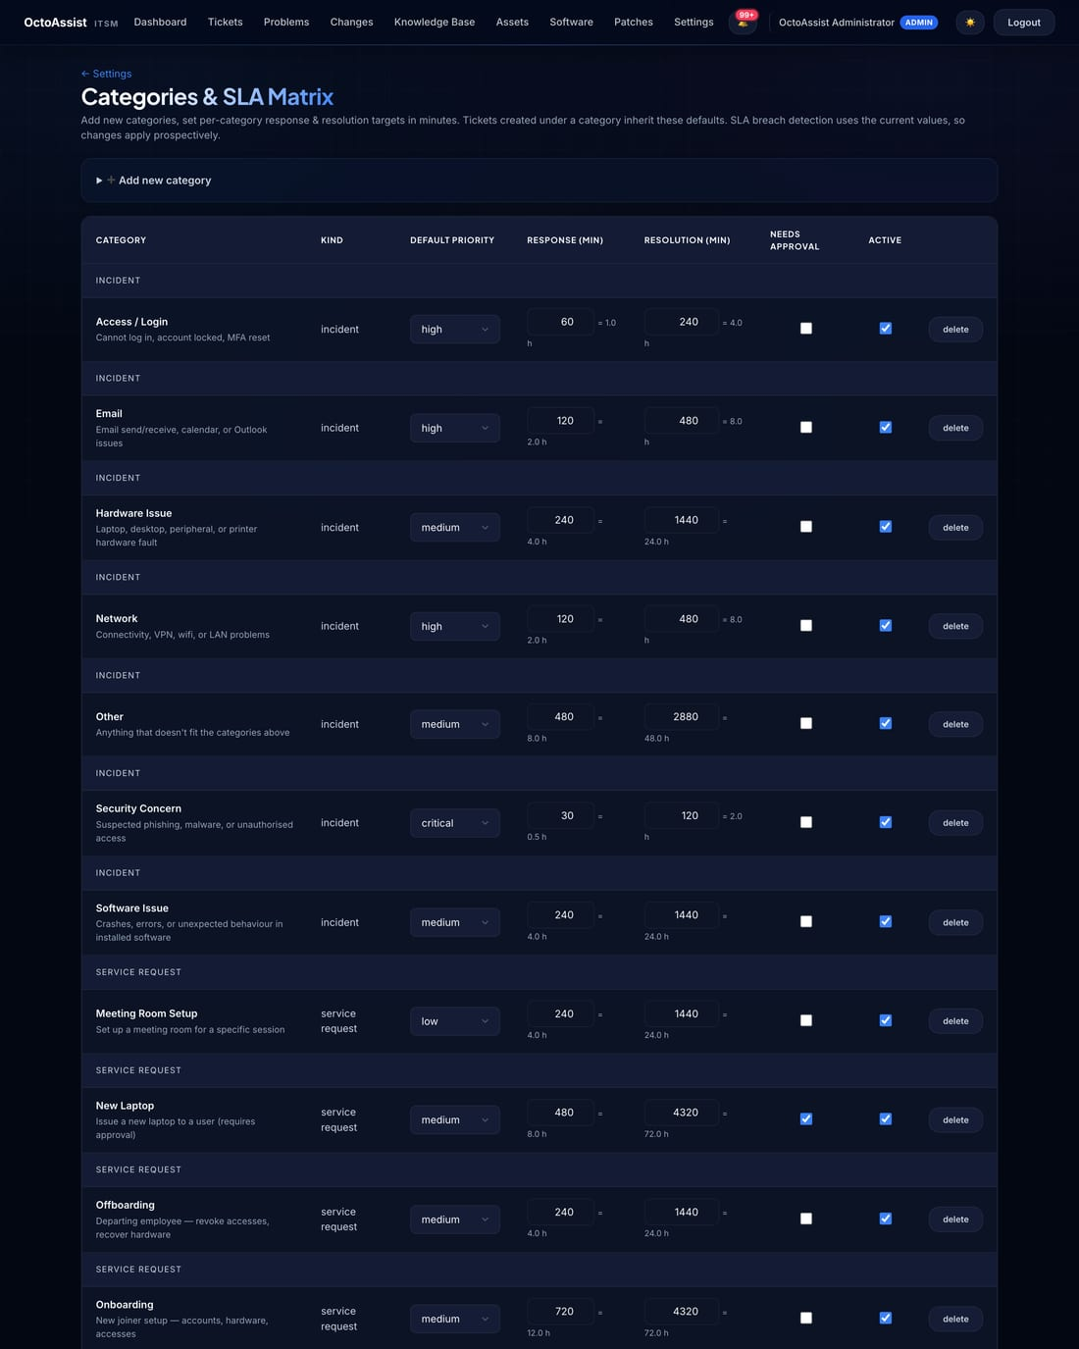
STEP 5 · SLA MATRIX
Per-category response and resolution targets
Notes:
The SLA matrix is the single source of truth for breach detection. Every ticket inherits its due-response and due-resolution timestamps from this matrix at creation time.

Slide 19
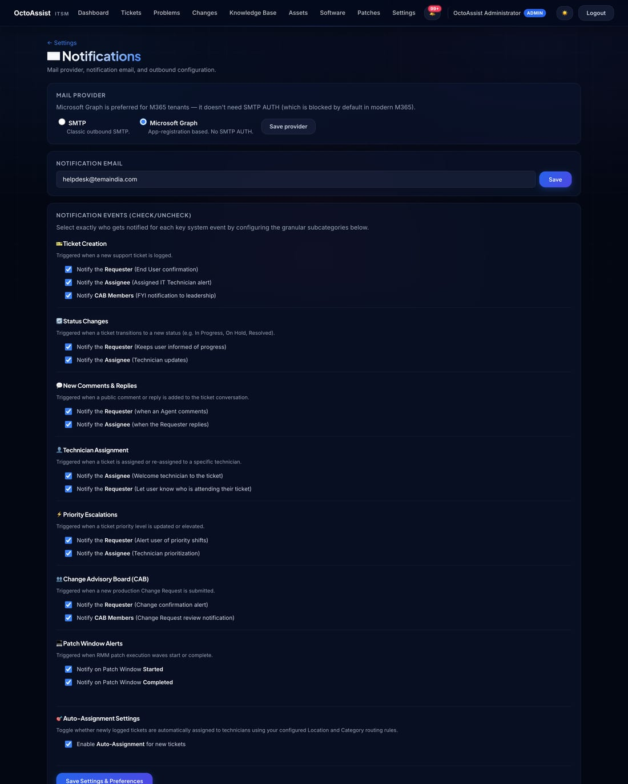
STEP 5 · MAIL PROVIDER
Configure Microsoft Graph and send a test email
Notes:
Microsoft Graph with Mail.Send application permission is the recommended mail path. Use Send test email after saving to confirm the wiring.

Slide 20
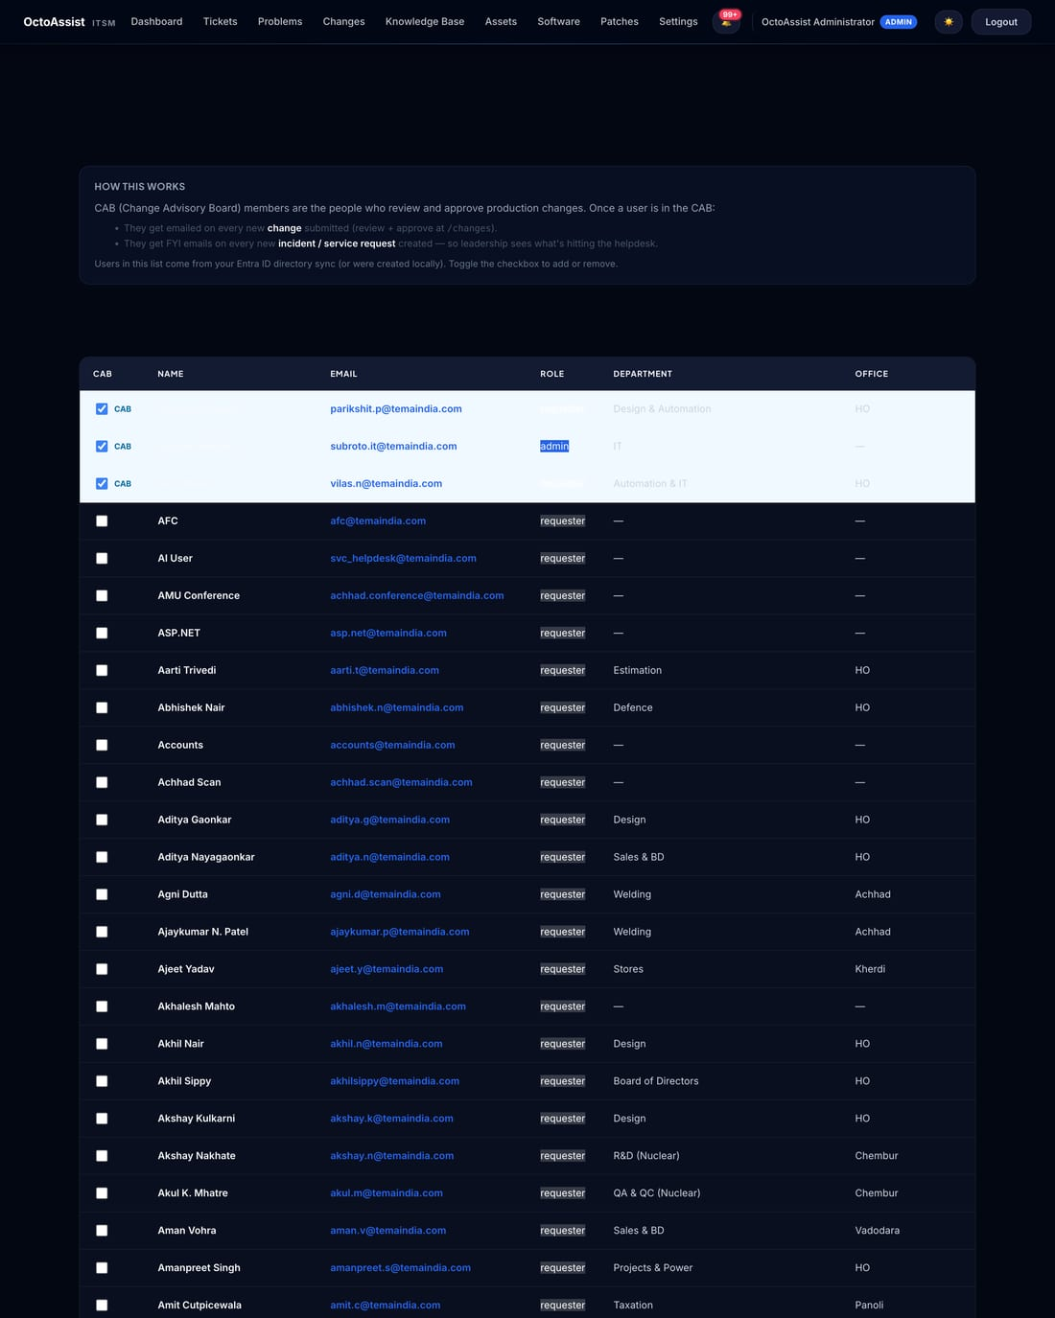
STEP 5 · CAB MEMBERS
Pick reviewers from your directory; group into committees
Notes:
CAB members get emailed on every Change. Use the CAB Committees sub-nav to group them — Change Management, Risk Management, Security Review.

Slide 21
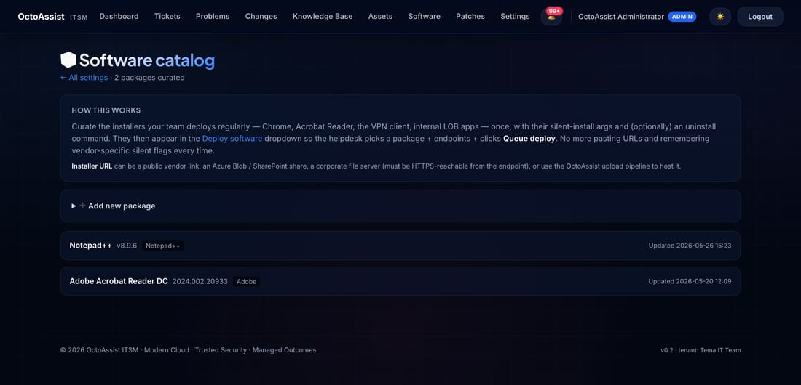
STEP 5 · SOFTWARE CATALOG
Add installers once — pick from a dropdown forever after
Notes:
Add the installer URL, the silent-install switches, and (optionally) an uninstall command. Every package in this catalog appears in the Software → Deploy dropdown.

Slide 22
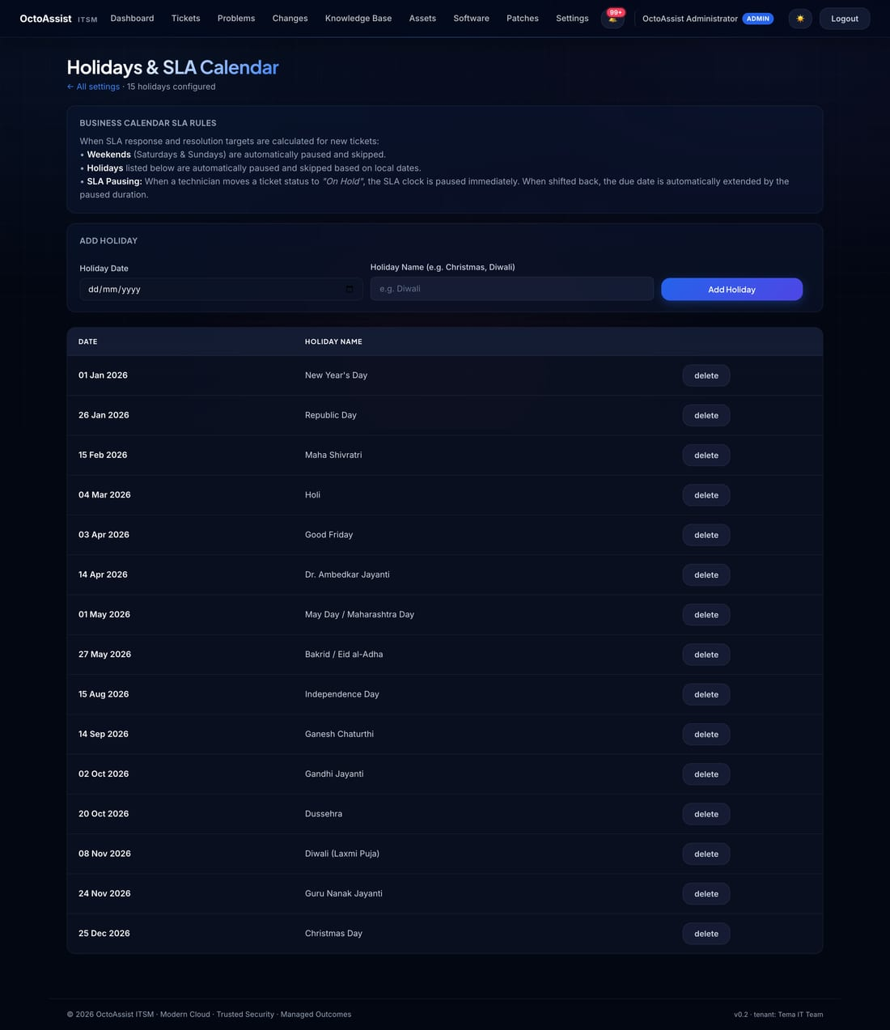
STEP 5 · HOLIDAYS
Skip business holidays in SLA math
Notes:
Fifteen standard Indian 2026 public holidays are seeded automatically. Add or remove dates that apply to your specific business.

Slide 23
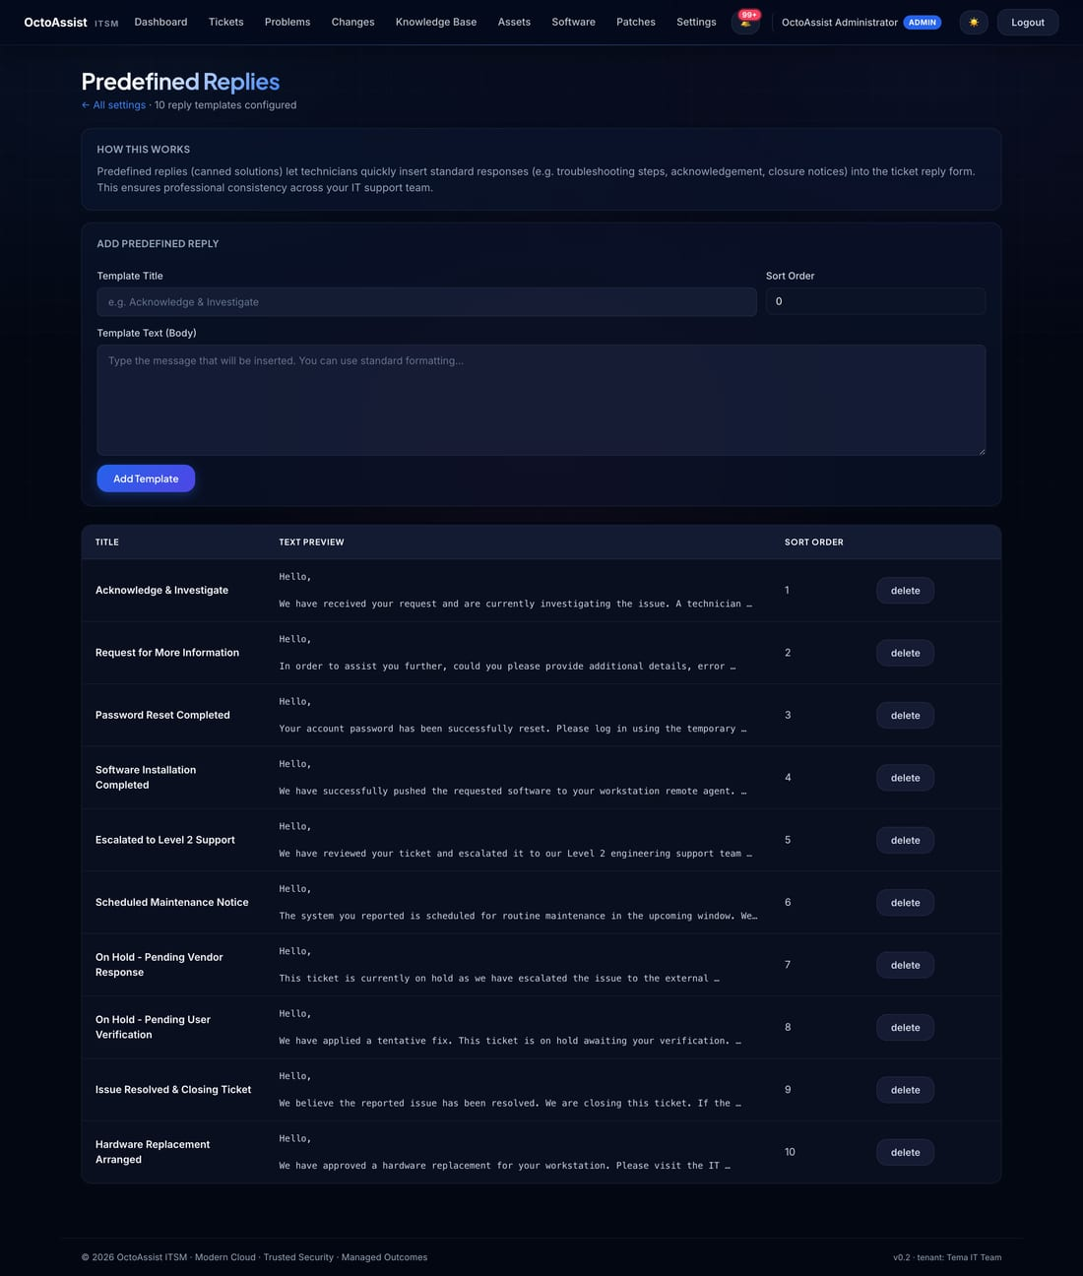
STEP 5 · PREDEFINED REPLIES
Curate canned responses your agents insert in one click
Notes:
Ten professional templates are seeded by default — Acknowledge & Investigate, Password Reset Completed, Escalated to Level 2, etc. Edit wording to match your team's voice.

Slide 24
QUICK REFERENCE
Common tasks — where to go
If you want to …
Go here
Raise a ticket (agent)
Tickets → New incident / New service request
Raise a ticket (requester)
/portal → New ticket
Search the Knowledge Base
Knowledge Base → search box
Approve a change
Email link → Changes → CHG-xxxx
Schedule patches
Patches → Patch windows → New window
Push software to a group of endpoints
Software → Deploy → pick package + group
See an endpoint's installed software
Assets → click hostname → Software tab
Add a CAB member
Settings → CAB Members → tick checkbox
Test email wiring
Settings → Notifications → Send test
Add a public holiday
Settings → Holidays → Add
Download an audit report
Reports → Reports library → pick → CSV
Find when something happened
Settings → Remote Actions / Audit Trail report
Notes:
Print this slide and tape it next to the helpdesk monitor.

Slide 25
That's the tour
Open the application and try each step
Production environment
https://octoassist.thirdoctopus.com
Third Octopus · Modern Cloud · Trusted Security · Managed Outcomes

