Slide 1
lntelligent chatbot to answer queries pertaining to
various Maintenance Processes within Substation
CSE7101- Capstone Project
Review-5
Batch Number: CSG_33
Roll Number | Student Name
Aravinda K Kambar | 20221CSG0076
Raghavendra Shreevatsa SR | 20221CSG0063
Sree Shiva R | 20221CSG0110
Under the Supervision of,
Mr.Ankita Bhaumik
Professor / Associate Professor / Assistant Professor
School of Computer Science and Engineering
Presidency University
Name of the Program: CSG
Name of the HoD: Dr. Anandaraj SP
Name of the Program Project Coordinator: Dr. Sharmasth Vali
Name of the School Project Coordinators: Dr. Sampath A K , Dr. Geetha A

Slide 2
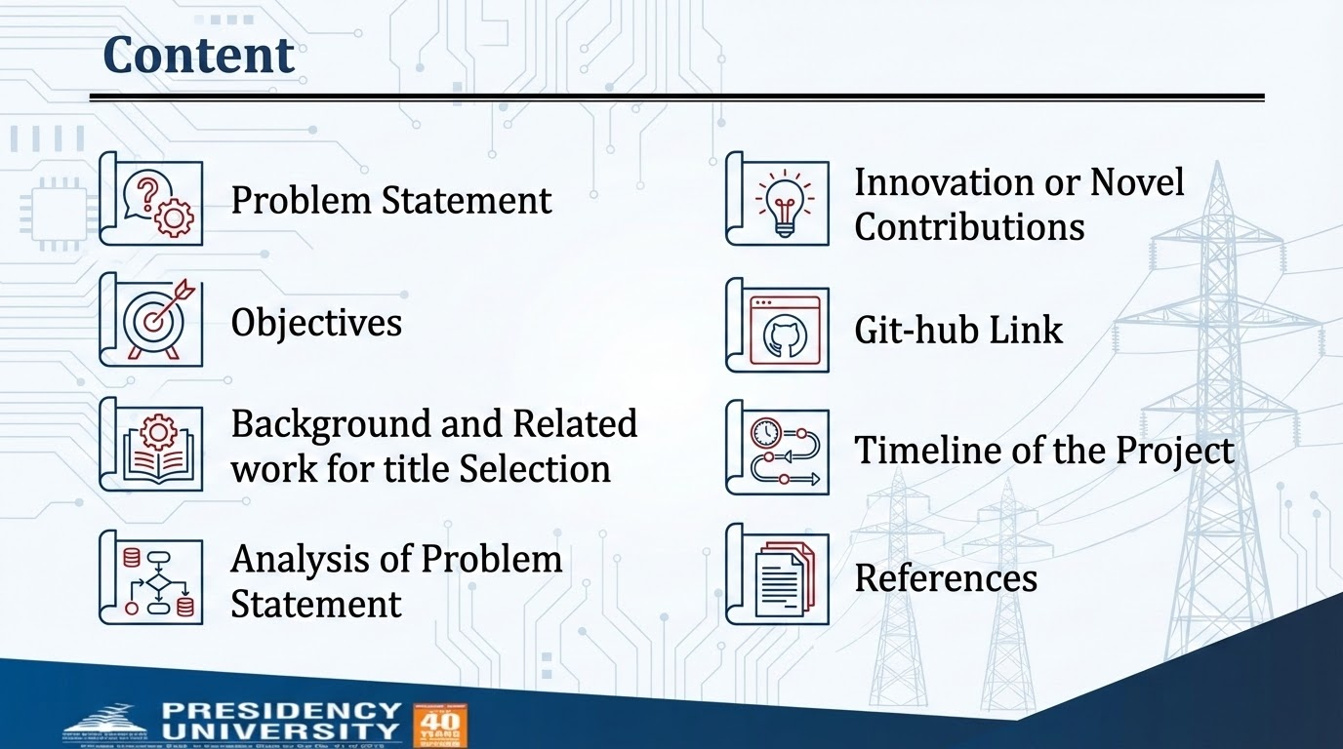

Slide 3
Problem Statement Number: PSCS_67
Organization: Ministry of Power
Category (Hardware / Software / Both) : Software
Challenges in Substation Maintenance:
Difficulty locating correct procedures during urgent maintenance.
Limited availability of senior experts → widening skill gap.
High risk of errors when interpreting manuals under time pressure.
Existing tools lack semantic understanding and standards-grounded output.
Project Goal: Create a chatbot that answers maintenance queries with high accuracy, zero hallucinations, and compliance to IEC/CBIP guidelines.

Slide 4
Objectives
Classify technician queries (informational, diagnostic, hybrid).
Retrieve relevant content from embedded manuals .
Generate safe, accurate answers using an LLM.
Provide a fast (<2 sec) response time for real-time field usage.
Develop a user-friendly interface for technicians.

Slide 5
Analysis of Problem Statement
Domain: Substation asset maintenance (transformers, reactors, circuit breakers, instrument transformers, surge arrestors).
Need: Quick, reliable guidance on tests, acceptable limits, and troubleshooting.
Challenge: Existing methods (manuals, human expertise) are time-consuming and lack real-time support.
Solution Direction: Develop an intelligent NLP-based chatbot capable of semantic query understanding.
Key Requirements:
Step-by-step procedures for maintenance activities
Acceptable test values & limits
Troubleshooting & corrective actions
Integration of safety guidelines & industry standards

Slide 6
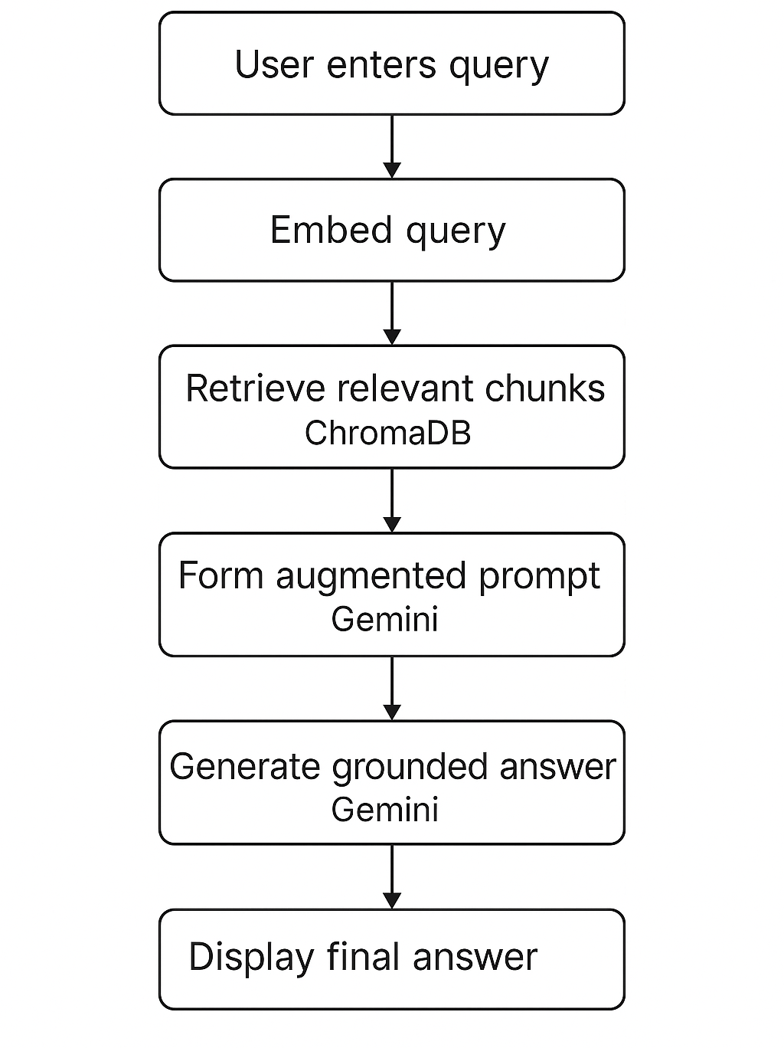
FlowChart
User enters query: Technician inputs a maintenance question.
Embed query: The system converts the query into a vector.
Retrieve relevant chunks (ChromaDB): Matching text passages from manuals and SOPs are fetched.
Form augmented prompt (Gemini): Retrieved context is combined with the query.
Generate grounded answer (Gemini): The model produces a standards-based, accurate response.
Display final answer: The system shows the final, grounded output to the user.

Slide 7
Innovation / Novel Contributions
1. Domain-Specific Intelligence
NLP-powered chatbot for substation asset maintenance
Semantic query understanding (beyond keyword search)
2. Multimodel Enhancements
Document-based queries → upload manuals/reports, retrieve context-specific answers
3. Real-Time Decision Support
Reliable, quick guidance → reduces downtime
Field-ready support for engineers & technicians

Slide 8
Technology Stack and Requirements
Backend
FastAPI, Python 3.10
HuggingFace Embeddings, ChromaDB
Gemini API
Frontend
Streamlit
System Requirements
RAM: 8–16GB (local dev)
Python libraries: LangChain, Uvicorn, Pydantic
Disk: ~1GB for vector store & manuals

Slide 9
GitHub Repository Link (public access enabled)
Github Link : https://github.com/substation-chatbot/substation-chatbot
Includes:
Backend (FastAPI)
RAG Pipeline Code
Embedding + Vector Store Scripts
Frontend UI
Test Cases & Evaluation Logs
Project Report
Research Paper

Slide 10
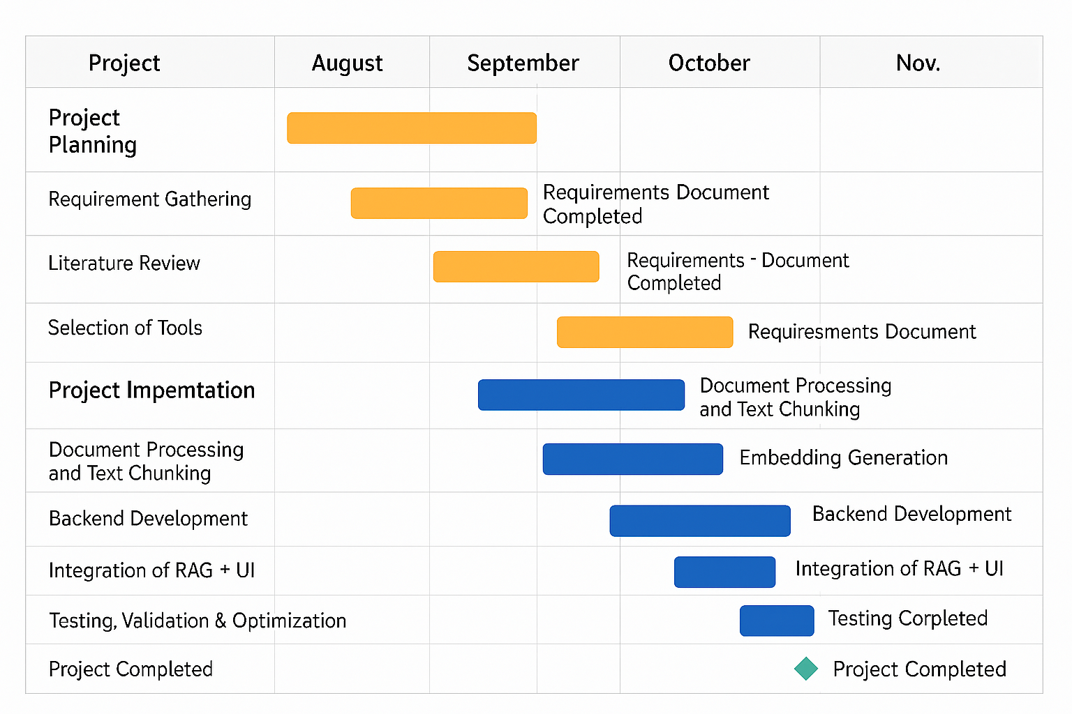
Timeline of the Project (Gantt Chart)

Slide 11
References (IEEE Paper format)
[1] P. Lewis, E. Perez, A. Karpukhin et al., “Retrieval-Augmented Generation for Knowledge-Intensive NLP Tasks,” Advances in Neural Information Processing Systems (NeurIPS), vol. 33, pp. 9459–9474, 2020.
[2] M. Ni, K. Xu, X. Liu, and Q. Zhu, “ChatGrid: Intelligent Knowledge Q&A for Power Dispatching Control Based on Large Language Models and Retrieval-Augmented Generation,” Energy Informatics, vol. 7, no. 1, pp. 1–15, 2024.
[3] A. J. C. Tang, M. H. Chen, N. J. Huang, and C. V. Trappey, “A VR-Enabled Chatbot Supporting Design and Manufacturing of Large and Complex Power Transformers,” Electronics, vol. 11, no. 1, p. 87, 2022.
[4] K. Zhang, “Knowledge Graph Construction Towards a Graph-RAG Enhanced Intelligent Maintenance Chatbot,” in Proc. 17th International Semantic Systems Conference (SEMANTiCS), 2025, pp. 1–12.
[5] International Electrotechnical Commission (IEC), Power Transformers – Part 1: General (IEC 60076), IEC Standard, 2021.

Slide 12


