Slide 1
Substrait validator overview
As of version 0.0.9, November 1st 2022

Slide 2
Topics
Goals and non-goals
Notable design choices
Implementation overview
Build & release quirks

Slide 3
Why have a validator? (1/2)
Substrait specification (still) uses loose language to make it easy to add or change features
Loose language is open to (mis)interpretation
Inconsistent Substrait implementations across vendors = SQL dialects with extra steps

Slide 4
Why have a validator? (2/2)
Need a reference implementation
  Full consumer?
    ideal, but a lot of work
  Pure validation?
    not enough: plan validity != correct interpretation of the plan
  Validation + generated documentation (“explain” output)

Slide 5
Original goals (1/4)
Validate with extreme prejudice
  Indicate when neither validity or invalidity can be proven
  Be as pedantic as possible by default
  Implement the complete specification (i.e. website), as written, without bias
    Including things technically legal (e.g. crazy function/type names like “…” or the empty string)
    If something requires an insane implementation in the validator, the spec should be updated, not the validator

Slide 6
Original goals (2/4)
Intelligent diagnostic system
  Error recovery: don’t stop after the first error
  Source information: track where diagnostics come from
  Configurability: allow severities to be customized
“Explain” output
  Data type/schema annotation
  Generated descriptions of how instances of protobuf message should be interpreted

Slide 7
Original goals (3/4)
Multi-version support
  Continue supporting deprecations until they are completely removed via a breaking change
  Check that no features from beyond a given version are used (not really implemented yet)
Easy-to-understand validation logic
  Reference implementation use case
  Maintenance should be easy, to reduce the burden of tracking the specification

Slide 8
Original goals (4/4)
Easy to use
  Batteries-included, cross-platform distribution so users can get started quickly
  Wide variety of input formats (binary, JSON, YAML, Saul’s JDOT, ...)
  Wide variety of output formats (exit code, user-friendly HTML, machine-friendly protobuf, ...)
  Various entry points (CLI, web browser, cross-language C API, ...)

Slide 9
Feature creep goals
Conversion between plan representations via CLI (without validation)
  The conversion logic is needed anyway
Parsing YAML extensions into a more machine-friendly protobuf format
  The validator needs to fully understand the extensions in order to validate them anyway

Slide 10
Non-goals (1/2)
Performance & memory usage
  Sacrificed in favor of code readability
  Only intended to be used during testing and debugging
  For production use, consumers will need their own validation anyway, to deal with:
    Supported advanced extensions
    Incomplete core Substrait support
    Workarounds for producer bugs

Slide 11
Non-goals (2/2)
Hardening against malicious actors
  Extension URI resolution in general requires downloading and parsing arbitrary YAML
  DoS attacks would undoubtedly be possible due to performance being a non-goal

Slide 12
Notable design choices (1/9)
Core library programming language: Rust
  Very hard to introduce bugs due to compile-time safety guarantees [validate with extreme prejudice]
  Cross-platform compiled language with first-class C binding support [library usage from any language]
  Fairly high abstraction level [easy-to-understand validation logic]
  Procedural macro support for hiding boilerplate code [easy-to-understand validation logic]
  Webassembly target [browser-based entry point]

Slide 13
Notable design choices (2/9)
Core protobuf support: prost
  Generates idiomatic Rust types and binary serdes from protobuf specification [easy-to-understand validation logic]
  Lacks introspection
    Need procedural macros to generate boilerplate traversal code
  Lacks proto3 JSON support
    Third party efforts to add this exist, but are not yet mature

Slide 14
Notable design choices (3/9)
Support for protobuf JSON: Python + official protobuf library
  Correct implementation by definition [validate with extreme prejudice]
  Option to fall back to pure-python implementation when libprotobuf throws a tantrum [cross-platform support]
  Requires Python

Slide 15
Notable design choices (4/9)
Rust/Python interoperability: Python native extension with PyO3 + maturin
  Don’t need to embed an interpreter
  maturin automates the entire wheel generation process in CI
  Main entry point is now in Python rather than Rust
  Can’t use JSON-based formats using the Rust or C API

Slide 16
Notable design choices (5/9)
CLI implementation: Python
  JSON-based formats are available from the CLI [ease of use]
Test framework: custom Python + Rust logic
  Can write test cases in JSON-based format vs. binary serializations [ease of maintenance]
  Language boundary makes debugging failing test cases difficult
  Learning curve of a custom framework

Slide 17
Notable design choices (6/9)
Distribution: pip/PyPI
  PyPI wheel format is precompiled, yet cross-platform and free of native dependencies [ease of use, cross-platform]
  Can fall back to sdist if no compatible wheel is available [cross-platform]
  Users are likely to already be familiar with pip [ease of use]

Slide 18
Notable design choices (7/9)
Simple extension support: serde-yaml, jsonschema, serde-json
  serde-yaml: idiomatic wrapper around libyaml [easy-to-understand validation logic, validate with extreme prejudice]
  jsonschema: implements validation for the schema published by Substrait [validate with extreme prejudice]
  serde-json: needed only to connect the YAML deserializer to jsonschema

Slide 19
Notable design choices (8/9)
Type expression syntax support: antlr-rust
  substrait-java already uses ANTLR
  ANTLR is good at auto-generating recovery and disambiguation from just EBNF input [easy-to-understand validation logic, error recovery]
    No EBNF-based alternatives seem to exist for Rust; the more idiomatic parser combinator crates would duplicate the language syntax specification
  Immature and non-idiomatic Rust

Slide 20
Notable design choices (9/9)
YAML URI resolution: curl (Rust) and urllib (Python)
  curl supports all kinds of URI formats and protocols out of the box [validate with extreme prejudice]
  The curl crate is not self-contained, making it incompatible with wheel distribution; fall back to Python’s internal urllib library
  Allow users to specify URI overrides when expected in-plan URIs cannot be resolved with curl or urllib

Slide 21
Project structure
GH actions
CLI user
Python user
Rust user
Other lib user
git
pip or git
pip or git
cargo
cmake and/or git
Test runner (tests/)
Python bindings (py/)
C bindings (c/)
cargo
libprotobuf
libprotobuf
cargo
cargo
Substrait validator core crate (rs/)
prost
serde-yaml, jsonschema
antlr-rust
prost
cargo
Input format spec (substrait/)
Output fmt spec (proto/)
Procedural macro crate (derive/)
Rust
Protobuf
C
Python
Other

Slide 22
Diagnostics (1/2)
Primary validation output
Validation verdict is derived directly from the most severe diagnostic:
  Info -> valid
  Error -> invalid
  Warning -> no proof either way
Diagnostic
Path
Path to the tree node that the diagnostic originated from
Level
Severity level: info, warning, or error
Cause
Classification
Structured 4-digit code, like an error number
Message
Unstructured cause information

Slide 23
Diagnostics (2/2)
The “cause” consists of a structured “classification” (basically an error code) and an unstructured message
Severity levels for a particular
classification can be clamped to a
certain range through configuration
  Can affect the validation verdict
  Original level is also tracked
Diagnostic
Path
Path to the tree node that the diagnostic originated from
Level
Severity level: info, warning, or error
Cause
Classification
Structured 4-digit code, like an error number
Message
Unstructured cause information

Slide 24
“Unresolved” values
Special enum variant that appears all over the place
Indicates that the value of something is unknown due to previous errors: error recovery
Similar to null or NaN: use of unresolved silently yields unresolved
If no unresolved variant exists, use whatever is least likely to result in spurious diagnostics later

Slide 25
Traversal (1/5)
Validation is abstracted as a tree transformation
Structure is generally preserved
Input and output node types differ
Substrait plan
Binary protobuf
Input tree
Protobuf, YAML, or ANTLR parse tree
Output tree
substrait_validator::output::tree::Node
Export format
Binary protobuf, text, or HTML
Deserialize
Depth-first traversal
Export
Resolve URI or parse with ANTLR

Slide 26
Traversal (2/5)
Node handling is done by “parse functions” of the form:
  parse(x: &Input, y: &mut Context, ...) -> Result<...>
x is the input node, and y points to the automatically generated output node, configuration, and state tracking structures
Substrait plan
Binary protobuf
Input tree
Protobuf, YAML, or ANTLR parse tree
Output tree
substrait_validator::output::tree::Node
Export format
Binary protobuf, text, or HTML
Deserialize
Depth-first traversal
Export
Resolve URI or parse with ANTLR

Slide 27
Traversal (3/5)
Parse functions must:
  Traverse each child node exactly once (in some order) by calling a child parser via a traversal macro
  Annotate the output node with validation information (including diagnostics)
  Update context/state information in Context as needed
Substrait plan
Binary protobuf
Input tree
Protobuf, YAML, or ANTLR parse tree
Output tree
substrait_validator::output::tree::Node
Export format
Binary protobuf, text, or HTML
Deserialize
Depth-first traversal
Export
Resolve URI or parse with ANTLR

Slide 28
Traversal (4/5)
Boilerplate traversal code sanity-checks the parse functions
  Child not traversed -> emit not-yet-implemented warning, and traverse subtree with fallback logic
  Child traversed twice -> panic (treated as a bug)
Substrait plan
Binary protobuf
Input tree
Protobuf, YAML, or ANTLR parse tree
Output tree
substrait_validator::output::tree::Node
Export format
Binary protobuf, text, or HTML
Deserialize
Depth-first traversal
Export
Resolve URI or parse with ANTLR

Slide 29

Traversal (5/5)
Boilerplate traversal code relies on derive crate
  One big pile of spaghetti, but…
  Unlikely to need maintenance, unless
  prost or Rust itself changes significantly
Substrait plan
Binary protobuf
Input tree
Protobuf, YAML, or ANTLR parse tree
Output tree
substrait_validator::output::tree::Node
Export format
Binary protobuf, text, or HTML
Deserialize
Depth-first traversal
Export
Resolve URI or parse with ANTLR

Slide 30
Output tree nodes
One type to rule them all: context-free traversal by export logic
Output node
Child reference
Class
Approximate role of a node within Substrait: data type, expression, relation, or misc.
Node type
Role of a node within the original data structure
(protobuf message, YAML map, primitive, AST node, etc.)
Node
Path element
Child type of the node in the original data structure (Protobuf field, YAML array element, oneof, etc.)
Recognized
Flag specifying whether the corresponding input node was recognized by the parent parse function
Brief + summary
Unstructured English description of how the node should be interpreted by a consumer
Data type
Substrait data type represented or returned by the complete node, if applicable (schema, expression return type, etc.)
One of
Comment
Inline unstructured information
Data
Ordered list of zero or more children
Data
Ordered list of zero or more children
Data
Ordered list of zero or more children
Data
Ordered list of zero or more children
Data
Ordered list of zero or more children
Diagnostic
Representation of a potential problem with the parent node
Data type
For intermediate data types

Slide 31
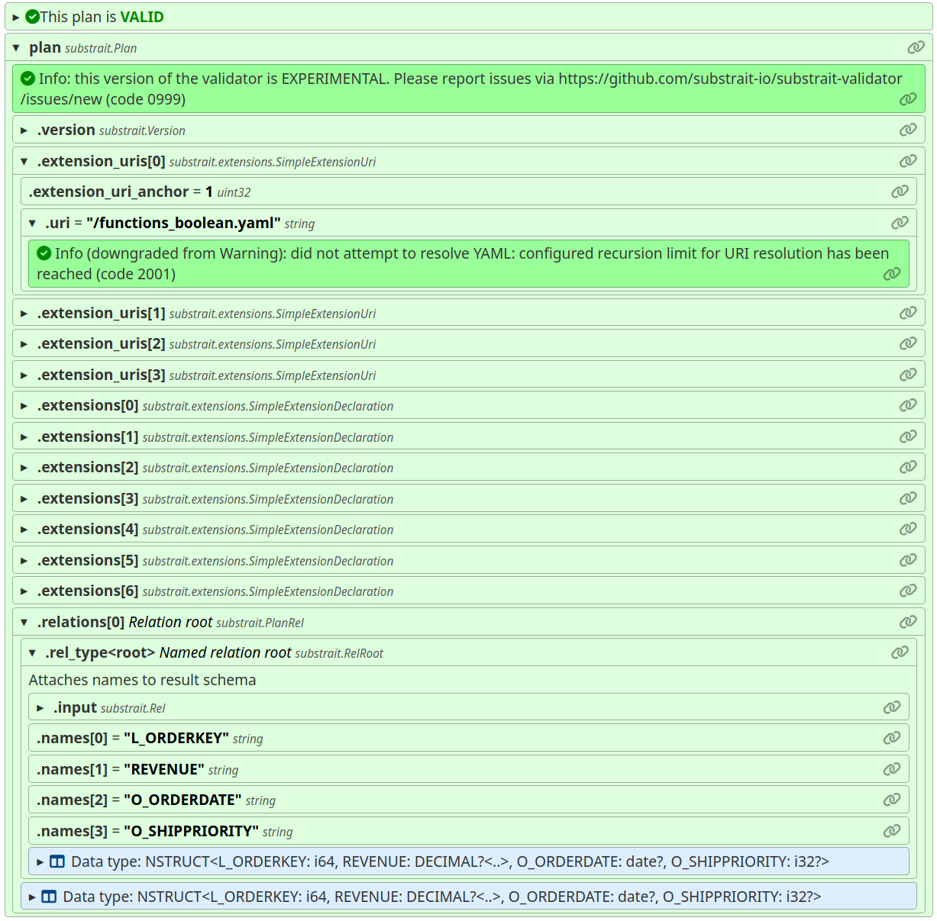
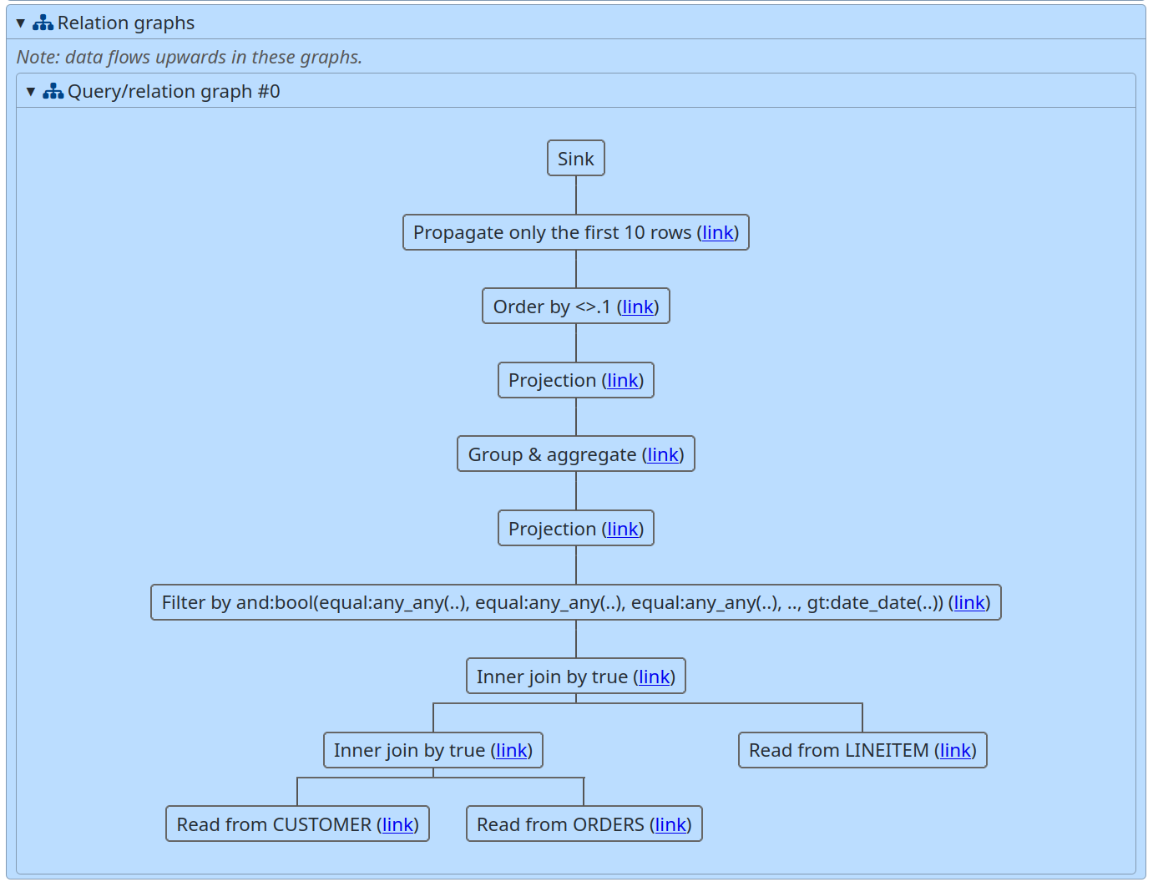
HTML export format
Self-contained human-readable HTML representation of the output tree

Slide 32
Core library structure
substrait_validator (rs/src/)
input
parse
output
export
proto
Mostly generated by prost and the derive crate
traversal
Boilerplate code and macros
tree
Output tree structure types
path
Types for tracking locations in a tree
proto
Serializes the output::tree structure to protobuf
context
Traversal state-tracking types and operations
diagnostic
Diagnostic manipulation
comment
Unstructured documentation
yaml
Boilerplate code for YAML traversal
html
Generates a rich HTML report from the output tree
plan
Toplevel parser for Substrait plan
type_system
traits
Facilitate traversal macros
data
Substrait data type logic
meta
Type derivation type system
diagnostics
Reports the diagnostics as a flat text file
config
User configuration data structure
...
Various modules implementing the actual validation logic
extension
Semantic representation of extensions
...
Various support modules
util
Utilities not specific to Substrait validation

Slide 33
Testing
Unit tests are admittedly scarce
Majority of testing is done by the integration test runner
  Test descriptions consist of YAML
  files that mimic the protobuf JSON
  DOM, but include test commands
  and support inlining YAML
  extensions
  Python portion of the test runner
  parses these files into a simpler
  format, which the Rust portion
  then executes
  See README.md for more info
name: rel-root-with-names
plan:
__test: # check that the error level is Info
- level: i
version: { producer: validator-test }
relations:
- root:
names:
- a
- b
input:
read:
baseSchema:
names: [x, y]
struct:
nullability: NULLABILITY_REQUIRED
types:
- string: { nullability: NULLABILITY_REQUIRED }
- i32: { nullability: NULLABILITY_NULLABLE }
namedTable:
names:
- test
__test: # Check that the derived schema is as expected
- type: "NSTRUCT<a: string, b: i32?>"

Slide 34
Versioning (1/2)
Substrait validator version is unrelated from Substrait version
  Support matrix tracked in main README.md
PyPI and crate versions are synchronized and released simultaneously
Versioning scheme is semver-compliant, using cargo semantics for 0.x.y regime (x++ = breaking, y++ = feature/patch)
Currently in 0.0.x regime

Slide 35
Versioning (2/2)
Change | Release type
Substrait breaking protobuf/spec change | Breaking release
Substrait protobuf feature addition | Feature release
Substrait breaking core extension change | Probably no release needed
Other Substrait changes | Probably no release needed
Fix of inconsistency between Substrait and validator | Patch release
Breaking validator interface change | Breaking release
Non-breaking validator interface change | Feature release
Validator-only bugfixes | Patch release
Semantic release implemented for validator | Release 0.1.0
Validator implements all of Substrait | Release 1.0.0
See also https://github.com/substrait-io/substrait-validator/issues/4

Slide 36
Release automation
Currently:
  Version increment is manual
  Version number synchronization is semi-automatic via the ci/version.py CLI script
  Release is automated using GH actions, but triggered manually by a tag push to main
Idea is to mimic substrait main repo eventually for consistency (conventional commit + semantic release)

Slide 37
Notable build quirks (1/2)
Pre-build code generation
  Several files must be synchronized from the substrait/ submodule to the py/ and rs/ trees
  Protobuf code generation is necessary for Python
  Ugly logic needed to distinguish between builds from git and builds from sdist packages
  Usually automatic, but no reliable hook exists
    see README.md files in py/ and rs/ for more information
  Sometimes a “git clean -fdx” may be needed

Slide 38

Notable build quirks (2/2)
Derive crate release dependency
  Cargo refuses to release if any dependency is not in the public index yet
  Index updates are asynchronous to completion of the “cargo release” command
  Blocking handled by ci/crates-io-wait.py script
  Might actually be fixed in cargo now;
    https://github.com/rust-lang/cargo/issues/9507

Slide 39
Where to find more information
Important directories have dedicated README.md files
RELEASE.md documents the release process
CONTRIBUTING.md is the entry point for new contributors
All Rust modules, functions, types, and fields have docstrings
  cargo doc --all-features --document-private-items --open

