Slide 1
Brand Sentiment Analysis of Twitter Posts
Jonathan Agustin
Fernando Calderon
Juliet Lawton
Video: https://vimeo.com/843997462/2f1e66d926?share=copy
Notes:
Let’s get started. Welcome to our project titled, Brand Sentiment Analysis of Twitter Posts.

Slide 2
Businesses increasingly leverage social media to gain key insights on market performance.
Notes:
Businesses today are increasingly reliant on social media to continuously monitor public perception of their brands. This digital revolution has opened up a wealth of data, providing businesses with unprecedented access to consumer behavior, preferences, and trends. By harnessing the power of social media, businesses can gain a deeper understanding of their market performance and make data-driven decisions. Machine Learning is a powerful tool for efficiently processing vast amounts of data and transforming it into meaningful information for decision-making.

Slide 3
Why Use AI in Business?
Understand customer sentiment
Identify emerging trends and preferences
Enhance customer engagement and loyalty
Predict future customer behavior
Improve marketing strategies
Notes:
Why should businesses consider integrating Artificial Intelligence, or AI, into their operations? The answer lies in the transformative potential of AI, particularly in the realm of customer understanding and engagement. First, AI can help businesses understand customer sentiment towards their brand. By analyzing social media data, AI can identify positive, negative, and neutral sentiments, providing businesses with a clear picture of how their brand is perceived. Second, AI can identify emerging trends and preferences. This allows businesses to stay ahead of the curve, adapting their products and services to meet changing customer needs. Third, AI can predict future customer behavior. This predictive capability can inform business strategies, helping companies to anticipate and respond to market changes effectively. Fourth, AI can improve targeted marketing strategies. By understanding customer preferences and behavior, businesses can tailor their marketing efforts to reach the right audience with the right message. Fifth, AI can enhance customer engagement and loyalty. By providing personalized experiences and interactions, businesses can build stronger relationships with their customers, fostering loyalty and driving growth.

Slide 4
Project Topic & Scope
Analyze tweets from Twitter for brand mentions and associated sentiment.
Notes:
The scope of our project is constrained to Twitter, one of the most popular social media platforms. We aim to analyze tweets for brand mentions and the sentiment associated with these mentions. This involves identifying tweets that mention specific brands and then classifying the sentiment of these tweets as positive or negative.

Slide 5
Overview & Goals
Build a Brand Classifier that can accurately detect brand names
Build a Sentiment Classifier that can accurately classify the sentiment of a tweet
Develop a Brand Sentiment Analyzer tool
Explore key course topics
Notes:
The goal of this project is to build a Brand Sentiment Analyzer that can classify sentiment towards brands in a collection of tweets from the Sentiment140 dataset. There are two parts to this problem – building a brand classifier and building a sentiment classifier. Several key course topics were explored for this project, including Natural Language Processing, Supervised Machine Learning, Classification, Regression, and Deep Learning.

Slide 6
Questions
How can we detect when a Twitter post is referencing a brand?
How can we accurately classify the sentiment of Twitter posts?
How can we create a tool that does both?
Notes:
Our project revolves around three main questions. How can one effectively detect instances where a Twitter post references a specific brand? This involves the systematic analysis of textual data, considering the diverse ways brands can be mentioned or alluded to. Following the detection process, the next objective is sentiment classification. The central inquiry here is: How can the sentiment of a Twitter post, once identified as brand-related, be classified with a high degree of accuracy? This task necessitates rigorous methodologies given the subtleties of human language and sentiment expression. Having addressed these two tasks, the overarching research aim is to design a tool that integrates both brand reference detection and sentiment analysis. That is, how can we create a tool that does both?

Slide 7
How Do We Create A Brand Sentiment Analyzer?
Explore Sentiment140 dataset
Use GPT-4 to generate synthetic data
Preprocess the data
Train and test different models
Select highest performer
Notes:
So, how do we create a brand sentiment analyzer? Our process involves several steps. First, we explore the Sentiment140 dataset to understand the information represented and discover any limitations. Next, we use OpenAI’s GPT-4 to generate synthetic entries to provide more support for each brand class. Then, we preprocess the data to clean and prepare it for model development. We test different models for brand classification, including Multinomial Naive Bayes, Linear Support Vector Classifier, and Logistic Regression. We also test different models for sentiment classification, all using the Logistic Regression algorithm but with different vectorization methods. We evaluate each model using metrics such as accuracy, precision, recall, and F1 score. Finally, we combine the highest performing brand and sentiment classifiers to create a Brand Sentiment Analyzer.

Slide 8
Machine Learning Algorithms Considered
Naïve Bayes
Logistic Regression
Support Vector Machines
Recurrent Neural Networks
Transformers (e.g., BERT)
Notes:
In our project, we considered several machine learning algorithms. These include Naïve Bayes, which is a simple yet powerful algorithm based on Bayes' theorem. We also considered Logistic Regression, a popular algorithm for binary classification problems. Support Vector Machines, or SVMs, were another option. These are powerful algorithms that can handle both linear and non-linear data. We also considered Recurrent Neural Networks, or RNNs, which are a type of neural network that are particularly good at processing sequential data. Finally, we looked at Transformers, such as BERT, which are state-of-the-art models for natural language processing tasks. Each of these algorithms has its own strengths and weaknesses, and the choice of algorithm depends on the specific requirements of the task at hand.

Slide 9
Datasets
Sentiment140
Surge AI
Notes:
In the field of sentiment analysis, two key datasets are the Sentiment140 dataset and the SurgeAI Brand Sentiment dataset. The Sentiment140 dataset, developed by Stanford researchers, is a comprehensive collection of 1.6 million tweets. Each tweet is annotated with a sentiment polarity - 0 indicating negative sentiment and 4 indicating positive sentiment. This large and diverse dataset is particularly useful for training robust machine learning models for sentiment analysis. On the other hand, the SurgeAI Brand Sentiment dataset is a curated collection of over 600 tweets that provide insights into public opinions about global brands like Nike, Tesla, and Chick-fil-A. Each tweet in this dataset is labeled with sentiment scores, making it a valuable resource for tasks such as brand monitoring, sentiment analysis, and understanding consumer trends. Both these datasets offer unique opportunities for data scientists and researchers. They provide a wealth of information to train models that can accurately gauge public sentiment based on tweet content, each with their own unique focus and application.

Slide 10
Brands Chosen
1. Facebook
2. Google
3. Apple
4. Starbucks
5. Disney
6. Walmart
7. Target
8. Microsoft
9. Amazon
10. Sony
Notes:
From the Sentiment140 dataset, we were able to find hundreds of tweets mentioning brands. Those brands included: Facebook, Google, Apple, Starbucks, Disney, Walmart, Target, Microsoft, Amazon, and Sony. Further, we randomly chose tweets that did not mention any brands because we aimed to build a brand classifier that predicts whether a brand is mentioned in a tweet. Hence, it was important to include example tweets with no brands so that our models could be trained on tweets with brands and no brands.

Slide 11
Datasets
Sentiment140
Surge AI
Notes:
After exploring the Surge AI dataset, we decided that it was not a suitable dataset. While the dataset was complete with tweet, brand, and sentiment, the dataset did not contain many tweets mentioning the brands chosen for this project. The Sentiment140 dataset contained hundreds of suitable samples for training, while the Surge AI dataset only contained a few per brand.

Slide 12
Experimental Design
Build model
Evaluate model
Choose model
Prep data
Notes:
We present a concise cyclical workflow. It begins with prepping the data, where we ensure that the data is curated and ready for processing. Once the data is primed, we choose a model, selecting the most appropriate algorithm or framework based on our requirements. Following this decision, we transition to build a model, actualizing our chosen algorithm and tailoring it to fit the data. And finally, we evaluate the model, critically assessing its performance and accuracy. It's worth noting that this process can be iterative: based on evaluations, we might loop back to refine data preparation or model selection, ensuring optimal outcomes.

Slide 13
First Stage: Assess
Notes:
In the assess stage, we analyzed the dataset and selected appropriate models based on the specific requirements of the sentiment analysis task, the characteristics of the available data, and the nature of the problem. The assessment stage of the project involves dataset analysis, model selection, and preliminary testing. This phase sets the foundation for subsequent stages by determining the most suitable models for sentiment analysis and brand identification. The project starts with an in-depth analysis of the Sentiment140 dataset. This dataset contains labeled tweets with sentiment polarity. The sentiment labels are remapped to binary values (0 for negative and 1 for positive) to simplify interpretation and analysis.

Slide 14
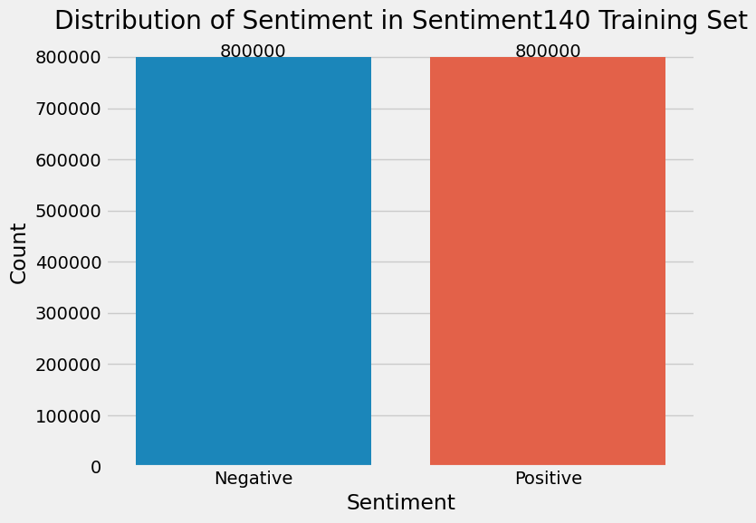
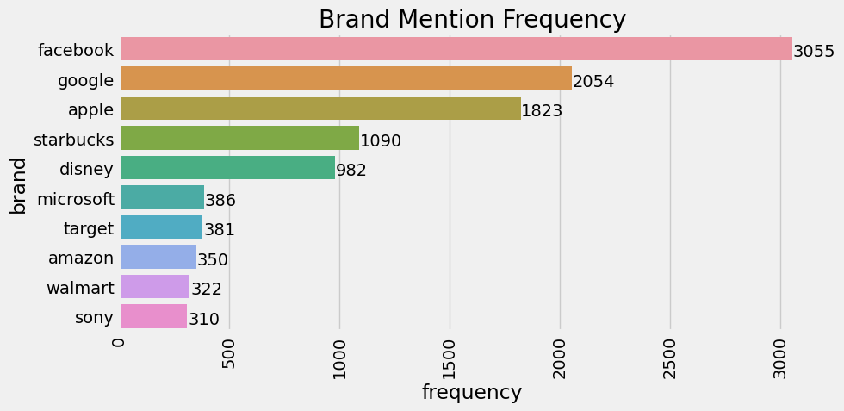
Exploratory Data Analysis
Notes:
placeholder voiceover

Slide 15
Preprocessing
Clean URLs and @mentions
Tokenize text
Remove stop words and punctuation
Reduce tokens to stems
I LOVE @Health4UandPets u guys r the best!!
['i', 'love', 'u', 'guy', 'r', 'best']
Notes:
Most machine learning algorithms to not accept raw text and instead expect vector representations as input, so it is necessary to transform the data to make it suitable for machine learning. The first step is cleaning the tweets, which strips extraneous information, in this case URLs and at mentions, to simplify the text. The text is then broken into a list of individual words, or tokens. After tokenization, we reduce the vocabulary by removing stop words such as and or the because they don't provide much additional information for understanding the meaning of a sentence. Punctuation is also removed. After this, the tokens are reduced to their root stems, in a process known as stemming. This process also reduces vocabulary by replacing words that have the same or similar meaning with the root word. For example, the words run, running, runs, and runner can all be replaced by the word run which preserves the original meaning.

Slide 16
Creating Data for the Brand Classifier
tweet sentiment
@ashman01 My only complaint about Facebook is they've changed it so much 0
tweet sentiment brand
@ashman01 My only complaint about Facebook is they've changed it so much 0 facebook
Notes:
In order to build the brand classifier, it was necessary to have a feature of the dataset that provided brand labels. The Sentiment140 dataset did not contain this information, so a supplementary Brands dataset was created. This dataset consisted of tweets from the Sentiment140 dataset and an equal number of tweets that did not reference any brand, labeled with "no brand"

Slide 17
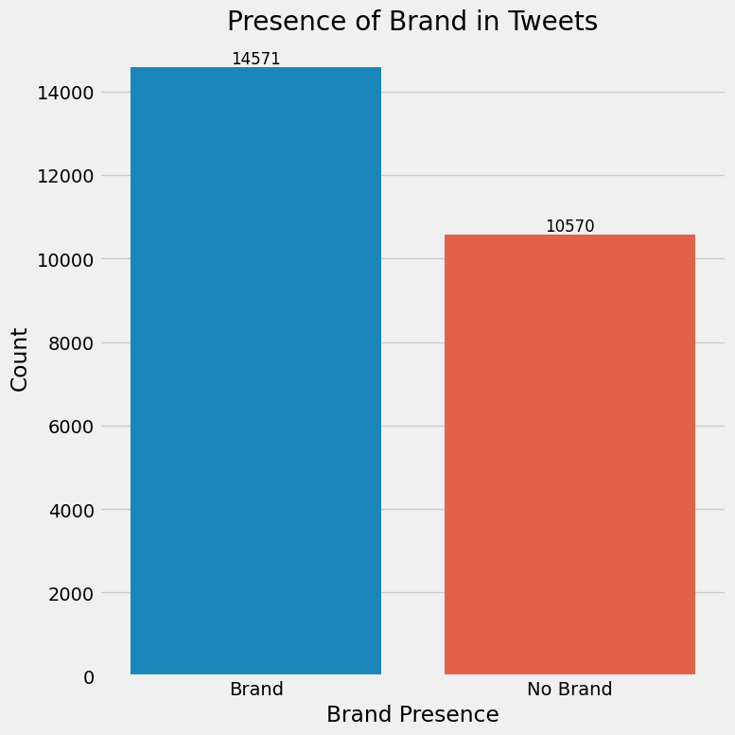
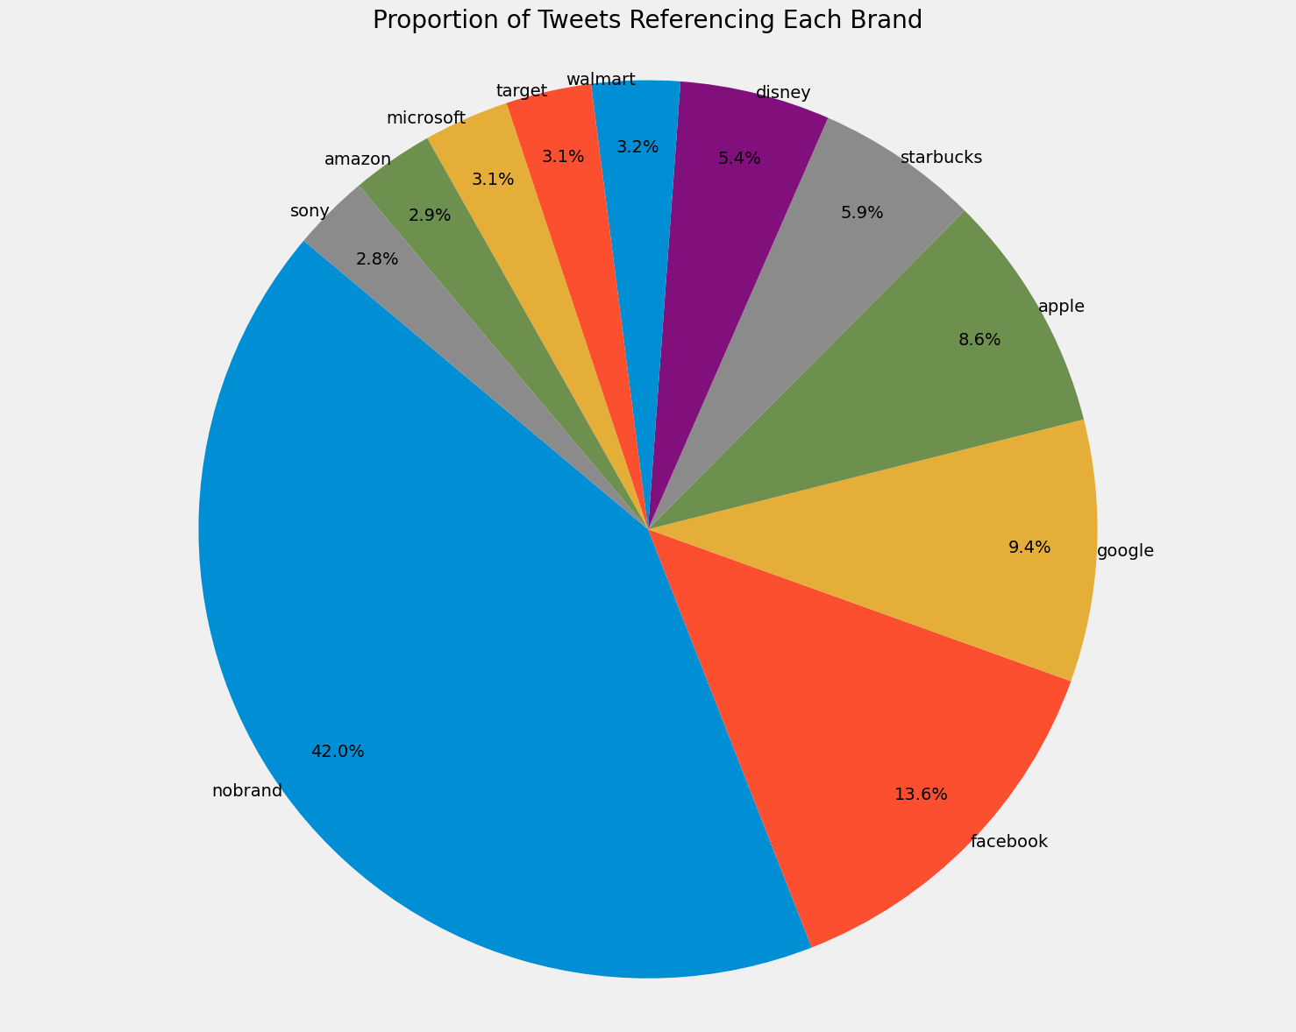
Creating Data for the Brand Classifier
Notes:
We divided the tweets into two categories: one included tweets discussing brands, while the other encompassed those without any brand mentions ("No Brand" mentions). The categorization led to a bar chart that displayed the tweet counts for each group. This visual enabled us to understand the balance between tweets that discussed brands and those that did not. After that, we quantified the frequency of each brand's appearance in the tweets and represented this information with a pie chart. The sizes of the slices in the chart directly correlated with the level of discussion about each brand. This graphical approach made it straightforward to pinpoint the brands generating more buzz in the tweets. These visuals provided us with meaningful insights into the conversations about brands within the tweets. Despite its simplicity, this approach allowed us to comprehend which brands were generating more interest and engagement within the tweeting community.

Slide 18
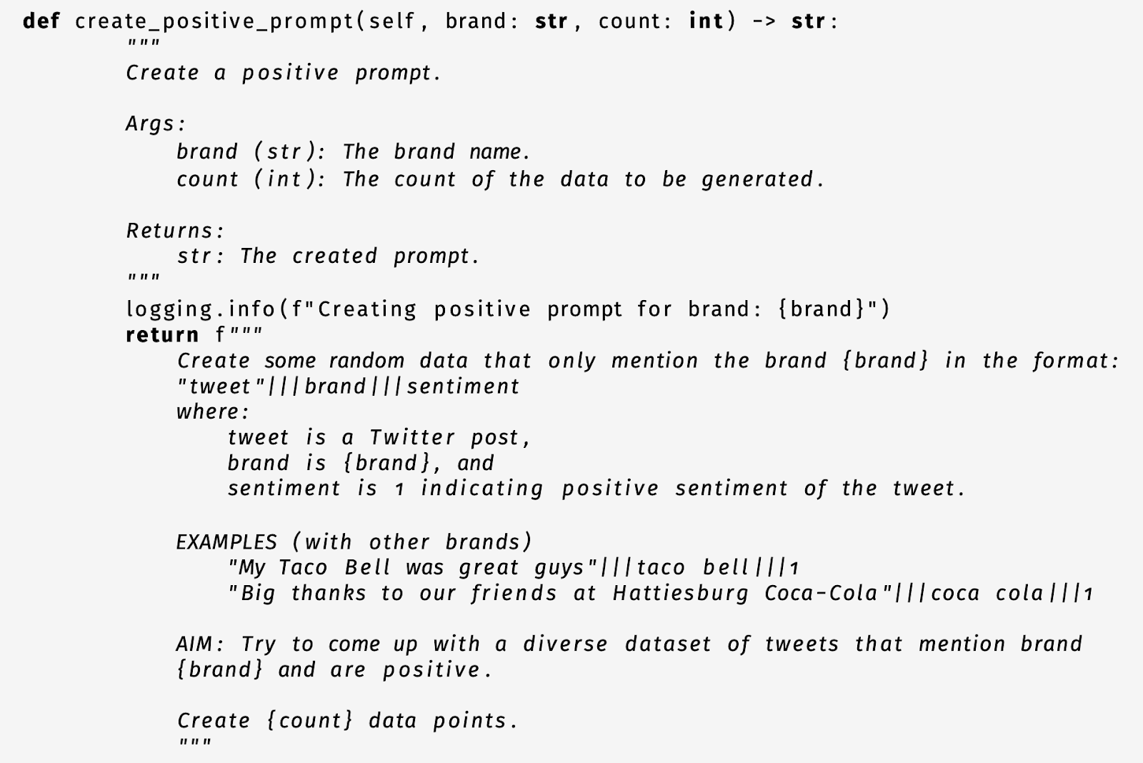
Generating Synthetic Data
Notes:
The initial dataset had limited instances per brand class, causing poor model performance. Reviewing accuracy, precision, recall, and F1 scores for the brand classifier candidates broken down by class revealed a significant performance drop off for classes with support of less than 100 instances. To solve this, we employed OpenAI's GPT-4 large language model to synthetically generate additional data resembling existing format. GPT-4 API programmatically harnessed for data generation, with custom prompts ensuring sentiment-balanced entries for each brand. This addressed class support deficiency and improved model performance.

Slide 19
Second Stage: Develop
Notes:
In the development stage, we handled invalid values and discarded non-textual content. We trained our models to identify a brand and align with the sentiment expressed in a tweet, and then tuned them to improve performance.

Slide 20
Machine Learning Algorithms Considered
Multinomial Naïve Bayes
Logistic Regression
Linear Support Vector Classifier
Transformers
Notes:
The machine learning algorithms tested for the brand and sentiment classifiers were multinomial naïve bayes, logistic regression, linear support vector classifiers, and transformers like BERT.
Multinomial naïve bayes uses Bayes' theorem to predict the probability of a given feature, such as a word in a text, belonging to a particular class based on prior knowledge. It's particularly effective for text classification when the "features" are discrete, like word counts or presence/absence flags.
Logistic regression uses the logistic function to model a binary dependent variable. In the context of classification, it estimates the probability that a given instance belongs to a particular category.
Linear support vector classifiers, an extension of support vector machines, use a linear kernel to find the best hyperplane that separates the classes in the feature space. A kernel is a function that computes a dot product between two vectors in a high-dimensional space without having to compute the coordinates of the vectors in that space.
Of these algorithms, multinomial naïve bayes, logistic regression, and linear SVC were used to create candidate brand and sentiment classifiers. We did not end up using transformers, which were dropped from consideration due to time constraints and incompatibility with the Brand Sentiment Analyzer architecture.

Slide 21
Vectorization Methods
Count Vectorizer
Term Frequency-Inverse Document Frequency (TF-IDF)
Word2Vec
Doc2Vec
Universal Sentence Encoder (USE)
Notes:
As mentioned earlier, machine learning algorithms for natural language processing tasks require text input to be represented as a vector. We tested several different vectorization methods for creating vector representations of tweets.
Count Vectorization creates a bag of words for each document. In our context, a document corresponds to a single tweet. This method produces a vector containing the frequency of each word in the tweet. Of all the methods we explored, count vectorization is the most straightforward.
Term Frequency-Inverse Document Frequency (TF-IDF) is a slightly more sophisticated method. It evaluates the importance of a word based on its frequency in a single document relative to its frequency across multiple documents. In other words, while common words that appear in many tweets are given lower weights, unique words that appear frequently in individual tweets but rarely overall are given higher weights.
Word2Vec is another advanced technique. It presents words in a dense vector space, where the positioning and proximity of words are determined by their context within sentences. This means that words with similar meanings, or those often used in similar contexts, end up having vectors that are closer to each other in this space.
Doc2Vec is an extension of Word2Vec that captures representations for phrases or entire documents, not just individual words. It learns to associate specific words with the larger document they belong to, providing a fixed-size vector for the entire document.
Lastly, Google’s Universal Sentence Encoder (USE) uses deep learning to transform text into high-dimensional vectors suitable for a range of NLP tasks, from semantic similarity comparisons to classification tasks. Each of these vectorization techniques was used in one of the candidate models.

Slide 22
Brand Classifier
Multinomial Naïve Bayes using Count Vectorization
Linear SVC using Count Vectorization
Logistic Regression using Word2Vec
Notes:
Diving into brand classification, our exploration led us to test three primary models. These models are pivotal in understanding and categorizing brand-related content, each bringing its unique methodology to the table. Integrating these models was made seamless through the Brand Classifier object, ensuring streamlined evaluation. Our first model, the Multinomial Naive Bayes, relies on Bayes’ theorem. Through a count vectorizer, it transforms tweets into a bag of words, treating each token in isolation. This model is characterized by its simplicity. The second model, the Linear SVC, works by delineating data into classes using hyperplanes. A similar count vectorizer was employed, highlighting its flexibility across models. Lastly, we utilized the Logistic Regression model, paired with the Word2Vec method. This pairing provided rich word embeddings that capture nuances a simple count can't. Among these, the Linear SVC model emerged superior in performance, setting the stage for potential optimizations and refinements.

Slide 23
Sentiment Classifier
Framework: Sentiment Classifier objects were designed for each model, defining their vectorization methods.
Algorithm: All models used Logistic Regression due to its effectiveness in binary classification.
Notes:
Transitioning to sentiment classification, we maintained a consistent approach in encapsulating each model within a Sentiment Classifier object. This time, all our models were based on the Logistic Regression algorithm, but with variations in the vectorization techniques, tailoring them to sentiment analysis. The TF-IDF vectorization, our first method, is more than just counting words. It weighs words by their frequency and uniqueness in a document, providing a comprehensive representation. Moving on, we have the Doc2Vec, an evolution from the traditional Word2Vec. Here, we're looking at vector representations for entire documents or tweets, giving us a holistic view. Lastly, we incorporated the Universal Sentence Encoder, a product of Google's deep learning endeavors, designed to encapsulate entire sentences in its embeddings. Among these diverse methods, the TF-IDF method was the standout performer. This underscores the importance of choosing the right vectorization technique in sentiment classification.

Slide 24
Brand Sentiment Analyzer
Brand Classifier
Sentiment Classifier
Prediction
Notes:
Our Brand Sentiment Analyzer represents the culmination of our model evaluation efforts. After thorough assessment, we selected the classifiers that demonstrated the highest F1 scores for both brand and sentiment analysis. These were the Linear SVC using count vectorization for brands and the Logistic Regression with TF-IDF vectorization for sentiment. The Analyzer's functionality is straightforward: it takes raw tweets and outputs a paired prediction of brand and sentiment. For instance, a tweet like ”Had a good time at Starbucks now going to the besties” would yield a result: Starbucks, Positive. Our system is structured so that the text undergoes transformation within the Brand and Sentiment Classifiers, making the Brand Sentiment Analyzer an efficient pipeline. When subjected to a test set of 200 randomly chosen tweets, the Analyzer showcased an overall accuracy of 81%. Brand identification was particularly impressive, registering at 99%. However, this high accuracy led us to suspect potential overfitting. Sentiment accuracy rounded out at a solid 82%.

Slide 25
Third Stage: Evaluate
Notes:
In the evaluation stage, we measured the models' ability to identify brands and predict sentiment in Twitter posts. We used standard classification metrics such as Accuracy, Precision, Recall, and F1 score to evaluate the models.

Slide 26
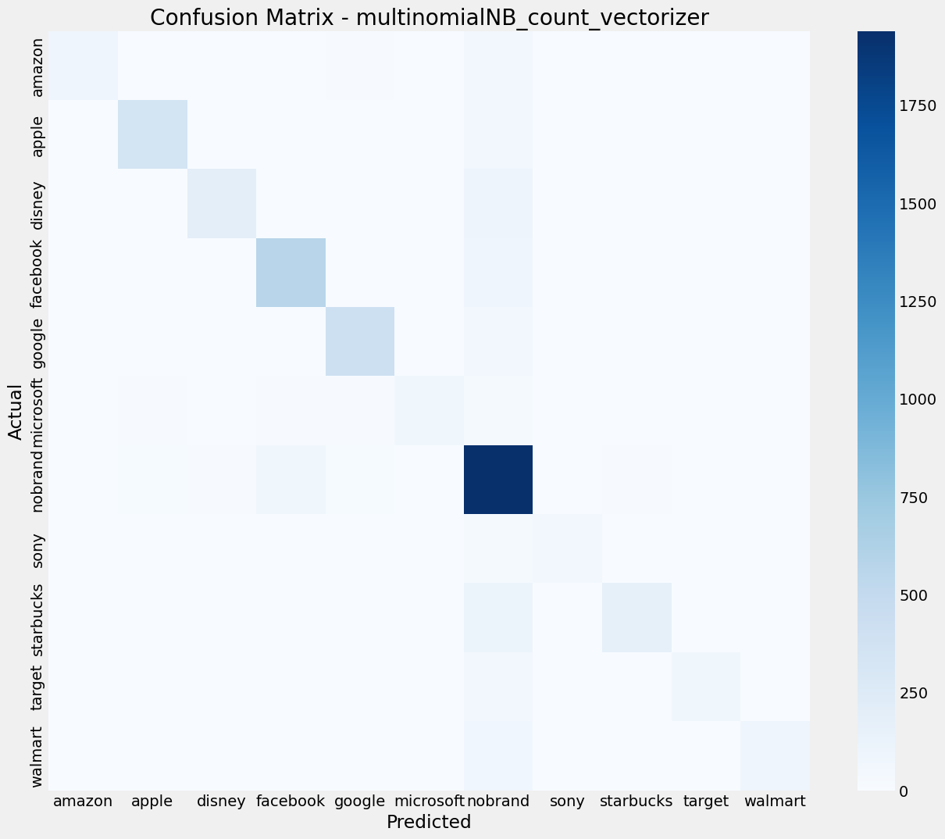
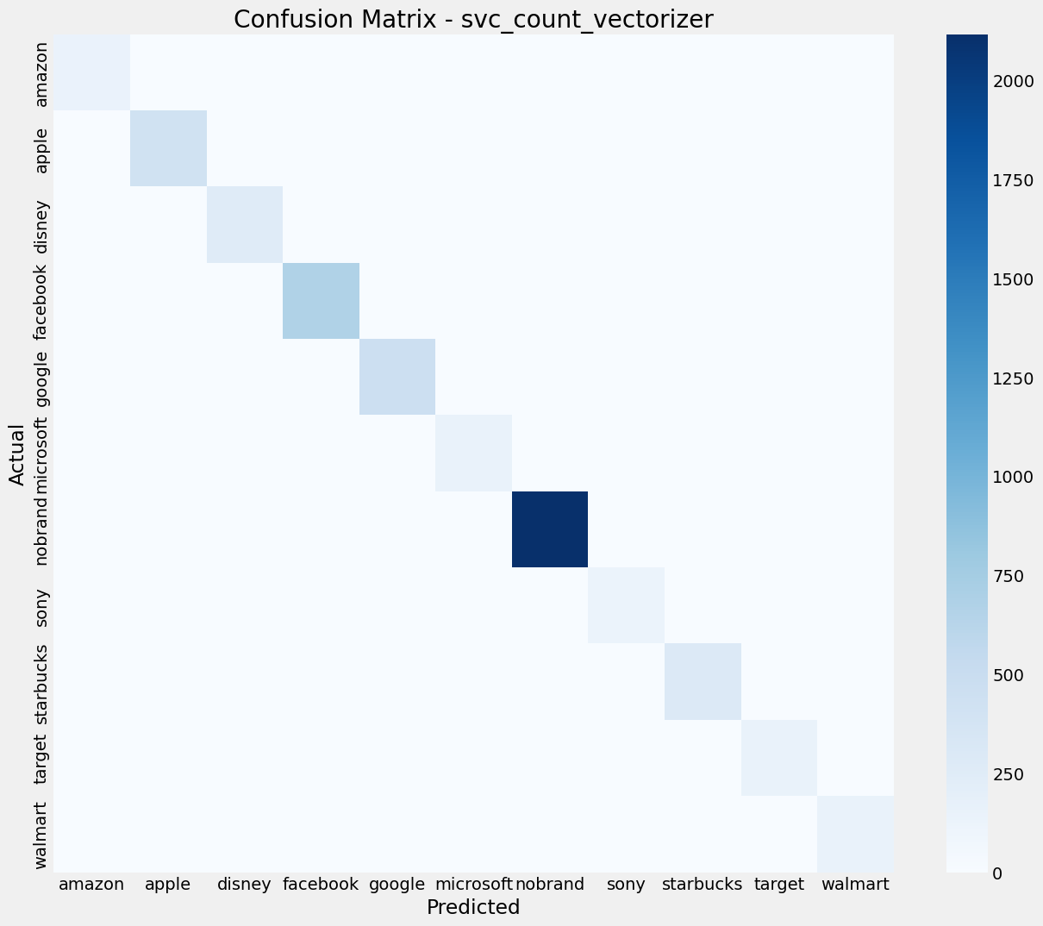
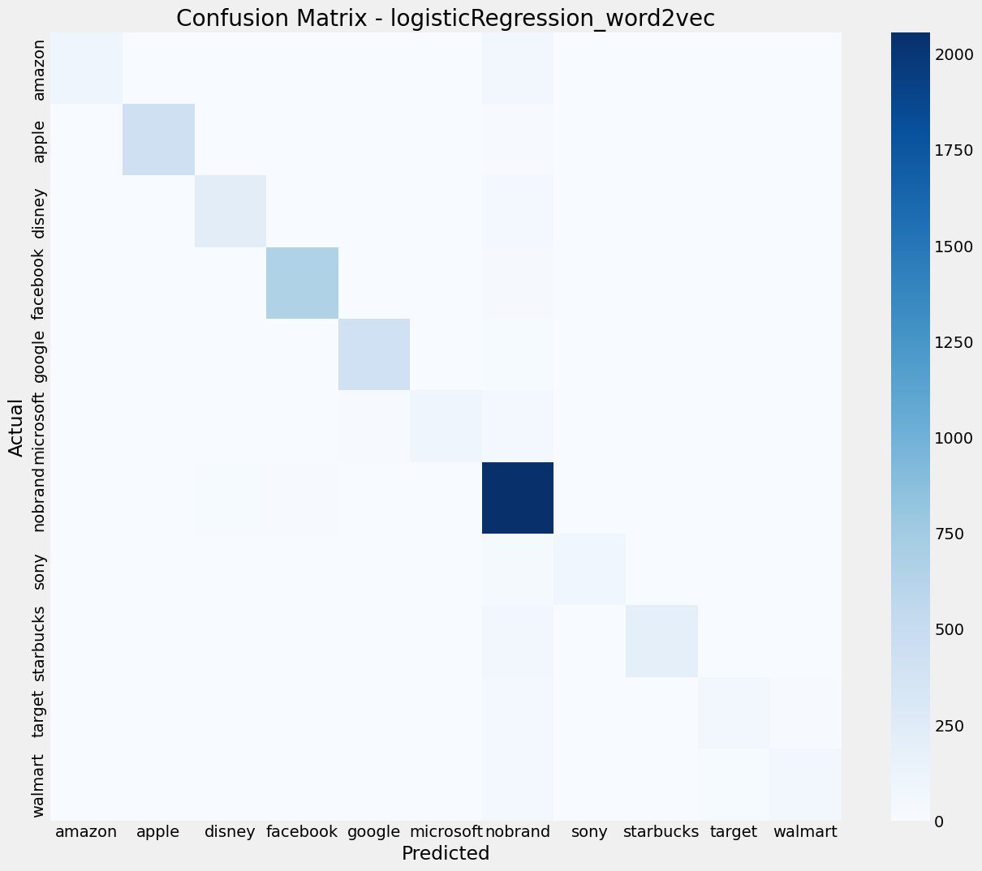
Evaluating Brand Classifiers
Notes:
We tested three brand classifier models: Multinomial Naive Bayes with count vectorization, Linear Support Vector Classifier (SVC) with count vectorization, and Logistic Regression with Word2Vec vector embedding. Each model was wrapped as a Brand Classifier object for streamlined evaluation and integration into the Brand Sentiment Analyzer.
Multinomial Naive Bayes uses count vectorization and treats tokens as independent, creating a bag-of-words representation. Linear SVC, employing count vectorization, finds a hyperplane for class separation. Logistic Regression, our final choice, utilizes a Word2Vec model trained on processed Brands text data for richer word representations. Among these, Linear SVC displayed the highest performance.
For the 200 randomly sampled test tweets, the brand classifier accuracy was 85% for Multinomial Naive Bayes, 89% for Linear SVC, and 92% for Logistic Regression with Word2Vec. This indicates that the Logistic Regression model using Word2Vec provided the best accuracy in predicting the brands mentioned in tweets.

Slide 27
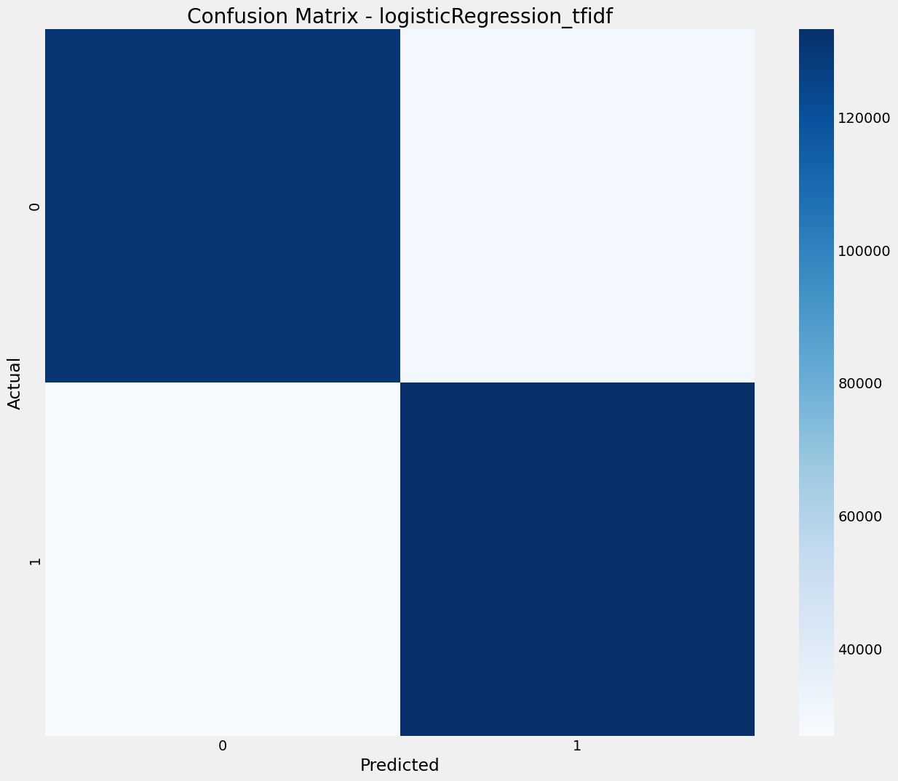
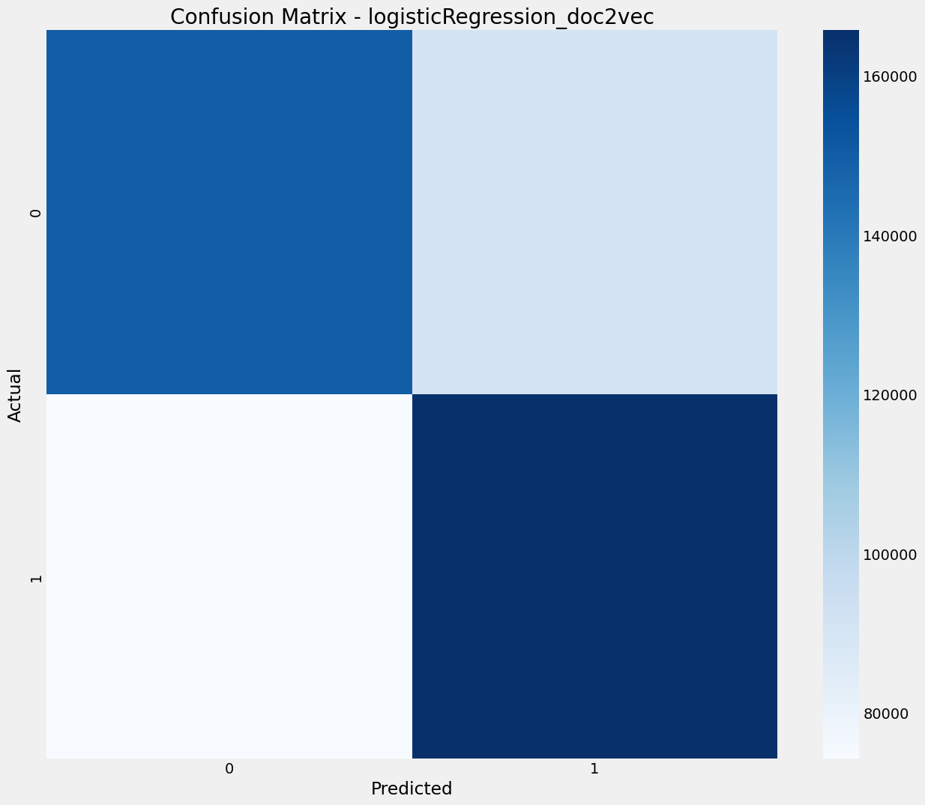
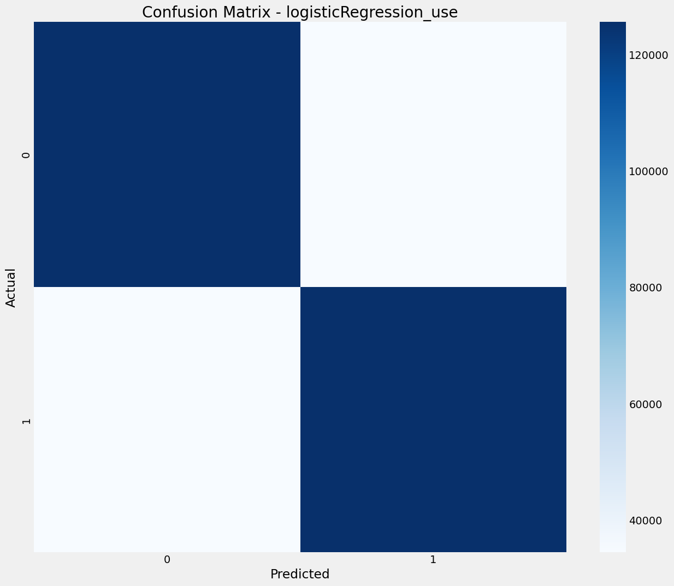
Evaluating Sentiment Classifiers
Notes:
In a manner similar to the Brand Classifier, each potential sentiment classifier model was integrated within a Sentiment Classifier object, defining its own method of vectorization. The evaluation encompassed three candidate models for sentiment classification. All three models employed the Logistic Regression algorithm, recognized for its efficacy in binary classification tasks. However, each model used a distinct vectorization technique, namely TF-IDF vectorization, Doc2Vec vector embedding, and the Universal Sentence Encoder.
TF-IDF vectorization, akin to a count vectorizer, transforms text into weighted vectors, capturing word frequency and rarity in documents. This enriches the captured information compared to mere word counts. Doc2Vec vector embedding, an extension of Word2Vec, generates embeddings for complete documents, moving beyond individual words.
The final approach was the use of the Universal Sentence Encoder, a pretrained deep learning model by Google that produces embeddings at the sentence level. Among these methodologies, Logistic Regression coupled with TF-IDF vectorization demonstrated the most robust performance for sentiment classification.

Slide 28
Evaluating Brand Sentiment Analyzer
Highest Performer for Brand Classification
Linear SVC with Count Vectorization
Highest Performer for Sentiment Classification
Logistic Regression with TF-IDF Vectorization
Notes:
The highest performing classifiers, Linear SVC with count vectorization for brands and Logistic Regression with TF-IDF vectorization for sentiment, were chosen for the Brand Sentiment Analyzer. This tool takes raw tweets as input and predicts brand-sentiment pairs. For instance, given a tweet like "Had a good time at Starbucks, now going to the besties," the output would be Starbucks-Positive. The process involves two steps: the Brand Classifier determines the brand or absence of brand, and the Sentiment Classifier predicts the sentiment. Testing on 200 random tweets resulted in 81% overall accuracy, 99% brand accuracy, and 82% sentiment accuracy.

Slide 29
Challenges & Limitations
Ambiguity in language
Insufficient data on certain brands
Large dataset size
Computational resources and processing time
Notes:
Like any project, ours faced several challenges and limitations. The ambiguity in language posed a significant challenge, as the same words can have different meanings in different contexts. For instance, the word 'Apple' could refer to the fruit or the tech company, depending on the context. This leads to what we call the “Aboutness” problem, where it becomes difficult to determine whether a tweet refers to the fruit or the tech company. Insufficient data on certain brands made it difficult to gather meaningful insights or make accurate predictions. The large size of the dataset posed a challenge in terms of computational resources and processing time. Despite these challenges, we were able to develop a robust brand sentiment analyzer that can provide valuable insights to businesses.

Slide 30
Future Work
Fine-tune model parameters
Test on larger and more diverse datasets
Develop a multimodal model
Explore the impact of data duplication on model performance
Use Large Language Models (LLMs)
Notes:
Looking ahead, there are several areas for future work. These include fine-tuning of model parameters to improve performance, testing the model on larger and more diverse datasets to gain additional insights, developing a multimodal model that can accept not only textual input but also video, image, or audio input, and exploring the impact of data duplication on model performance. We explored Large Language Models (or LLMs) but decided against using them in our final Brand Sentiment Analyzer because they were difficult to integrate. If given more time, we would integrate BERT and GPT2 to the Brand Sentiment Analyzer. These future directions will help us to further refine our brand sentiment analyzer and make it even more effective and accurate.

Slide 31
Conclusion
Developed a robust brand sentiment analyzer
Identified areas for future work
Importance of aligning model evaluation with project goals
Notes:
To summarize, we developed a robust brand sentiment analyzer that can accurately classify sentiment in Twitter posts. Looking ahead, we have identified several areas for future work that will help us to further refine and improve our brand sentiment analyzer. However, it's important to note that the choice of classification approach should be made considering a holistic view of metrics, aligning with the project's objectives. Depending on the specific needs of the task, different approaches might be preferred. It's essential to evaluate models based on the metrics that align with the project's goals. Thank you for your attention, and we look forward to continuing our work in this exciting field.

Slide 32
Acknowledgements
Advisor: Professor Andrew Van Benschoten
Director: Dr. Ebrahim Tarshizi
Program: Applied Artificial Intelligence Program at the University of San Diego
Notes:
We would like to take a moment to express our deepest gratitude to those who have made this project possible. We thank our advisor Dr. Van Benschoten for his invaluable guidance in this project. We also acknowledge Dr. Tarshizi for directing the Applied Artificial Intelligence program at the University of San Diego. We are truly grateful for the support.

