Slide 1



You publish. We care.

Slide 2

Metrics @ Copernicus Publications What numbers tell (and what not)
Dr Xenia van Edig
*Metrics in Transition Workshop 2019| 28 Mar 2019

Slide 3

Copernicus at a glance
Founded in 1988 by scientists as non-profit society
Scientific conferences organized since 1988
Journal publisher since 1994
Flipped to OA in 2001
2018: 5,757 journal articles, 3,850 discussion papers (preprints)
>2,000 editors, >10,100 referees, 28,555 authors
Articles are published CC BY 4.0 with author’s copyright
All-in: full-text XML & HTML, MathML, PDF
56 staff members in Göttingen, Germany
Co-founder of OASPA, member of ORCID, member of COPE
Notes:
33 journals, 9 peer-reviewed proceedings

Slide 4
Copernicus 2019
42 peer-reviewed journals | 21 journals with Interactive Public Peer Review
33 journals in the geosciences | 9 journals in engineering, life sciences, and social sciences
Collaboration with 17 associations and institutions (38 journals owned by them)
APCs (28) | institutional support (10) | community fee (4)
Waivers available (default: 10% of the previous year’s pages)
Central APC payment schemes with 28 institutions
Notes:
Associations appoint chief editors; they appoint topical eds.
Editors are not paid & are not employed by Copernicus
CrossRef, CrossCheck, COPE, CLOCKSS, Portico, WoS
Take home: journals are owned by associations, articles are owned by authors

Slide 5
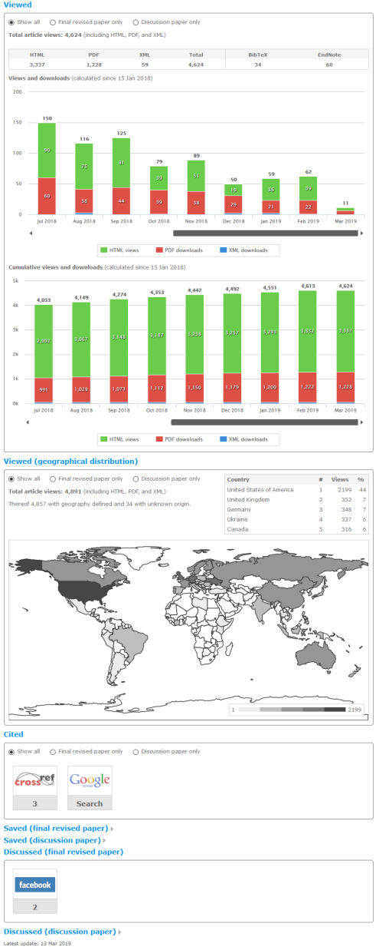
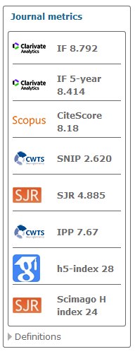
Metrics
Journal metrics
Clarivate Analytics: Journal Impact Factor, 5 years Journal Impact Factor, etc.
Scopus: CiteScore, etc.
CWTS: P, IPP, SNIP, % self citations
SJR
Article-level metrics
Altmetrics.com
Lagotto
Crossref Event Data
Impact Story (researcher perspective)
Plum Analytics (institutional perspective)

Slide 6
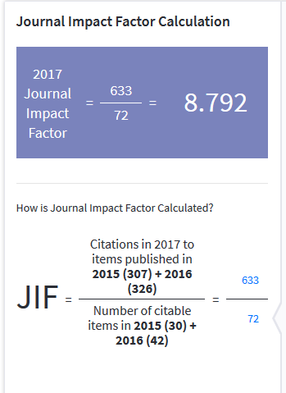
Journal Impact Factor
Still very important for appointments, tenure, promotion, and grants
Based on a proprietary data base
Does not tell anything about individual articles
Highly influenced by citations to individual articles
Not entirely transparent
Not comparable across disciplines
Notes:
Journals are owned by scientific associations
Associations appoint chief editors; they appoint topical eds.
Editors are not paid & are not employed by Copernicus
Articles are published CC BY 4.0 with author’s copyright
All-in: full-text XML & HTML, MathML, PDF
CrossRef, CrossCheck, COPE, CLOCKSS, Portico, WoS
Take home: journals are owned by associations, articles are owned by authors

Slide 7
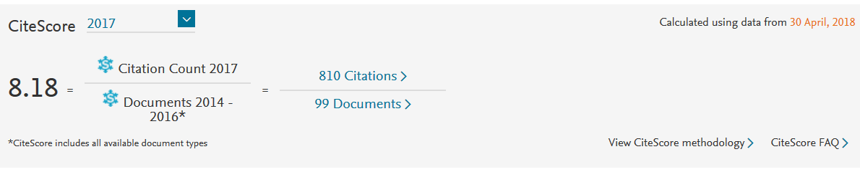
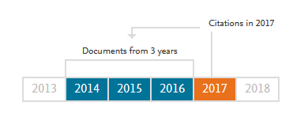
Cite Score
Relatively new metric by Scopus
No subscription needed to access values
Similar to the impact factor, but larger citation window
Based on a proprietary data base
Not comparable across disciplines
Notes:
Journals are owned by scientific associations
Associations appoint chief editors; they appoint topical eds.
Editors are not paid & are not employed by Copernicus
Articles are published CC BY 4.0 with author’s copyright
All-in: full-text XML & HTML, MathML, PDF
CrossRef, CrossCheck, COPE, CLOCKSS, Portico, WoS
Take home: journals are owned by associations, articles are owned by authors

Slide 8
SNIP
Source normalized impact per paper
CWTS journal indicator
Data from Scopus
The number of citations given in the present year to publications in the past three years divided by the total number of publications in the past three years
Uses a source normalized approach to correct for differences in citation practices between scientific fields
Not widely used
Notes:
Journals are owned by scientific associations
Associations appoint chief editors; they appoint topical eds.
Editors are not paid & are not employed by Copernicus
Articles are published CC BY 4.0 with author’s copyright
All-in: full-text XML & HTML, MathML, PDF
CrossRef, CrossCheck, COPE, CLOCKSS, Portico, WoS
Take home: journals are owned by associations, articles are owned by authors

Slide 9
Article-level metrics
Initially based on PLOS API (pre lagotto)
Now: own harvesting of data sources
Categories
Viewed: html, pdf, xml, supplement, BibTeX, EndNote
Geographical distribution
Cited: CrossRef, Google Scholar
Saved: citeulike, Mendeley
Discussed: reddit, facebook, Wikipedia, Wordpress
Notes:
Journals are owned by scientific associations
Associations appoint chief editors; they appoint topical eds.
Editors are not paid & are not employed by Copernicus
Articles are published CC BY 4.0 with author’s copyright
All-in: full-text XML & HTML, MathML, PDF
CrossRef, CrossCheck, COPE, CLOCKSS, Portico, WoS
Take home: journals are owned by associations, articles are owned by authors

Slide 10
Examples
https://www.atmos-chem-phys.net/16/3761/2016/acp-16-3761-2016-metrics.html
https://www.geosci-model-dev.net/11/1799/2018/gmd-11-1799-2018-metrics.html
Future plans
Revisit existing data sources
Add more data sources, e.g. Scopus citation
Revisit of download measurements: COUNTER
Notes:
Journals are owned by scientific associations
Associations appoint chief editors; they appoint topical eds.
Editors are not paid & are not employed by Copernicus
Articles are published CC BY 4.0 with author’s copyright
All-in: full-text XML & HTML, MathML, PDF
CrossRef, CrossCheck, COPE, CLOCKSS, Portico, WoS
Take home: journals are owned by associations, articles are owned by authors

Slide 11
Conclusions + open questions
Tenure commissions and funders still focused on JIF
Quantitative measure needed in evaluation processes
Editors and authors are therefore very much after it
Regional differences
San Francisco Declaration on Research Assessment (DORA)
Authors are also interested in own impact
Reach of their works
Impact is more than citations
Does it make sense to replace one number with another?
Not all ALM providers are using the same ways to retrieve the numbers
Reliability of data sources?
Notes:
Journals are owned by scientific associations
Associations appoint chief editors; they appoint topical eds.
Editors are not paid & are not employed by Copernicus
Articles are published CC BY 4.0 with author’s copyright
All-in: full-text XML & HTML, MathML, PDF
CrossRef, CrossCheck, COPE, CLOCKSS, Portico, WoS
Take home: journals are owned by associations, articles are owned by authors

Slide 12
Thank you. For your attention.
@XeniavanEdig
@copernicus_org
xenia.van.edig@copernicus.org

