Slide 1
*metrics from a Technical Point of View
Julius Stropel
Verbundzentrale des GBV (VZG)

Slide 2
Main motivation behind this work package:
Explore which practical challenges occur
when crawling for *metrics data on the internet.
Notes:
Which information specify a work?
Full text? Author list? Identifiers?
Repositories
Identifiers
Dois

Slide 3
How do we get the information that a person interacted with a certain scientific work online?
„a person“ → Who?
„interacted“ → How?
„a certain work“ → Which one?
Notes:
Which information specify a work?
Full text? Author list? Identifiers?
Repositories
Identifiers
Dois

Slide 4
So who do we ask?

Slide 5






Gathering Information about Scientific Impact on Social Media / Online Platforms
our
database
Notes:
Go to Facebook – ask if…
Go to twitter –ask if…
Anything missing? For sure - but trade off between ressources and size of result set

Slide 6
Current state of data gathering
Crawling for ~ 225k works
From repositories „GoeScholar“, „EconStor“, „SSOAR“, …
By doi, handle, landing page url, metadata
Some results:
17k tweets, 1.87 million Mendeley readers, 6.5k Wikipedia citations, …

Slide 7
What were the challenges?
Services‘ API restrictions
Services‘ API malfunctions
*metrics manipulation?
Some works did not have a unique identifier
Collecting data by some identifiers does not yield many results (doi works best)
Data protection
Notes:
Restrictions – Twitter, 300k works in our database, query length (identifier + landing page url + …) -> make comparable – same query elements for every work
Malfunctions for example google+ and youtube
Manipulation – etremely high number of facebook interactions while having low numbers in other services AND the same number of fb interactions for several works of the same publisher company
Data protection – data comes from 3rd party services → for example: what if the user deletes his/her data there?

Slide 8
How is *metrics different from commercial providers?
Our data is free.
Our data is fully accessible.
Our software is open-source, hence the algorithms are public.
We have no conflict of interest when it comes to honesty about limitations of data quality.
Notes:
Restrictions – Twitter, 300k works in our database, query length (identifier + landing page url + …) -> make comparable – same query elements for every work
Malfunctions for example google+ and youtube
Manipulation – etremely high number of facebook interactions while having low numbers in other services AND the same number of fb interactions for several works of the same publisher company
Data protection – data comes from 3rd party services → for example: what if the user deletes his/her data there?

Slide 9
Should I make use of alternative metrics?
What can they tell you?
Social relevance of certain research topics
Public opinion about these topics (at least in the world of social media)
What information should be handled with care when looking at alternative metrics?
Quality of a scientific work
Scientific relevance of a topic

Slide 10
How is he data of the *metrics project shared?
Software: https://github.com/gbv/metrics-crawler
Data
API: http://api.metrics.gbv.de/v1/work/doi?v={doi}
Data dumps (ask us)
Web-Interface: http://explore.metrics.gbv.de/

Slide 11
How can I make sure that my work is visible on social media?
Make sure it has a unique identifier (doi) and a proper landing page users can post links to
Post your work into relevant subgroups and increase the chance that users repost your work
But be aware that extensive posting of irrelevant content may be seen as spam by algorithms (problem of „gaming“)

Slide 12
What do I need to use your service or data?
… to use our web-interface:
Internet access and some dois
… to use our API:
Internet access, dois, knowledge in consuming json-data from a http-request
… to use our software:
Internet access, dois or local handles (max. 300k), a server with certain software such as Node.js, MySQL, chromedriver, …, someone who is capable of managing the server and configuring the software (should only take 1 or 2 days)

Slide 13
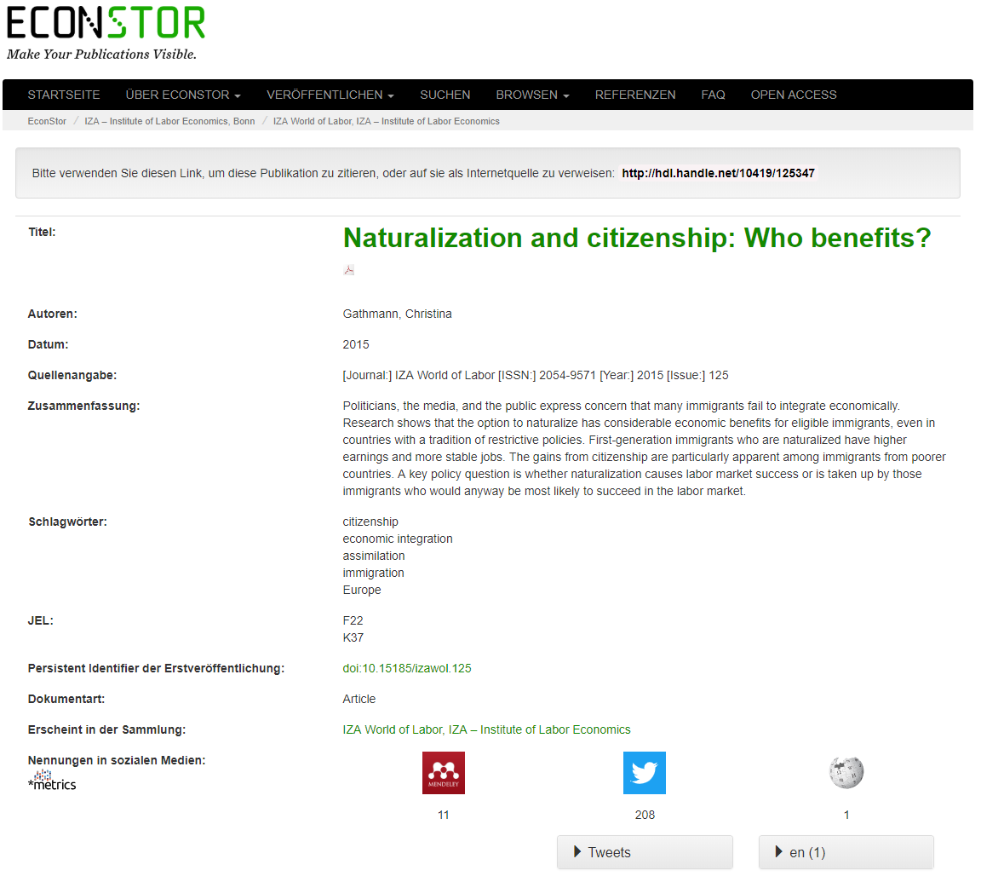

Slide 14
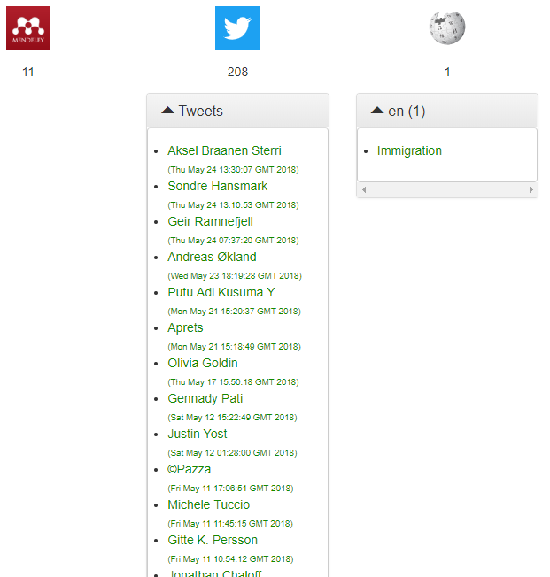

Slide 15
Thank you / Vielen Dank!
Web metrics-project.net
Email metrics-project@sub.uni-goettingen.de
Twitter @metrics_project
Facebook @metricsproject

