Slide 1
The *metrics-project‘s user studies: How researchers perceive and use metrics
Steffen Lemke
*Metrics in Transition Workshop
Göttingen, 27th – 28th March 2019

Slide 2
User Studies – Overview
Survey I
Interviews
Survey II
Online Experiment
Which tools/functions are used?
How are tools and metrics used?
How are tools and metrics used?
How do metrics influence users?
Broad exploratory survey
To which extent are 90 online platforms that are potential sources for metrics used by researchers?
~3400 respondents from 84 countries
In-depth qualitative interviews
Which use cases do online platforms solve for researchers? How do they think about research metrics?
4 group interviews with 9 researchers
Follow-up survey on use cases
To which degree do the findings from the interviews apply to a wider sample of researchers?
~2000 respondents from 70 countries
Interactive online experiment
How do researchers use metrics during literature research? How do individual metrics compare?
~250 respondents from 38 countries
S
I
S
CA
1
Notes:
Survey I: achieving a sense of orientation regarding the degree to which a wide array of online tools and –platforms are used in researchers workflows
Interviews: exploring researchers use cases for social media- and online tools, as well as their perceptions and expertise about metrics for research evaluation
Survey II: to which degree can the findings from the interviews be confirmed for a large sample of researchers?
CA-experiments: how do metrics influence researchers in a more practical scenario; do they act the way their responses to interviews and survey II suggest? How do individual metrics compare with each other?
Focus on social sciences and economics: between 80-90% identified as primarily working in these disciplines
Bias towards researchers based in Germany: between 25-50% named Germany as current country of affiliation
Rate of response for both surveys around 5%; for CA-analysis significantly higher, around 25%

Slide 3







S
I
S
CA
Survey I: Differences in usage frequencies
Welch test - comparison between early-stage researchers and professors:
of 58 tested actions, 27 are used with significantly different frequencies
Early-stage researchers (n = 1,010) :
Professors (n = 1,419) :
Writing
Downloading
Bookmarking
Facebook
Twitter
Based on: Lemke, S., Mehrazar, M., Mazarakis, A., & Peters, I. (2018). Are There Different Types of Online Research Impact?
Proceedings of the 81st ASIS&T Annual Meeting (p. 282-289). American Society for Information Science, Silver Springs, MD, USA.
2

Slide 4
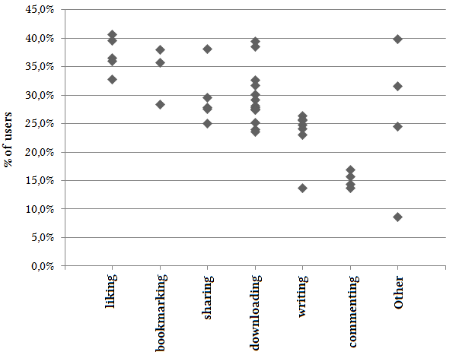





S
I
S
CA
Survey I:
Which online actions are reliably used to express positive sentiments towards their targets?
Lessons learned from survey I:
Most researchers make use of online tools for their work, many on a daily basis.
Different actions measurable as impact metrics reflect different users‘ judgements to varying degrees.
Different actions vary regarding the reliability with which they reflect praise.
Aggregations of web-based metrics are dangerous.
Share of users of an action who exclusively perform it to express a positive stance towards its target.
42 actions with responses from 150+ survey respondents:
Based on: Lemke, S., Mehrazar, M., Mazarakis, A., & Peters, I. (2018). Are There Different Types of Online Research Impact?
Proceedings of the 81st ASIS&T Annual Meeting (p. 282-289). American Society for Information Science, Silver Springs, MD, USA.
3

Slide 5
S
I
S
CA
Interviews: How do researchers assess the relevance of scientific outputs?
Selection criteria, roughly sorted by numbers of mentions (descending):
Journal reputation
Journal Impact Factor
Citations
Authors‘ names
Sharing source
Title & abstract
Peer review status
Method section
…
… but no web-based impact metrics!
4
Notes:
In fact, when we later explained the concept of web-based metrics/altmetrics to the participants, this seemed to be completely new to most of them.

Slide 6
S
I
S
CA
Interviews: Which concerns do researchers have regarding metrics for research evaluation?
Concern groups, roughly sorted by numbers of mentions (descending):
Lack of familiarity and transparency
Restricted comparability
Increasing publication pressure
Manipulation/Gaming
…
But still, as seen before – bibliometrics play a role for our interviewees when deciding which research products to consume.
Based on: Lemke, S., Mehrazar, M., Mazarakis, A., & Peters, I. (2019). “When You Use Social Media You Are Not Working”: Barriers for the
Use of Metrics in Social Sciences. Frontiers in Research Metrics and Analytics (3). http://doi.org/10.3389/frma.2018.00039
5

Slide 7
S
I
S
CA
Survey II: How useful do researchers find different metrics for assessing an output’s relevance?
Lessons learned from interviews and survey II:
Interviewees expressed a lack of trust due to a lack of familiarity with metrics as a significant problem.
But still, bibliometric indicators are considered important.
Towards web-based metrics skepticism seems more severe.
Many researchers could likely benefit from formal training regarding the use and interpretation of research metrics.
For web-based metrics, a way to increase their transparency and value might lie in enriching them with more context.
Based on: Lemke, S., Mehrazar, M., Mazarakis, A., & Peters, I. (2019). “When You Use Social Media You Are Not Working”: Barriers for the
Use of Metrics in Social Sciences. Frontiers in Research Metrics and Analytics (3). http://doi.org/10.3389/frma.2018.00039
6
Notes:
However, researchers are aware of certain limitations of individual indicators.

Slide 8
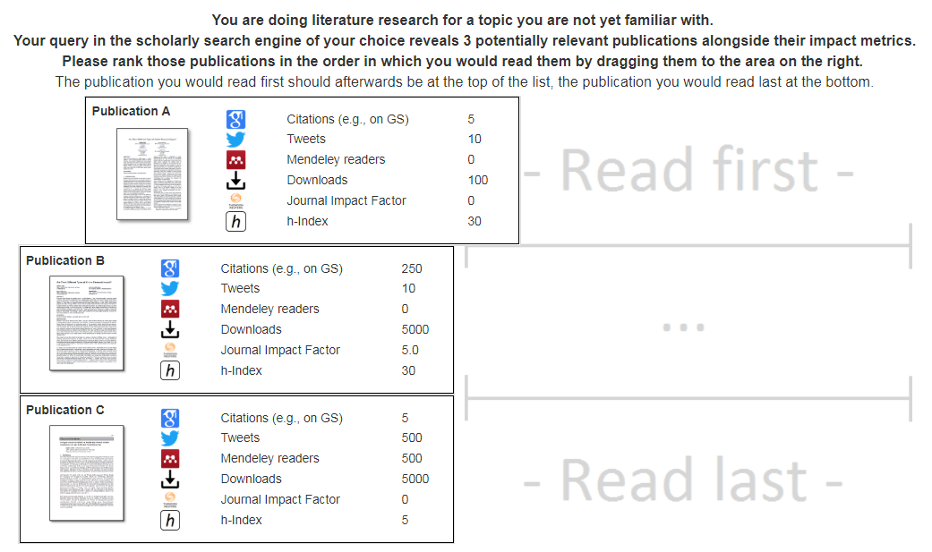

S
I
S
CA
CA-Experiments: How do metrics influence researchers during literature research?
Task:
7

Slide 9
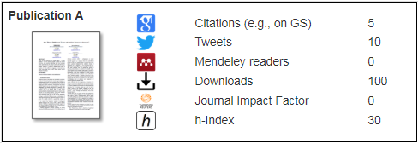
S
I
S
CA
CA-Experiments: How do metrics influence researchers during literature research? (WIP)
Every participant was asked to complete 20 such tasks, each presenting three alternatives with six features
6760 user decisions were then fed into a logistic regression model to examine individual indicators‘ effect on the likelihood for a publication to be ranked above another one
First two and last two tasks were excluded from analysis for each participant
Variables were standardized for easier comparison
8

Slide 10
S
I
S
CA
CA-Experiments: How do metrics influence researchers during literature research? (WIP)
Resulting model coefficients (log odds ratios):
Also, after the experiment we asked which indicator the participant would generally find most useful:
Citations | JIF | Downloads | Tweets | Mendeley | H-Index
0.59973 | 0.47941 | 0.25371 | 0.18765 | 0.17955 | 0.12914
All coefficients are significant with p < 0.0001.
(Intercept) | Citations | Tweets | Mendeley | JIF | Downloads | H-Index
0.63935 | 1.82163 | 1.20641 | 1.19667 | 1.61511 | 1.28879 | 1.13784
9

Slide 11
Conclusions
Several concerns and reservations against metrics prevail among researchers, several of them linked to their intransparency
Bibliometrics do play an important role for many researchers, e.g., as filters during literature search
Web-based metrics reach far lower levels of acceptance than bibliometrics
Are only used complementary to other indicators
Means to increase metrics‘ utility include:
More widespread training of researchers regarding their use
The avoidance of aggregated indicators which obscure existing differences
The enrichment of metrics with context information
10

Slide 12
Thank you very much!
Web: metrics-project.net
Email: s.lemke@zbw.eu
Twitter: @metrics_project, @stl90

Slide 13
The following are backup slides.

Slide 14











Survey I: Researchers’ social media usage
S
I
S
CA
Most Popular Services
Most Frequently Used Services
 | Service | Use
1. | Google Scholar | 75.2%
2. | JSTOR | 60.7%
3. | Wikipedia | 60.1%
4. | ResearchGate | 55.6%
5. | EBSCO | 36.7%
 | Service | Use daily
1. | Google Scholar | 31.0%
2. | Wikipedia | 21.0%
3. | Facebook | 14.0%
4. | Twitter | 10.0%
5. | JSTOR | 10.0%
Long-Established Services
Up-and-Coming Services
 | Service | Use for 5+ years
1. | Wikipedia | 81.9%
2. | Amazon | 73.6%
3. | JSTOR | 70.2%
4. | Facebook | 66.6%
5. | ICPSR | 65.6%
 | Service | Use <1 year
1. | ResearchGate | 5.1%
2. | Academia.edu | 2.7%
3. | Mendeley | 2.6%
4. | sci-hub.io | 2.5%
5. | Twitter | 2.5%
Based on: Lemke et al. (2017). Exploring the Meaning and Perception of Altmetrics. http://doi.org/10.5281/zenodo.1037146
2
Notes:
Most frequently used services: shares of users who reported to use said service at least once a day/on a daily basis

Slide 15
S
I
S
CA
Survey II: Which concerns do researchers have regarding metrics for research evaluation?
Occurrences | Theme | Example
37 | Measure popularity, not quality | “Many of these metrics rely on some measure of "Popularity", which is usually a poor indicator of quality for new scholarly work.”
25 | Low reliability / Inherent biases | “Metrics are affected by superficial characteristics such as the use of terms in the title or abstract of a publication that connect with currently fashionable topics.”
25 | Useful only for certain use cases | “These metrics are sometimes helpful to find important research, but very limited in evaluating researchers.”
23 | Manipulation / Gaming | “They could be faked by bots, especially likes or posts and retweets.”
11 | Metrics are (almost) useless | “Yes, most metrics just serve non-useful or even non-desirable goals, they are a useless invention.”
9 | Restricted comparability | “These metrics are useful for comparison within sub-fields, but not across sub-fields and especially not across disciplines.”
9 | Must not replace content analysis | “None of the metrics substitute reading the paper.”
7 | Need to be used in conjunction | “They ought to be used very carefully and in a complex manner (combination of a few metrics).”
6 | Could have negative effects on science | “Metrics may lead to decreased submits to lower ranked journals in specials and lead to more generic journal design.”
6 | Measure dissemination efforts | “Social media metrics are primarily a measure of time and effort the author puts in disseminating research.”
… | … | …
Based on: Lemke, S., Mehrazar, M., Mazarakis, A., & Peters, I. (2019). “When You Use Social Media You Are Not Working”: Barriers for the
Use of Metrics in Social Sciences. Frontiers in Research Metrics and Analytics (3). http://doi.org/10.3389/frma.2018.00039
7

Slide 16
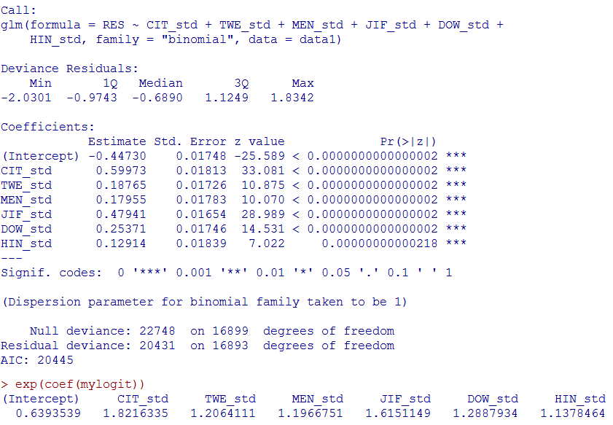
S
I
S
CA
CA-Experiments: Full model summary from R
A1
Notes:
However, researchers are aware of certain limitations of individual indicators.

Slide 17

Usage of Actions: Facebook

Slide 18



Usage of Actions: Differences in Frequency (Welch test)
Actions that are used significantly more frequently by…
…early-stage researchers:
Cite academic research on Wikipedia
Comment on a post about academic research on Facebook
Favor a tweet about academic research
Like a post about academic research on Facebook
Reply to a tweet about academic research
Retweet a tweet about academic research
Share a post about academic research on Facebook
Share a post about academic research on LinkedIn
Share a scientific video on Youtube
Write a post about academic research on Facebook
Write a tweet about academic research
Write a post about academic research on LinkedIn
Write a post about academic research on Wordpress
Download a publication from ResearchGate
Download a repository from GitHub
Download a sample from EBSCO
Download an article from Academia.edu
Download an article from arXiv
Download an article from EconStor
Download an article from JSTOR
Download an article from MPRA
Download an article from PLoS
Download an article from PubMed Central
Download an article from RePEc
Download an article from SSRN
Export/save a sample on EBSCO
Save a bookmark on Citavi
Save a bookmark on JSTOR
Save a bookmark on Mendeley
Write a post on StackOverflow
…professors:

