Slide 1
Computational Musicology as a ‘Data Rich’ Discipline: Lessons from a Project on Schenkerian Analysis
Alan Marsden, Lancaster University, UK

Slide 2
Musicology as a ‘data-rich’ discipline
Clarke & Cook (2004) called for musicology to become a ‘data-rich’ discipline
  Following Huron’s (1999) comparison of method in science and humanities
  Huron: science is often ‘data-rich’, but rich-poor distinction is not coincident with science-humanities distinction.
  Both argued that computer technology facilitates ‘data-rich’ studies in musicology
This has rarely been the case: why?
  Research questions
  Nature of data
  Organisation/availability of data
  Availability of tools
SDH 2010, Vienna, 19 October 2010

Slide 3
Schenkerian analysis
The most thorough and influential theory of tonal music, originating in the work of Heinrich Schenker (1935) here in Vienna
Comparable to a ‘grammar’ for tonal music
Summary of main tenets:
  Any piece of (good) tonal music can be progressively reduced to one of three possible basic structures, called an ‘Ursatz’, by the removal of ‘ornamental’ elaborating notes.
  There is a fixed repertoire of possible elaborations (and therefore of possible reductions).
  Every level of reduction must contain valid harmony and counterpoint.
SDH 2010, Vienna, 19 October 2010

Slide 4
Schenkerian analysis by computer
Previous work (Kassler, 1967, etc.; Mavromatis & Brown, 2004; Hamanaka, Hirata & Tojo, 2006, etc.; Gilbert & Conklin, 2007; Kirlin & Utgof, 2008) has shown the theoretical possibility of Schenkerian reduction by computer.
Recent successful implementation producing analyses entirely automatically from a full extract (Marsden, 2010) using a chart-parsing approach, but
  Computationally extremely intensive (sometimes >1hr for a single phrase)
  Produces very large numbers of possible analyses
  Established ‘rules’ of analysis are not sufficient
  Apparently competing criteria required to distinguish ‘good’ analyses from ‘bad’
  Only tested on a very small data set (five extracts of Mozart piano sonatas
SDH 2010, Vienna, 19 October 2010

Slide 5
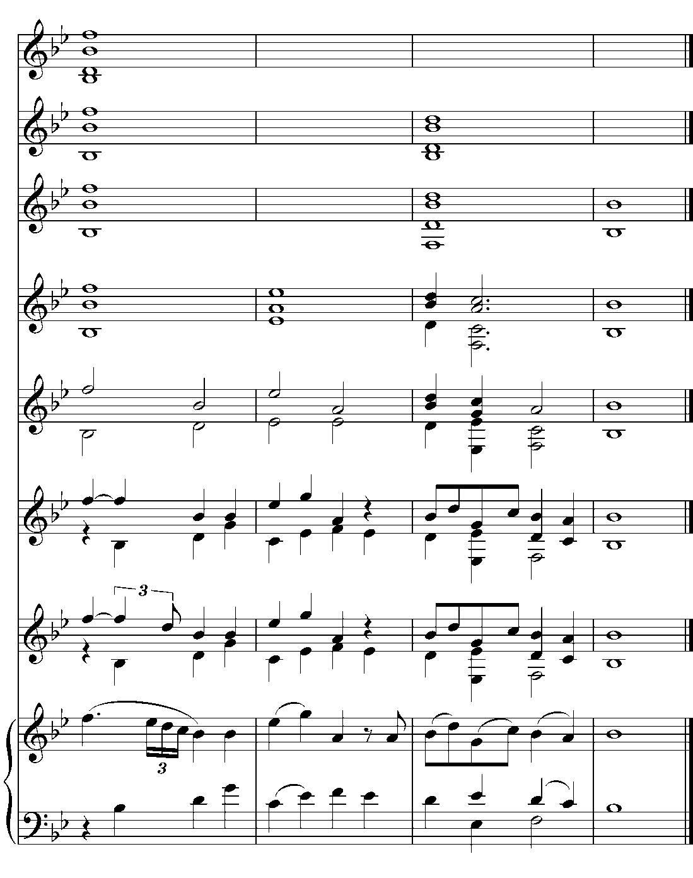
Example
SDH 2010, Vienna, 19 October 2010

Slide 6
Research question: Schenker project
Is there a definite process which derives a ‘good’ Schenkerian analysis from the information in a score?
If so, can that process be implemented in a computer program for use as a musicological research tool?
  Effectively testing the nature of Schenkerian theory
  Kassler had already demonstrated that there was a process, though non-deterministic
Research method: broadly to attempt to write a computer program which takes as input a representation of a score and produces as output an analysis of that music.
SDH 2010, Vienna, 19 October 2010

Slide 7
Validity criteria
1. A valid implementation will produce analyses which match those produced by human experts
  Use of published analyses as ‘ground truth’
  Adapt criteria so as to match published analyses of the same extracts
  Process used in the original project (JNMR, 2010)
2. A valid implementation will produce analyses of variations which match, at deeper levels of structure, the analyses of their themes.
  In variations Classical composers made new pieces of music which share a basic structure with the theme
  Explored in recent study (ISMIR, 2010)
SDH 2010, Vienna, 19 October 2010

Slide 8
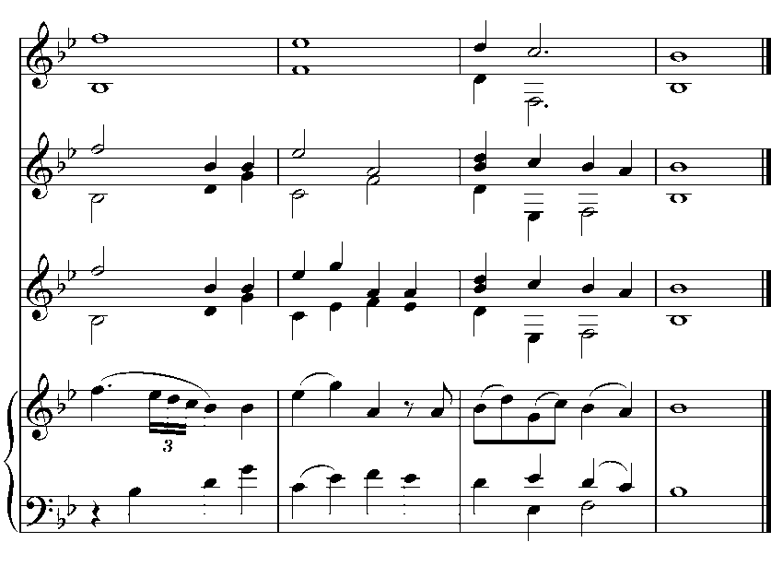
Nature of data 1
1. Symbolic representations of extracts from pieces of music & representations of prior analyses of those pieces
  Short extracts from Mozart piano sonatas, taken from rondo themes and themes for variation movements (short and self-contained)
  Analyses of these same extracts used in my teaching, published in text books, and done by colleagues
SDH 2010, Vienna, 19 October 2010

Slide 9
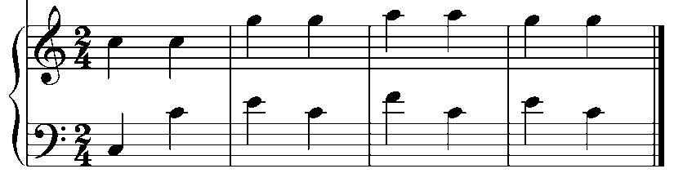
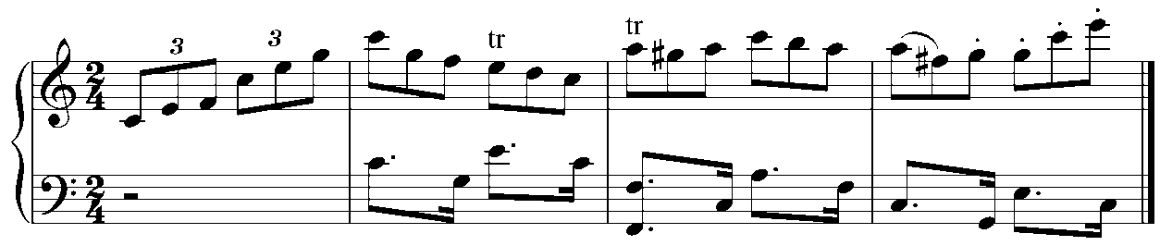
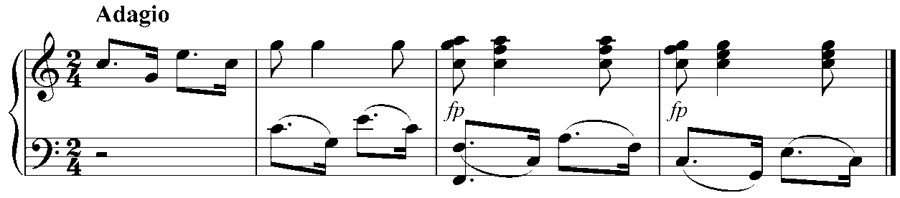
Nature of data 2
Symbolic representations of extracts from themes and variations
  First four bars of themes and variations from Mozart variations for piano
SDH 2010, Vienna, 19 October 2010

Slide 10
Availability of data
No suitable existing database
  Few pieces of music contain suitable short self-contained themes
  Few available prior analyses of such themes
  No pre-existing symbolic digital database of suitable music
  No existing encoding scheme for analyses
SDH 2010, Vienna, 19 October 2010

Slide 11
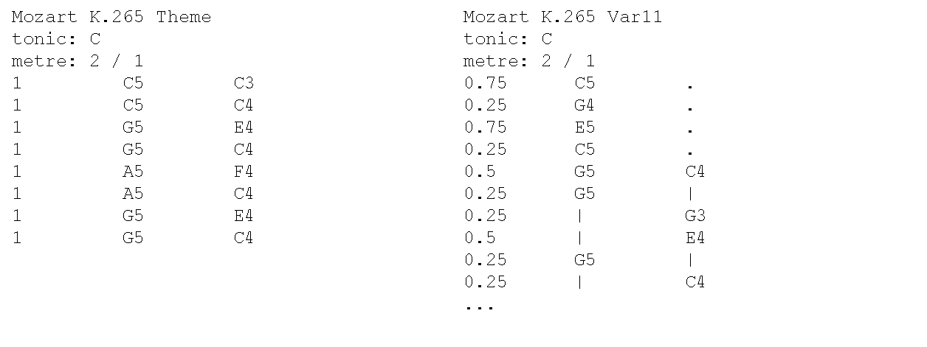
Organisation of data
Constructed my own small database
  Six Mozart themes for which prior analyses exist
  Ten prior analyses
  Encoded in a simple plain-text scheme designed for the purpose
    easier to make up a special-purpose encoding than to both encode extracts and write software to read a pre-existing encoding
SDH 2010, Vienna, 19 October 2010

Slide 12
Software tools
Analysis software written from scratch in Java
Software which might have formed a basis exists (e.g., models for music-processing, frameworks for parsing) but
  Computational demands are severe, requiring early optimisation steps.
  Peculiarities of music case (multiple voices, peculiar context-dependencies) are problematic for tools for parsing text.
  Feasible analysis process was not clear at the outset of the project; software-writing helped to clarify it.
Results written out as text files and analysed using Excel
SDH 2010, Vienna, 19 October 2010

Slide 13
Other projects: not data-rich
Many projects in musicology ask specific questions
  E.g., ‘what was the chronology of composition of Mozart’s Così fan’tutte?’
  Small steps can make data rich enough, e.g., recovery of autograph manuscript
Woodfield (2008)
Musicologists have often relied on very little data to answer general questions
  E.g., ‘what is the cause of emotion in music?’
    Meyer answered ‘non-fulfilment of expectation’ on the basis of a small number of texts in psychology and < 50 music examples, not including any counter-examples
Meyer (1956)
SDH 2010, Vienna, 19 October 2010

Slide 14

Other data-rich projects: Tomita
Study of provenance of sources for Bach’s Well-tempered Clavier, Book II
  No definitive autograph or publication of this piece
  Many manuscript sources (> 45)
  Self-made database of all differences between all known sources
  General-purpose spreadsheet software
  Self-designed encoding (including new font!) to match data to capabilities of the software
  Enabled testing of hypotheses on provenance, and of
  authenticity of alternative readings
Tomita (1995)
SDH 2010, Vienna, 19 October 2010

Slide 15

Other data-rich projects: Meredith
Comparison of methods of determining ‘spelling’ of pitches in tonal music
  Important software/theoretical problem: to convert MIDI data (e.g., pitch code 61) to correctly spelt pitch (e.g., C# or Db)
  Database of 216 complete movements (195972 notes) from eighteenth and nineteenth centuries, from CCARH (Stanford University)
  Reimplementation of most existing schemes in Lisp
  Pitches converted to MIDI codes, then re-spelled using each scheme
  Results compared with original spellings
  Enabled thorough testing and comparison of
  pitch-spelling methods with high validity of results
Meredith (2006)
SDH 2010, Vienna, 19 October 2010

Slide 16

Other data-rich projects: Mazurkas
Project at CHARM Royal Holloway and King’s, University of London
One aspect examined variations of timing in performances throughout the twentieth century
  Many recordings of Chopin Mazurka op.63 no.3 from 1923 to present
    some already digitised (CD), others specially digitised
  Timings of beats in each measured by a ‘reverse conducting’ process using specially written software (Craig Sapp)
  Comparison of variations in beat length in different parts of the piece
    slowing towards the end of phrases, commonly
    regarded as common performance style, found only
    to be a consistent characteristic of post-WW2
    recordings
Cook (2009)
SDH 2010, Vienna, 19 October 2010

Slide 17
Conclusions: richness of data
Musicologists often accept research findings based on little data.
This might have been acceptable in the past, but is no longer so.
  Not a view shared by many musicologists!
SDH 2010, Vienna, 19 October 2010

Slide 18
Conclusions: nature of data
Musicology uses many different kinds of data.
  Scores (symbolic encodings)
  Recordings
  Textual information
  Analyses
Often requires alignment
  E.g., timing of beats
  structural analyses and scores
  like annotation in other disciplines?
SDH 2010, Vienna, 19 October 2010

Slide 19
Conclusions: availability of data
Some repositories of digital score data
  CCARH: complete pieces from Baroque to 19C, but small in comparison to the number of pieces from the time
  RISM: incipits of many pieces
Much MIDI data (symbolic but not score-like) available on the internet
  Often unreliable
Vast quantities of digital recorded music
  Access protected by commercial interests
Very little analysis data
  tendency for continual reuse of the same data, e.g., Harte transcriptions of Beatles chord sequences
SDH 2010, Vienna, 19 October 2010

Slide 20
Conclusions: software tools
Few specialised tools for symbolic music data
  Humdrum
    requires high level of expertise
  Others little used
  Commercial systems (e.g., Sibelius) directed at education or composition and too closed for research
Specialised tools for audio data more available
  Sonic Visualiser (Queen Mary, University of London)
  Marsyas (George Tzanetakis)
  Often used in Music Information Retrieval projects
Some use of general software
  Spreadsheets
  HMM-building tools, etc.
SDH 2010, Vienna, 19 October 2010

Slide 21
Future needs for digital musicology
1. Musicologists should learn more about what research in Music Information Retrieval can offer.
2. Initiatives for co-ordination for reuse of data should be more widely supported.
3. Established mechanisms for correction of mistakes in data.
4. Common intermediate-level representations would help alignment of data and reuse of software components.
5. Clarity on ‘fair use’ of copyright material, and co-operation from copyright holders, is essential.
6. Software for Optical Music Recognition is essential.
SDH 2010, Vienna, 19 October 2010

Slide 22
References
Gilbert, E., & Conklin, D. (2007). A probabilistic context-free grammar for melodic reduction. Proceedings of the International Workshop on Artificial Intelligence and Music, 20th International Joint Conference on Artificial Intelligence (IJCAI). Hyderabad, India, 83–94.
Hamanaka, M., Hirata, K., & Tojo, S. (2006). Implementing “A Generative Theory of Tonal Music”. Journal of New Music Research, 35, 249–277.
Clarke, E. & Cook, N. (eds.) (2004), Empirical Musicology (Oxford University Press).
Cook, N. (2009). ‘Squaring the Circle: Phrase Arching in Recordings of Chopin's Mazurkas’. Musica Humana, 1, 5-28.
Huron, D. (1999). ‘The new empiricism; systematic musicology in a post-modern age’, no.3 of the Ernst Bloch Lectures (University of California, Berkeley, 1999) http://www.musiccog.ohio-state.edu/Music220/Bloch.lectures/3.Methodology.html
Kassler, M. (1967). A Trinity of Essays. PhD dissertation, Princeton University.
Kirlin, P.B & Utgoff, P.E. (2008). A framework for automated Schenkerian analysis. Proceedings of the International Conference on Music Information Retrieval (ISMIR), Philadelphia, USA, 363–368.
Marsden, A. (2010). Schenkerian analysis by computer: a proof of concept, Journal of New Music Reserach (in press).
Mavromatis, P., & Brown, M. (2004). Parsing Context-Free Grammars for Music: A Computational Model of Schenkerian Analysis. Proceedings of the 8th International Conference on Music Perception and Cognition, Evanston, USA, 414–415.
Meredith, D. (2006). The ps13 pitch spelling algorithm. Journal of New Music Research, 35, 121‒159.
Meyer, L. (1956). Emotion and Meaning in Music (University of Chicago Press).
Schenker, H. (1935). Der frei Satz. Vienna: Universal Edition. Published in English as Free Composition, translated and edited by E. Oster, New York: Longman, 1979.
Tomita, Y. (1995). J.S. Bach’s ‘Das Wohltemperierte Klavier II’: A Critical Commentary, vol. 2 (Leeds: Household World).
Woodfield, I. (2008). Mozart’s Così fan tutte: A Compositional History (Woodbridge: Boydell & Brewer).
SDH 2010, Vienna, 19 October 2010

