Slide 1

Sharing Qualitative Data-Infrastructure and User Engagement
Louise Corti
Associate Director,
UK Data Archive
SDH Workshop, Vienna 19-20 October 2010

Slide 2
First: defining qualitative data
  diverse data types: in-depth interviews ; semi-structured interviews; focus groups; oral histories; mixed methods data; open-ended survey questions; case notes/records of meetings; diaries/ research diaries
  multi-media: audio, video, photos and text (most common is interview transcriptions)
  formats: digital, paper, analogue audio-visual
Notes:
Most common is interview transcripts
Moving to digital, but slow process for older material
Most valuable is methods insights

Slide 3
How can qualitative data be used?
description and context
comparative research, restudy or follow-up study
re-analysis/secondary analysis
research design and methodological advancement
replication/validation of published work
teaching and learning

Slide 4
Why are qualitative data not shared that much?
cultural reasons – not practised by the typical social scientist, easier to collect ones own data!
issues about ethics & loss of context and not ‘being there’
re-use has never been a well-documented research method
different methods of data description
few dedicated archives holding data
no co-ordinated resource discovery or dissemination infrastructure

Slide 5

Where can you find qualitative data?
Researchers, research groups and organisations
  universities, public and private sectors
  often held by default/legacy/a record/cupboard
University Archives
  where there is a strong social science research tradition
  where there already significant collections of older research materials
Libraries and Museums
  local ethnology, local/oral history collections
  sound archives e.g. oral history
Data Archives and Digital libraries
  proactive acquisition of digital research resources but very few acquiring qualitative data
Libraries
Research groups
Data Archives
University archives
Museums

Slide 6
Local oral history collections
typically accessible via a visit:
  listen to a recording
  browse paper materials
  copy at own cost
some are digitising materials, but money is scarce
very few offer on-line provision
rely on researcher having time to visit and immerse themselves…

Slide 7
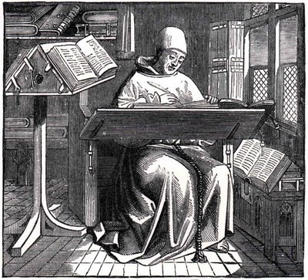
…which is what historians have done for centuries!

Slide 8
Examples of oral history archives
National Life Story Collection at the National Sound Archive , British Library:
  Life stories by theme/trade e.g. architects, authors, City financiers, publishing industry
Oral History Archive (OHA) of the Institute for the History of the 1956 Hungarian Revolution
some have web-based access now
but finding aids do not always suit researchers’ needs

Slide 9
A brief history of qualitative archiving in the UK
academic pilot study (1991/2) by Paul Thompson
  availability of academic data and willingness to share qualitative data
project to save ‘endangered’ qualitative social research 1994
material identified:
  collated and organised
  catalogued and described
  deposited with ‘paper’ archives
  collections promoted and users supported
development of pilot archive, procedures, an online catalogue and a user service (1995-)

Slide 10
Qualidata: developments and innovation I
no existing procedures to meet specific needs
developed data processing procedures over first 3 years then continuous refining – archiving and technical
campaigned for a formalised Research Council (ESRC) national Datasets Policy to include qualitative data
persuaded other funding bodies to encourage archiving and data sharing
proved service viability beyond pilot period
Promoted, encouraged and contributed to academic debate – new methods

Slide 11
Qualidata: developments and innovation II
built a limited user community & recognition of secondary analysis as a robust method
created synergy and harmonisation with quantitative UK Data Archive early on
gained recognition by international data archiving community
merged with UK Data Archive (est. 1968) in 2001
trialled online access
Economic and Social Data Service (ESDS) funded in 2003, funded as a longer-term specialist service

Slide 12
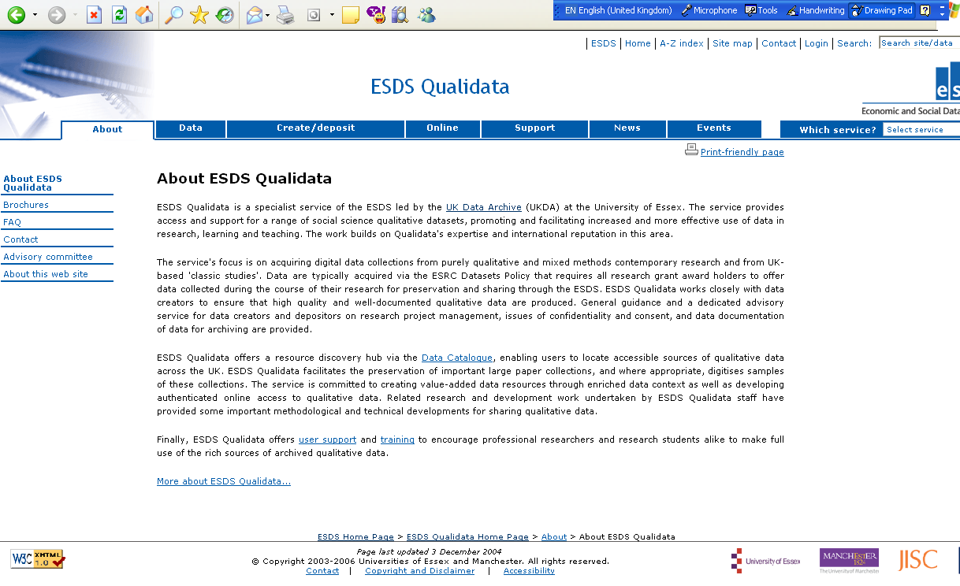
NSPSCA screen shot

Slide 13
Qualidata funding 1994 -2009
Year funding £ Funder Staffing
1991 small 2 year scoping study grant ESRC
1992
1993
1994 700k over 5 years ESRC 3 staff 2.2 FTE
1995 5 staff 3.0 FTE
1996 50k for Social Policy Archive JRF 7 staff 3.0 FTE
250k funding for 3 years ESRC
1997
1998
1999 39k for preservation project MRC
2000 100k for 1 year ESRC 3 staff 3.0 FTE
2001 200k for 2 years ESRC
2002
2003 share of 700k for 5 years, ESDS ESRC 6 staff 3.25 FTE
2007 share of 1400k for 5 years, ESDS ESRC
2009 6 staff 3.5 FTE
NOTE: 2001 onwards also access to technical infrastructure, secretarial and HR and finances support

Slide 14
Who are the staff?
high level staff have expertise in qualitative methods
most of the staff now are multi skilled – can handle qualitative and quantitative data – mixed methods
quali-centric staff suffer from being scared of numeric data, which means they are less flexible
I believe that all staff should be able to handle all data types (bilingual) and metadata (trilingual), otherwise synergies are less effective

Slide 15
Qualidata: sourcing data collections
national focus
ESDS Qualidata has about 300 collections of qualitative research data in its catalogue
data from individual and programme research grant awards
data from ‘classic’ social science studies - in depth interviews plus ethnography
pointing to existing archived paper-based collections and digitising for social research use
spontaneous gifts

Slide 16
Acquisitions criteria
rich data that are well-documented
format, usability and condition of material
data that have further analytic potential than the original investigation (depth; large-scale; longitudinal)
relative importance or impact of the study e.g. major influence in its field and/or representing the life of a significant researcher
copyright and confidentiality issues ok
complementary to existing data holdings (series)

Slide 17
How do we archive qualitative data?
data archiving vs. traditional archiving (listing)
data description: DDI versus ISAD(G)
data are ‘processed’ at the study and interview levels
  error checking/validation of collection contents
  check consent and confidentiality agreements met
  basic reformatting of text undertaken
  possibly anonymisation undertaken
  creation of digital user guides, data listings
  access conditions agreed and applied
  data mounted for download system at RTF or PDF
not much audio material is offered, download system
published ESDS guide to data processing techniques

Slide 18
Capturing context
being present during fieldwork adds a richness over and above the raw data
but context can be provided at many levels
  audio-visual record and full transcription
  description of setting, observations
  details of methods, sampling, analysis
  relevant macro-level details (period, events etc.)
good to interview the principal investigator
if historians can make use of partial sources that are centuries old, why can’t sociologists?

Slide 19
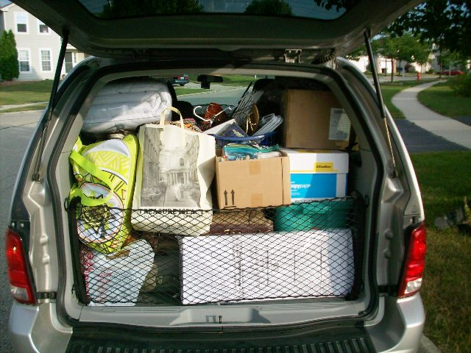
I needed to empty my office….

Slide 20
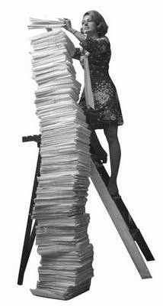
The paper mountain
much older data in paper format
  may selectively digitise ‘highlights’
  scan and OCR samples of key data
  scan as image files - enable faster throughput
  store whole collection in traditional archive
examples:
  Peter Townsend – poverty, old age
  Paul Thompson – oral history and the Edwardians
  Goldthorpe – affluent worker
  Dennis Marsden – fatherless families

Slide 21
Accessing our data
data list and user guides free for download
preserve data originals but supply copies under licence and via any access conditions specified
users sign up to an agreement and tell us about intended data use
web download of data behind authentication system for registered users
online access to data browsing also behind access control system
some data require depositor permission - done manually

Slide 22
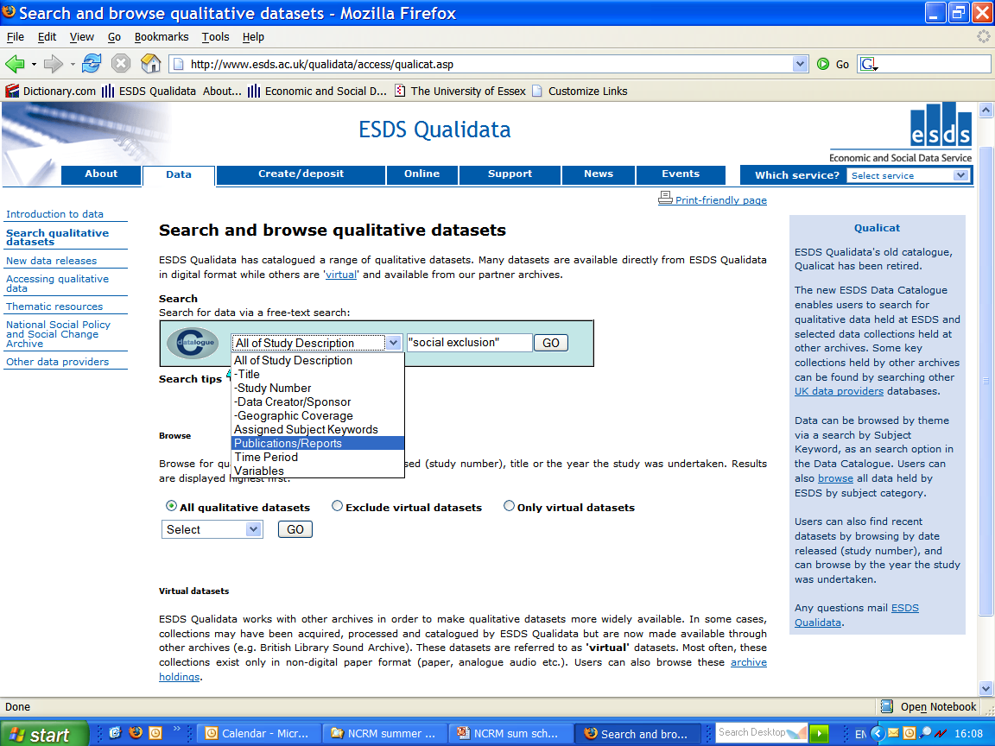

Slide 23
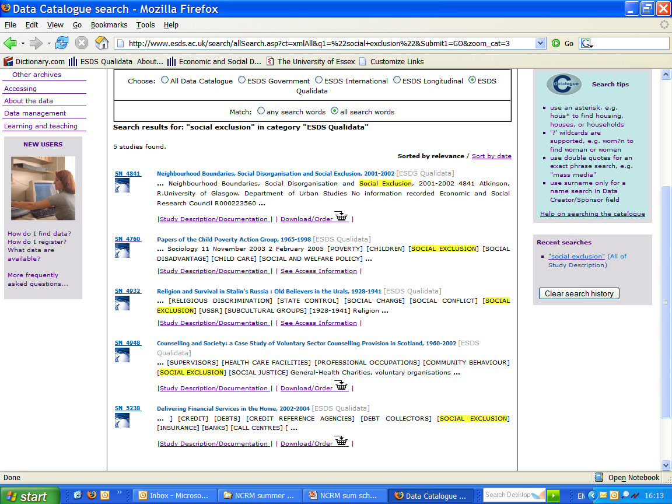
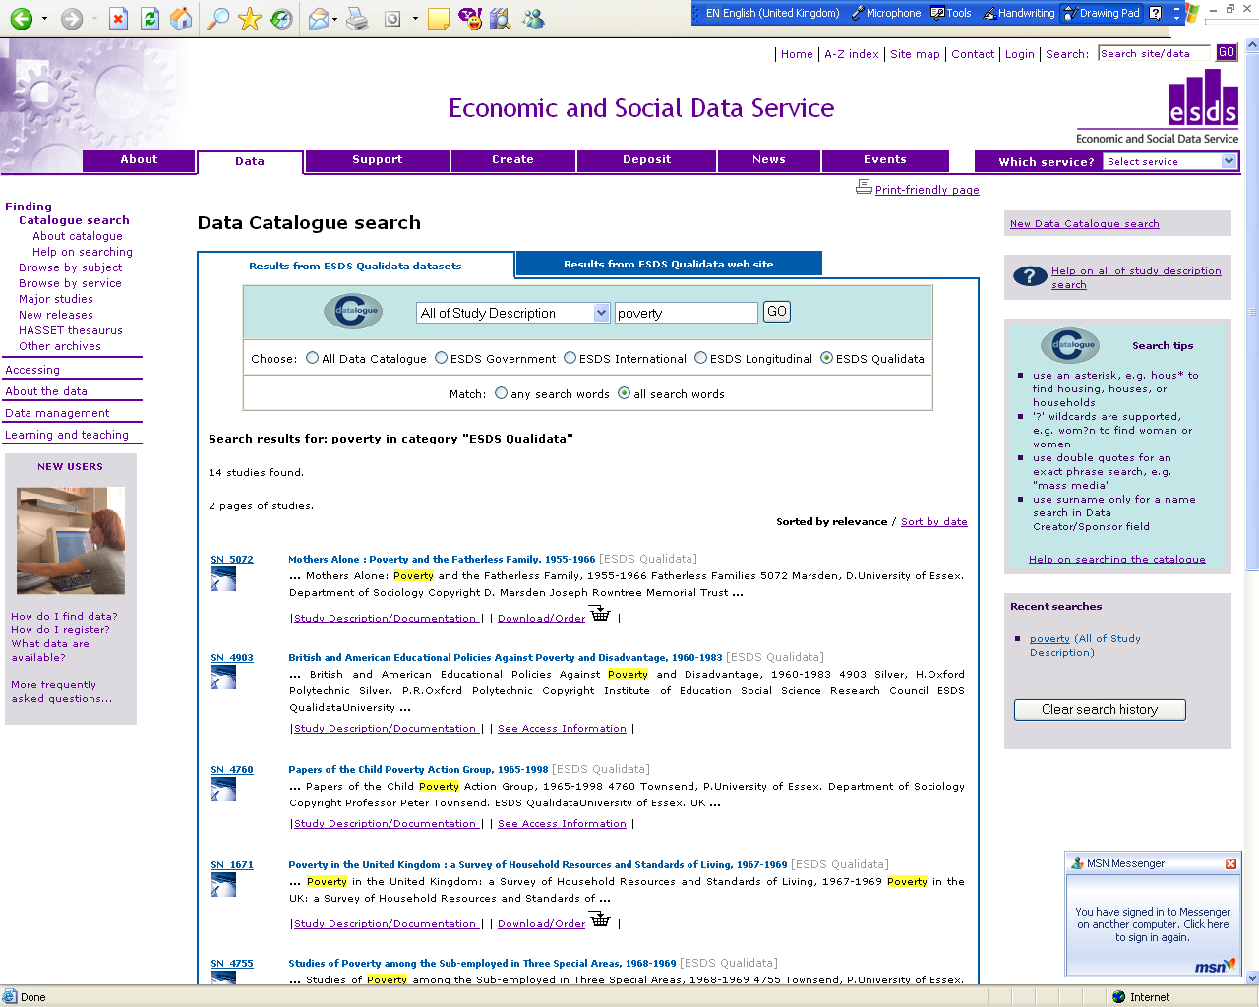
UKDA Catalogue screen shot

Slide 24
Online access and development
2003 digital humanities computational linguist in-house
developed an XML metadata schema and basic online access system (TEI) – Edwardians Online and ESDS Qualidata Online
working with international team on specifying metadata for complex qualitative studies. QuDex/DDI
funded QUADS initiative to show innovative ways of sharing qualitative data
  enhanced publications (walk though AV guides)
  text mining - named entity recognition and anonymisation tools
  self-archiving ‘research boxes’ using FEDORA - working with research teams to ingest and share data
  backend processing system that creates RTF and TEI marked-up interview texts to go - ready for download & publication
just need a cool data visualisation system but no resources in house, so looking to use open source common tools

Slide 25
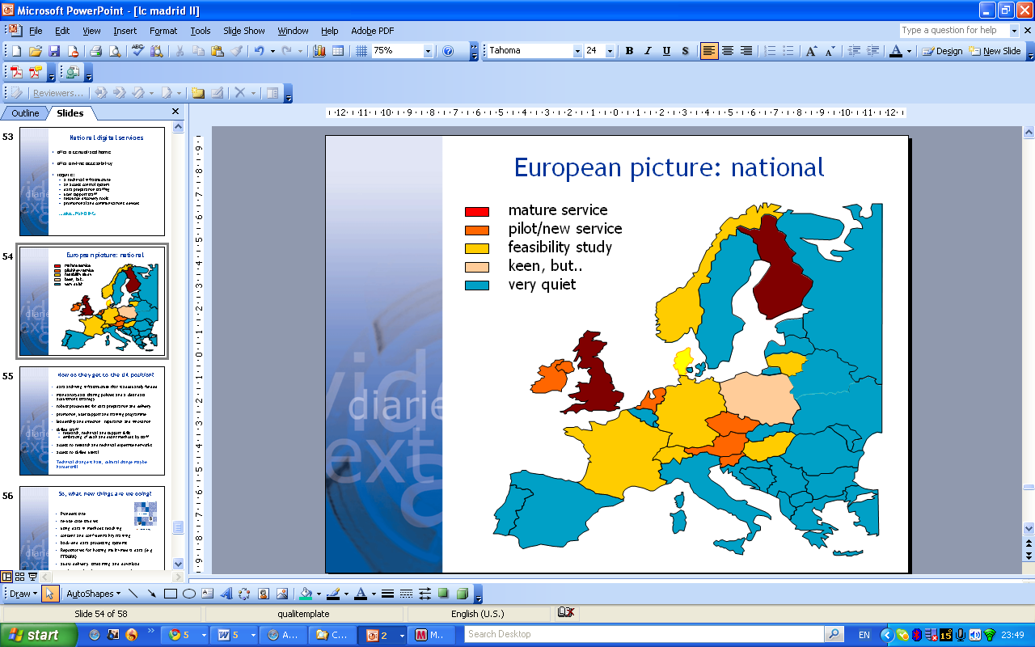
European map

Slide 26
Getting to the UK position
adequately funded data archiving infrastructure
mandatory research data sharing policies
robust procedures for data preparation and delivery
stimulating, creating and adding to the methodological debate and training on data sharing and re-use
skilled staff: research, technical and support skills
access to research and technical expertise networks/money and collaborators. Don’t get siloed…. link with humanities!
working to adopt common tools
access to skilled users!

Slide 27
User Engagement

Slide 28
Facilitating reuse of data
acquire a broad range of rich qualitative data
make obtaining data as straightforward as possible (procedures & templates)
create rich context for data
get samplers and exemplars up quickly
provide case studies of data re-use
engage in active promotion, outreach, training and publishing

Slide 29
Successful workshop topics
overview of collections
exploring data/hands on exercises
depositors and re-users talking
managing your data
  gaining consent and ethical review
  anonymisation exercises
  model transcription
  capturing context
guidance and resources for methods teachers
  showcase tailor-made teaching datasets
  collaborate with methods teachers - resources
data for CAQDAS software applications

Slide 30
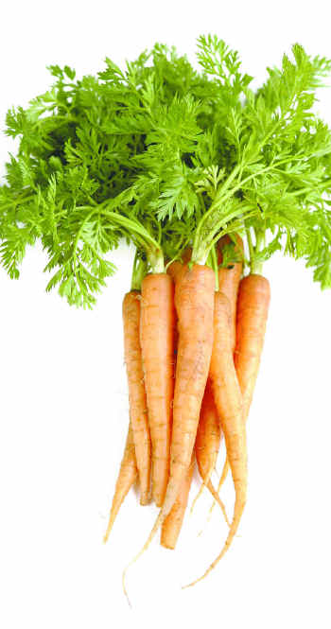

Engaging researchers: sharing
carrots:
  data should be recognised as a valid
  academic output (ISDataN)
  recognition is given for re-using data
  not just creating data
  archives can help researchers promote data
  show archive-readyness to funders
  collaboration in archiving projects
sticks:
  mandatory data sharing policies
  data management plans
  peer review on the long-term
  value of research data

Slide 31
References
Many publications including 4 dedicated journal issues on archiving and re-use of quali data 2000; 2001; 2004; 2007 arising out of conferences/workshops
www.esds.ac.uk/qualidata/support/
www.esds.ac.uk/qualidata/news/

