Slide 1
The Veteran Tapes
An Inquiry into the benefits, disadvantages and preconditions for the reuse of interviews as sources of scientific knowledge
Stef Scagliola
Veterans Institute - The Netherlands
Supporting the Digital Humanities
Vienna, 19-20 October 2010

Slide 2
Background
military historian – social history at the Erasmus University Rotterdam – history combined with the insights of the social sciences
Italian background – perspective from the ‘outside’ on Dutch history and historiography
PhD 2002 : The Burden of War – Coming to terms with Dutch war crimes committed in Indonesia during the decolonisation war 1945-1949
Interviewproject Dutch Veterans – 2006-2010

Slide 3
Goal of the Interviewproject Dutch Veterans
Collect 1000 interviews with a representative number of veterans of all conflicts and military missions in which the Netherlands were involved (1940-2010)
(WWII, Decolonisation war Indonesia, Korea, UN-Libanon, ex-Jugoslavia, Cambodia, Iraq, Afghanistan)

Slide 4
Organisation of the project
Coördinator + Assistent
15 trained free-lance interviewers distributed over the country
Three times a year training courses and 1 x personal evaluation
Three times a year meeting with the Board of Advisors, representatives of academic institutions/research centres/Military Academy
Website with password protected access: http://interview.veteraneninstituut.nl

Slide 5
Retrospective life-story- interviews
semi-structured topiclist
jouth – education – preparation for war/military
mission – experiences during mission/conflict -
return and adjustment – retrospective
main themes older veterans: conscription, real war,
long periods, look back on their lives
main themes younger veterans: professional army,
‘peace missions’, maximum of 4 months, relatively
young

Slide 6
DATABASE:
1000 biographical interviews of ± 2,5 hours
Digitale database
Personal data
Registration number
Military education and career
Personal documentation
Summery for every 10 minutes
Thesaurus with thematic keywords
Explanation of abbreviations, linggo, technical terms
matches data ministry of Defense
Channel to cultural heritage institutions
Searchable with text
Searchable by attributed key-words
Material for military dictionary, anticipating automatic speech retrieval

Slide 7
Who is going to use the archive?
First reactions:
military psychologist: it’s not representative
social psychologist: it does not yield answers to
my specific research question
military historian: it’s not truthful
anthropologist: my relation to my respondent is exclusive
discourse analyst: I need to know everything about the background of the interviewer

Slide 8
proces generated data
collections based on a broad generic topic-list,
meant to be archived and consulted by a broad range of target groups
no anonimity, consent has been arranged
meta-data available
if recent, recorded digitally

Slide 9
research generated data
collection with the purpose of answering a specific research question
meant for the exclusive use of the researcher (but payed with public money!)
in social sciences ethical code of anonimity
often no consistent meta-data structure
old carriers, need to be digitized
data end up in the desk draw and perish

Slide 10
ICT- solutions
long term digital preservation
tools to give selective access to authorized researchers
tools to facilitaite re-use of qualitative data
tools to compare data from different disciplines
tools to give direct access to spoken document
tools to enhance qualitative data
different mindset = sharing, preserving, checking, overcoming barriers

Slide 11
The Veteran Tapes
Combined effort by the Veteran Institute and Data Archiving Networked Services (DANS) to bring together Oral History and Social Science.
full text-transcriptions of 25 of our interviews on various military conflicts/missions (1940 - now)
diverse group of researchers (theology, anthropology, sociology, psychology, discourse analysis, methodology) have been invited to write an article based on the same set of interviews.
The project is meant to prove that this type of collections can be of use to social scientists of various disciplines, as long as a set of conditions for the reuse of qualitative data is met.

Slide 12
Results
7 articles from different perspectives:
Images of friend and foe
Discours of acts of violence
Moral dilemma’s
Religion and spirituality
Coping with shocking experiences
Images of the local population
Personal experience versus institutional history

Slide 13
Veteran Tapes: enhanced publications
Objective: Link structure for rich biographical reports, including links to external sources and fragments of recorded audio (aligned via ASR)
Challenges: transcript alignment, NE relation detection, interactive timelines and maps, topic classification, result presentation, harmonisation of reference styles, faceted IPR handling
Further aims: explore the (dis)similarities in user needs for the various disciplines involved, and prepare for processing larger volumes, stimulate resource sharing.

Slide 14
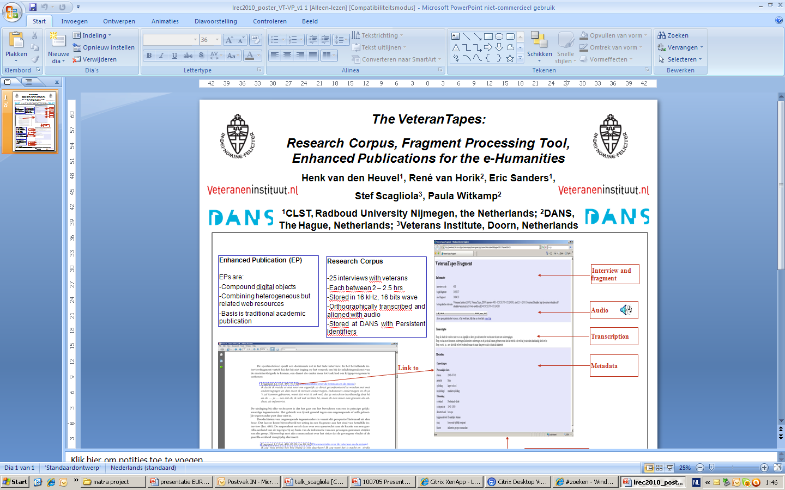

Slide 15
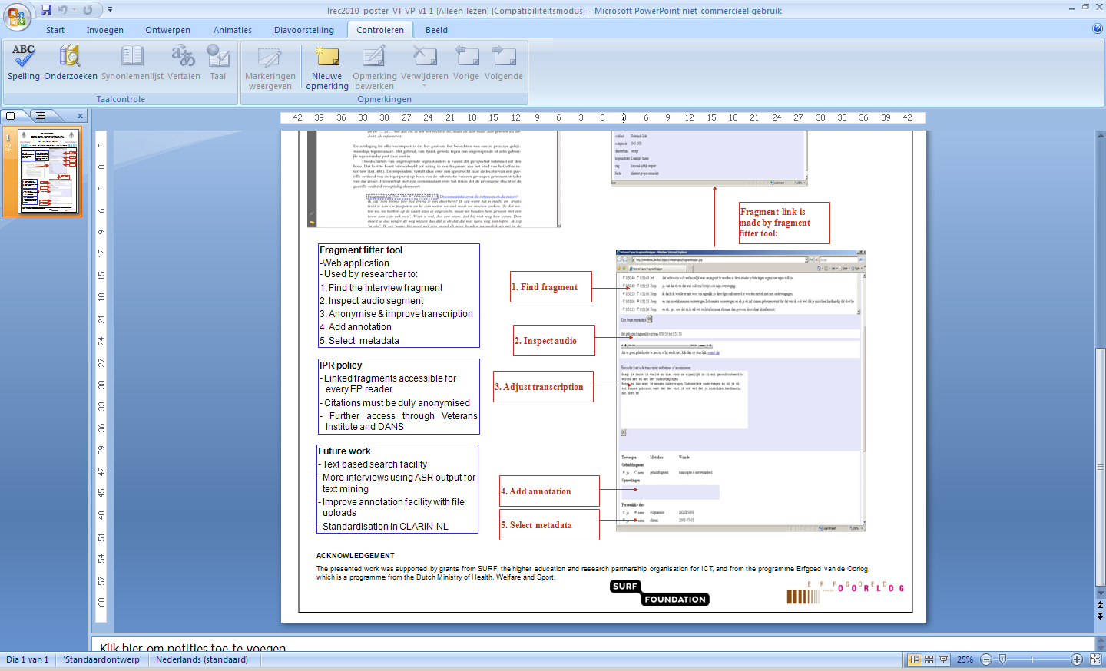

Slide 16
Fragment-fitter and annotationtool
Search function
  Time codes
  Words (using Automatic Speech Recognition)
Result of search is presented in list of fragments
Presentation of metadata of fragments
User functions:
  Adjust beginning and end of audio clip
  Add annotations and transcriptions
  Uploading additional files (e.g. Maps / photographs)
  Access to stored transcriptions and annotations
  of user and user group (collaboration)
Manual

Slide 17
Links online
Demonstration “enhanced publication”
link film SURF 0.00- 1.07 / 2.44 –
3.54
Demonstration annotation tool
http://wwwlands2.let.kun.nl/spex/annotationtool/

Slide 18
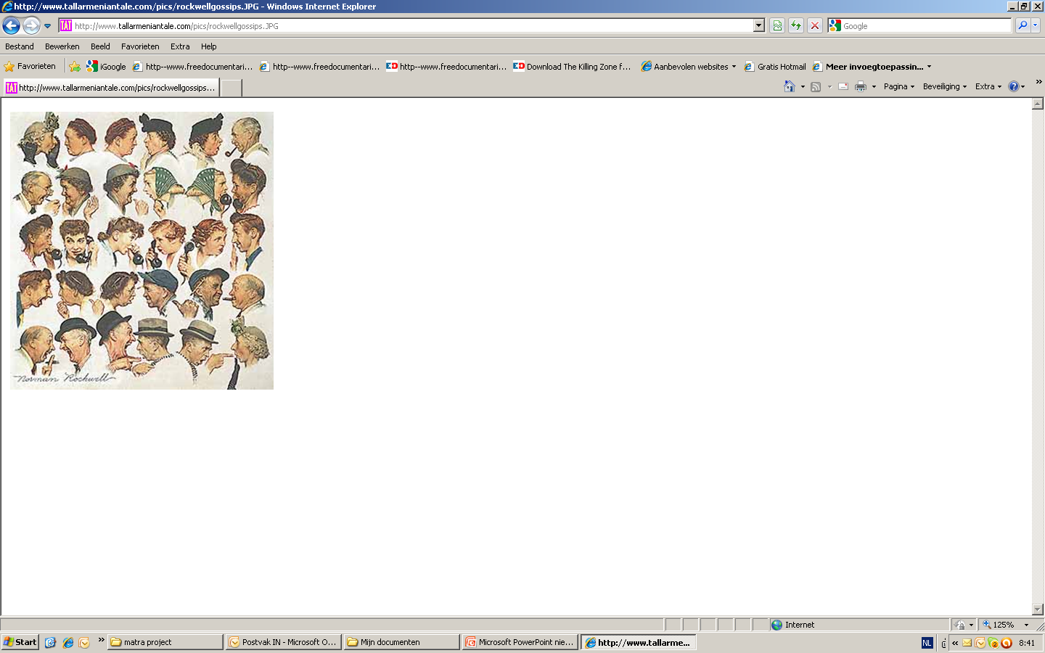
Thanks!

