Slide 1
Merton, accountability and the sociolinguistic study of variation
Frans Gregersen
The DNRF LANCHART Centre
A member of the Danish CLARIN

Slide 3
INTRO ON THE SOCIOLOGY OF SCIENCE
PART I

Slide 4
Robert K. Merton 1942
The sociology of science:
The need to scrutinize the ethos of science became pressing in 1942 in the face of the Nazi denial of rationalism

Slide 5
The CUDOS norms
Communism – the common ownership of scientific discoveries, according to which scientists give up intellectual property in exchange for recognition and esteem.
Universalism – according to which claims to truth are evaluated in terms of universal or impersonal criteria, and not on the basis of race, class, gender, religion, or nationality;
Disinterestedness – according to which scientists are rewarded for acting in ways that outwardly appear to be selfless;
Organized skepticism – all ideas must be tested and are subject to rigorous, structured community scrutiny

Slide 6
The natural sciences and the CUDOS norms
Communism: the need for collective work and division of labour, the praxis of big science
Universalism: Natural sciences are more universal and less bound to local languages, traditions and culture than the human sciences
Disinterestedness: sharing results
Organized skepticism: double blind peer review systems, evaluation procedures

Slide 7
The human sciences and CUDOS
Communism: More individual researchers than groups; prototypically little science
Universalism: Human sciences less universal and more bound to local languages, traditions and cultures than the natural sciences
Disinterestedness: Often the individual is tied to the method and results
Organized skepticism: More skepticism than organization

Slide 8
THE LANCHART PROJECT
Part II

Slide 9
The LANCHART Centre
Established 2005 by a grant from the Danish National Research Foundation to Frans Gregersen
Will last at least until May 2013 and hopefully two years longer
Repeats previous studies of Danish spoken language at six sites from all over Denmark by re-recording informants

Slide 10
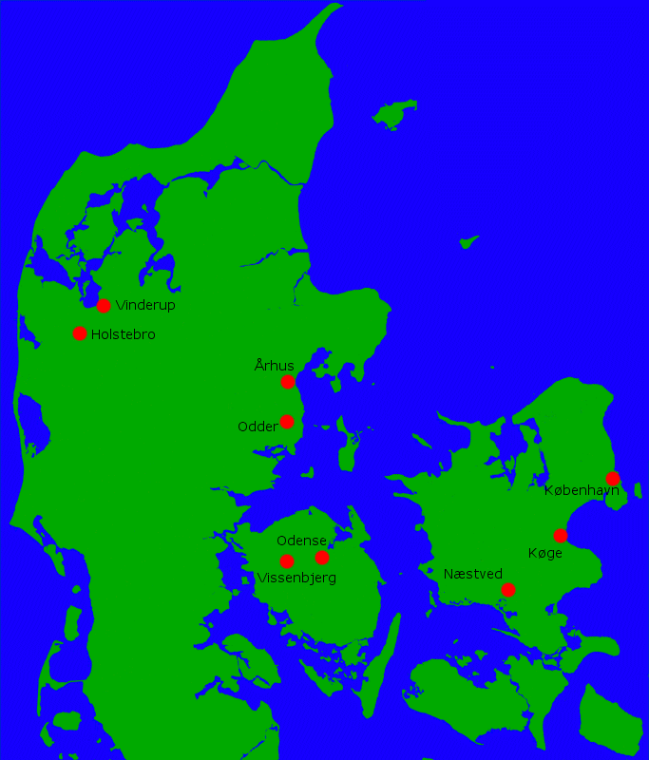
The LANCHART Sites
In Jutland:
Vinderup 1973, 1978 and 2006
Odder 1986-87 and 2005
On Funen:
Vissenbjerg 1980-84 and 1999-2000
On Zealand:
Næstved 1986-89 and 2005-6
Næstved 1986-90 and 2005-07
Køge 1989-98 and 2006-08
København (Copenhagen) 1986-88 and 2006-10

Slide 11
The Copenhagen data set
42 informants in total:
24 in generation 1 (born 1944-62) interviewed first time in 1986-88 (OLD recordings), second time in 2006-08 (NEW recordings), 6 in each cell: Middle Class (MC), Working Class (WC), males (m) and females (f)
18 in generation 2 (born 1963-73); 4 in the two WC groups and 5 in the two MC groups; OLD and NEW recordings

Slide 12
Technically speaking…
All transcription is done using the Transcriber programme
All files are then stored as Praat text grids since Praat allows any number of tiers for coding; tiers are tied to the orthography
Information about the informants is stored in a separate mySQL data base using the ID no. as the cue
The search engine connects the informant data base and the orthographical tier

Slide 13
THE VARIABLE
Part III

Slide 14
The variable [ɛ] > [e]_[ŋ]
The raising of the [ɛ] before the velar nasal may be operationalized as follows:
Three values:
Original (standard) value: [ɛ]
Raised variant: [e]
An in-between variant which is heard as neither identical to [e] or [ɛ]: in-btw.
penge (money) realized as [peŋə] or [pɛŋə]

Slide 15
Method
Auditory coding by two independent coders; any discrepancy is solved by a third person, the checker
In principle forced choice, either [e] or [ɛ] but in practice the coders felt the need for the in-btw. value as well

Slide 16
RESULTS
Part IV

Slide 17
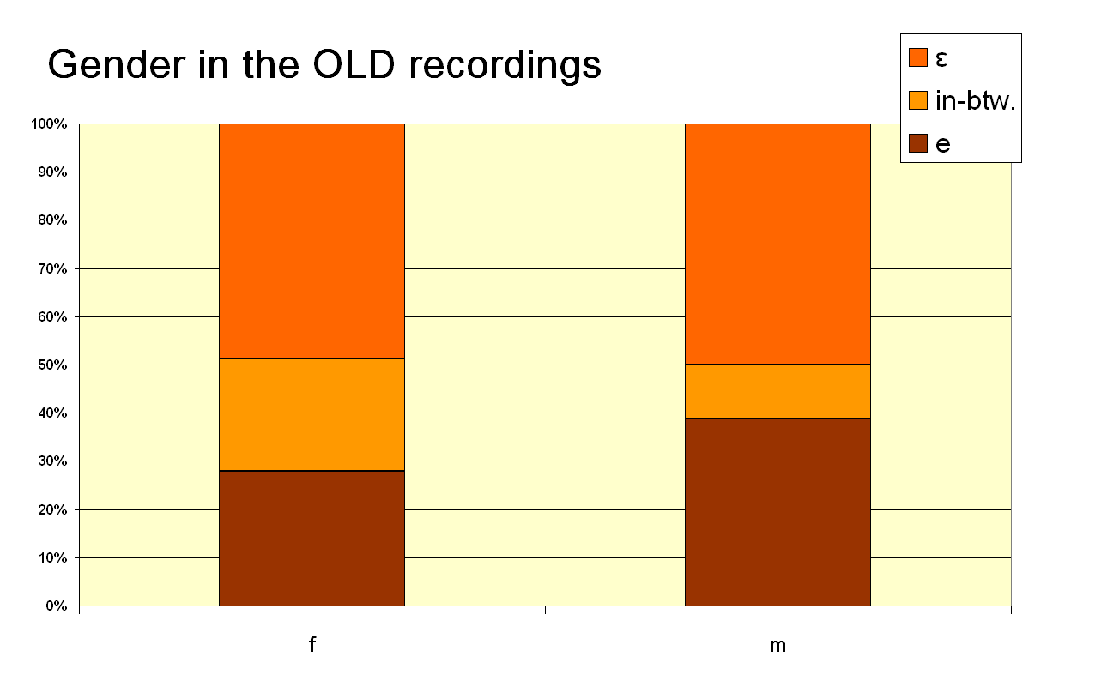
The generation 1 results: Gender (N= 689)

Slide 18
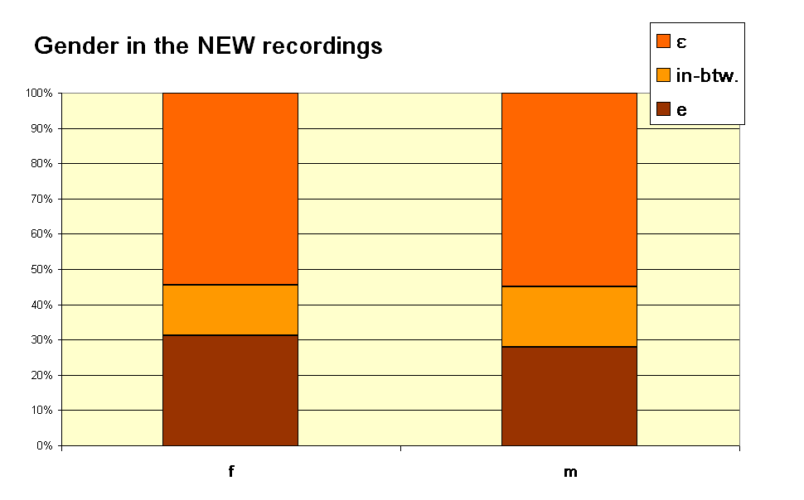
Gender in the NEW recordings (N= 74)

Slide 19
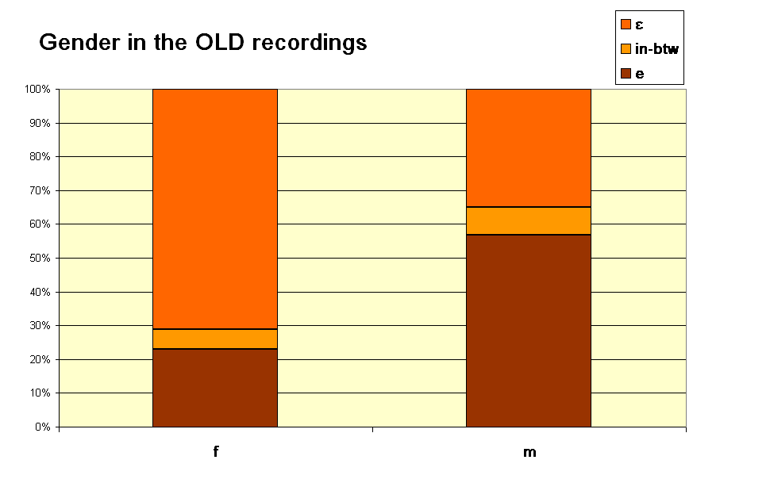
The generation 2 results: gender (N=396)

Slide 20
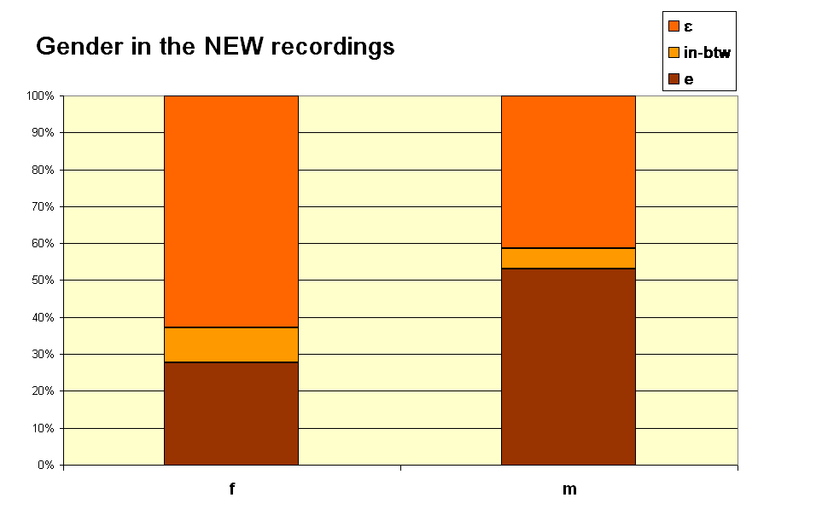
Gender in the NEW recordings (N=447)

Slide 21
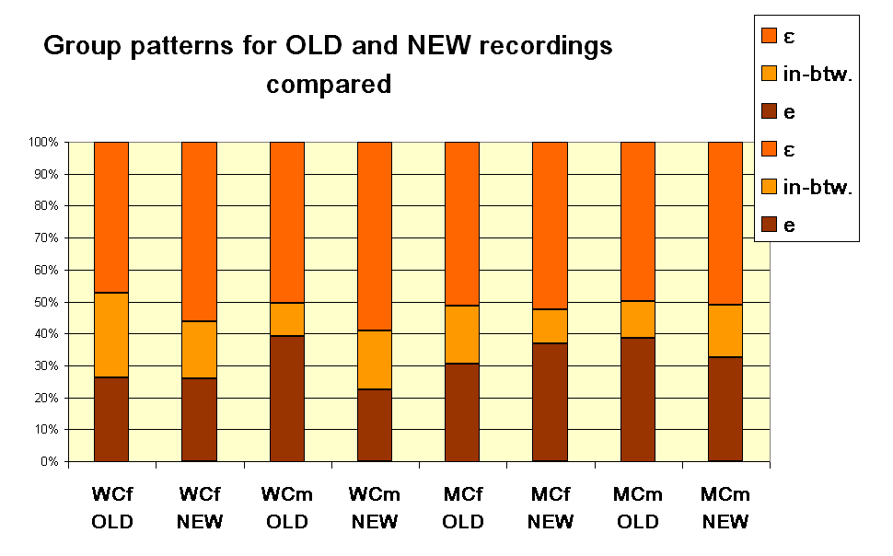
The generation 1 groups

Slide 22
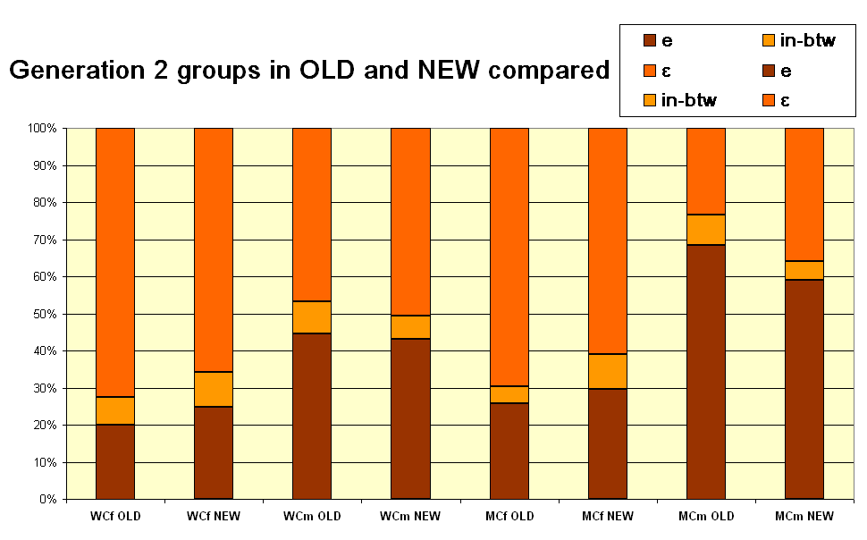
The generation 2 groups

Slide 23
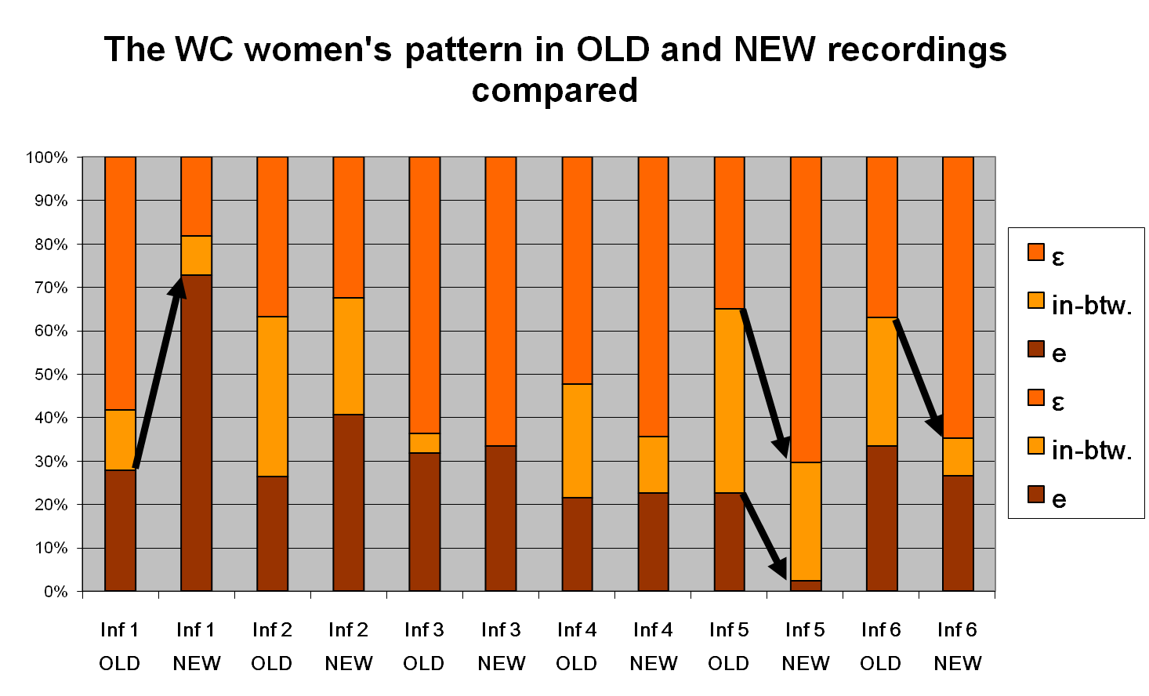
Individual differences in real time

Slide 24
DISCUSSION
Part V

Slide 25
Linguistic points
The status of the in-between variant: [ɛ] as the standard variant and everything else as raising - or three distinct values with their separate stories?
Is this stable variation or variation with a direction (a change) and if so how old is it?
Is this lexical diffusion and if so from which part of the lexicon?

Slide 26
Lexical diffusion or morphophonology?
’penge’, money (no relation to modern word forms with any [a]) vs. ’længe’, (for long, adv.) with a connection to the word ’lang’, long
Chi square: 48.7 p< 0.000
 | [e] | in- btw. | [ɛ]
’længe’ | 28 | 29 | 248
’penge’ | 200 | 101 | 448

Slide 27
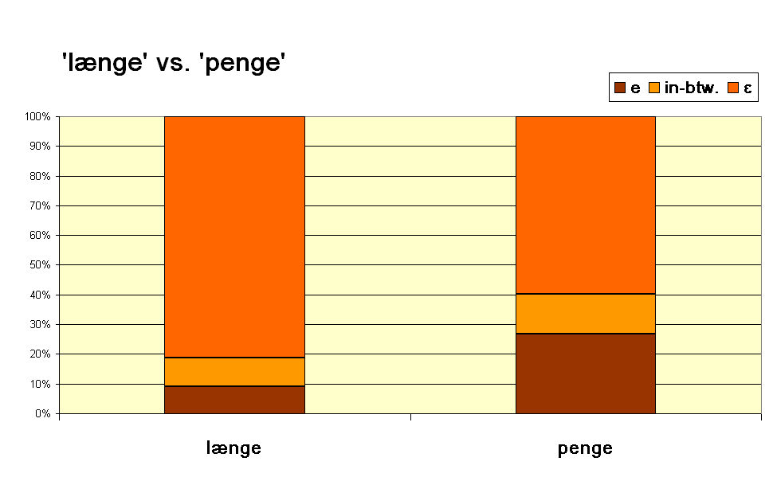

Slide 28
Accountability
It is uniquely retrievable which variant was coded where in the data
The data may be re-analyzed by others
PROBLEM: confidentiality
Thus all data are in principle – if stored as part of the project – available for inspection by others – the norms of communism and organized skepticism may be applied

Slide 29
Thanks
To the CLARIN Denmark partners for collaboration, in particular WP3 on spoken language
To the DNRF for the grant
Last but not least:
To you the public for listening!
See you at: www.lanchart.dk

