Slide 1
Circulation of Knowledge and Learned Practices in the 17th-century Dutch Republic
A Web-based Humanities’ Collaboratory on Correspondences
Walter Ravenek
Huygens Institute KNAW
University of Utrecht – Descartes Center
University of Amsterdam
KB – Dutch National Library
Data Archiving and Networked Services (DANS)
Virtual Knowledge Studio

Slide 2
Outline
Project
Approach
Epistolarium
Outlook

Slide 3
Outline
Project
Approach
Epistolarium
Outlook

Slide 4
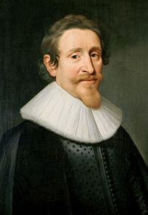
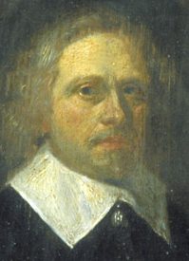
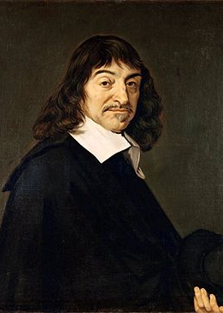
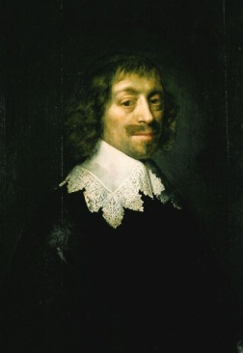
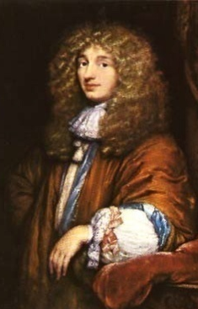
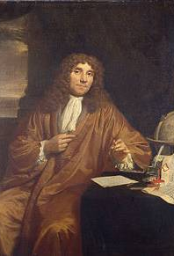
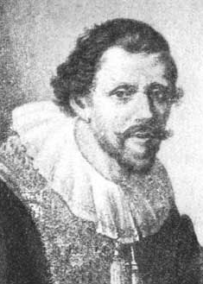
17th Century Scholars
Hugo Grotius (1583-1645)
Caspar Barlaeus (1584-1648)
René Descartes (1596-1650)
Constantijn Huygens (1596-1687)
Christiaan Huygens (1629-1695)
Antoni van Leeuwenhoek (1632-1723)
Jan Swammerdam (1637-1680)

Slide 5
Circulation of Knowledge: Questions
Qualitative: Who is corresponding/introducing? Can we distinguish circles and types of scholars? Where are they located/do they meet? Can we distinguish types of letters/rethorical structures? Can we distinguish emerging themes and debates in these networks?
Quantitative: Number of correspondents. Frequency and duration of correspondence. Percentage of various languages and themes.
Notes:
Qualititaive questions
Quantitative questions which basically are formulated as parameters to support our qualitative questions

Slide 6
Outline
Project
Approach
Epistolarium
Outlook

Slide 7
Present data from various sources in integrated research tool
Digitized letters
  topic modeling (LDA)
Metadata
  date, correspondents, locations, language
CEN database (Catalogus Epistularum Neerlandicarum)
  network of correspondents

Slide 8
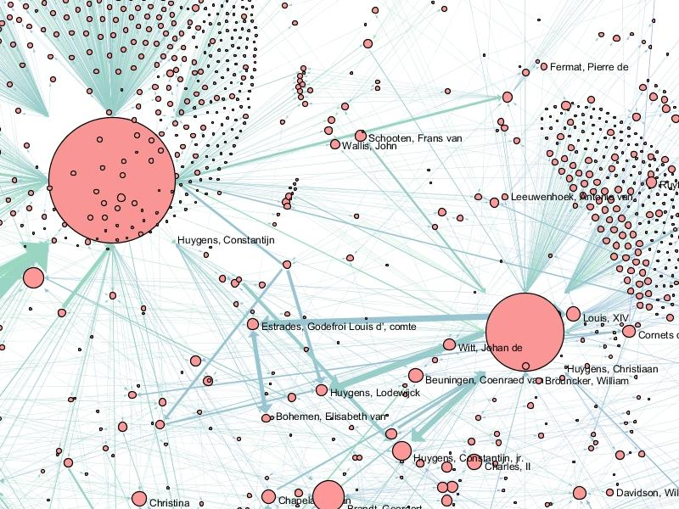
CEN Network 1550-1750
13 587 correspondents
>700 in our corpus

Slide 9

Workflow
language identification
letters
preprocess
LDA
topics
- tokenization
- stopword removal
- short word removal

Slide 10
Corpus size by language
Corpus | total | nl | la | fr | de | other | not assigned
Hugo de Groot | 7961 | 2057 | 4611 | 914 | 287 | 35 | 57
Constantijn Huygens | 7298 | 4759 | 470 | 1816 | 1 | - | 251
Christiaan Huygens | 3085 | 238 | 798 | 1943 | 3 | 101 | 2
Total | 18344 | 7054 | 5879 | 4677 | 291 | 136 | 310
Notes:
English is insignificant
Constantijn Huygens corpus is assigned by software
unknown also because of multilangual letters

Slide 11
Workflow
language identification
letters
preprocess
LDA
topics
- tokenization
- stopword removal
- short word removal

Slide 12

Topic Modeling
Basic idea: documents are mixtures of topics, where a topic is a probability distribution over words
David Blei, Andrew Ng, Michael Jordan. Latent Dirichlet Allocation (2003)
Implementation: Mallet
Dutch, French, Latin: separately

Slide 13
Example Topics (French)
Label | Words in topic
astronomy | saturne soleil lune terre lieu anneau vers temps observations heures jupiter cercle ciel planete diametre figure estoit distance comete
geometry | courbe quadrature construction probleme courbes ligne methode hyperbole bernoulli trouver solution quadratures tangentes espace soutangente lignes
army | arm ennemis groot apr troupes nouvelles jours altesse place general fils obeissant colonel passer chevaux croy marechal party quartiers
<deleted> | per quod sed cum hoc quae sit quam esse sunt inter vel enim quo haec pro sic omnia ejus

Slide 14
Outline
Project
Approach
Epistolarium
Outlook

Slide 15
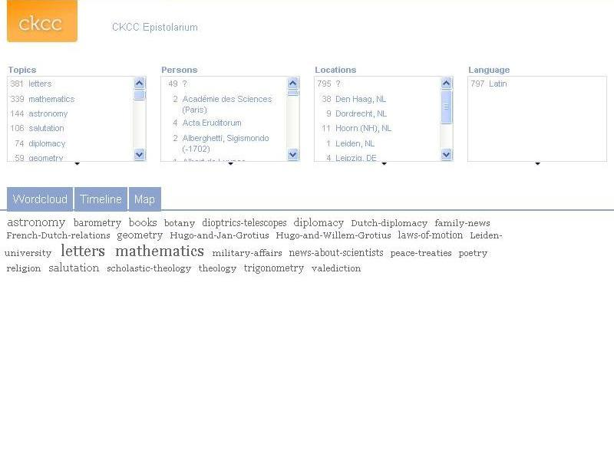
Chr. Huygens corpus
Latin letters

Slide 16
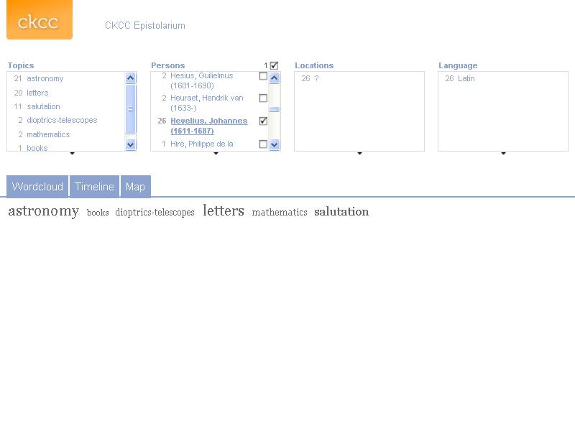
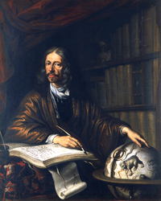
Chr. Huygens corpus
Latin letters

Slide 17
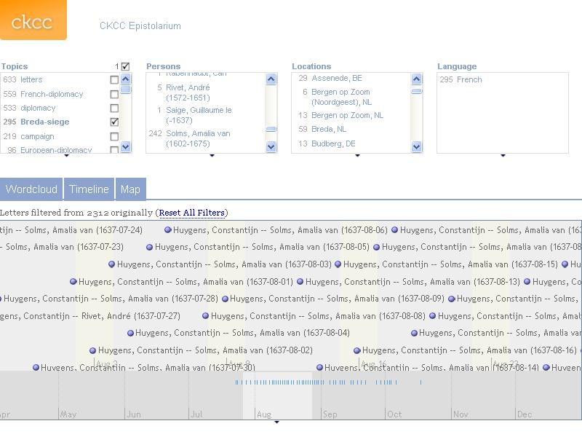

Slide 18
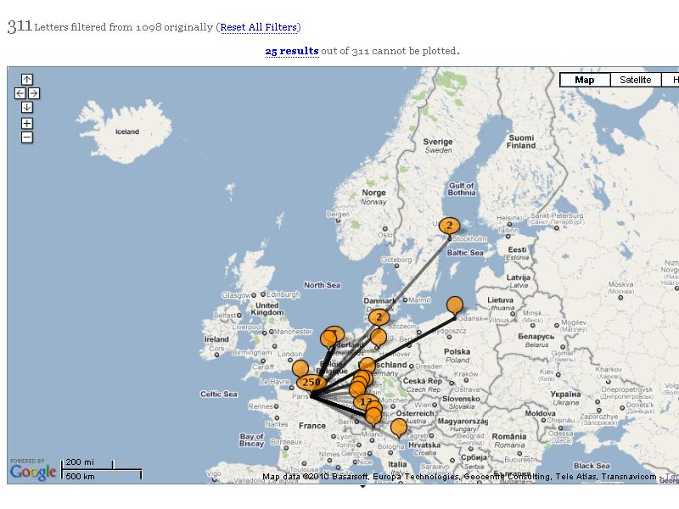
Grotius corpus
French letters

Slide 19
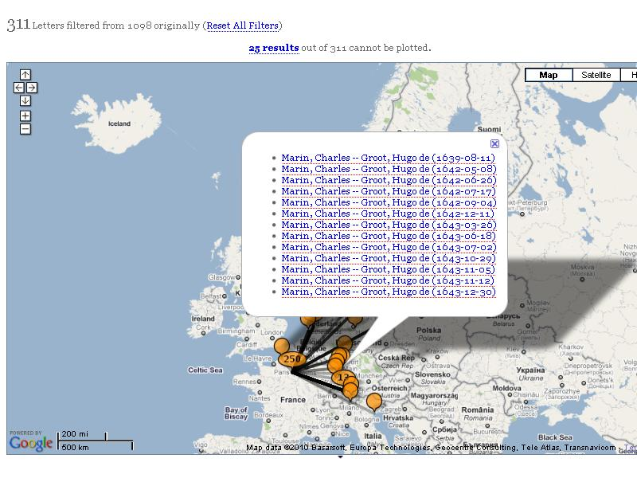
Grotius corpus
French letters

Slide 20
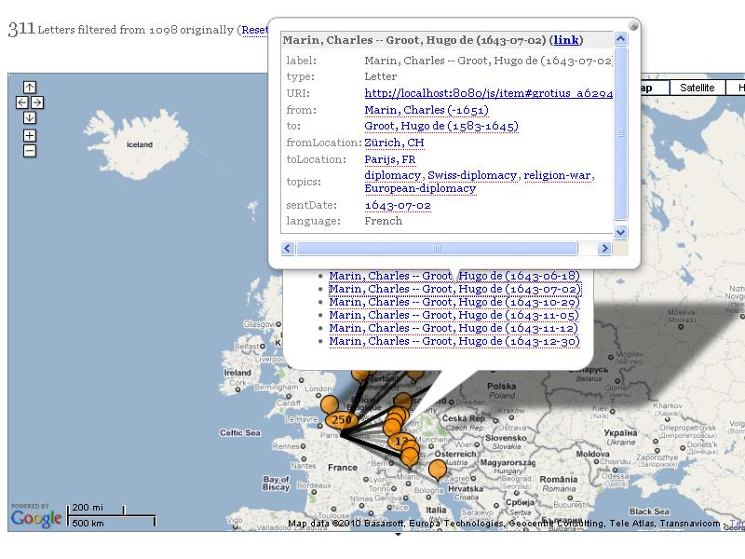
Grotius corpus
French letters

Slide 21
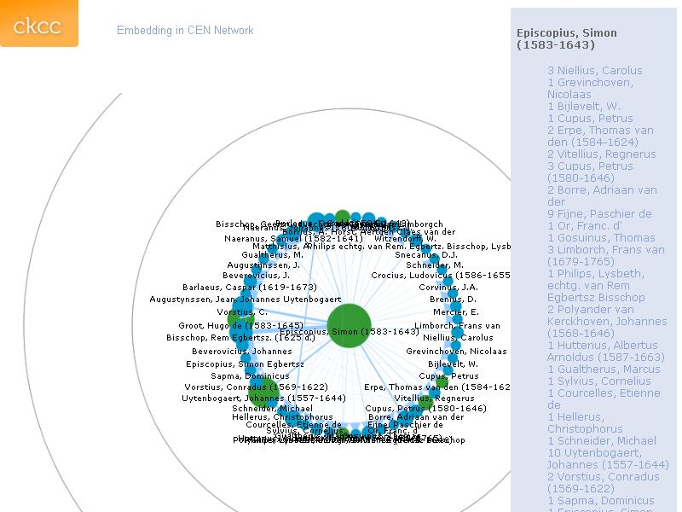
Simon Episcopius
in CEN network

Slide 22
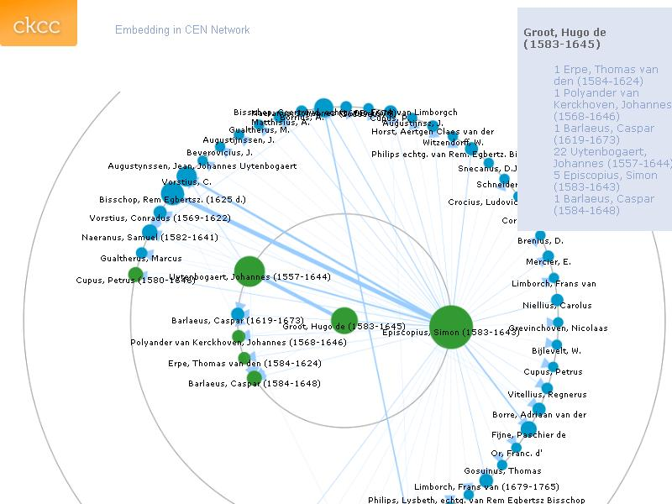
Simon Episcopius
in CEN network

Slide 23
Outline
Project
Approach
Epistolarium
Outlook

Slide 24
Future Directions
Content
More corpora
More metadata
Technical
Production version
Display letter texts
Full text search
Conceptual
Evaluation
Improve topic modeling
  Algorithm
  Language technology
Concept modeling
More facets (NER)
More visualizations
….

Slide 25
Workflow
language identification
letters
preprocess
LDA
topics
- tokenization
- stopword removal
short word removal
[stemming]

Slide 26

Effect of stemming on topic modeling
Experiment
French letters (Grotius, Const. Huygens)
Porter stemming (Lucene implementation)
Topic distribution of authors
Similarity: Jensen-Shannon divergence

Slide 27
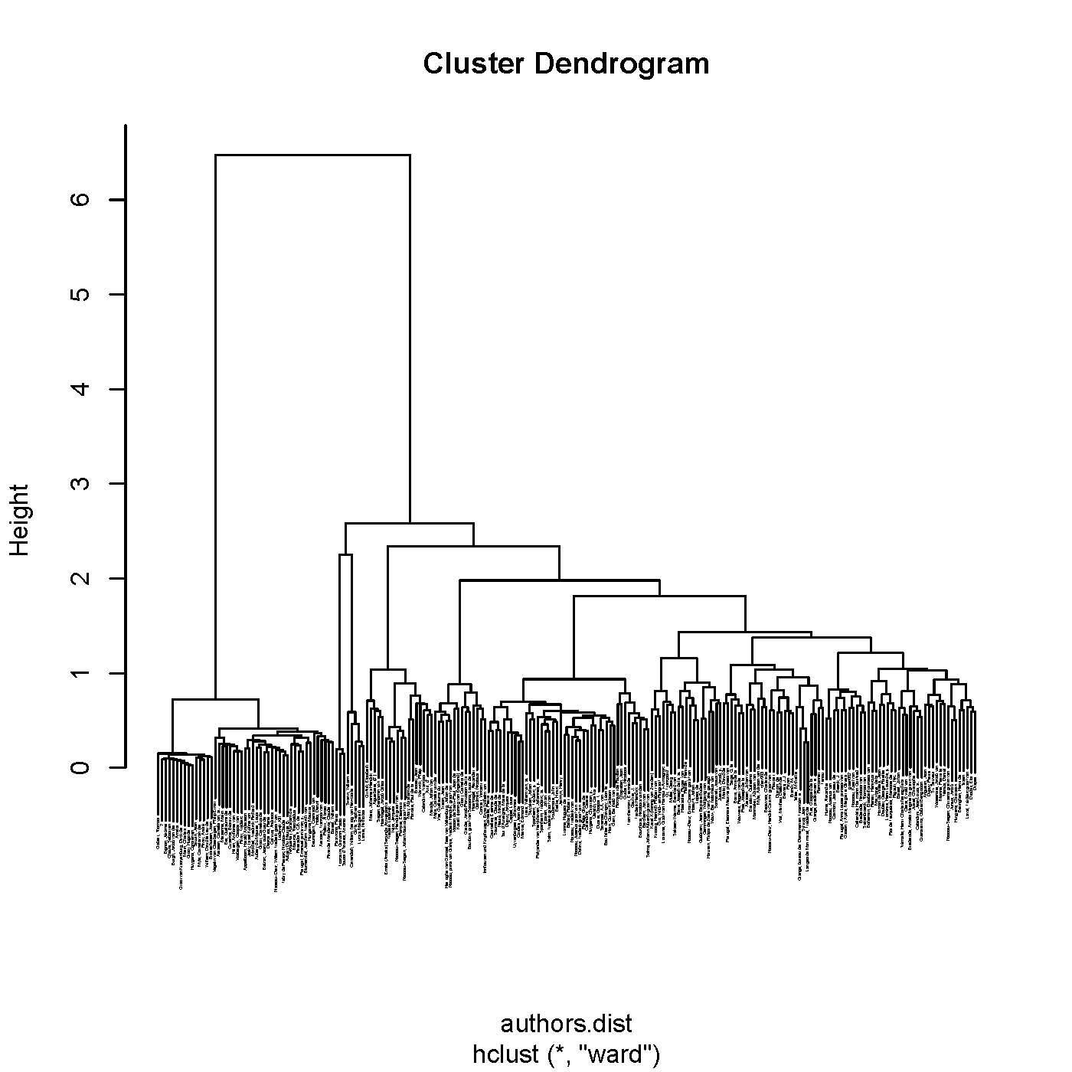
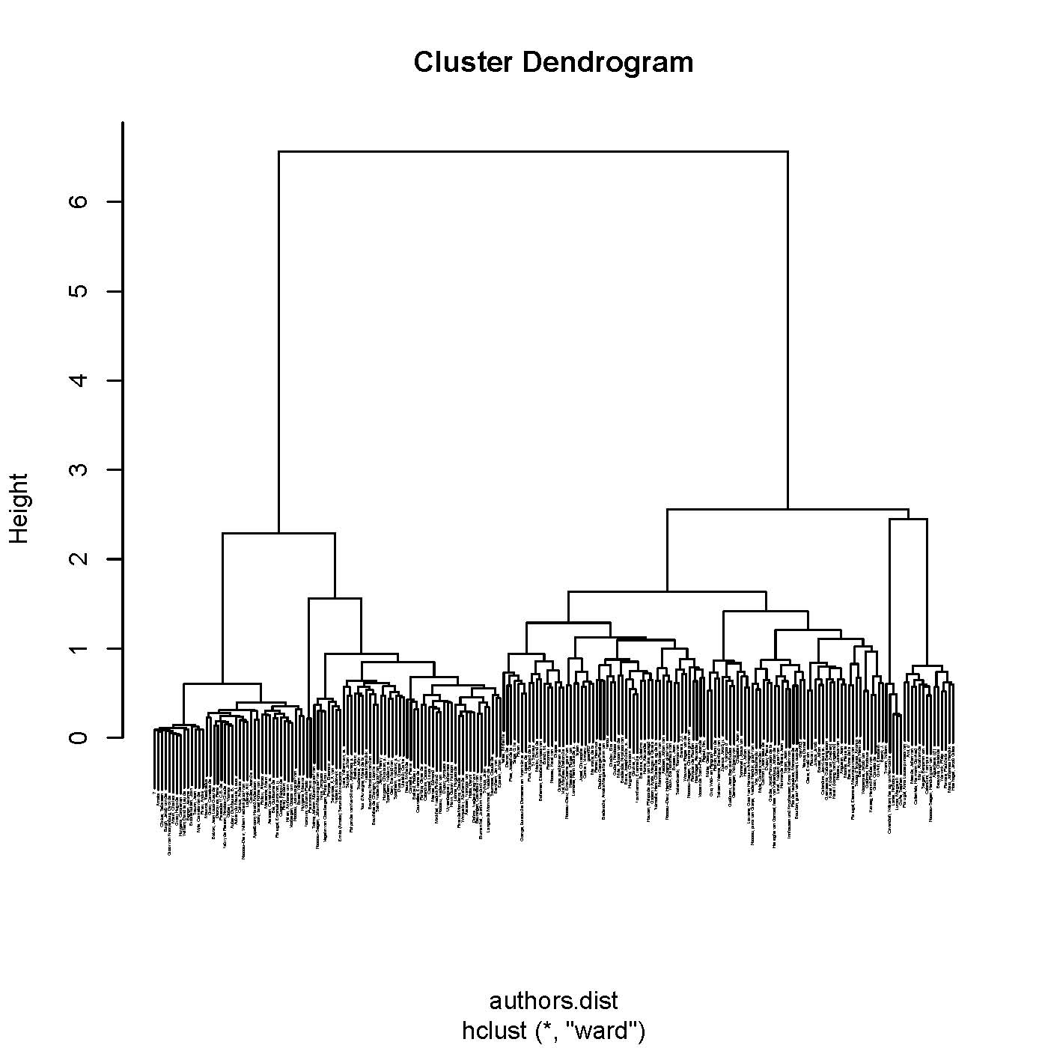
Author Similarity
unstemmed
stemmed

Slide 28
Acknowledgements
Ronald Dekker, Bas Doppen, Guido Gerritsen, Scott Weingart
Alistair Baron, Joseph Biberstine, Erik-Jan Bos, Jeroen Bouterse, Celine Camps, Russel Duhon, Margot Hermus, Charles van den Heuvel, Brit Hopmann, Chin Hua Kong, Dirk van Miert, Henk Nellen, Paul Rayson, Marlise Rijks, Dirk Roorda, Nienke Smit, Steven Surdel, Huib Zuidervaart

