Slide 1
Intensity of Emotions and Narrative Structure
Tibor Pólya
Institute for Psychology
Hungarian Academy of Sciences
Notes:
SDH 2010, 19-20 October, Vienna

Slide 2
Different Methods for Automated Analysis of Emotions
Emotion labels
  Pennebaker: LIWC (915 emotion labels in 5 categories)
Emotional connotation of words
  Whissel: DAL (8742 words scored for evaluation, activation and imagery)
Identifying theory based emotion relevant categories in narratives
  Stein: Narcoder (14 categories, e.g. precipitating event, emotion and mood states, beliefs, goal, action, outcome…)
Narrative structure
SDH 2010, 19-20 October, Vienna
Notes:
SDH 2010, 19-20 October, Vienna

Slide 3
Structural Analogy
Emotional States and Narratives
have analog structure
Emotional state has components
  Appraisal processes
  Subjective experience
  Physiological changes
  Expressions
  Action tendency
Evaluation
Temporal unfolding
Reflectivity
SDH 2010, 19-20 October, Vienna
Notes:
SDH 2010, 19-20 October, Vienna

Slide 4
Structural Analogy 1.
Evaluation
Emotional states
are caused
by appraised events
Narrative:
Events + Evaluations
SDH 2010, 19-20 October, Vienna
Notes:
SDH 2010, 19-20 October, Vienna

Slide 5
Narrative Evaluation
Default narrative structure: Successive chain of events
Elaborated narrative structure: Events + Evaluations
SDH 2010, 19-20 October, Vienna

Slide 6
Structural Analogy 2.
Temporal unfolding
Emotional states
are time bound
and dynamic
Narrative:
Temporal contour
SDH 2010, 19-20 October, Vienna
Notes:
SDH 2010, 19-20 October, Vienna

Slide 7
Temporal Unfolding
Default narrative structure: Punctual events
Explicit sequencing of events
Later …
Elabortaed narrative structure: Rich temporal organization
Temporally extended event
I was sitting …
Temporally salient event
I was there already …
SDH 2010, 19-20 October, Vienna

Slide 8
Structural Analogy 3.
Reflectivity
Emotional states
can be reflected
or non-reflected
Narrative:
Spatio-temporal
perspective
SDH 2010, 19-20 October, Vienna
Notes:
SDH 2010, 19-20 October, Vienna

Slide 9

Spatio-temporal Perspective
Retrospetive form
I was there …
Experiencing form
I see you …
Meta-narrative form
I remember …
Deictic
center
SDH 2010, 19-20 October, Vienna

Slide 10
Linguistic Markers:
Narrative Evaluation (Labov, 1982)
Types of Evaluation
  External
    Direct evaluation
    Past evaluative remark
  Embedded
  Evaluative action
  Suspension of the action
Elements of Evaluation
  Intensifiers
    Quantifiers
    Repetition
    Ritual utterance
  Comparators
    Negated event
    Modal expression
    Future events
  Correlatives
    Progressive
  Explicatives
    Qualification
    Causal explanation
SDH 2010, 19-20 October, Vienna

Slide 11
Linguistic Markers:
Narrative Evaluation
Types of Evaluation
  External
    Direct evaluation
    Past evaluative remark
  Embedded
  Evaluative action
  Suspension of the action
Elements of Evaluation
  Intensifiers
    Quantifiers
    Repetition
    Ritual utterance
  Comparators
    Negated event
    Modal expression
    Future events
  Correlatives
    Progressive
  Explicatives
    Qualification
    Causal explanation
SDH 2010, 19-20 October, Vienna

Slide 12
Linguistic Markers:
Temporal Unfolding
Verbal aspect
  Continuous
  Perfect (verb prefix)
Temporal adverbs
  Temporally salient event (e.g. I was sitting already in the car …)
  Explicit sequencing of events (e.g. later)
SDH 2010, 19-20 October, Vienna

Slide 13
Linguistic Markers:
Spatio-temporal perspectives
Verb time (morphological analysis)
  Present (and Future)
  Past
Temporal and Spatial Deictic terms
  Proximal (e.g. now, here)
  Distal (e.g. then, there)
Characteristic words
  Retrospective: some temporal adverb without verb (e.g then)
  Experiencing: interjections (e.g. hoops)
  Meta-narrative: some mental verb term in present tense with I as subject (e.g. I remember…)
SDH 2010, 19-20 October, Vienna

Slide 14
NooJ
Silberztein (2008)
Linguistic Preprocessing
  Hungarian linguistic resources for NooJ (Váradi & Gábor, 2004)
  Hungarian tool chain
    tokenization (built-in NooJ module)
    sentence splitting
    lemmatization, morphology (Vajda et al., 2006): inflectional dictionary for 60.000 lemmata + lookup: frequent word forms from the HNC
    to achieve better coverage, the output of the NooJ-internal morphology was completed with the Humor morphological analyzer (Prószéky, 1995)
Rule-based syntactic parser is included in the Hungarian NooJ module (Váradi, 2003; Gábor, 2007)
User-friendly interface: easy to handle, develop, share and re-use grammars
SDH 2010, 19-20 October, Vienna

Slide 15
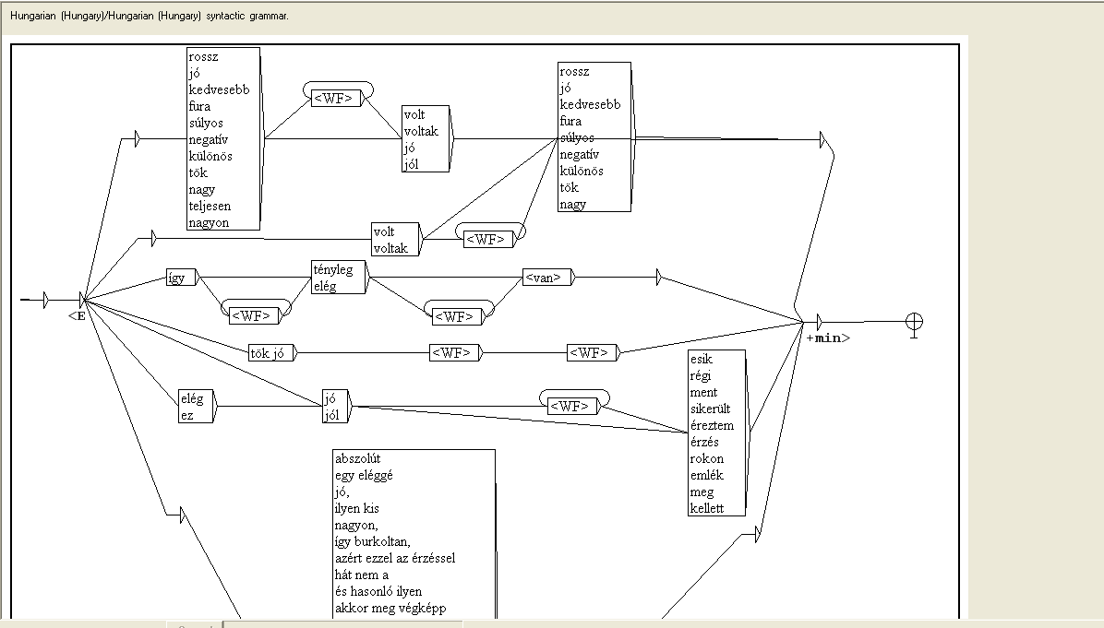
Qualifier Grammar
SDH 2010, 19-20 October, Vienna

Slide 16
Reliability
(16 stories, 1312 narrative clauses, coded by 3 judges)
 | Recall % | Precision %
Narrative Evaluation | 87.2 | 92.1
Temporal Unfolding | 90.3 | 92.7
Spatio-temporal Perspective | 85.4 | 88.7
SDH 2010, 19-20 October, Vienna
Notes:
SDH 2010, 19-20 October, Vienna

Slide 17
Validation: Empirical Study
Hypothesis: If a story has an elaborated narrative structure the intensity of an emotional state during narration is higher than the story has a default narrative structure
Default narrative structure
  Core narrative clauses
  Chain of punctual events
  Retrospective perspective form
Elaborated narrative structure
  Evaluative narrative clauses
  Rich temporal structure
  Experiencing and meta-narrative perspective forms
SDH 2010, 19-20 October, Vienna
Notes:
SDH 2010, 19-20 October, Vienna

Slide 18
Baseline Physiological
Measures, 2 mins
HR, RESP, SC
Affective Grid:
Baseline
Narration and
Continuous Physiological
Measures:
HR, RESP, SC
Cue Word:
Pride
Excitement
Relief
Fear
Sadness
Embarrassment
Affective Grid:
Past
Affective Grid:
Present
SDH 2010, 19-20 October, Vienna
Notes:
SDH 2010, 19-20 October, Vienna

Slide 19
Results: Physiological measures
107 stories from 18 subjects
Relative frequencies | Heart Rate Mean | Heart Rate Amp. | Respiration Mean | Respiration Amplitude | Skin Conduc.
Narrative evaluation |  |  |  | -.16*
Past direct evaluation | .21** |  |  | .14* | .13*
Quantifier | -.13* |  |  |  | -.18**
Negated event
Modal expression |  | .17**
Qualifier |  | -.28*** | -.13*
ST Perspective
Retrospective |  |  | -.14* | .13*
Experiencing |  |  |  | -.23**
Meta-narrative |  | -.29*** | .21**
Temporal unfolding
Continuous verb aspect | .13* |  |  |  | -.19*
Temporal salience |  |  |  | -.17*
Sequencing |  | .18*
*** p < 0.01; ** p < 0.05, * p < 0.10

Slide 20
Results: Physiological measures
18 stories, Cue word: Relief
Relative frequencies of structural features | Heart Rate Mean | Heart Rate Amp. | Respiration Mean | Respiration Amplitude | Skin Conduc.
Narrative evaluation
Past direct evaluation
Quantifier |  |  |  |  | -.41**
Negated event | -.34* |  |  |  | .40**
Modal expression | .34* | .50** | -.42**
Qualifier | .45** |  |  | -.37*
ST Perspective
Retrospective |  |  | -.51** |  | -.54**
Experiencing |  | 34*
Meta-narrative |  |  | .43** |  | .53**
Temporal unfolding
Continuous verb aspect |  |  | -.38*
Temporal salience |  |  | .36* |  | .42**
Sequencing
** p < 0.05, * p < 0.10

Slide 21
Conclusions
We are able to automatically analyse narrative structure
It is promising to use deep linguistic description to this end
Narratives are proper tools for reliving and sharing emotion experiences
We can study emotion through the structure of narratives
SDH 2010, 19-20 October, Vienna
Notes:
SDH 2010, 19-20 October, Vienna

Slide 22
Thank you for your attention!
Bea Ehmann
Kata Gábor
Tilmann Habermas
Piroska Kabai
Norbert Kollárszky
Ildikó Kovács
János László
Anthony Marcel
Erika Szatmári
Hungarian Scientific Research Fund
Bolyai Research Scheme
polya@mtapi.hu
SDH 2010, 19-20 October, Vienna
Notes:
SDH 2010, 19-20 October, Vienna

Slide 23
SDH 2010, 19-20 October, Vienna

Slide 24
Analysis of Narrative Structure versus Content
Content
Narrative Structure
Category: based on meaning
Representation
Face validity
Feature: linguistic markers with same function
Construction
Deeper level of validity
Story world
Text
Narration
SDH 2010, 19-20 October, Vienna
Notes:
SDH 2010, 19-20 October, Vienna

Slide 25
Results: Self-report measures
 | Arousal Past | Arousal Present | Abs. Valence Past | Abs. Valence Present
Narrative evaluation |  | .21** | -.19** | -.13*
Past direct evaluation | .13*
Quantifier
Negated event | .13*
Modal expression |  | -.14* |  | .16*
Qualifier | -.14* |  | .15*
ST perspective
Retrospective |  |  |  | .20**
Experiencing |  |  | -.13* | -.14*
Meta-narrative | -.21** |  |  | -.16*
Temporal unfolding
Continuous verb aspect
Temporal salience
Sequencing

Slide 26
Structure of the Presentation
Methods for automated analysis of emotions in psychology
Reasons for studying narrative structure
Automated analysis of narrative structure
Empirical study for validation
SDH 2010, 19-20 October, Vienna
Notes:
SDH 2010, 19-20 October, Vienna

Slide 27
Role of Narratives in
Emotion Research
Narratives describe emotional responses
  Stein, Trabasso, Folkman, Richards (1997)
Narratives genarate emotions in readers
  Oatley (1999)
Narratives provide definition for emotions
  Hogan (2004)
Narratives are tools for reliving and sharing emotional experiences
SDH 2010, 19-20 October, Vienna
Notes:
SDH 2010, 19-20 October, Vienna

Slide 28
Conclusions
We can study emotion through the structure of narratives
Narratives are proper tools for reliving and sharing emotion experiences
Narrative structure opens a window on construction processes, on-line
A new and a non-invasive way for studying rather elusive emotion states
It is promising to use deep linguistic description to analyse narrative structure
SDH 2010, 19-20 October, Vienna
Notes:
SDH 2010, 19-20 October, Vienna

Slide 29
SDH 2010, 19-20 October, Vienna

Slide 30
Automatically Analysed
Structural Features
Narrative Evaluation
  (Core narrative clauses)
  Quantifiers
  Qualifications
  Negated events
Temporal Contour
  Perfect verb aspect
  Continuous verb aspect
  Specific temporal adverbs
Spatio-temporal Perspective Forms
  Retrospective
  Experiencing
  Metanarrative
SDH 2010, 19-20 October, Vienna
Notes:
SDH 2010, 19-20 October, Vienna

Slide 31
Further work
Analysis of
  A whole Corpus
  More linguistic markers
  Patterns of narrative structure, not simply relative frequencies
English corpus
SDH 2010, 19-20 October, Vienna
Notes:
SDH 2010, 19-20 October, Vienna

Slide 32
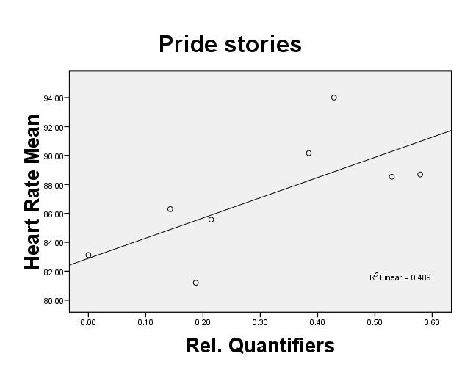
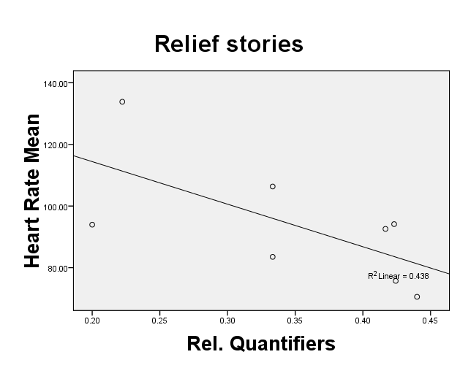
Narrative Evaluation and Physiological Measures
Strong, but reverse correlations
r_{Proud}=0.70 p<0.01 r_{Fear}=-0.66 p<0.01
SDH 2010, 19-20 October, Vienna
Notes:
SDH 2010, 19-20 October, Vienna

Slide 33
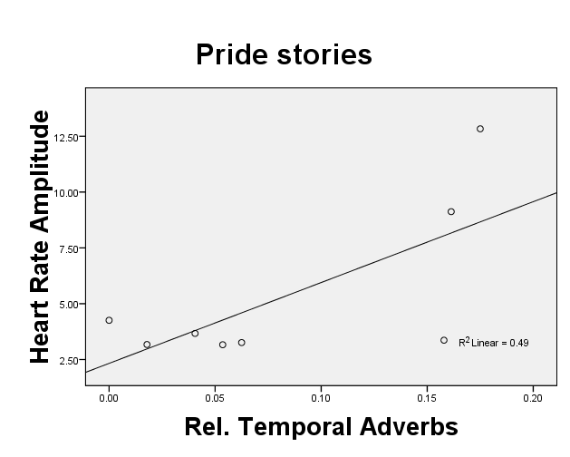
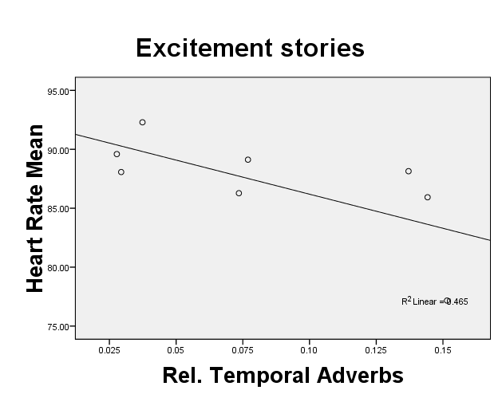
Temporal Contour and Physiological Measures
Strong, but reverse correlations
r_{Excitement}=0.70 p<0.01 r_{Fear}=-0.68 p<0.01
SDH 2010, 19-20 October, Vienna
Notes:
SDH 2010, 19-20 October, Vienna

Slide 34
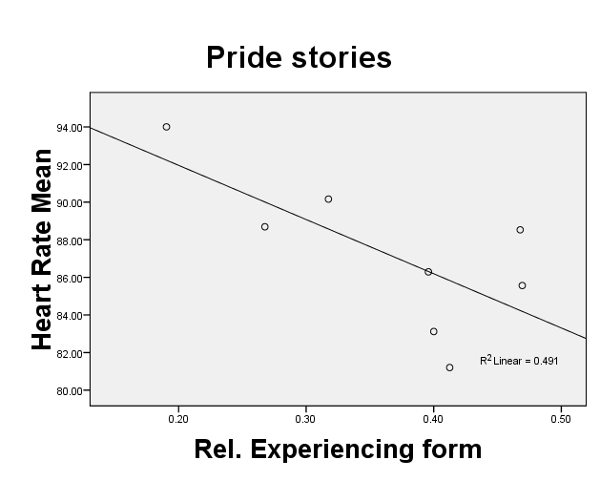
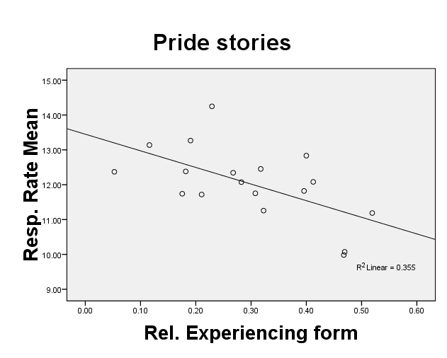
Perspective and
Physiological Measures
r=-0.70 p<0.01 r=-0.60 p<0.01
SDH 2010, 19-20 October, Vienna
Notes:
SDH 2010, 19-20 October, Vienna

Slide 35
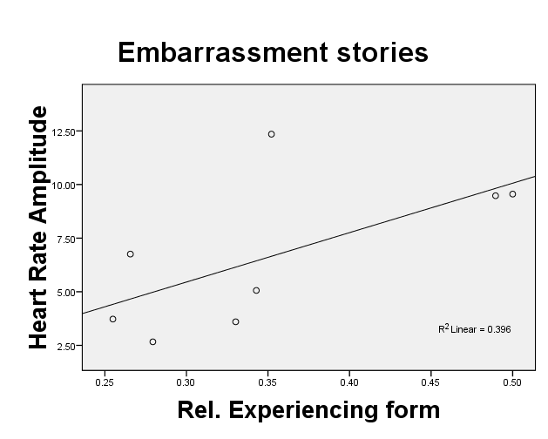
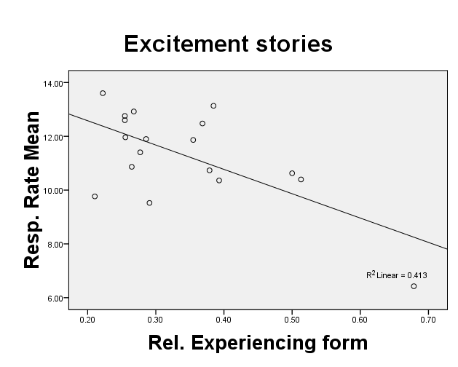
Perspective and
Physiological Measures
r=0.63 p<0.01 r=-0.64 p<0.01
SDH 2010, 19-20 October, Vienna
Notes:
SDH 2010, 19-20 October, Vienna

Slide 36
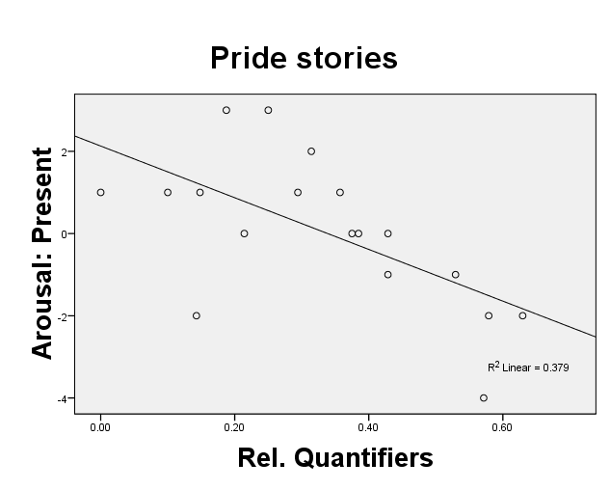
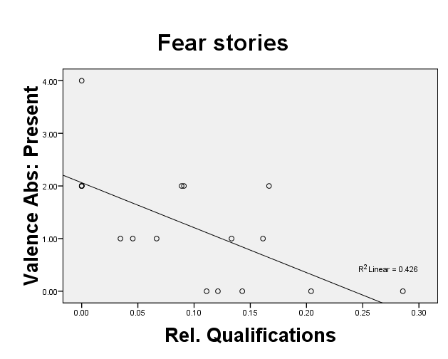
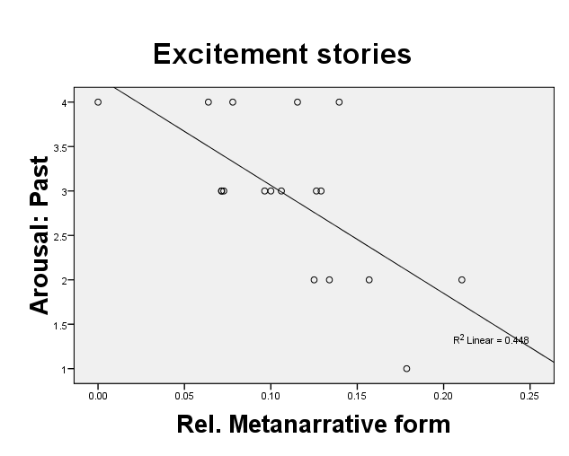
Narrative Structure and Affective Grid
Strong negative correlations
r_{Pride}=-0.62 p<0.01
r_{Fear}=-0.65 p<0.01
r_{Excitement}=-0.67 p<0.01
SDH 2010, 19-20 October, Vienna
Notes:
SDH 2010, 19-20 October, Vienna

