Slide 1


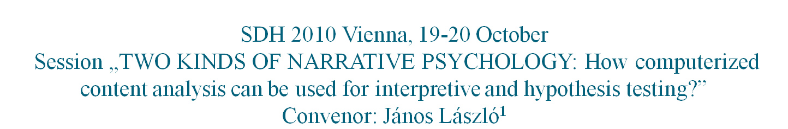

Bea Ehmann¹:
Psychological Relevance of Temporal Expressions
¹Hungarian Academy of Sciences, Institute for Psychology, Budapest

Slide 2
Three approaches to language based psychological research
Approach One: How personality states, traits and pathologies are coded in human verbal behavior?
Approach Two: How psychological health is coded in temporal structural patterns of self narratives of individuals?
Approach Three: How psychological history of small groups is coded in individual’s narratives generated in sequential temporal segments?

Slide 3
Approach One¹: How personality states, traits and pathologies are coded in human verbal behavior?
Logic of the method in general:
Hypothesis forming: Identifying the linguistic markers of the psychological construct (e.g. ‘depression’)
Sampling: Using tests for forming a test sample and a control sample for the psychological construct (e.g. ‘depressive versus non-depressive people’)
Corpus making: Generating narratives from both groups
Hypothesis testing: Measuring the statistical difference of the frequency of linguistic markers (words and expressions) between the test group and the control group.
A. If the frequency of linguistic markers of the given psychological construct differ significantly in the two groups, one can say one has found the linguistic markers of the given psychological construct.
B. In this case the given psychological construct can be measured directly from the texts, and no psychological tests are needed for diagnosis.
¹Ehmann, B., Garami, V., Naszódi, M., Kis, B., László, J. (2007): Subjective Time Experience: Identifying Psychological Correlates by Narrative Psychological Content Analysis, Empirical Text and Cultural Research 3, 2007, 14-25.

Slide 4
Example of Approach One: Subjective time experience as a personality trait
Logic of the method in particular:
1. Timeline anchorable utterances:
FIXED (now, tomorrow) >>―――X――――>>
CONTINUOUS (for four days) >>――XXXX―――>>
PERFECT (until, ever since) >>―――►|―――>>
SEQUENTIAL (then, later) >>――X―X―X―>>
2. Non-anchorable utterances: >>―――?――――>>
CONDITIONALITY (if, would have)
ETERNAL TIME (always, all the time)
NEVERTIME (never)
REPEATED (often)
UNCERTAIN (any time)

Slide 5
Example of Approach One: Subjective time experience as a personality trait
Sample and Method:
Normal stratified sample (n=90)
Corpus: various stories (loss, fear, proud, TAT stories, etc.)
Word frequency time codes (12.323 hits on 281.306 words)
One-sample t-test
Lowest and highest quartiles compared with
The EWP test, Time Factors
The Sense of Coherence Test
Big Five Questionnaire

Slide 6
Example of Approach One: Subjective time experience as a personality trait
Results:
WELL-MANAGED PEOPLE:
MORE TIME-FIXED ANCHORING AND SEQUENTIAL ADVANCE EXPRESSIONS
      (e.g. ‘at two o’clock yesterday’, ‘and then’, etc.)
POORLY MANAGED, DAY-DREAMING PEOPLE:
MORE DURATION AND EVERTIME EXPRESSIONS ( e.g. ‘all the day’, ‘always’, etc.)
DEPRESSED PEOPLE:
SLOWENED TIME PERCEPTION AND MORE DISTANT FUTURE
      (e.g. utterances referring to slow movement and rumination)
IMPULSIVE PEOPLE:
MORE REFERENCES TO START AND NEAR FUTURE
      ( e.g. ‘Let’s begin it right now!’)

Slide 7
Summary of Approach One:
The Word Frequency Method
Traditional test based approach:
„Fill in a test and I make the diagnosis”.
Language technology based approach:
„Tell me a life episode and I make the diagnosis”.

Slide 8
Approach Two: How states and changes in psychological health are coded in structural patterns of self narratives of individuals and groups?
Logic of the method:
1. Narrative psychology¹ claims that
narrative chronology is different from sequential (calendar) chronology;
The temporal structure of self-narratives is indicative of the psychological meanings of events for the speaker and her group.
2. Language based Hypothesis:
Non-traumatic stories are evolving along normal timeline
Traumatic stories involve time loops back to earlier past and forward to present
  Past perfect verb tense and third conditional sentences (‘I should have done it otherwise’) are indicators of rumination, cognitive elaboration;
  Present and future verb tense is indicator of emotional involvement in the traumatic life event.
¹János László: The Science of Stories. An Introduction into Narrative Psychology. Routledge, London and New York, 2008)

Slide 9
Approach Two¹: How states and changes in psychological health are coded in structural patterns of self narratives of individuals and groups?
Sample and Method:
Corpus: 100 traumatic self narratives collected by James W. Pennebaker, University of Texas at Austin
Text processing: Concordance lists by NooJ local grammars
Plotting the concordance list in SPSS
  Linguistic markers referring to different time planes are transformed into numerical values
      ---- simple past = 0 (Baseline)
      ---- past perfect = -1
      ---- present perfect = 1
      ---- simple present = 2, etc.
      ¹Ehmann, B., Garami, V. (2010): Narrative Psychological Content Analysis with NooJ: Linguistic Markers of Time Experience in Self-Reports. In: Váradi, T., Kuti, J., Silberztein, M. (2010): Applications of Finite-State Language Processing -- Selected Papers from the 2008 International NooJ Conference" Cambridge Scolars Publishing. p.186-196. (in press)

Slide 10
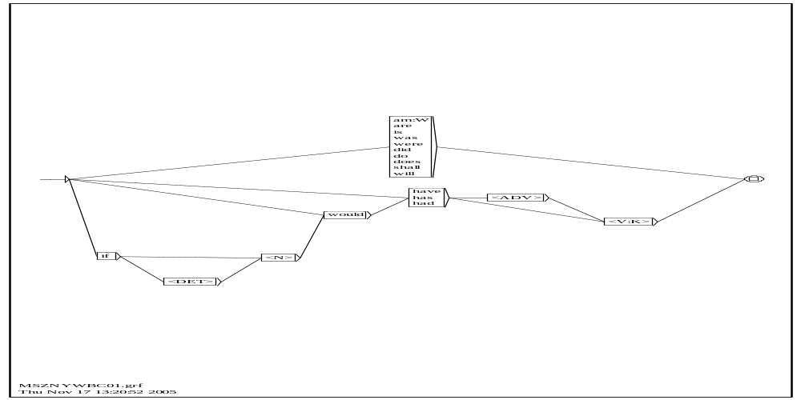
Approach Two: How states and changes in psychological health are coded in structural patterns of self narratives of individuals and groups?
Illustration 1:
User made graph (local grammar) for searching verb tenses (NooJ software¹)
¹Silberztein, 2004

Slide 11
Approach Two: How states and changes in psychological health are coded in structural patterns of self narratives of individuals and groups?
Illustration 2: A car crash story from the Pennebaker corpus:
« I was only 9 years old. I had left my home in California to go to my Uncle's house in Mount Minnesota. A neat place right on the lake. I was going there for Uncle Bills camp. Something my siblings had done and it was now my turn. A time to learn some things I did not get a chance to at home. A wonderful trip but with an experience I can describe. My cousin lived there as well and worked at the local fast food chain. Uncle Bill, Aunt Anne and myself jumped into Rosey, a 69 Dodge Dart in shining red. We got up to the restaurant and went in and saw my cousin Sally. She was working and we ordered a big dinner. Then I was a bit hungry again. As we left, Uncle Bill went back and we got an apple pie. Now we got in Rosey and headed home. About 100 yards up the four lane road we stopped to witness the very first moments of the victims of a car accident. We were there first, the only civilians helping. We pulled over and Uncle Bill jumped out with Aunt Anne. They told me to lie down in the back. I had seen the accident already. Blood was dripping out of the car door. High pitched screams of pain from the passengers side in the car. I had seen these bodies. A 4 seater 2 door hatchback with 4 people inside. The two in back were crushed into the back of the car. The ones in front were lying on the dash trying to move. They could not get out. They could not move. The car was a ball of steel. I looked up to see Uncle Bill pulling one of the front seat, I think the driver, out of the car. He was covered in blood screaming at the top of his lungs, talking about his friends in the back. I was terrified. I lay back down and grabbed the small pillow that sat in the back seat and hugged it for security. The sound of screams and cars was terrifying. I do not remember sirens. Suddenly the door opened and Uncle Bill told me he needed the pillow. I gave it to him, my last security blanket, and jumped to the seat again. I was crying, terrified, and nervous. I did not know what to do. I kept thinking that if I had not gotten the apple pie we would have seen the accident - the compression of bodies - the splattering of blood. I do not remember hearing sirens or seeing rescue people. I do not remember driving home. I just know that I sat awake for 3 nights terrified. I remember repeatedly seeing the crash behind the driver. There was glass everywhere. I remember more people somewhere and the car was white. I have seen that scene again in my mind when I am very tired. I do not know what happened to any of them. I do not want to know. »

Slide 12
Approach Two: How states and changes in psychological health are coded in structural patterns of self narratives of individuals and groups?
Illustration 3: Concordance of verb tenses in the car crash story
ed a big dinner. Then I was a bit hungry again. As we left
ms of a car accident. We were there first, the only civilian
lie down in the back. I had seen the accident already. Blo
accident already. Blood was dripping out of the car door.
friends in the back. I was terrified. I lay back down and
ound of screams and cars was terrifying. I do not remember
cars was terrifying. I do not remember sirens. Suddenly th
ed to the seat again. I was crying, terrified, and nervous.
errified, and nervous. I did not know what to do. I kept th
. I did not know what to do. I kept thinking that if I had
kept thinking that if I had not gotten the apple pie we wou
gotten the apple pie we would have seen the accident - the
splattering of blood. I do not remember hearing sirens or s
seeing rescue people. I do not remember driving home. I jus
ehind the driver. There was glass everywhere. I remember m
le somewhere and the car was white. I have seen that scene a
and the car was white. I have seen that scene again in my mi
hen I am very tired. I do not know what happened to any of
pened to any of them. I do not want to know. 1

Slide 13
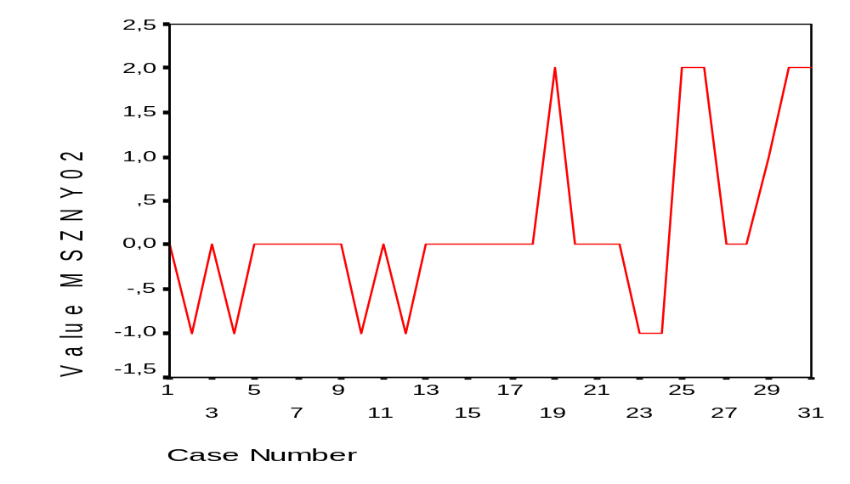
Approach Two: How states and changes in psychological health are coded in structural patterns of self narratives of individuals and groups?
Temporal structure of the car crash story
LEVELS OF CHRONOLOGY:
Simple Present/
Present Perfect
Simple Past
Past Perfect/
Past Conditional
THE ENFOLDING STORY

Slide 14
Approach Two: How states and changes in psychological health are coded in structural patterns of self narratives of individuals and groups?
Results:
A tool for psycho-therapeutical intervention:
Cognitive and emotional elaboration of traumatic life events can be mapped
False/pseudo traumas can be detected

Slide 15
Summary of Approach Two:
The Structural Method
Traditional clinical psychological expertise based approach:
„Tell me your traumatic story and I tell you to what extent it affects your psychological health now.”
Language technology based approach:
„Tell me your traumatic story and I show you an objective mirror of to what extent it affects your psychological health now”.

Slide 16
Approach Three¹: How psychological processes are coded in individuals and group narratives generated in sequential temporal segments?
General logic of the approach:
ICE Groups = Crews of ships, submarines, Arctic scientific outposts, space analog experiments, spaceships
Why monitoring?: confinement may have psychological consequences which may affect behavior and performance of the crew
The problem: Psychological tests are of limited use in the monitoring of group dynamics
The solution: Content analysis of group communication is suitable for the distant psychodynamic monitoring of the crew.
¹Ehmann, B., Balázs, L., Fülöp, É., Hargitai, R., Kabai, P., Péley, B., Pólya, T., Vargha, A, Vincze, O., & László, J. (2010): Narrative psychological content analysis as a tool for psychological status monitoring of crews in isolated, confined and extreme settings. Acta Astronautica, in press.

Slide 17
Approach Three: How psychological processes are coded in individuals and group narratives generated in sequential temporal segments?
Sample and Method:
Participants: ‘Hungaromars 2008’ - MDRS Crew 71 (Apr. 13 - Apr. 26, 2008) – 5 males and 1 female
Corpus: Personal diaries written individually during the 14 mission days
Psychological aspects monitored:
    EMOTINALITY RATING (negative/positive)
    TEAM SPIRIT RATING (I/we references)
Data processing: NooJ (modules developed by members of the Narrative Psychology Group – E. Fülöp, R. Hargitai and B. Ehmann, respectively)

Slide 18
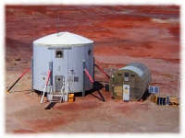
A MARS SOCIETY PROJECT: Mars Desert Research Station MDRS, Utah, USA

Slide 19
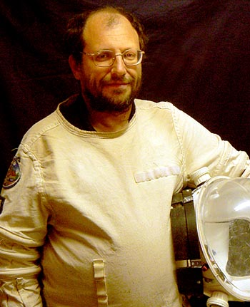
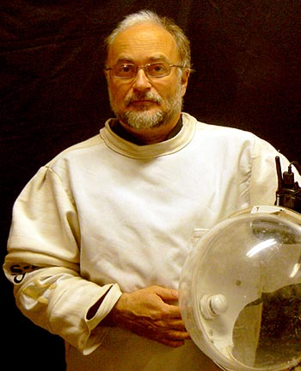

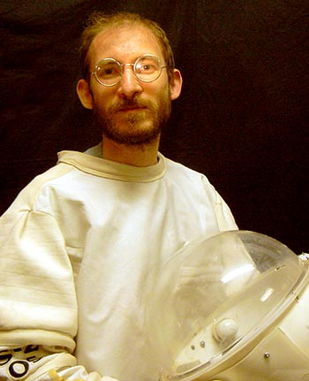
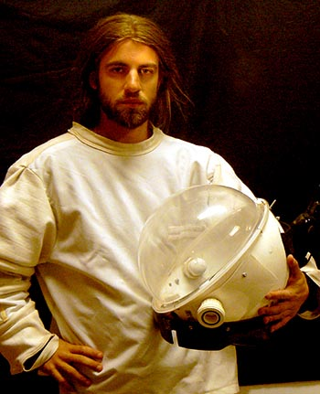
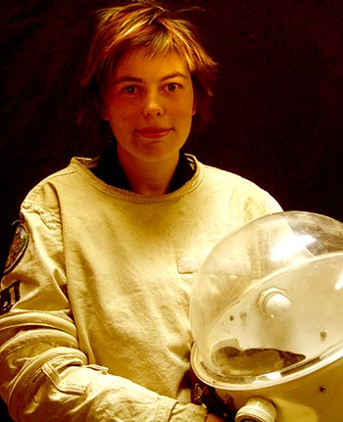
Approach Three: How psychological processes are coded in individuals and group narratives generated in sequential temporal segments?
JOURNALIST
SPACEMAN
COMMANDER
MOVIEMAN
ASTRONOMER

Slide 20
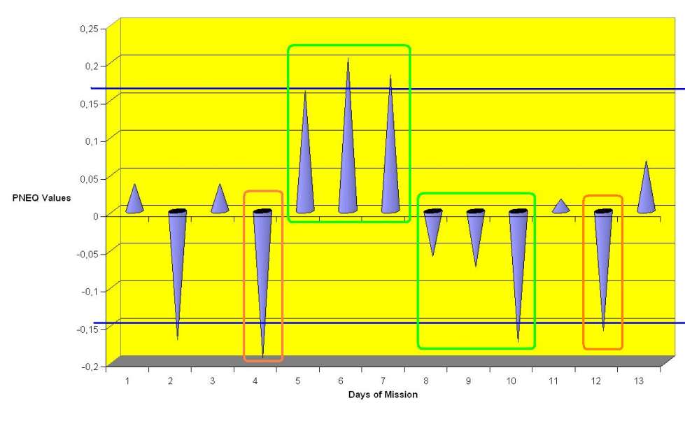
GROUP LEVEL RESULTS – I
PATTERNS OF EMOTIONALITY
Negative and positive peaks
Conflict days
Q3 Period: „Emotional disphoria” /Kanas and Manzey, 2005/

Slide 21

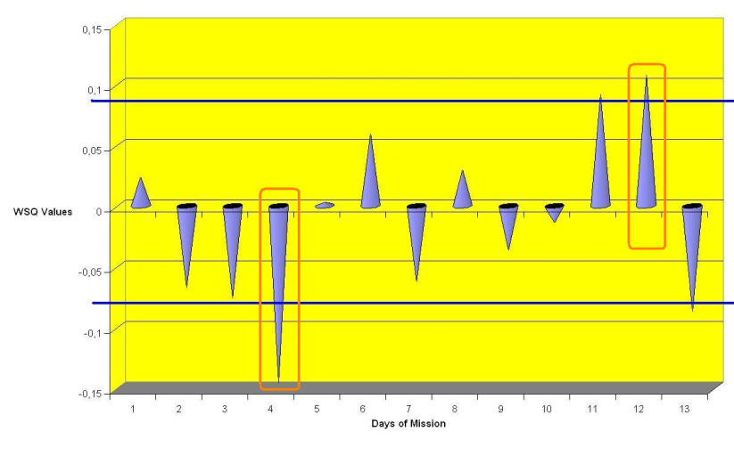
Negative and positive pikes
Conflict days

Slide 22
Summary of Approach Three:
The Time Segment Method
Traditional test based approach:
„Fill in the same psychological tests repeatedly and I show you psychologcal dynamics of your small group during mission.”
Language technology based approach:
„Give me your individual self narratives and I show you the trajectory of the psychological history of your small group during mission.”

Slide 23
Thank you for kind attention.

