Slide 1



Integrated Public Use Microdata Series
International: census microdata for research and policy
* * *
Robert McCaa Albert Esteve Palós
Minnesota Population Center Centre d’Estudis Demogràfics
“Only used statistics are useful statistics.”

Slide 2
1. IPUMS international: goals and benefits
“…best practice for a data repository of international statistical data”
--Dennis Trewin
chair UNECE task force on Statistical Confidentiality & Microdata Access

Slide 3
IPUMS-International Goals
Preserve census microdata and documentation for all the countries in the world
Integrate microdata and metadata
--a CD with source data and codebook is not sufficient
Disseminate--without cost--extracts of samples to bona-fide researchers worldwide, regardless of country of birth, citizenship or residence.
Sustained, major funding since 1999 through 2014 by:
  National Science Foundation (USA)
  National Institutes of Health (USA)
  University of Minnesota

Slide 4
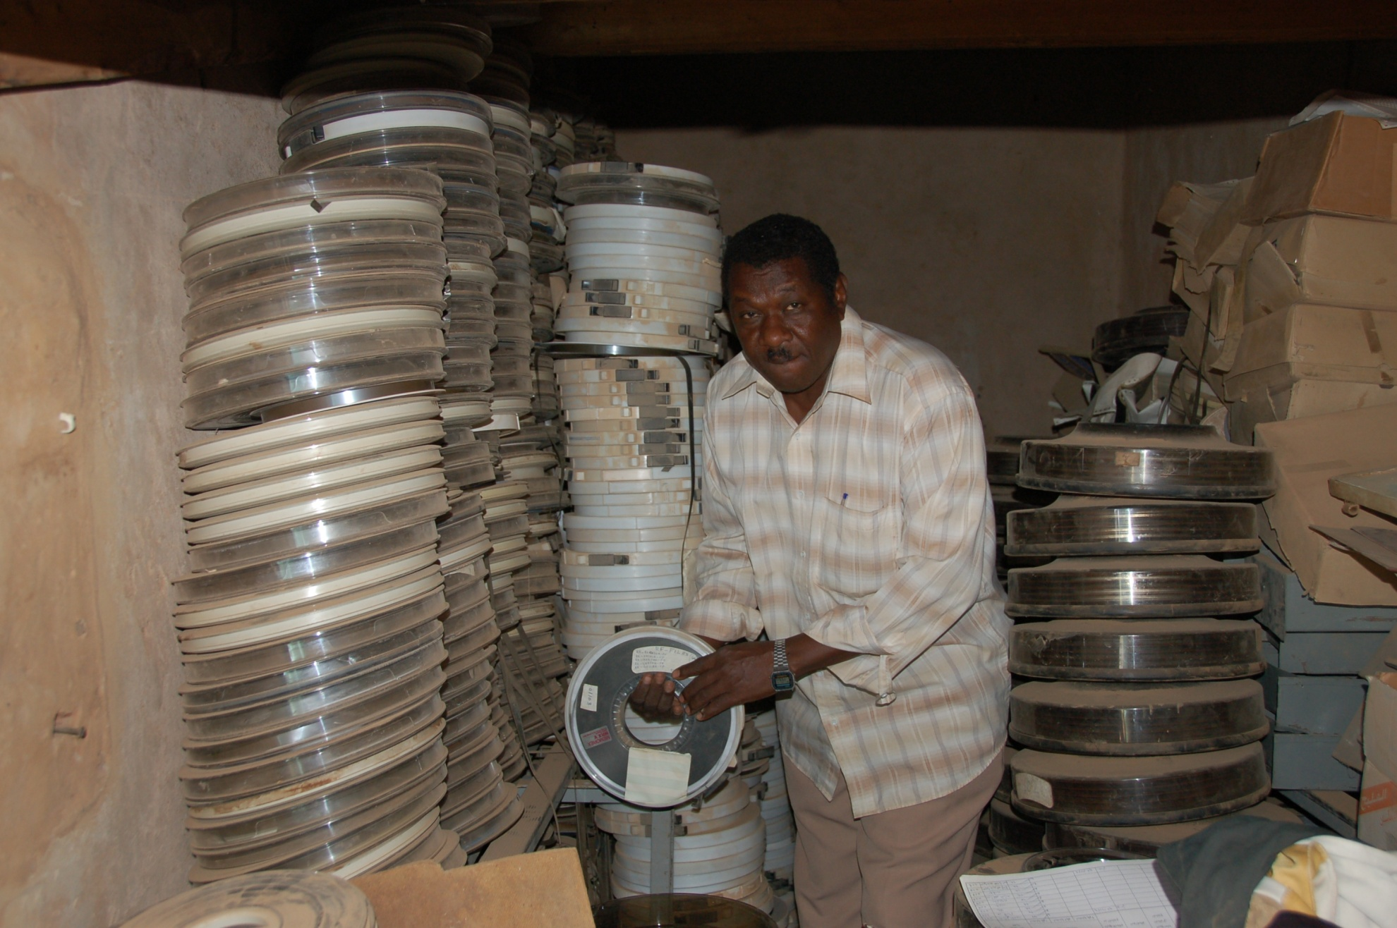
Preservation:
1973 census tapes of Sudan at risk!

Slide 5
Benefits of IPUMS-International
Preservation – IPUMS provides material and technical resources
  Recover historical census data and documentation
  Archive data and documentation to the highest international standards
Integration – IPUMS does the work
  Draw high-precision samples to uniform specifications
  Anonymize microdata to highest international standards
  Integrate samples according to national practices and international principles
Dissemination – IPUMS manages the risk
  License samples and documentation in a global initiative (US$5,000 per census of 1 million or more person records)
  Disseminate microdata with minimal risk and maximum benefit, at no cost

Slide 6
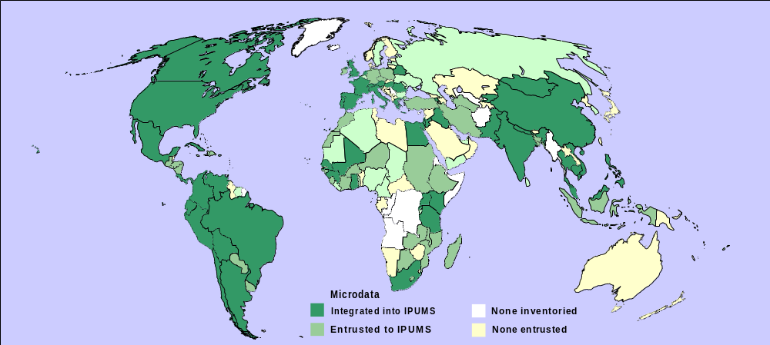
IPUMS-International
dark green = integrated and disseminating
(55 countries, 159 censuses, 325 millon person records)
green = to be integrated (35 countries, 90 censuses, 150 mill.)
IPUMS-International
2011:
Cambodia 2008
Egypt 2006
France 2006
Germany
Ireland
Nicaragua
Sierra Leone etc.
Mollweide projection

Slide 7
IPUMS-International strengths:
cooperation—national, regional, global
Uniform legal authorization with national statistical authorities
Access restricted to academics with need who agree to abide by stringent confidentiality protections. Sanctions against individual and institution—denial of access to all microdata for the entire institution
Strong technical methods of microdata anonymization
Experienced integration teams
Proven web-based access management system
High producer and user satisfaction
Sustainable: MPC, NSF, NIH

Slide 8
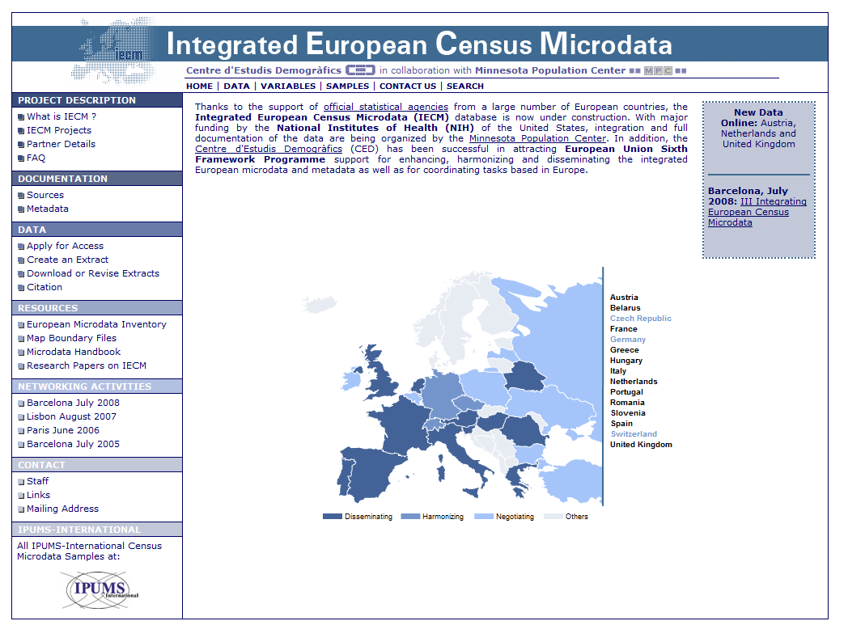
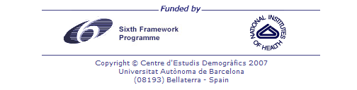
www.iecm-project.org

Slide 9

www.iecm-project.org
PROJECT OVERVIEW | COORDINATION | HARMONIZATION | DISSEMINATION
Integrated European Census Microdata
Coordination
Integration
Dissemination
Meetings:
Barcelona 2005
Paris 2006
Lisbon 2007
Barcelona 2008
Integrated Documentation
Intra-European classifications
Mirror site
Additional documentation
Data Browser /
Online Tabulator

Slide 10
2. Integrating Census Microdata and Metadata
See also:
2009: “Timely dissemination of integrated census microdata and metadata: The IPUMS-International approach.” ASSD V: “Information and communication technology in data dissemination: bridging closer producers and users during the 2010 round of Population and Housing Censuses” (19-21 November 2009, Dakar, Senegal)

Slide 11
Constructing the IPUMS-International integrated metadata and microdata system
IPUMS-International NEVER disseminates source microdata!
5 step process of integration—
2+ years to integrate metadata and microdata:
  Confirm the integrity and validity of source microdata and metadata
  Draw and anonymize high precision samples
  Integrate microdata sample (next slide)
  Integrate metadata (following slide)
  Confirm the integrity and validity of the integrated microdata sample and metadata

Slide 12
Step 3 of integration in the IPUMS system
Composite coding scheme:
    preserve every significant detail and
    harmonize every code
Example: marital status
    …
    200 = married/in union
    210 = married, formal
    211 = married, civil
    212 = married, religious
    ….
    215 = traditional or customary
    217 = polygamous
    …
    220 = married, consensual union
    …

Slide 13
Step 4: integrate metadata
Integrate metadata (XML): Document every census, sample, variable and code:
  Source documents (pdf) in official language and English
  Dynamic metadata system—compare any combination of countries and samples:
    wording of any census question and instructions to field workers
  Characteristics of each census and sample
  Describe each variable: “universe”, definition, comparability, etc.

Slide 14
3. IPUMS-International:
Dissemination
See also:
2010: "Disseminating internationally integrated census microdata for the 2010 round and beyond: the Integrated Public Use Microdata Series-International Experience.” ECE/CES/GE.41/2010/19.

Slide 15


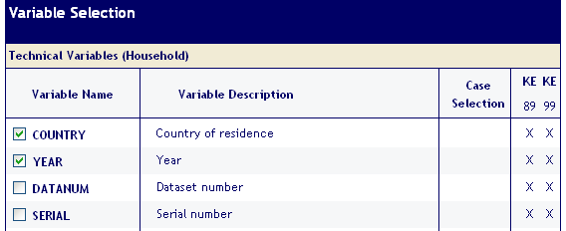



2. Using https://www.ipums.org/international:
2a. Study documentation
2b. Design extract
3. Receive email; logon with p/word
1. Logon
w/ password
(also SAS, STATA)
4. Download extract (SSL encrypted)
5. UnZip data
6. Analyze

Slide 16
Dissemination of microdata extracts via
IPUMS-International
IPUMS-International NEVER disseminates source microdata!
Usage is restricted to bona-fide researchers who agree to stringent conditions of use to protect statistical confidentiality
IPUMS disseminates extracts, custom-tailored to researchers needs
  Unlike most statistical agencies which disseminates an identical entire sample to every user

Slide 17
Dissemination of microdata and metadata extracts
The massive scale of IPUMS requires users to be selective:
  Select country (or countries)
  Select samples (census years)
  Select variables (e.g., age, sex, educational attainment, etc.)
  Select sub-populations (e.g., nurses)
  Select sample density
Once an extract request is submitted, the IPUMS extract engine:
  Constructs the microdata extract
  Constructs the metadata
  Emails the researcher to retrieve the extract
  password protected, transmission is encrypted 128 bit SSL
The researcher downloads the extract, un-zips and analyzes
Extract system validated as usage has soared

Slide 18
4. IPUMS-International
Usage statistics
See card hand-out for list of current samples and usage statistics

Slide 19
59,170 extracts—586,643 variables—dissemination jumped 10% in June, with the 2010 launch
IPUMS-International NEVER disseminates source microdata!
4 IPUMS constructed variables ranked in the top 30
    Spouse’s location in household
    Mother’s location in household
    Father’s location in household
    Spouse rule for inferring location in household
These variables are constructed from household samples
  3 countries with person samples are invited to construct household samples:
    Canada
    Netherlands
    UK

Slide 20
Who Uses the Microdata (1,264 undertakings, 2007)
Affiliation
  University professors and students: 91%
  Others: 9%
    International agencies (World Bank, DFID, etc.): n=31
    International research institutes: n=26
    United Nations (ILO, WHO, etc.): n=21
    National Statistical Officials: n=18
    National government officials: n=18
    Employees of Non-Governmental Organizations: n =3

Slide 21
Who Uses the Microdata (1,264 undertakings, 2007)
Disciplines
  Economics: 44%
  Demography: 13%
  Sociology: 12%
  Public policy: 5%
  History: 4%
  Others: 22% (32 disciplines)

Slide 22
Research Topics—extraordinarily diverse
Economists:
  Comparative study of labor force participation
  Demand and supply of public services (water, electricity, sewage, etc.)
  Economic impact of family planning and fertility decline
  Discrimination in credit markets
  Econometric analysis of labor force and income
  Effect of long-term youth unemployment
  Effects of volume of human capital on returns to education
  Human capital and aging
  Impact of trade policies on growth, development, immigration, labor markets, and inequality
  Etc.

Slide 23
Table 2. Usage statistics: Sample Rank and Details
Table 2. Extract Rank and Sample Details for the Top Five and all European Countries
Rank | Country | Sample %* | Variables (n)* | Years of census samples | Extracts
1 | Mexico | 10 | 120 | 1960p, 70, 90, 95, 2000, 05 | 7,637
2 | Brazil | 5 | 106 | 1960, 70, 80, 91, 2000 | 5,191
3 | United States | 5 | 92 | 1960, 70, 80, 90, 2000, 05 | 4,559
4 | Colombia | 10 | 120 | 1964p, 72, 85, 93, 2005 | 3,428
5 | France | 5 | 99 | 1962, 68, 75, 82, 90, 99 | 2,795
10 | Canada | 2.5 | 59 | 1971p, 81p, 91p, 2001p | 1,614
12 | Spain | 5 | 99 | 1981, 91, 2001 | 1,514
13 | Greece | 10 | 89 | 1971, 81, 91, 2001 | 1,496
19 | Hungary | 5 | 74 | 1970, 80, 90, 2001 | 1,132
21 | Austria | 10 | 75 | 1971, 81, 91, 2001 | 1,087
22 | Portugal | 5 | 96 | 1981, 91, 2001 | 1,028
23 | Romania | 10 | 97 | 1976, 92, 2002 | 1,012
23 | Austria | 10 | 75 | 1971, 81, 91, 2001 | 1,087
29 | UK | 3 | 47 | 1991, 2001p | 657
30 | Netherlands | 1 | 33 | 1960p, 71p, 2001p | 570
32 | Belarus | 10 | 84 | 1999 | 333
38 | Italy | 5 | 81 | 2001 | 209
43 | Slovenia | 10 | 80 | 2002 | 133
Total extracts from the IPUMS-International database for 55 countries (158 samples) Jun 4, 2010 |  |  |  |  | 59,170
*2000 round census; refers to all integrated variables, including IPUMS constructed variables. “p” = person sample; all other samples are of households

Slide 24
Table 3. 32 most popular variables
Table 3. Thirty-two most popular variables in IPUMS-International
 | Label | Extracts | Mnemonic | Comment
1 | Educational attainment | 19,307 | EDATTAN
2 | Age (single years to 85+) | 19,009 | AGE | Grouped age n=3,838
3 | Employment status | 18,490 | EMPSTAT
4 | Marital status | 18,214 | MARST
5 | Person weight | 17,511 | WTPER | Technical variable
6 | Relationship to head | 15,783 | RELATE
7 | Sex | 14,595 | SEX
8 | Class of work | 12,583 | CLASSWK
9 | Ownership of dwelling | 8,050 | OWNRSHP
10 | Occupation ISCO recode | 8,004 | OCCISCO
11 | School attendance | 7,919 | SCHOOL
12 | Years of schooling | 7,576 | YRSCHL
13 | Literate | 7,290 | LIT
14 | Urban/rural | 7,098 | URBAN
15 | Industry-general code | 7,044 | INDGEN
16 | Household weight | 6,656 | WTHH | Technical variable
17 | Children ever born | 6,363 | CHBORN
18 | Nativity (native/foreign born) | 6,332 | NATIVTY
19 | Occupation | 6,246 | OCC

Slide 25
Table 3. 32 most popular variables (cont.)
Table 3. Thirty-two most popular variables in IPUMS-International
 | Label | Extracts | Mnemonic | Comment
1 | Educational attainment | 19,307 | EDATTAN
19 | Occupation | 6,246 | OCC
20 | Country of birth | 6,153 | BPLCTRY
21 | Religion | 6,075 | RELIG
22 | Industry | 5,670 | IND
23 | Location of spouse in household | 5,007 | SPLOC | Constructed (household)
24 | Rule for locating spouse | 4,171 | SPRULE | Constructed (household)
25 | Location of mother in household | 4,153 | MOMLOC | Constructed (household)
26 | Number of children surviving | 4,074 | CHSURV
27 | Place of residence 5 years ago | 4,064 | MGRATE5
28 | Location of father in household | 3,983 | POPLOC | Constructed (household)
29 | Total household income | 3,965 | INCTOT | Household variable
30 | Earned income | 3,655 | INCEARN
31 | Number of rooms | 3,465 | ROOMS
32 | Consensual union | 3,443 | CONSENS

Slide 26
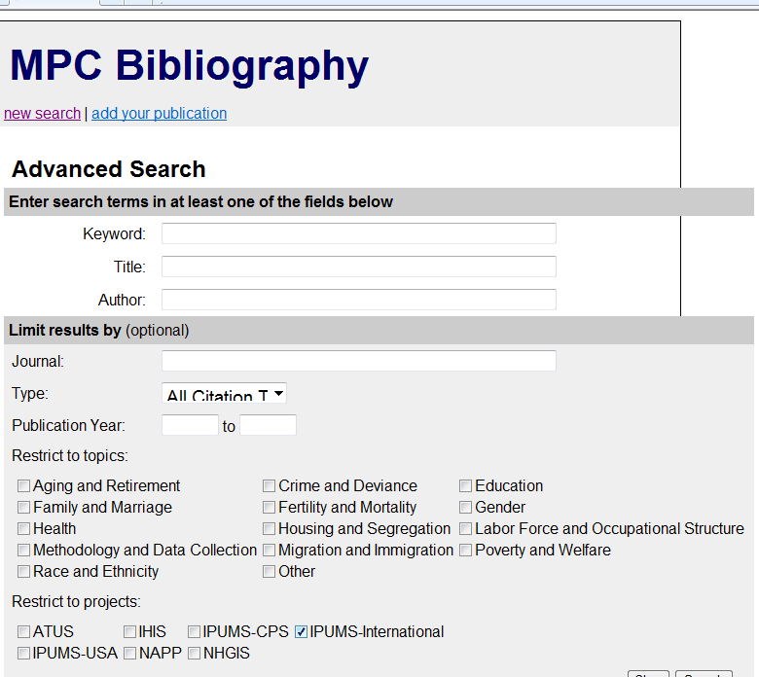
For uses, see http://bibliography.ipums.org

Slide 27
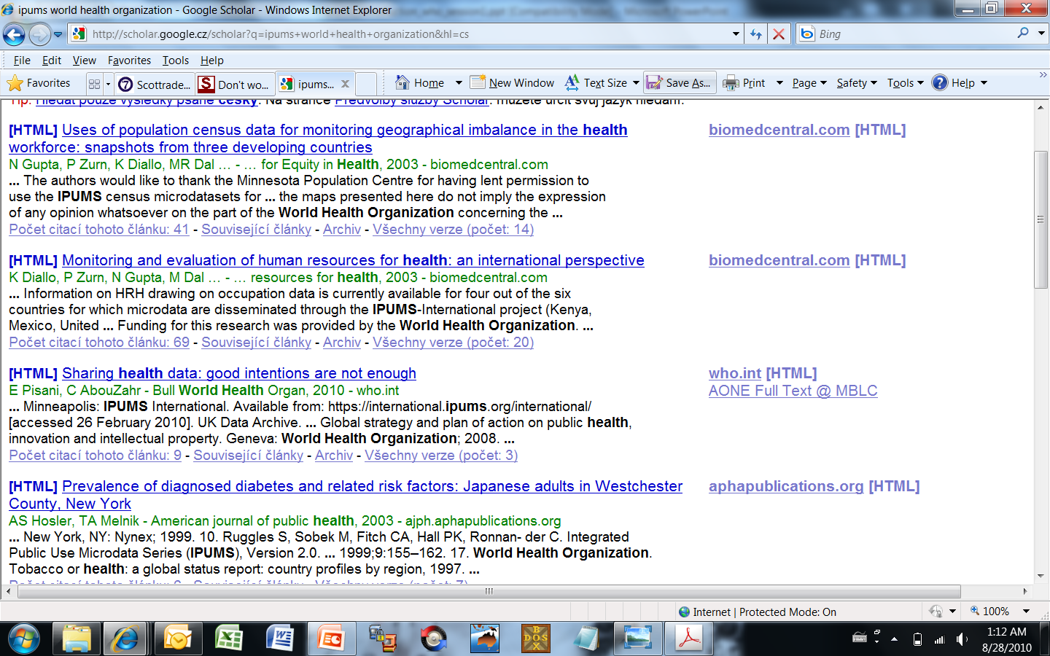
Better: scholar.google.com
IPUMS & key-word: subject, name of country, etc.

Slide 28
Conclusion: Invitation to continued cooperation
In 1999, our dream: integrate samples of 21 countries in 10 years
  Thanks to generous cooperation of 55 National Statistical Offices
  Undreamed technological innovations
By 2009, integrated samples for 44 countries
  Number of users and usage far exceeded expectations
For the 2010 decade, our dream:
  Double (2x) the number of integrated samples
  Triple (3x) the number of users
  Quadruple (4x) research output from census microdata

Slide 29
Thank you
aesteve@ced.uab.es rmccaa@ced.uab.es
www.ipums.org/international

