Slide 1
LOW POWER HIGH SPEED DYNAMIC COMPARATOR
GROUP MEMBERS:
AJINKYA SURESHRAO KAUTIKWAR 18MVD0061
SUBURAAJ R 18MVD0072
ANNAMALAI S 18MVD0083

Slide 2
AIM
To design a low power High Speed Dynamic Comparator when compared to existing dynamic comparator.

Slide 3
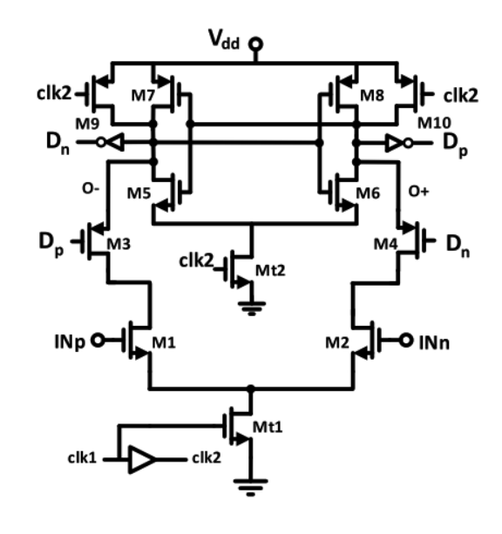
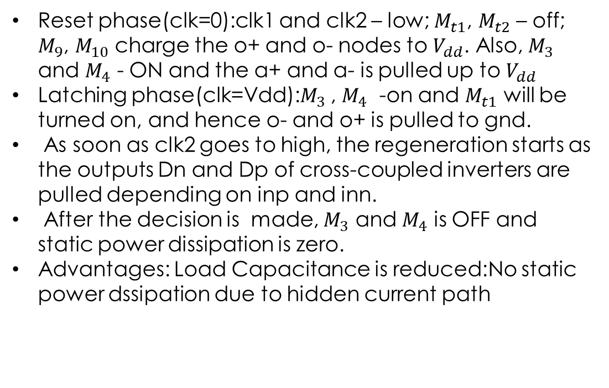
EXISTING DYNAMIC COMPARATOR
Reset phase(clk=0):clk1 and clk2 – low; $M_{t1}$, $M_{t2}$ – off; $M_{9}$, $M_{10}$ charge the o+ and o- nodes to $V_{dd}$. Also, $M_{3}$ and $M_{4}$ - ON and the a+ and a- is pulled up to $V_{dd}$
Latching phase(clk=Vdd):$M_{3}$ , $M_{4}$ -on and $M_{t1}$ will be turned on, and hence o- and o+ is pulled to gnd.
As soon as clk2 goes to high, the regeneration starts as the outputs Dn and Dp of cross-coupled inverters are pulled depending on inp and inn.
After the decision is made, $M_{3}$ and $M_{4}$ is OFF and static power dissipation is zero.
Advantages: Load Capacitance is reduced:No static power dssipation due to hidden current path
a+
a-

Slide 4
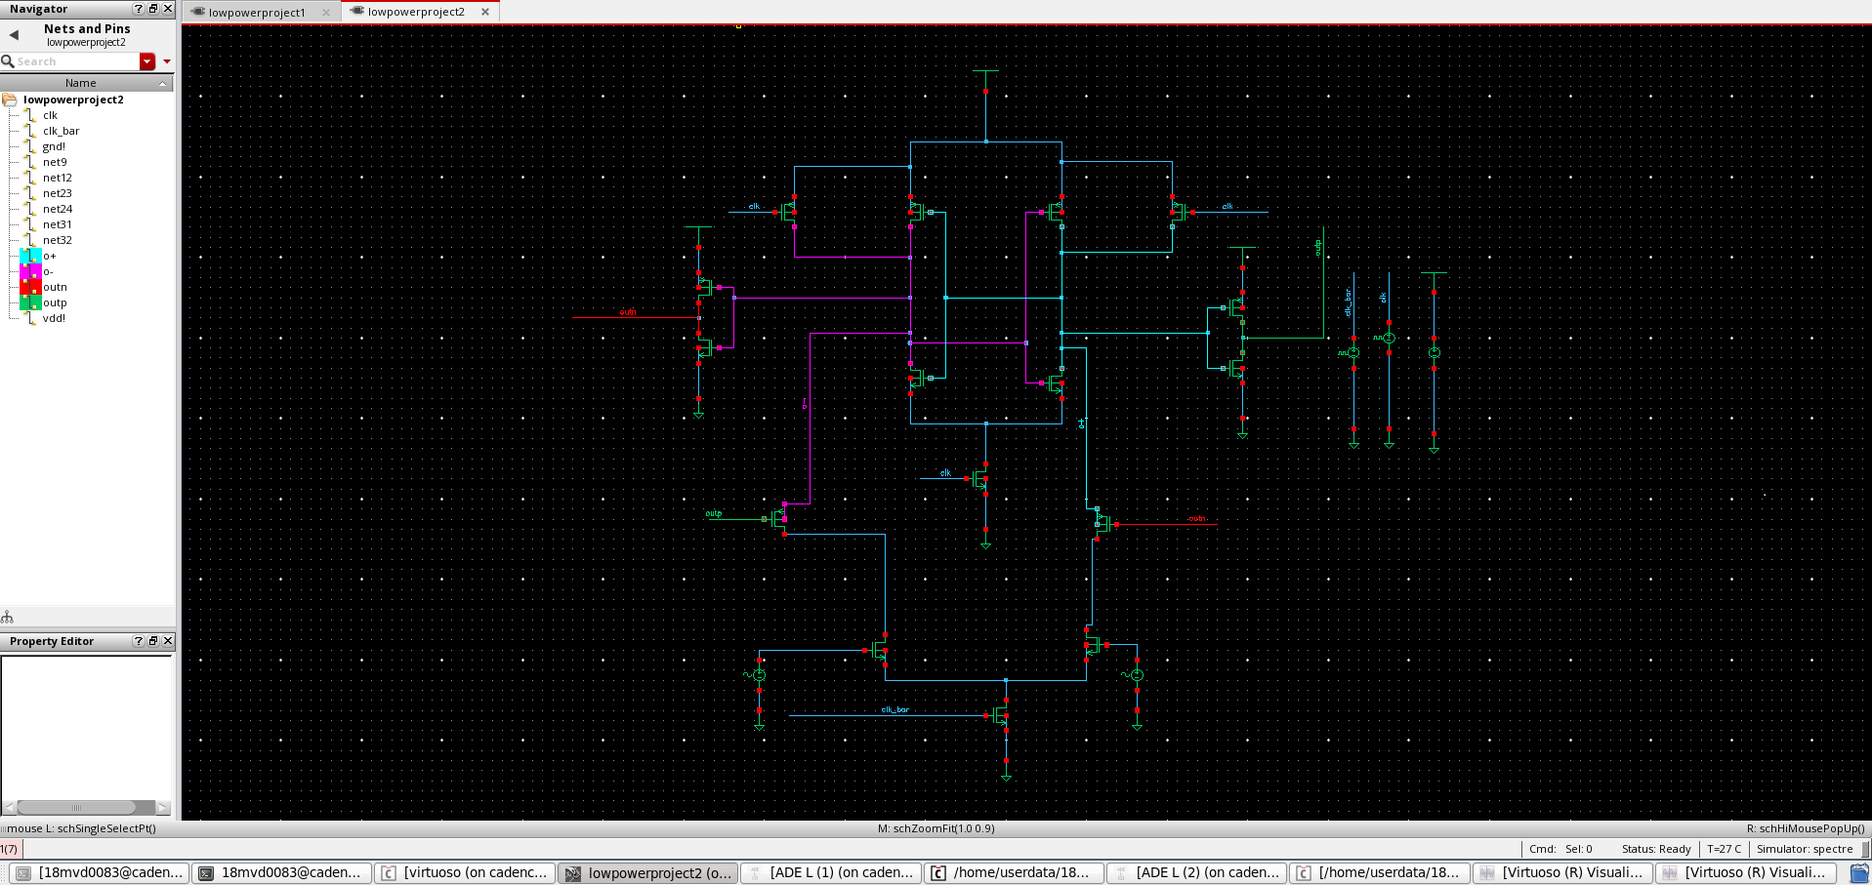
IMPLEMENTATION OF EXISTING DYNAMIC COMPARATOR

Slide 5
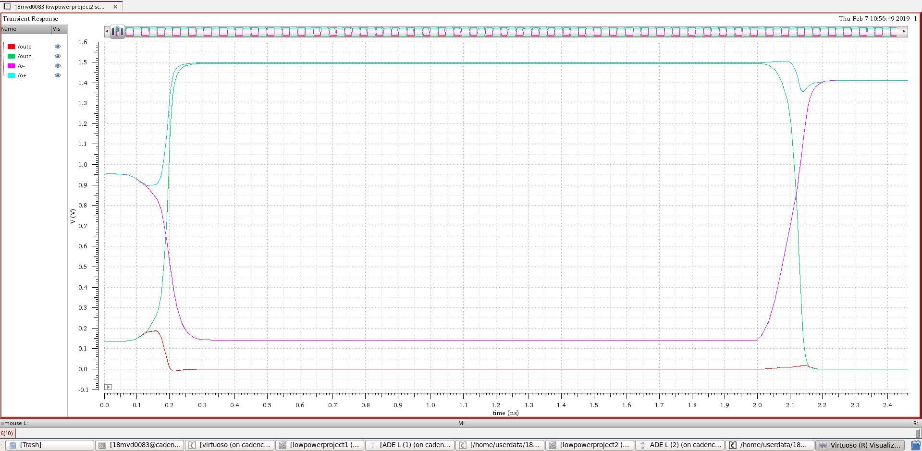
FUNCTIONAL VERIFICATION OF EXISTING DYNAMIC COMPARATOR

Slide 6
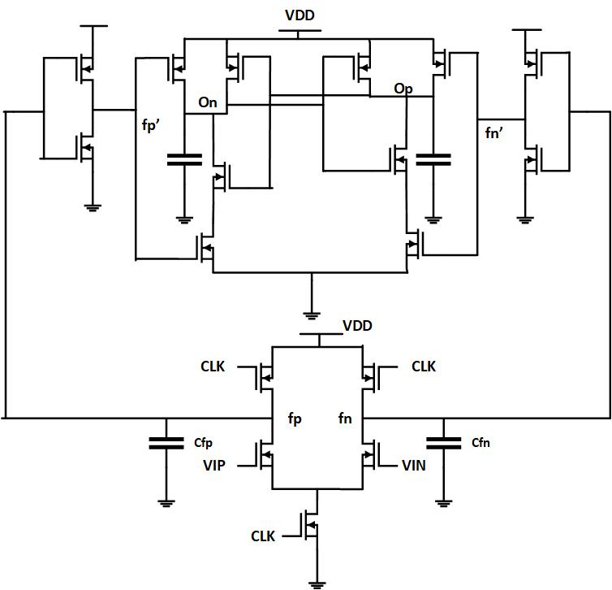
MODIFIED LOW POWER HIGH SPEED DYNAMIC COMPARATOR
During precharge or Reset phase(CLK = 0), M5-OFF and hence no static power dissipation due to absence of current flow from Vdd to gnd.
M1,M2-ON and hence Vfn and Vfp is pulled to Vdd, and hence the output of both inverters Vfp’ and Vfn’ becomes zero.
Hence M10,M11 is ON and output nodes are pre-charged to Vdd.
During comparison or decision making phase(CLK=Vdd), M1,M2-OFF and M5-ON and hence the pre-charged Capacitor voltage Cfp and Cfn are discharged from Vdd to ground.
Discharge rates depend upon the input voltages applied VIP and VIN.
When VIP >VIN ,VOP becomes logic ‘1’ and VON becomes logic ‘0’.

Slide 7
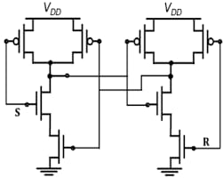
ADVANTAGES OF NAND LATCH
If the inputs s’ and r’ of nand latch circuit are kept at logic 1 then the output will have no change/transition. Therefore, power consumption will reduce.
Only one clock pulse is enough to complete both reset and latching phase, which reduces delay and saves power.

Slide 8
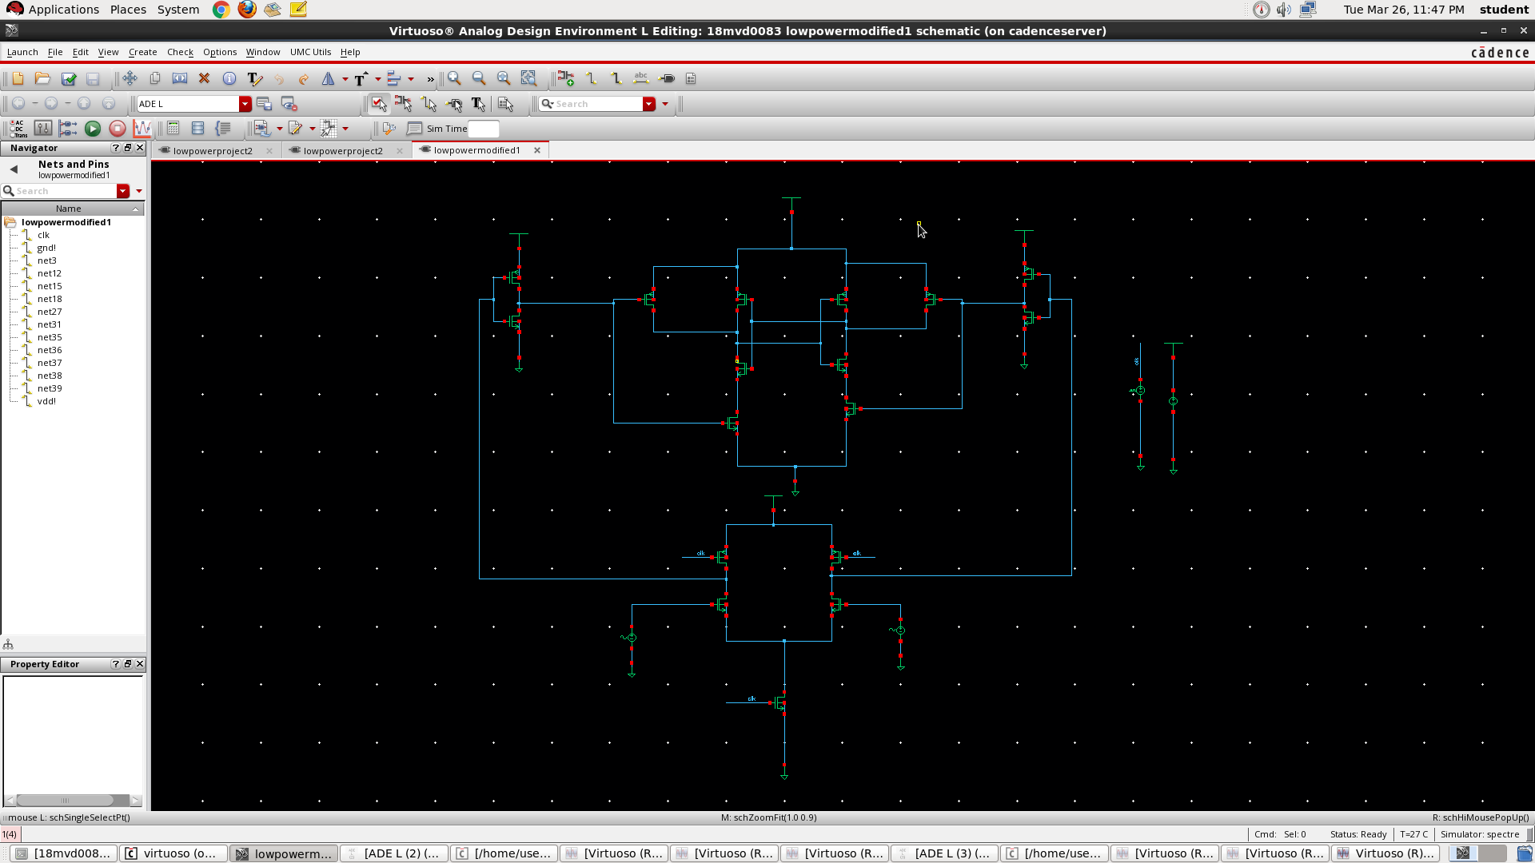
IMPLEMENTATION OF MODIFIED LOW POWER HIGH SPEED COMPARATOR

Slide 9
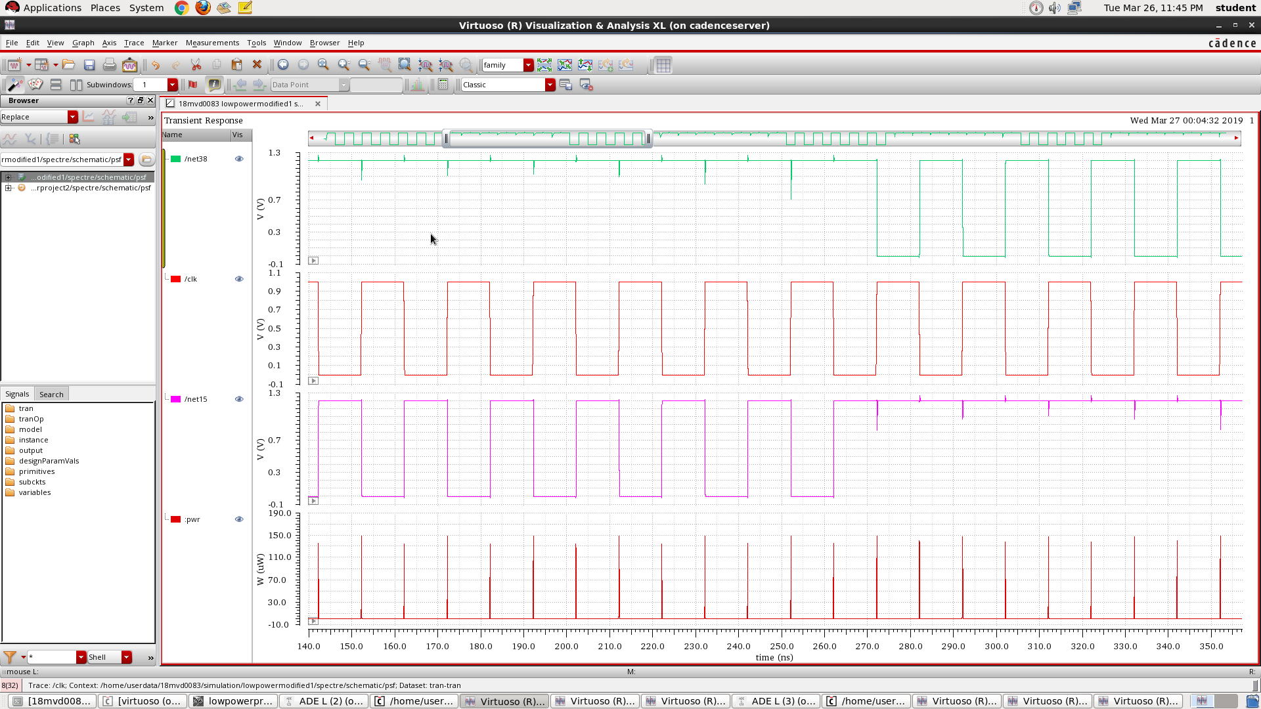
FUNCTIONAL VERIFICATION OF MODIFIED LOW POWER HIGH SPEED COMPARATOR

Slide 10
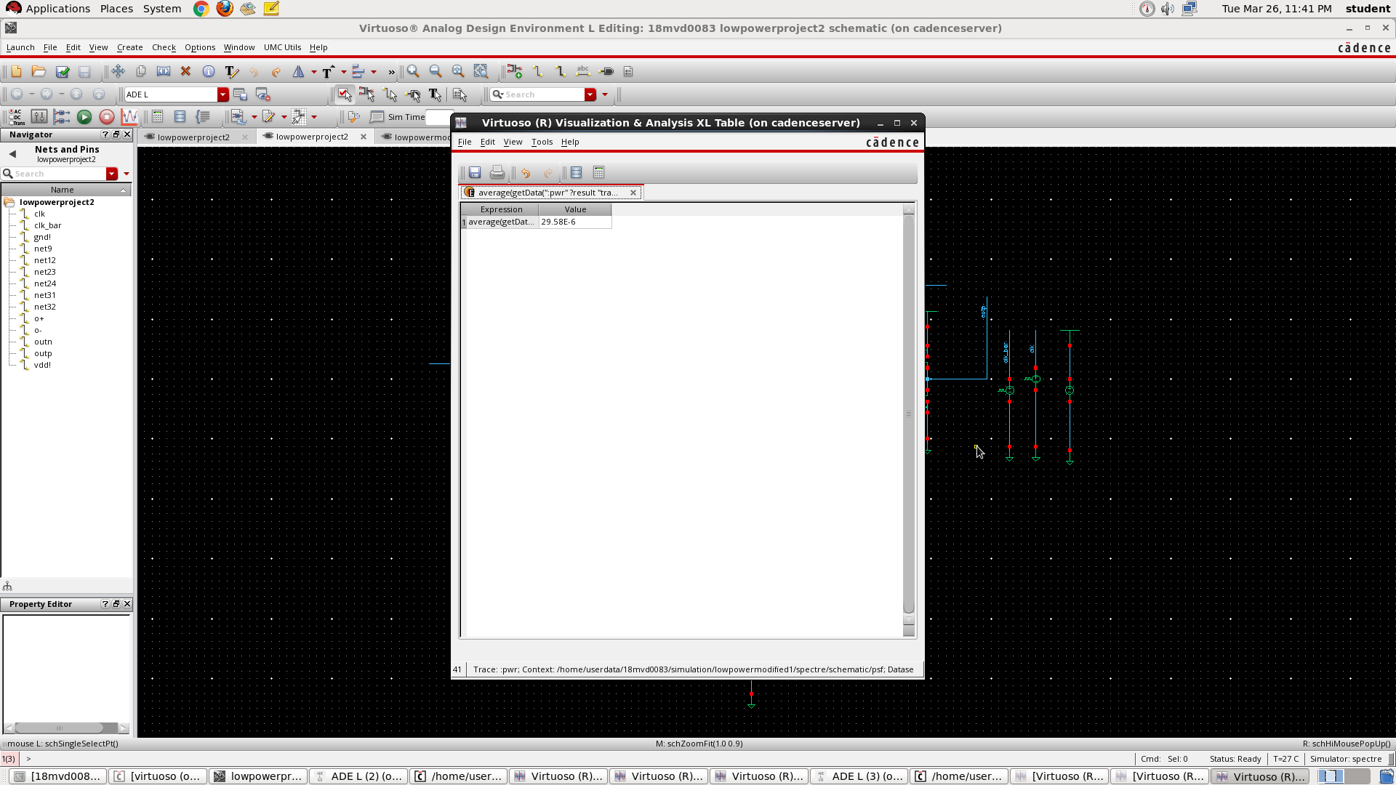
RESULTS
AVERAGE DYNAMIC POWER OF EXISTING DYNAMIC COMPARATOR=29.58uW

Slide 11
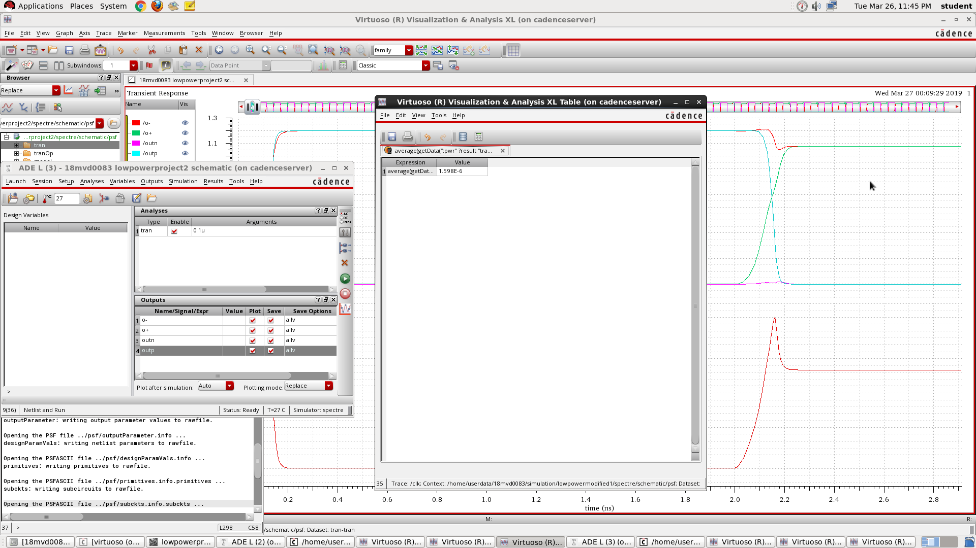
AVERAGE DYNAMIC POWER OF MODIFIED ULTRA LOW POWER HIGH SPEED DYNAMIC COMPARATOR = 1.598uW

