Slide 1

Genomic Sequence Query and Analysis Program
Emily Taylor
SAT4650 Fall 2024

Slide 2
Goal/Application
Make genomic sequence data query, storage, and organization simple and easy
Application in genetics/genomics research, Genome-Wide Association Studies
Good introductory bioinformatics project

Slide 3
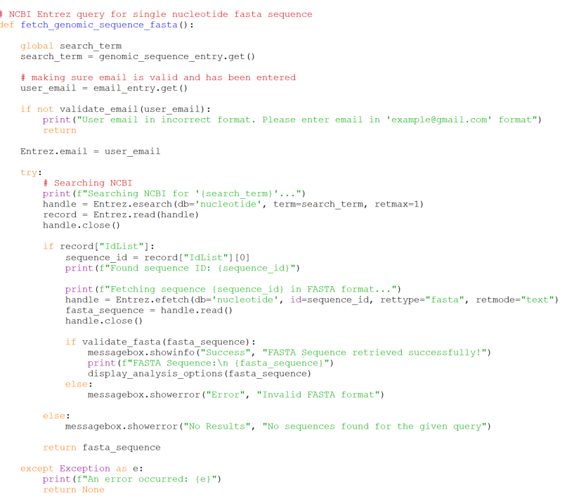
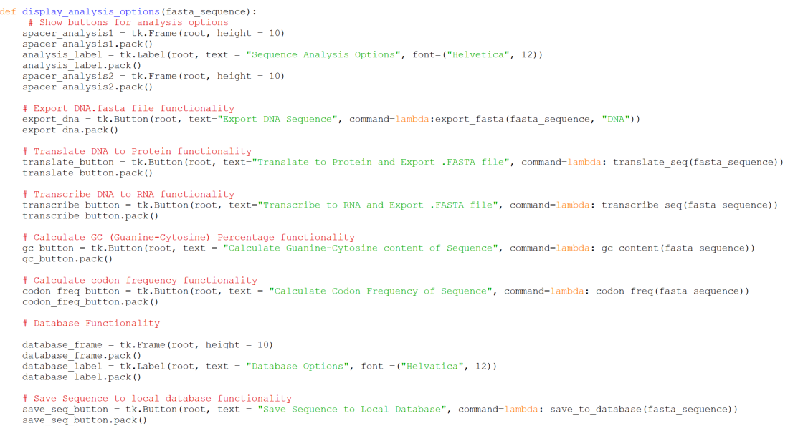
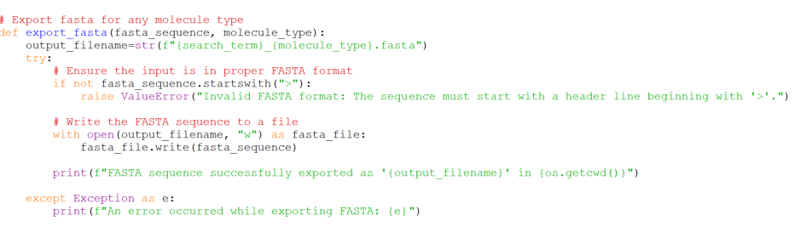
Main Functions
Fetching Genomic Sequences from NCBI
Displaying Analysis Options in tkinter GUI
Exporting .fasta files

Slide 4
List of all program functionalities
User-friendly GUI
Query DNA sequence from NCBI online database
Convert DNA sequence to RNA or Protein
Calculate guanine-cytosine percentage of a DNA sequence
Calculate codon frequencies of an RNA sequence
Save a sequence and metadata to a local database
Export sequence and metadata in zip file
Contains DNA , RNA, Protein sequences in .fasta format and metadata report

Slide 5
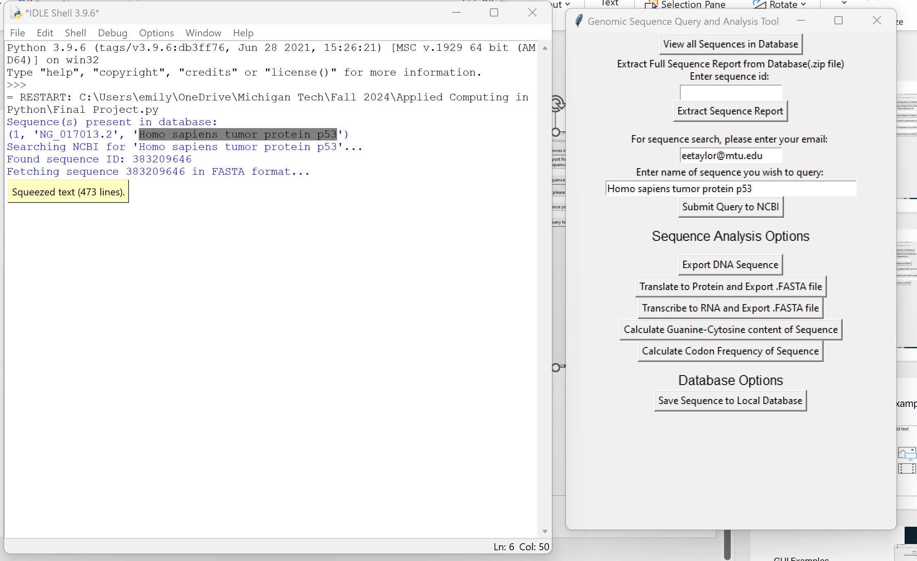
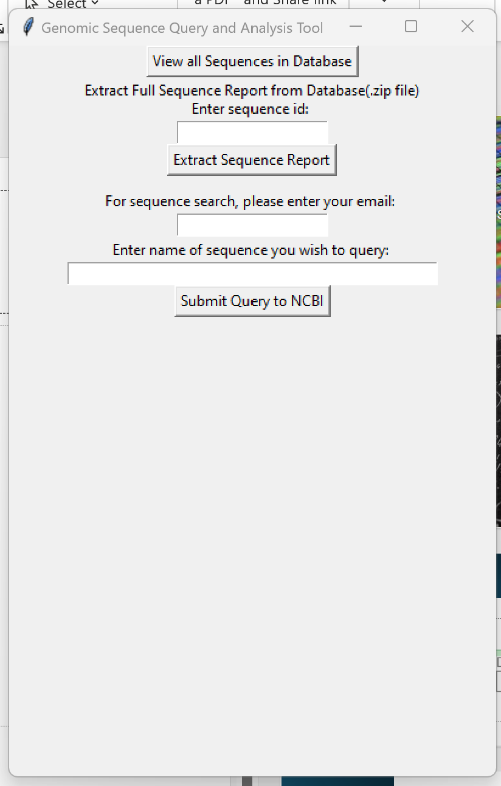
GUI Examples
Analysis Options for query sequence
Initial GUI Appearance

Slide 6
Thank you! Questions?
Demo: actin beta gene sequence
Purpose of gene: involved in maintaining cell structure and motility

