Slide 1

Semantics derived automatically from language corpora contain human-like biases
by Aylin Caliskan, Joanna J. Bryson, and Arvind Narayanan
Science
Volume 356(6334):183-186
April 14, 2017
Published by AAAS

Slide 2
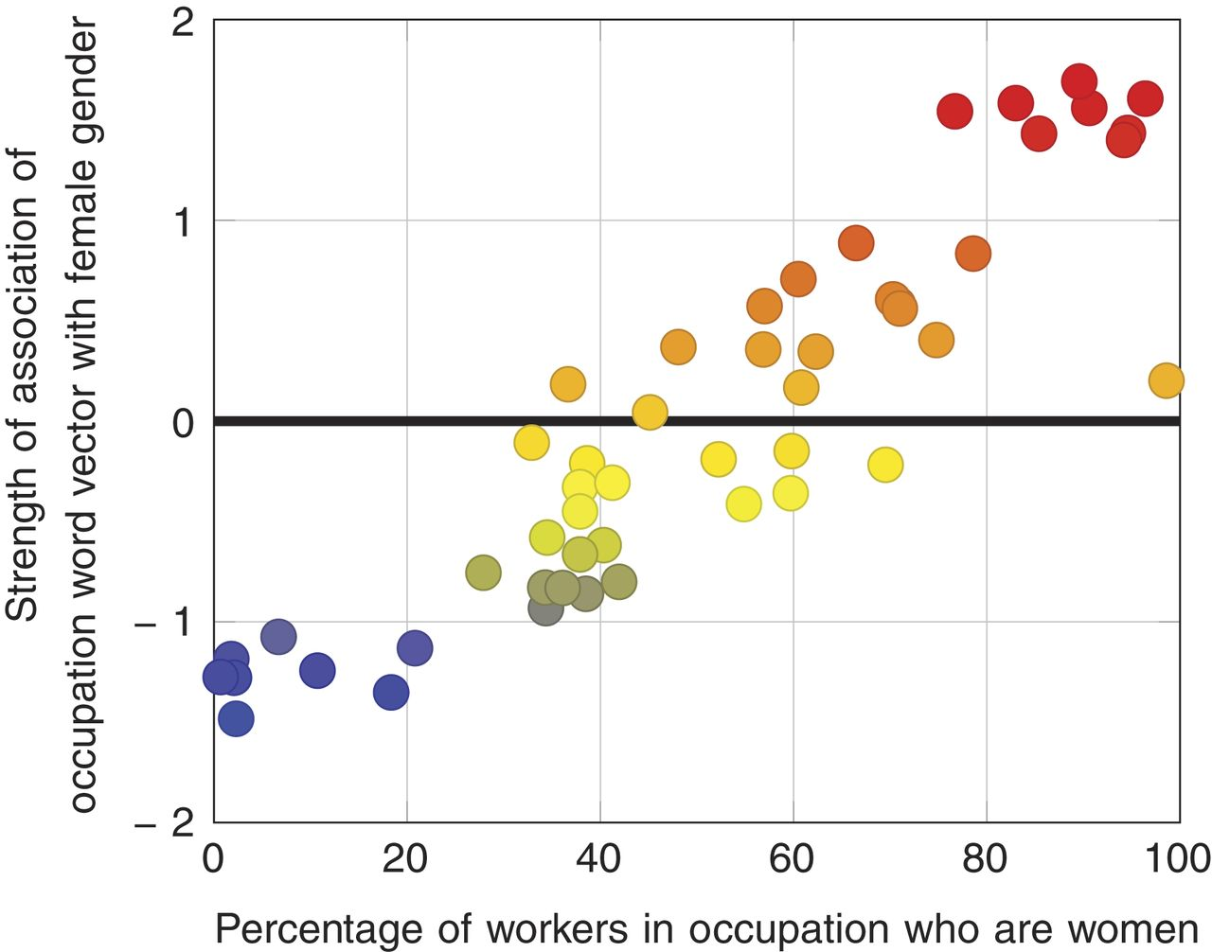
Fig. 1 Occupation-gender association.
Aylin Caliskan et al. Science 2017;356:183-186
Published by AAAS
Notes:
Occupation-gender association. Pearson’s correlation coefficient ρ = 0.90 with P < 10⁻¹⁸.

Slide 3
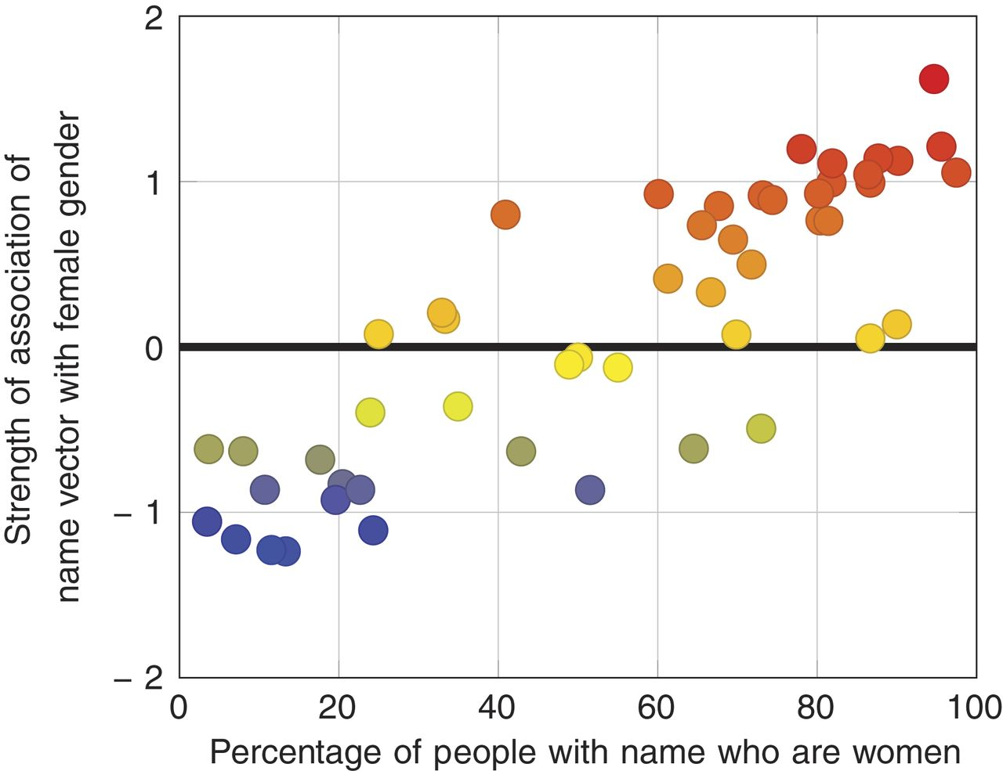
Fig. 2 Name-gender association.
Aylin Caliskan et al. Science 2017;356:183-186
Published by AAAS
Notes:
Name-gender association. Pearson’s correlation coefficient ρ = 0.84 with P < 10⁻¹³.

