Slide 1

October Cybersecurity Awareness Month
Artificial Intelligence Topics

Slide 2

Cybersecurity Awareness Month
Cybersecurity Awareness Month is a collaboration between government and private industry to raise awareness about digital security and empower everyone to protect their personal data from digital forms of crime.
Cybersecurity Awareness Month 2023 will focuses on four key
Enabling multi-factor authentication
Using strong passwords and a password manager
Updating software
Recognizing and reporting phishing
More 2023 October Cybersecurity Awareness Month Information
https://www.cisa.gov/cybersecurity-awareness-month​
​

Slide 3
Add AI Topics for Security Awareness !
Deep Fakes
Disinformation
Data Collection
Protecting Connected Mental Health
This work is licensed under a Creative Commons Attribution 4.0 International License https://creativecommons.org/licenses/by-sa/3.0/

Slide 4
Use the information provided in these slides to include important AI Security Awareness Topics for October Cybersecurity Awareness Month
!
This work is licensed under a Creative Commons Attribution 4.0 International License https://creativecommons.org/licenses/by-sa/3.0/

Slide 5
Deep Fakes
Deep Fakes also called synthetic content or synthetic media refers to a broad range of generated or manipulated data which includes images, videos, audio, or text, created using artificial intelligence.
Deep Fakes can depict the alteration or impersonation of a person's identity to make it appear as if they are doing or saying things they did not do or say.
GenAI Changed the Game
Recent technology advancements have improved the quality, customizability, and accessibility of artificial intelligence (AI)-enabled content creation. This content is used for blackmail, bullying, extortion, or fake kidnapping scams.
This work is licensed under a Creative Commons Attribution 4.0 International License https://creativecommons.org/licenses/by-sa/3.0/

Slide 6
Deep Fake Recommendations
TALK to all family members about Deep Fakes and advances in Generative Artificial Intelligence & how malicious actors use them to deceive people & for illicit purposes
Create a Secret Code to protect against fake phone audio or video calls. Be prepared with a secret code word every family member knows, but that criminals won’t guess
Monitor children's online activity & discuss risks associated with sharing personal content
Research privacy, data sharing, & data retention policies of social media platforms, apps, and websites before uploading & sharing images, videos, or other personal content
Use the privacy settings on social media account, including setting profiles & your friends lists to private
Secure social media & other online accounts using complex passwords or passphrases & multi-factor authentication
Think & exercise caution when posting or direct messaging personal photos, videos, & identifying information on social media, dating apps, & other online sites
Be aware hacked social media accounts can easily be manipulated by malicious actors to gain trust from friends or contacts to further criminal schemes or activity
https://www.ic3.gov/Media/Y2023/PSA230605#fna
This work is licensed under a Creative Commons Attribution 4.0 International License https://creativecommons.org/licenses/by-sa/3.0/

Slide 7
Deep Fake Victim Resources
If you or a family member are you are the victim
FBI Retain all information regarding the incident (e.g., usernames, email addresses, websites or names of platforms used for communication, photos, videos, etc.) and immediately report. FBI Internet Crime Complaint Center www.ic3.gov 1-800-225-5324
Stop Non-Consensual Intimate Image Abuse An original normal photo is manipulated to create a nude photo, submit the original photo and edited photo. https://stopncii.org
The National Center for Missing and Exploited Children https://takeitdown.ncmec.org www.cybertipline.org
This work is licensed under a Creative Commons Attribution 4.0 International License https://creativecommons.org/licenses/by-sa/3.0/

Slide 8
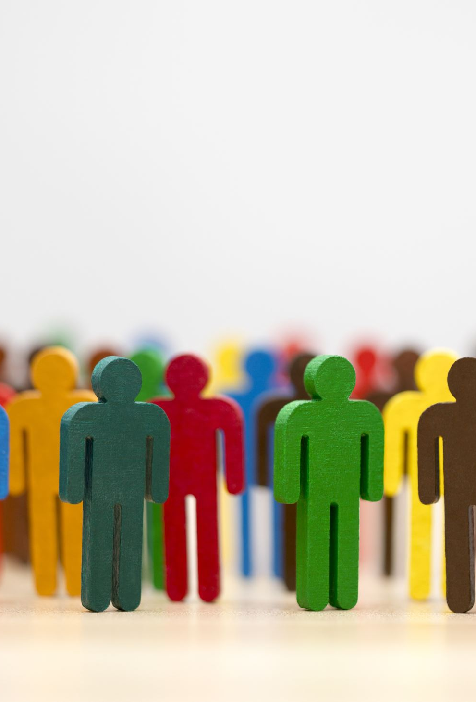
Misinformation & Disinformation
https://library.csuchico.edu/sites/default/files/craap-test.pdf
Large Language Models are notorious for providing answers which appear to be real but are “hallucinations”, false, or inaccurate information.
Fake news is not new, but it’s easier than ever to create, post, and spread!
DON'T TRUST INFORMATION FROM A CHATBOT
DON'T TRUST INFORMATION FROM THE INTERNET
This work is licensed under a Creative Commons Attribution 4.0 International License https://creativecommons.org/licenses/by-sa/3.0/
Notes:
https://guides.library.duke.edu/c.php?g=1297624&p=9531612
This test was first created by Molly Beestrum and ​Kenneth Orenic at Dominican University as "CRAP," a team of librarians at Meriam Library, CSU then developed the test into CRAAP The original worksheet is linked here Evaluating Information -- Applying the CRAAP Test;)

Slide 9

Recommendations Misinformation & Disinformation
Currency: The timeliness of the information
Relevance: The importance of the information to you
Authority: The source of the information
Accuracy: The reliability, truthfulness and correctness of the content
Purpose: The reason the information exists
Pause, think, question, and use the C.R.A.A.P Test to evaluate internet information
More on the C.R.A.A.P Test Information Method Here https://library.csuchico.edu/sites/default/files/craap-test.pdf
This work is licensed under a Creative Commons Attribution 4.0 International License https://creativecommons.org/licenses/by-sa/3.0/
Notes:
https://guides.library.duke.edu/c.php?g=1297624&p=9531612
This test was first created by Molly Beestrum and ​Kenneth Orenic at Dominican University as "CRAP," a team of librarians at Meriam Library, CSU then developed the test into CRAAP The original worksheet is linked here Evaluating Information -- Applying the CRAAP Test;)

Slide 10

Data Collection
AI privacy is important to ensure that AI systems are not used to manipulate individuals or discriminate against them based on their personal data.
01
Data collection, privacy, and misuse are an existing challenge with many states and regulation addressing how data can be collected and used.
02
Now is a great time to think about what you are sharing and where!
03
This work is licensed under a Creative Commons Attribution 4.0 International License https://creativecommons.org/licenses/by-sa/3.0/

Slide 11
Data Collection Recommendations
Check your Browser Privacy Settings (check your phone and internet connected TV too)
Block ads and trackers with browser extension like uBlock Origin blocks ads and the data they collect. Combine uBlock with Privacy Badger, which blocks trackers
Reconsider free apps and platforms. Social media platforms are free because they sell your data.
Review website cookie notices and practice good cookie housekeeping.
Practice caution and protect your primary email address and phone number.
https://consumer.ftc.gov/articles/how-websites-and-apps-collect-and-use-your-information#how

Slide 12
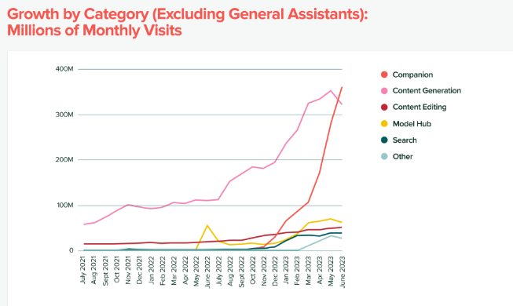
Protecting Connected Mental Health
AI Companions are one of the fastest growing GenAI categories
The lifelike nature of generated characters makes distinguishing between real and fake information challenging.
Virtual characters could potentially be exploited by cyber criminals
DANGER !
Source: andreessen horowitz
https://consumer.ftc.gov/articles/how-websites-and-apps-collect-and-use-your-information#how
Notes:
https://cybernews.com/tech/ai-companions-explained/
https://www.context.news/ai/my-perfect-girlfriend-are-ai-partners-a-threat-to-womens-rights

Slide 13
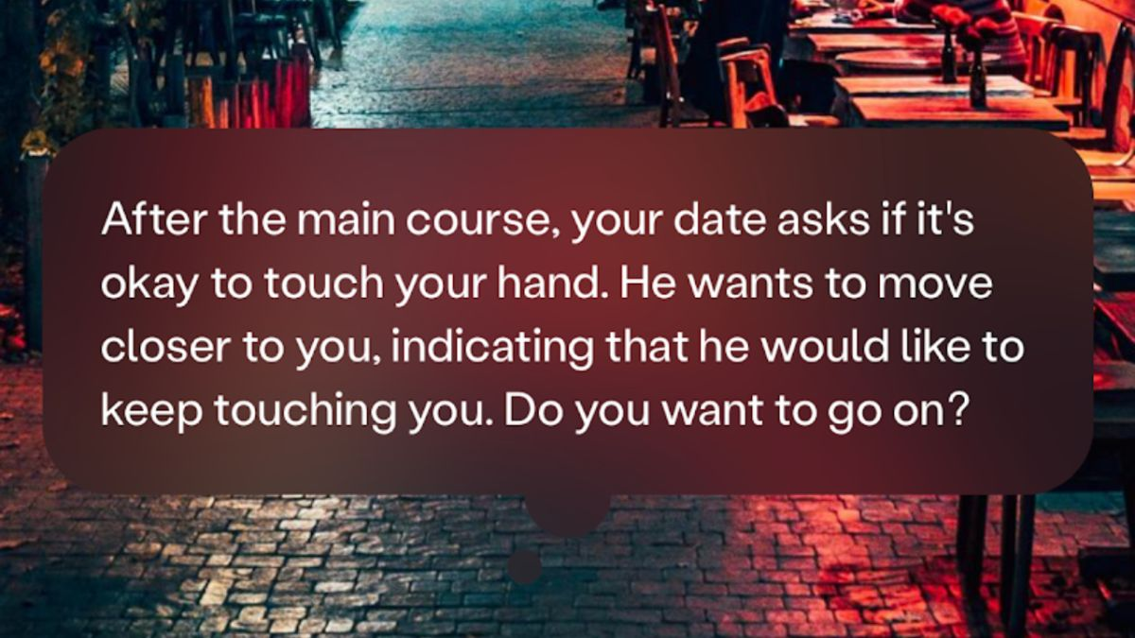
Blush an AI Dating Simulation
:https//techcrunch.com/2023/06/07/blush-ai-dating-sim-replika-sexbot/?tpcc=tcpluslinkedin
Notes:
Blush is an example of an AI Companion Dating Simulation Application which has the potential to be misused and have harmful effects.

Slide 14
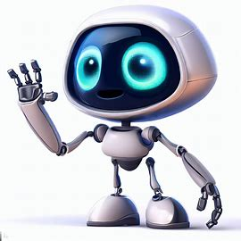
The Eliza Effect
The Eliza Effect describes the human tendency to attribute human characteristics to non-human entities, (anthropomorphizing) machines, computers, & things. The effect is named for ELIZA a chatbot developed in 1966 at MIT by computer scientist Joseph Weizenbaum
Falsely attributing human thought processes and emotions to AI
Believing that the AI is more intelligent than it is, capable of complex reasoning and problem-solving
Forming emotional connections with the AI
Assuming that the AI's outputs reflects an emotional intelligence or connection
Projecting human traits onto the AI. Someone interacting with a chatbot may unconsciously assume an AI's behavior is similar to human behavior
Eliza Effect Warning Flags
https://consumer.ftc.gov/articles/how-websites-and-apps-collect-and-use-your-information#how
Notes:
https://modelthinkers.com/mental-model/eliza-effect
https://www.humanprotocol.org/blog/what-is-the-eliza-effect-or-the-art-of-falling-in-love-with-an-ai

Slide 15

Internet Mental Recommendations
Seek professional help for mental issues
Don’t ignore the dangers because a chatbot assistant conversations seem harmless or cute. REMEMBER a chatbot is created by a corporate entity which has an agenda.
STAY informed on popular apps such as character.AI, Replika, Pygmalion AI, & Chai and be aware of the potential for misuse
KNOW the symptoms of mental duress which include anxiety, depression, & withdrawing
Aware of the ELIZA Effect & set boundaries.
Watch! AI Companions may compound existing mental health challenges
https://consumer.ftc.gov/articles/how-websites-and-apps-collect-and-use-your-information#how
Notes:
https://www.apa.org/topics/social-media-internet/health-advisory-adolescent-social-media-use
https://etactics.com/blog/negative-effects-of-technology-on-mental-health
https://www.commonsensemedia.org/sites/default/files/featured-content/final-ai-and-our-kids-final-for-web.pdf
https://www.goodrx.com/health-topic/mental-health/what-is-digital-overload

Slide 16
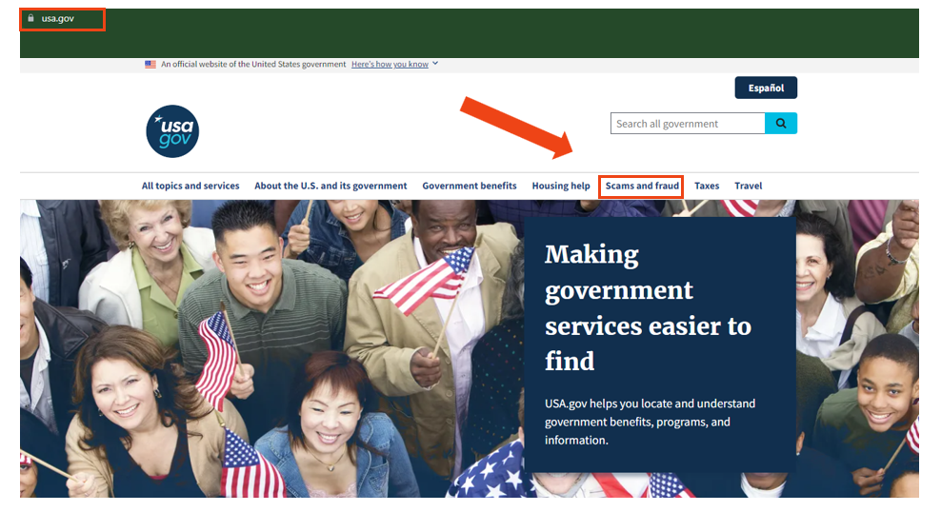
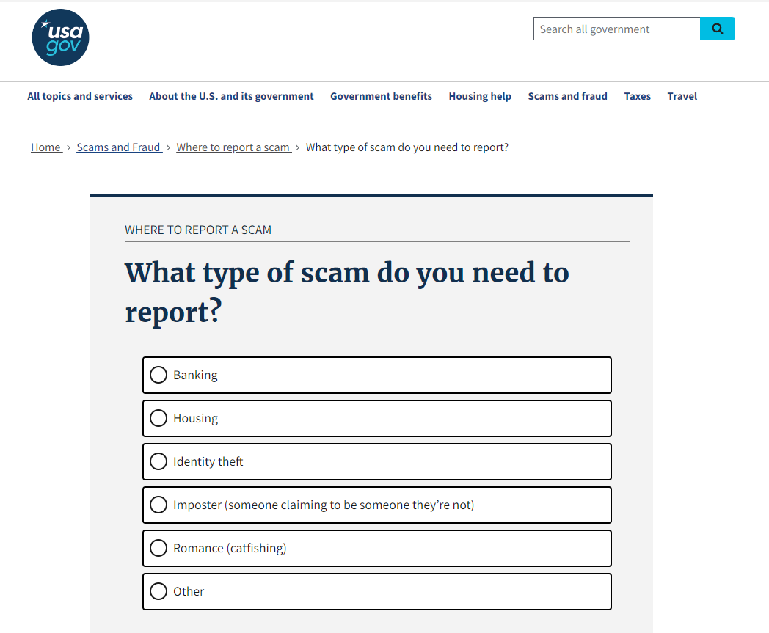
Report Scams USA.gov
https://consumer.ftc.gov/articles/how-websites-and-apps-collect-and-use-your-information#how
Notes:
If you or a loved one have been a victim of a scam, go to USA.gov, click on the Scams and Fraud link which will ask questions about the type of scam, where to report it, and next steps to protect you or a loved one.

Slide 17
https://quarkiq.com
This work is licensed under a Creative Commons Attribution 4.0 International License
https://consumer.ftc.gov/articles/how-websites-and-apps-collect-and-use-your-information#how

