Slide 1


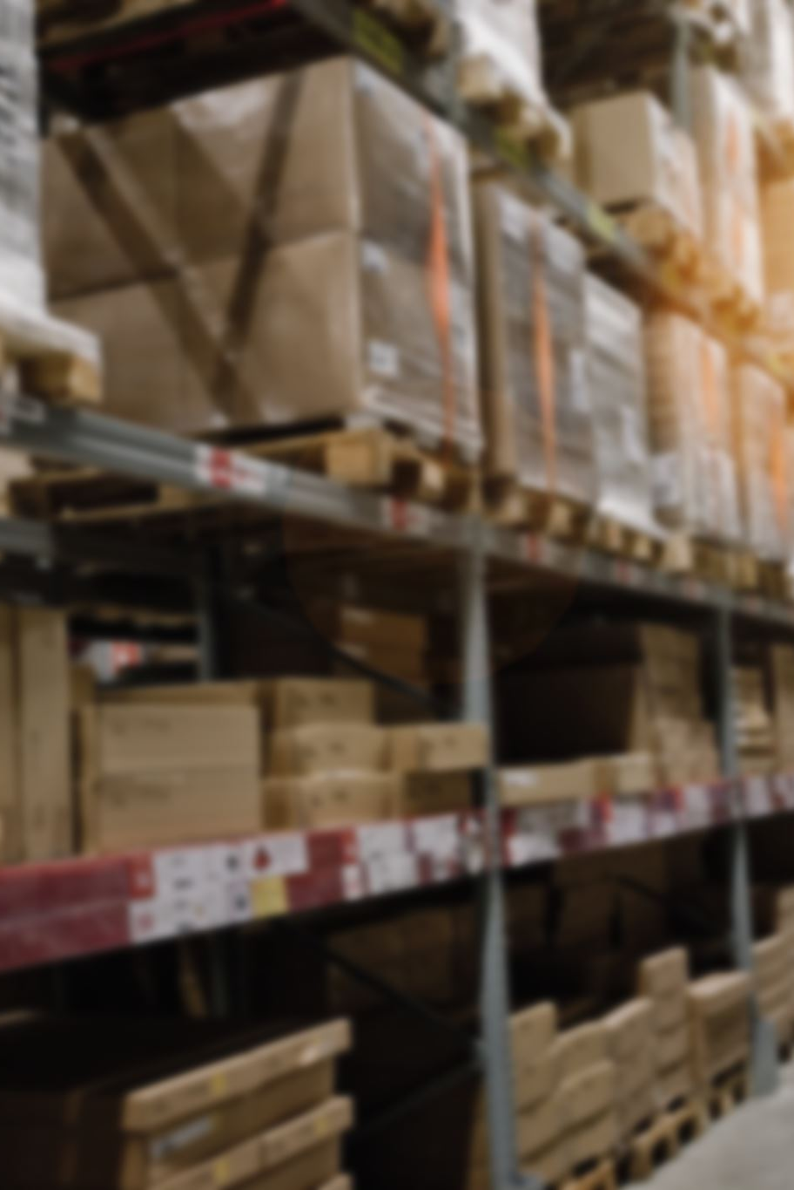
Stock Management System
Student Names:
Carlos Sucapuca
Aaron AMAya

Slide 2
Key Features
Inventory Management: - CRUD operations for products - Real-time stock updates - Product filtering and search - Product categories - Stock level tracking - Product details view
Order Management: - Order creation and tracking - Order status updates - Order filtering by status - Order history - Customer information tracking - Total order value calculation
User Profile Management: - User authentication and authorization - Profile viewing and editing - Email updates - Password management - User role management
UI/UX Features: - Responsive design - Animated transitions - Interactive tables and forms - Status color coding - Real-time updates - Form validation and error handling

Slide 3
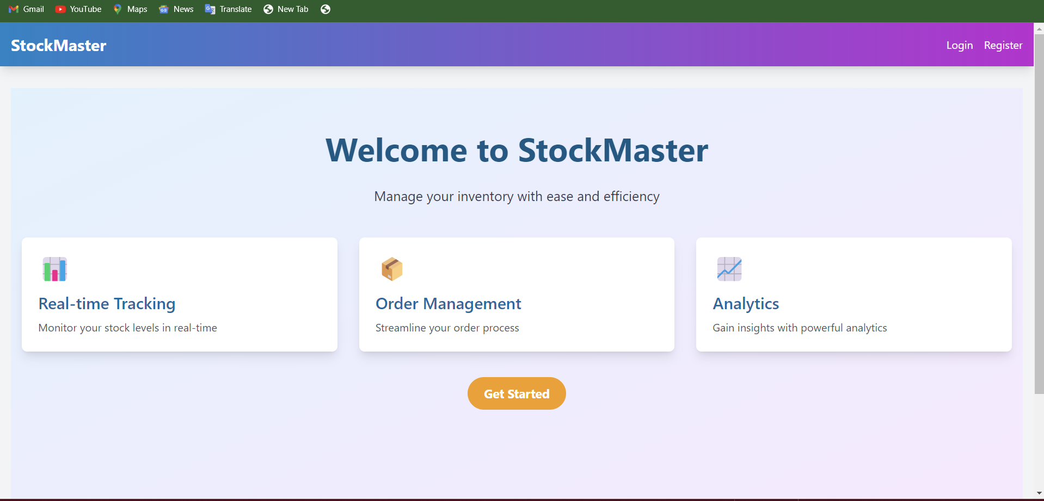
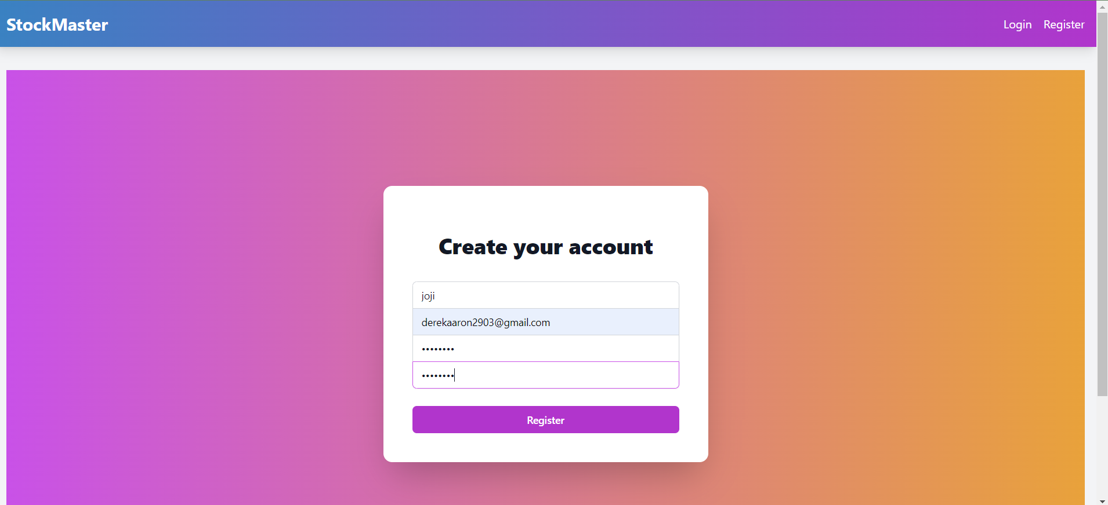
Application Screenshots
.

Slide 4
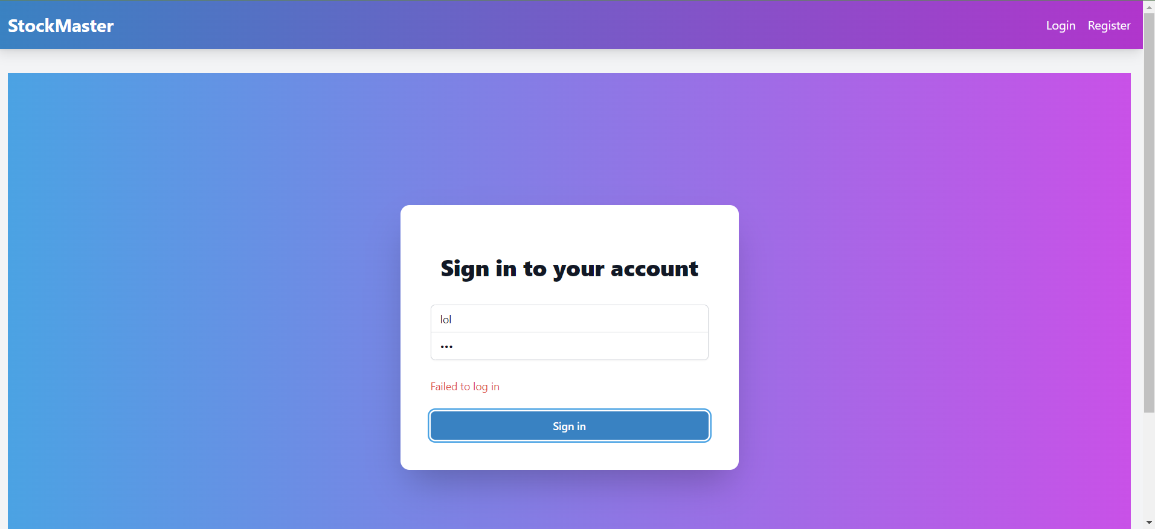
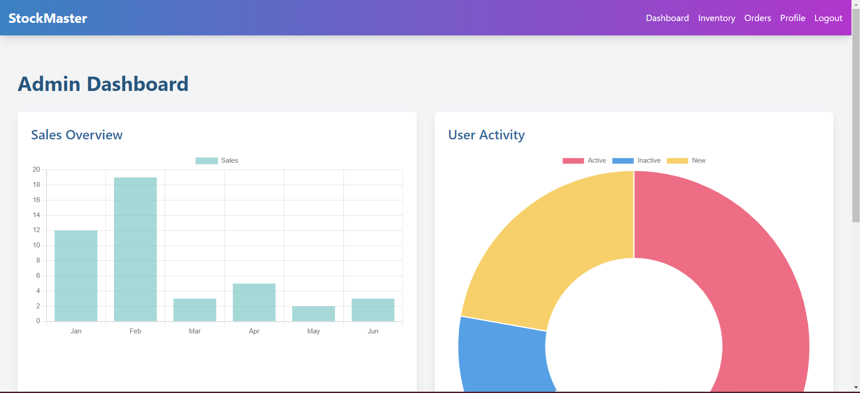

Slide 5
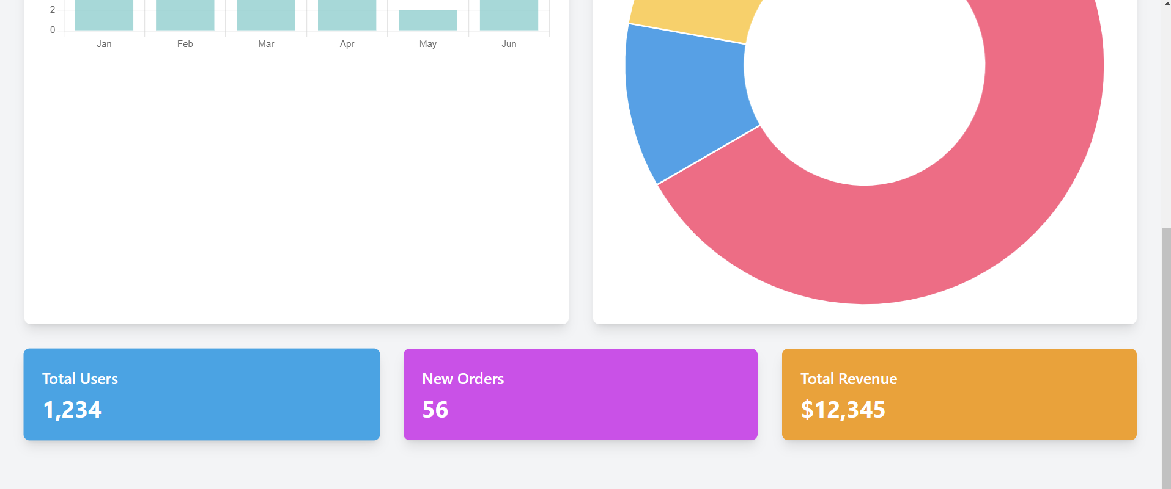
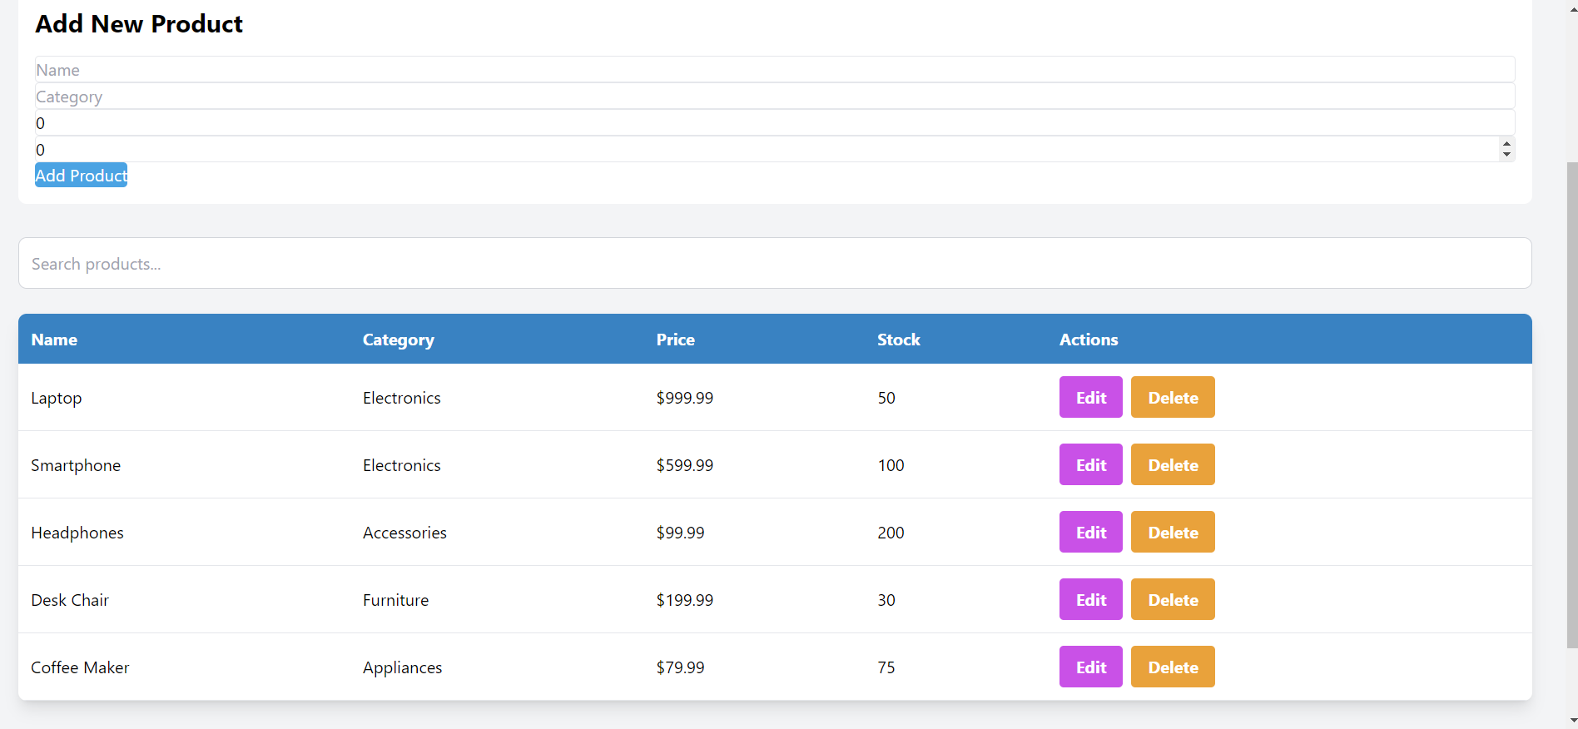

Slide 6
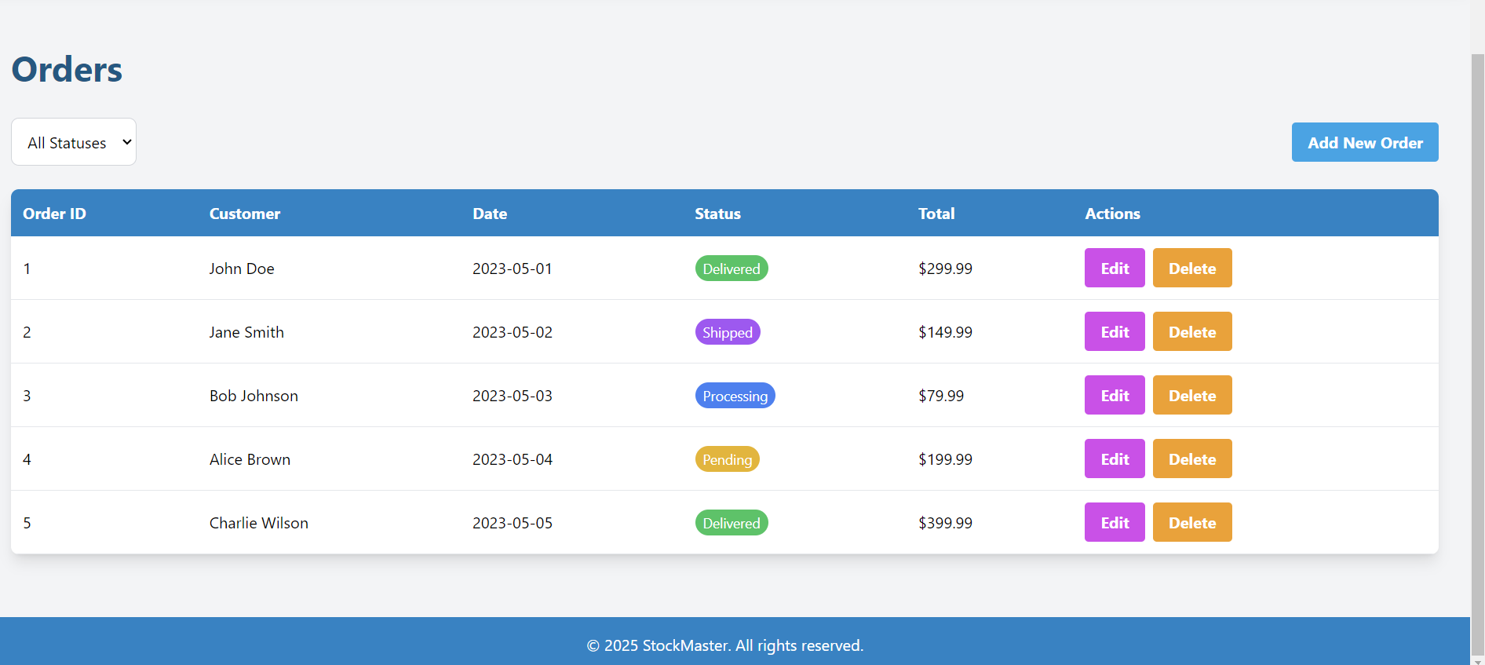

Slide 7
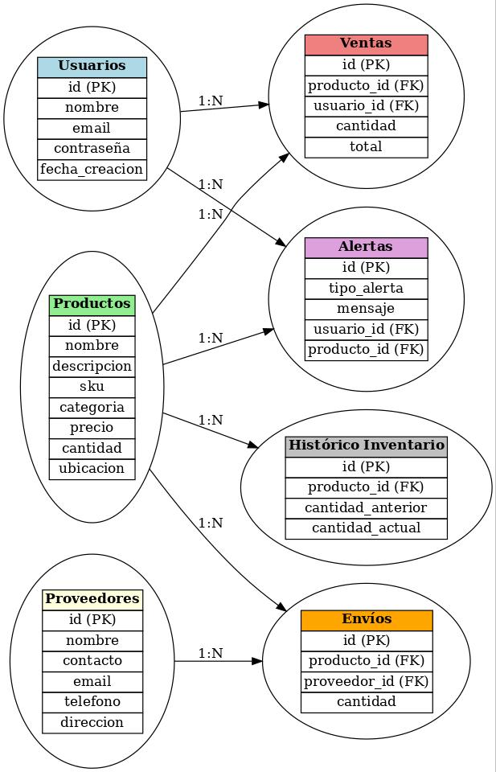
Database Schema

Slide 8
User Stories
1. As a store manager, I want to add, edit, and delete products so that I can keep the inventory updated.
2. As a customer, I want to track my order status so I know when to expect delivery.
3. As an admin, I want to manage user roles to control access to different system features.
4. As a user, I want to receive stock alerts when products run low so I can restock timely.
5. As a supplier, I want to view and manage shipment records for transparency.

Slide 9
Conclusion
This project demonstrates a complete inventory and order management system with user-friendly UI, real-time updates, and secure user management.

