Slide 1

Low cost IoT Platform
Cosmin Plășoianu
Paul Sucală
Paul Marian

Slide 2
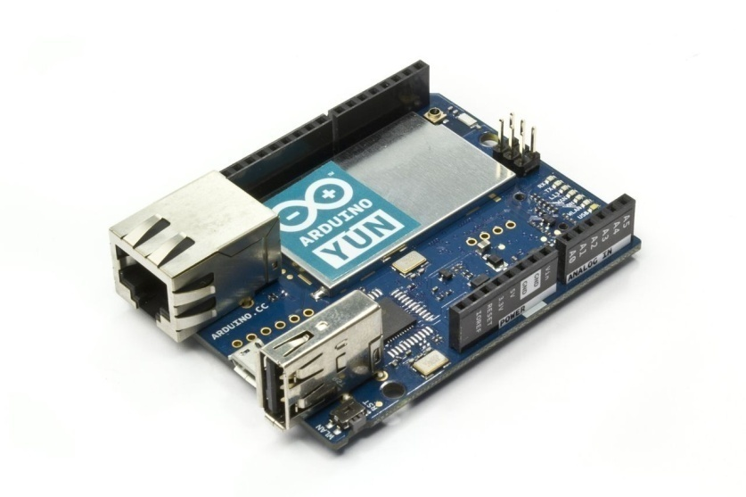
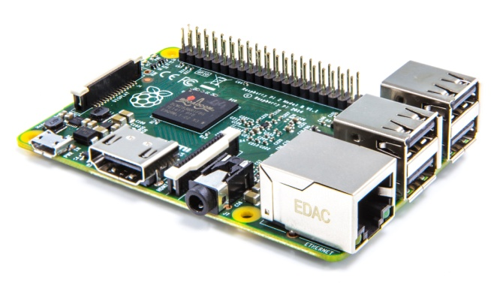
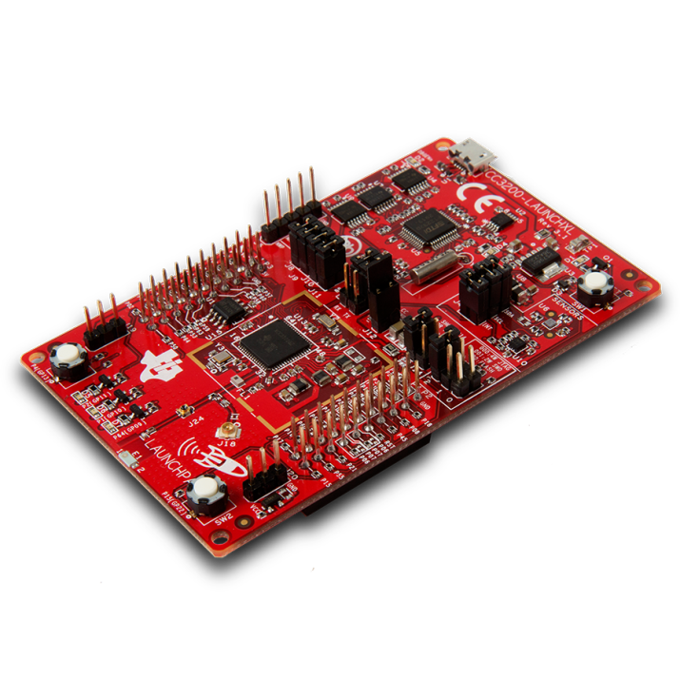
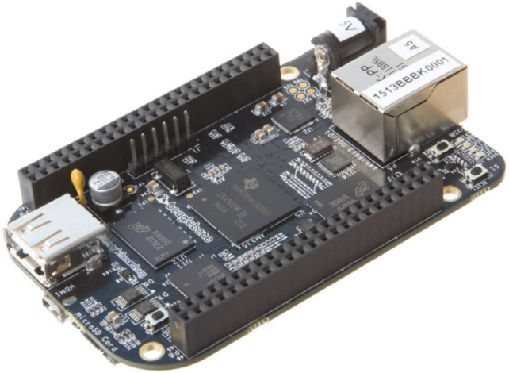
$30-50

Slide 3
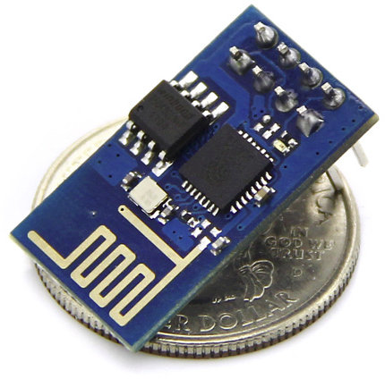
ESP8266
Price: $2
WiFi connectivity
80 MHz CPU
Open Source SDK
Low power

Slide 4


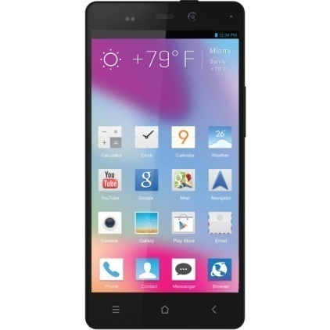
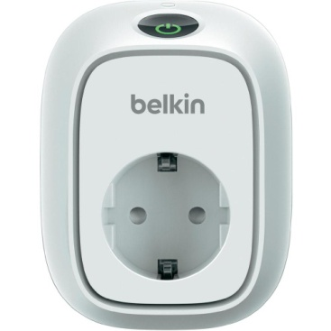
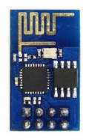

Slide 5
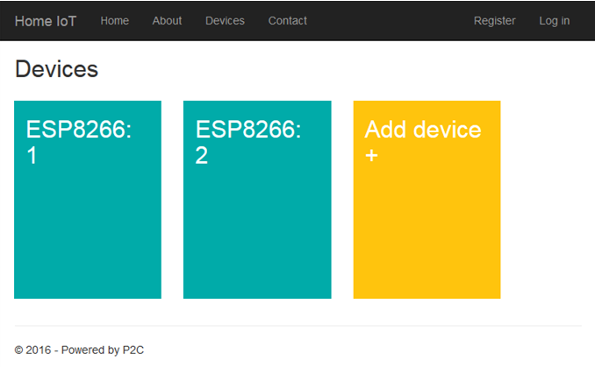
Web interface for managing devices

Slide 6
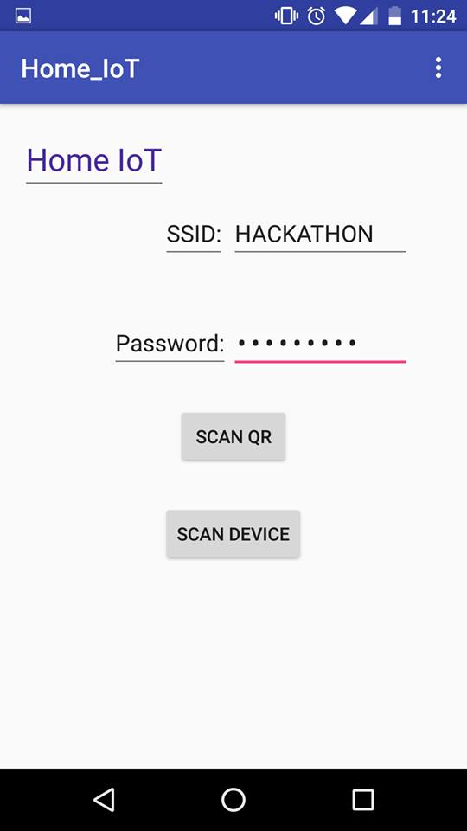
Mobile application for connecting the devices to the cloud

Slide 7

Questions?

