Slide 1
Neural Networks in Formal Concept Analysis
Subject: Ordered Sets In Data Analysis
Presenter: M. Kirdin
Professor: Kuznetsov S.

Slide 2
Outline
Introduction
Problem Statement
Model Evaluation
Results
Conclusion
References

Slide 3
Introduction
The overarching goal of this homework is to implement a merge of machine learning and formal concept analysis. This can be done by basing the neural network(NN) architecture on the covering relation (graph of the diagram) of a lattice coming from monotone Galois connections as proposed by Kuznetsov and his colleagues [1].

Slide 4
Problem Statement
For this task a dataset has to be chosen, its data binarized using scaling (binarization) strategy of choice, and finally the target attribute defined. Then, a comparison between several standard classification methods and the neural network produced as the result of this homework should be made by calculating performance metrics best suited for the dataset.

Slide 5
Model Evaluation
First dataset chosen was the Employee Attrition dataset. It describes employees’ satisfaction with their workplace in a certain company.
Emp ID | satisfaction_level | last_evaluation | number_project | average_montly_hours | time_spend_company | Work_accident | promotion_last_5years | dept | salary
1 | 0.38 | 0.53 | 2.0 | 157.0 | 3.0 | 0.0 | 0.0 | sales | low
2 | 0.80 | 0.86 | 5.0 | 262.0 | 6.0 | 0.0 | 0.0 | sales | medium
3 | 0.11 | 0.88 | 7.0 | 272.0 | 4.0 | 0.0 | 0.0 | sales | medium
4 | 0.72 | 0.87 | 5.0 | 223.0 | 5.0 | 0.0 | 0.0 | sales | low
5 | 0.37 | 0.52 | 2.0 | 159.0 | 3.0 | 0.0 | 0.0 | sales | low

Slide 6
Model Evaluation
Let’s see how the number of concepts used impacts the interpretability of a neural network

Slide 7
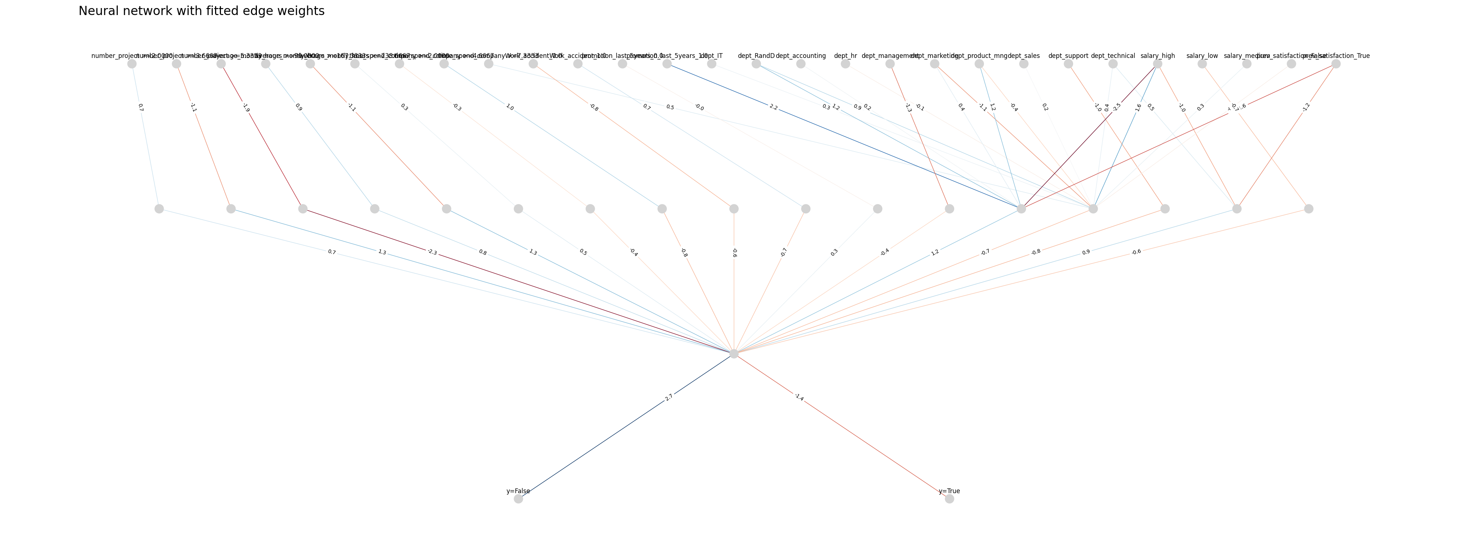
Model Evaluation

Slide 8
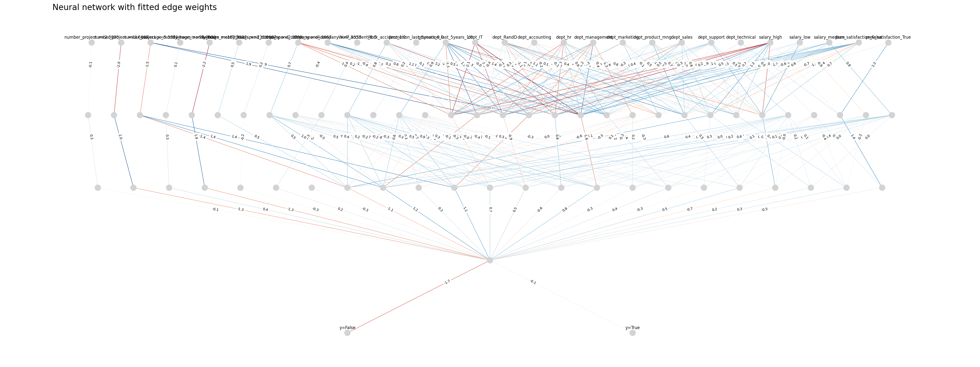
Model Evaluation

Slide 9
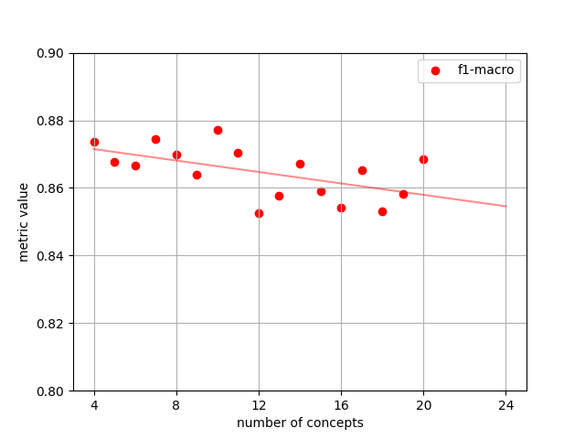
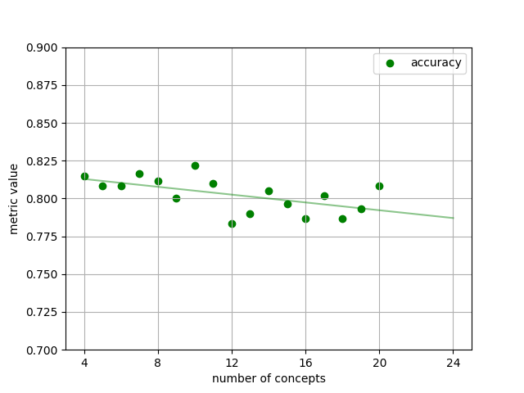
Model Evaluation
The impact of an increase in number of concepts used on performance metrics has to be considered too:

Slide 10
Model Evaluation
Let’s also compare the impact of different binarization strategies on the interpretability of NN’s architecture.

Slide 11
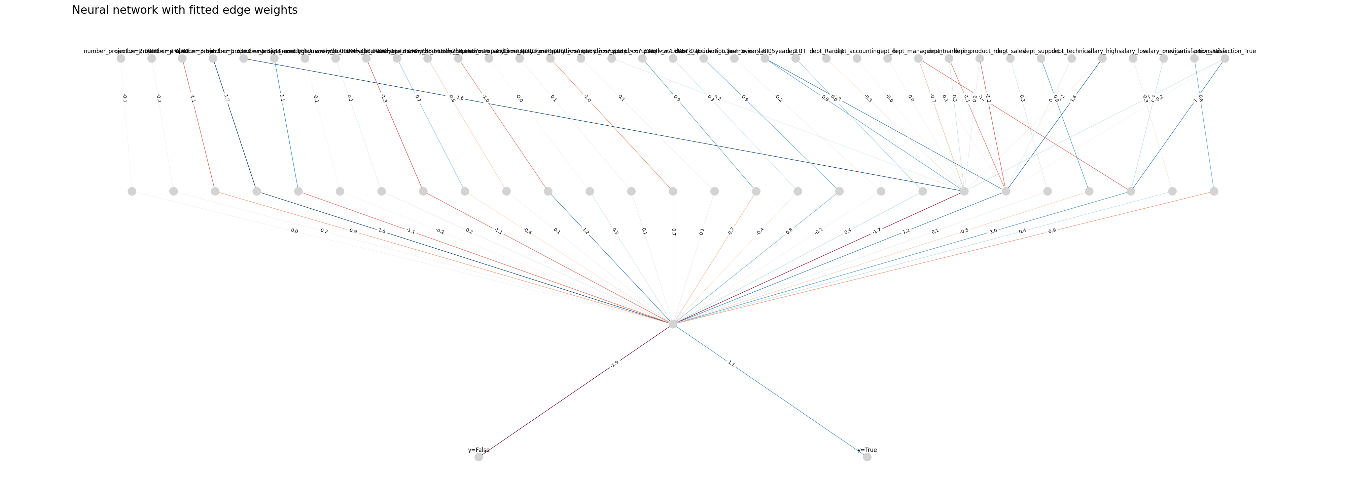
Model Evaluation

Slide 12
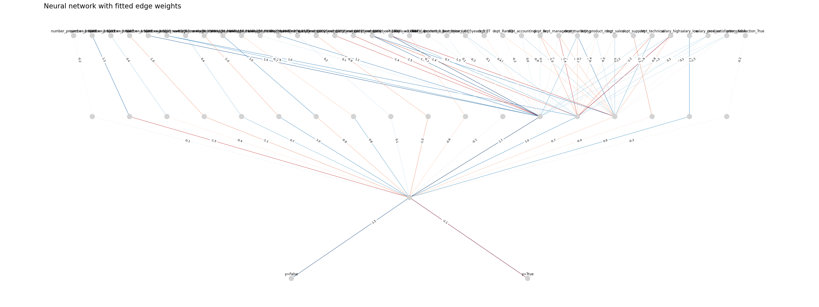
Model Evaluation

Slide 13
Model Evaluation
Let’s look at the performance metrics of the neural network and several other classifiers on the Employee Attrition dataset.
Classifier | f1-macro | accuracy
GaussianNB | 0.8318 | 0.7567
RandomForest | 0.8889 | 0.8383
HistGradientBoosting | 0.8791 | 0.8300
NeuralFCA(base) | 0.8643 | 0.8017
NeuralFCA(interordinal) | 0.8707 | 0.8100
NeuralFCA(fine) | 0.9001 | 0.8550

Slide 14
Model Evaluation
We should also check how the neural network performs on skewed data. For this task the Estonia Disaster dataset was used.
PassengerId | Country | Firstname | Lastname | Sex | Age | Category | Survived
1 | Sweden | ARVID KALLE | AADLI | M | 62 | P | 0
2 | Estonia | LEA | AALISTE | F | 22 | C | 0
3 | Estonia | AIRI | AAVASTE | F | 21 | C | 0
4 | Sweden | JURI | AAVIK | M | 53 | C | 0
5 | Sweden | BRITTA ELISABET | AHLSTROM | F | 55 | P | 0

Slide 15
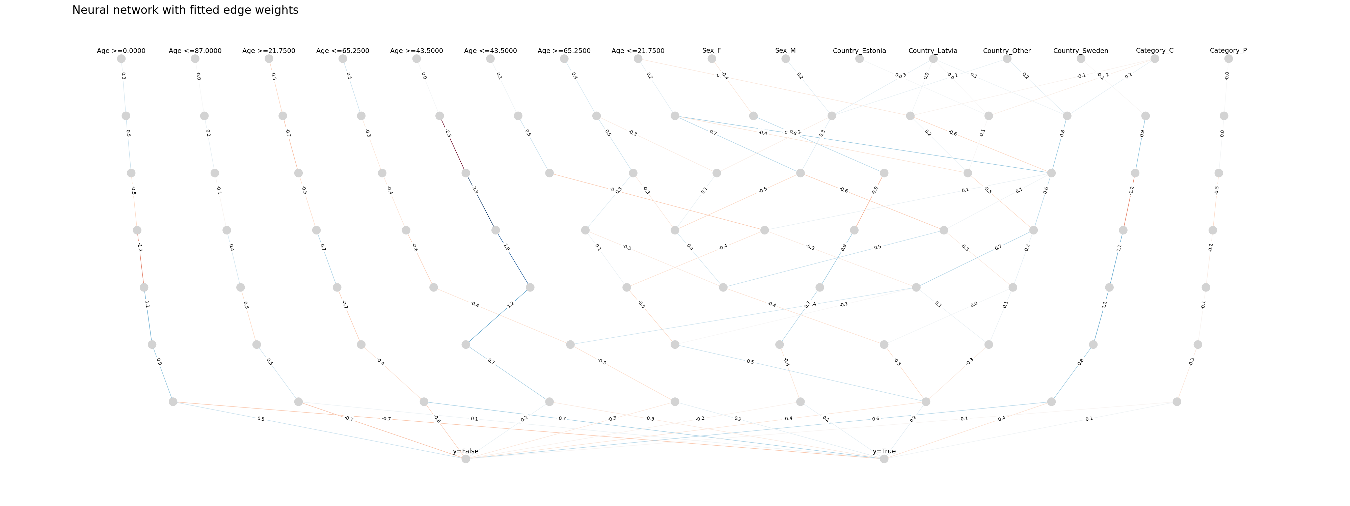
Model Evaluation

Slide 16
Results
Finer binarization produces better results in terms of model metrics than both the baseline and binarization using interordinal encoding with similar number of nodes, however this comes at the cost of interpretability. Increasing the number of formal concepts used to construct the concept lattice does not improve the model's performance; on the contrary, it seems to correlate with decrease in classification performance. Furthermore, the NN architecture used in this work struggles with overfitting on skewed data as exemplified by the Estonia Disaster dataset.

Slide 17
Conclusion
Neural Networks based on concept lattices perform on par with several ensemble models and show promise in some machine learning applications. As exemplified by the Estonia Disaster dataset, these NNs can show connections between various features and their impact on its final decision, hence improving human interpretability of their inner workings.

Slide 18
References
Kuznetsov, S.O., Makhazhanov, N., Ushakov, M. On Neural Network Architecture Based on Concept Lattices // Foundations of Intelligent Systems. ISMIS 2017. Lecture Notes in Computer Science(), vol 10352, pp. 653-663. Springer, Cham. https://doi.org/10.1007/978-3-319-60438-1_64

