Slide 1
TOPICAL: TOPIC Pages AutomagicaLly
Presenters: M. Kirdin, K. Ostudina
Authors: John Giorgi, Amanpreet Singh, Doug Downey, Sergey Feldman, Lucy Lu Wang
Conference: NAACL 2024, Mexico City, Mexico.

Slide 2
Outline
Problem Statement
Methods
Human evaluation
Conclusion
References

Slide 3
Problem Statement
The article addresses challenge of creating a tool that solves the following problems:
First of all it is helping manage the torrent of scientific literature.
The second one is improving the accessibility of scientific texts.

Slide 4
Methods

Slide 5
Methods
The authors propose TOPICAL – an open-source tool, which is also available as a web application. It, unlike many of its predecessors, generates topic pages in an abstractive fashion, rather than Wikipedia-like articles.

Slide 6
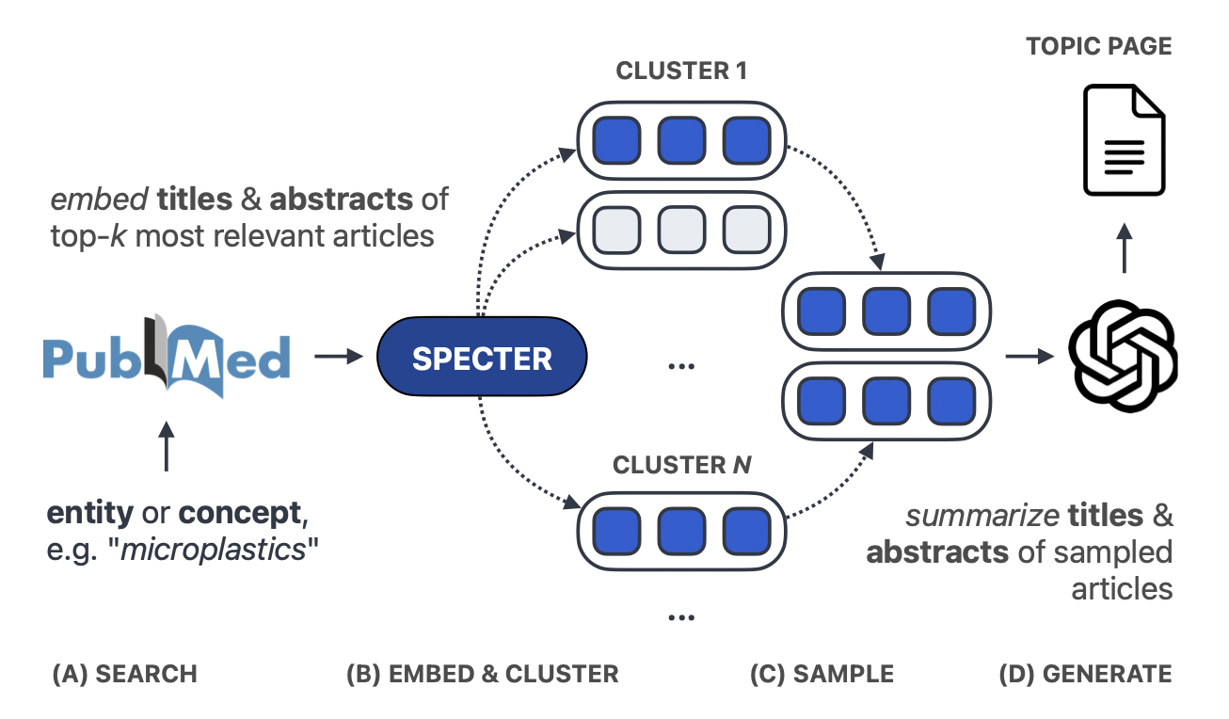
Methods
Figure 2: Overview of TOPICAL

Slide 7
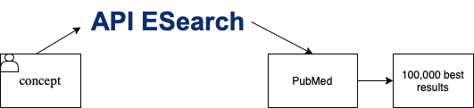
Querying PubMed
Algorithm:
Receive a user-provided biomedical entity or concept
System leverages the Entrez ESearch API to query PubMed
ESearch API applies automatic term mapping (ATM) to the query
Return 10,000 most relevant papers

Slide 8
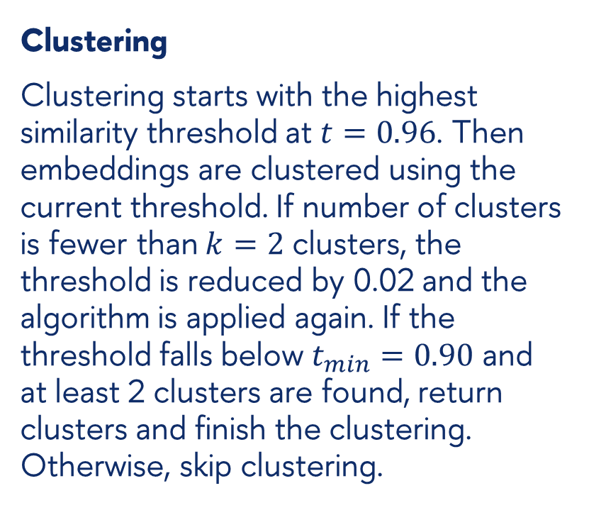
Embedding and clustering
Embedding
Titles and abstracts are jointly embedded using the SPECTER2 PRX model
Each input are formatted as: “{title}[SEP]{abstract}”
Clustering
Clustering starts with the highest similarity threshold at $t=0.96$. Then embeddings are clustered using the current threshold. If number of clusters is fewer than $k=2$ clusters, the threshold is reduced by 0.02 and the algorithm is applied again. If the threshold falls below $t_{min}=0.90$ and at least 2 clusters are found, return clusters and finish the clustering. Otherwise, skip clustering.

Slide 9
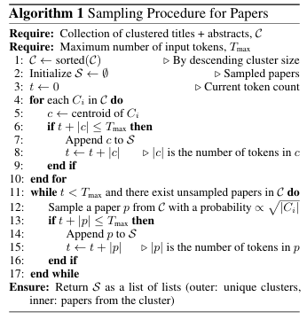
Sampling
Sample as many title-abstract pairs as fits in a prompt. The sample itself is comprised of cluster centroids and, if all centroids have been selected and the model’s maximum input tokens are not exhausted, samples from the remaining clusters are drawn with probabilities proportional to the square root of their cluster size.

Slide 10
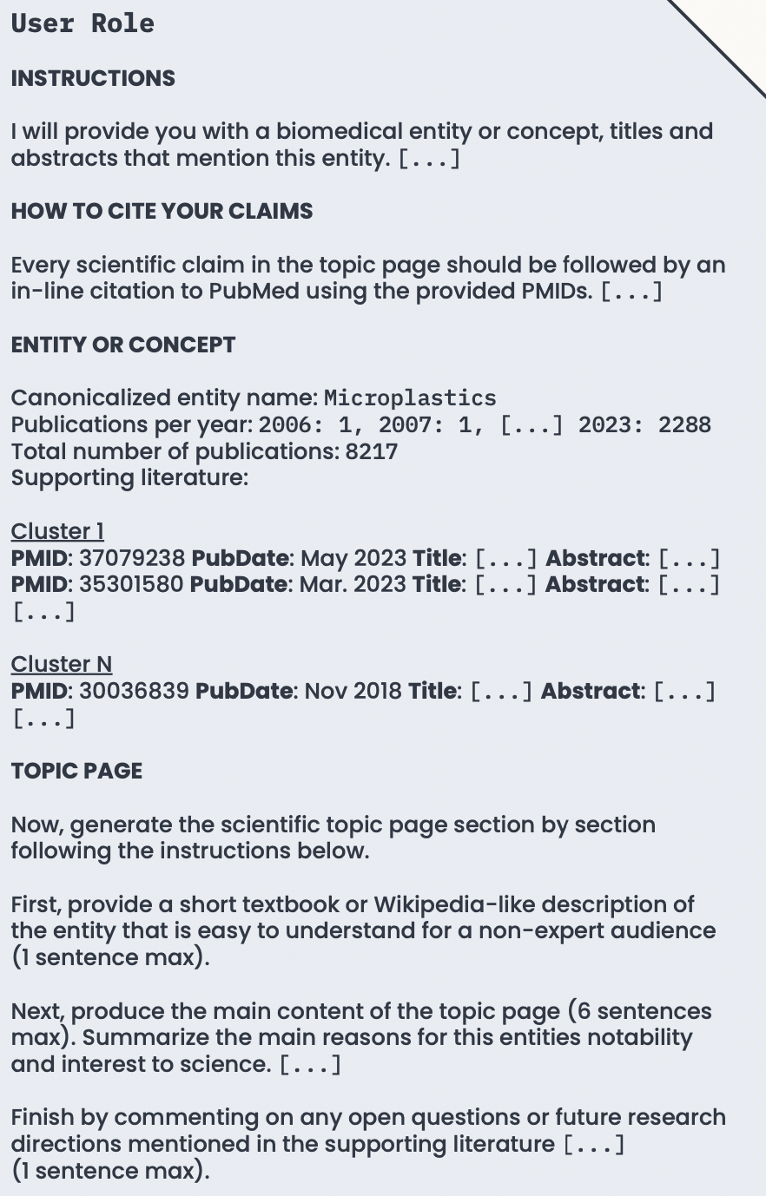
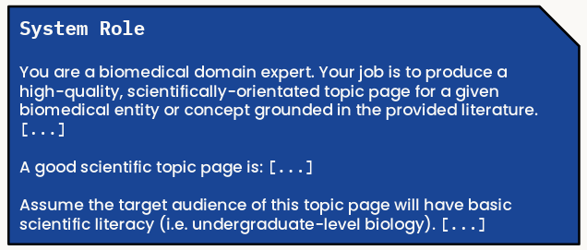
Generating the topic page
LLM model: GPT-4
Model’s input:
natural language instructions, which contains user role
publication metadata
the sampled titles and abstracts
Customization:
temperature to 0.0
max_tokens to 512
All other hyperparameters of the OpenAI API at default values

Slide 11
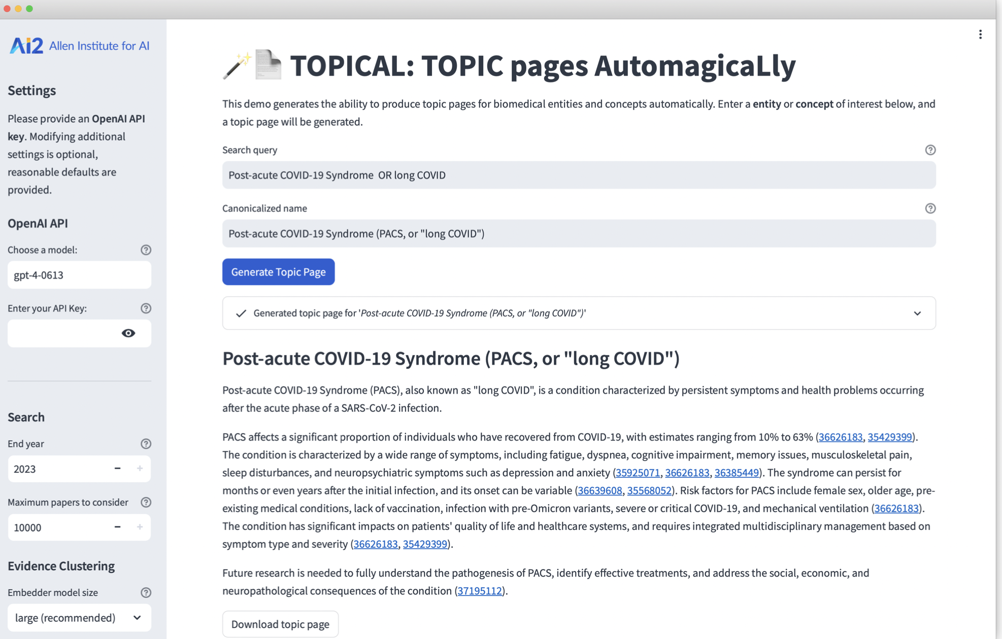
TOPICAL web app

Slide 12
Human evaluation
The quality of generated topic pages was evaluated by human specialists. The evaluation itself consisted of two tasks:
overall quality of a topic page;
relevance and sufficiency of generated citations.

Slide 13
Human evaluation
The quality of the topic page was represented by three facets {relevance, accuracy, coherence} each of which had three options:
“not {relevant, accurate, coherent}”;
“somewhat {relevant, accurate, coherent}”;
“{relevant, accurate, coherent}”.

Slide 14
Human evaluation
Citations were annotated as:
Correct: citation was topically relevant and provides sufficient evidence for the corresponding claim(s) in the topic page.
Incorrect (topically relevant): citation was topically relevant but does not provide sufficient evidence for the corresponding claim(s).
Incorrect (topically irrelevant): citation was topically irrelevant.
Incorrect (invalid): citation was not valid, e.g. the PMID does not exist or was truncated.

Slide 15
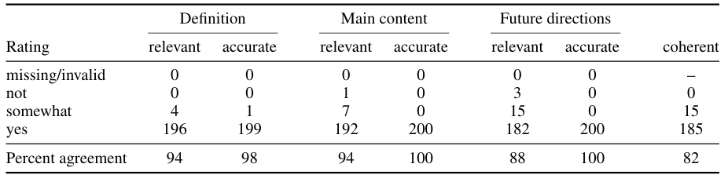
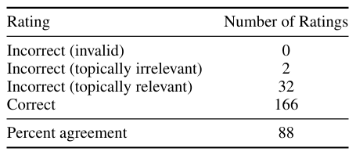
Human evaluation

Slide 16
Results
Most topic pages are rated as relevant, accurate, and coherent, with high annotator agreement (≥82%). The model always produces topic pages with the expected three-section structure. All sections received nearly perfect ratings for accuracy. The future direction section received the lowest rating for relevancy (18/200 ratings of “not” or “somewhat” relevant).

Slide 17
Conclusion
The paper introduces TOPICAL, a method for automatically generating high-quality scientific topic pages using LLMs and retrieval-augmented generation. Through human evaluation of 150 biomedical topics, most generated pages were rated as relevant, accurate, and coherent, with correct citations. A public web app is released for on-demand topic page generation.

Slide 18

References
Thanks!
John Giorgi, Amanpreet Singh, Doug Downey, Sergey Feldman, and Lucy Wang. 2024. TOPICAL: TOPIC Pages AutomagicaLly. In Proceedings of the 2024 Conference of the North American Chapter of the Association for Computational Linguistics: Human Language Technologies (Volume 3: System Demonstrations), pp.1–11, Mexico City, Mexico. Association for Computational Linguistics.
https://github.com/allenai/TOPICAL
https://s2-topical.apps.allenai.org/

