Slide 1

Chapter 7
Configuring and Managing Data Storage

Slide 2
Learning Objectives
Understand storage options for Windows Server 2008
Use the Disk Management tool to configure and manage storage
Explain and configure RAID disk storage fault tolerance
Understand storage enhancements in Windows Server 2008
Back up disk storage
MCITP Guide to Microsoft Windows Server 2008,
Server Administration (Exam #70-646)

Slide 3
Learning Objectives (cont’d.)
Develop a data backup and recovery strategy
MCITP Guide to Microsoft Windows Server 2008,
Server Administration (Exam #70-646)

Slide 4
Windows Server 2008 Storage Options
Storage systems
  Basic disk
    Traditional disk management techniques
    Contains: primary and extended partitions and logical drives
  Dynamic disk
    Provides more flexibility
    No restriction on number of volumes
MCITP Guide to Microsoft Windows Server 2008,
Server Administration (Exam #70-646)

Slide 5
Basic Disks
Partitioning
  Blocks a group of tracks and sectors to be used by a particular file system
Formatting
  Creates a table containing file and folder information for a specific file system in a partition
Volume
  Logical designation of disk storage
  Created out of one or more physical disk
Recognize primary and extended partitions
MCITP Guide to Microsoft Windows Server 2008,
Server Administration (Exam #70-646)

Slide 6
Basic Disks (cont’d.)
Can be configured for any of three RAID levels:
  Disk striping (RAID level 0)
  Disk mirroring (RAID level 1)
  Disk striping with parity (RAID level 5)
RAID (Redundant array of inexpensive disks)
Striping
  Spread data over multiple disks or volume
Disk mirroring
  Creating a mirror image of all data on an original disk
MCITP Guide to Microsoft Windows Server 2008,
Server Administration (Exam #70-646)

Slide 7
Basic Disks (cont’d.)
MBR and GPT Support
  Master Boot Record (MBR)
    Contains startup information about partitions and how to access the disk
  Partition table
    Contains information about each partition created
  Globally Unique Identifier (GUID) Partition Table (GPT)
    Newer way to partition disks
    Part of Unified Extensible Firmware Interface (UEFI) approach
MCITP Guide to Microsoft Windows Server 2008,
Server Administration (Exam #70-646)

Slide 8
Basic Disks (cont’d.)
  GPT disks
    Store partition information in each partition using main and backup tables
  GPT partition
    Can theoretically be up to 18 exabytes
  Can convert an MBR disk to GPT and vice versa
MCITP Guide to Microsoft Windows Server 2008,
Server Administration (Exam #70-646)

Slide 9
Basic Disks (cont’d.)
Primary and Extended Partitions on MBR Disks
  Primary partition can boot an operating system
  Active partition where computer will look for operating system startup files
  Extended partition created from space that is not yet partitioned
    Exceed the four-partition limit of a basic disk
MCITP Guide to Microsoft Windows Server 2008,
Server Administration (Exam #70-646)

Slide 10
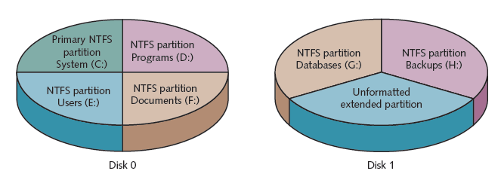
Basic Disks (cont’d.)
Figure 7-1 Partitions on two disk drives
Courtesy Course Technology/Cengage Learning
MCITP Guide to Microsoft Windows Server 2008,
Server Administration (Exam #70-646)

Slide 11
Basic Disks (cont’d.)
Activity 7-1: Viewing the Active Partition
  Objective: Verify which partition is marked as active
Activity 7-2: Customizing the MMC to Access Disk Management Tools
  Objective: Create a customized console from which to perform disk management and disk defragmentation
MCITP Guide to Microsoft Windows Server 2008,
Server Administration (Exam #70-646)

Slide 12
Basic Disks (cont’d.)
Volume and Stripe Sets
  Volume set
    Two or more partitions that are combined to look like one volume with a single drive letter
  Stripe set
    Two or more disks that are combined like a volume set, but that are striped for RAID level 0 or RAID level 5
MCITP Guide to Microsoft Windows Server 2008,
Server Administration (Exam #70-646)

Slide 13
Dynamic Disks
Do not use traditional partitioning
Possible to set up a large number of volumes on one disk
Can be formatted for NTFS
Convert basic disks to dynamic disks after you install Windows Server 2008
Simple Volume
  Portion of a disk or an entire disk that is set up as a dynamic disk
MCITP Guide to Microsoft Windows Server 2008,
Server Administration (Exam #70-646)

Slide 14
Dynamic Disks (cont’d.)
Spanned volume
  Stored on 2 to 32 dynamic disks that are treated as one volume
Striped volume
  RAID-0
  Main purpose to extend the life of hard disk drives by spreading data equally over two or more drives
MCITP Guide to Microsoft Windows Server 2008,
Server Administration (Exam #70-646)

Slide 15
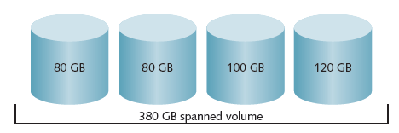
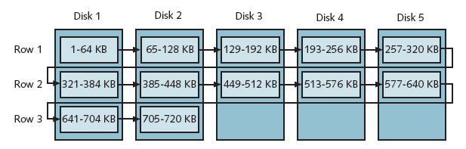
Figure 7-4 Creating one spanned volume from four disks
Courtesy Course Technology/Cengage Learning
Figure 7-5 Disks in a striped volume
Courtesy Course Technology/Cengage Learning
MCITP Guide to Microsoft Windows Server 2008,
Server Administration (Exam #70-646)

Slide 16
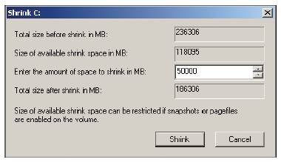
Dynamic Disks (cont’d.)
Shrinking a Volume
  Create a new partition when one is needed and you don’t have extra disks
Figure 7-6 Shrinking a volume
Courtesy Course Technology/Cengage Learning
MCITP Guide to Microsoft Windows Server 2008,
Server Administration (Exam #70-646)

Slide 17
Disk Management
Disk Management tool
  Central location for viewing disk information
  Perform tasks such as creating and deleting partitions and volumes
MCITP Guide to Microsoft Windows Server 2008,
Server Administration (Exam #70-646)

Slide 18
Creating a Partition and Simple Volume
Leave 1 MB or more of the disk space free
  Windows Server 2008 needs to convert a basic disk to a dynamic disk, in case you want to upgrade later
Partitions operate as separate storage units on a hard disk
Activity 7-3: Creating a Simple Volume
  Objective: Create a new partition from unpartitioned disk space
Once a partition is formatted
  It is called a volume
  Can be assigned a drive letter
MCITP Guide to Microsoft Windows Server 2008,
Server Administration (Exam #70-646)

Slide 19
Converting a Partitioned Basic Disk to a Dynamic Disk
Use Disk Management tool
Be certain that 1 MB or more of free space is available on the basic disk
Activity 7-4: Converting a Basic Disk
  Objective: Convert a simple basic disk to a dynamic disk
MCITP Guide to Microsoft Windows Server 2008,
Server Administration (Exam #70-646)

Slide 20
Mounting a Drive
Mounted drive
  Appears as a folder
  Accessed through a path like any other folder
Can mount
  Basic or dynamic disk drive
  CD/DVD drive
  Removable drive
MCITP Guide to Microsoft Windows Server 2008,
Server Administration (Exam #70-646)

Slide 21
Mounting a Drive (cont’d.)
Home directory or home folder
  Server folder that is associated with a user’s account
  Designated workspace for the user to store files
Activity 7-5: Configuring a Mounted Drive
  Objective: Learn how to set up a mounted drive
MCITP Guide to Microsoft Windows Server 2008,
Server Administration (Exam #70-646)

Slide 22
Managing Disks
Using Disk Defragmenter
  Fragmented
    Data not stored contiguously
  Defragmenting
    Locates fragmented folders and files
    Moves them to a location on the physical disk so they are in contiguous order
  Activity 7-6: Using the Disk Defragmenter
    Objective: Practice using Disk Defragmenter
MCITP Guide to Microsoft Windows Server 2008,
Server Administration (Exam #70-646)

Slide 23
Managing Disks (cont’d.)
Using Disk Check
  Scan a disk for bad sectors and file system errors
  Options:
    Automatically fix file system errors
    Scan for and attempt recovery of bad sectors
Activity 7-7: Using Disk Check
  Objective: Learn how to use Disk Check
MCITP Guide to Microsoft Windows Server 2008,
Server Administration (Exam #70-646)

Slide 24
Managing Disks (cont’d.)
Using chkdsk
  Start from command prompt
  May run automatically
  Activity 7-8: Using chkdsk from the Command Line
    Objective: Learn how to use chkdsk from the command line
MCITP Guide to Microsoft Windows Server 2008,
Server Administration (Exam #70-646)

Slide 25
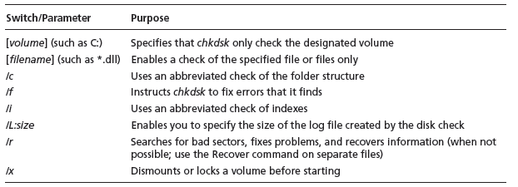
Managing Disks (cont’d.)
Table 7-1 chkdsk switch and parameter options
MCITP Guide to Microsoft Windows Server 2008,
Server Administration (Exam #70-646)

Slide 26
Introduction to Fault Tolerance
Fault tolerance
  Ability of a system to gracefully recover from hardware or software failure
Software-level RAID
  Not meant as a replacement for performing regular backups of data
MCITP Guide to Microsoft Windows Server 2008,
Server Administration (Exam #70-646)

Slide 27
RAID Volumes
RAID
  Set of standards for lengthening disk life, preventing data loss, and enabling relatively uninterrupted access to data
6 Levels
  Striping
  Mirroring
  Duplexing
  Windows Server 2008 supports RAID levels 0, 1, and 5
MCITP Guide to Microsoft Windows Server 2008,
Server Administration (Exam #70-646)

Slide 28
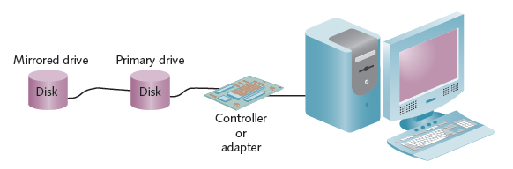
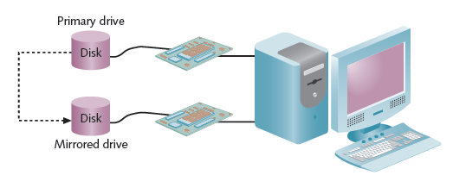
Figure 7-13 Disk mirroring
Courtesy Course Technology/Cengage Learning
Figure 7-14 Disk duplexing
Courtesy Course Technology/Cengage Learning
MCITP Guide to Microsoft Windows Server 2008,
Server Administration (Exam #70-646)

Slide 29
Using a Striped Volume (RAID-0)
Reasons for using a RAID level 0
  Reduce the wear on multiple disk drives by equally spreading the load
  Increase disk performance compared with other methods for configuring dynamic disk volumes
MCITP Guide to Microsoft Windows Server 2008,
Server Administration (Exam #70-646)

Slide 30
Using a Mirrored Volume (RAID-1)
Disk mirroring
  Creating a shadow copy of data on a backup disk
  RAID level 1
Only dynamic disks
Can be a slight performance degradation for disk writes
Well suited for situations in which data is mission-critical and must not be lost under any circumstances
MCITP Guide to Microsoft Windows Server 2008,
Server Administration (Exam #70-646)

Slide 31
Using a RAID-5 Volume
RAID-5 volume
  Requires a minimum of three disk drives
Performance is not as fast as with a striped volume
Useful in a client/server system that uses a separate database for queries and creating reports
Amount of storage space used
  Based on the formula 1/n where n is the number of physical disks in the volume
MCITP Guide to Microsoft Windows Server 2008,
Server Administration (Exam #70-646)

Slide 32
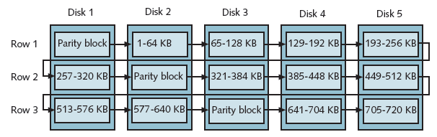
Using a RAID-5 Volume (cont’d.)
Figure 7-15 Disks in a RAID-5 volume
Courtesy Course Technology/Cengage Learning
MCITP Guide to Microsoft Windows Server 2008,
Server Administration (Exam #70-646)

Slide 33
Software RAID vs. Hardware RAID
Software RAID
  Implements fault tolerance through the server’s operating system
Hardware RAID
  Implemented through the server hardware
  Independent of the operating system
  More expensive than software RAID
  Offers many advantages over software RAID
MCITP Guide to Microsoft Windows Server 2008,
Server Administration (Exam #70-646)

Slide 34
Windows Server 2008 Storage Enhancements
Management of Storage Area Networks
Using multiple paths to storage for fault tolerance
For medium to large networks
MCITP Guide to Microsoft Windows Server 2008,
Server Administration (Exam #70-646)

Slide 35
Storage Manager for SANs and LUNs
Storage Area Network (SAN)
  Grouping of storage devices that forms a subnet
  Uses Fibre Channel or iSCSI technology
Storage Manager for SANs
  Manage logical unit numbers for Small Computer System Interface drives
    32- or 64-bit computer adapter that transports data between one or more attached devices
Logical unit number (LUN)
  Identifies a physical SCSI drive or logical SCSI targets
MCITP Guide to Microsoft Windows Server 2008,
Server Administration (Exam #70-646)

Slide 36
Storage Manager for SANs and LUNs (cont’d.)
Types of LUNs
  Simple
  Spanned
  Striped
  Mirrored
  Striped with parity
Virtual Disk Service (VDS)
  Enables management of disk volumes in SANs through one interface at a server
Storage Manager for SANs
  Three windows of operation
MCITP Guide to Microsoft Windows Server 2008,
Server Administration (Exam #70-646)

Slide 37
Multipath Input/Output Enhancements
Multipath I/O
  Establishes multiple paths between a server and its disk storage
Set up multipath I/O
  Create the multiple paths between the storage and the server or servers
  Install Multipath I/O and Device Specific Module (DSM)
Windows Server 2008 DSM configuration models
  Six models to choose from
MCITP Guide to Microsoft Windows Server 2008,
Server Administration (Exam #70-646)

Slide 38
Disk Backup
Advantages of performing backups from a backup device installed on the server
  No extra load is produced on the network
  Can perform backups on a multiple-server network, even if a backup device fails on one of the servers
MCITP Guide to Microsoft Windows Server 2008,
Server Administration (Exam #70-646)

Slide 39
Disk Backup (cont’d.)
Advantages of performing a network backup
  Backup jobs can be stored on a single backup media
  One administrator can be responsible for backing up multiple servers
Disadvantage
  Increase in network traffic
MCITP Guide to Microsoft Windows Server 2008,
Server Administration (Exam #70-646)

Slide 40
Windows Server Backup
Windows Server Backup tool
  Install with Server Manager
Enhanced features
  Better options to recover specific objects
  More backup options including Volume Shadow Copy Service (VSS)
  More reliable in recovering applications
  Provides information about disk use
  Offers the wbadmin command-line tool
  Full support to back up to optical media
MCITP Guide to Microsoft Windows Server 2008,
Server Administration (Exam #70-646)

Slide 41
Windows Server Backup (cont’d.)
Considerations for using the Windows Server Backup tool
  Only backs up NTFS volumes
  Does not back up to tape
  Cannot restore Windows Server 2003 backups
Activity 7-9: Installing the Windows Server Backup Tool
  Objective: Install the Windows Server Backup tool
MCITP Guide to Microsoft Windows Server 2008,
Server Administration (Exam #70-646)

Slide 42
Backup Options
Full backup
  Backup of an entire system, including all system files, programs, and data files
Incremental backup
  Only backs up files that are new or that have been updated
  Backs up only files that have the archive attribute marked
Custom backup
  Configure backups differently for each volume
MCITP Guide to Microsoft Windows Server 2008,
Server Administration (Exam #70-646)

Slide 43
Backup Options (cont’d.)
Activity 7-10: Backing Up a Server
  Objective: Perform a full backup
MCITP Guide to Microsoft Windows Server 2008,
Server Administration (Exam #70-646)

Slide 44
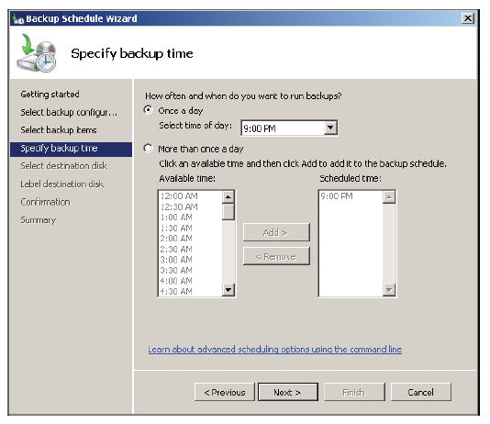
Scheduling Backups
Scheduling
  Automatically start backups after regular work hours
  Or at a specific time of day
Figure 7-19 Specifying the backup time
Courtesy Course Technology/Cengage Learning
MCITP Guide to Microsoft Windows Server 2008,
Server Administration (Exam #70-646)

Slide 45
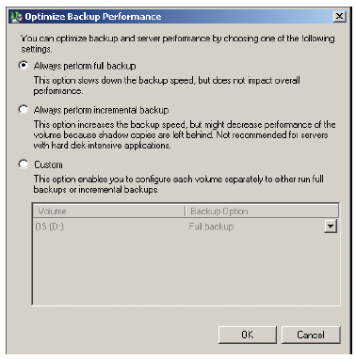
Configuring Backup Performance
Specify which types of backups to perform:
  Full, incremental, and custom
  Default is full
Figure 7-20 Optimizing backup performance
Courtesy Course Technology/Cengage Learning
MCITP Guide to Microsoft Windows Server 2008,
Server Administration (Exam #70-646)

Slide 46
Developing a Data Backup and Recovery Strategy
Advantage of a full backup
  Contains the system state data as well as all applications and user data
Use Backup Schedule Wizard to regularly schedule backups
Disaster recovery plan
  Store a copy of a backup off-site in case of fire, flooding, or some other natural disaster
  Use off-site backup services or software
MCITP Guide to Microsoft Windows Server 2008,
Server Administration (Exam #70-646)

Slide 47
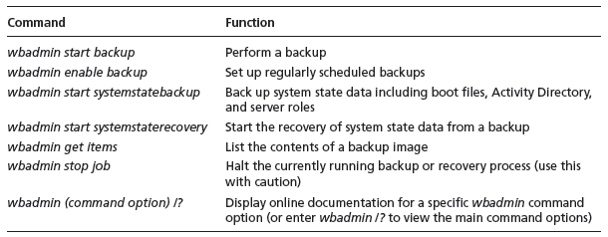
Useful wbadmin.exe Commands
wbadmin.exe command-line program
  Offers advantages over the GUI-based Windows Server Backup Tool
Install wbadmin.exe in Server Core
Table 7-2 wbadmin.exe commands
MCITP Guide to Microsoft Windows Server 2008,
Server Administration (Exam #70-646)

Slide 48
Performing a Recovery
Windows Server Backup tool allows recovery of:
  Files
  Folders
  Volumes
  Applications and application data
  Backup catalog (of information in the backup)
  Operating system (to the same computer or to another computer using identical hardware)
MCITP Guide to Microsoft Windows Server 2008,
Server Administration (Exam #70-646)

Slide 49
Summary
Basic and dynamic disks
  Dynamic disks can be configured as simple, spanned, striped, mirrored, and RAID-5 volumes
Disk Management tool
  Create basic and dynamic disks
Disk Check and chkdsk tools
  Find and repair disk problems
Enhancements for Windows Server 2008 include new features for Storage Manager for SANs and features for Multipath I/O
MCITP Guide to Microsoft Windows Server 2008,
Server Administration (Exam #70-646)

Slide 50
Summary (cont’d.)
Windows Server Backup
  Schedule backups, perform full or incremental backups and recover data from backups
wbadmin.exe tool
  Version of Windows Server Backup that can be used from the command line
  Particularly important for Server Core users
MCITP Guide to Microsoft Windows Server 2008,
Server Administration (Exam #70-646)

