Slide 1
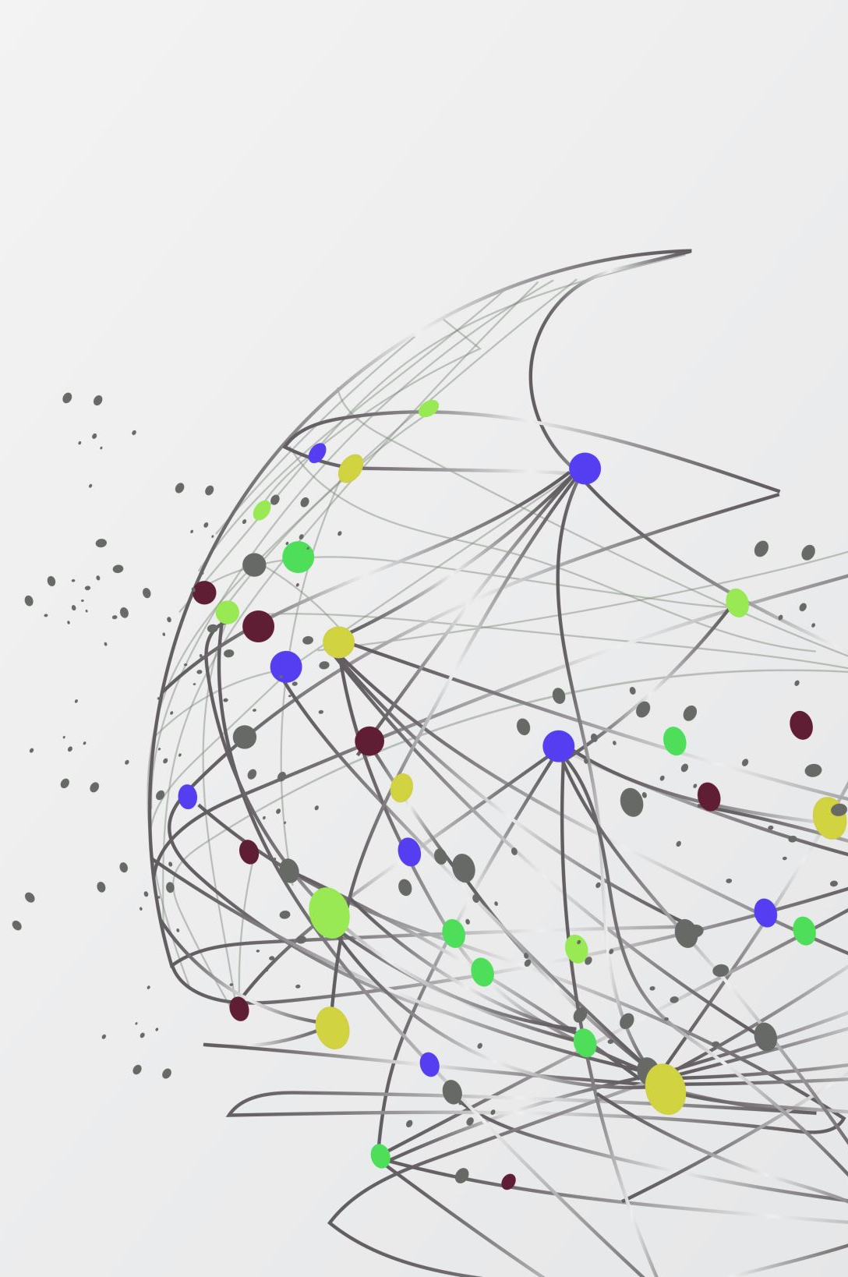

Microservices

Slide 2
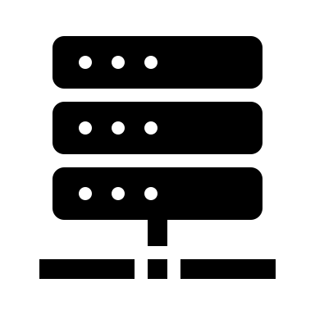
What are Microservices ?
Breaking big application into many small applications

Slide 3
Vertical Scaling vs Horizontal Scaling
More Resources
App (Resources)
More resource additions – Vertical Scaling
App (Resources)
App (Resources)
App (Resources)
App (Resources)
App (Resources)
App (Resources)
Load balancer
Adding more replicas – Horizontal Scaling

Slide 4

Monolithic Apps and Architecture - Problems
Scalability Issues
Horizontal scaling involves scaling of full monolithic app.
Resource wastage
Deployment Issues
Full App - Single deployment
Longer deployment time
Tight coupling and more complexity
Complex development
Higher QA effort and time
Slow business changes adoption
Rigid technology stack
Limited fault tolerance
Single point of failure
Team and Project management challenges

Slide 5
Why are we going microservices ?
Optimized Cost of Deployment (Independent Deployment)
Scalability
Smaller teams
Faster time to market
Faster change adoption
Tech Stack Flexibility
Easy Maintenance

Slide 6

How to Adapt microservices ?
How to architect microservices ?
How to implement microservices ?
How to deploy microservices ?

Slide 7
How to Architect Microservices ?

Slide 8
Microservices Patterns

Slide 9
Microservices Patterns
Service Decomposition
Communication
Data management
Resiliency
Observability
Deployment
Security

Slide 10
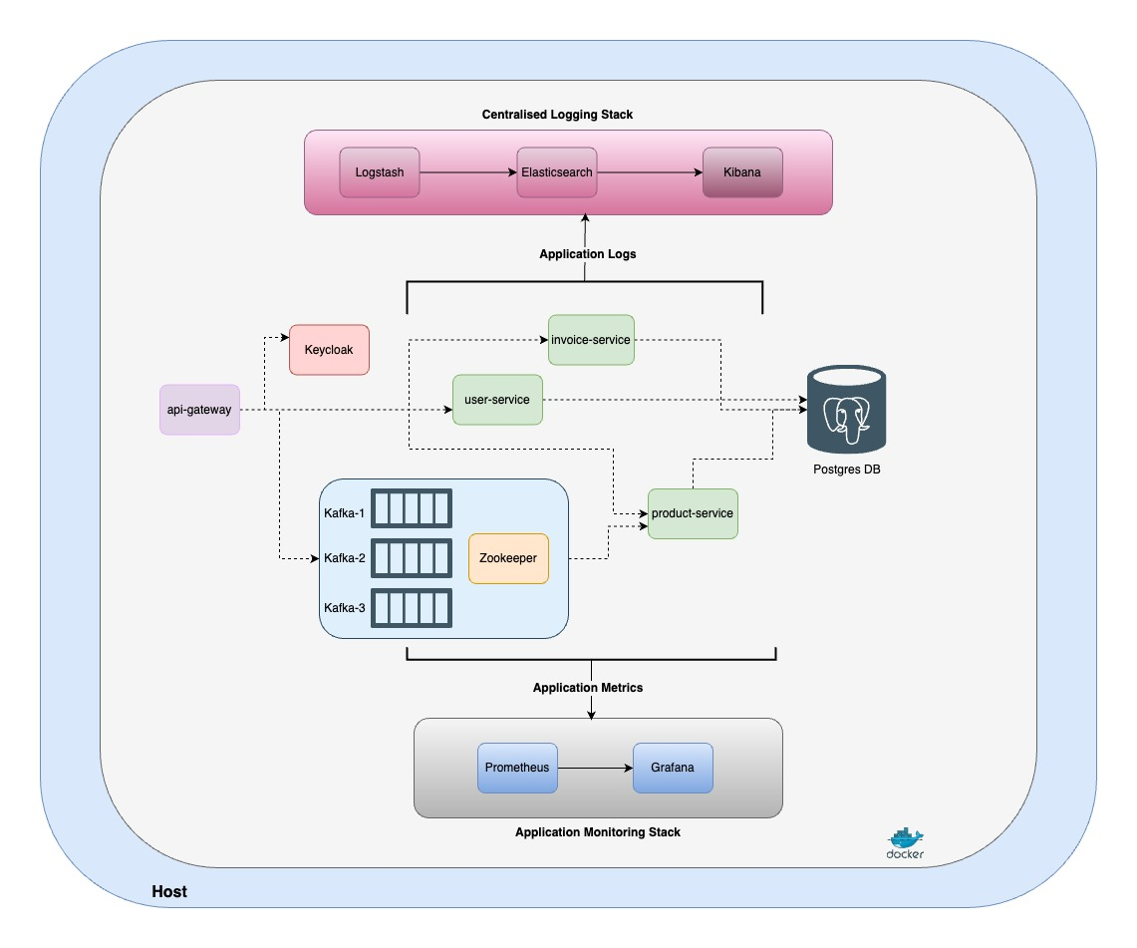

Slide 11
How to implement microservices ?
Java
Spring Boot
Quarkus
Micronaut
Python
Fast API
Flask
NodeJS
ExpressJs
Go
GIN
Go Restful

Slide 12
How to deploy microservices ?

Slide 13



Continuous deploying tech at scale - CICD
Phase – Development
Phase – Quality verification
Phase – User Acceptance
Phase – Live
DEV
QA
UAT
Production

Slide 14
Deployment Ways
On Prem
Puppet
Ansible
On Cloud
Containers
Kubernetes
Package Manager
Helm
Open shift

Slide 15
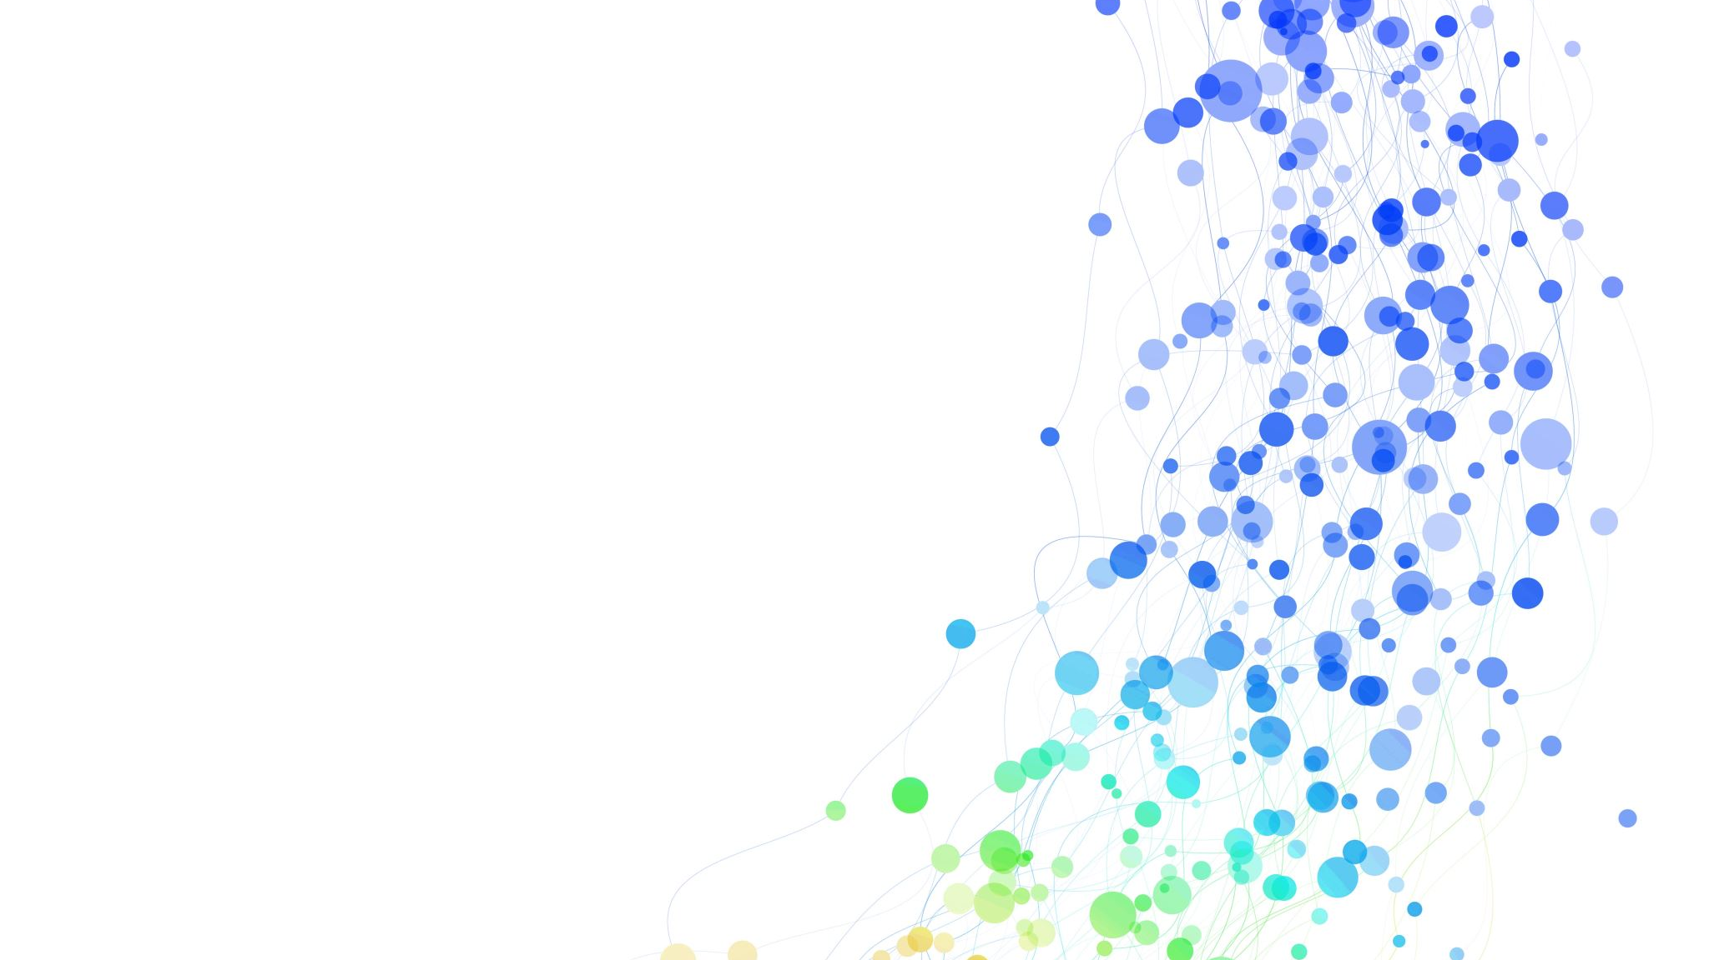
Containerization - Docker

Slide 16
Dependency - 1
Dependency - 2
Application Code
Application Code
Dependency - 3
Dependency - 4
Dependency - 1
Dependency - 2
Dependency - 3
Dependency - 4
Environment
Spring Boot App
Spring Boot App
JDK
Curl - Utility
JDK
Curl - Utility

Slide 17
Dependency - 1
Dependency - 2
Application Code
Open Port
Application Code
Dependency - 3
Dependency - 4
Dependency - 1
Dependency - 2
Dependency - 3
Dependency - 4
Container
Environment
Spring Boot App
Spring Boot App
JDK
Curl - Utility
JDK
Curl - Utility

Slide 18
Why Docker ?
Consistency across environments
Isolation
Simplified Deployment
Portability
Efficient resource utilization

Slide 19
Patterns in Microservices Implementation Demo
Framework
Java – Spring Boot (JDK 17)
Communication
REST
Open Feign Client
Event Driven
Kafka
Data Management
Shared Database
Integration
API Gateway
Resiliency
Retry , Circuit Breaker, Bulkhead
Observability
Distributed tracing
Centralized Logging
Deployment
Containerization
Rolling Update

Slide 20
Features
APIs
Calling APIs
Database Integration
Database Migration
Logging and Centralized Logging solution with ELK Stack
Exception handling
Distributed Tracing and Monitoring
Application Monitoring
Containerization
API Specification
Kubernetes Manifests files
Deployment to Kubernetes

Slide 21
Features Implementation Details
Framework – Spring Boot
APIs – Spring Boot
Calling APIs – Open Feign Client
Database Integration - JPA
Database Migration - Flyway
Logging and Centralized Logging solution - ELK Stack
Exception handling – Spring Boot
Distributed Tracing and Monitoring - Micrometer
Application Monitoring – Spring boot, Prometheus, Grafana
Containerization – Docker, Dockerfiles
API Specification – OpenAPI(Swagger)
Event Driven – Kafka
Caching – Spring Boot Caching
Reliability –
Bulkhead and Circuit Breaker in API Gateway
Retry in Open Feign
Spring Retry in Kafka template Send
Deployment using docker compose
Kubernetes Manifests files
Deployment to Kubernetes

