Slide 1
JBoss Fuse Project Demo
Introduction to Openshift & JBoss Fuse (Route)

Slide 2
OPENSHIFT
WEB URL : https://gekkoadmin.fwd.com:8443
Username: fuseadmin
Password: 7useAdm!n
View the Project List
Fuse Console
Three route
Project Front Page
Basic status of the project

Slide 3
OPENSHIFT Project Page
Details
Pods
Environment
Environment variables
Logging
Build The Project

Slide 4
JBoss Fuse (Route Description)
Three Routes
Rest-to-rest route
Rest-to-soap route
Soap-to-rest route

Slide 5
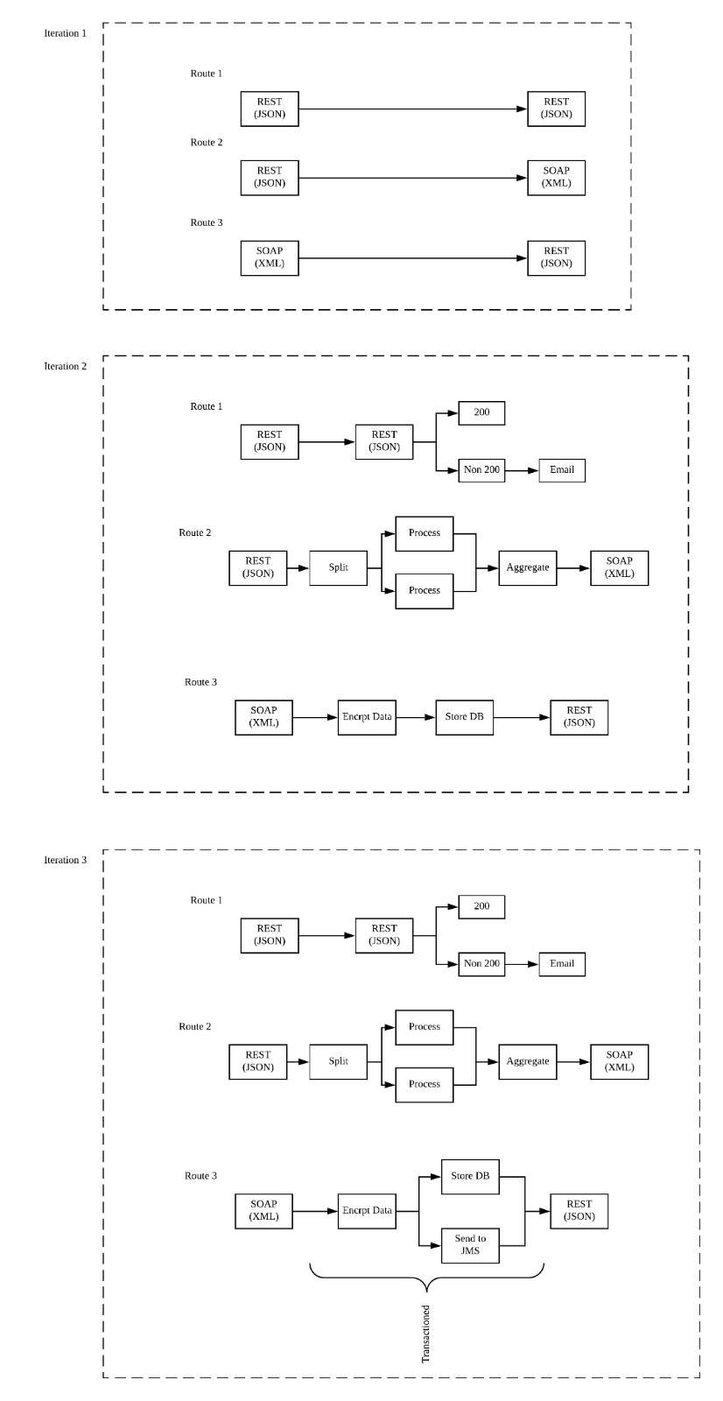
Routes: Rest-to-rest
Request (json) to Response (json)
Two Endpoint for indicate the request result

Slide 6
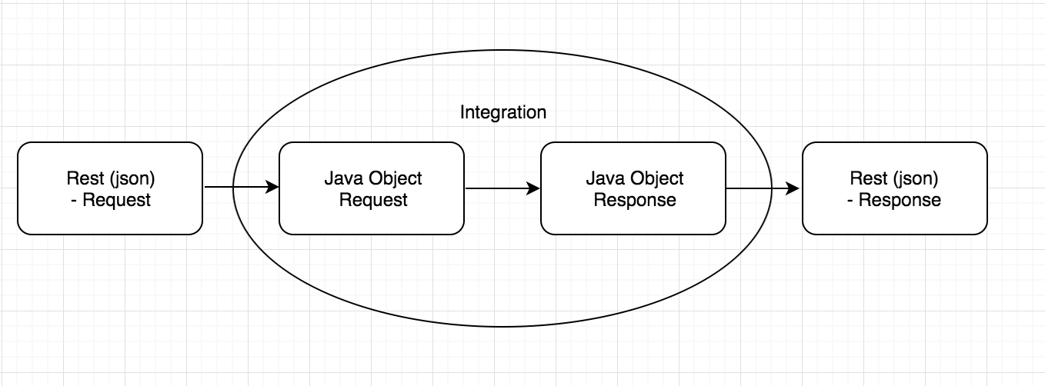
Routes: Rest-to-rest
Integration between request and response
Java coding

Slide 7
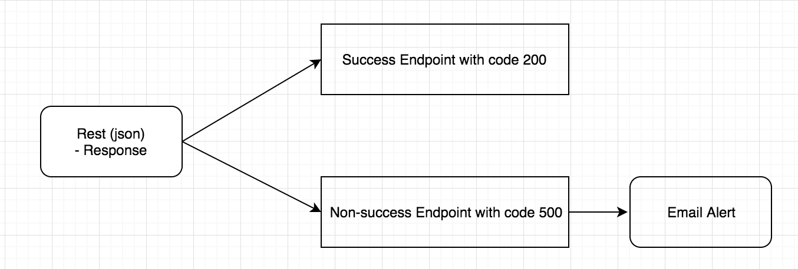
Routes: Rest-to-rest
Endpoint with Different Code
Code 200 (success)
Non 200 Code (Error)
Email Alert

Slide 8
Routes: Rest-to-soap
Json to XML
Split and Aggregate

Slide 9
Routes: Soap-to-rest
XML to Json
Encrption (Java Coding)
WireTap Route:
Data Storing on DB
Message sending to JMS

Slide 10
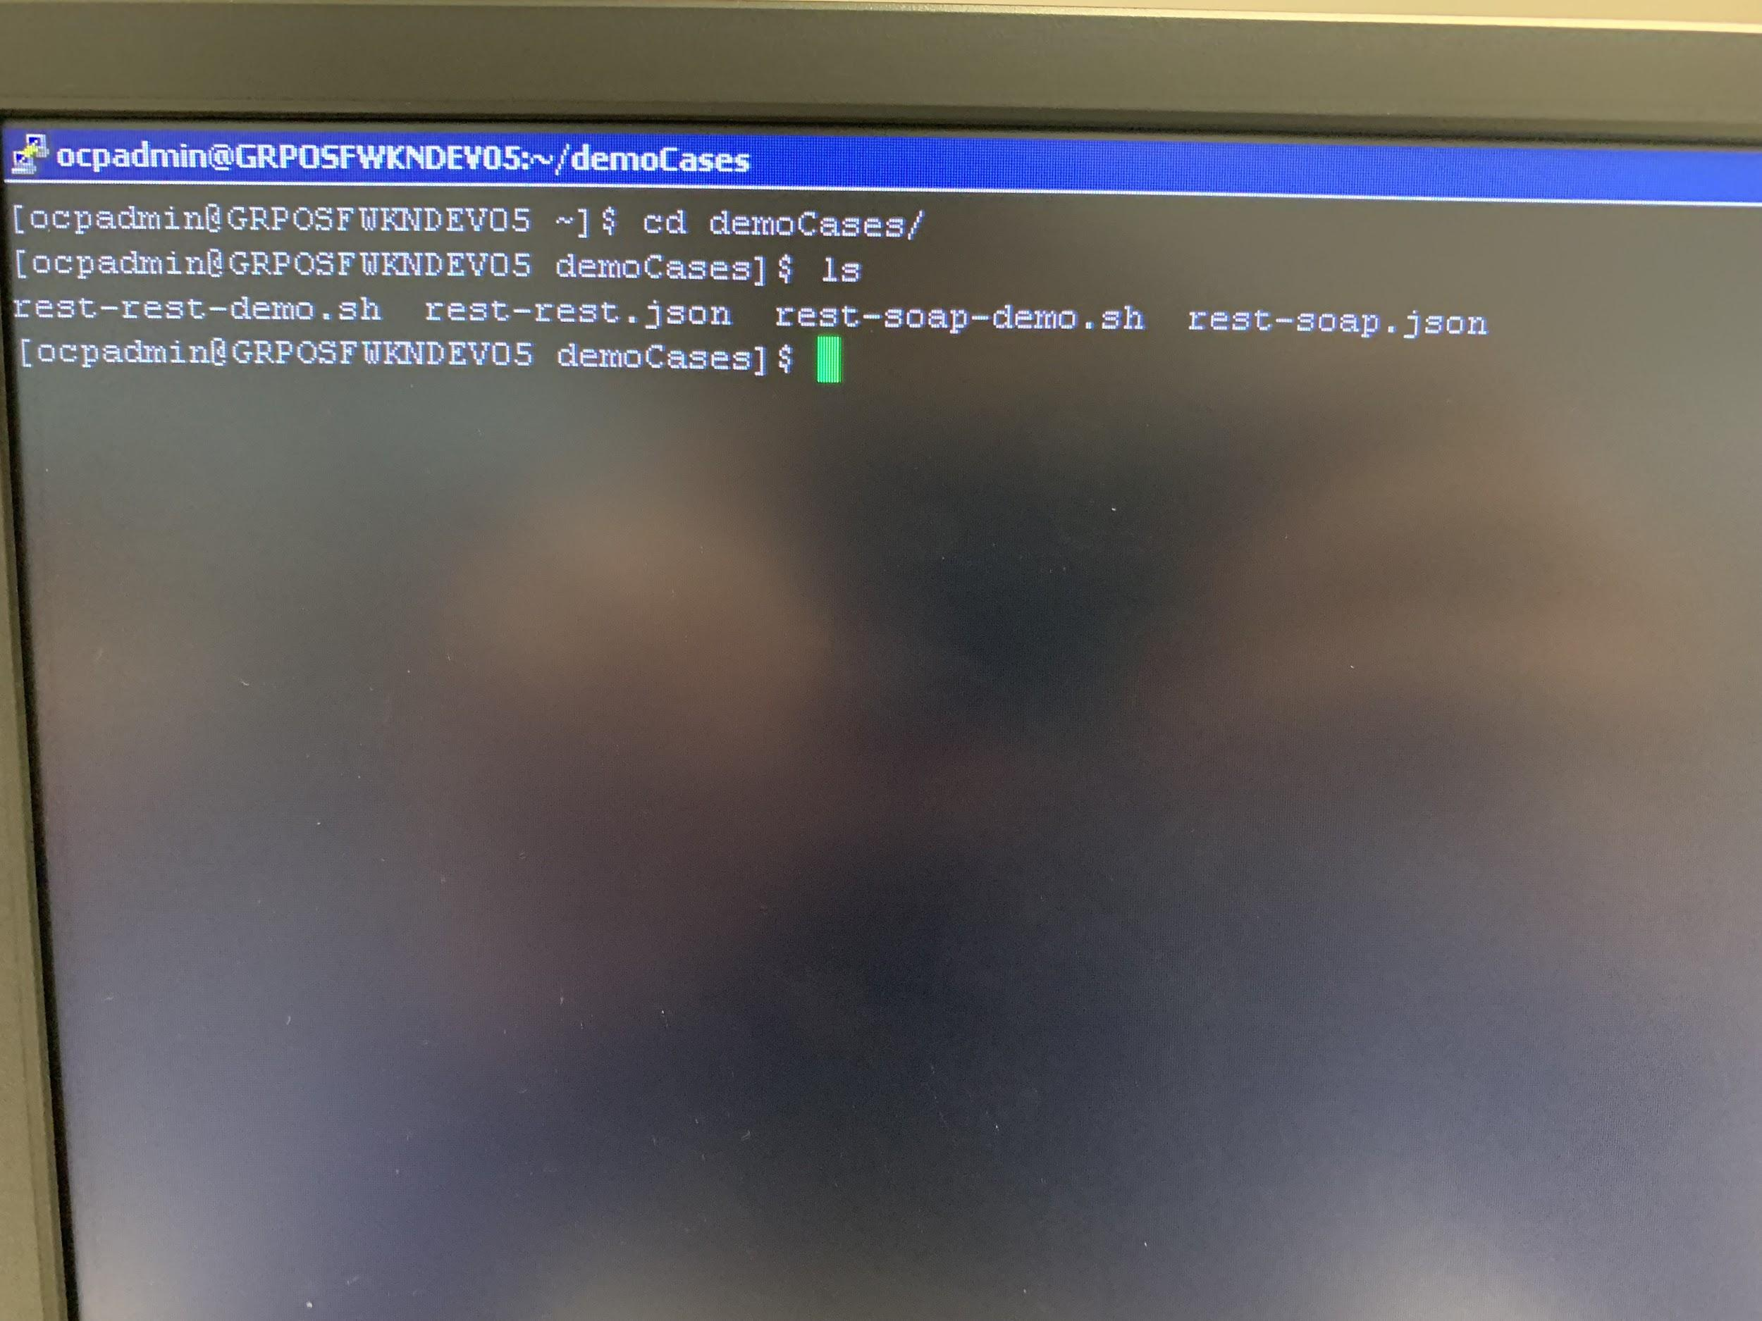
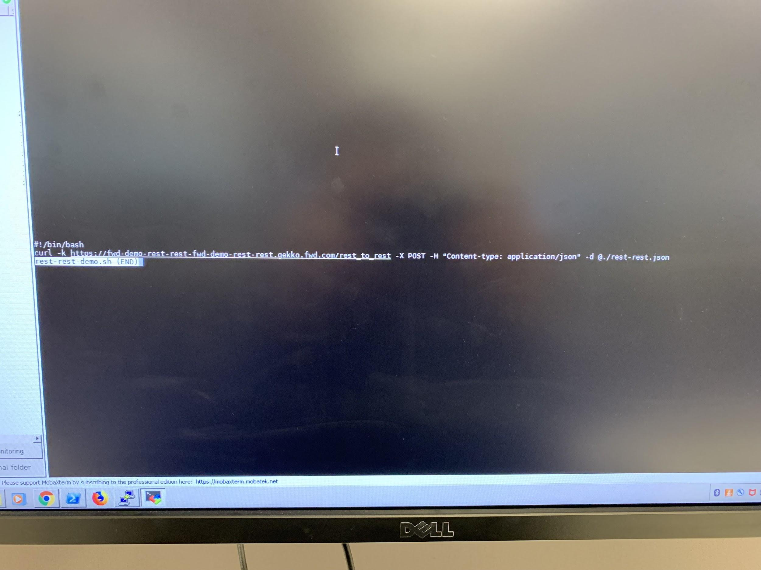
Testing for the Route
Bit bucket for camel code
Build the project on Openshift
CMD Test Case

Slide 11
End Thank You!

