Slide 1



Error Handling and Recovery Strategies in Compiler Design
Error Handling
Compiler design is a complex process that requires meticulous error handling to ensure reliability.
Recovery Strategies
Robust recovery strategies are essential for resolving issues during the compilation process.

Slide 2

Types of Errors in Compiler Design
1
Syntax Errors
2
Semantic Errors
3
Runtime Errors
Errors that occur due to violations of the programming language's grammar rules, such as missing semicolons or mismatched parentheses.
Errors that arise from logical or contextual inconsistencies in the source code, such as type mismatches or invalid variable declarations.
Errors that occur during the execution of the compiled program, such as division by zero or accessing out-of-bounds memory locations.

Slide 3

Error Detection Techniques
Static Analysis
Dynamic Analysis
Incremental Compilation
Analyzing the source code without executing it to identify potential issues, such as syntax and semantic errors.
Monitoring the behavior of the compiled program during runtime to detect and diagnose runtime errors.
Compiling the source code in small, manageable chunks to quickly identify and locate errors.

Slide 4

Error Reporting and Diagnostics
Informative Error Messages
Line and Column Numbers
Provide clear, concise, and helpful error messages that guide the developer towards the root cause of the issue.
Indicate the specific location of the error within the source code to aid in debugging.
Suggested Fixes
Error Logging
Offer potential solutions or workarounds to help the developer resolve the error quickly.
Maintain a comprehensive log of all errors encountered during the compilation process for future reference and analysis.

Slide 5

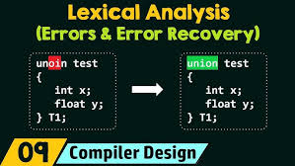
Error Recovery Strategies
1
Panic Mode
Quickly skip over the current erroneous construct and continue the compilation process to identify and report additional errors.
2
Backtracking
Undo the last few parsing decisions and try alternative paths to recover from the error and resume compilation.
3
Error Productions
Define special grammar rules to handle known error patterns and recover the compilation process gracefully.

Slide 6



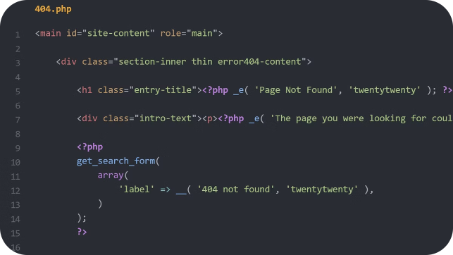


Syntax Error Handling
Error Detection
Error Correction
Identify syntax violations during the parsing stage and report them with relevant context.
Attempt to automatically fix minor syntax errors by inserting, deleting, or modifying tokens.
Error Reporting
Error Recovery
Provide clear and actionable error messages to help the developer understand and resolve the issue.
Implement strategies like panic mode or backtracking to continue the compilation process after a syntax error.

Slide 7


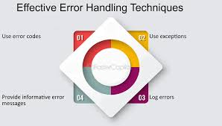


Semantic Error Handling
Type Checking
Verify the correctness of variable types and operations to identify semantic inconsistencies.
Symbol Table Management
Maintain a symbol table to track the scope and context of variables, functions, and other language constructs.
Error Reporting
Provide detailed error messages that explain the nature of the semantic error and suggest possible solutions.

Slide 8


Runtime Error Handling
Error Type
Description
Handling Strategy
Divide by Zero
Attempting to divide a number by zero
Catch the exception and provide a meaningful error message
Out of Bounds
Accessing an array or memory location outside its valid range
Validate input and array bounds to prevent the error
Null Reference
Dereferencing a null pointer or reference
Implement null checks and provide graceful error handling

Slide 9

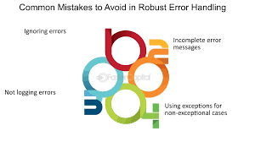
Robust Error Handling Practices
1
Comprehensive Testing
2
Continuous Improvement
Implement extensive unit, integration, and end-to-end tests to identify and address errors at all stages of the compilation process.
Analyze error logs and feedback to continuously refine and enhance the error handling mechanisms of the compiler.
3
Collaborative Debugging
4
Documentation and Training
Encourage developers to work together to investigate and resolve complex errors, leveraging their collective expertise.
Provide comprehensive documentation and training resources to help developers understand and effectively utilize the compiler's error handling features.

Slide 10
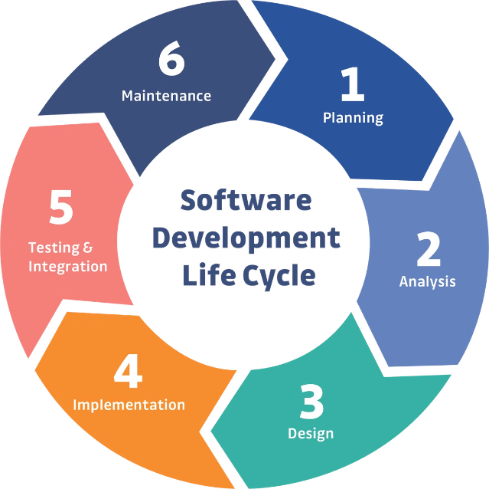
Conclusion
Effective error handling and recovery strategies are essential for building reliable and robust compilers. By implementing a comprehensive approach to error detection, reporting, and recovery, compiler designers can ensure that their products can handle a wide range of issues and provide a seamless user experience for developers.

