Slide 1


Likelihood
$$L(θ;x)$$
all
info
Inferences about $θ$

Slide 2



Likelihood
$$L(θ;x)$$
all
info
Inferences about $θ$
same
info
Likelihood
$$L_{1}(θ;x)$$
$$L_{1}∝L_{2}$$
Likelihood
$$L_{2}(θ;x)$$

Slide 3
Likelihood
$$L(θ;x)$$
all
info
Inferences about $θ$
# looks at data we take
same
info
Likelihood
$$L_{1}(θ;x)$$
stopping rule of study
$$L_{1}∝L_{2}$$
Likelihood
$$L_{2}(θ;x)$$

Slide 4
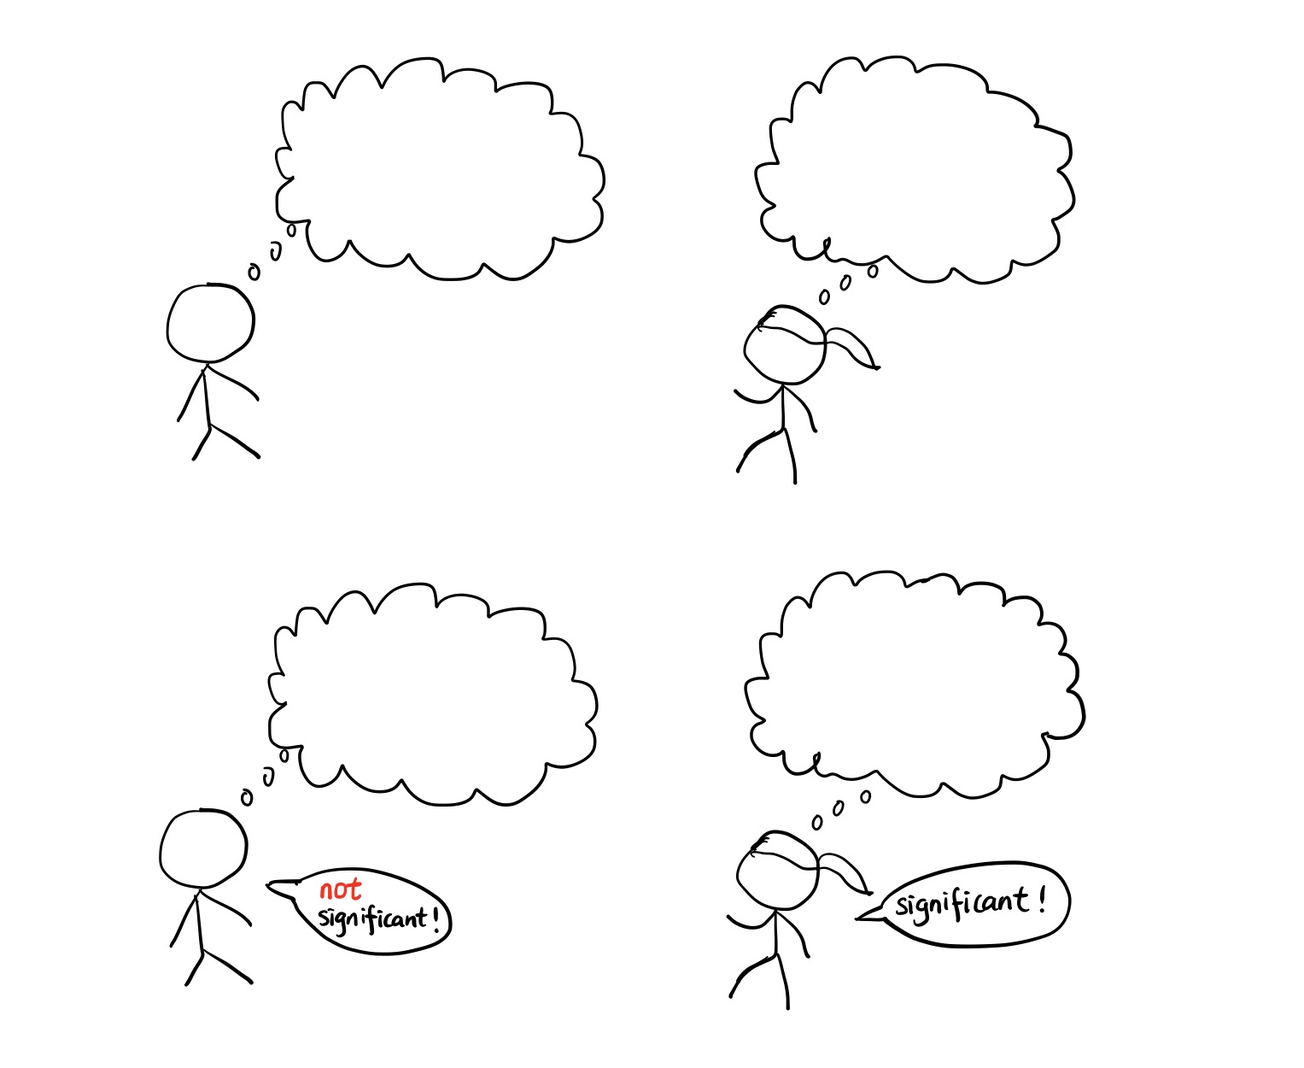




I will observe 12 results before I stop
$$X\sim Binom(12,θ)$$
I will see 3 failures before I stop
$$X\sim NB(3,θ)$$
$$P\left(X=9\right)=\left(\begin{matrix}12 \\ 9\end{matrix}\right)θ^{9}{\left(1−θ\right)}^{3}$$
$$P\left(X=9\right)=\left(\begin{matrix}12 \\ 9\end{matrix}\right)θ^{9}{\left(1−θ\right)}^{3}$$
p-val = .0730
p-val = .0338

