Slide 1




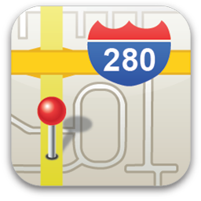
DeepBLE: Navigation using Low Energy Bluetooth
Eric Kim | Faculty Advisor: Boon Thau Loo
Abstract
With the new Bluetooth Low Energy APIs released by Android, we leverage the geofencing power of BLE in tracking position. We use a network on anchors that communicate with other devices
System Design
Design Goals
Levine
Towne
Moore
Eric
Jane
Jane
John
John
Portable
Enriched Context
Scalable
Robust
Anchors placed anywhere
Each anchor/user with contextualized information
Easy to add more anchors
Fault tolerant, esp. with regards to line of sight
Don’t need preexisting framework
Motivation
Bluetooth Low Energy
No need for network signal
No costly setup
Scalable and flexible
Each anchor broadcasts info about the users and anchors in their field, forming a network.
Screenshots
Future Work
- More precise position tracking - Render map of relative positions - Graph display of network of anchors
Main anchor screen Set your device
List of anchors and their users
Information – set context for anchor
More robust/portable than Wifi
Less impact by LOS -> Indoor use
Conclusion
Designed an Android app to track location using BLE, which can be extended to fit a wide variety of use cases
Use Cases
Senior Project Poster Day 2014 – Department of Computer and Information Science – University of Pennsylvania

Slide 2
Feedback

