Slide 1

DeepBLE Progress Report
Eric Kim
Aditya Sood

Slide 2
Bluetooth Low Energy Positioning
Indoor positioning using BLE exclusively
No Wifi or network signal needed
No prior context – anywhere an anchor can be placed can be a map
Anchors that are set down anywhere, create a field in which location can be tracked
User friendly map – find your friends devices

Slide 3
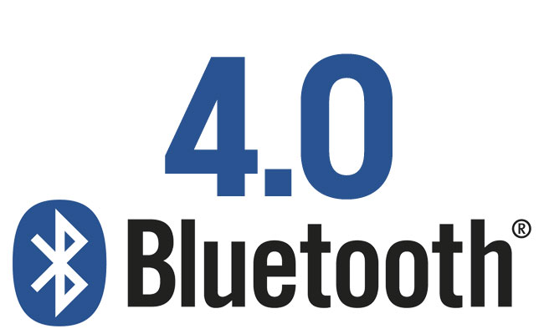
Accomplished Last Year
Bluetooth communication between devices – app on the devices that handles the read/writes
Devices should detect one another, be able to send messages to either each other or to the anchor
Basic implementation (List of devices currently in area)

Slide 4
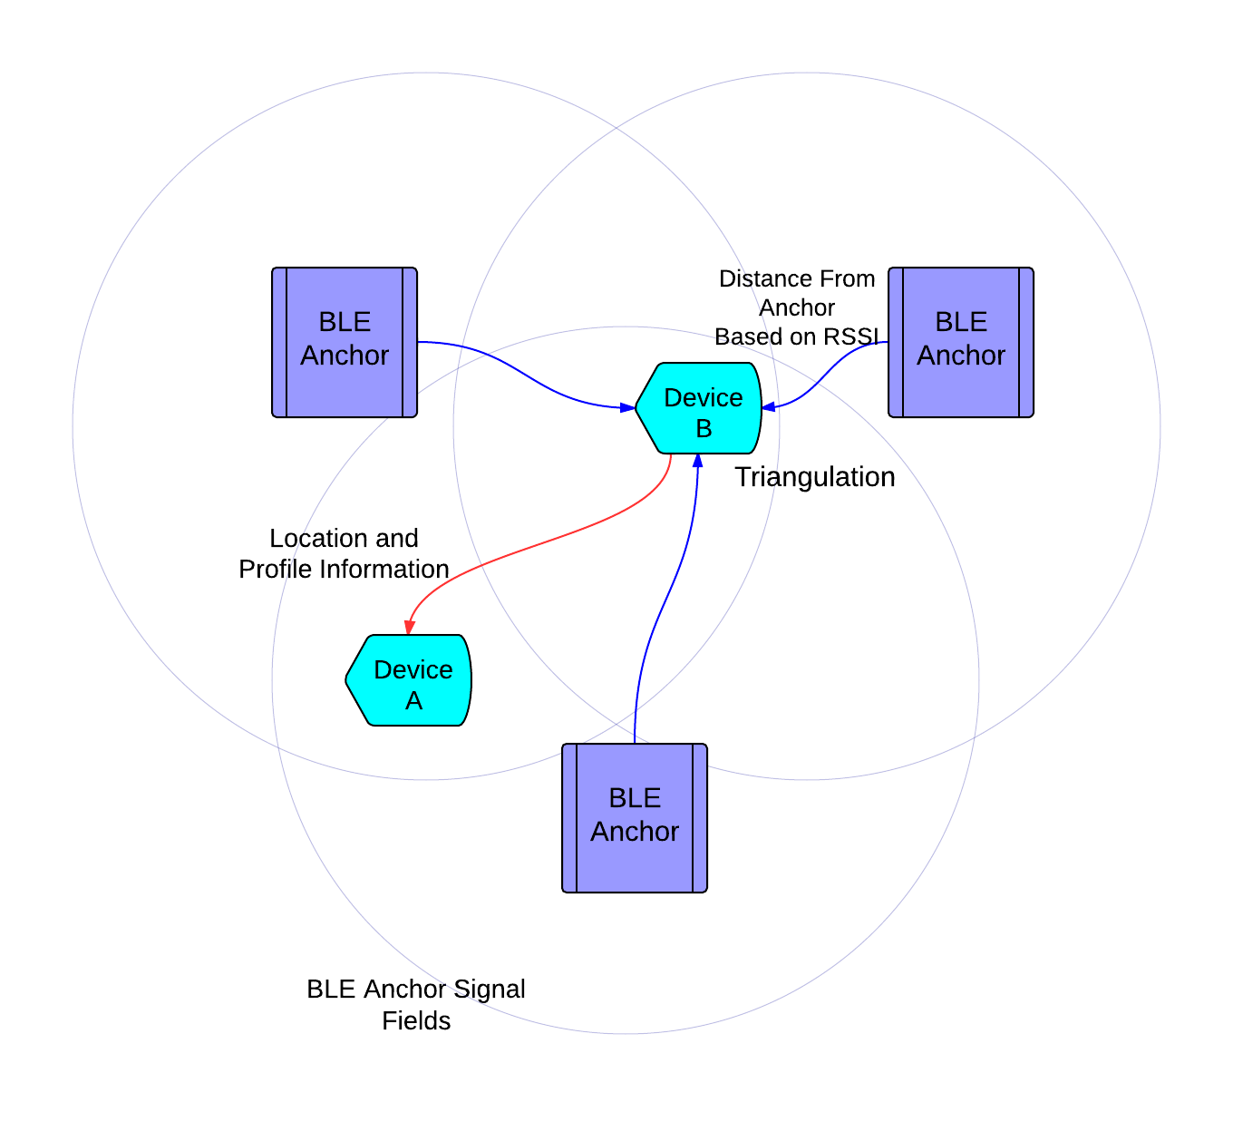
Accomplished So Far
Genetic Attribute Profile (GATT) Design
Anchor – Constantly broadcasting (x,y) coordinates as static location
User – Broadcasts (x, y) coordinates to other users
Reads all points, identifies (anchor or user)
Triangulation coordinate calculation & RSSI Strength testing
Done with “hard coded” values (not on real devices)
-6dB correlates to double the distance (for line of sight)

Slide 5
What Remains to be Done
Implementing the triangulation with real world devices
So far triangulation calculations have only been done with hard coded values; we need to test with real devices
Rendering the map
We expect this to be the majority of our time commitment from here on out
Rendering in a way that is easy to understand, and robust enough to handle uncertainty

Slide 6
Some Challenges
Bluetooth communication between devices is hard to test
Signal can be inconsistent, especially when objects interfere/block
Scalability hard to test as well.
We test the correctness of the calculations using hard coded values (test anchors/values). We need a way to test with many devices
Fault tolerance
The signal strength varies sometimes, and position jumps around as a result

Slide 7
Q&A

