Slide 1

Indoor Navigation Using Low Energy Bluetooth
Eric Kim
Aditya Sood

Slide 2
Outline
Background on Bluetooth Low Energy
Motivation
Implementation Details
Technical Challenges
Moving Forward

Slide 3
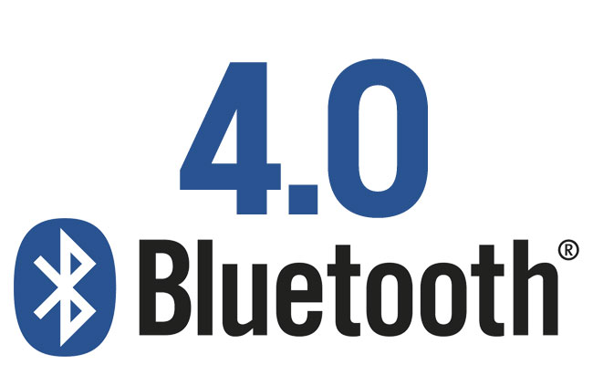
Low Energy Bluetooth
Bluetooth standard since 2010
For context, Galaxy S3 and iPhone 4S were the first devices to support BLE
Genetic Attribute Profile (GATT)
Client – Device (computer, smartphone, signal transmitter)
Server – receives commands/requests, reponds
Android – built-in platform support for 4.3 and up
iOS – built-in platform support for iOS7 and up
iBeacon – communication between beacon and phone

Slide 4
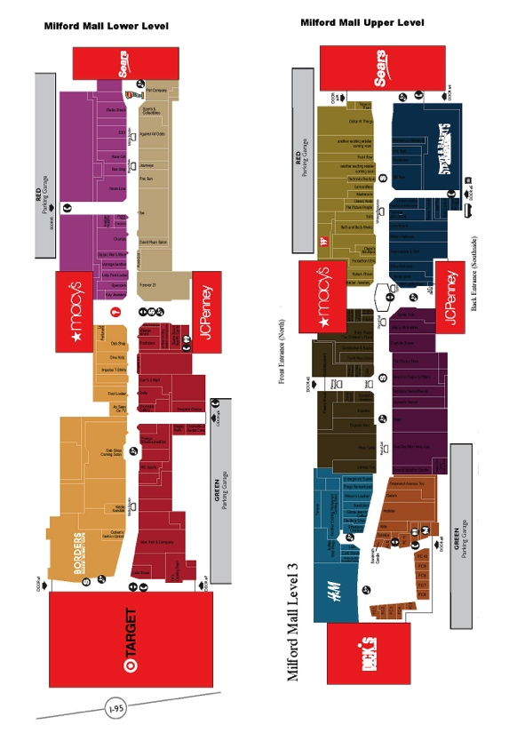
Indoor Navigation
GPS navigation severely limited indoors – no signal!
Subproblem – no contextual awareness
Standard today is through Wi-fi access points
Wi-fi trilateration methods – fixed access points
Measure Wi-fi signal strength to determine position of device
Distance between point of unknown position and three points of known position
Very expensive set up cost, needs predefined context

Slide 5
How It fits together
Advantages of BLE positioning
Limited communication data can be provided with the positioning information
In other words, we can enrich position with context!
The more clients, the more accurate – BLE found in most smartphones released in the past year
Localization with accuracy of ±1 meter!
Disadvantages
Decentralized – without framework for devices to communicate with each other, associated information is useless

Slide 6
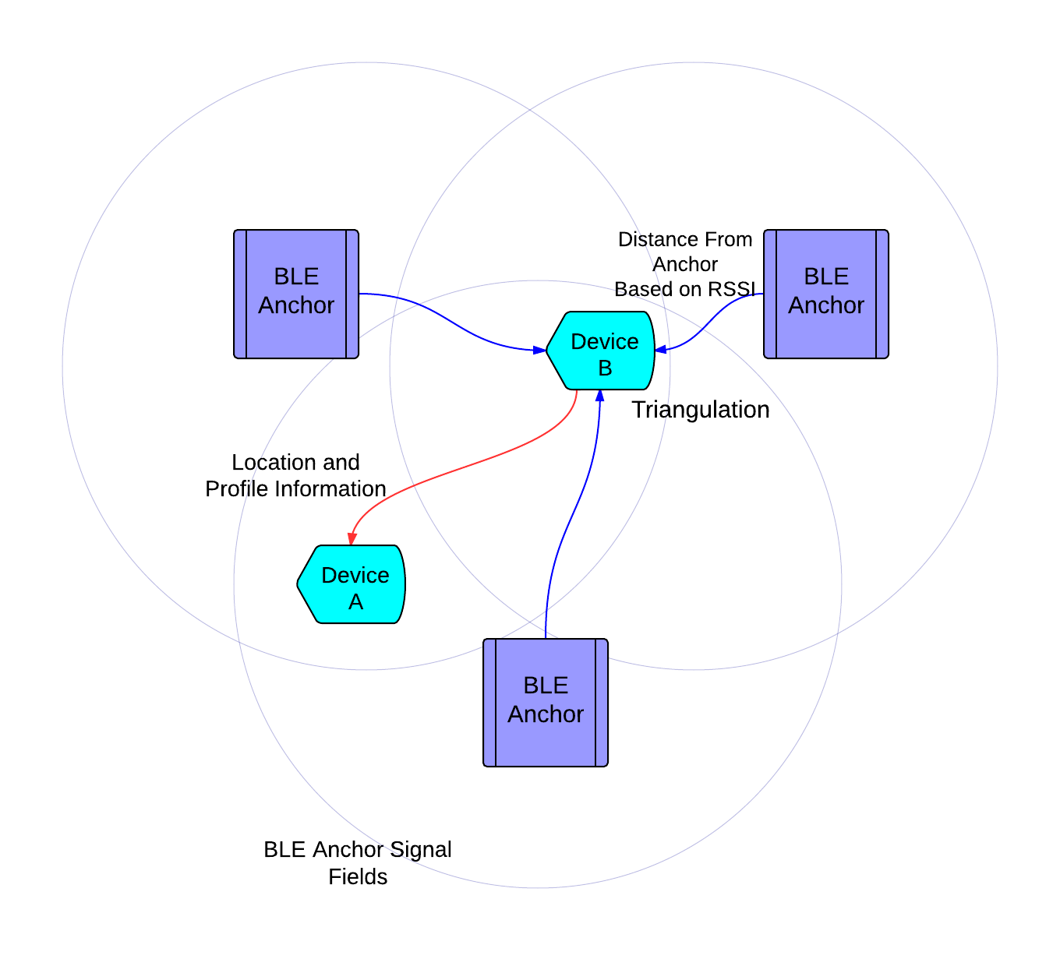
The Framework
Peer to peer messaging
Each device can communicate with one another
Send information to each other using GATT profile
Information can include user id in addition to location
Anchor
Receive information about devices in area
Can be dedicated signal receiver/transmitter or another device

Slide 7
Planned Approach
Bluetooth communication between devices – app on the devices that handles the read/writes
Devices should detect one another, be able to send messages to either each other or to the anchor
Anchor implementation – anchor can be another device or dedicated transmitter
Anchor should transmit information about the location of devices within its range
Calculation of Position – Using just direction and RSSI strength, calculate position
“Virtual map” – A map of all positions and locations, with no context

Slide 8
Measures of Success
Device to device communication
Have two-three devices, each of which when in bluetooth range can detect the presence of each other.
In addition, have the device to device communication – send messages between each other.
This should be easily demonstrable!
Simulator
Write basic simulator that simulates the behavior of devices and anchors
This will be used to test scalability
Multiple moving devices, set number of fixed anchors, location calculator will calculate the positions of all devices by triangulation

Slide 9
Technical Challenges
Bluetooth 4.0 API is brand new
We will be developing on Android, and using the Android BLE API as our method of peer to peer messaging
Hardware Challenges
Bluetooth range and signal strength will need to be stress tested for our use
Phones themselves must calculate its own position – so it must be fault tolerant in case the anchors or bluetooth signal is faulty
Scalability
We will be restricting our demo/use case to just a simple two device

