Slide 1

E-Commerce Product Clustering
UNSUPERVISED LEARNING · MINI PROJECT
Grouping 6,000 real Amazon products with no labels, using text, price and ratings
Sucheendra Ramesh
PES1PGE25DS067
Dayanand Kenchappanavr
SRN: ____________
PES University · RRBatch-1 · November 2026
Notes:
Introduce yourselves. One line: we built a system that automatically groups e-commerce products into meaningful clusters without any labels, using real Amazon data.

Slide 2



Online catalogues are too big and messy to label by hand
Millions of products
Messy categories
Manual labelling is slow
Thousands of sellers upload listings every day
Sellers pick categories themselves, so similar items land in different places
Experts can't review a catalogue this size
PROBLEM STATEMENT
Using only a product's title, description, price, rating and review count, automatically group products into meaningful clusters, without any category labels.
Notes:
Why this problem matters: on Amazon or Flipkart, sellers choose categories, so labels are inconsistent. Clustering is unsupervised: it needs no labels, so it fits this situation. Read the problem statement.

Slide 3





Our approach in five steps
1
2
3
4
5
Collect
Represent
Choose K
Cluster
Evaluate & demo
6,000 real Amazon products, cleaned
Text → TF-IDF → 50 topics; scale numbers
Elbow method + Silhouette score
K-Means vs Agglomerative vs DBSCAN
Keywords, purity, ARI, live app
Key rule: Amazon's real category is hidden from the model. We use it only at the end, like an answer key, to check whether the clusters make sense.
Notes:
Walk the pipeline left to right. Stress the key rule: labels are never used for training, only for evaluation. That is what makes it unsupervised.

Slide 4
Real data: Amazon Reviews 2023 (UC San Diego)
6,000
6
1,000
117K
products used
Amazon categories
per category (balanced)
products in source
Columns used
Cleaning
title, description: what the product is
price, rating, num_reviews: value & popularity
true_category: hidden, evaluation only
Removed missing price / rating, $0 and ≥ $2,000 prices
Stripped HTML, removed duplicates & very short titles
Balanced 1,000 per category (smallest has 1,338)
Source: Hou et al. (2024), McAuley Lab, UCSD · huggingface.co/datasets/milistu/AMAZON-Products-2023 · free, no login
Notes:
Real, public data, not synthetic. Categories: Fashion, Home, Tools & Home Improvement, Cell Phones, Pet Supplies, Sports & Outdoors. We balanced them so no category dominates. The download script streams only the 6 columns we need from a 1.6 GB dataset.

Slide 5
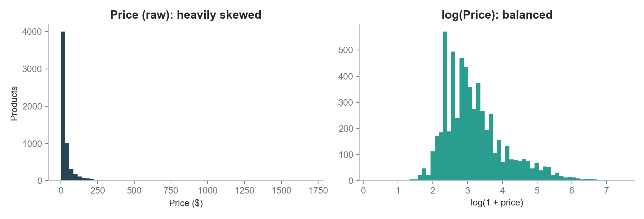
Prices are skewed, so we take the logarithm
$19.88
median price
$43.57
mean price: more than 2× the median
Why it matters: K-Means uses distances. Without log, a few expensive products would dominate. After log(1 + price), the distribution is balanced. Review counts get the same treatment.
Average rating 4.14 · median 14 reviews
Notes:
Most products are cheap, a few are very expensive: mean is more than double the median. Since K-Means works on distances, we compress with a log before scaling.

Slide 6
Turning products into numbers
Title + description
text
TF-IDF
46K word weights
Truncated SVD
50 topics + normalise
53 features
text × 1.0 · numbers × 0.1
Price, reviews
numbers
log(1 + x)
fix skew
StandardScaler
+ rating
K-Means
K = 6
TF-IDF: “dog” in a dog bowl matters; “the” doesn't
SVD (LSA): thousands of words → 50 topics, groups related words
Weights: text decides what a product is; numbers only nudge. At 0.25 the model made a “badly rated products” cluster instead
Notes:
Two branches. Text: TF-IDF scores important words, SVD compresses them into 50 topics. Numbers: log fixes skew, StandardScaler puts them on the same scale. We combine with weights so text dominates. Everything is one scikit-learn Pipeline, so a new product goes through identical steps.

Slide 7
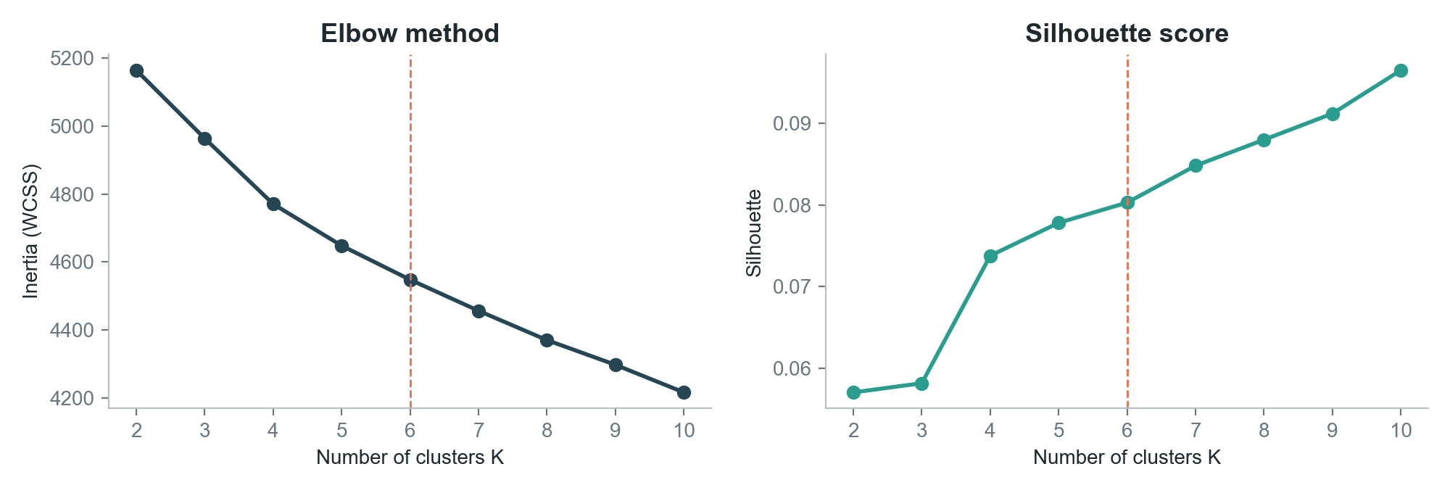
Choosing K: elbow flattens, K = 6 is interpretable
No sharp elbow, slowly rising silhouette (0.06 → 0.10): normal for text data. We chose K = 6, where gains flatten and every cluster can be named in business terms.
Notes:
We ran K-Means for K = 2 to 10. Inertia always decreases; we look for the bend. Silhouette is low because text is high-dimensional and products overlap. K = 6 balances score and interpretability; more clusters just split big groups into tiny ones.

Slide 8
Six clusters K-Means found on its own
0
Pet supplies
1
Clothing
2
Lighting
832 products · avg $27.2
932 products · avg $43.9
257 products · avg $40.1
dog · dogs · cat · pet · cats
women · men · sleeve · shirt · casual
light · led · lights · lamp · solar
97% Pet Supplies
76% Fashion
85% Tools & Home
3
Hard goods & outdoor
4
Phone accessories
5
Home & storage
1,898 products · avg $59.9
876 products · avg $27.1
1,205 products · avg $41.7
steel · water · bag · stainless · size
case · phone · galaxy · samsung · compatible
storage · home · set · room · gift
41% Sports & Outdoors
98% Cell Phones
59% Amazon Home
Notes:
Names are ours, given from each cluster's top keywords. The bottom line of each card shows the largest Amazon category inside the cluster. Pets 97% and phones 98% pure, without seeing a single label. Lighting is a new segment: Amazon hides it inside Tools & Home Improvement.

Slide 9
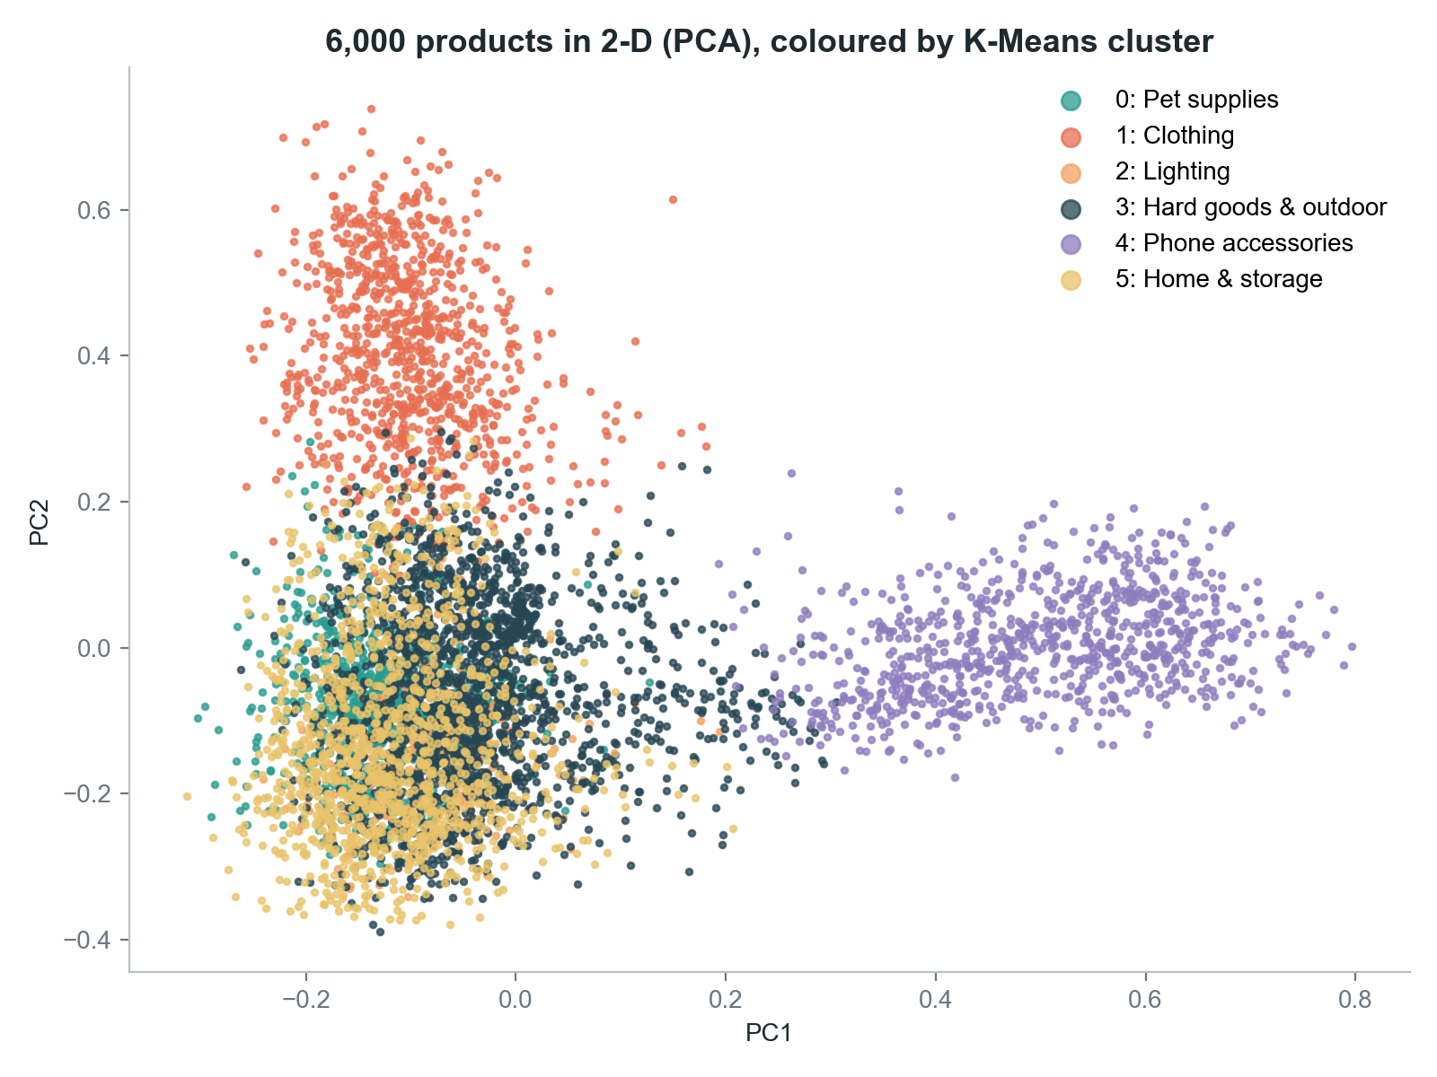


Seeing the clusters: 53 dimensions squeezed into 2
Clearly separate
Phone accessories (purple) and clothing (orange) form their own regions
Overlap is expected
PCA keeps only 2 of 53 dimensions; home, pets and hard goods separate better in the full space
In the live demo
hover any dot to see the product name
Notes:
PCA is only for visualisation. The clusters were computed in 53 dimensions; overlap here doesn't mean the clusters are wrong.

Slide 10
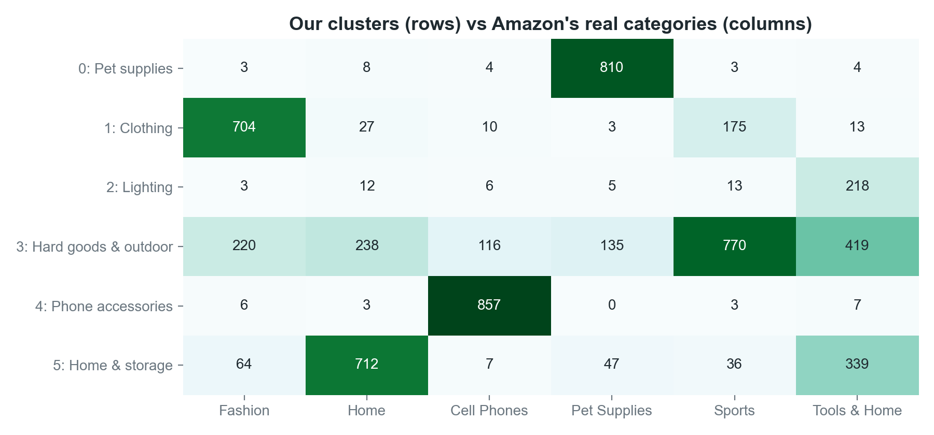
Checking against Amazon's categories (answer key)
0.41
ARI (0 = random, 1 = perfect)
97% · 98%
pet & phone cluster purity
Why not 1.0? Amazon's own categories overlap (a water bottle can be Sports, Home or Tools), and clustering found new groups such as lighting. Stable: 1,800 → 6,000 products gave the same 6 themes (ARI 0.43 → 0.41).
Notes:
Rows are our clusters, columns Amazon's categories. Dark diagonal-like cells mean strong agreement. ARI 0.41 is far above random (0). We also tripled the data and got the same 6 themes, so the result is stable.

Slide 11
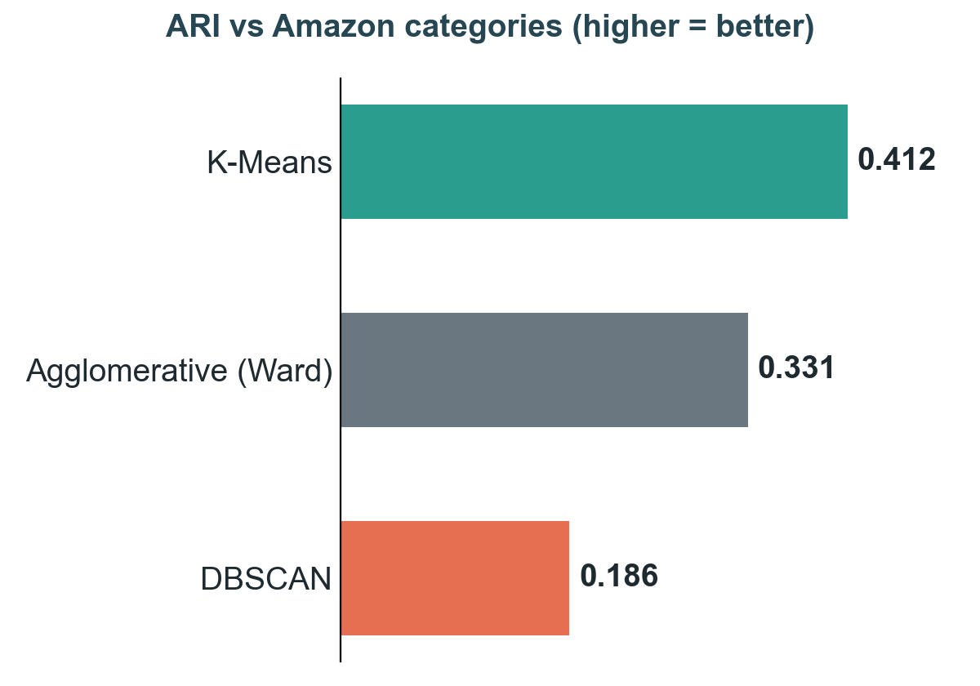

K-Means beats Agglomerative and DBSCAN
Algorithm | Clusters | Noise | Silhouette ↑ | DB index ↓
K-Means | 6 | 0 | 0.080 | 3.508
Agglomerative (Ward) | 6 | 0 | 0.067 | 3.559
DBSCAN | 35 | 2,464 | 0.114 | 1.562
DBSCAN's good-looking silhouette is a trap: it threw away 2,464 products (41%) as noise and made 35 tiny clusters. Text has no clear dense regions.
K-Means: best ARI, best silhouette and DB index among methods that keep all products, plus it can predict new products.
Notes:
Same features, three algorithms. Agglomerative merges closest groups bottom-up; DBSCAN looks for dense regions. Point out the DBSCAN trap: its scores are computed only on products it kept. K-Means is the final choice.

Slide 12



Live demo: Streamlit app
1. Data
Real products, price distribution, categories
TRY IT
“Stainless steel dog food bowl, non-slip” · $14.99
2. Choose K
Elbow + silhouette charts
→ Cluster 0: Pet supplies
Top match: insulated stainless-steel pet bowl (similarity 0.86); all 5 matches are pet bowls
3. Clusters
Move the K slider and re-cluster live; hover products
4. Compare
Change DBSCAN eps and watch noise points change
5. Try a product
streamlit run app.py
Type any product → its cluster + 5 similar items
Notes:
Switch to the browser (start the app before presenting). Show tab 3, move the K slider. Tab 4, move eps. Tab 5: type the dog bowl, then let the professor type a product of their choice.

Slide 13


Business value and what we learned
Catalogue clean-up
Recommendations
Segment discovery
Products whose cluster disagrees with their listed category are flagged for review
New products with no sales history get “customers also viewed” matches instantly
Found a lighting segment hidden inside Tools & Home Improvement
Learnings
Feature engineering (log, weights, TF-IDF settings) mattered more than the choice of algorithm
Internal metrics can mislead: DBSCAN won silhouette but gave the least useful clusters
Hidden labels, used only for checking, are a strong sanity test for unsupervised models
Notes:
How a real store would use this, then three learnings. The first one is important: tuning features moved ARI from 0.25 to about 0.36 on our first sample.

Slide 14
Limitations and future work
Limitation
Next step
TF-IDF matches exact words only (“sofa” ≠ “couch”)
Sentence embeddings (BERT / sentence-transformers)
One broad hard-goods cluster
Re-cluster it (hierarchical drill-down)
Each product in exactly one cluster
Gaussian Mixture Models for soft membership
Images not used
Add CNN image features
6 categories, 6,000 products
Scale to the full catalogue with MiniBatchKMeans
Notes:
Be honest about limitations; each one maps to a concrete next step. Sentence embeddings are the biggest expected improvement.

Slide 15
CONCLUSION
6,000
6
0.41
98%
real products
meaningful clusters
ARI, no labels used
best cluster purity
TF-IDF + SVD + K-Means grouped real Amazon products into clusters that are interpretable, stable and useful for catalogue organisation and recommendations.
Thank you · Questions?
Sucheendra Ramesh (PES1PGE25DS067) · Dayanand Kenchappanavr
Notes:
Summarise with the four numbers, then invite questions. Likely questions are listed in README.md section 11.

