Slide 1
DATA ANALYTICS Practical Project 1 Report
Student name:
Student ID:

Slide 2
Background information
Two separate datasets, including GTD and crypto currency datasets, have been discussed in the study report for the purpose of data evaluation and implementation (Agarwal et al. 2019).
The GTD has a comprehensive list of incidents that happened in numerous countries around the world.

Slide 3
Purpose of the research report
The research article has entailed interpreting, extrapolating, and analyzing these two datasets with the aim of this company to use data analytics technology to provide applicable findings and conclusions.
Data analysis is mostly used to obtain information for data-related decision making processes (Akay et al. 2020).

Slide 4
Key questions
What kind of tools do terrorists frequently employ in their attacks?
What kind of attack is employed most frequently?
Who do terrorists most frequently target?
Is the high volume efficient for the crypto currency?

Slide 5
Methodology
Data sources
The GTD is collected from open source databases which contain details on terrorist acts that occurred worldwide between 1970 and 2017.

Slide 6
Data collection methodology
The GTD has built a vast, effectively executed longitudinal data collection on incidents of terrorism both domestically and internationally.
The primary objective is to simplify the academic and analyst's understanding of the current assault situation.
Notes:
According to the slide above, The GTD would be specifically designed to be compatible with the most recent numerical analytic techniques used in computer science and inferential statistics.

Slide 7
Data cleaning and preparation
The data must be correctly arranged to allow for the addition of the confirmation and retraining data (Atsa’am et al. 2020).
It is crucial to ensure that the data is gathered in the appropriate format in order to guarantee the approach.

Slide 8
Data analysis methods and techniques
In order to have a thorough grasp of how the information acts and to help with the research methodology, it is important to possess both visual and statistical assessments (Diab, 2019).
The article's extensive examination and discussion of such measures served as even the foundation for the investigation of these two databases' characteristics.
Notes:
Based on the preceding slide, the evaluation of the two datasets highlights the important components of the prediction model. These datasets have offered more thorough interpretations of the database's data.

Slide 9
Summary of the missing outliers and values
Huge range of datasets
Missing value in attributes
Missing value in target variable
Errors in forecasting value
lack of data maintaince issues due to huge amount dataset
Redundant data

Slide 10
Explanation of the data cleaning and preparation
Up to date information
Current data is required for obtaining the minimum value from the data analysis.
Missing value
Missing values are counted and analyzed the missing outliers.
Duplicate value
Duplicate data is removed during the data cleaning process.
Define the valid output
data labels are properly maintained for the valid data.
Numerical outliers
Numerical outliers are used for removing and detecting.

Slide 11
Data analysis
Descriptive statistics of the key variables
For the GTD dataset, the variables for Attack type and the majority of nations are utilized to analyze terrorist attacks. High and low cost values are utilized to interpret the crypto currency data set (Huamaní et al. 2020).

Slide 12
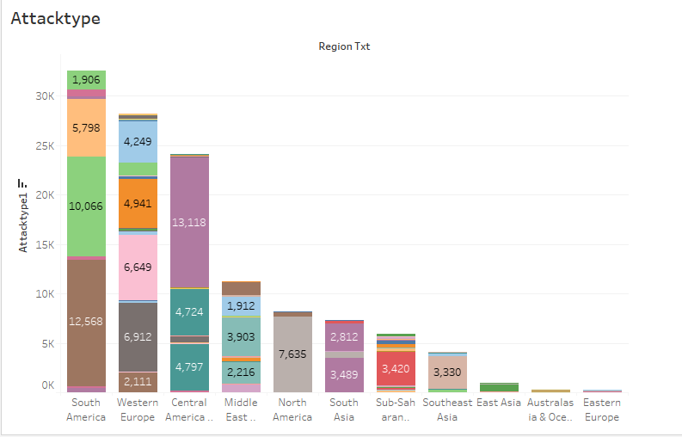
Visualization to support insights and findings

Slide 13
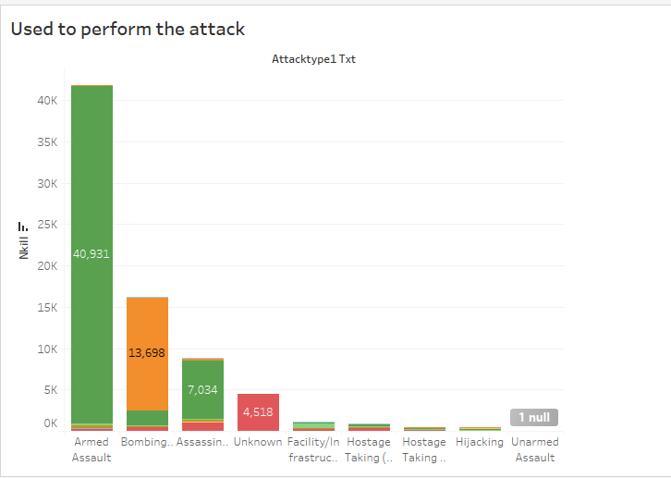
Model result and interpretation

Slide 14
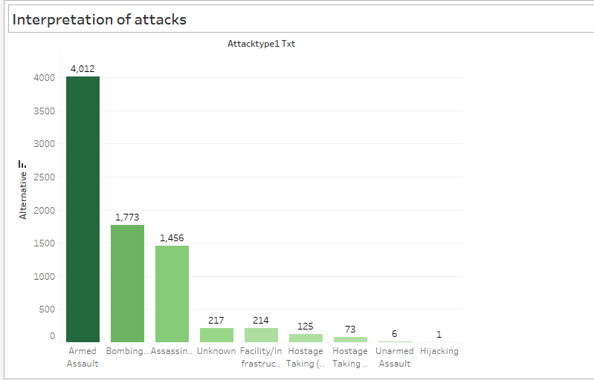
Result
Key results and findings

Slide 15
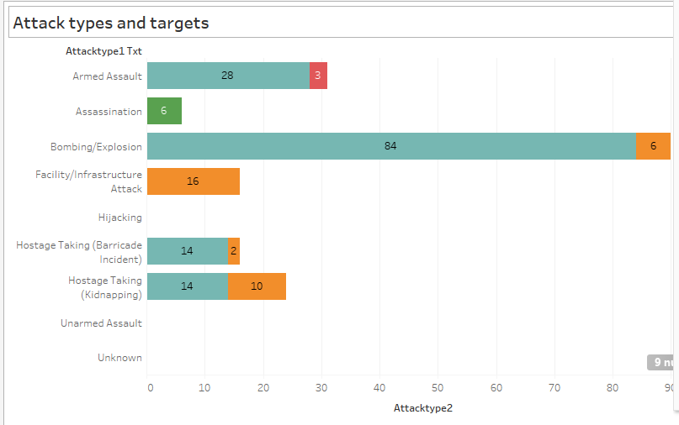
Interpretation of the results

Slide 16
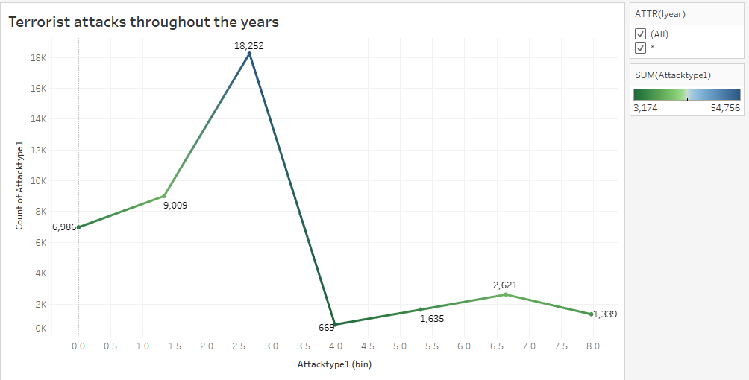
Explanation of the unexpected patterns and results

Slide 17
THANK YOU

