Slide 1
INTRODUCTION TO INFORMATION TECHNOLOGY
STUDENT NAME:
STUDENT ID:

Slide 2
Introduction
Hospital management system (HIS)
Information system
For patient care
Managerial information system
Patient management system
Clinical information system
System for clinical support services
Patient information database
Managerial information system
Electronic medical record
Notes:
Databases in the healthcare industry offer a suitable system for collecting, analyzing, and monitoring vital health data, including test results, financial information, billing and reimbursement information, patient records, and more. Although it must be kept private from the general public, such information may nevertheless be available to medical experts who need it to preserve lives.

Slide 3
Project overview
Scope
Patient registration
Staff management
System administration
Payment
Notes:
It is impossible to overestimate the significance of the database technology inside the healthcare industry. Its reliability and effectiveness of healthcare records affect all aspects of healthcare organisations, from complex systems to small-scale procedures.

Slide 4
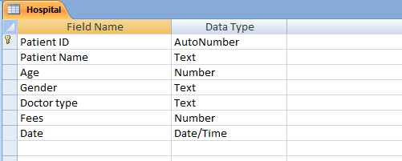
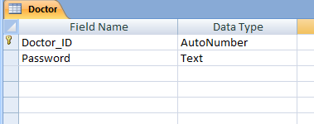
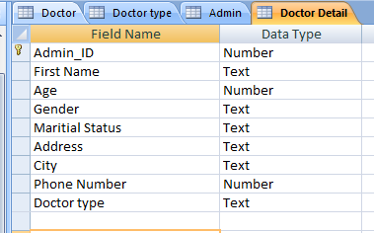
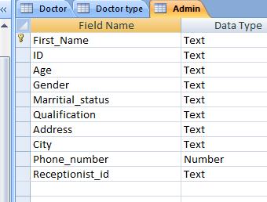
Tables in MS Access
Notes:
The tables are created in MS Access.

Slide 5
Reasons to create database in Access
Easy accessible
Huge amount of data
Cost-Effective
Easy to import the existing data
Notes:
Users in businesses and enterprises may efficiently handle data and look into big quantities of information thanks to Microsoft Access. The software enables the creation of simple elements by combining relational capabilities with achieve significant.

Slide 6
Problem faced when creating queries in MS Access
The index in table is not found
It is unable for reading the records
If the database isn't restored, the files aren't relational file
Database corruption
Showing the incorrect records

Slide 7
Contribution
The patient appointment lists are used to generate the databases.
The responsibilities that employees play when dealing with this system are heavily assigned.
The insurance policy covers hospital maintenance.
The attending physician in this facility is able to access the patient's medical information.
Notes:
Few assumptions are discussed to create the database of the hospital management system.

Slide 8
CONTD…
Effective communication among the management, worker, and patient populations results in significant time savings.
They are assisted in preserving the institution's full operating effectiveness and minimizing repetitious chores.

Slide 9
Reference list
Dash, S., Shakyawar, S.K., Sharma, M. and Kaushik, S., 2019. Big data in healthcare: management, analysis and future prospects. Journal of Big Data, 6(1), pp.1-25.
Figueroa, C.A., Harrison, R., Chauhan, A. and Meyer, L., 2019. Priorities and challenges for health leadership and workforce management globally: a rapid review. BMC health services research, 19(1), pp.1-11.
Khatoon, A., 2020. A blockchain-based smart contract system for healthcare management. Electronics, 9(1), p.94.
Singh, R.P., Javaid, M., Haleem, A. and Suman, R., 2020. Internet of things (IoT) applications to fight against COVID-19 pandemic. Diabetes & Metabolic Syndrome: Clinical Research & Reviews, 14(4), pp.521-524.

Slide 10
THANK YOU

