Slide 1


Ace Consulting Services
We Help You Lead the Deck
Business proposal for a
Single Army Logistics Enterprise system (SALE)
27th April, 2015
Sucheth Renuka Prasad

Slide 2
Who are We?
Founded in 1989, we are one of the world’s leading organizations specializing in management consulting, technology and outsourcing services
A US$ 30 billion Fortune Global 500 company, we operate in more than 200 cities in 56 countries
With a strong work force of 319,000, our current clients include 79 Fortune Global 100 and around three-quarters of the Fortune Global 500

Slide 3
US Army: Present Problem Scenario
At present, using old system the army logisticians are not able to accurately measure the requirements on battlefield and are unable to respond properly
Support provided to the soldiers is solely based on assumptions
Communication Infrastructure is not able to give desired results
There is a lack of asset visibility and it is affecting the supply management

Slide 4
Strategic Objectives
Replacement of old and outdated legacy systems by modernized and powerful information systems
Common information platform for army logisticians to access the Master Data globally
Effective reduction in the number of disparate systems through exhaustive Portfolio Management
Enhance networks for efficient communications

Slide 5
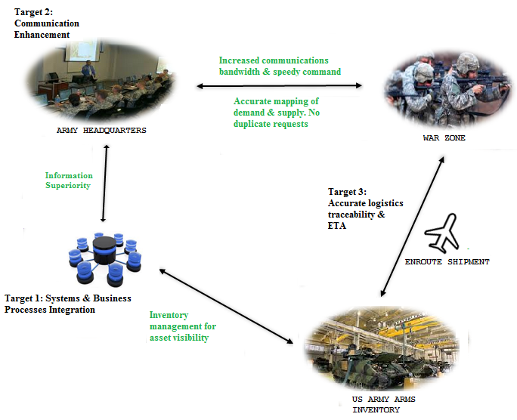
Mission Objectives

Slide 6
Strategies
Lay the foundation for implementations through Product Lifecycle Management Plus (PLM+)
Design and implement an integrated system and provide an E2E architectural view of the system
Phase wise go-live & pilot implementation of project activities comprising Global Combat Support System Army (GCSS-Army)and Logistics Modernization Program (LMP)
Implement project management tools (SAP Project System module) to plan, carry out and control target-oriented projects

Slide 7
Identified Projects
Logistics Modernization Program
Global Combat Support System – Army
Product Lifecycle Management Plus (PLM+)

Slide 8
Logistics Modernization Program (LMP)
Provide modernized national level logistics
Replace batch processing legacy systems of Commodity Command Standard System (CCSS) and Standard Depot System (SDS)
SAP-based ERP solution that will manage and track orders and delivery of material from the Army Material Command (AMC) to Soldiers where and when they need it
Supply, Finance, Planning, Production, Maintenance Execution & Data Control under one umbrella
Vertical and horizontal integration at all levels of logistics across the Army
Provide financial reporting to track order details
Program undertakes integration of around 80 DoD systems

Slide 9
Global Combat Support System Army
Provide modernized battlefield logistics
Tactical unit for logistics supply, material maintenance and financial reporting
Integration with an ERP solution to track supplies, organizational equipment and spare parts
Will replace outdated Standard Army Management Information Systems
SAP web based application will provide the users a single maneuver sustainment picture for leaders and decision-makers to manage combat power
Single integrated form of about 40,000 local supply and databases
Will improve the efficiency and visibility for approximately 160,000 users

Slide 10
Product Lifecycle Management Plus (PLM+)
Establish an enterprise level data hub
Provide architectural planning for bringing together, as a successful enterprise, the separate SAP solutions of LMP and GCSS-Army
Provide program and project management
Quality assurance and asset life-cycle management

Slide 11
Business Processes
Material Procurement
Material Management
Repairable Management
Plant Maintenance
Execution Management
Finance

Slide 12
Material Procurement Business Process
Utilization of purchase method to commit, obligate and expense funds throughout the procurement process up to the point of receipt
Track consumables applied to a work order and attached onto a piece of equipment
Record and trace total costs involved in maintenance or repair of an equipment

Slide 13
Repairable Management Business Process
Will track asset recovery and repair to replenish serviceable inventories and ensure equipment readiness
Reporting tools to efficiently query the system for repair statuses

Slide 14
Material Management Business Process
Monitor repairable management turn-ins and repair status
Material availability in inventory
Report on outstanding reparable management

Slide 15
Financial Business Process
Track & record financial transactions for material procurement, repair, production and fulfillment
Create cost driver reports

Slide 16
Plant Maintenance Business Process
Process reparable management turn-ins
Monitor, manage and verify materials ensuring compliance

Slide 17
Execution Management Business Process
Will track, validate and report maintenance operations
Validate, report and enforce reparable turn-ins and ensuring they are processed as per local policies
Provide credit status reporting

Slide 18
Methodology for Implementing PLM+
Accelerated SAP (ASAP) Methodology is recommended by our firm to implement Product Lifecycle Management Plus
ASAP consist of different components like Roadmap/Project Plan, ASAP specific tools and ASAP services and training.
Phased Implementation is used ASAP which will ensure the overall quality of the final outcome of the project
We recommend using Solution Manager tool for efficiently integrating LMP and GCSS - Army

Slide 19
Scope of the Project
Implementation of PLM+ will ensure the successful integration of the other two projects
This implementation will provide single entry interface with the external domains which will reduce the complexity of operations
By implementing single entry interface, all logistics data can be handled centrally
More optimized communication will be ensured through optimized networks and SAP’s exchange infrastructure

Slide 20
Phases in ASAP Methodology
Project Preparation
Business Blueprint
Realization
Final Preparation
Go live and Support

Slide 21
Business Processes Integration with Information Systems
After the successful implementation of this project, different business processes like Material Procurement, Material Management, Finance, plant maintenance etcetera will be handled by different SAP modules Execution Management
Material Procurement
MM Module
Material Management
MM Module
Repairable Management
CS Module
Plant Maintenance
PM Module
Execution Management
SD Module
Finance
FI Module
Business Processes
SAP Modules

Slide 22
Project Roadmap
Project preparation
Business Blueprint
Realization
Final Preparation
Go Live and support
Life Cycle Data Management Planning
Defining information systems integration with current business processes
Integrating already existent system with new interfaces
Testing New interfaces and User Training
Starting to use PLM+ system
Asset Configuration
Designing of single entry and exist interface
System Development and Management
Identifying drawbacks and making improvements
Asset Lifecycle management and optimized communication
2015
2016
2017
2018
2019
2020
2021
2022

Slide 23
Executive structure for the project organization
Executive steering committee
Advisory board
Business Process Council
Deputy for Army Logistics
Enterprise Integration

Slide 24
Information Systems Architecture
PLM+
GCSS
LMP
Single Entry Single Exit Interface
Master Data
Material Procurement
MM
Material Management
SAP ECC R/3
CS
Repairable Management
PM
Plant Maintenance
SD
Execution Management
FI
Finance
Functional Modules handling Business Processes
Others
Business Processes
Functional Modules

Slide 25
Executive Structure of Project Organization
Executive Steering Committee will provide guidance in deciding strategies
Advisory Board will help in resolving policy level issues and it will take part in change management
Business Process Council will handle matters regarding end-to-end business scenarios and make recommendations
Deputy for Army Logistics Enterprise Integration (DALEI) will focus on program architecture and maintain project standards

Slide 26
Project Organization on Team Lead Level
Project Manager will provide broad insight of the project to different team leads and co-ordinate with them
Technical Team Leads will handle the management of different SAP modules and other information systems architecture parts
Development Lead will handle designing of project and modifications
System test Lead will work in final preparations phase and handle overall system testing
Change Management Lead will handle final training and communication

Slide 27
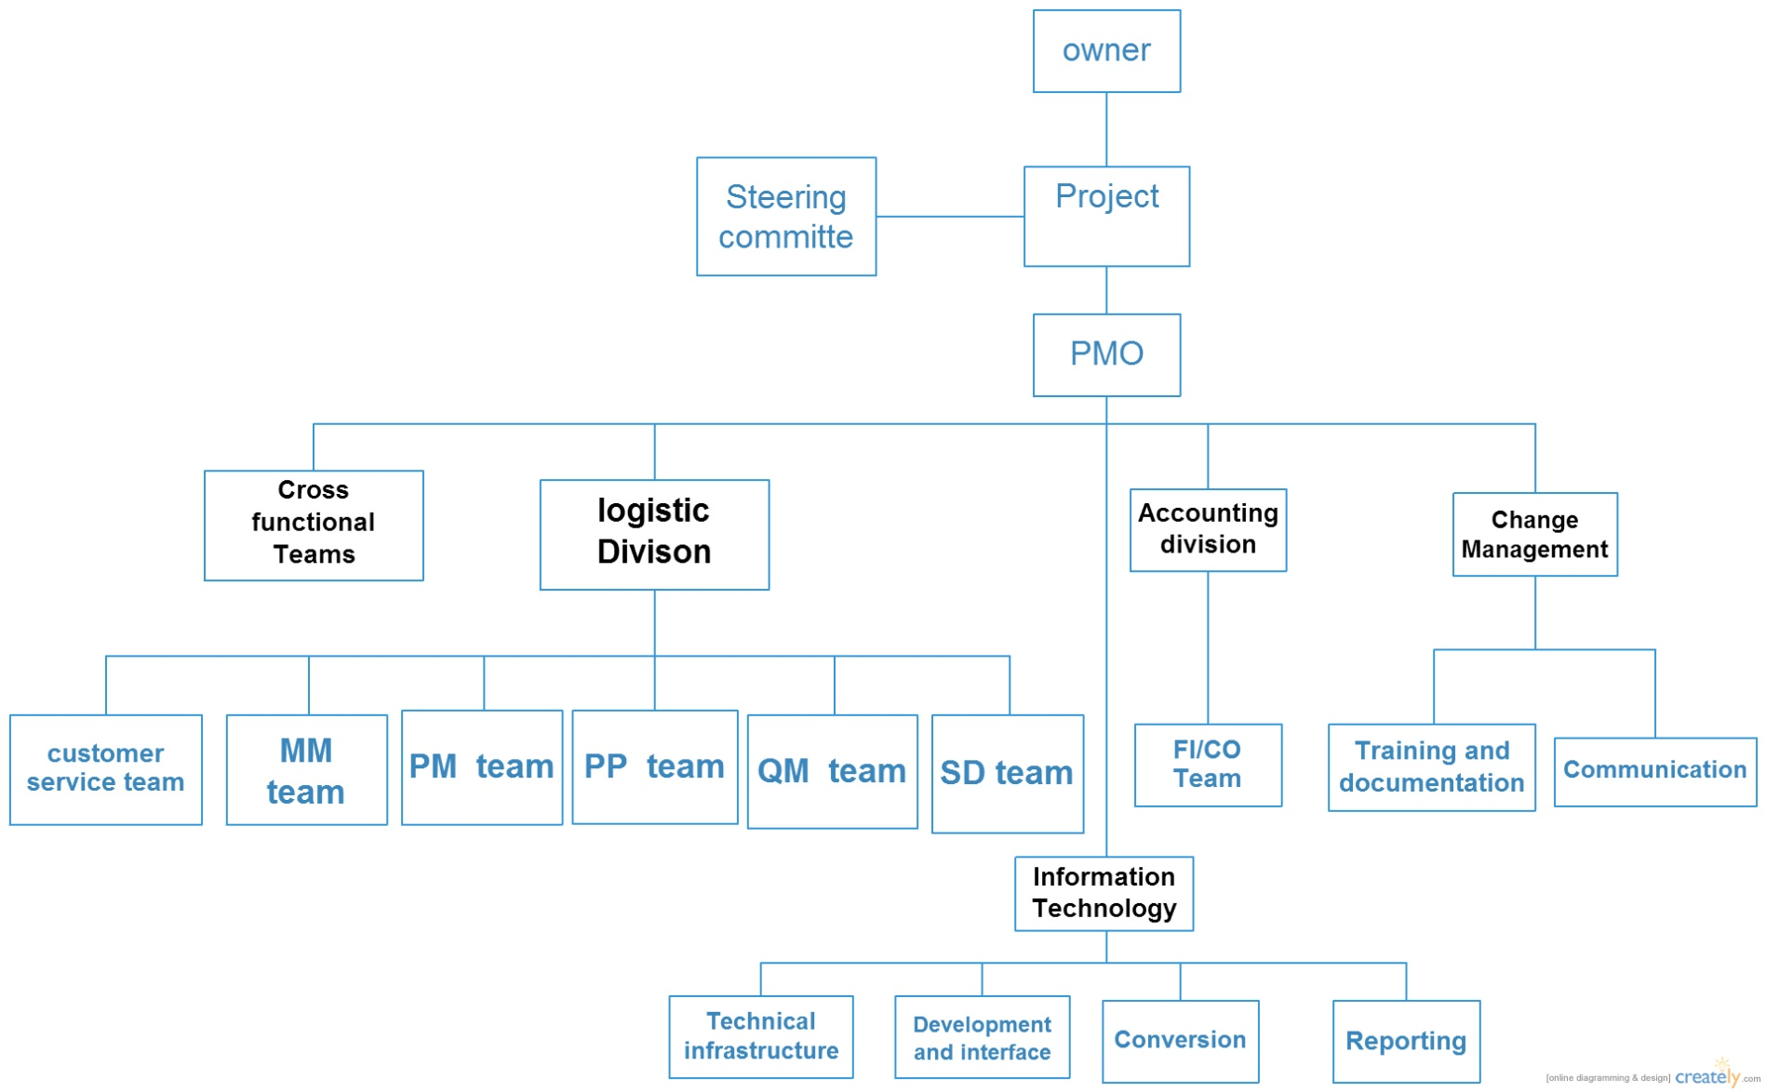
Project Organization Structure Chart

Slide 28
Benefits
Successful implementation of PLM+ will provide a single set of authoritative master data
It will provide optimized messaging system and thus enhance communication experience
It will help in asset life cycle management and end-to-end customer service
It’s single entry interface will reduce the complexity of communication system compared to old systems
It will help in providing visibility of logistics information to all users on a real-time basis

Slide 29
Recommendations
We recommend using ASAP methodology for project implementation because it provides phased implementation which gives insight for ensuring the success and quality of large scale implementation
We recommend using SAP exchange infrastructure for optimized messaging which will further provide support for implementing efficient communication system

Slide 30
Recommendations (Contd.)
We Recommend using Solution Manager Tool for serving the following purposes:
For successful implementation of ASAP methodology, this tool will help managing the central system we are building
It will ensure that our business blueprint will be configured, tested and monitored properly
It will help ensuring that our project’s progress stays with the timeline that we have decided
It will help organizing the complex SAP system components and smoothen the operation for this large scale project
Key leaders must be appointed as champions for positive change during implementation in order to advocate the necessary behavioral and process changes.
Users including strategic and operational leaders must get trained well before the system comes online .

Slide 31
Project Resource Estimation
Module | Number of consultants | JOB_TITILE | Estimated fee per hour | No. of hours per week
SAP module SME | 800 | SME_SAP | $125 | 25
Training | 20 | Training consultant | $100 | 30
Technical infrastructure | 300 | Infrastructure consultant | $100 | 20
Development and interface | 300 | Developer | $110 | 30
Conversion | 100 | SAP-Data Conversion Consultant | $90 | 20
Reporting | 100 | reporting | $70 | 20

Slide 32
Project Schedule
Project preperation
4/27/2015 - 12/24/2015
Developing Blue print
12/25/2015 - 12/25/2016
Project Realization
12/26/2016 - 10/1/2019
Final Preperaton
10/2/2019 - 12/2/2021
Go live
12/1/2021 - 6/24/2022
174 days
project preparation
261 days
4/27/2015
Go Live support
722 days
Blueprint
realizition
Final Preperation
567 days
12/25/2015
12/25/2016
10/1/2019
12/1/2021
148 days
2022
2015
2016
2017
2018
2019
2020
2021
2022
Today
Task(s)
Duration (days) | Start Date | End Date | Description
242 | 04/27/2015 | 12/24/2015 | Project preperation
367 | 12/25/2015 | 12/25/2016 | Developing Blue print
1010 | 12/26/2016 | 10/01/2019 | Project Realization
793 | 10/02/2019 | 12/02/2021 | Final Preperaton
206 | 12/01/2021 | 06/24/2022 | Go live
2015

Slide 33
Thank You

